Slide 1
Scintillators: Setup, performance and lessons learned
Ran Hong
CENPA, University of Washington

Slide 2
Scintillator/Light-guide Setup
PMT Setup
Signal reading

Slide 3
Scintillator Setup
ScR
μ Beam
μ Veto
ScL

Slide 4
Scintillator Setup
Easy to change Scintillator angle, but hard to change it’s height, impossible to change its horizontal position
Tiny shift between ScL and SiL
Very hard to mount the light guides after the scintillators are glued on

Slide 5
Light guide configuration
Plastic Light Guide
Torr Seal: Cause severe leak!
Aluminum/Stainless steel sleeve
Sealed by pressure/friction: plastic to metal
KF40 flange
Diff. Pumping port

Slide 6
Light guide leak
LEAK!

Slide 7
Fix the leak
Newest Torr-seal, leaks most
UHV sealant does not help
Easy Fix: Covering with excessive
UV cured optical glue

Slide 8
PMT
PMT Module: XP2982 (datasheet elog:490)
Bias: -1800V (see elog:507)
2 PMT bases broke, 1 person shocked!
ScR first, then Mu-Veto

Slide 9
PMT Base Problem

Slide 10
Why shocked?
HV supply
Cathode
HV cable GND
Dynodes
Anode
PMT Base GND
Becomes HV!

Slide 11
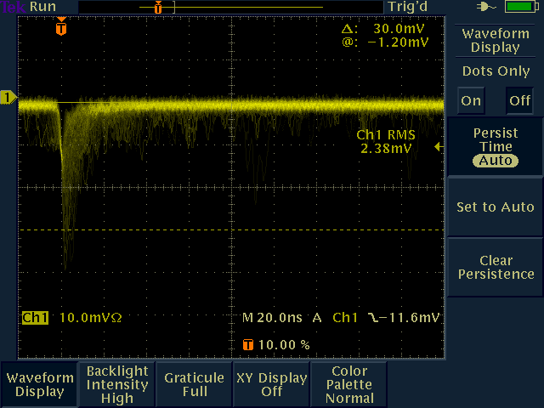
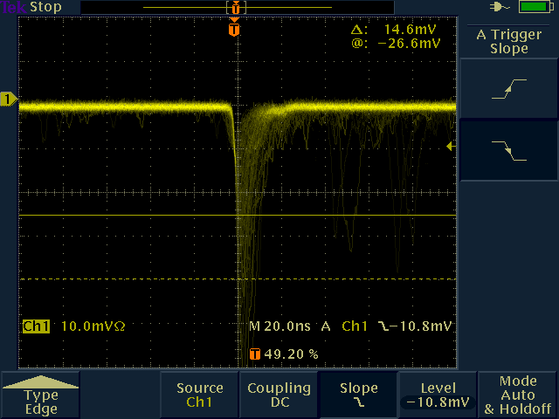
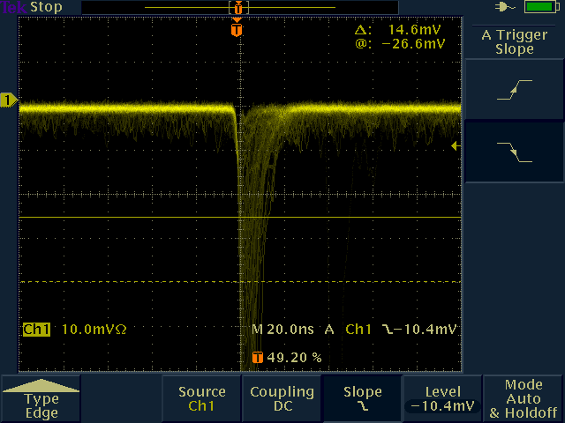
Signal of ScL/ScR/MuVeto
ScL
MuVeto
Pictures are from elog:475
ScR
ScL may be broken (elog:440)

Slide 12
Signal of ScL/ScR/MuVeto
Pulse shapes using FADC, elog:513,535

Slide 13
Signal of ScL/ScR/MuVeto
Using BU digitizer to read the Scintillators (elog:539)
Ch0: muSC
Ch1: ScL
Ch2: ScR
Ch3: muVeto
For analysis: see whether we have good energy resolutions / good pulse shapes.

Slide 14
Lessons learned
The seal between the light guide and its sleeve is flaky, the KF feed-throughs are OK.
PMT bases are fragile, need more careful handling. Check connections before biasing. Need more spare ones (or more robust ones).
FADC sample rate is not high enough for PMTs, need shaping amplifiers or faster digitizers. Analysis group should pay attention to the pulse shapes of the PMTs.

Slide 15
Bonus: Si16

Slide 16
Bonus: Si16
Cover the bunch of cables with copper tape
Braids of the cables are isolated from the connector
Tricky to get rid of noise/ground loop (elog:599)
Achieved resolution using 1MeV pulser: 100 keV
Not be able to use Am241 to calibrate: The air attenuate the alpha particles too much (elog:607)

