Slide 1
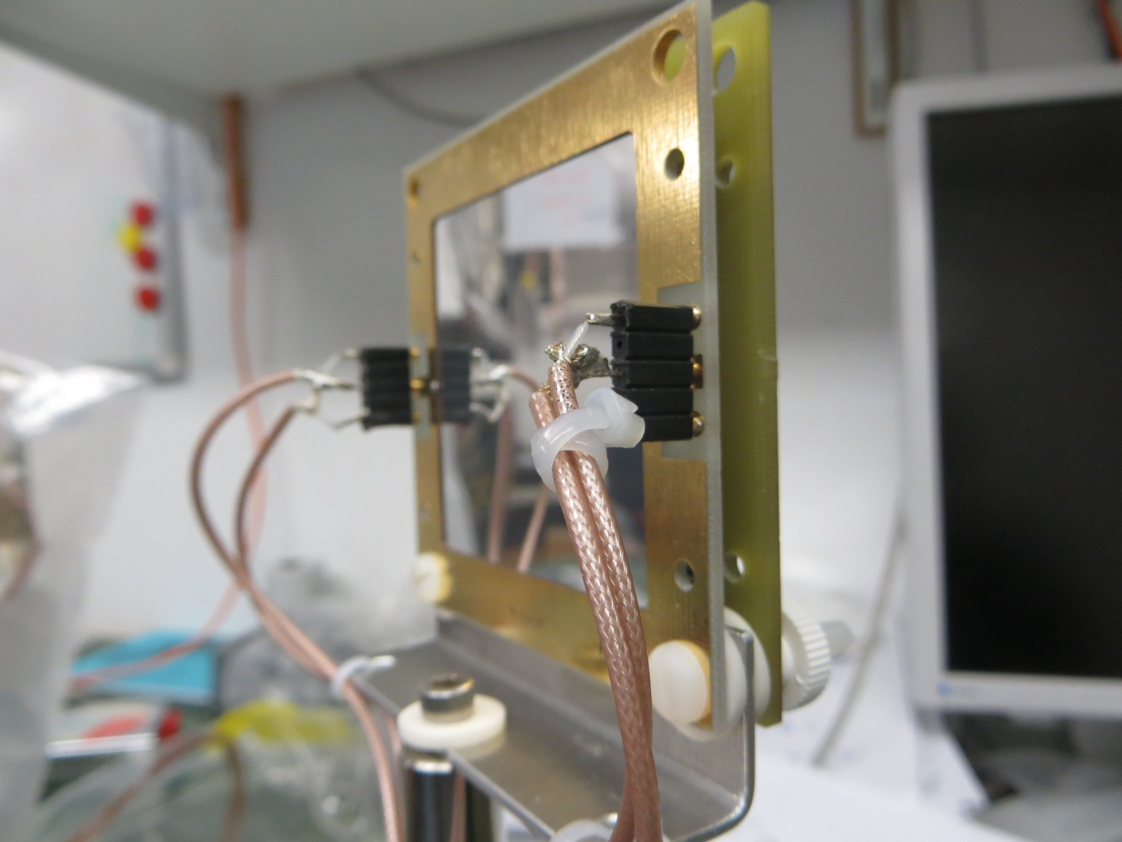
Hardware Upgrade Summary
Peter Kammel
Silicon detectors
Other components
from previous speakers
Run and Preparations
Overall impression:
heroic and lucky job, because we assembled exp during beamtime
but stability, consistency compromised

Slide 2
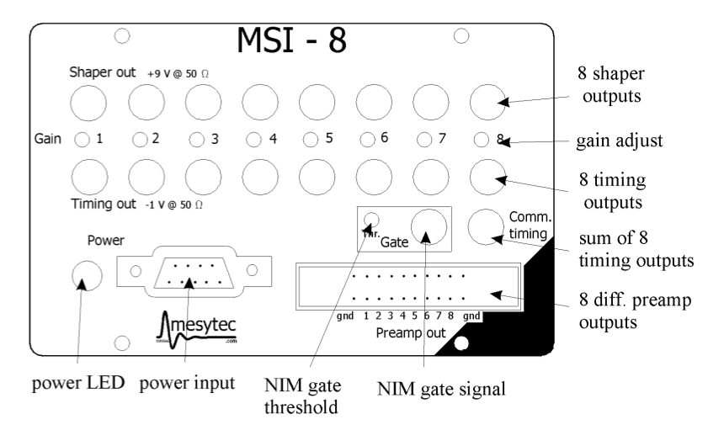
Si Detector Improvements I
Natural setup
SiL/SiR
each on separate MSI8
try to improve TFA shaping or modify that sum is 1-4 only
prepare attenuator
modified Osaka flange
Si16
on MSI16
prepare cables
prepare attenuators
Accuglas sub-d feedthrough
Needs testing
Who wants to get involved ?
How to organize

Slide 3
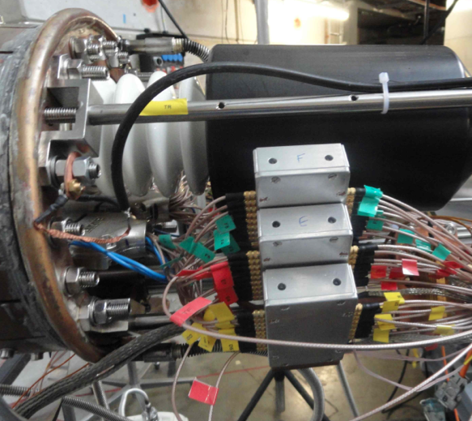
Si Detector Improvements II
Improve noise stability
Improve feedthrough and cables: high quality BNC cables and lemo
Mount shielded boxes on flange to protect preamp and feedthroughShort cables
UW/OU
Other ideas ?
In vacuum requires effort, but interesting,
if we can use sub-d feedthrough
Build new FADC crate with linear power supply (UW)
Dedicated test set-up for Si16 with MSI16, noise, cables, dynamic range

Slide 4
Other system improvements
DAQ
500 MHz FADC for muSC and other scintillators
or muSC on TDC
FADC
Stability of new firmware, better crate, losses under study
Alignment
Prepare better alignment laser set-up
Ge detector
In good shape, some puzzles, better measurement position?
Neutron detectors
Still some work ahead
Scintillators
Vacuum seals (better gluing or no aluminum pipe), improve strain relief

Slide 5
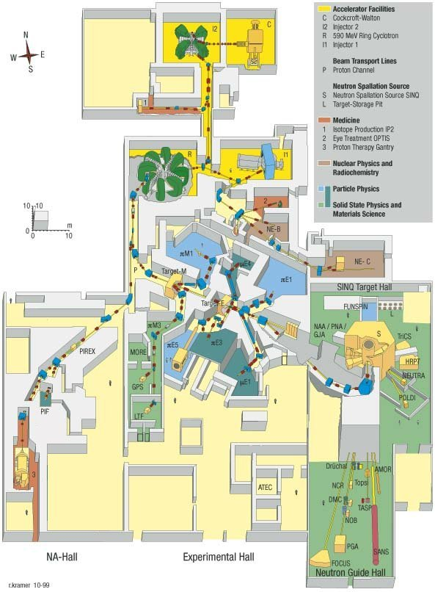
Run Planning
PSI will only run 6 months during the next 2 yrs
Director’s decision to increase funds for new light source construction
piE1 was one of the most competitive areas
I think it will be difficult to get more than 2 weeks in piE1 (request 4?), neutron measurement in piM1? Final MuSun run.
Would 2 weeks be enough ?
Run first in cycle with >2 weeks advanced on site preparations, to be ready ?
Preparation time in area not a problem, if properly scheduled, separating wall

