Slide 1
Tevatron Data Curation Update
Gene Oleynik, Fermilab
Department Head, Data Movement and Storage

Slide 2
Current Tevatron Storage
Tevatron Data located in two Data Centers on site
21 PB of tape storage about equally split between D0 & CDF
Combined front-end disk cache on the order of 3 PB
GRID Computing Center: RAW and Online Database backups:
Tevatron uses 1/4 10000 slot libraries there
Feynman Computing Center: Reconstructed and other data:
3 10,000 slot SL8500 shared with other experiments
cache disks located here
22 Run II T10000C drives
Copy of CDF RAW + n-tuples @ CNAF in progress

Slide 3
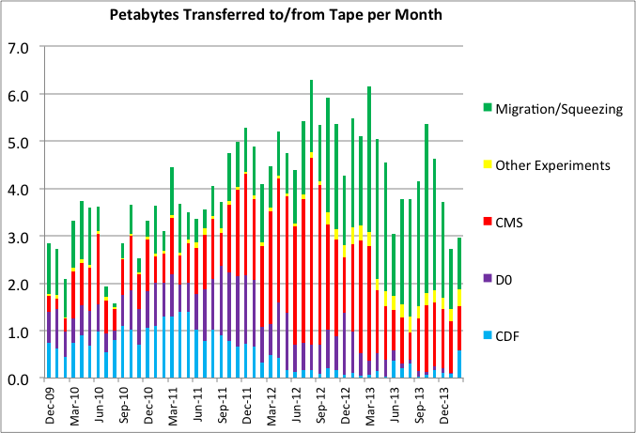
Current Tevatron Tape Transfers
500 TB to CNAF

Slide 4
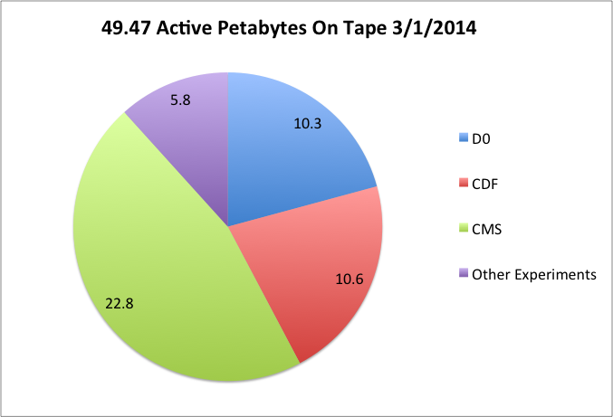
Distribution of Active Data

Slide 5
Technology Migration
 |  |  |  | 2008 |  |  |  | 2009 |  |  |  | 2010 |  |  |  | 2011 |  |  |  | 2012 |  |  |  | 2013 |  |  |  | 2014
LTO2 > LTO4 (7380)
9940A > LTO4 (1330)
9940B > LTO4 (18300)
LTO1 > LTO4 (1075)
LTO3 > LTO4,T2 (4000)
LTO4 > T2 (18963/25028) |  |  |  |  |  |  |  |  |  |  |  |  |  |  |  |  |  |  |  | In progress
Parenthetical numbers are number of tapes migrated.
Migration Activities – Obviously a continual process
76% complete overall: 94% done with CDF, 58% D0
RAW data is complete, need spokes signoff to remove LTO4
By the end of FY14, we will have migrated over 57,000 Tevatron media with a final count of less than 4000!

Slide 6
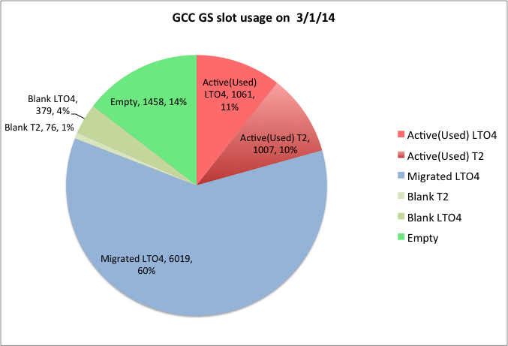
Media distribution at GCC GS Library

Slide 7
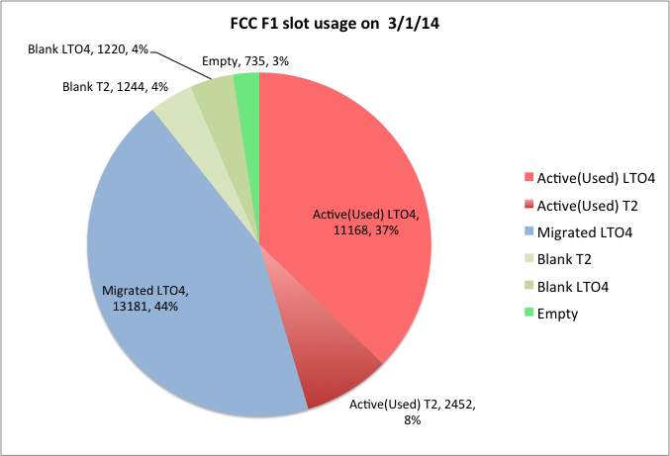
Media distribution at FCC Libraries

Slide 8
Technology Migration
Cyclically move to newer denser tape technology.
Run II is T10000C (5 TB/cart). These same media can be used in T10000D (8 TB/cart) and T10000D can read T10000C written media.
=> This technology will last the preservation period.
Continue to use in-house developed and HEP collaborative storage software:
Enstore
SAM, SAM cache
dCache (we are about to deploy a D0 dCache for preservation)

Slide 9
Moving Forward
Minimize the differences in technologies by the experiments and support sustainable ones.
Plan to stay on T2 media for some time. Complete migration to T2 by the end of FY14.
D0 investigating moving to SAM+dCache rather than SAM Cache
Reduce the amount of equipment to support
CDF plans to reduce their cache disk from the 2011 level down to about 6% of that by 2016. D0 will likely do similar
T10000C tape drive count has been reduced from LTO4
Completion of Fermi >> CNAF copies

Slide 10
Conclusion
We are near completion of migration to T2 media.
We are on track on our commitment to maintain Tevatron data to 2020.
Questions?

Slide 11
Backup slides

Slide 12
Technology Migration
Over the course of the Tevatron (not even counting 8mm):
> 90x increase in tape capacity
> 24x increase in transfer rate
Decommissioned 9310 & ADIC AML-2 tape libraries.
Migrated off 9940A, 9940B, LTO1, LTO2, LTO3 to LTO4
Currently migrating LTO4 to T2 (5.4TB/cartridge media)
Care taken to insure all migrated data is copied and correct:
Read back and verify checksum for every migrated file
Validate metadata is correct
Verify no file left behind when disposing of older media (new extra paranoid step)
Ramping up migration took to a lot of effort and time. Use up to 8 “Migration Stations” in parallel.

Slide 13
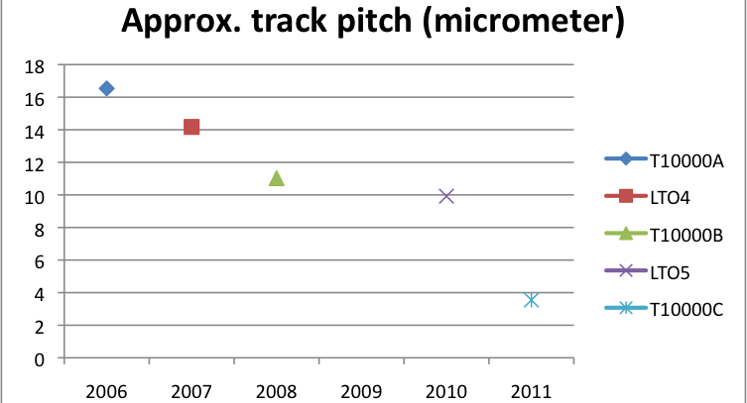
Environment
Decreasing track pitch yields higher demands on the environment
Dimensional stability: Temperature and humidity results in creep and can cause read problems
Dust and other debris. Fine dust is of most concern.

Slide 14
Environment
We try to stay within the recommended operating range for Humidity and temperature:
For Dust, the recommendation is Class 8 cleanroom. We are about class 9 (better).
We still see dust built up in the libraries over the years, though it has not caused problems yet.

Slide 15
Integrity, Monitoring and Disaster Recovery
Data integrity:
End-to-end checksumming; Spot sampling files’ checksums
Experiment accesses (very good coverage while running)
Write-protect filled tapes
Extensive proactive health monitoring (soft errors, rates, etc.).
Environment monitoring:
Wireless temperature/humidity recorders at libraries
Portable industrial dust detector. Sampled around the rooms
DR:
Data is mostly single copy, but CDF RAW is basically included in RECO, and The RAW and RECO are in separate data centers
Online database backups at different data center than databases
Second copy efforts started for CDF (FNAL to CNAF)

Slide 16
Integrity Issues We Have Encountered
Fine debris buildup in LTO4 drives (bad tape batch?) resulting in slow transfers (like an hour to successfully! read a GB file), No data loss, required close monitoring to proactively replace drives. .
Slitting Debris in a batch of T2 media. No data loss.
Several instances of insects on tape at Grid Center. Some data loss (CMS T2).
Mangled tape (very rare, though we just recently had such an incident with a CMS T2 media 15,170/15,707 recovered).
Other firmware bugs – potential data losses (had copies).
A number of unreadable files: 13/15M for Tevatron. We have never encountered a checksum error from tape, just sense media errors. Successful reading of files may be sufficient.

Slide 17
Integrity and Monitoring open questions
We currently sample randomly selected tapes and files and tapes and verify checksums.
Is this the right thing to do in data preservation mode? Do we risk mangling or inserting debris or…?
How do we measure Data loss?
The real impact is lost statistical significance, and that varies (a calibration file vs. a RAW data file).
Easiest to do is lost files or potentially lost (is it lost if it exists elsewhere?).
A work in progress.

Slide 18
So what does all this cost?
Amortized costs (M&S costs over the appropriate lifetimes)
Tape and disk hardware
Infrastructure equipment, servers, network switches.
Migration (media amortization ~ 6 year), tape trade-in, decrease in tape cost over time
Yearly costs:
Salaries: 5.5 system admin, 4.5 developers
Facilities (electric, building)
Maintenance
Lab overhead costs for staff and M&S
Duty factor: assume 50% of library occupied by customers
Estimate ~ $25-35/TB/yr for tape 5-10x this for disk

Slide 19
What keeps me awake
Large unplanned effort and costs:
Is the software technology sustainable. In-house and collaborative expertise sustainable?
This can be expensive to move from: new interfaces, formats, data migration and etc. may all be needed
Reliance on proprietary vendor technology
We use widely adopted hardware, but it could be costly and require a costly migration to different technology if there is a vendor issue
Dust Cleanup?

Slide 20
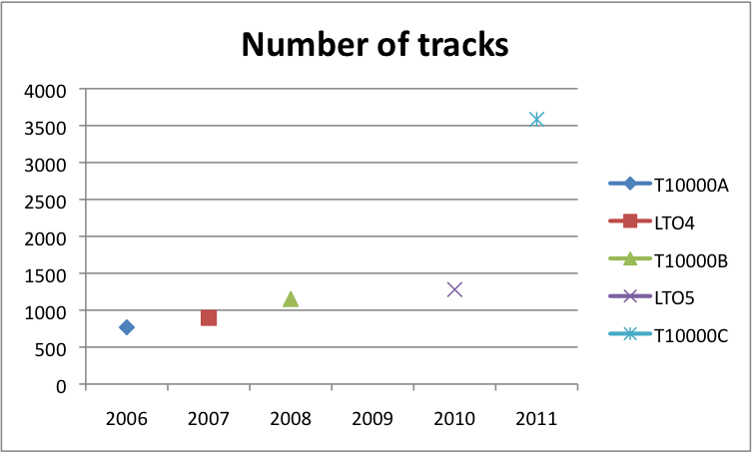
Tape track density trend

