Slide 1
Muon Collider Physics and Detector
Ronald Lipton, Fermilab
Energy Physics has had remarkable success at the Frontier culminating Sessions:
Theory Perspectives
  Zhen Liu
  Adam Martin the Higgs.
  \
Physics and detector studies status
  Anna Mazzacane
  Vito DiBenedetto
  Hans Wenzel (Alex Conway)

Slide 2
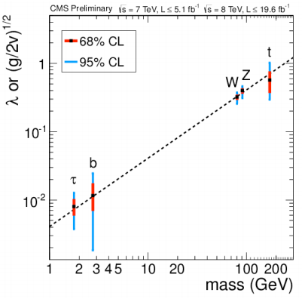


  Higgs Width: Motivation - Zhen Liu
Setting the overall scale of the coupling strength
A measurement/indicator of ``buried decay mode’’[1]
[1] For example, see some well-motivated yet challenging modes discussed in the Exotic Higgs Decay, by D. Curtin, Z.L. et al., arxiv: 1312.4992

Slide 3
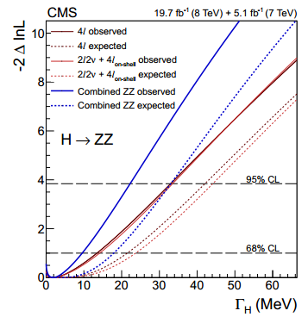

  Total Width at the LHC- Zhen Liu
The cross sections:
On-shell:
Off-shell:
F. Caola and K. Melnikov estimated an “eventually” reach of ~10 SM width;
CMS with current data ~5.4 SM witdh;
Great measurement, but:
On-shell rate uncertainty
Loop-running⬄interplay of (at least) undetermined Top Yukawa [1]
Possible NP input [1,2]
arXiv:1405.3455
[1]C. Englert and M. Spannowsky, arXiv:1405.0285
[2]For some interesting discussion of NP feed down into SM Higgs production, see F. Yu, arXiv:1404.2924

Slide 4
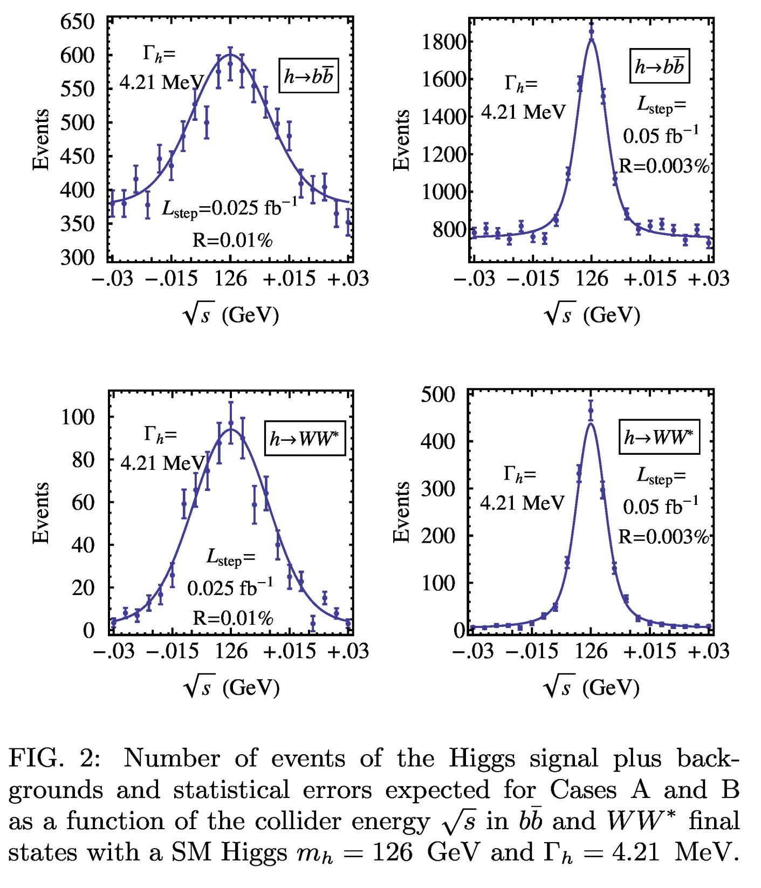
  Profile for
  SM Higgs - Zhen Liu
Leading channels
Sig+Bkg
Randomize
Step choice

Slide 5

  Fitting the SM Higgs Zhen Liu

Slide 6
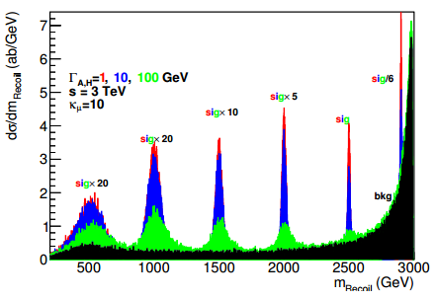
  3 TeV - H/A Recoil Mass Zhen Liu
“Shiny Higgs” – radiative returns
Huge background for photon inclusive
So we need to rely on exclusive process
MG5+Pythia+smearing
Black—background;
Red—1 GeV Width;
Blue—10 GeV Width;
Green—100 GeV Width;
Take bb decay mode for example,
Assuming 80% tagging efficiency on a heavy Higgs with Br to bb 80%.
Effectively 64%; can be interpreted (approximately) 64% of Heavy Higgs decay useful.

Slide 7
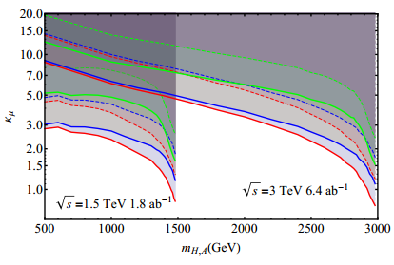
Sensitivities
Red, Blue, Green for 1, 10, 100 GeV Total Width
Solid, Dashed for 2-sigma 5-sigma significance
Bin size choice optimized for k_\mu=10

Slide 8
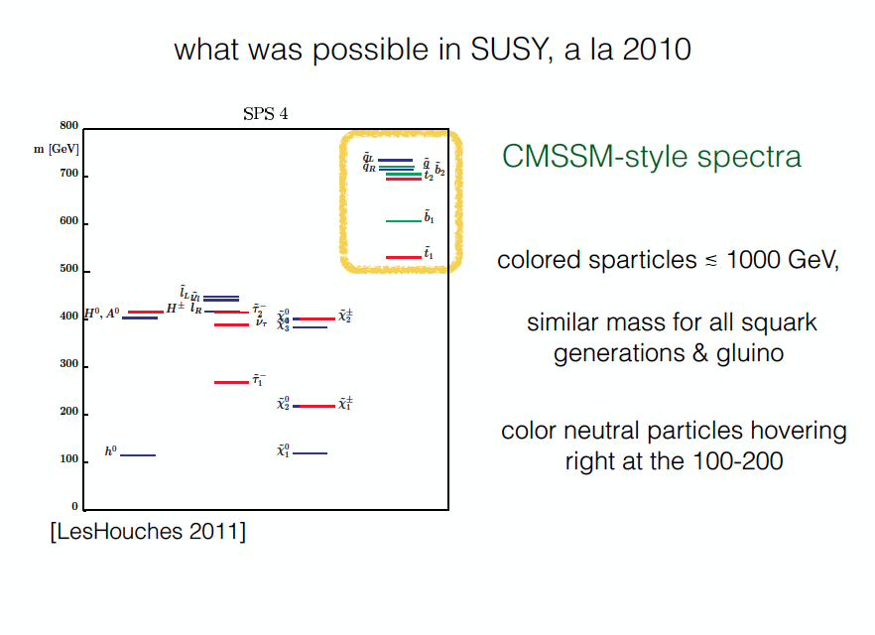
(Adam Martin)

Slide 9
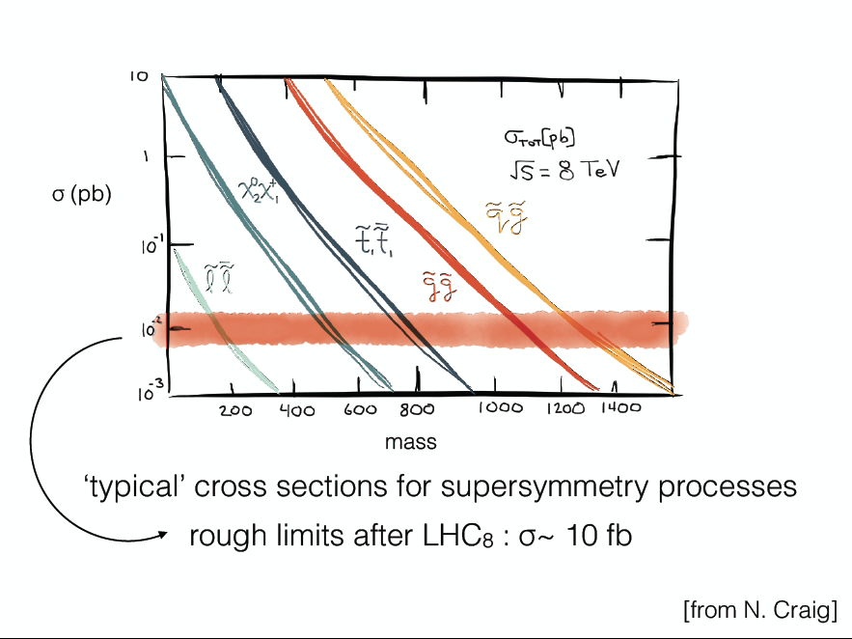
(Adam Martin)

Slide 10
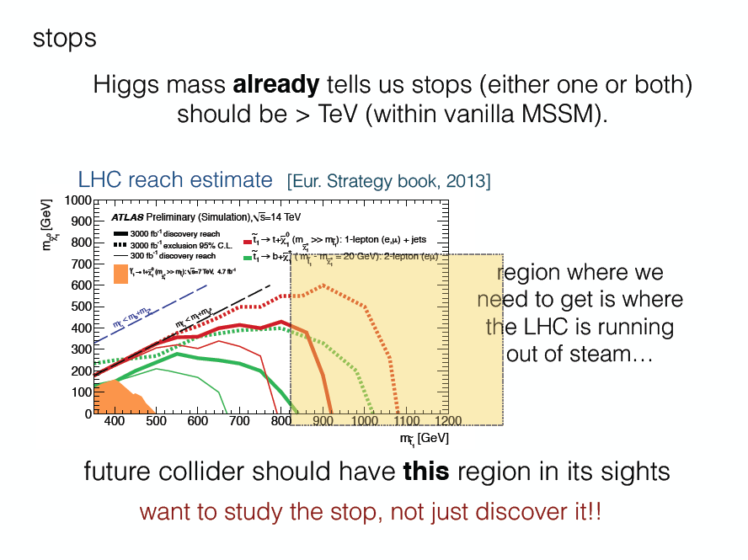
(Adam Martin)
?

Slide 11
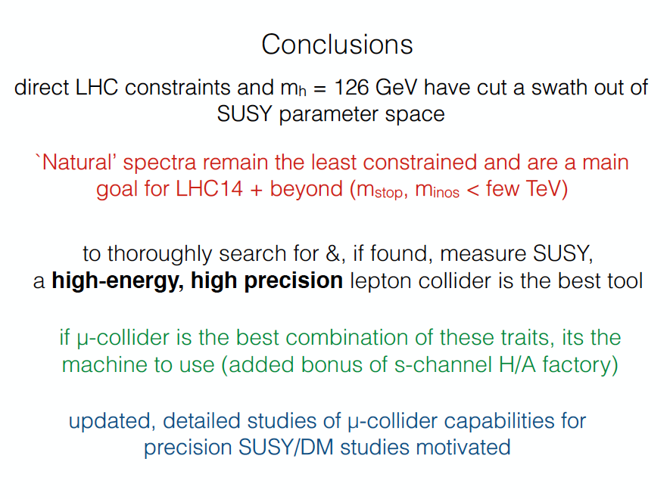
(Adam Martin)

Slide 12
Software framework
(Hans Wenzel)
Used for ILC and CLIC physics studies:
Many reconstruction modules available e.g.
PFA
Tracking, Vertexing, B-tagging
Good relations with SLAC group provide support, contribute to the tutorial, e.g. changes specific to the muon collider

Slide 13
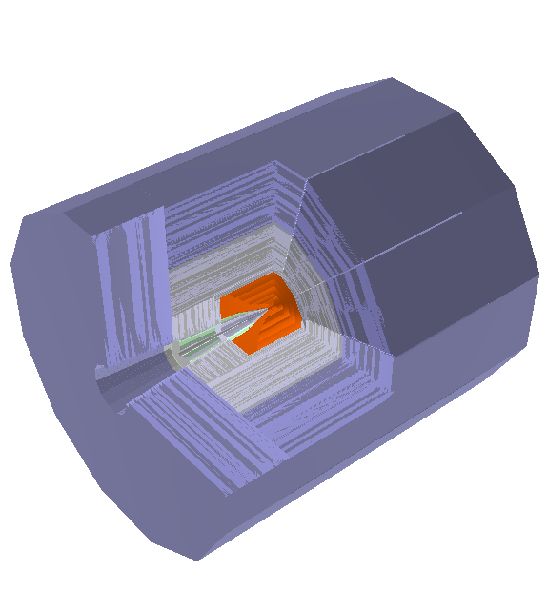
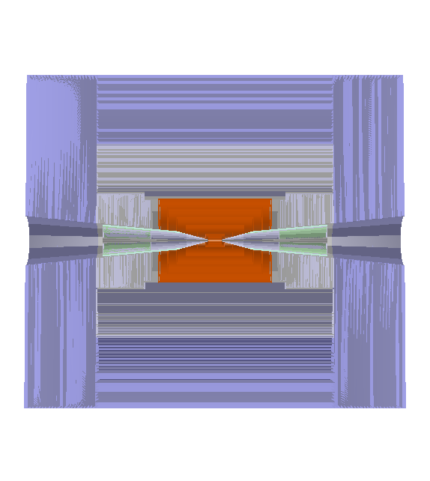
The mcdrcal01 detector in org.lcsim
(Hans Wenzel)
5T solenoidal field,
radius=3.075m
Calorimeter dimensions:
Rmin: 1.36 m
Rmax: 3.07 m
Length: 2x3.702 m
Good relation with accelerator group,
Easy to change detector design if e.g.
shielding/MDI changes. Declared DMZ.

Slide 14
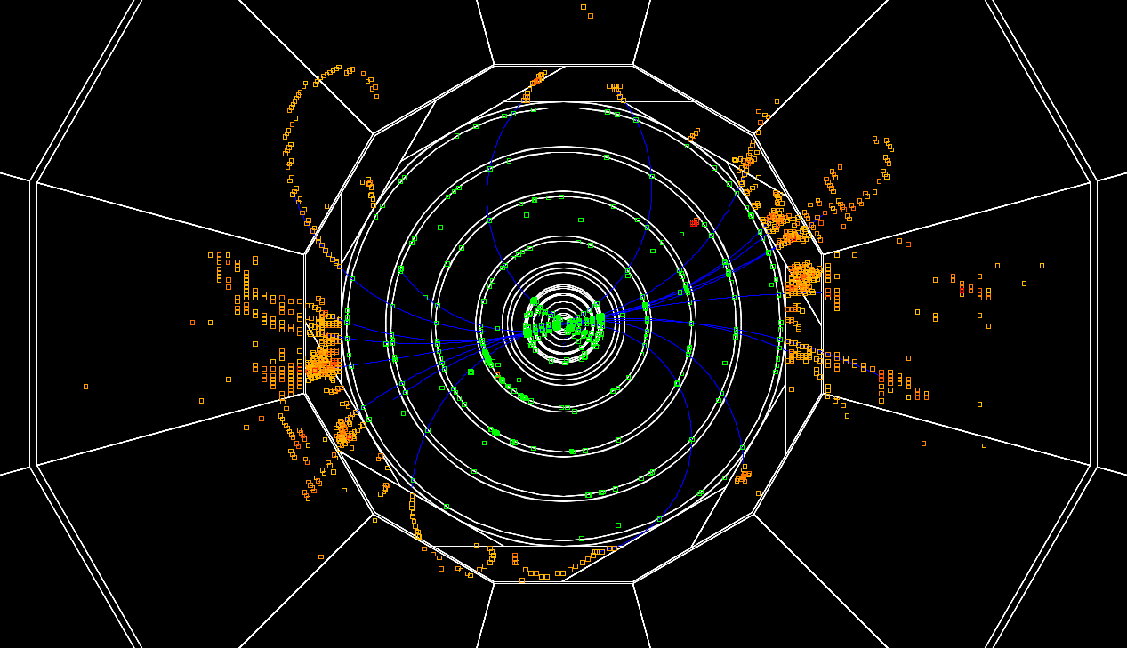
H⁰→ bb event
(Hans Wenzel)

Slide 15
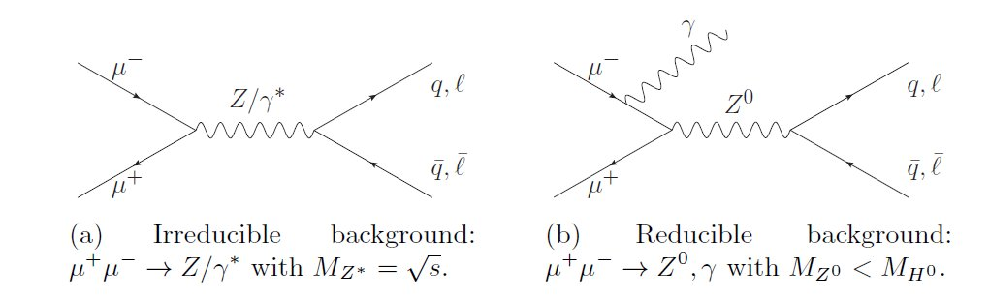
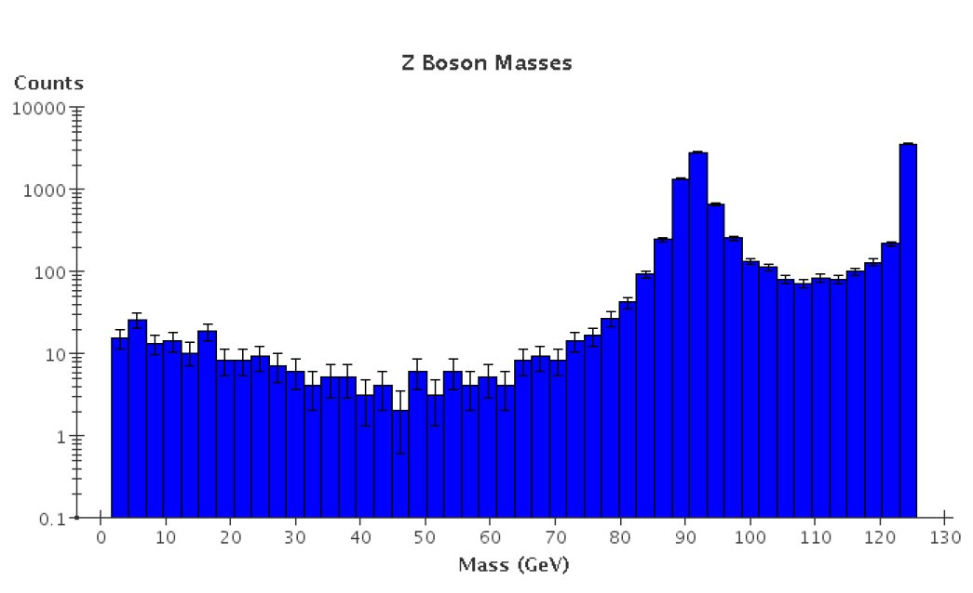
Higgs Study - SM Background
(Hans Wenzel)
Require:
Evis> 98GeV
in Detector

Slide 16
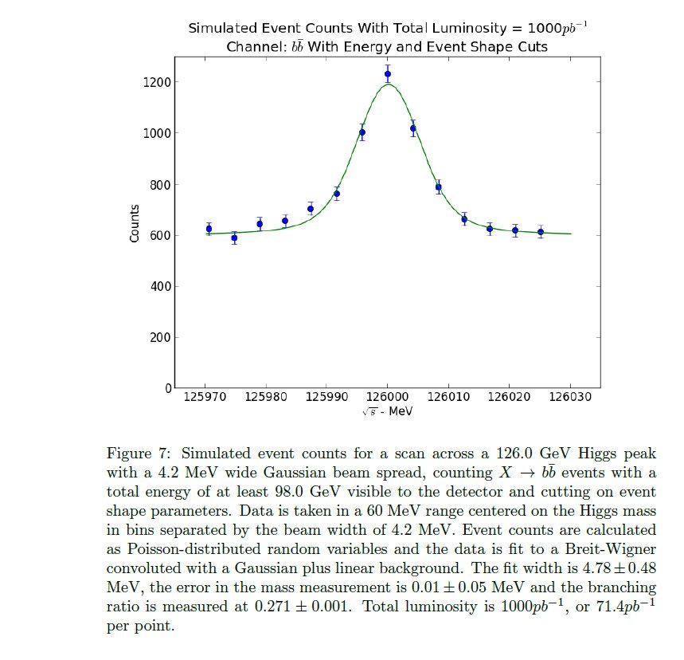
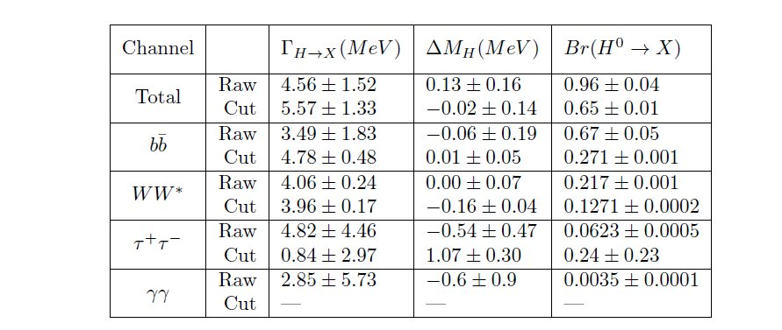
Higgs fits
(Hans Wenzel)

Slide 17
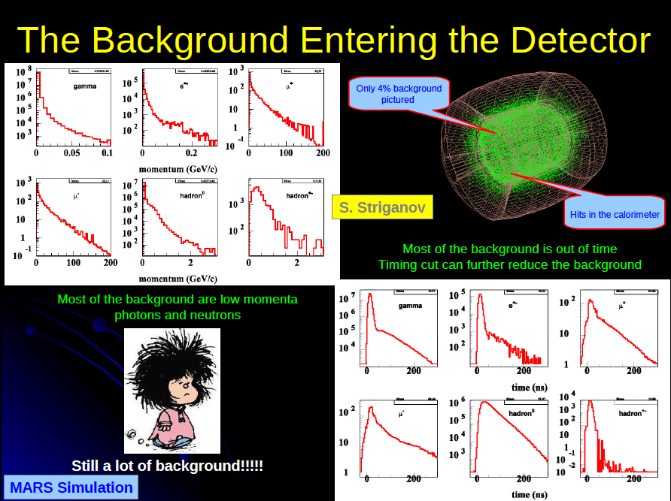
(A. Mazzacane)

Slide 18
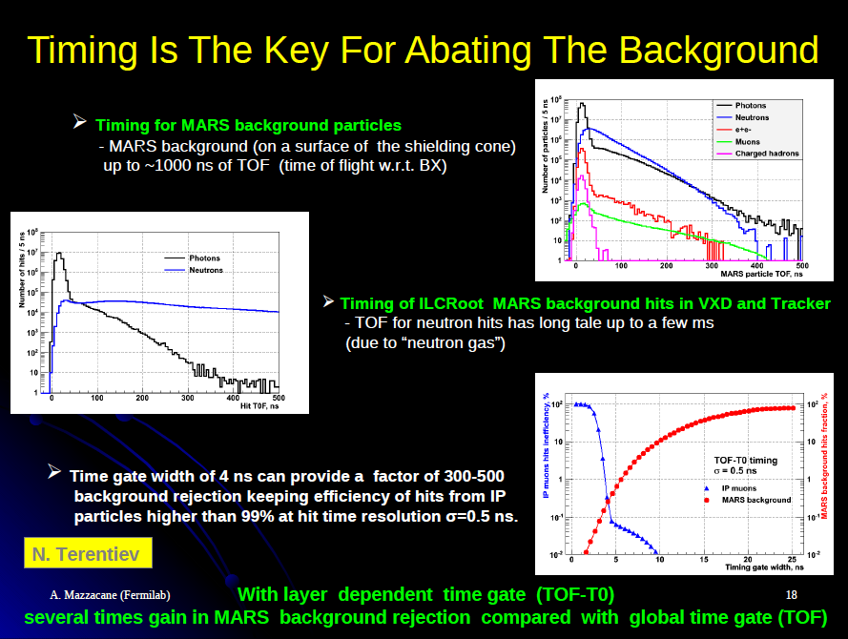
(A. Mazzacane)

Slide 19
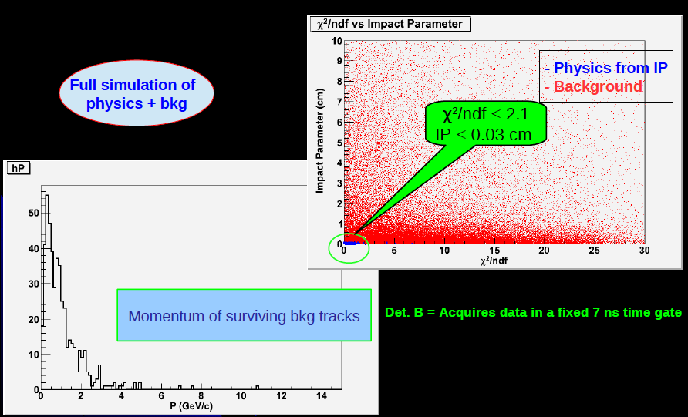
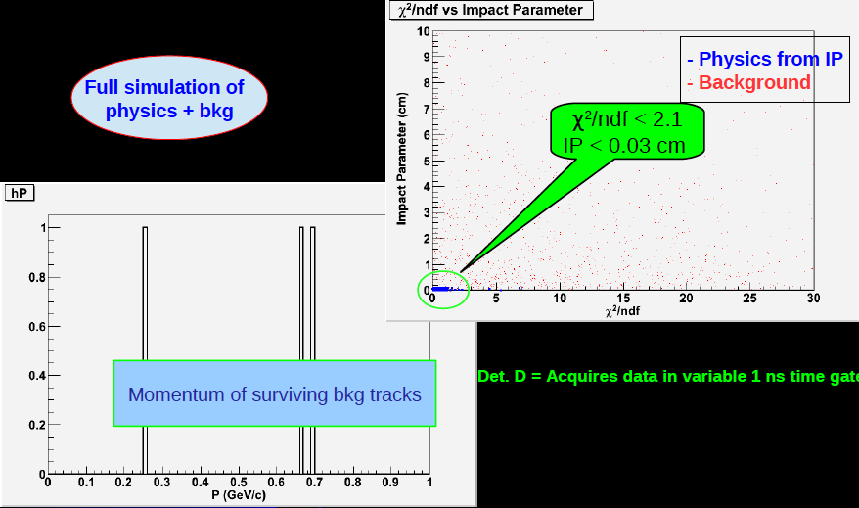
(A. Mazzacane)

Slide 20
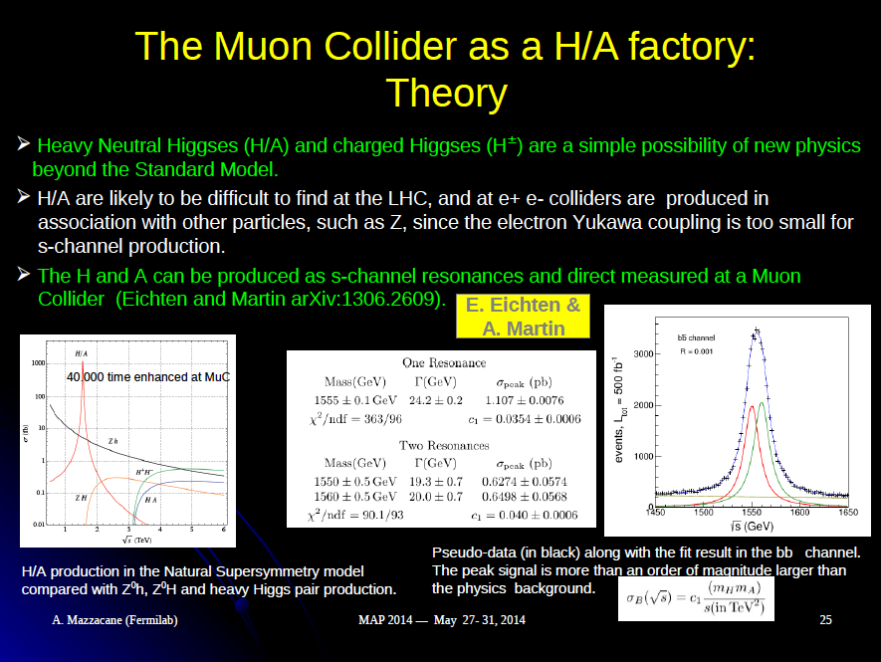
(A. Mazzacane)

Slide 21
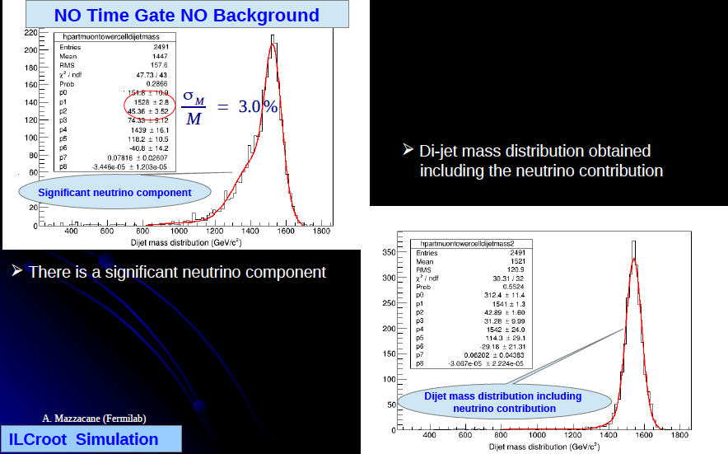
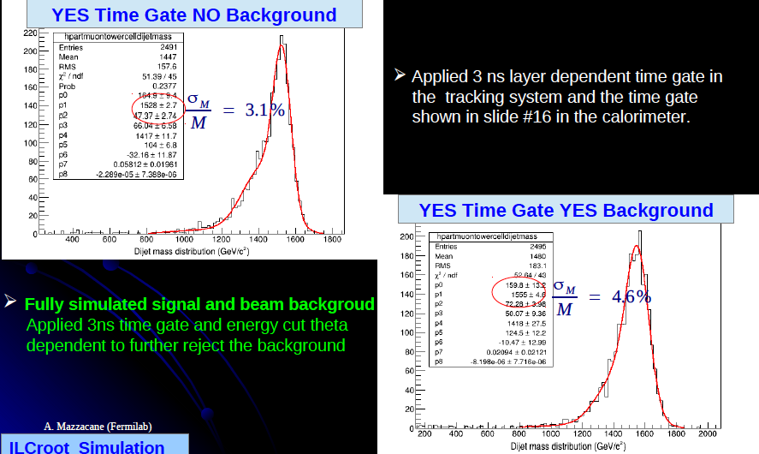
(A. Mazzacane)

Slide 22
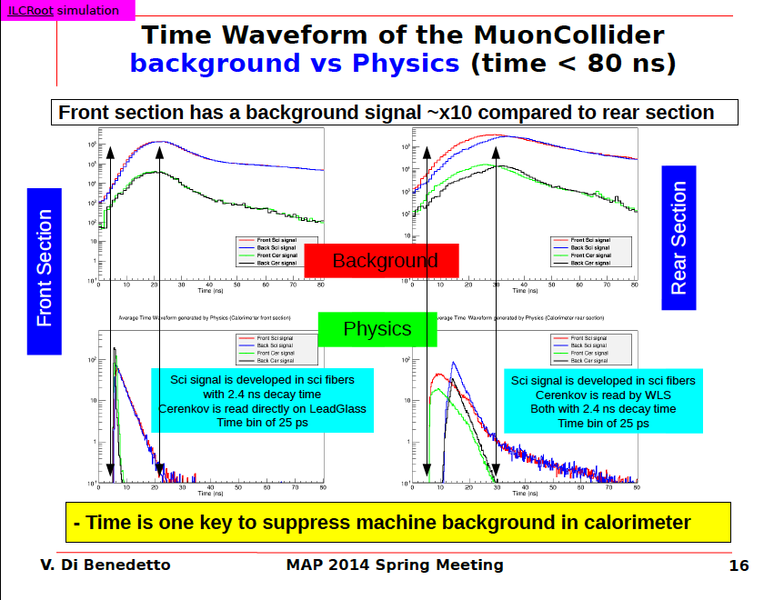

Slide 23
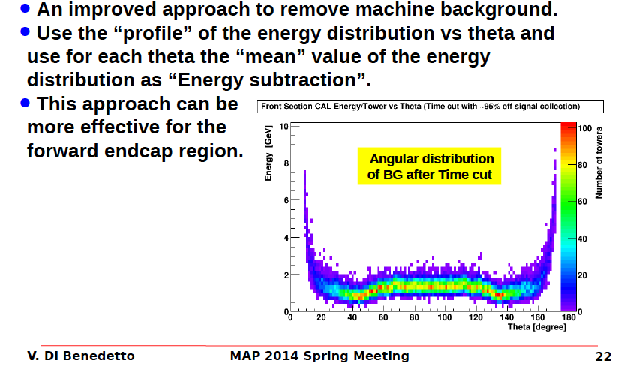

Slide 24
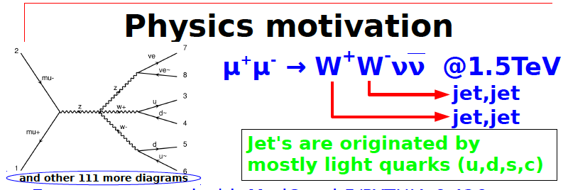
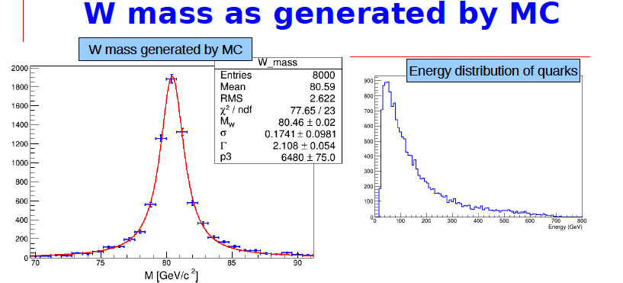

Slide 25
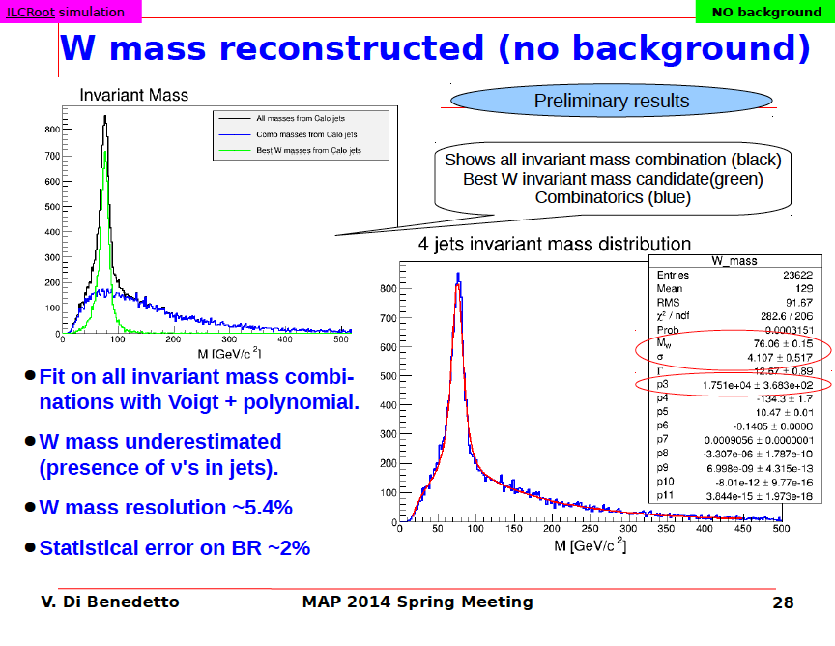

Slide 26
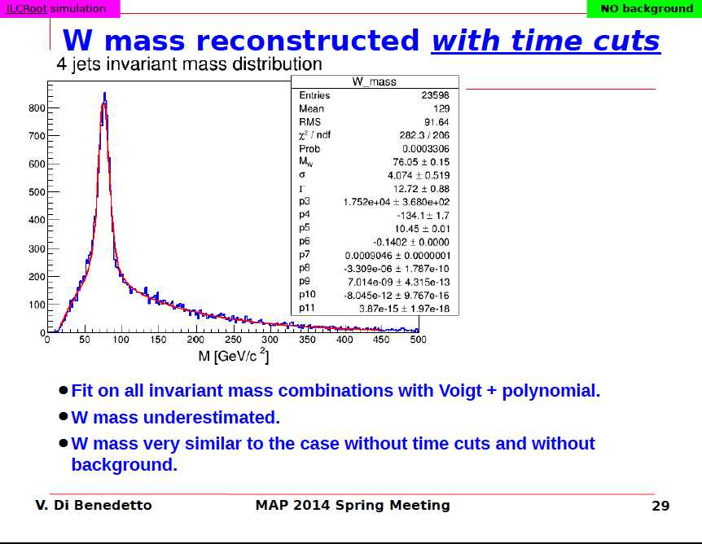

Slide 27
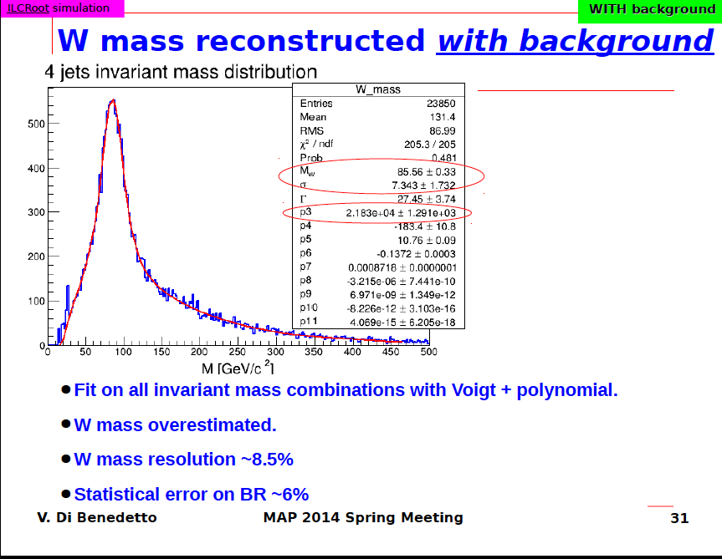

Slide 28
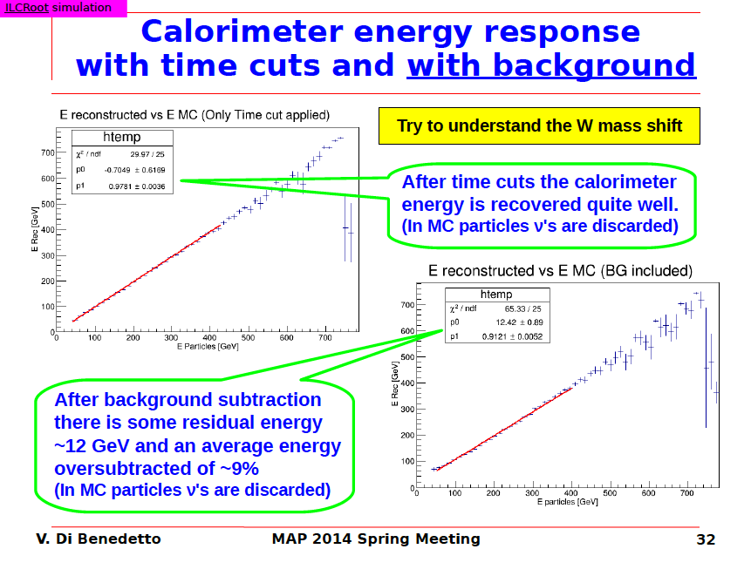

Slide 29
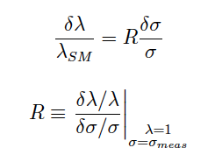
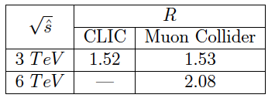
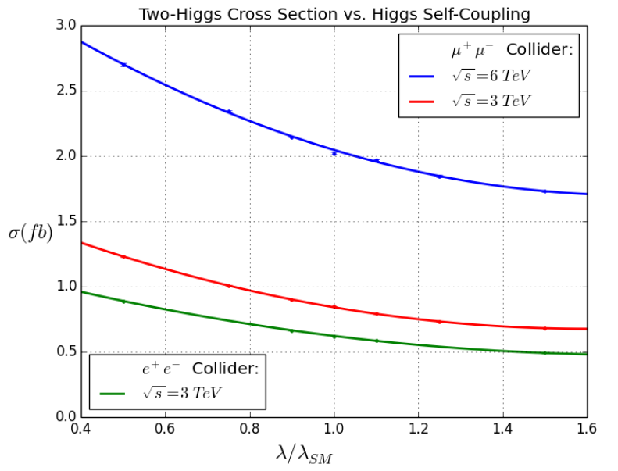
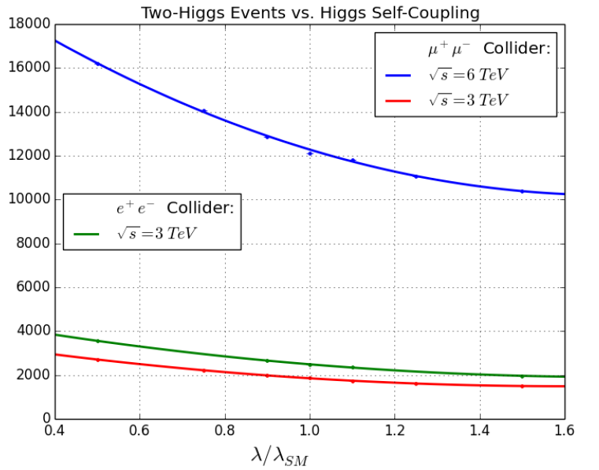
Other Studies
Cross section to coupling uncertainty
A. Conway looked at higgs self-coupling at a high energy machine based on scaling CLIC studies.
Estimate 8% precision

Slide 30
Conclusions
Over the last several years there has been enormous progress in understanding how to meet the challenges of detectors at a muon collider – this was due to a great team working with very limited resources.
We now believe we have a reasonable understanding of the tools needed and tradeoffs required to reduce backgrounds
We would like to conclude some of the basic studies for high energy machines.
We hope to preserve this knowledge and software infrastructure.

