Slide 1
H- Stripping in Linacs
David Johnson
Fermilab
May 30, 2014
MAP Collaboration Meeting

Slide 2
Talking Points
Physical Processes
  Interaction with residual gasses
  Lorentz stripping
  Black body stripping
  Intrabeam stripping
  H- Stripping from SCRF EM fields

Slide 3
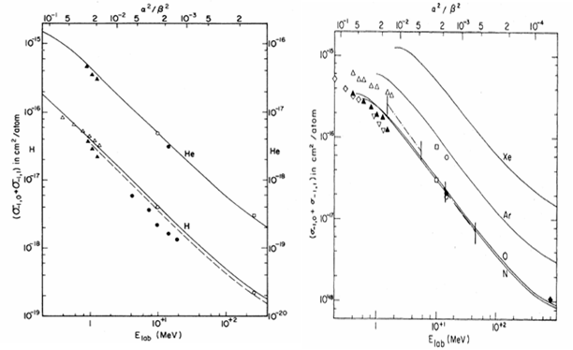
Residual Gas
8GeV
8GeV
Pressure = 1E-9 torr
Temp = 300ºK
Energy dependence of H- Stripping cross sections. Left: G.H. Gillespie, Phys. Rev. A 15, 563 (1977). Right: Gillespie, Phys. Rev. A 16, 943 (1977).
Loss rate [per meter] for 8 GeV, 300ºK is approximately equal to vacuum level in torr.
Not an issue for standard vacuum levels.

Slide 4
Lorentz stripping
From: Proton Driver Design Book

Slide 5
Black Body Radiation
Proposed as a source of loss during PD H- transport mini-workshop circa 2005 (FNAL)
Independent calculations of stripping rates by Howard Bryant (UNM) and Chris HILL (FNAL)
Thermal photons from black body radiation fill inside of beam pipe.
The photon energy << H- binding energy.
Large velocity ions :: photons are Doppler shifter to higher energies :: overlapping
photodetachment cross section

Slide 6
Black Body Radiation

Slide 7
Summary of losses for Proton Driver Transport line
Loss | Initial (132 kW) |  | Ultimate (2MW) |  | Ultimate w/BeamScreen (2MW)
 | Loss Rate [/m] | Power [mW/m] | Loss Rate [/m] | Power [mW/m] | Loss Rate [/m] | Power [mW/m]
Black Body | 5E-7 | 65 | 5E-7 | 1000 | 2E-10 | 0.4
Residual Gas(10⁻⁸) | 4E-8 | 24 | 4E-8 | 377 | 0.8E-10 | 3.0
Magnetic(480G) | 1.4E-10 | 0.018 | 1.4E-10 | 0.27 | 1.4E-10 | 0.27
Total | 5.4E-7 | ~90 | 5.4E-7 | ~1377 | 4.2E-10 | 3.73
For a uniform loss rate 1 W/m (FNAL Booster arcs) residual dose rates on contact are up
to 350 mrem/hr on bare beam pipe and 6-12 mrem/hr on magnet surfaces. For hands-on
maintenance the tolerable beam loss rate < 0.3 W/m. [Krivosheev, Mokhov,
7th ICFA workshop, Lake Como, 1999]
For PD we specified a uniform loss rate of 0.1 W/m

Slide 8
Intra-beam Scattering
Collisions between H- ions within a bunch lead to the neutralization of the H- ion, i.e. H⁻ + H⁻ → H⁻ + H⁰ + e⁻
  Depends on transverse velocities
  Proportional to bunch density squared
  Loss rate increases with focusing gradients.
V Lebedev suggested that intra-beam stripping may be responsible for the unexplained losses in the SNS superconducting linac.
This mechanism was verified at SNS by accelerating protons (with similar size and dynamics) and comparing losses between the H- and protons.
This mechanism may be important in the design of future high energy /power SC linacs.
Needs to be taken into account.

Slide 9
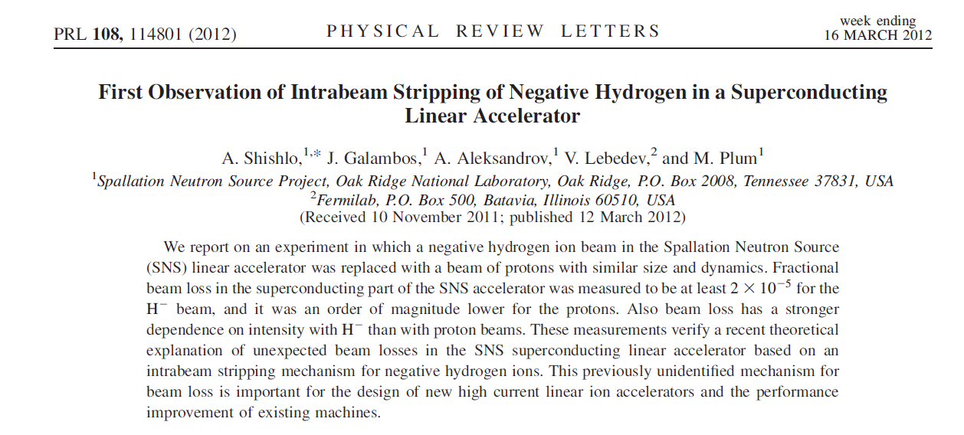

Slide 10
SNS Experimental Data
From: Shishlo, et. al. Proceedings IPAC12
H- Design Lattice
H- Production Lattice
Proton Design & Production Lattice
Figure 5: The normalized BLM signals vs. peak current for different beams and optics:
(a) and (b) H- beam for the design and production SCL optics respectively; (c) and (d)
proton beam for the design and production SCL optics respectively

Slide 11
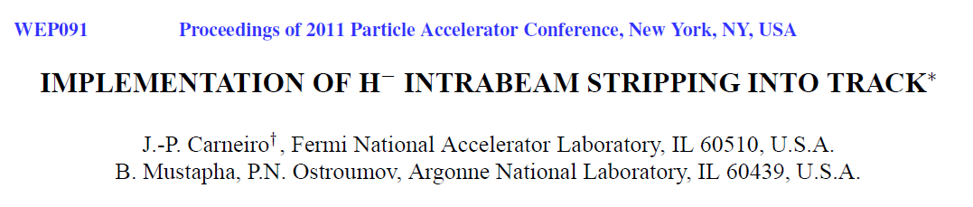
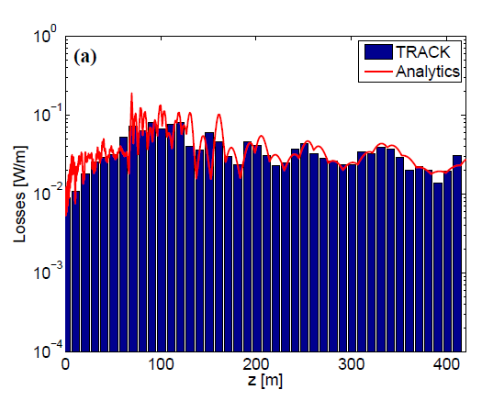
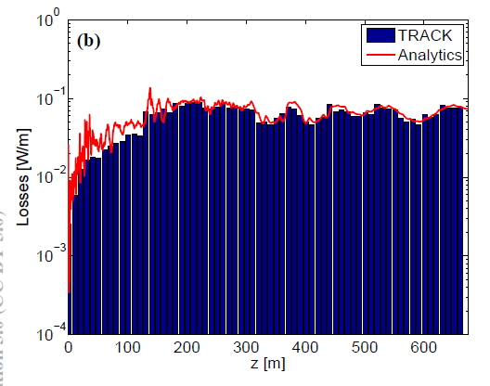
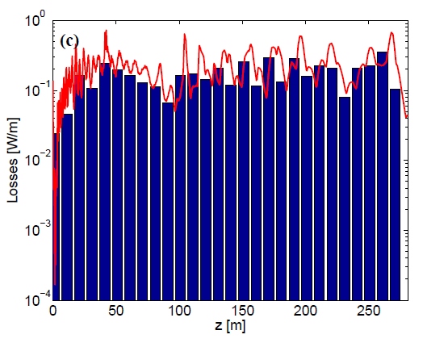
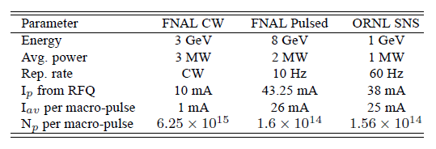
3GeV (3MW)
8 GeV (2MW)
1GeV (1 MW)

Slide 12
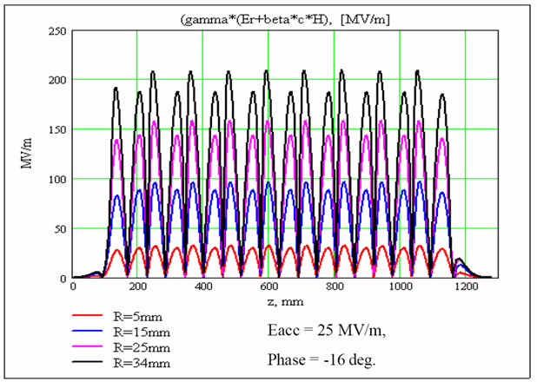
H- Stripping from SCRF EM Fields
From: Proton Driver Design Book
H- ions experience both electric and magnetic fields from accelerating cavities.
Both contribute to the H- rest frame electric field which determines the H- lifetime.
The electric field is amplified due to Lorentz boost seen by moving ions.
Depends on magnitude of the E_{acc} and the synchronous phase.
Figure 29 – Magnitude of H- rest-frame radial electric field seen by an 8 GeV H- traveling off-axis in the β=1 superconducting cavities of the Proton Driver linac. The H- frame electric field can exceed the peak (lab frame) cavity electric field E_{PEAK}=52 MV/m due to the gamma factor in the Lorentz boost. The peak field also depends on the synchronous phase, and is maximal for φ_{SYNCH}=90° when the particle passes near the cavity iris as the field goes through its maximum. A second maximum occurs when the particle passes off-center through the equator of the cavity, where the B-field maximum creates an electric field in the H- rest frame

Slide 13
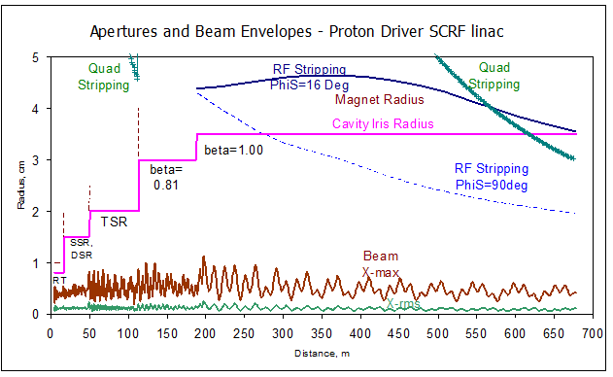
Proton Driver Summary
Figure 28 – Apertures and Beam Envelopes along the Proton Driver Linac. Beam envelopes are 1-σ (RMS), and Maximum (out of 100k particles tracked). Also shown are SCRF cavity iris apertures, quadrupole radial bores, and H- magnetic stripping radius (probability .0001/m) in quadrupole magnetic fields, and stripping apertures in the RF fields of the cavities at two different values of synchronous phase. Note the beam is collimated to R=3.7 mm in the RFQ and to R=7.5 mm in the Room-Temperature TSR section
From: Proton Driver Design Book

Slide 14
Summary
Acceleration and transport of high energy/intensity H- ions can be a perilous business.
  Various physical phenomena can lead to unwanted beam loss as indicated in these few slides.
  By judicious design choices of lattice parameters, fields, and beam pipe temperature losses may be minimized

