Slide 1
Overview of Injection & Painting Schemes
David Johnson
Fermilab
May 28, 2014
MAP Collaboration Meeting

Slide 2
Topics for Discussion
Injection parameters/ requirements for Accumulator ring
Phase space painting
Charge-exchange stripping
Laser stripping
SNS injection
FNAL Proton Driver / Project X
MAP Preliminary Conceptual Injection layout ideas

Slide 3
Preliminary Parameters for 1 MW Initial MAP Facility
Courtesy of K. Gollwitzer
*Assume Accumulator Ring final emittance 5 μm (rms-unnormalized)
*Ring circumference 308.23 m
*From : Y. Alexahin#, D. Neuffer IPAC12
Ratio of ring emittance to linac ~ 200 … good for painting

Slide 4
Phase Space Painting 1
General Comments
In an accumulator ring, typically want large transverse emittances to reduce space charge tune shift
The transverse emittance of SCL << final ring emittance
The linac beam position is fixed at the injection point (H- -> H+) with respect to the ring closed orbit.
The ring closed orbit (and/or the injection angle from the linac) is adjusted as a function of time during the injection process.
Motion of closed orbit: offset from the central orbit increases or decreases during injection period-> correlated or anti-correlated painting
Popular functional forms of the painting waveform are square-root or exponential or a combination.
  SNS uses exponential (anti-correlated)
  JPARC uses square-root (anti-correlated)
  CSNS proposing a combination of square-root and exponential (anti-correlated)

Slide 5
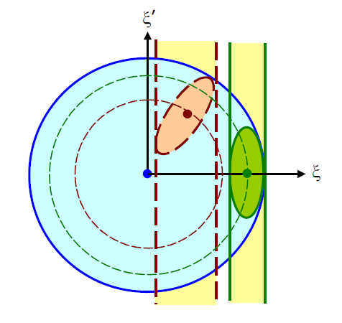
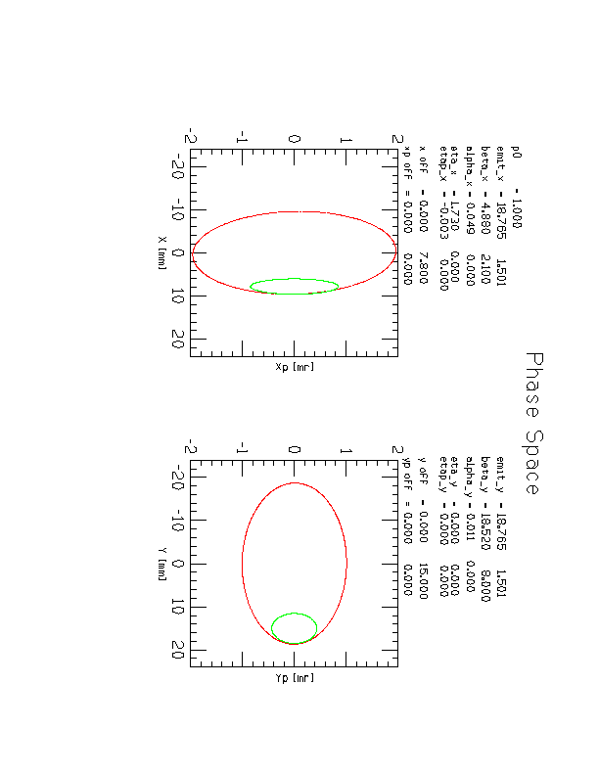
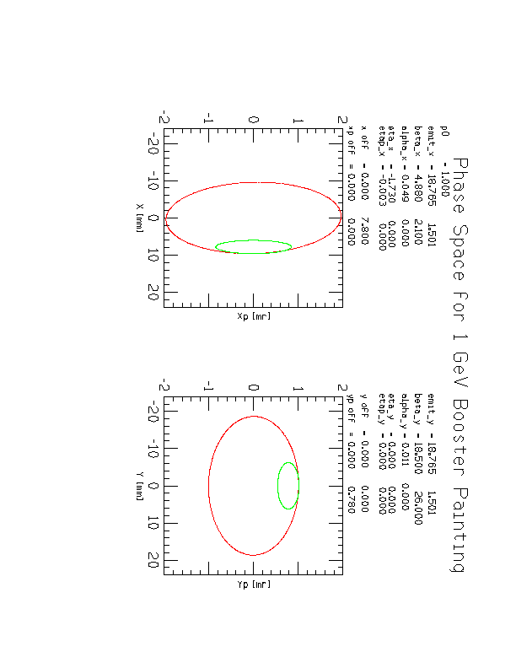
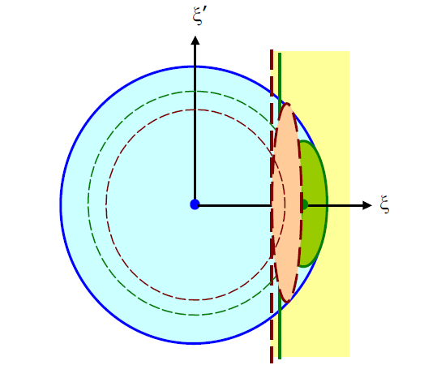
Phase Space Painting 2
J B-Wang, C. Prior SNS/BNL Note 080
Optimal positioning/orientation of injected beam in circulating beam ellipse.
In our case α ~ 0 for both ring and line (upright ellipse)
Injected beam proper aspect ratio (minimize hits)
Determines values for transport line lattice functions
Examples
Paint x & y
Paint x & steer y

Slide 6
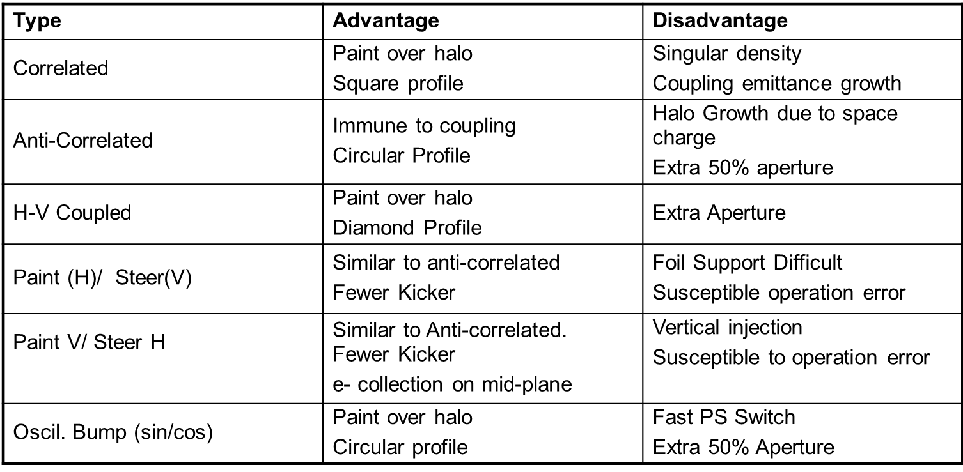
Painting Schemes

Slide 7
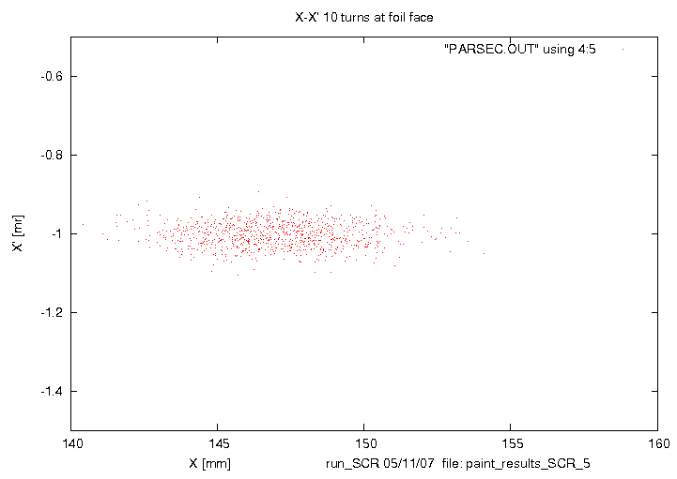
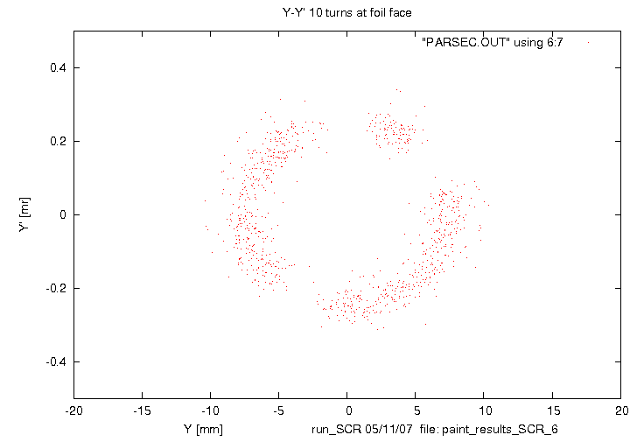
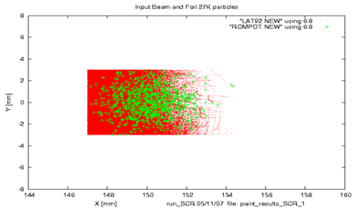
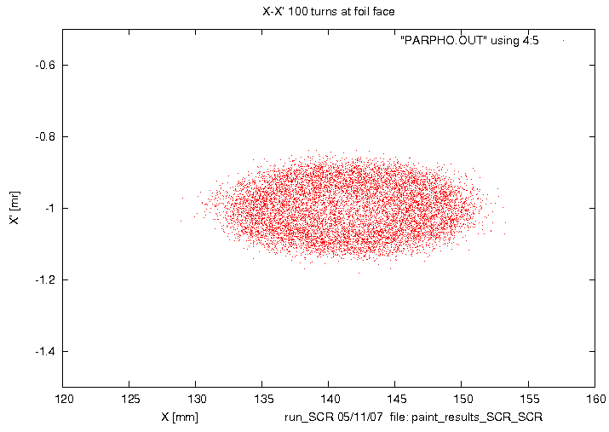
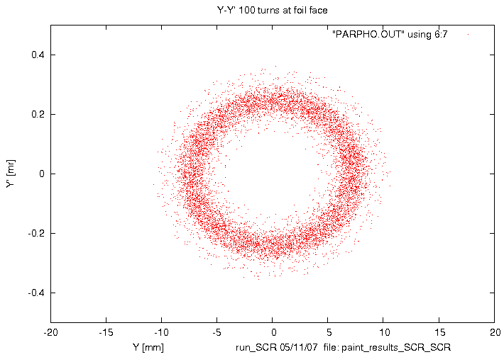
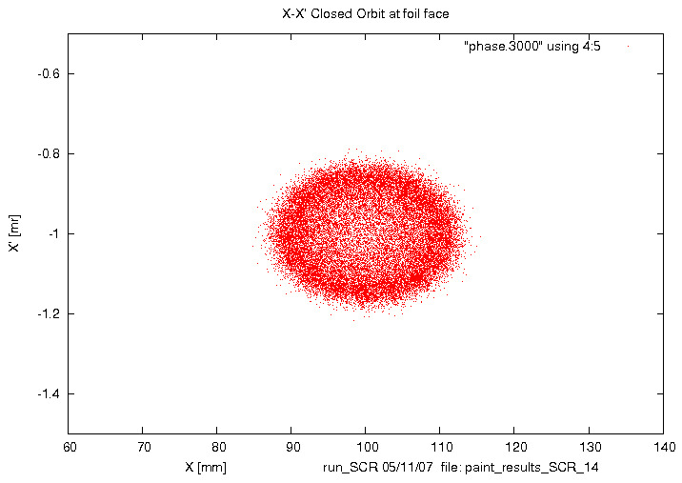
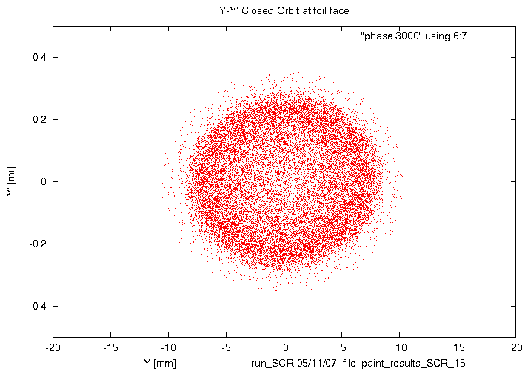
Phase space painting (PD)
Foil hits for injected &
parasitic interacrions
Result of anti-correlated paint/steer painting.
Total injection time 270 turns
Beams doc 2957

Slide 8
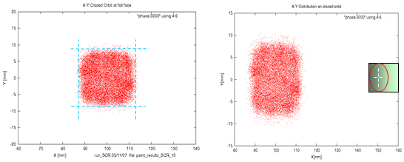
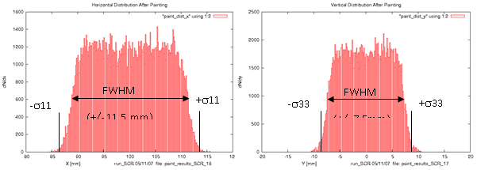
Final Distribution
Beams doc 2957

Slide 9
Charge Exchange Stripping
Technique utilized for many decades for multi-turn injection of H- ions.
The efficiency of converting H⁻ into protons and the distribution of H⁰ excited states have been measured at energies up 800 MeV [Stinsen (69), Webber (79), Mohagheghi (91) , Gulley (96), and Keating (98)]
Scale the 800 MeV cross sections for H⁻→H⁺,H⁻ → H⁰, and H⁰ → H⁺, by 1/β². [W.Chou, et.al. NIM A 590 (2008) 1-12]

Slide 10
Calculations have been scaled by 1/β² suggested by W. Chou

Slide 11
Populations of Excited States
Kurpick and Reinhold (ORNL)et.al. have presented a relativistic generalization of a classical transport theory to describe the production of excited states of hydrogen in the energy range 100 MeV -100 GeV. They found---
  “not only the n-shell population od excited states but also the sub-shell populations are in reasonable agreement with experiments by Keating [800MeV].”
  “The fraction of excited levels as a function of scaled distances (un units of mean free path) is (almost) independent of the beam energy.”
  Performing calculations in the range of 0.8 to 100 GeV, they found that “the population fractions are practically only a function of the ratio of the foil thickness to the total mean free path between collisions”.

Slide 12
A thickness/mfp of 13 corresponds to a foil thickness of ~500 υg/cm² at 8 GeV

Slide 13
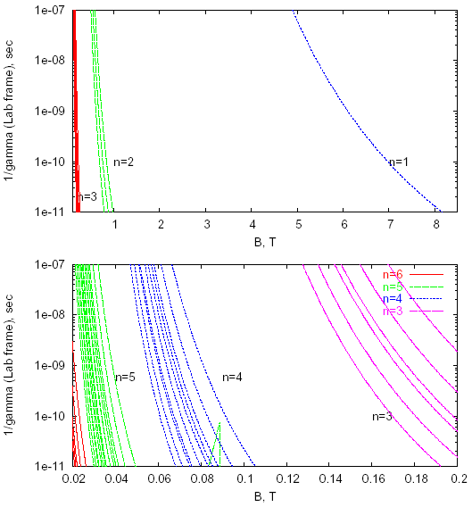
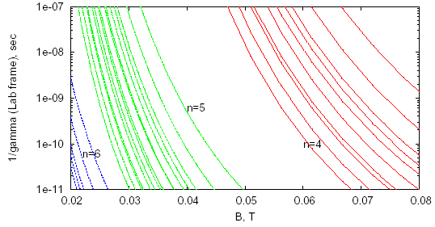
Stark State Lifetimes

Slide 14
Foil Issues
Foil Temperature
  What is an acceptable maximum temperature?
    SNS initial camera system designed to measure temps down to 1500-1600ºK but never got a good measurement. A new system is planned…. Best guess for 1.4MW is in the 1500-1600ºK range (M. Plum)
    JPARC reported on initial tests of measurement system of phototransistor and photodiode. Large errors in photodiode output. Focusing on pulsed measurement. Estimate safe carbon or diamond foil temp around 1600ºK (A. Takagi)
Secondary Electrons
  Shape and magnitude of magnetic field – trajectory of electrons – beam normal to B
  Resistivity of injection foil ( build up of static charge – lesson learned SNS)
Minimizing secondary hits by circulating protons
  Ring lattice functions ( symmetric insertion, a=0 at foil)
  Foil size and orientation (matched to injection beam size)
  Painting algorithm
Losses due to
  H0 excited states
  Nuclear collision in 500 mg/cm2 foil
    -> probability 8.3E-6 -> Power=n hits*int/sec*NCP*E*C -> for 30 hits loss approaches 84 W
  Large angle coulomb scattering -> previously estimated for 30 hits est. 81 W
  H- missing the foil (utilize beam shaping to safely remove large amplitude)

Slide 15
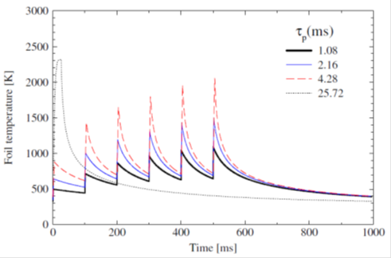
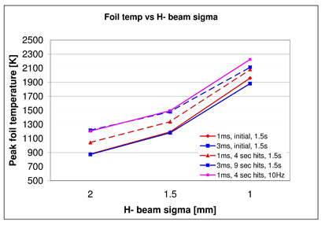

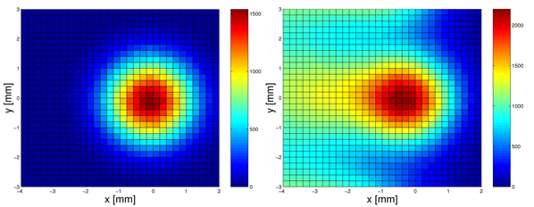
Foil Heating
Two contributions to foil heating:
  Injected beam (intensity and sigma)
  Circulating beam hits

Slide 16
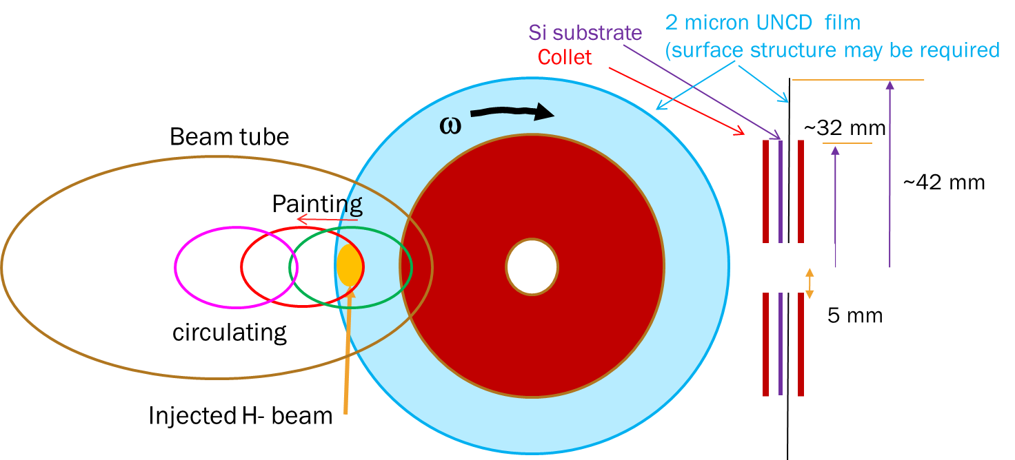
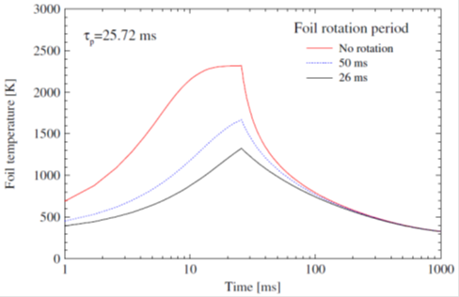
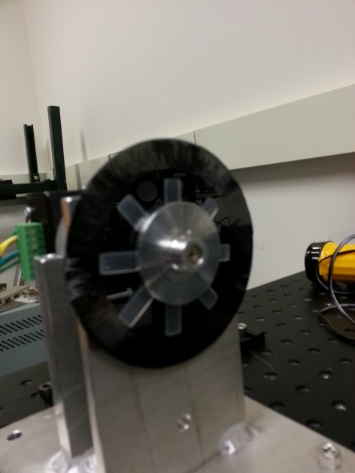
Rotating Foil
To ameliorate peak foil temperatures, spread energy deposition over a larger area.

Slide 17
Laser Stripping
Being pioneered and developed at SNS in
  Proof of principal experiment validated theoretical estimates ( stripped only a single 400 MHz bunch (7 ns) 2006
  the advancement of theoretical predictions
  the advancement of laser technology and accelerator and laser techniques to reduce required laser power
  An intermediate experiment planned to demonstrate >90% efficiency in 10 μs long pulse (2016)
Stripping requirements for several beam scenarios in Project X have been estimated by Timofey Gorlov (SNS)
Project X requirements are applicable to Accumulator ring injection.

Slide 18
Stripping Efficiency
Peak power levels of the Laser stripping process using the standard 3 step process in the absence of a magnetic field.
Timofey Gorlov

Slide 19
Power Est. For 8 GeV
Required Laser Parameters for 98% stripping Efficiency
*Timofey Gorlov (SNS)
Wavelength [nm] | 1900 | 1064 | 1900 | 1064 | 1900 | 1064
 | elliptical |  | circular |  | Strong Field
Incidence angle [deg] | 49.8 | 94.6 | 49.8 | 94.6 | 49.8 | 94.6
Peak Power, P0 [MW] | 1.1 | 5 | 1.1 | 5.5 | 2.1 | 10
Micropulse energy [mJ] | 0.08 | 0.3 | 0.08 | 0.4 | 0.14 | 0.7
Power at 325 Mhz [kW] | 26 | 100 | 26 | 130 | 47 | 230
Power at 162.5 Mhz [kW] | 13 | 50 | 13 | 65 | 24 | 115
Micropulse duration (rms) [ps] | 29 | 28 | 29 | 28 | 27 | 28
X-rms size [mm] | 4.3 | 5.0 | 2.1 | 2 | 2 | 2
Y-rms size [mm] | 1.9 | 1.9 | 2.1 | 2 | 2 | 2
X’-divergence [mr] | 1.4 | 0.6 | 1.7 | .8 | 0 | 0
Y’-divergence [mr] | 0.9 | 0.6 | 1.7 | .8 | 0 | 0

Slide 20
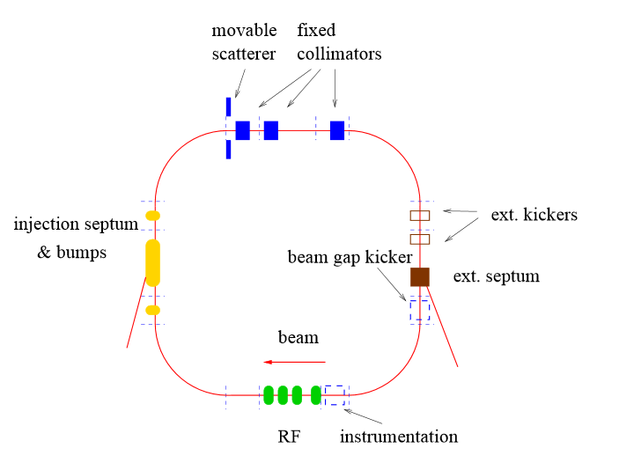
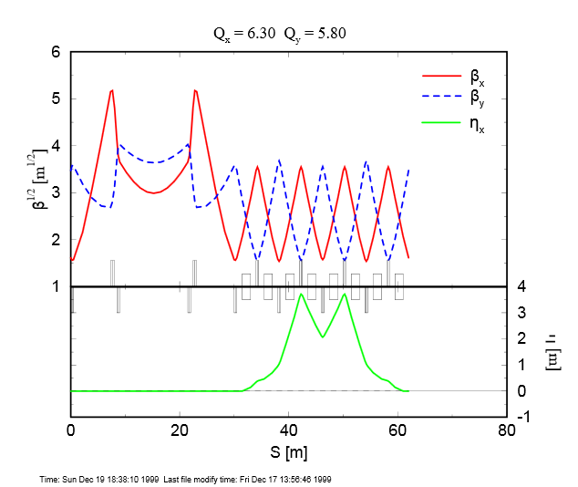
SNS layout/Lattice
Beam Energy 1 GeV
Proton Power 1.4 MW
Rep rate 60 Hz
PPP 1.5 x 10¹⁴
Linac macropulse 26 mA
Ring circumference 308.23 m
Ring filling time 1 ms
Number of turns 1060

Slide 21
SNS Injection Straight
Chicane Dipoles
2.72 kG 42 mr
2.99 kG 46.2 mr
2.63 kG 41.3 mr
2.84 kG 45.5 mr
Fixed Chicane
H
V
Painting magnets
quads
12.5 meters

Slide 22
SNS Issues
SNS Injection issues and solutions presented by M. Plum (at HB2008)
  Chicane magnets do not function as designed
    Bend ang. adjusted for good inj. But problems in injection dump line
  Original design did not allow individual control over the H0 and H- waste beams (H0 and H- beams after injection foil have different trajectories due to location of injection foil)
    Added c-magnet just downstream of the septum magnet
  High beam loss in injection dump line
    Beam halo
    Scattering in the secondary stripper foil -> reduced foil thickness
  Beam profile and position info at vacuum window/dump difficult to determine
    Add a view screen at vacuum window
  Advice: 3D field simulations and tracking in complex regions such as injection area. Map magnets well enough to determine higher order multipoles, for a wide range of currents. Allow independent control over multiple beams.

Slide 23
FNAL Proton Driver/ Project X
8 GeV SC linac injecting into Main Injector or Recycler
Initial injected beam power for Proton driver 132 kW (1.5E14@2.5Hz)
Initial injected beam power for Project X 360 kW (2.8E14@5Hz) required 5 injections/cycle
Clearly, the beam power at injection is significantly less than the benchmark high power injection at SNS.
Injection Design for Proton Driver and Project X utilize the existing accelerator straight section MI-10.
Utilize a SNS style injection style insertion .
Utilized JPARC style painting scheme (i.e. paint/steer anti-corr.)

Slide 24
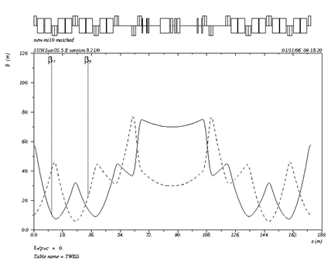
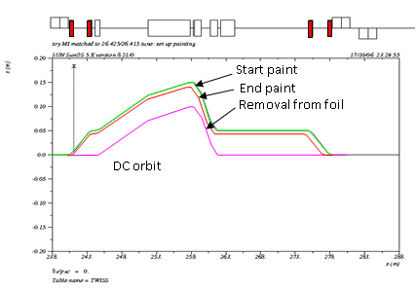
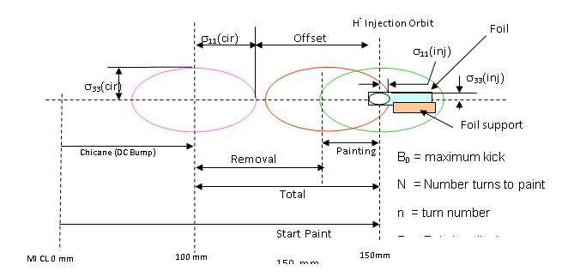
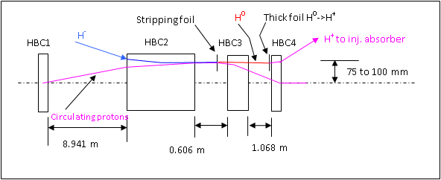
MI/Recycler Injection layout
Clean disposal of waste beam important
~35 m
Beams doc 2957

Slide 25
MAP Preliminary “Conceptual” Injection Ideas
Assume the Accumulator is a FMC lattice described by Yuri Alexhdrin earlier in this workshop and IPAC12 paper.
The injection straight section (as defined by ring dipoles on either side is XX meters.
A doublet pair is located about 5 meter inside the straight leaving ~14 meters between the doublets.
An alternate version increased this space to ~22 m between quad doublets.

Slide 26
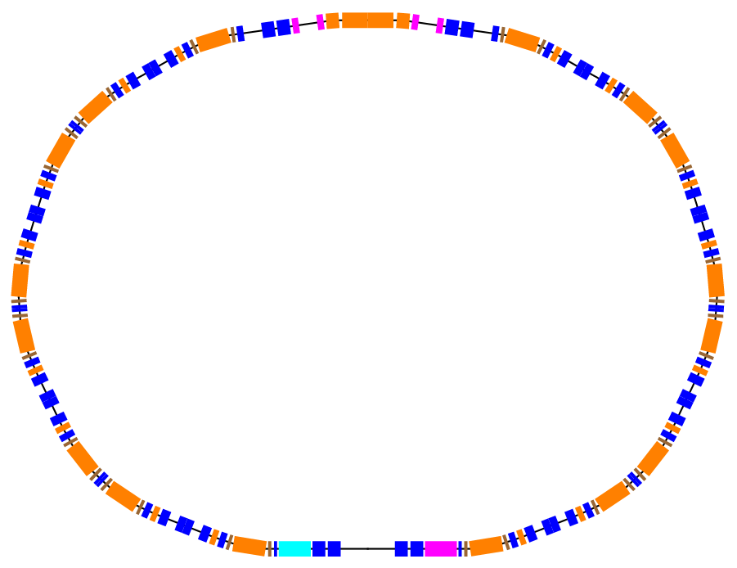
FMC Accumulator lattice
Injection Straight section

Slide 27
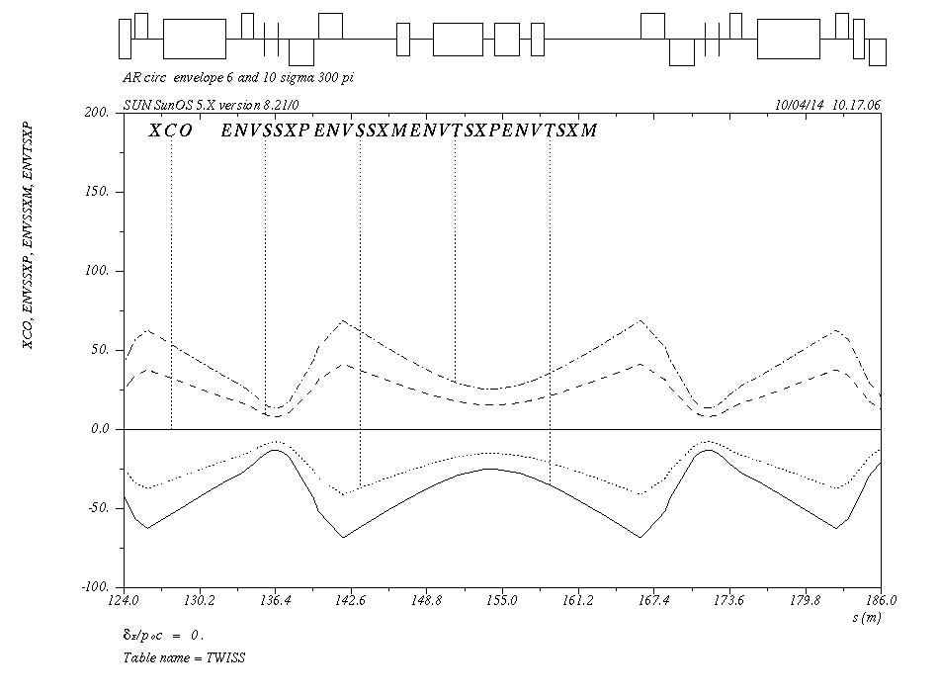
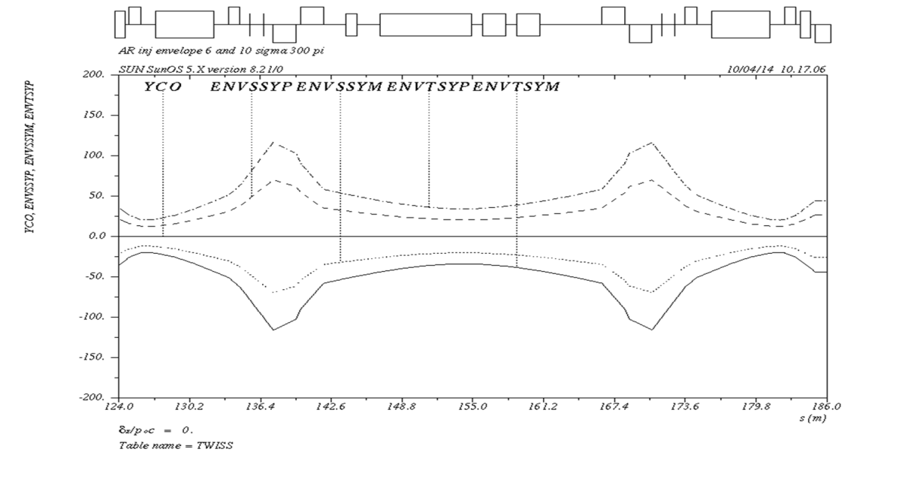
Accumulator injection straight Envelopes
Assume
5 um rms geometric
50 um normalized rms
300 pmmmr 95%
8 GeV

Slide 28
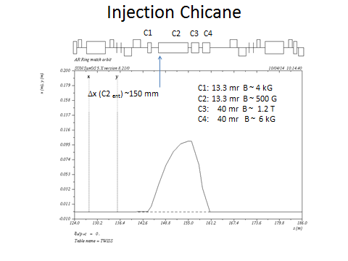
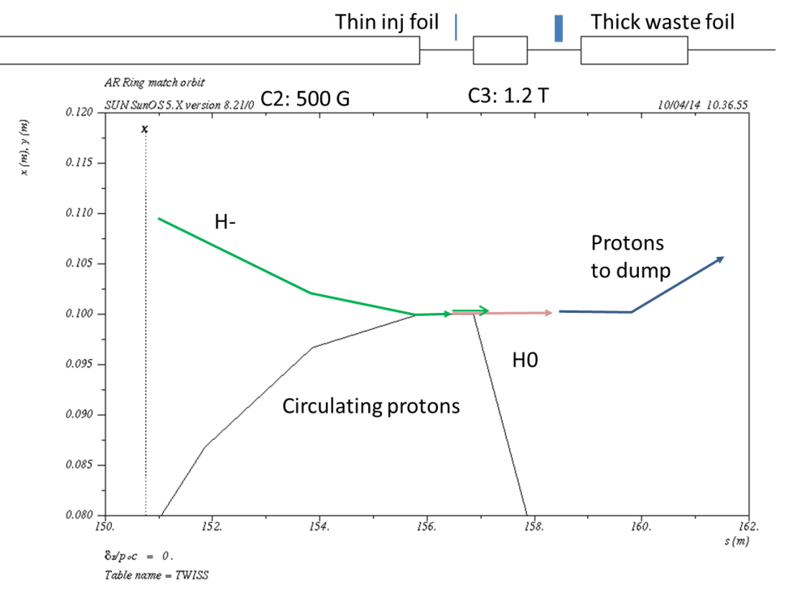
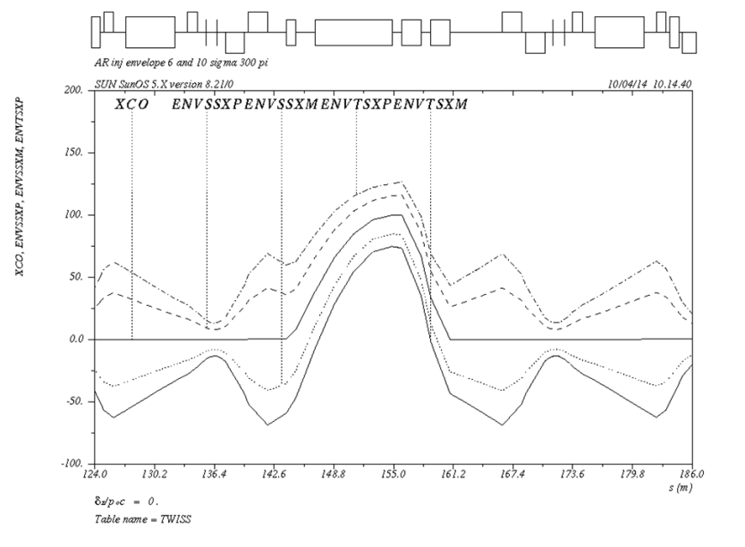
Injection Scheme based on MI

Slide 29
Summary
Multi-turn H- injection at 8 GeV (or 6.75 GeV) has never been done. It is challenging at best.
Handling of waste beams very important to keep residual radiation levels at reasonable level. [Lessons learned SNS]
Highest Beam power multi-turn injection is SNS.
Detailed 3D simulations of all magnetic fields is very important
Survivability for stationary foils (due to foil heating) is questionable due to long injection time. Use of rotating foils?
Laser stripping is a good candidate for high injection beam power.
Need ample room in the injection straight due to low fields required not to strip incoming H-.
Several concepts have been proposed

