Slide 1
Photon & e+e- Hits in Muon Higgs Factory
T. Markiewicz
T. Maruyama
SLAC
MAP Collaboration Meeting. Fermilab
29 May 2014

Slide 2
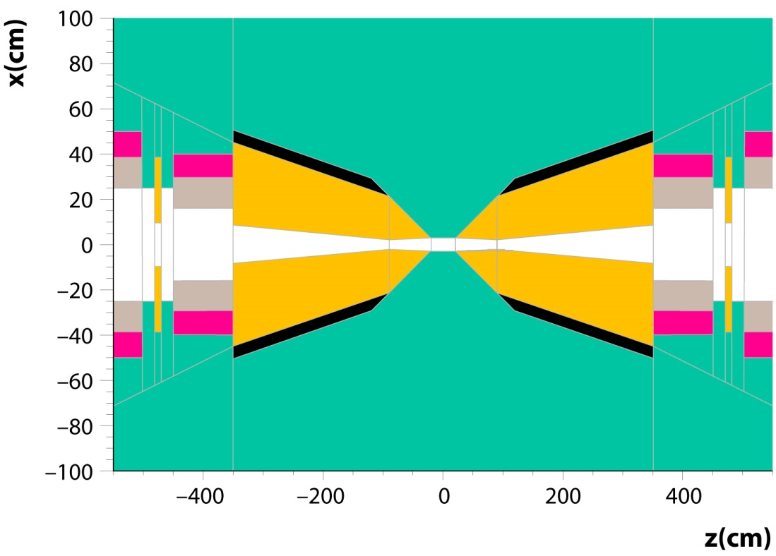
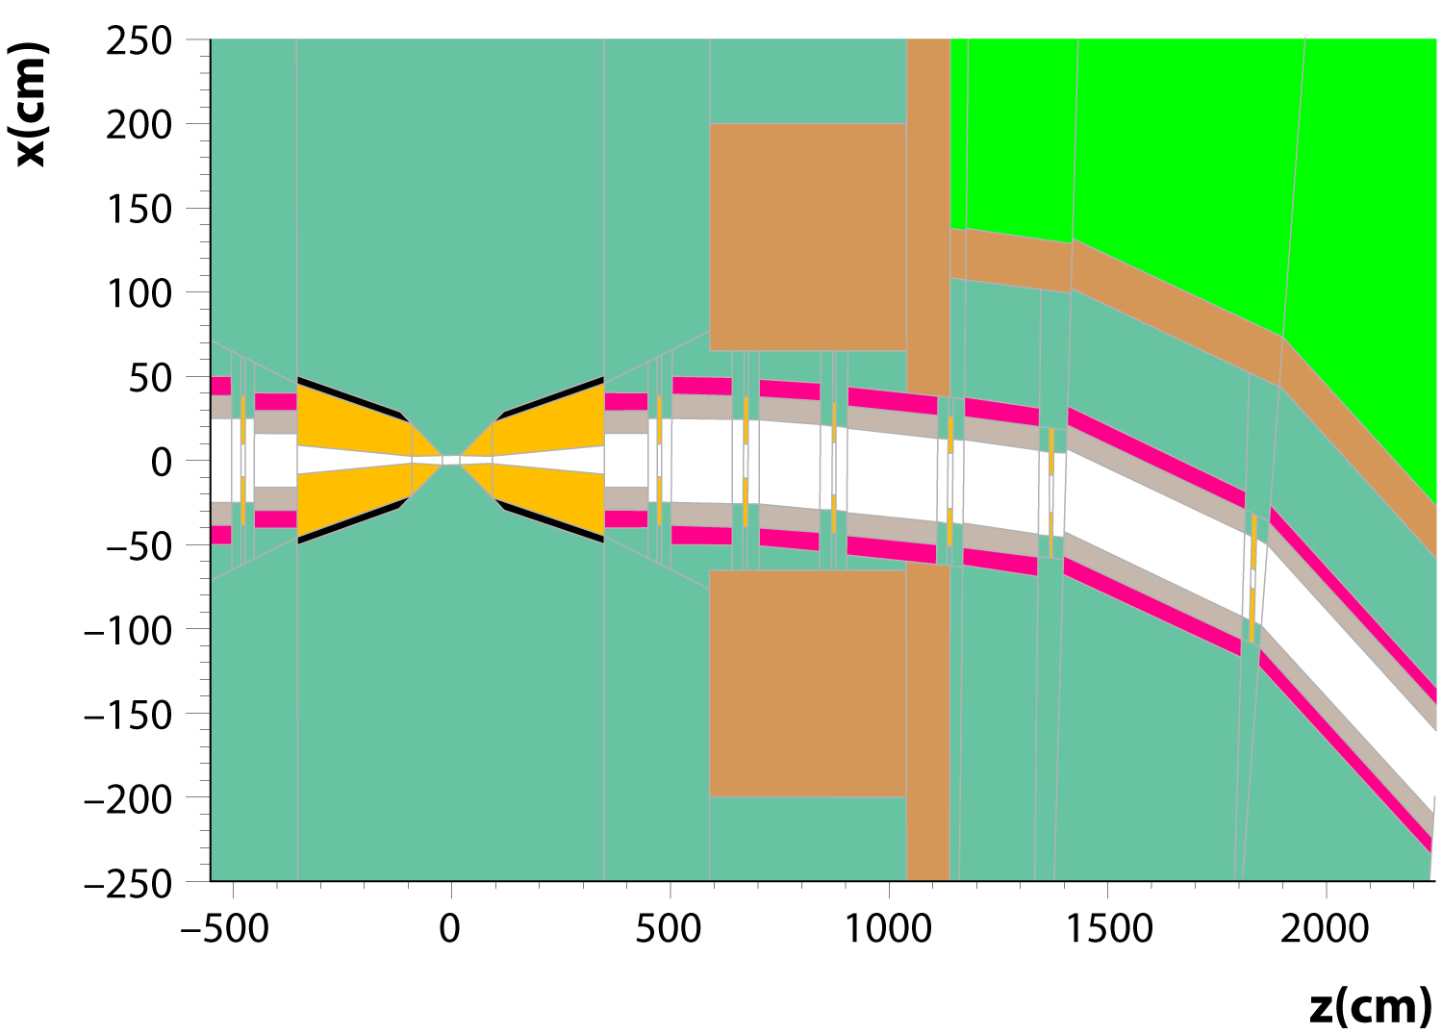
FLUKA Geometry
Takashi Maruyama
In all plots:
1 beam only
beam enters from R side
Beam starts at
X=-1.947m
Z=22.5077m
S=22.71m
T0=75.7ns

Slide 3
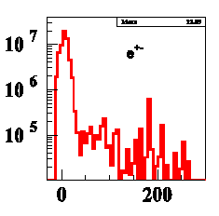
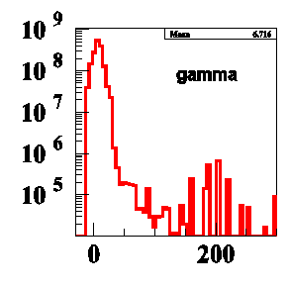
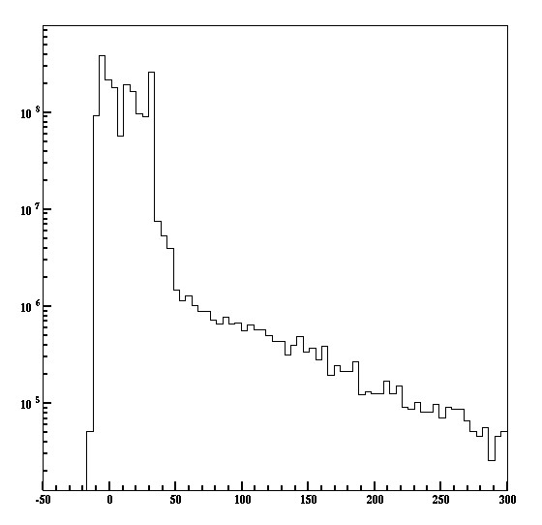
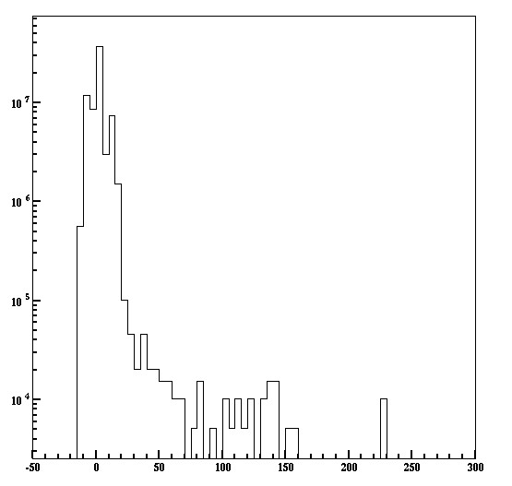
Summer 2013 Work Attempted to Ensure Agreement w/ MARS as presented by Striganov at June 2013 MAP CM
Per beam | Striganov | Maruyama | Cutoff E
Photons | 1.6×10⁹ | 1.8×10⁹ | 0.1 MeV
e+/e- | 6.1×10⁷ | 7.0×10⁷ | 0.5 MeV
Neutrons | 8.6×10⁷ | 10×10⁷ | 0.1 MeV
Ch. Hadrons | 5.1×10⁴ | 7×10⁴ | 1 MeV
Time (ns)
e+/e-
gamma
Time (ns)

Slide 4
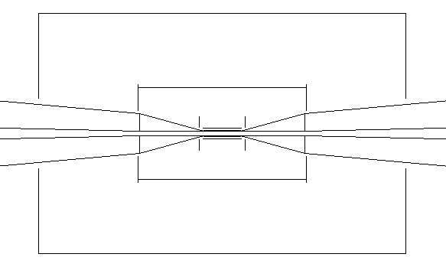
Study Hit Density per Readout Plane
Barrel Detector | Radius (cm) | Half Length (cm)
VXD | 5.5 | 20.5
Tracker | 50.0 | 91.0
ECAL | 131.0 | 200
Geant 3 Detector planes
  Each 300um Silicon
Track Fluka generated particles in 4 Tesla field
Record hit position and hit time
Find hit density per readout time w/ and w/o timing cut
  Figure of merit for ILC backgrounds and detectors
  Some preliminary discussions of readout electronics required
Endcap | Z (cm) | Rin (cm) | Rout (cm)
VXD | 24.8 | 6.7 | 18.4
Tracker | 92.0 | 25.2 | 53.3
ECAL | 200.1 | 38.0 | 130.9

Slide 5
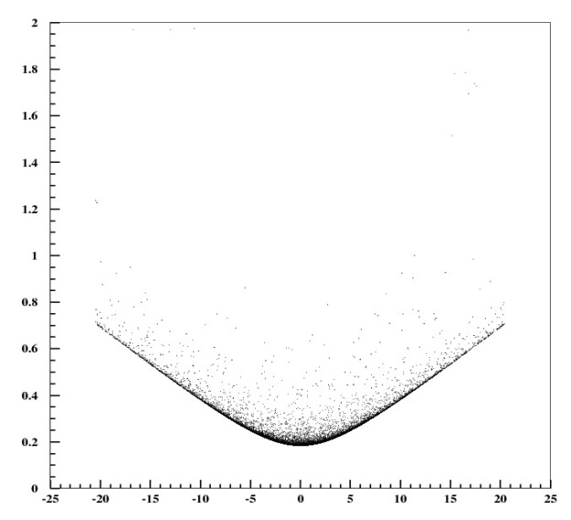
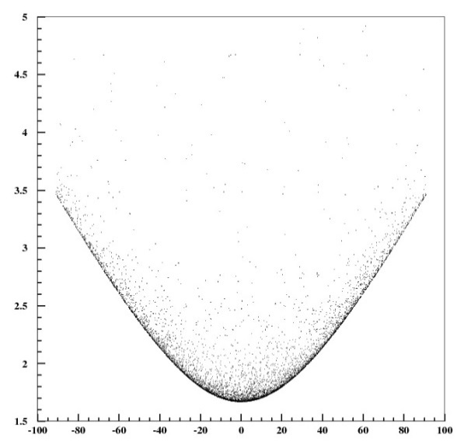
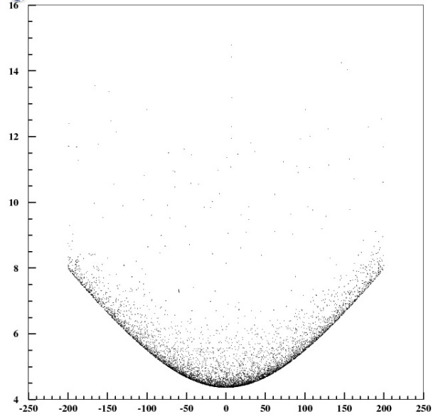
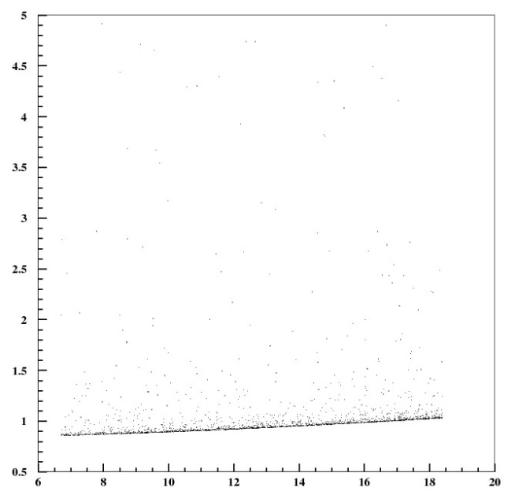
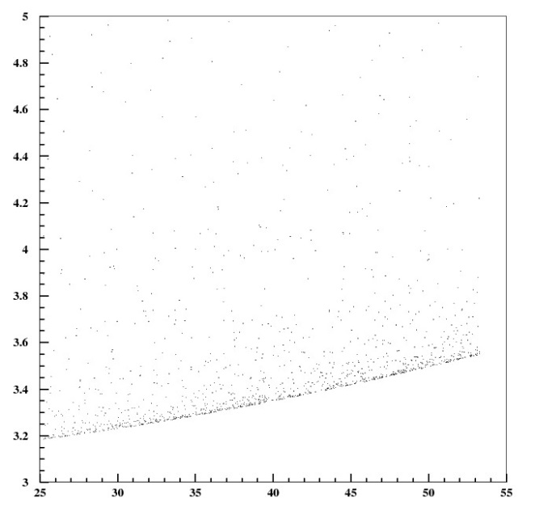
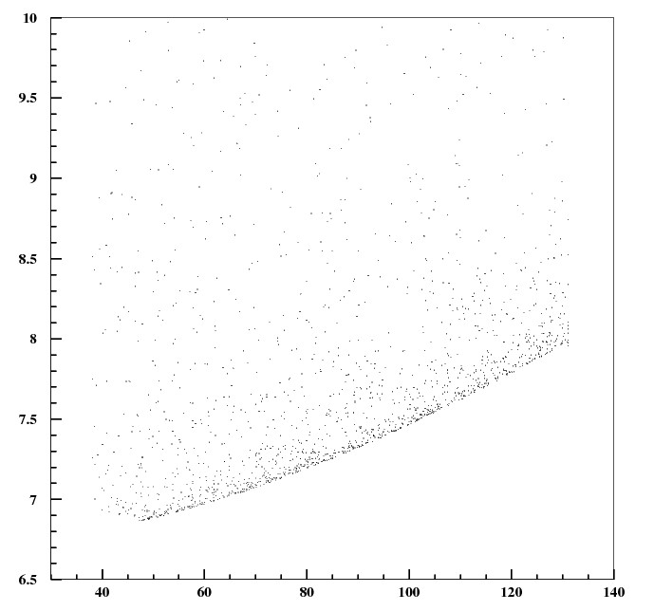
Pythia timing to set timing gates
Barrel 1
Barrel 2
Barrel 3
Time (ns)
Z (cm)
Endcap 1
Endcap 2
Endcap 3
R (cm)

Slide 6
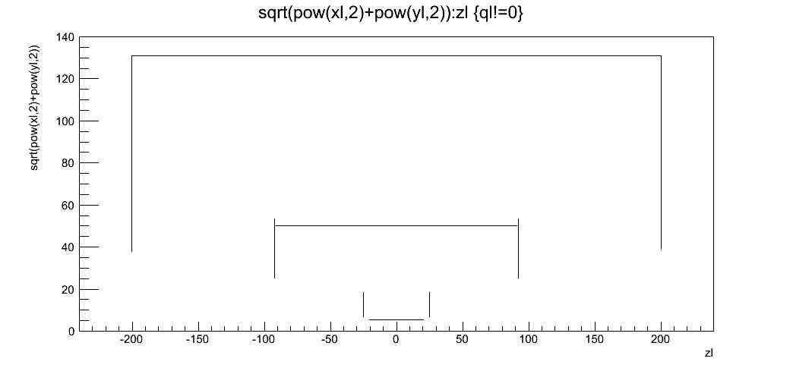
Photons Crossing Defined Silicon Layers

Slide 7
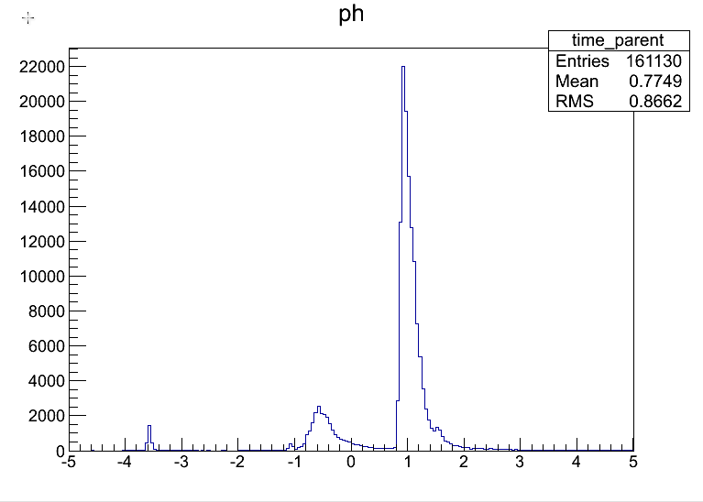
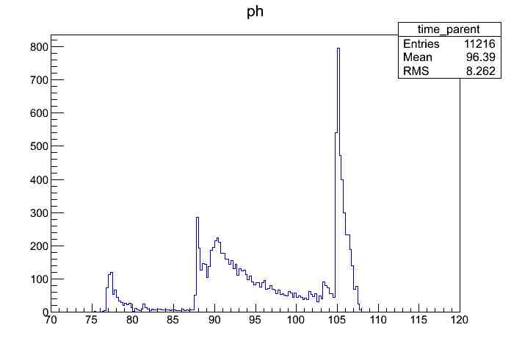
Error in our Interpretation of “FLUKA time” Uncovered
On 5/20/14 discover error in time assigned to parent particle by our interpretation of FLUKA:
  NOT time it left beampipe, W cone or W disk, but rather time at the end of the “FLUKA step” which is large in the case of photons, charged hadrons & neutrons and small in the case of e+/e-
For photons, Takashi reran FLUKA for 1 bunch & scored the photons (rather than letting them convert): Multiply by 5100 x 2% = 102 to get background associated with one bunch. # hits/converted γ underestimated (hits/γ~4)
For electrons: error small, use Takashi’s full statistics: Multiply unnormalized plots by x510 to get backgrounds associated with 1 bunch
Time when photon produced by showering decay electron
(all 9 Silicon layers in this plot)
Current correct result
Previous incorrect result (+75 ns) June 2013

Slide 8
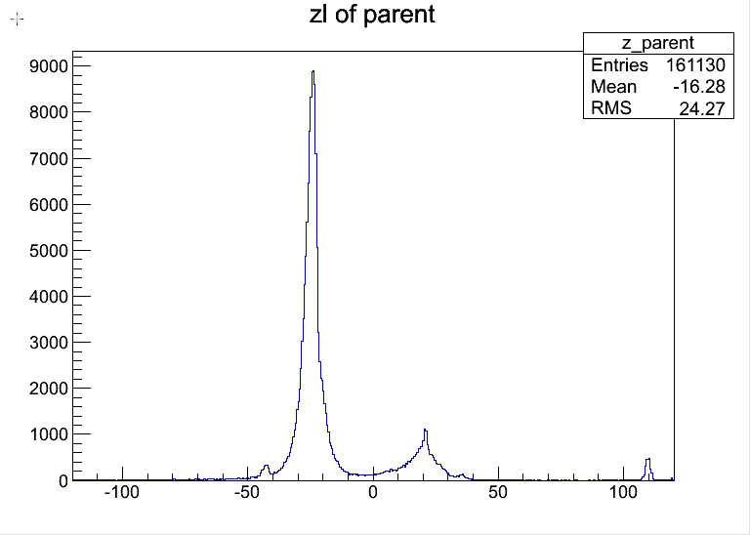
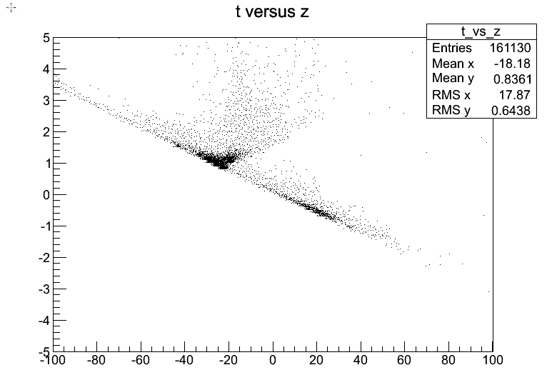
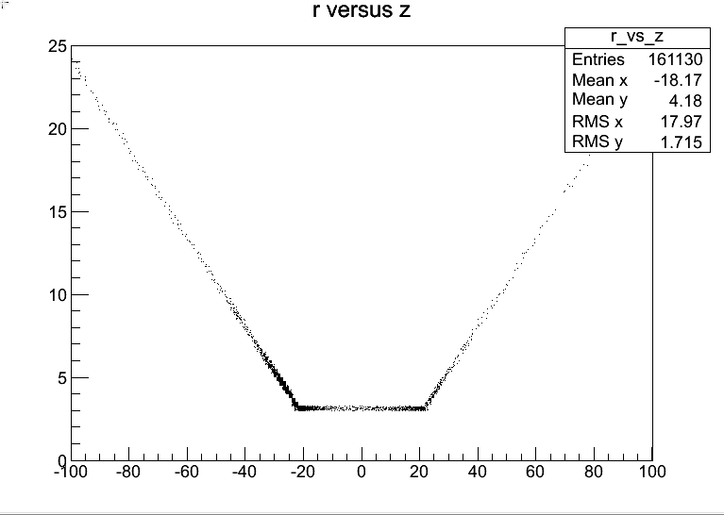
Time and z of produced photon background
Downbeam Cone tip:
Z=-20.45cm
R=2.8cm
Upbeam Cone tip:
Z=+20.45cm
R=2.8cm
Muon Beam

Slide 9
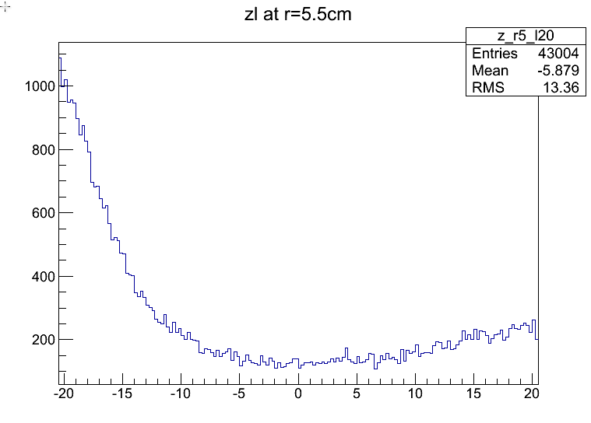
Z Distribution of Photons in r=5.5cm Barrel VXD
Use this to get Peak/Average occupancy
Should also look at azimuth as more background in horizontal plane

Slide 10
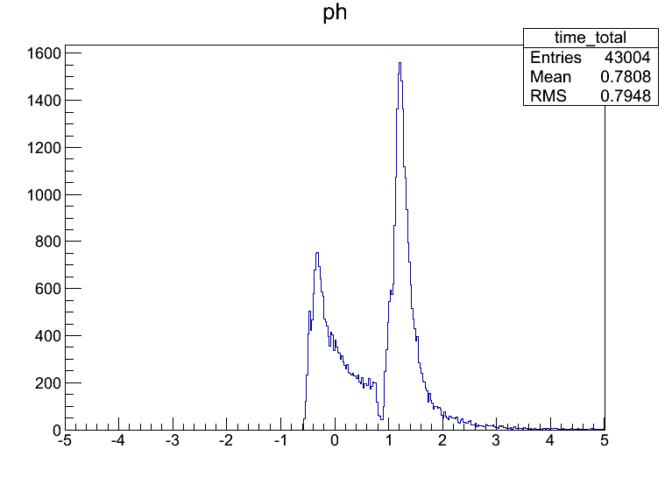
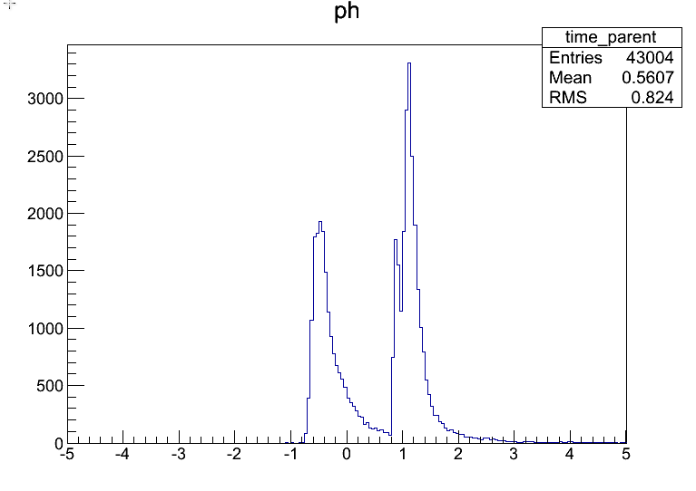
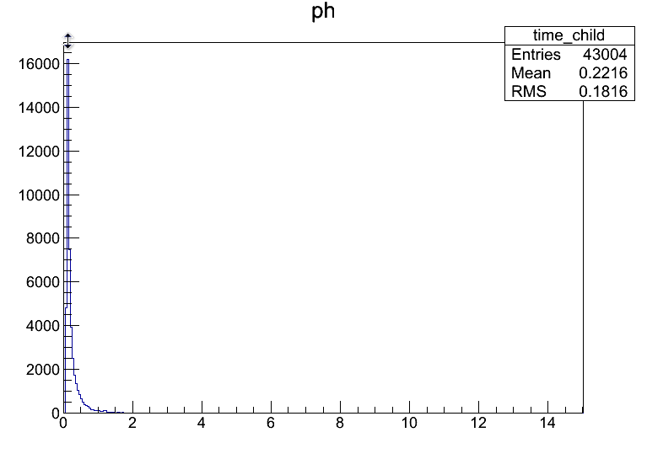
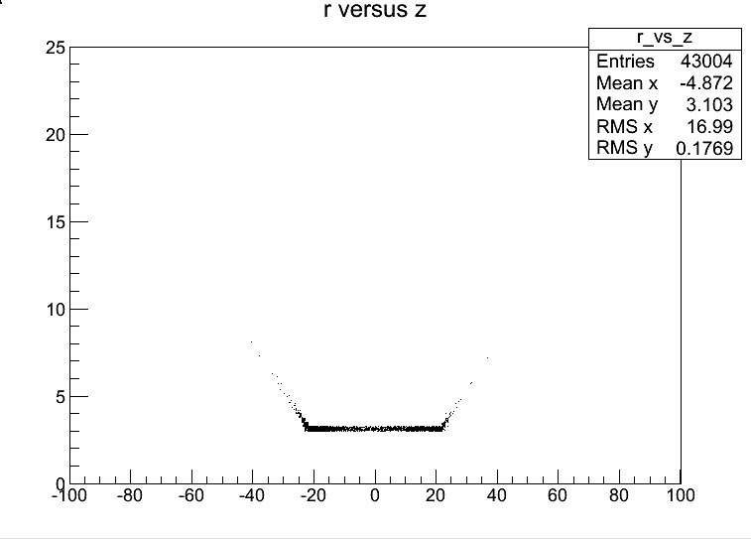
Time Distribution of photon hits on r=5.5cm Barrel
time=time_parent+time_child
time_parent
time_child rel. to parent
Source of photons

Slide 11
Converted Photon Background Occupancy in r=5.5cm VXD Barrel
Max. transit time for prompt photon from vertex is 0.71ns
ALL background hits 43k x 102 x 2 x 1000 = 8.8 x 10^9 hits per train
Layer has r=5.5cm and L=2x20.5=41cm; Area=1417cm^2
Average hit density is 6.2 x 10^6 hits/cm^2
If pixel = 20um x 20 um, this is 25 hits/pixel average per train
Peak occupancy is ~4x average occupancy -> 100 hits/pixel
A +/-0.8ns time cut would be required to reject the backgrounds from tip of the downstream cone, leave background from the upbeam cone and the beampipe. 18.59k/43.0k= 43%
Occupancy is to be compared to engineered KPIX architecture for 4 hits per readout per train

Slide 12
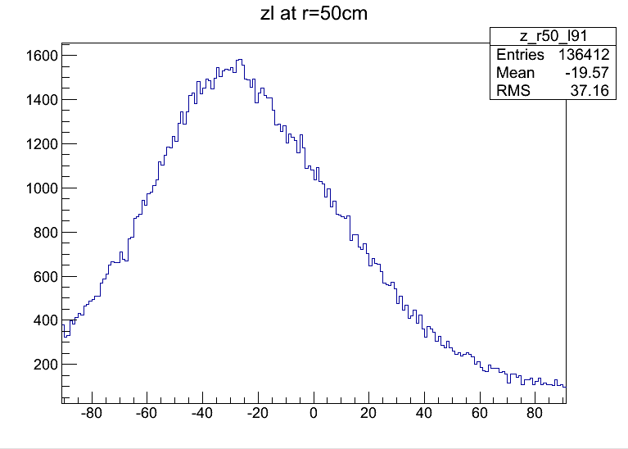
Z Distribution of photons in r=50 Barrel
Look at photons at r=50cm -91<z<91 Silicon layer: 1st layer of tracker

Slide 13
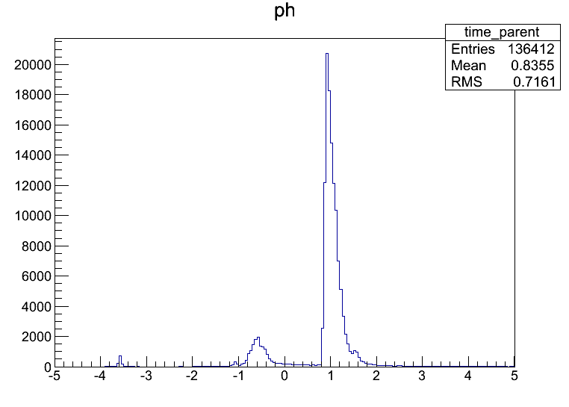
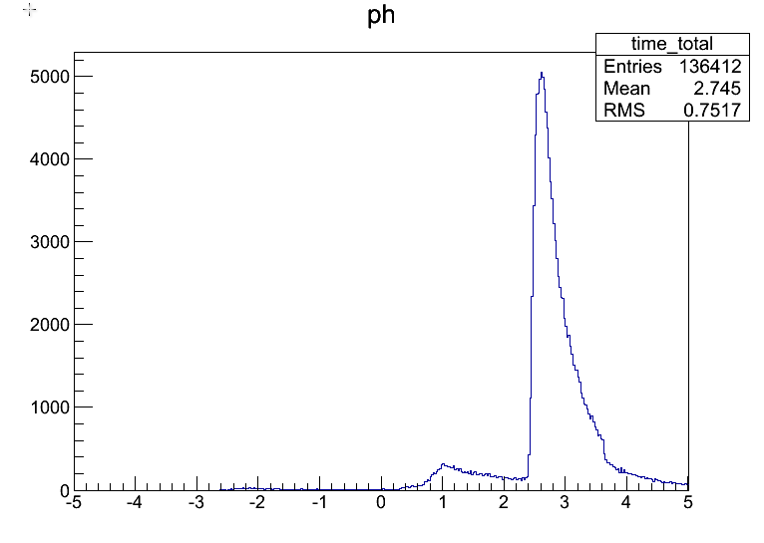
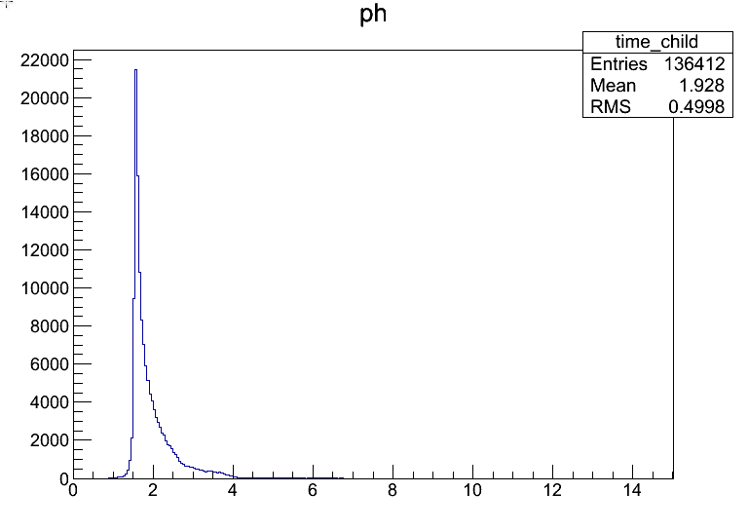

Time Distribution of photon hits on r=50cm Barrel
time_parent
time=time_parent+time_child
Source of photons
time_child rel. to parent

Slide 14
Converted Photon Background Occupancy in r=50cm Tracker
Max. transit time for prompt photon from vertex is 3.5ns
ALL background hits 136.4k x 102 x 2 x 1000 = 27.8 x 10^9 hits per train
Layer has r=50cm and L=2x91=182cm; Area=57177cm^2
Average hit density is 0.486 x 10^6 hits/cm^2
If detector is = 50um x 1 cm strip, this is 2430 hits/strip average per train
Peak occupancy is ~2x average occupancy -> 5000 hits/strip
The time of flight variation across the barrel (1.5-4.0ns) encompasses the majority of the background
Occupancy is to be compared to engineered KPIX architecture for 4 hits per readout per train

Slide 15
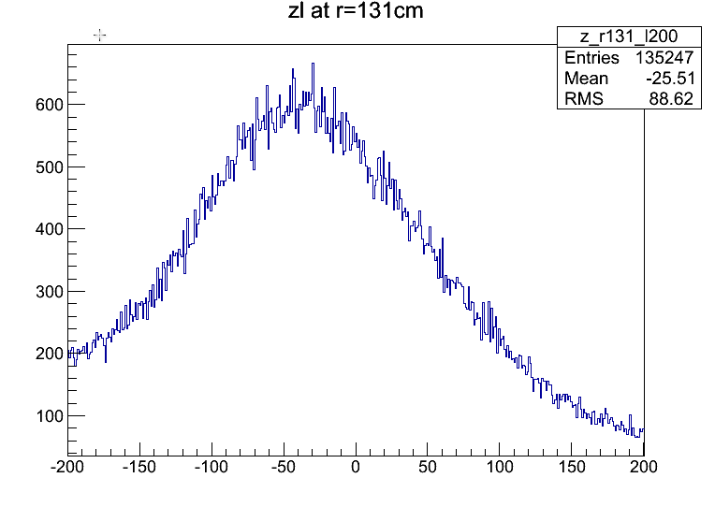
Z Distribution of photons on r=131cm ECAL Barrel

Slide 16
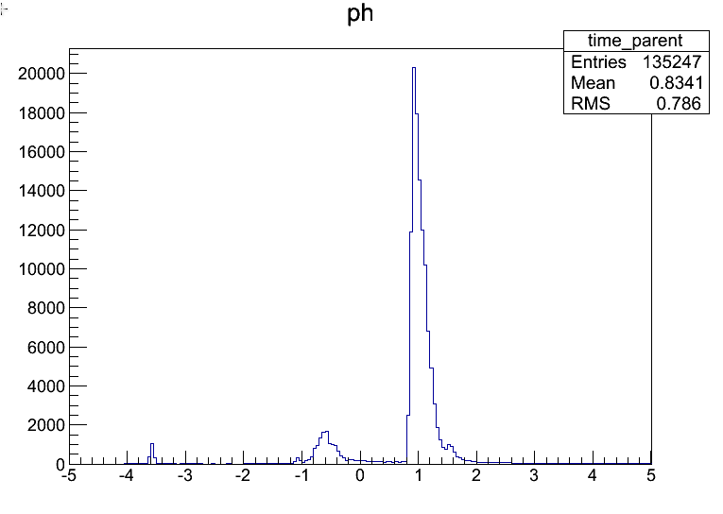
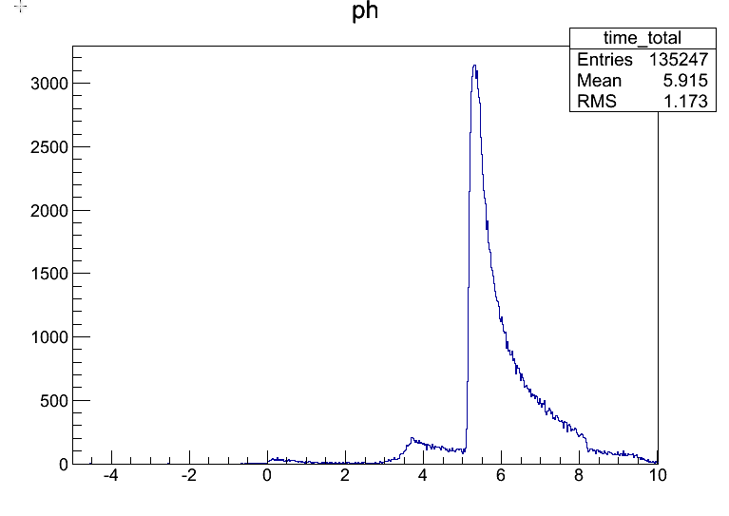
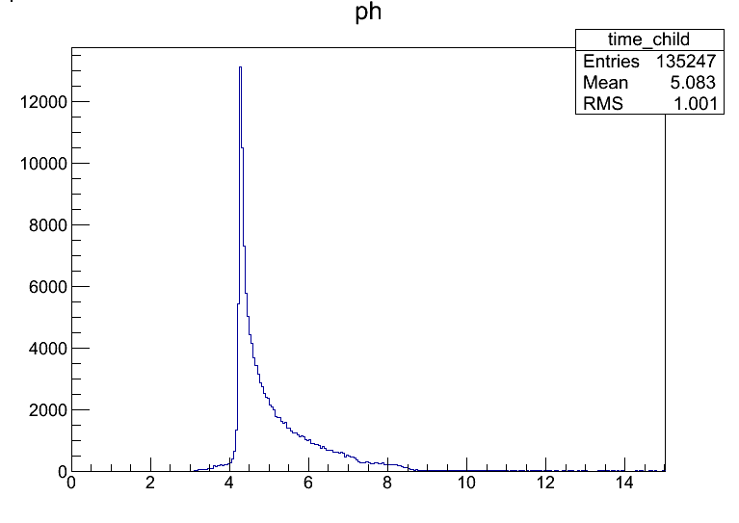

Time Distribution of photon hits on r=131cm Barrel
time_parent
time=time_parent+time_child
Source of photons
time_child rel. to parent

Slide 17
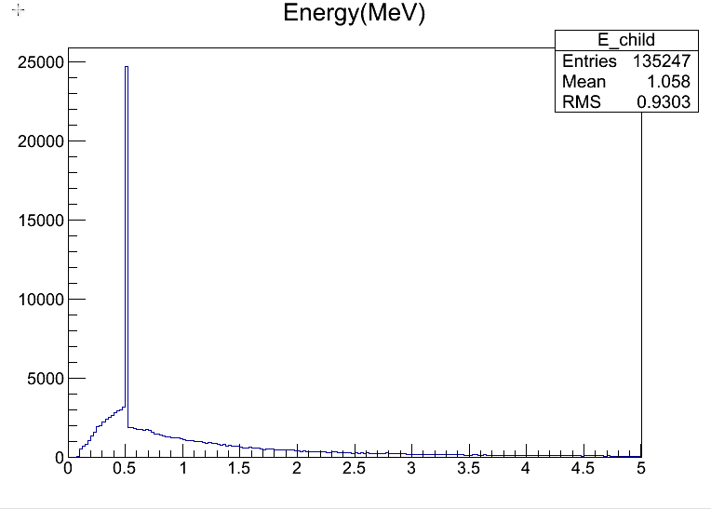
Background Converted Photon Occupancy at r=131cm
Max. transit time for prompt photon from vertex is 8ns
ALL background hits 135.2k x 102 x 2 x 1000 = 27.6 x 10^9 hits per train
Layer has r=131cm and L=2x200=400cm; Area=3.29E5cm^2
Average hit density is 8.4x 10^4 hits/cm^2
If detector is = 1cm x 1 cm pad, this is 8.4x10^4 hits/pad average per train
Peak occupancy is ~2x average occupancy -> 16k hits/pad
The time of flight variation across the barrel (4.0-10.0ns) encompasses the majority of the background
Occupancy is to be compared to engineered KPIX architecture for 4 hits per readout per train
Average photon energy is 1 MeV
  At calorimeter, an energy cut would work
  It is difficult to shield 1 MeV photons
    No easy fix for trackers

Slide 18
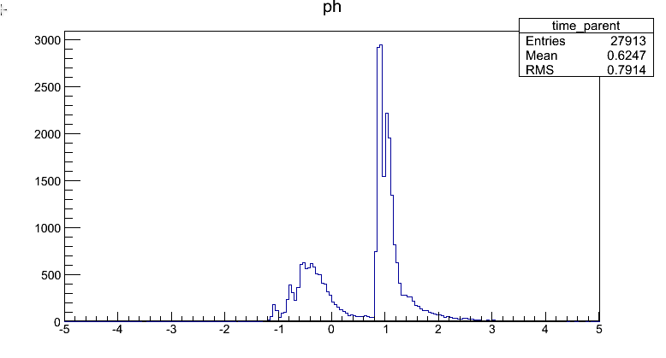
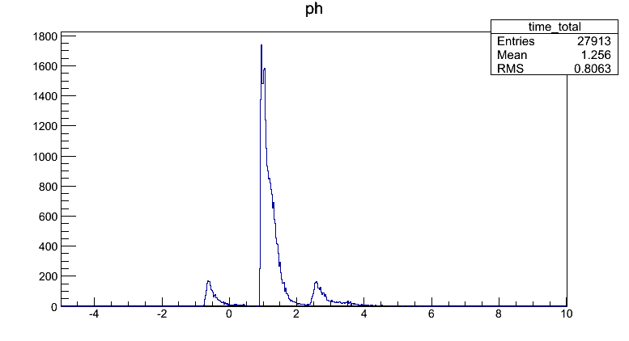
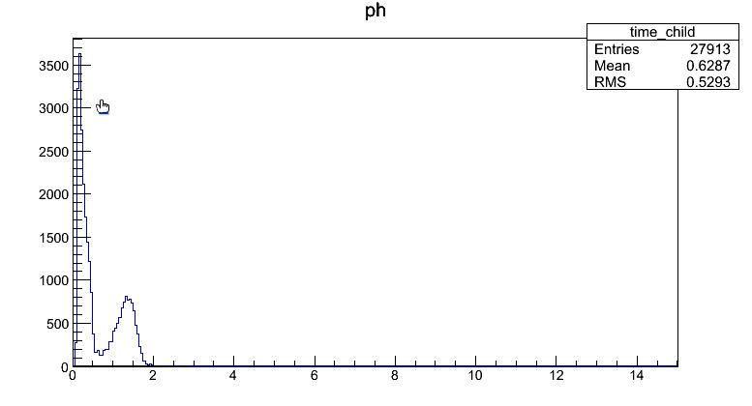
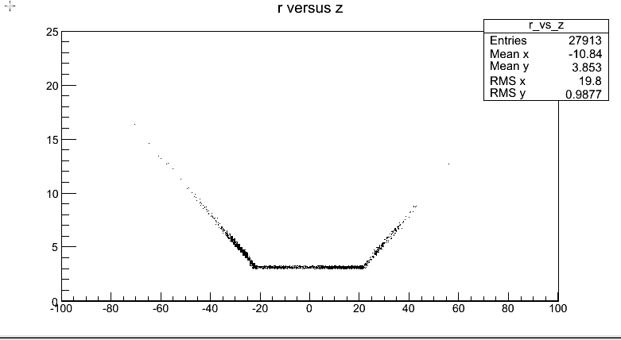
Time Distribution of photon hits on 2 VXD disks at z=25cm, 6.7<r<18.4
time_parent
TOF from vertex =1.0 ns
Gate 0.5<t<1.5ns
time_child rel. to parent
Near disk/far disk
Source of photons

Slide 19
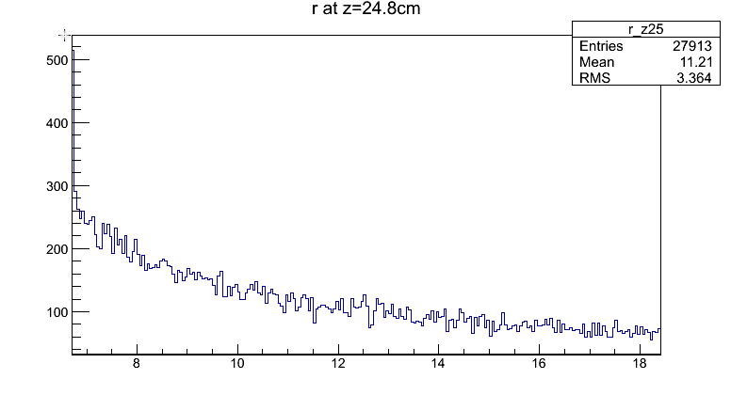
Converted Photon Background Occupancy at on 2 disks at z=25cm, 6.7<r<18.4cm
Max. transit time for prompt photon from vertex is 1.0 ns
ALL background hits 28k x 102 x 1 x 1000 = 2.85 x 10^9 hits per train
Area of each disk=923cm^2
Average hit density is 3.1 x 10^6 hits/cm^2
If pixel = 20um x 20 um, this is 12.3 hits/pixel average per train
Peak occupancy is ~2.5x average occupancy -> 31 hits/pixel
A 0.5-1.5ns gate leaves most of the background intact

Slide 20
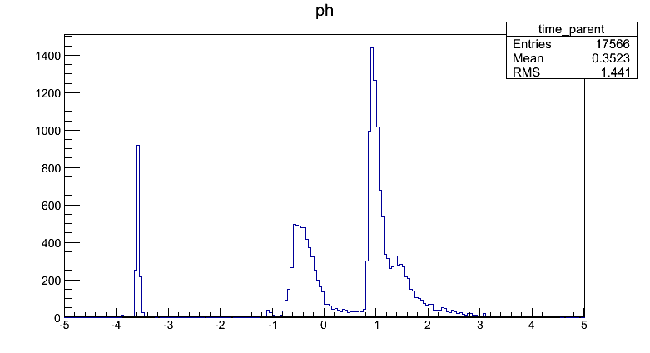
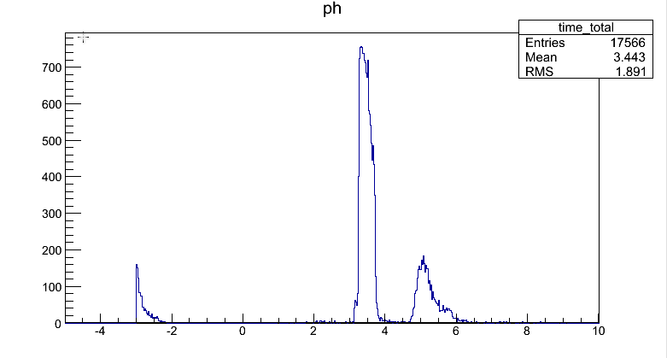
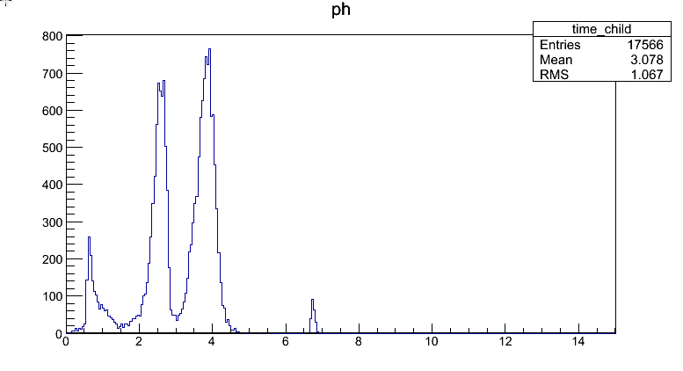
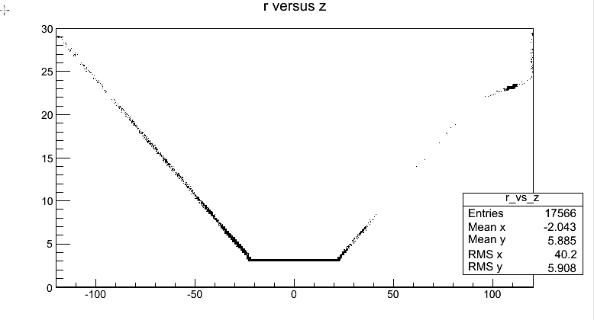
Time Distribution of photon hits on 2 disks at z=92cm, 25.3<r<53.3cm
time_parent
TOF from vertex =3.5 ns
Gate 3<t<4ns
time_child rel. to parent
Near disk/far disk
From cone tips + anomaly
Source of photons

Slide 21
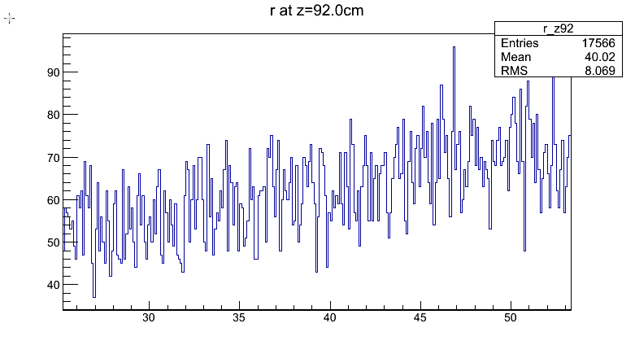
Background Occupancy at on 2 disks at z=92cm, 25.3<r<53.3cm
Max. transit time for prompt photon from vertex is 3.54 ns
ALL background hits 17.6k x 102 x 1 x 1000 = 1.79 x 10^9 hits per train
Area of each disk=6914cm^2
Average hit density is 2.6 x 10^5 hits/cm^2
If strip = 50um x 1cm, this is 1300 hits/strip average per train
Peak occupancy is ~1.25x average occupancy -> 1600 hits/strip
A 3-4ns gate leaves 12.1/17.6=69% of these hits

Slide 22
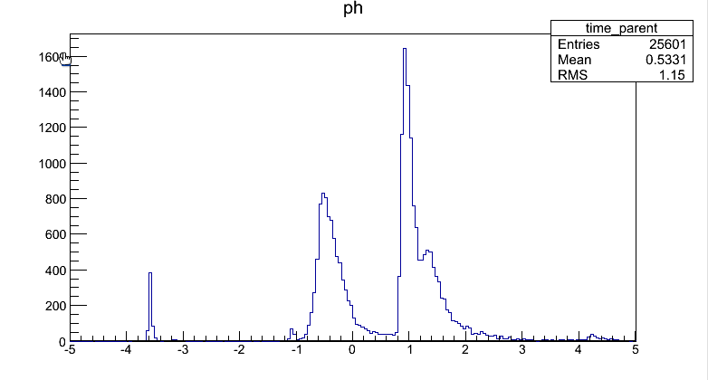
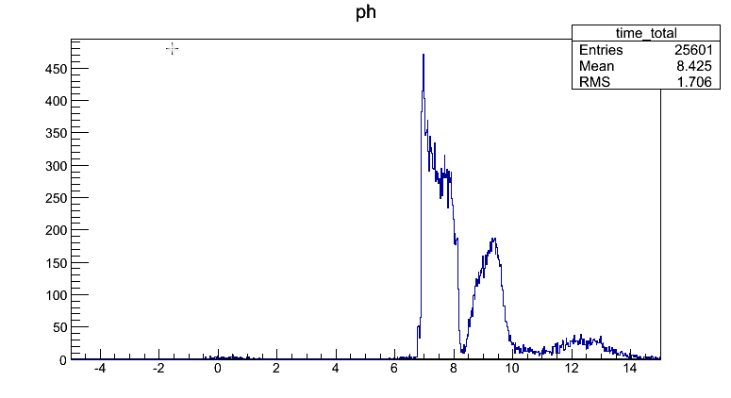
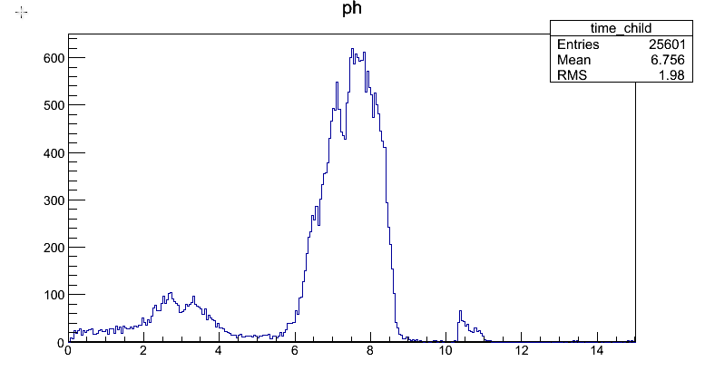
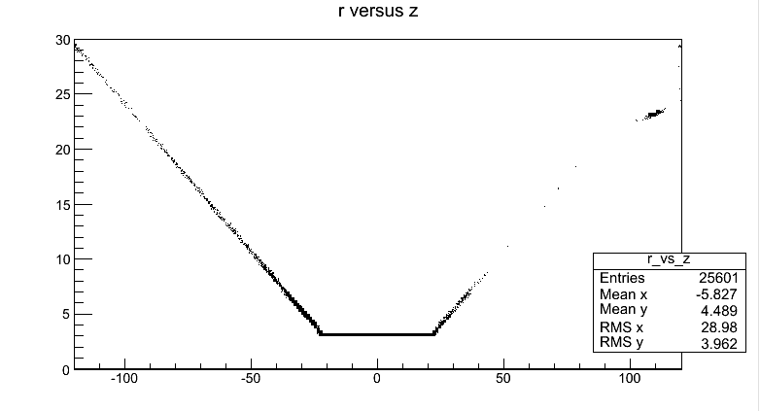
Time Distribution of photon hits on 2 disks at z=200cm, 38<r<130.9cm
time_parent
TOF from vertex =8.0 ns
Gate 6.5<t<9ns
time_child rel. to parent
Near disk/far disk
From cone tips + anomaly
Source of photons

Slide 23
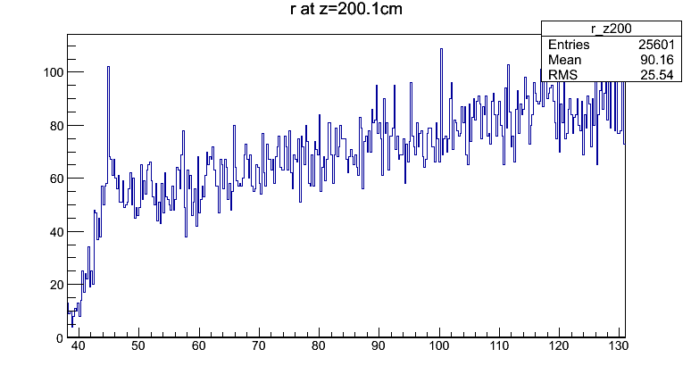
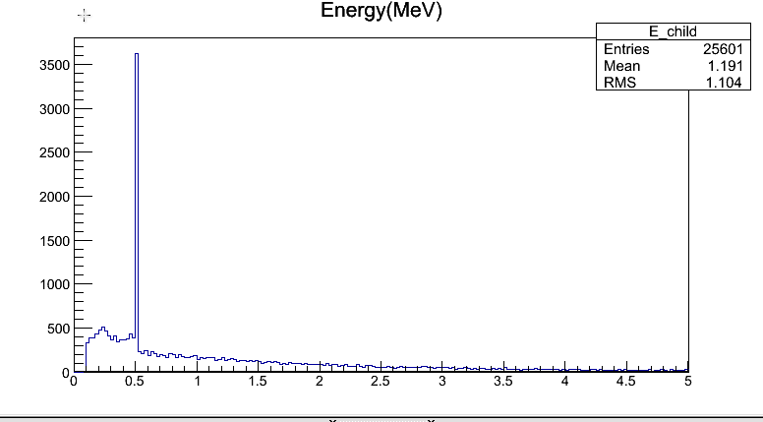
Background Occupancy at on 2 disks at z=200cm, 38<r<130.9
Max. transit time for prompt photon from vertex is 8ns
ALL background hits 25.6k x 102 x 1 x 1000 = 2.6 x 10^9 hits per train
Area=49.3E3cm^2
Average hit density is 5.3x 10^4 hits/cm^2
If detector is = 1cm x 1 cm pad, this is 53x10^3 hits/pad average per train
Peak occupancy is ~1.2x average occupancy -> 64k hits/pad
68% background hits are in 6.5-9ns gate
Average photon energy is 1.2 MeV
  At calorimeter, an energy cut would work
  It is difficult to shield 1 MeV photons
    No easy fix for trackers

Slide 24
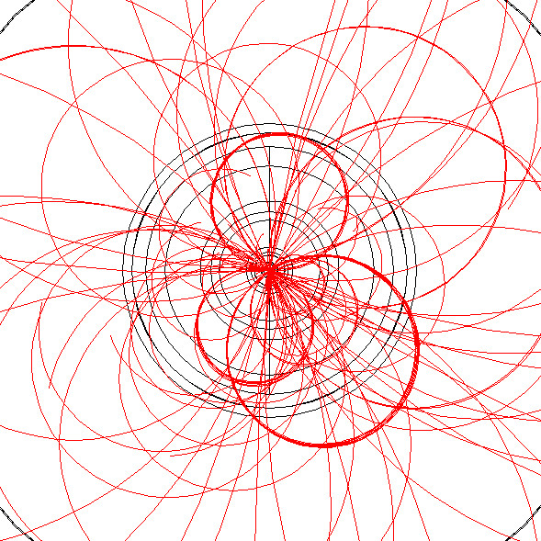

There are many slow looping particles both from physics and background events
Pythia charged hadrons
Barrel 1
Time (ns)

Slide 25




e+e- backgrounds: Source locations more broadly distributed than that of photon backgrounds

Slide 26



e+e- backgrounds: multiple hits and hit times from loopers
All scoring planes
Hit time
All scoring planes
Hit_child rel. to parent e+/e-
<n_hit>~6-8

Slide 27




Time Distribution of e+e- hits on r=5.5cm Barrel
time_parent
time=time_parent+time_child
0-1ns gate
time_child rel. to parent

Slide 28
e+/e- Background Occupancy at r=5.5cm
Max. transit time for prompt photon from vertex is 0.71ns
ALL background hits 18.1k x 510 x 2 x 1000 = 18.5 x 10^9 hits per train
Layer has r=5.5cm and L=2x20.5=41cm; Area=1417cm^2
Average hit density is 13 x 10^6 hits/cm^2
If pixel = 20um x 20 um, this is 52 hits/pixel average per train
Peak occupancy is ~3x average occupancy -> 150 hits/pixel/train
A 0-1ns gate leaves 1.2k/18.1k= 6.5%

Slide 29




Relatively few e+/e- Backgrounds make it to the r=50cm barrel tracker & the r=131cm surface of the barrel Ecal, but those hits are “in time” with physics events

Slide 30




Time Distribution of e+e- hits on z=25cm Disks
Many, many spirals before hitting disk delays arrival
time_parent
time=time_parent+time_child
0.5-1.5ns gate
time_child rel. to parent

Slide 31

e+/e- Background Occupancy at z=25cm disks
Max. transit time for prompt photon from vertex is 1ns
ALL background hits 1973 x 510 x 1 x 1000 = 1 x 10^9 hits per train
Area of each disk=922.6cm^2
Average hit density is 1.1 x 10^6 hits/cm^2
If pixel = 20um x 20 um, this is 4.4 hits/pixel average per train
Peak occupancy is ~4x average occupancy -> 17 hits/pixel/train
As the source of these at this disk are 30-80cm from the IP, not the cone tip, a timing cut is very effective: A 0.5-1.5ns gate leaves 1%

Slide 32




Relatively few e+/e- Backgrounds make it to the z=92cm fwd tracker & the z=200cm surface of the Endcap Ecal the tighter time cuts help further as e+/e- source is far up the cone, away from the IP at large z

Slide 33
Summary Table

Slide 34
Conclusions
Irreducible backgrounds emanating from the IP come predominately from the downbeam cone tip and are thus largely in time with the collision
~1 MeV photons that convert (2% probability) in 300um Silicon VXD and Tracking layers are the dominate background
Timing cuts not particularly effective given (in this IR geometry) proximity of cone tips to the IP (±0.7ns away)
Silicon strip tracker (50um x 1cm) show 100%-500% occupancy per BX to be compared to ILC performance of 1-2%. Can argue what is max. allowed (10%), but 100% does not work.
Hits per readout unit per train (1000 BX) >> 4 buffers designed for the ILC Readout architecture (“KPIX”)
Reading each readout element each bunch crossing probably required
Barrel backgrounds more important than endcap backgrounds
Endcap hits caused by spiraling e+e- are out of time when they hit endcap trackers
Tracker backgrounds with 50um x 1cm strips >> VXD backgrounds with 20 um x 20um pixels
Barrel and Endcap ECAL need to passively absorb 50-200 ~1 MeV photons/pad/BX without showing a hit
Future work:
  Fix problems with how we use FLUKA timing information
  Investigate larger beam pipe, more relaxed shielding cone geometries

Slide 35
EXTRA

Slide 36




Charged h backgrounds: Source locations about the same as that of e-/e+ backgrounds but produced typically much, much later
(this is hallmark of FLUKA problem mentioned at beginning of talk: so forget charged hadrons and neutrons for now)

Slide 37



Charged h backgrounds: multiple hits and long hit times from loopers
Pions
Kaons
protons
All scoring planes
Hit_child rel. to parent e+/e-
Many low p loopers
<n_hit>~3

