Slide 1
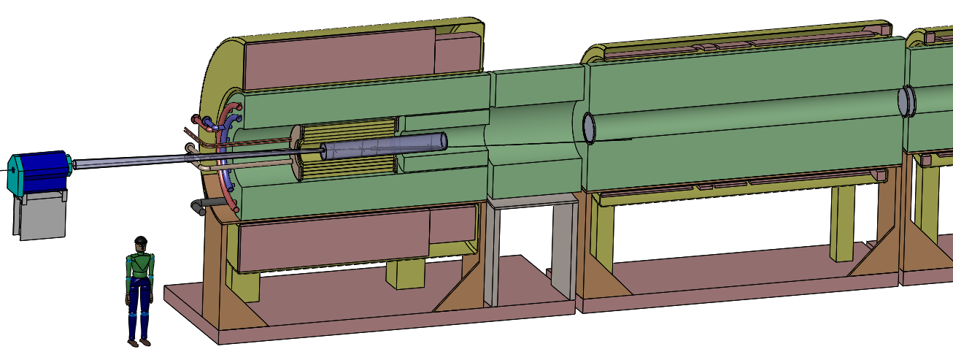
Target System Concept
for a Muon Collider/Neutrino Factory
K.T. McDonald
Princeton University
(May 28, 2014)

Slide 2
Specifications from the Muon Accelerator Staging Scenario
6.75 GeV (kinetic energy) proton beam with 3 ns (rms) pulse.
1 MW initial beam power, upgradable to 2 MW (perhaps even to 4 MW).
60 Hz initial rep rate for Neutrino Factory;
15 Hz rep rate for later Muon Collider.
The goal is to deliver a maximum number of soft muons,
~ 40 < KE < ~ 180 MeV.

Slide 3
Target System Concept
Graphite target (ρ ~ 1.8 g/cm³), radiation cooled (with option for convection cooling); liquid metal jet as option for 2-4 MW beam power.
Target inside high-field solenoid magnet (20 T) that collects both µ±.
Target and proton beam tilted with respect to magnetic axis.
Superconducting magnet coils shielded by He-gas-cooled W beads.
Proton beam dump via a graphite rod just downstream of the target.
Some of the proton and π/µ transport near the target is in air.

Slide 4
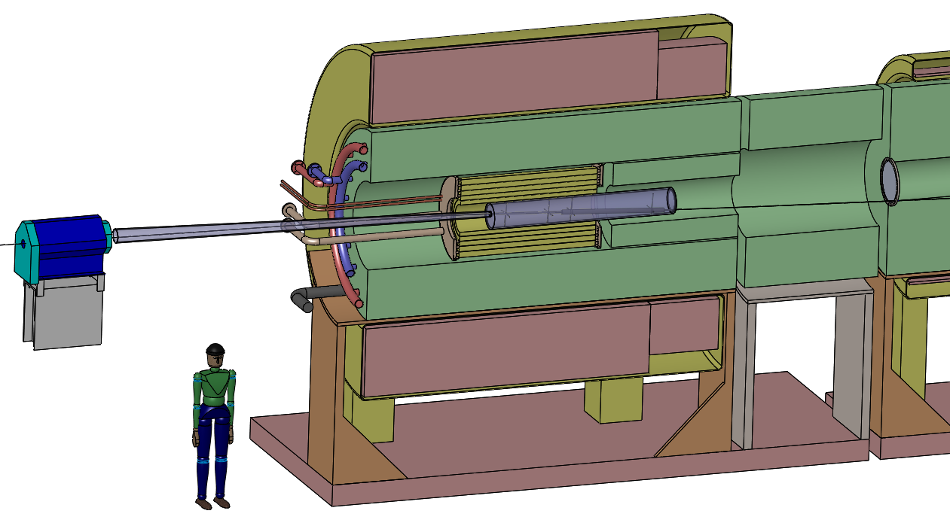
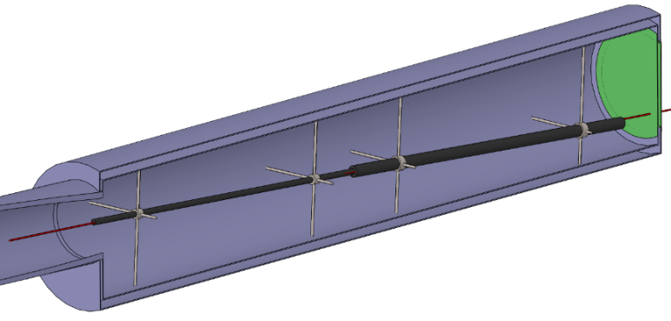
Target System Concept
15 T superconducting coil outsert,
Stored energy ~ 3 GJ, ~ 100 tons
Proton beam tube
Be window (at each end of downstream magnet modules if beam not in air
Last
Final-Focus
quad
Stainless-steel target vessel (double-walled with intramural He-gas flow for cooling) with graphite target and beam dump, and downstream Be window.
This vessel would be replaced every few months at 1 MW beam power.
Upstream proton beam window
5 T copper-coil insert; Water-cooled,
MgO insulated
He-gas cooled W-bead shielding (~ 100 tons)

Slide 5
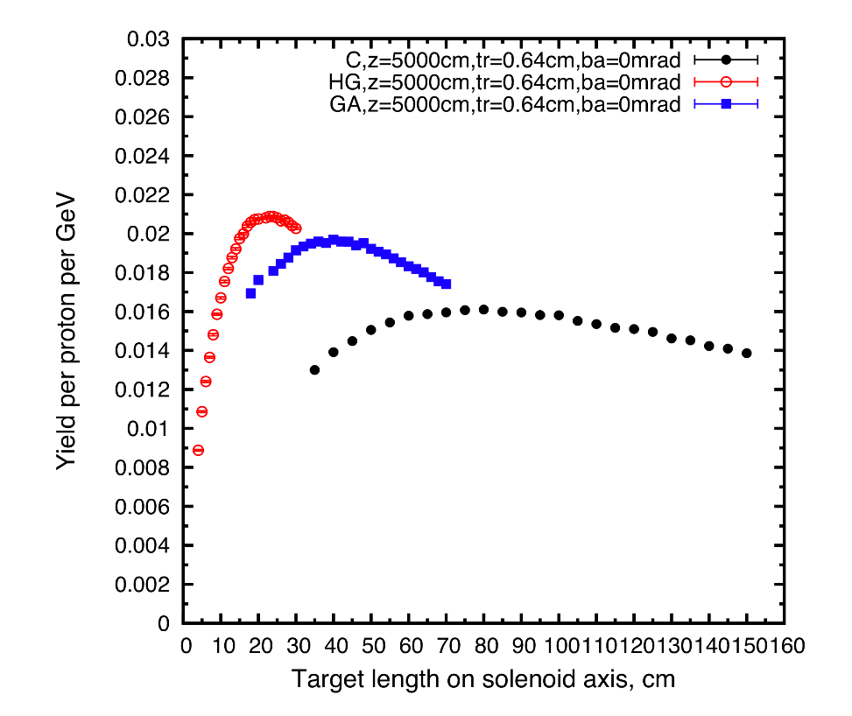
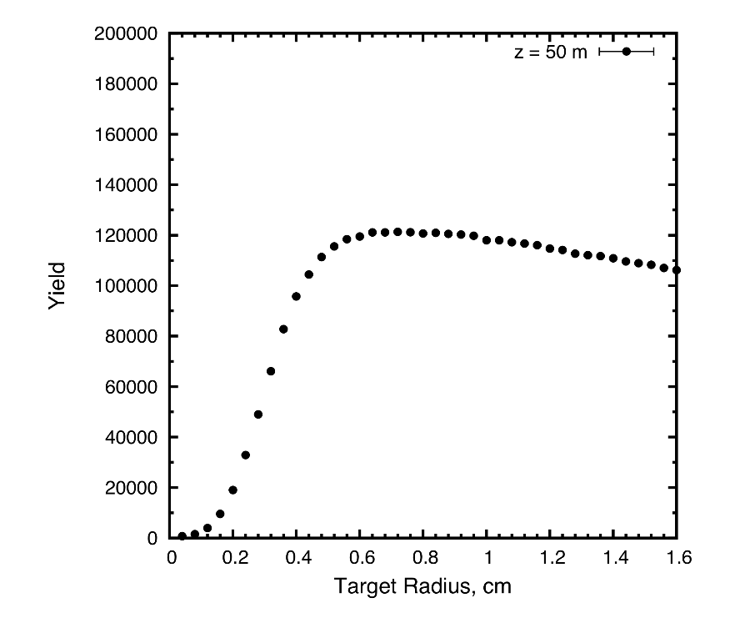
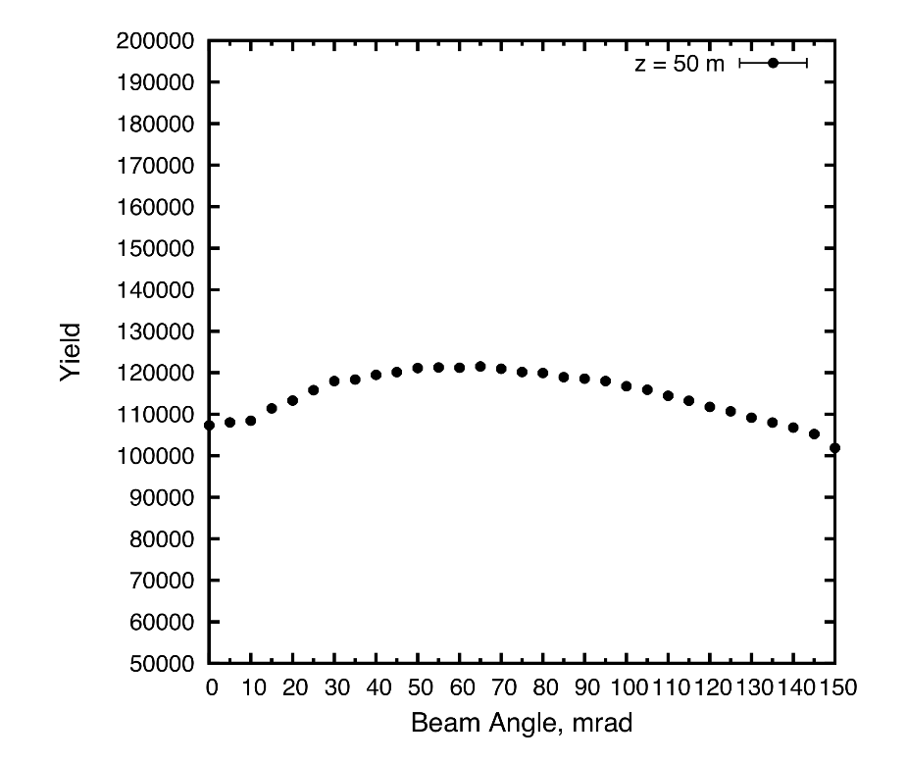
Target System Optimization

Slide 6
Target System Optimizations
High-Z favored.
Optima for graphite target (ρ = 1.8 g/cm³): length = 80 cm,
radius ~ 8 mm (with σ_{r} = 2 mm (rms) beam radius),
tilt angle = 65 mrad,
nominal geometric rms emittance ε⊥ = 5 µm.
β* = σ_{r}² /ε⊥ = 0.8 m.
Graphite proton beam dump, 120 cm long, 24 mm radius to intercept most of the (diverging) unscattered proton beam.
The 20 T field on target should drop to the ~ 2 T field in the rest of the Front End over ~ 5 m.

Slide 7
Issues for Further Study
Thermal “shock” of the short proton pulse
Probably OK for 2 MW and 60 Hz operation;
15-Hz option needs study: carbon-carbon composite vs. graphite.
Cooling of target, and the W beads.
Lifetime of target against radiation damage.
Beam windows.
β* and beam emittance at the target.
To preserve liquid-metal-jet upgrade option, need related infrastructure installed at t = 0.

Slide 8
Appendix: Thermal Issues for Solid Targets
When beam pulse length t is less than target radius r divided by speed of sound v_{sound}, beam-induced pressure waves (thermal shock) are a major issue.
Simple model: if U = beam energy deposition in, say, Joules/g, then the instantaneous temperature rise ∆T is given by ∆T = U /C, where C = heat\ capacity in Joules/g/K.
The temperature rise leads to a strain Δr/r given by ∆r/r = α ∆T = α U/C,
where α = thermal expansion coefficient.
The strain leads to a stress P (= force/area) given by P = E ∆r/r = E α U/C,
where E = modulus of elasticity.
In many metals, the tensile strength obeys P ≈ 0.002 E, α ≈ 10⁻⁵, and C ≈ 0.3 J/g/K,
in which case U_{max} ≈ P C / E α ≈ 0.002 ∙ 0.3 / 10⁻⁵ ≈ 60\ J/g.
Graphite @ 1400° C: P = 42.4 Mpa, E = 7.2 Gpa, α = 4.8 × 10⁻⁵, C = 1.4 J/g, U_{max} ≈ 1700 J/g.
(α ≈ 1 × 10⁻⁵ for carbon-carbon composite)
[A nickel target at FNAL has operated with U_{max} ≈ 1500 J/g.]
These arguments are from A Short Course on Targetry, KTM, NuFact03 Summer Institute,
following earlier suggestions by P. Sievers.

Slide 9
How Much Beam Power Can a Solid Target Stand?
What is the maximum beam power this material can withstand without cracking, for
a 10-GeV beam at 10 Hz with area 0.1 cm²?
Ans: If we ignore “showers” in the material, we still have dE /dx ionization loss of about 1.5 MeV/g/cm².
Now, 1.5 MeV = 2.46 × 10⁻¹³ J, so 1500 J/g requires a proton beam intensity of
1500 /(2.4 × 10⁻¹³) = 6 × 10¹⁵/cm².
So, P_{max} ≈ 10 Hz ∙ 10¹⁰ eV ∙ 1.6 × 10⁻¹⁹ J/eV ∙ 6 × 10¹⁵ cm² ∙ 0.1 cm² ≈ 10⁷ J/s = 10 MW.
If graphite cracks under singles pulses of > 1500 J/g, then safe up to 10 MW beam power IF could ignore the higher energy deposition due to showers. But, model in 2000 by A. Hassanein (ANL) suggests that including showers limits a graphite target to 0.5 MW @ 15 Hz.
http://www.hep.princeton.edu/~mcdonald/mumu/target/AH=Fermi=Report.pdf
If increase beam/target radius by √2, graphite good to 1 MW @ 15 Hz.
A larger-radius carbon-carbon composite target might then be good up to 5 MW @ 15 Hz.
More study needed!

