Slide 1
Preliminary Consideration of
Superconducting Magnets for Muon Acceleration
Henryk Piekarz
Muon Acceleration Program
APC, Fermilab
with
J. Blowers¹, S. Hays² and V. Shiltsev³
¹TD, ² AD and ³ APC, Fermilab
MAP Collaboration Meeting, Fermilab, 27-31 May, 2014

Slide 2
Motivation n
Studies for large-scale synchrotrons, e.g. PS2, S-SPS, LER and VLHC-Stage 1 show that miniaturization of warm-iron accelerator magnet with superconducting power cable leads to a lower cost of synchrotron construction and utilization (cryogenic-plant included) with respect to the same synchrotrons if constructed using a normal conducting power cable.
In MAP project the RCS’s constitute large scale synchrotrons, so the application of super- ferric (iron dominated with SC power cable) magnets for the muon acceleration synchrotrons is likely to be justified.

Slide 3
Why HTS Rapid-Cycling Magnet ?
Muon beam acceleration requires magnetic field cycling rates in ~2000 T/s range, orders of magnitude beyond any known application with NC or SC magnets, leading to magnet system power exceeding anything experienced until now.
Goal: Develop HTS-based rapid-cycling magnet in order to:
(I) Minimize accelerator magnet required power and power losses
(II) Lower accelerator construction and operation costs
Attributes of accelerator magnet powered with HTS cable:
Low dynamic cable power losses (with optimization of core and cable design)
Wide temperature margin for cable operation (20 K or more, if needed)
Resilience to radiation
High HTS current density leads to small size of power cable which results in:
(1) Smaller magnet core and consequently lower core power losses
(2) Lower magnetic inductance and consequently lower ramping power
Small size of accelerator magnet reduces cost of materials and construction
Preliminary analysis¹⁾ of super-ferric magnets powered with NC and SC (HTS) cables suggests
strong minimization of the HTS magnet system required power relative to the NC one.
1) H. Piekarz, “A Preliminary Consideration of SC Rapid Cycling Magnets for Muon Acceleration”, MAP-doc-4374, 2013

Slide 4
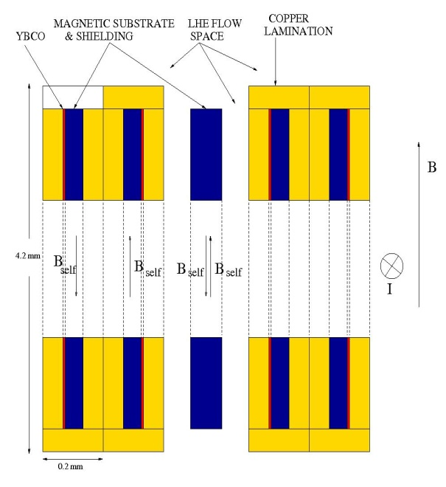
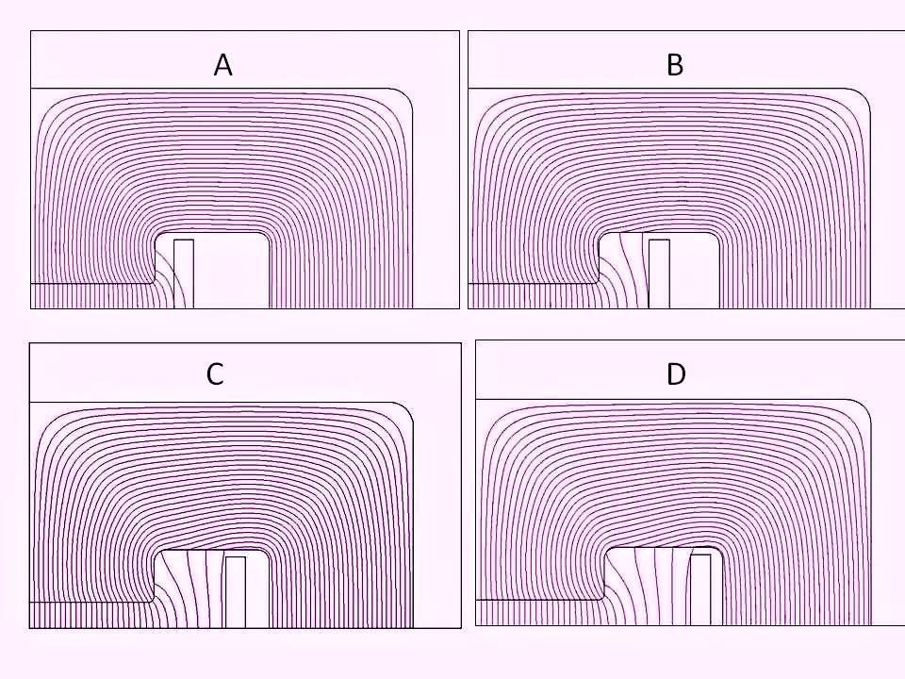
Magnetic Core and Cable designs for Rapid-Cycling HTS Magnet
Possible options to minimize core and cable power losses as well as ramping power:
1. Minimize magnet core size, including the cable gap by using SC power cable. SC strand can carry 200 times more current than NC one. Smaller core size reduces its power loss, and smaller cable gap reduces magnetic inductance minimizing the required ramping power.
2. Use core design (Fig.1) to minimize B-field crossing the conductor, and use the SC cable design (Fig.2) to minimize self-field coupling of the strands. Both actions will significantly reduce cable power loss.
Fig. 2 The HTS tape strands arranged into pairs with magnetic substrates facing each other. Additional substrate is placed between the pairs. The 80 µm Ni5%W tape absorbs field of
70 mT thus strongly suppressing strand’s self-field coupling.
Fig. 1 Cable size and position within core cavity help minimize core-induced field through cable space. Position B is the most optimal one with expected < (1-2)% gap field in cable space.

Slide 5
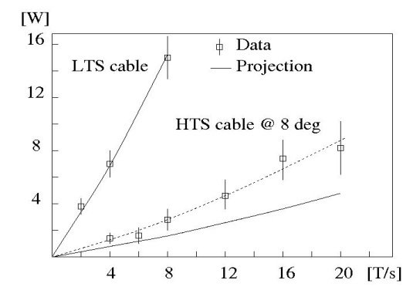
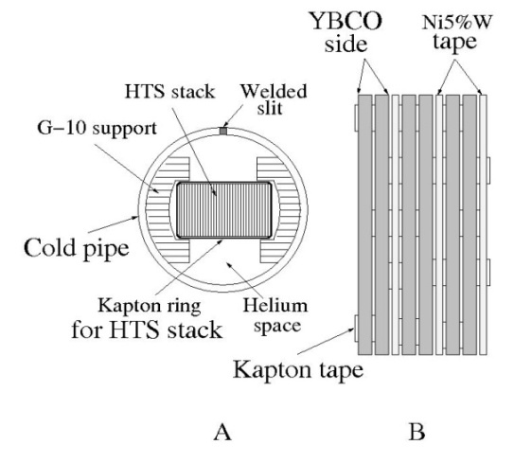
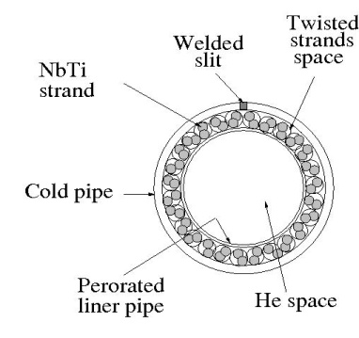
Expectations for HTS Cable Power Losses
The power loss of HTS cable (15 kA @ 25 K) was measured [1] in a ramping field up to 20 T/s. The cable was positioned at 8⁰ relative to B-field to account for a possible divergence in practical alignment. For the LTS cable (NbTi) of the same critical current and measured in the same conditions, the power loss at 4 T/s is equal to the HTS cable power loss at 20 T/s.
Measured and projected power loss of LTS
and HTS cables in 2 -20 T/s range [1]
[1] H. Piekarz et al., IEEE Vol 22 (2012)
A – HTS test cable cross-section
B- Arrangement of HTS stack
LTS test cable cross-section
Assuming 1% beam gap field crossing the cable space then the HTS test cable power loss at 20 T/s corresponds to 2000 T/s field in the beam gap, as required for the muon acceleration magnet.

Slide 6
Example of Relevant Synchrotron Parameters for Rapid-Cycling Magnet Design
Initial MAP High-Energy Muon Collider: Collision energy at 1.5 TeV using
muon acceleration of (30 -> 375) GeV (Synch. I) and (375 ->750) GeV (Synch. II)
Main parameters of Synchrotron I and II
Parameter | Synchrotron I | Synchrotron II *)
Circumference (Tevatron tunnel) [m] | 6283 | 6283
Injection energy [GeV] | 15 | 375
Extraction energy [GeV] | 375 | 750
Muon bunch polarity (collider ready) | + & - | + & -
Acceleration per orbit *) [GeV] | 15 | 7.2
Number of orbits | 24 | 52
Orbit circulation time [µs] | 21 | 21
Nominal acceleration period [ms] | 0.504 | 1.09
Beam gap : vert. x hor. [mm x mm] | 25 x 100 | 25 x 100
B _{injection} / B _{extraction} [T / T] | 0.15 / 1.8 | +1.8 / -1.8
B-field wave-form | triangular | sin-wave
Nominal dB/dt (beam gap) [T/s] | 2000 | 2000
Bunch frequency [Hz] | 15 | 15
*) Also employs 8T DC magnets
*) Determines muon survival rate
Beam gap accommodates elliptical ceramic pipe
of 18 mm (v) x 60 mm (h) inner dimensions.

Slide 7
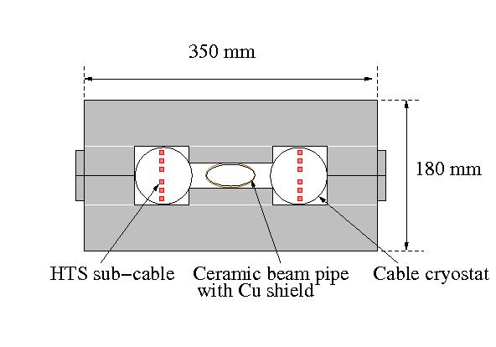
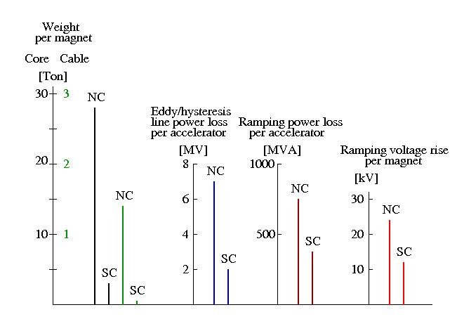
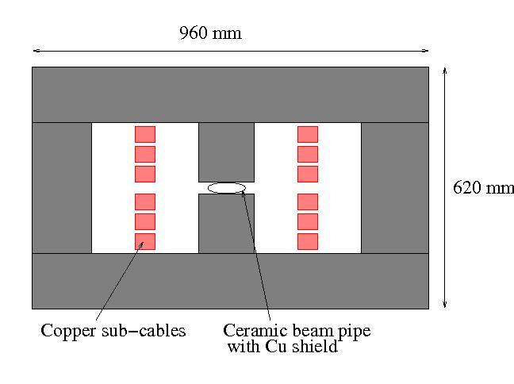
Tentative Projection of Required Power for SC and NC Options of Rapid-Cycling Magnet
Assumptions:
Beam gap: 25 mm (v) x 100 mm (h)
Core design to minimize cable power losses
Unit magnet length 7.5 m
Sketch of HTS rapid-cycling magnet with 25 mm gap.
Tentative projection of core and cable weights per magnet, line power for Eddy and hysteresis losses in cable and core, ramping power and voltage rise for NC and SC magnets.
Sketch of copper based rapid-cycling magnet with 25 mm gap.

Slide 8
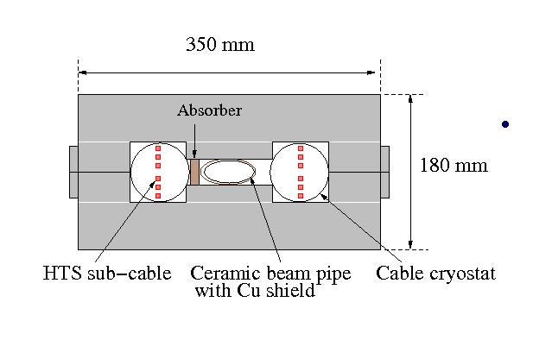
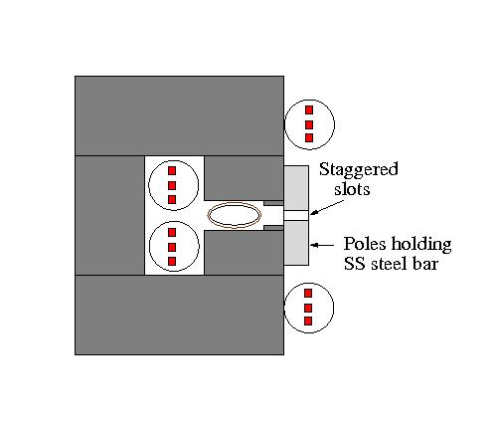
Core Design Options to Counter Muon Decay Induced Radiation and Cycling Magnetic Force
Strong radiation background from muons decay
will adversely affect the superconducting power cable.
With µ⁺ and µ⁻ beams circulating in opposite directions radiation background goes to one side. For a window frame core placing an absorber to protect the cable may help solve this problem, but careful radiation background studies are required.
Another option is to use a C-shape core and allow
radiation leave magnet space. In this case, however,
magnetic poles must be strongly supported with a
non-magnetic steel to counter a very strong force
(~ 3 Ton/m) acting on magnet poles at 500 Hz.
Needed:
1) For window-frame magnet a careful study of radiation background to asses
the absorber and its cooling system,
2) A careful C-shape magnet design with very strong supports of the poles.

Slide 9
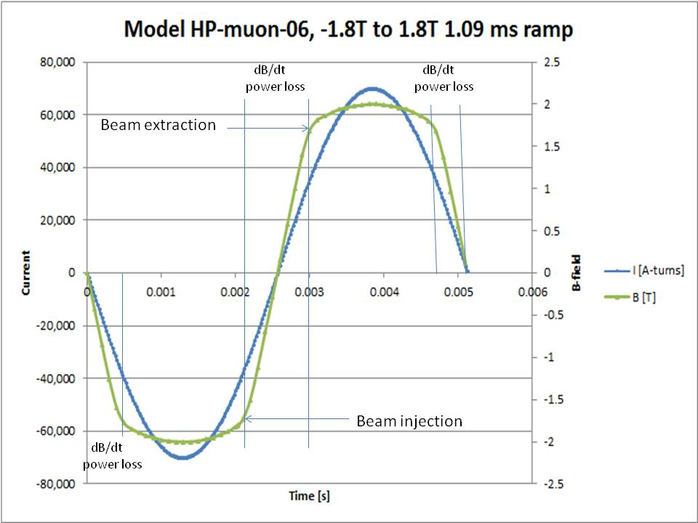
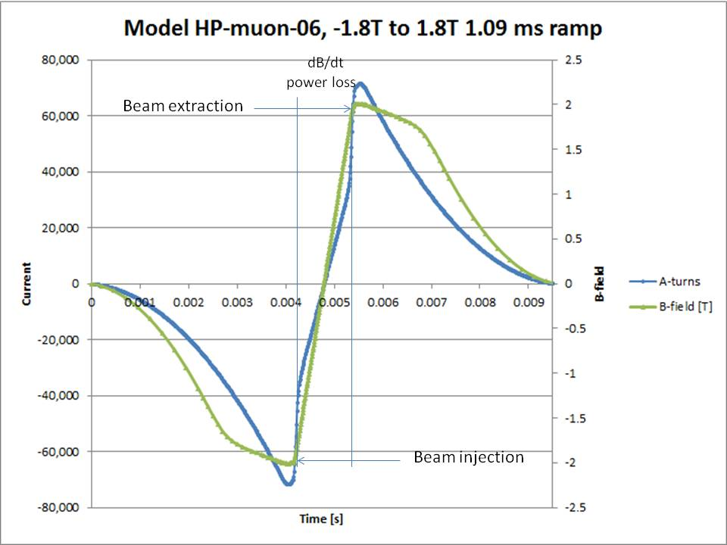
Magnetic and Current Wave-Forms
for Muon Acceleration Magnet
The dB/dt rate must be constant over the acceleration period
to allow multiple beam passes match the RF operation cycle.
Due to core magnetic saturation the current and magnetic wave-forms do not replicate each other.
Core constructed of Surahammar Steel: Non-oriented Fe3%Si, 0.005” (104 µm) thick laminations.
A standard sine-wave current induces limited linear B -field response (< + / - 1.7 T) through acceleration period. B-field is always ramping faster than the current with the exception of the field saturation regions.
Example of hypothetical current form for a perfectly linear B-field response in acceleration period of -2 T to +2 T. Together with the slow rising & falling current before and after the acceleration the power loss would be ~ factor 4 reduced relative to a standard current sine-wave.

Slide 10
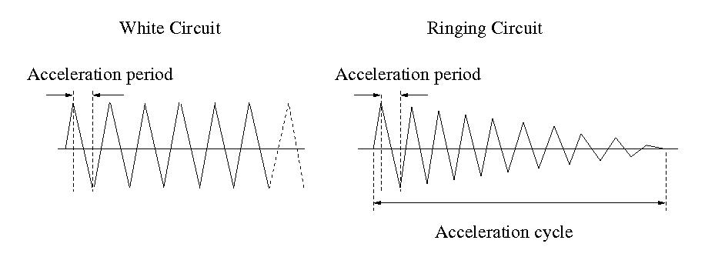
Power Supply Circuits with Sine-Wave Current
Sine-wave current form can be generated using 2 modes of power supply operation:
(1) White Circuit (continual) and (2) Ringing Circuit (periodical).
Beam bunch is accelerated using the first full leading edge of the current sine-wave.
In both White and Ringing Circuit modes the power loss is not limited to acceleration period.
The Ringing Circuit mode, however, operates at the same frequency as beam, e.g. 15 Hz,
and rapidly decaying current and B-field within the acceleration cycle considerably reduce
power losses.
Contrary to the Ringing Circuit the White Circuit mode is well developed and it has been
applied in many rapid-cycling accelerators (e.g. Booster at Fermilab).
Significant R&D is required to insure that the first sine-wave leading edge of the Ringing
Power Supply is suitable for the beam acceleration.

Slide 11
Technology Limitations for Rapid-Cycling Magnet Power Supply
The IGBT semiconductor technology is typically used to construct fast ramping and switching
high-current magnet power supplies.
A commercial IGBT (e.g. POWEREX CM600HX-24A ) allows for a pulse current of up
to 1200 A with a transient time of 10 µs. Muon acceleration magnet requires 72000 A
(single turn) and 12000 A (six turn) current but with a 500 µs transient time.
The IGBT can be modified to generate higher than the design current, e.g. in ILC studies
the IGBT FZ800R33KF2 (Eupec.inc) of 800 A was modified to switch 3000 A at ~10000 A/µs
(M.N. Nguyen et al.,SLAC-PUB-12591, 2001). Such an improvement may be even more
likely with required transient time much slower than the original one.
Without any improvements there would be 60 POWEREX CM600Hx-24A units per magnet
string. As each unit is 15 cm x 6 cm x 1.7 cm (~ 150 cm³) a power supply would occupy
about 1 m³ space.
Semiconductor technology should allow for implementation of a modified sine-wave pulse current but rather very significant R&D in cooperation with industry will be required.

Slide 12
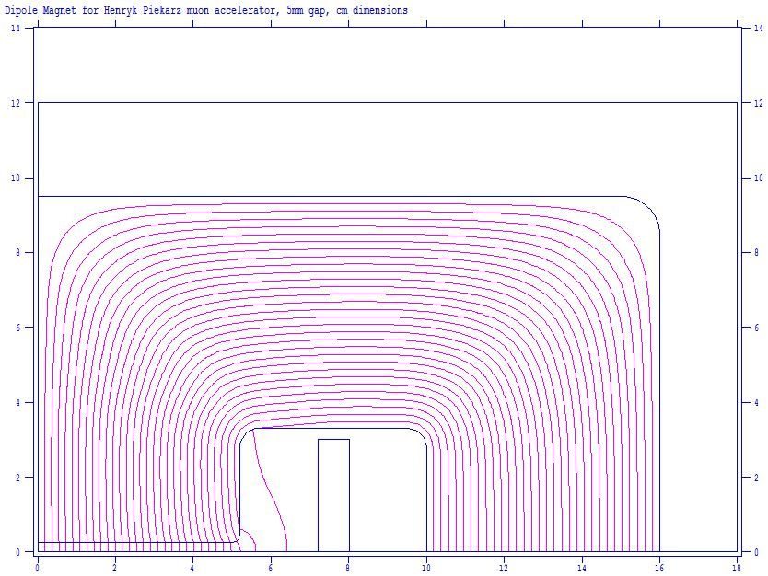
Rapid-Cycling Test Magnet Design and Goals
A 0.5 m long test magnet with 5 mm x 100 mm gap will feature 1.8 T field in the beam gap. The field in the cable space will be primarily due to un-suppressed self-fields thus allowing test the efficiency of self-filed suppression with the Ni5%W magnetic substrates.
A 3 kA current source will be assembled with the unused
parts from the Main Injector power supplies and modified
to operate at:
(A) 600 Hz in a ringing mode (2100 T/s), and
(B) 20 Hz in a white circuit mode (72 T/s)
Core design for rapid-cycling test magnet (gap 5 mm x 100 mm).
Basic parameters of rapid-cycling test magnet.
Core
Laminations | Fe3%Si non-oriented, 0.1 mm
Cross-section, H x V [mm x mm] | 350 x 180
Length [mm] | 500
Beam gap, V x H [mm x mm] | 5 x 100
Mass [kg] | 206
Cable
Manufacturer | Super-Power
Strand cross-section, W x T [mm x mm] | 4 x 0.1
Number of strands / sub-cable | 3
Number of sub-cables | 6
Strand length / sub-cable [m] | 4.5
Current (operations) [kA-turns] | 9
Number of turns | 3
Total strand length [m] | 27
Cable mass (with Ni5%W) [kg] | 2
Critical current @ 20 K [kA] | 3
Current max @ 7 K (operations) [kA] | 4.5
Magnetic inductance [µH] | 9

Slide 13
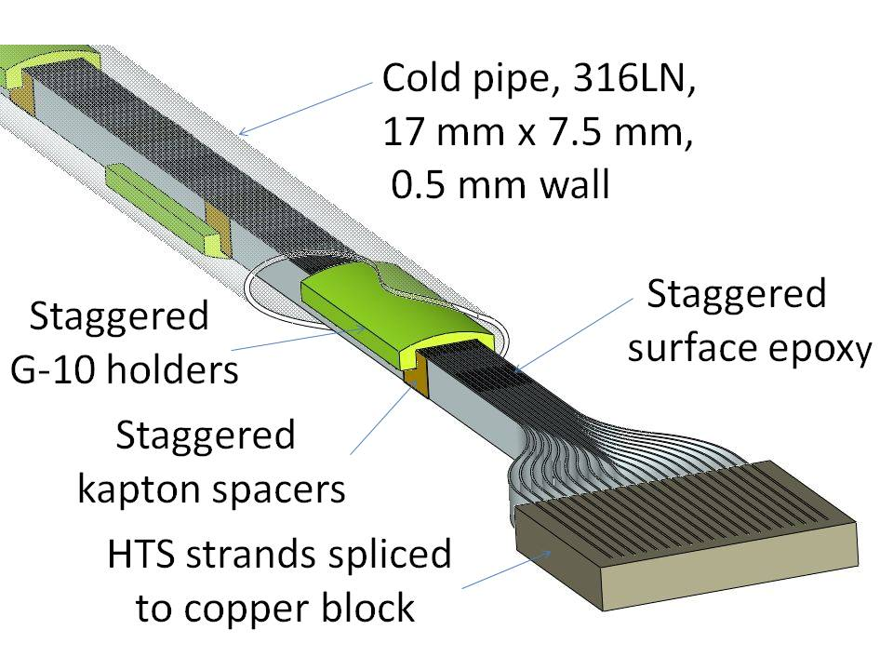
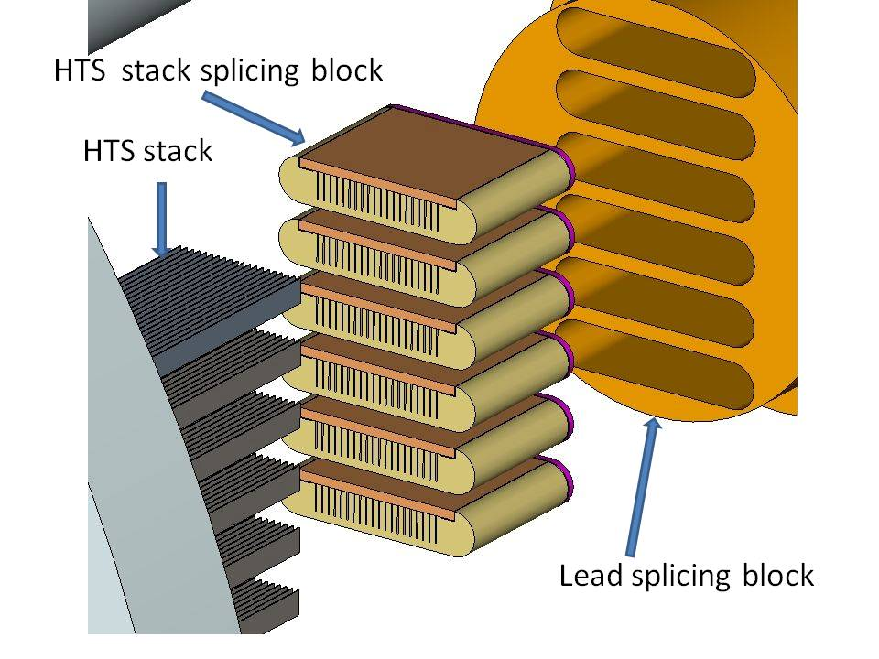
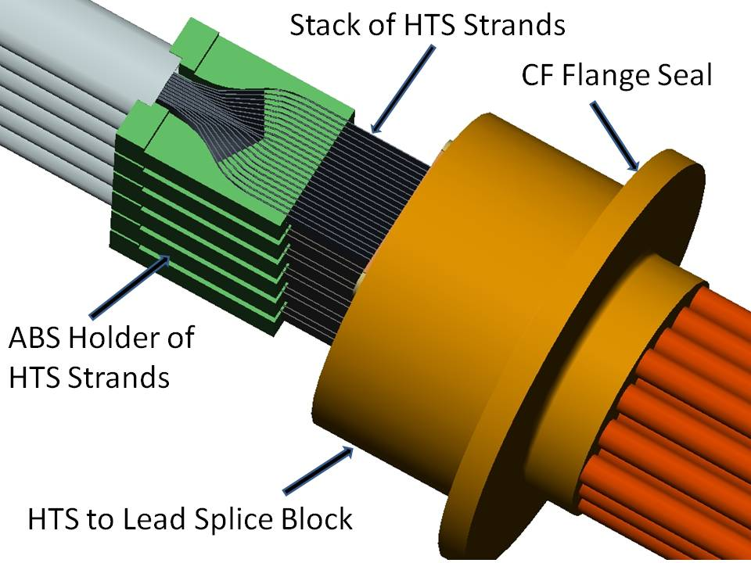
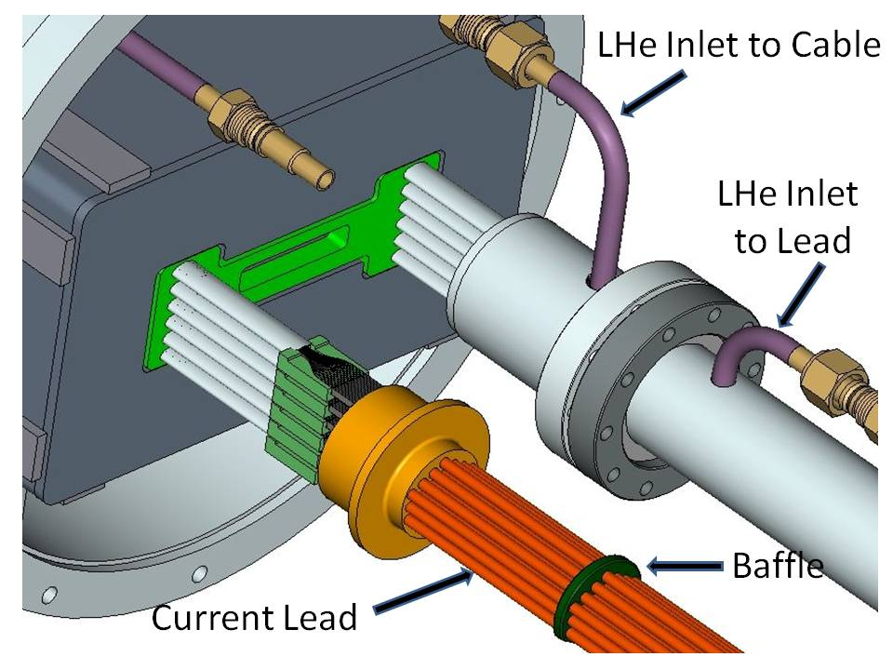
Fast-Cycling HTS Magnet Cable Design
HTS sub-cable with 20 strands.
Splicing arrangement of HTS strands to power lead.
HTS strands connected to power lead.
View of HTS cable with lead and cryogenic support.

Slide 14
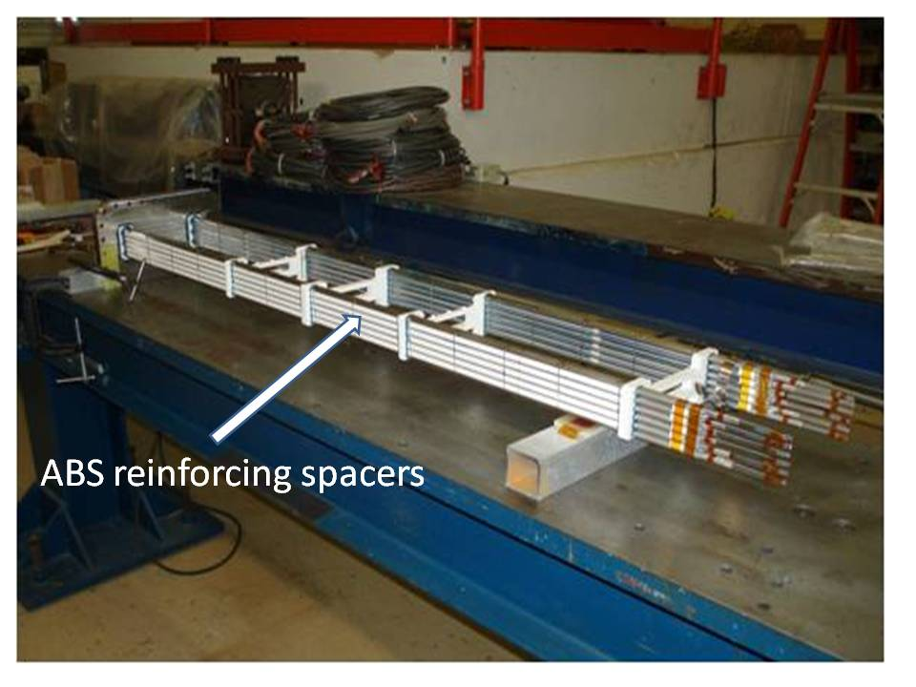
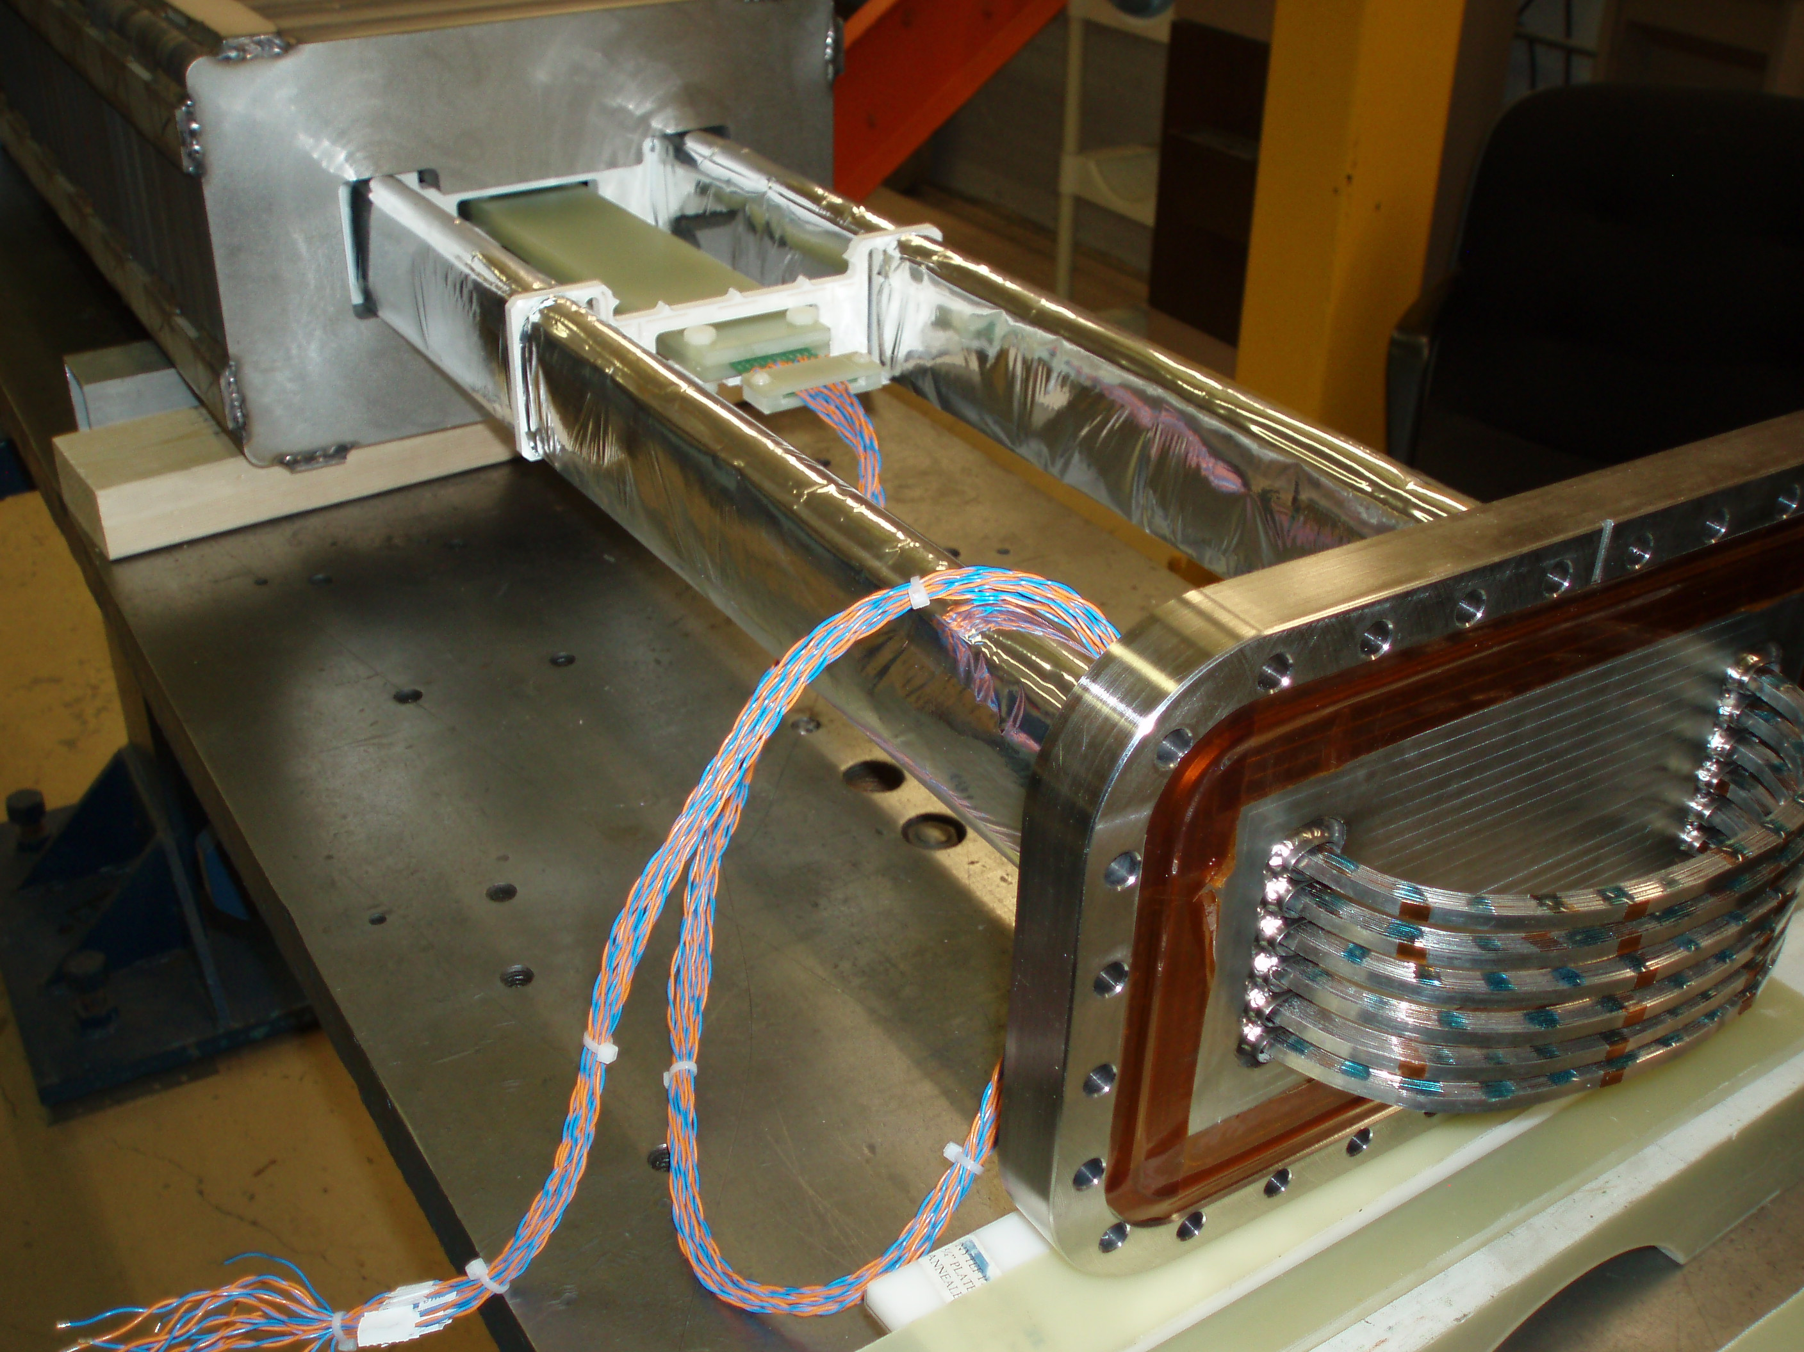
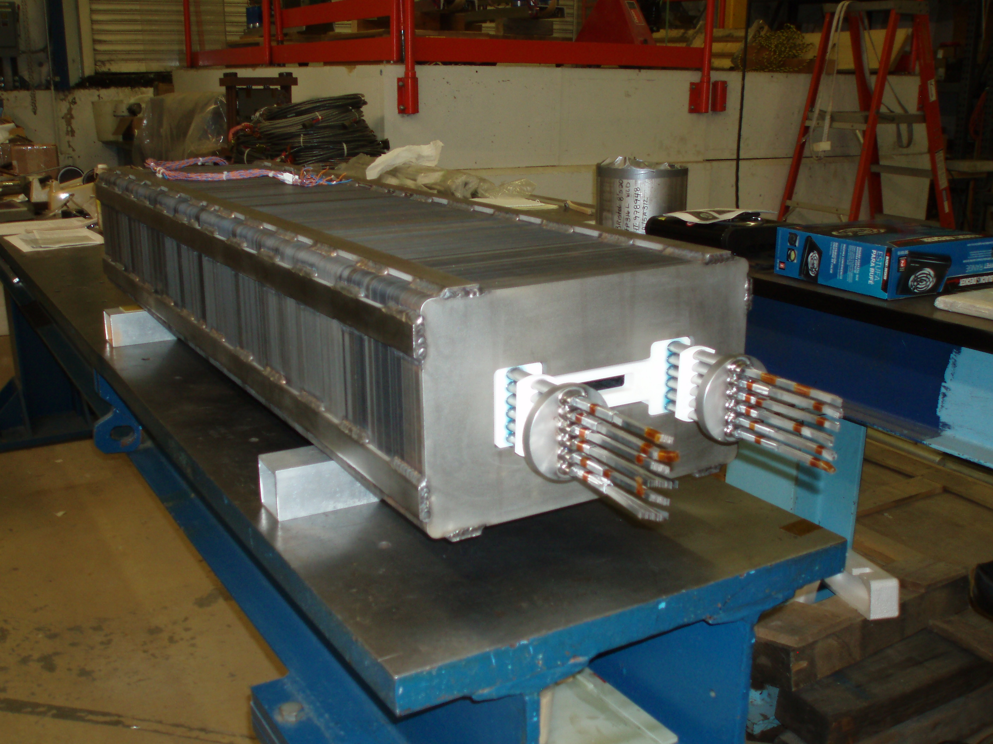
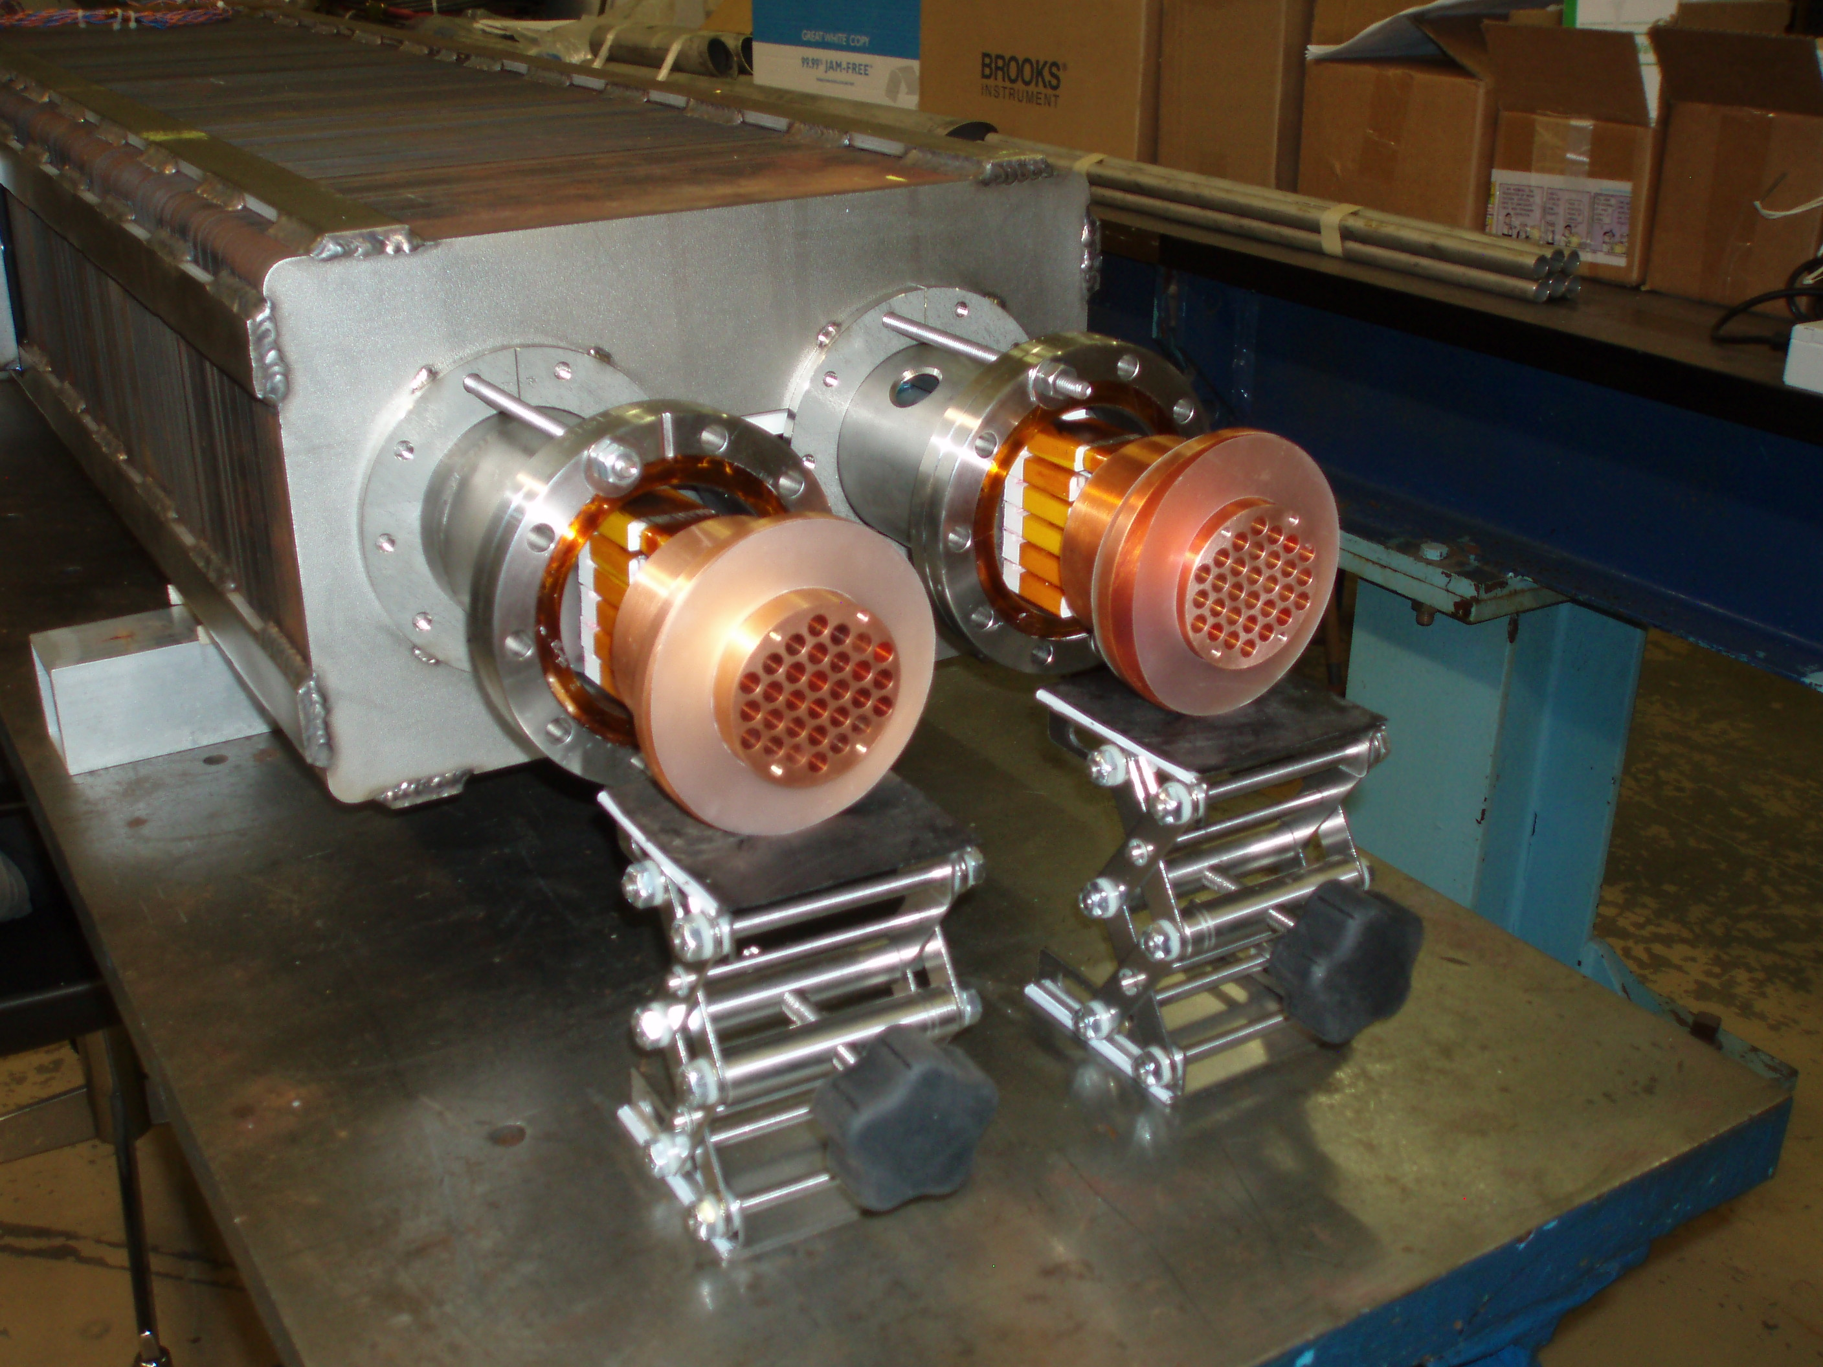
Status of Fast Cycling HTS Test Magnet Construction
6 HTS coils stacked into a cable
Inserting HTS cable into magnet core
HTS cable installed in magnet core
HTS cable spliced to lead-connecting copper blocks

Slide 15
Main References n
Since 1999, the warm-iron superconducting accelerator magnets with matching power supplies and leads were being developed at Fermilab.
Related papers published in IEEE Transactions on Applied Superconductivity (Proceedings of International Conferences on Magnet Technology: MT19, MT20, MT21 and MT22):
DC magnet (RLA type)
H. Piekarz et al., “Test of a 2 Tesla Superconducting Transmission Line Magnet System”, IEEE, Vol.16, No 2,(2006)
Y. Huang et al., ”Development of 100 kA Current Leads for a Superconducting Transmission Line Magnet”, IEEE, Vol.16, No 2,(2006)
S. Hays et al., ”The 100000 Amp DC Power Supply for a Staged Hadron Collider Super-Ferric Magnet” IEEE,Vol.16 (2006)
G. Velev et al., “Field Quality Measurements of a 2 Tesla Superconducting Transmission Line Magnet”, IEEE, Vol.16, (2006)
2. AC magnet (FCS and RCS type):
H. Piekarz, S. Hays, Y. Huang, V. Kashikhin, G. de Rijk, L. Rossi, “Design Considerations of Transmission Line Superconductors for Fast-Cycling Accelerator Magnets”, IEEE, Vol. 18, No 2,(2008)
S. Hays, H. Piekarz, H. Pfeffer, B. Claypool, “Design Considerations of a Power Supply System for Fast Cycling Superconducting Accelerator Magnets”, IEEE, Vol. 18, No 2,(2008)
Y. Huang, S. Hays, H. Piekarz, G. de Rijk, L. Rossi, “Design Considerations of a Pair of Power Leads for Fast Cycling Superconducting Accelerator Magnets, IEEE, Vol. 18, No 2,(2008)
H. Piekarz, S. Hays, J. Blowers, V. Shiltsev, “Design Study and Test Arrangement of HTS Transmission Line Power Cable for Fast-Cycling Accelerator Magnets”, IEEE, Vol. 20, No 3,(2010)
H. Piekarz, S. Hays, J. Blowers and V. Shiltsev, “A Measurement of HTS Cable Power Loss in a Sweeping Magnetic Field”, IEEE, Vol. 22, No 3, (2012)
H. Piekarz, J. Blowers, S. Hays and V. Shiltsev, “Design, Construction and Test Arrangement of a Fast Cycling HTS Accelerator Magnet”, IEEE, Vol. 24, No 3 (2014)
15

