Slide 1
Charge Separation For a Muon Collider
*Work supported in part by DOE STTR grant DE-SC 0007634.

Slide 2
Outline
Overview
Review of past work which remains the most recent
  NA-PAC13 THPHO19
Concepts for combining charge separation and matching into the HCC
Summary

Slide 3
Preliminaries
This work was supported under a phase II STTR grant with JLAB with start date 4/22/13.
We have had weekly meetings with attendance and/or input by:
  Slava Derbenev (JLAB subgrant PI), Vasiliy Morozov, Rol Johnson, Chuck Ankenbrandt, Dave Neuffer, Katsuya Yonehara, Jim Maloney, & Cary Yoshikawa (MuPlus PI)

Slide 4
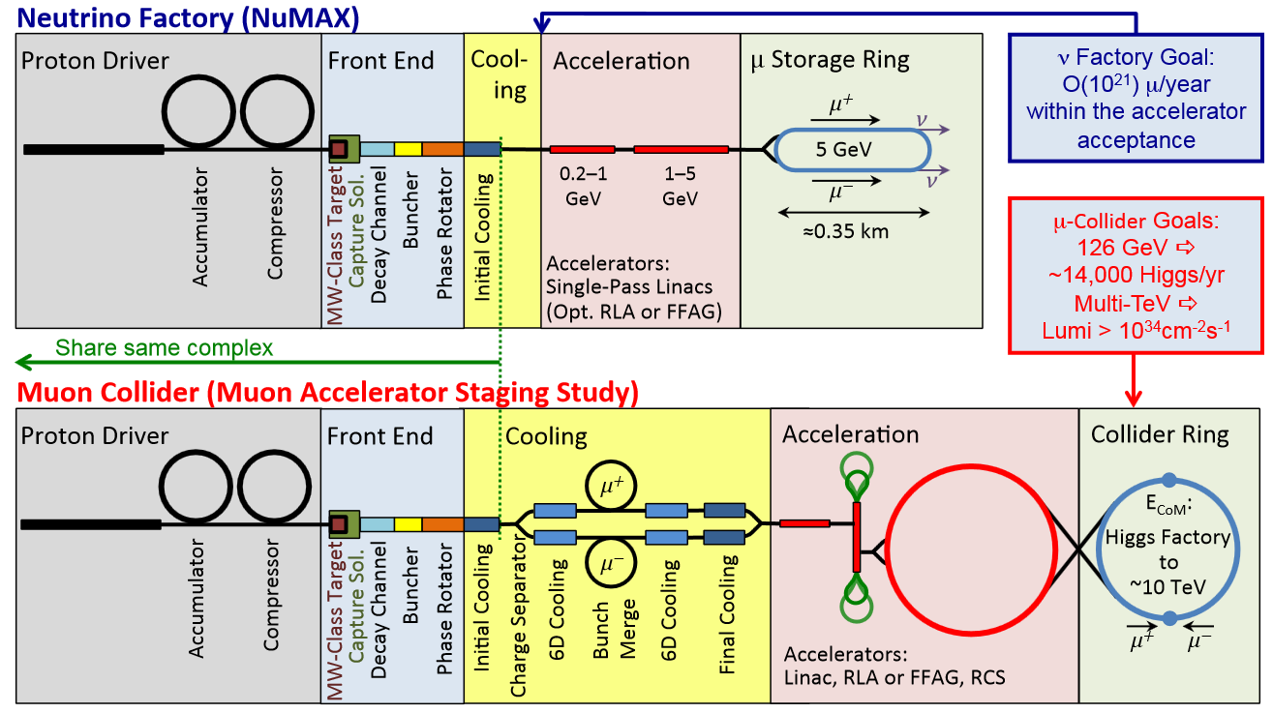
Overview

Slide 5
Review of past work which remains the most recent
Motivation was to obtain particle distributions that possess the effects of having gone through a charge splitter, since this is necessary for a more realistic design of the HCC.
Our goal was not to design a realistic charge splitter, but rather to extract particle distributions that provide the starting point in designing the complete cooling channel.
Secondary Benefits:
The resultant particle distributions was to have served as the basis upon which the various 6D cooling channel schemes use as input for performance comparisons between the options that apply to a single charge sign. But, the success in separating charges in this study eliminated the need for simulating charge splitting by options that can accept beam out of the front end.
Lessons learned can be fed back into the design of a real charge separator.

Slide 6
Review of past work which remains the most recent
This study benefited from an earlier effort by Palmer & Fernow [PAC11 MOP001] that used bent solenoids to separate opposite charges in the beam.
Scrutiny of the above study revealed that it might be possible to separate charges for muons with momentum expected out of the front end (~250 MeV/c).

Slide 7
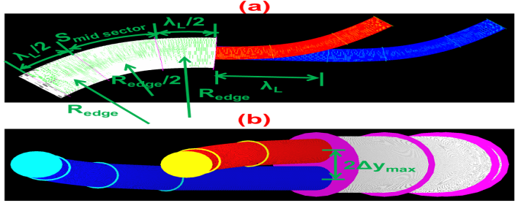
The Charge Separator Concept
Cartoon of coil configuration illustrating the concept of a charge separator from top view (a) and at downstream facing upstream (b).

Slide 8
The Simplified Charge Separator
Designing a realistic charge separator will involve:
Dealing with fringe fields at the end of the forward bend and start of the two smaller solenoids.
Dealing with fringe fields between the two downstream solenoids.
Possibly tilting the coils in the downstream segments, if the path difference introduced by the coils being vertically displaced have a negative impact on performance.

Slide 9
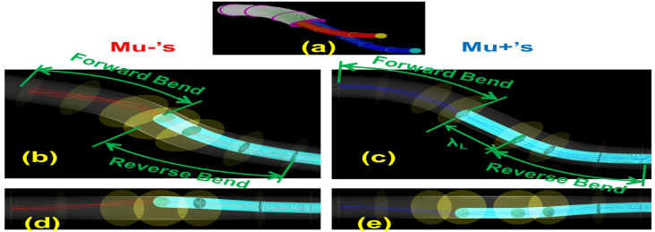
The Simplified Charge Separator
Association of a charge splitter coil concept in (a) to two separate pseudo charge splitters (one for each sign) with transparent large radii coils. Yellow discs demarcate sectors. Oblique view of µ⁻s in (b) and side view in (d) showing vertical rise in forward bend and vertical drop in reverse bend. Oblique view of µ⁺s in (c) and side view in (e) showing vertical drop in forward bend and vertical rise in reverse bend.

Slide 10
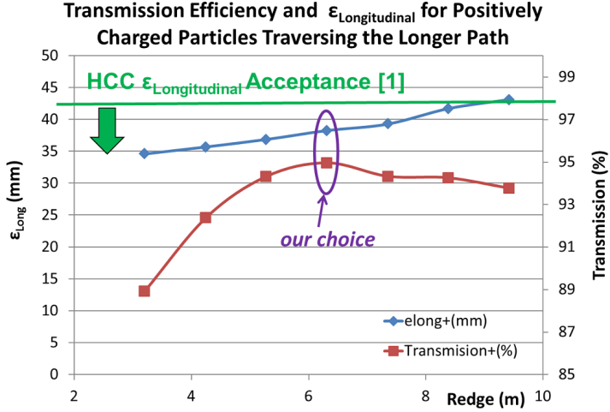
Optimization
P=Pz | MeV/c | 250
B | T | 2
λ_{L}=(2πP_{z})/(B_{φ}c) | m | 2.62
R_{edge} | m | 3.21 | 4.25 | 5.28 | 6.32 | 7.36 | 8.39 | 9.43
α_{edge}(vert angle) | deg | 7.4 | 5.6 | 4.5 | 3.8 | 3.2 | 2.8 | 2.5
S_{mid sector} | m | 0 | 0.42 | 0.85 | 1.27 | 1.70 | 2.13 | 2.55
Δy_{max} | m | 0.342
S_{Longer Channel}(µ⁺) | m | 7.86 | 8.71 | 9.56 | 10.41 | 11.26 | 12.11 | 12.96

Slide 11
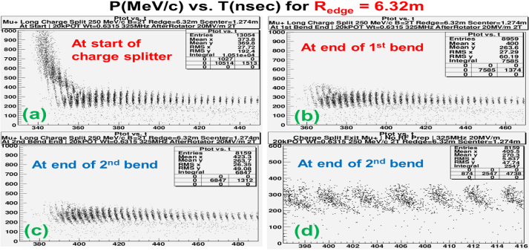
Longitudinal Distortion & Its Remedy

Slide 12
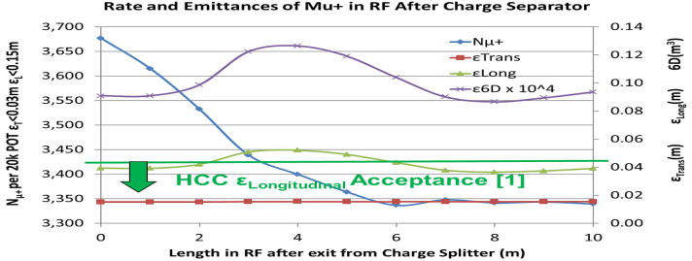
Longitudinal Distortion & Its Remedy
Muons exiting the charge separator will need to be caught into RF buckets
Lose 9% of µ₊’s and ε_{L} oscillates above HCC acceptance.

Slide 13
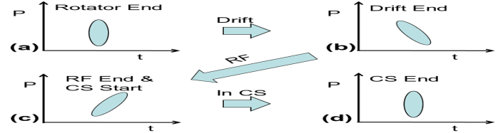
Longitudinal Distortion & Its Remedy
Remedy: RF gymnastics

Slide 14
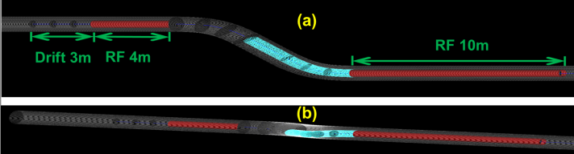
Longitudinal Distortion & Its Remedy

Slide 15
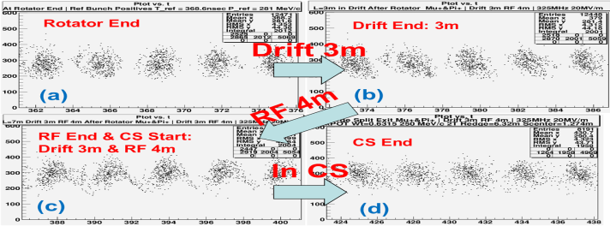
Longitudinal Distortion & Its Remedy

Slide 16
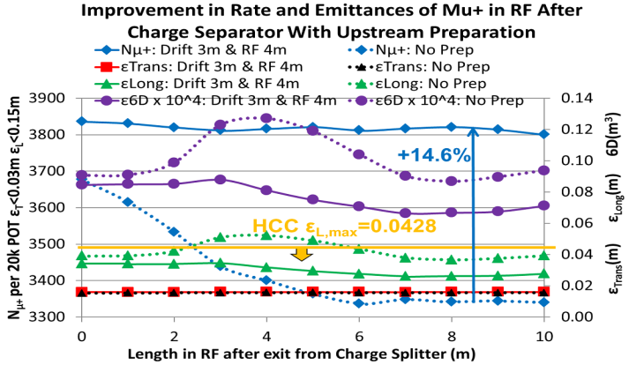
Longitudinal Distortion & Its Remedy
Improvement in Rate and Emittances of (longer path) µ⁺’s in RF after Charge Separator with Upstream Preparation.
ε_{L} is lowered and remains within the HCC acceptance
yield increase of 14.6%

Slide 17
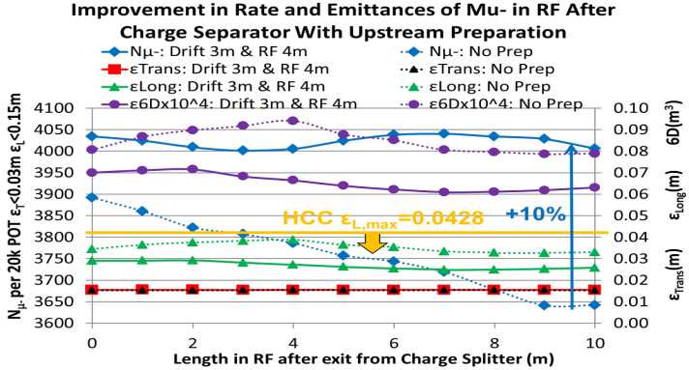
Longitudinal Distortion & Its Remedy
Improvement in Rate and Emittances of (shorter path) µ⁻’s in RF after Charge Separator with Upstream Preparation.
ε_{L} that was within the HCC acceptance is further lowered
yield increase of 10%

Slide 18
Longitudinal Distortion & Its Remedy
Survival Rates and Emittances of Muons at 1 m Past a Charge Separator.

Slide 19
Concepts for combining charge separation and matching into the HCC
Two possible solutions are:
The “Easy Way”
  The momentum is lowered (~170 MeV/c) to lower the b_{s} on the reference in the HCC that is matched in the from the upstream forward-only bent solenoid, which increases the vertical angle of separation in order to achieve the necessary charge separation.
    Pros:
      Shorter channel meaning simpler, less cost, shorter distance for beam to spread.
      Neither charge sign would need be subjected to a longer channel to avoid collisions between coils.
    Con: Lower momentum means more time spread per unit distance.
The “Hard Way”
  This incorporates a full forward bend, a straight for one charge sign to avoid overlapping coils, and partial reverse bends to achieve the desired dispersion.
    Pros: More flexibility in momentum choice. Can design for two cases:
      P=204.8 MeV/c out of Yuri’s pre-cooler
      P=278 MeV/c out of front end phase rotator
    Cons:
      Longer channel meaning more complexity, higher cost, longer distance for beam to spread.
      One charge sign would have to travel an extra λ_{HCC} to avoid collisions between coils.

Slide 20
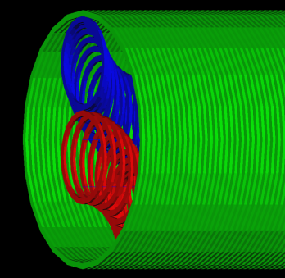

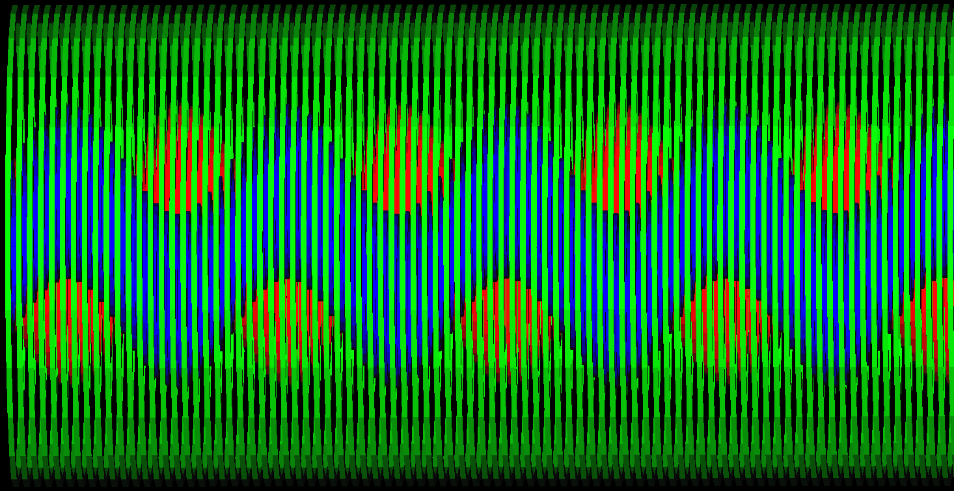
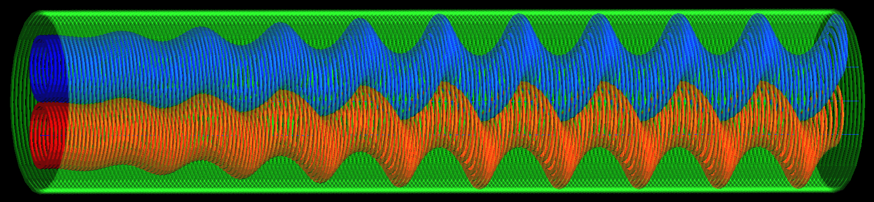
Concept to Match Adiabatically Out of “Easy Way”
To match out of the charge separating bent solenoid, the large radius anti-solenoid could start with currents of the charge separator and reduce it and reverse its polarity (recall the “anti” in “anti-solenoid”) adiabatically as the inner coils ramp up in current and helical pitch.

Slide 21
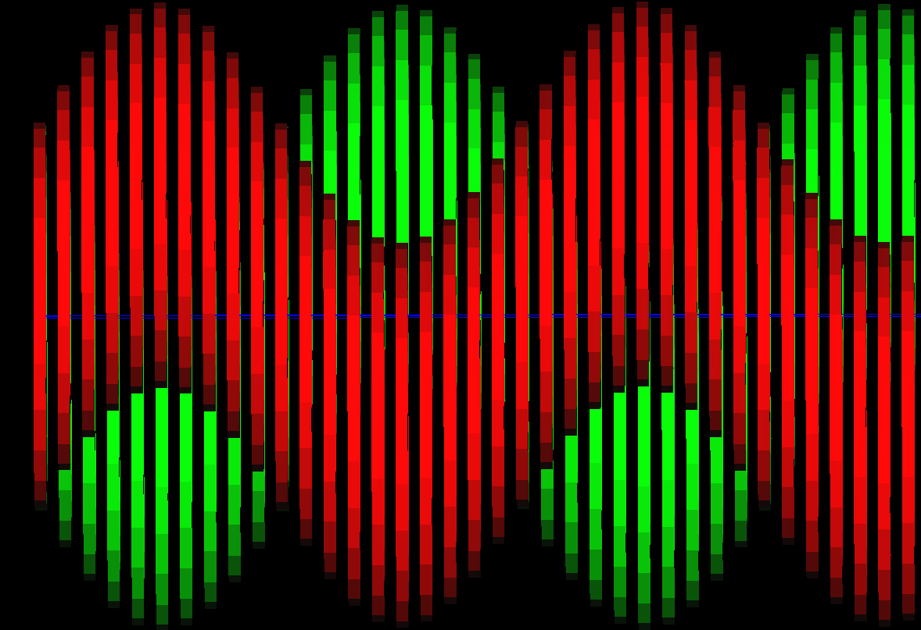
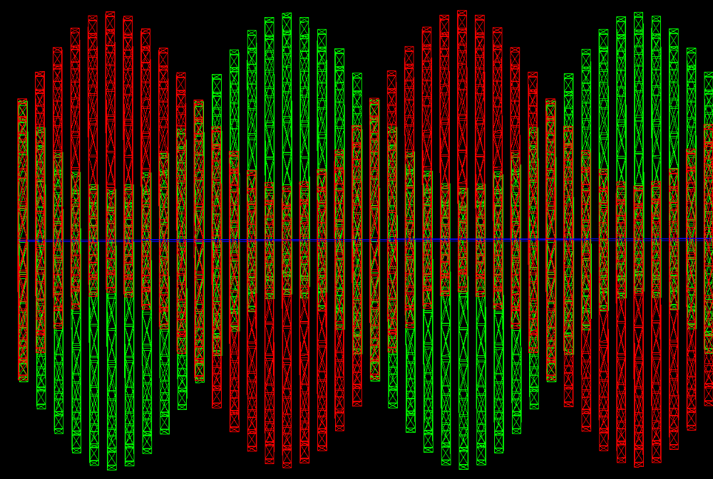
Concept to Match Non-Adiabatically Out of “Easy Way”
Perhaps tilted coils could provide the ~25○ split to match both charges into their respective HCCs.

Slide 22
Summary
The most recent work on charge separation is summarized in NA-PAC13 THPHO19. Details can be found in a Friday MAP meeting on 9/9/2013.
The concept shows reasonable charge separation efficiencies.
Concepts were presented to combine charge separation and match into the HCC, but they can apply to the Vacuum RF solution as well.

