Slide 1
LHC, HL-LHC and future upgrades
Lucio Rossi - CERN
MAP Collab. Meeting
28 May 2014 (via readytlak)

Slide 2
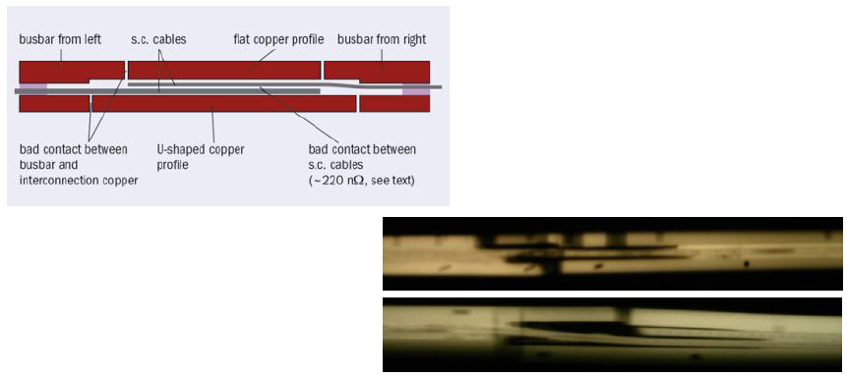
Splice consolidation: why?
The splice components
X-rays of splices, presenting bad contacts

Slide 3
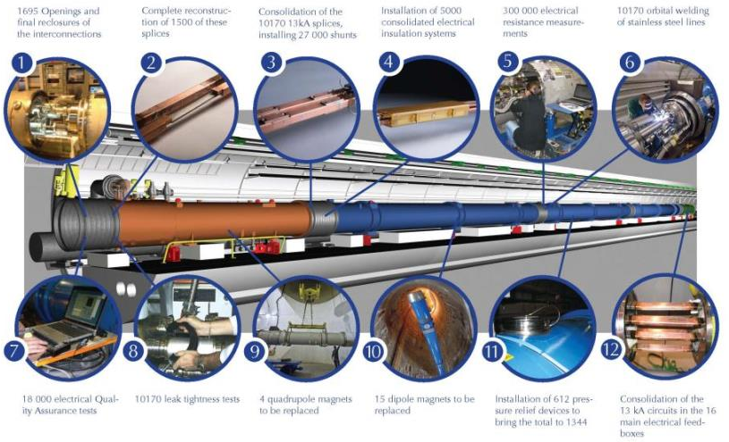
Wor ahead of uis (2 years ago)

Slide 4
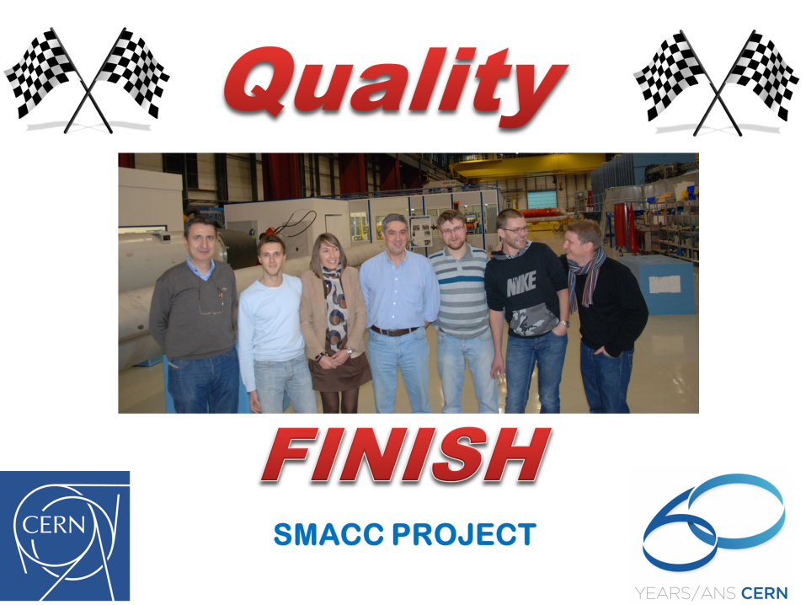

Slide 5
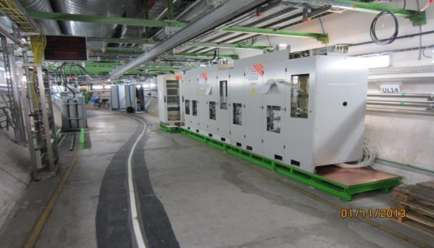
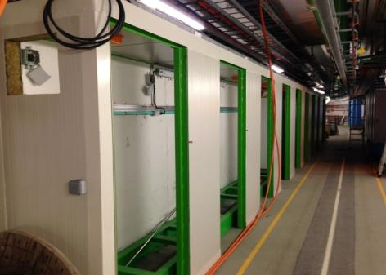
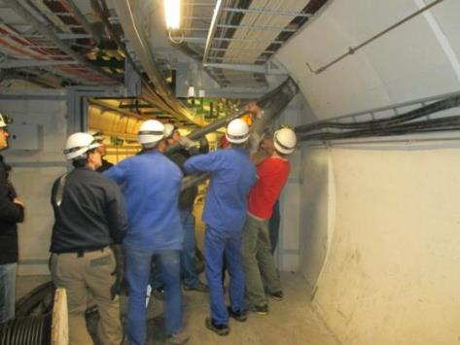
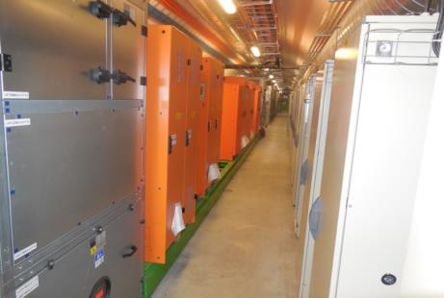
Other works : R2E
Point 1
  All equipment are reinstalled and reconnected
  Commissioning in progress
Point 5 & Point 7
  Major cabling campaign in progress
UL16 power converters
UL55 safe-room
Warm Cable installation @ P5
TZ76

Slide 6
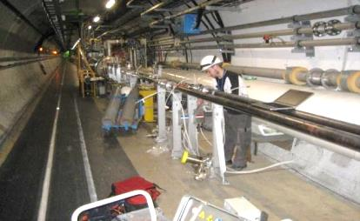
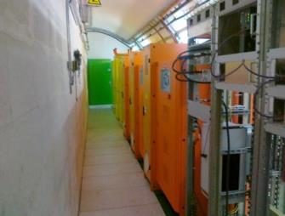
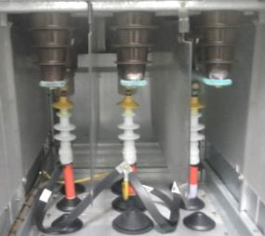
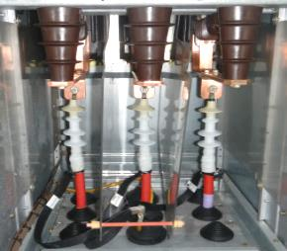

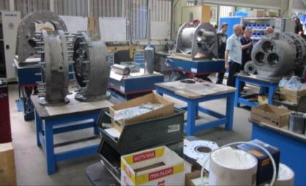
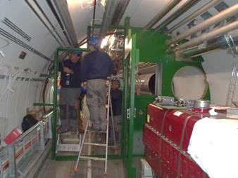
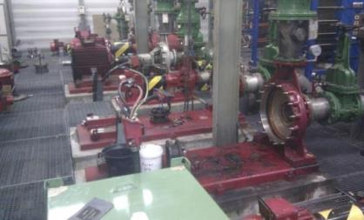
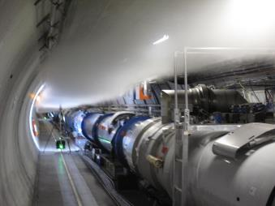
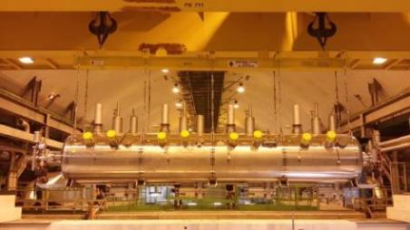
And many others
Vacuum
UPS-RE82
18 kV & 3.3 kV circuit breakers
Before
After
Cryo plants
Pumping station
RF module replacement

Slide 7
Key points
We are on time for restarting Physics in LHC
In April 2015
Start at 50 ns, then 25 ns as son possible (test of scrubbing to reduce e-clouds)
Chamonix Workshop on 22-25 September

Slide 8
 | N_{bcoll} [10¹¹] | ε*_{coll} [μm] | # Coll. pairs IP1,5 | B-B Sep [σ] | Full Xing angle [μrad] | L_{peak} [10³⁴ cm⁻²s⁻¹] | Max. Avg. Peak-pile-up density/Pile-up [ev./mm]/[ev./xing]
BCMS | 1.24 | 1.65 | 2592 | 12 | 295 | 2.1 | 0.46/45
Standard | 1.24 | 2.0 | 2736 | 12 | 320 | 1.8 | 0.46/45
 | L_{lev} [10³⁴ cm⁻²s⁻¹] | Lev. time [h] | Opt. Fill length [h]
BCMS | 1.5 | 2.9 | 8
Standard | 1.6 | 1.7 | 8.1
Limited by:
  Inner triplet heat due to collisions debris (1.7 x 10³⁴ cm⁻² s⁻¹ ± 20%)
  Pile-up (here assumed to be 45 events/crossing)
  ➔ Will need levelling

Slide 9
0.75 10³⁴ cm⁻²s⁻¹
50 ns bunch
high pile up ∼40
1.5 10³⁴ cm⁻²s⁻¹
25 ns bunch
pile up ∼40
1.7-2.2 10³⁴ cm⁻²s⁻¹
25 ns bunch
pile up ∼60
Technical limits (experiments, too) like :

Slide 10
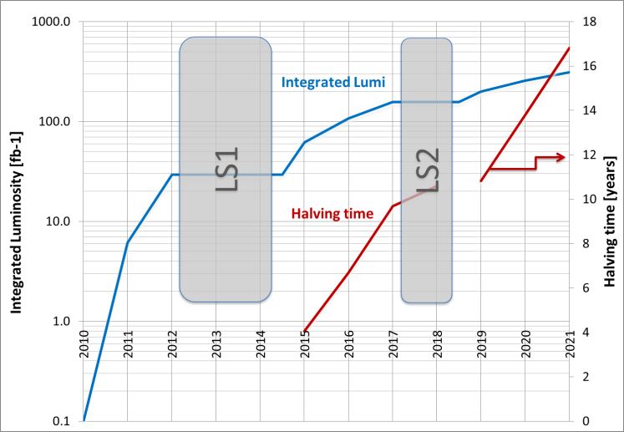
Mantain and increase physics reach
Necessity of a jump in luminosity
(useful luminosty ⇒ data quality)

Slide 11
Goal of High Luminosity LHC (HL-LHC) as fixed in November 2010
The main objective of HiLumi LHC Design Study is to determine a hardware configuration and a set of beam parameters that will allow the LHC to reach the following targets:
A peak luminosity of 5×10³⁴ cm⁻²s⁻¹ with levelling, allowing:
An integrated luminosity of 250 fb⁻¹ per year, enabling the goal of 3000 fb⁻¹ twelve years after the upgrade.
This luminosity is more than ten times the luminosity reach of the first 10 years of the LHC lifetime.

Slide 12
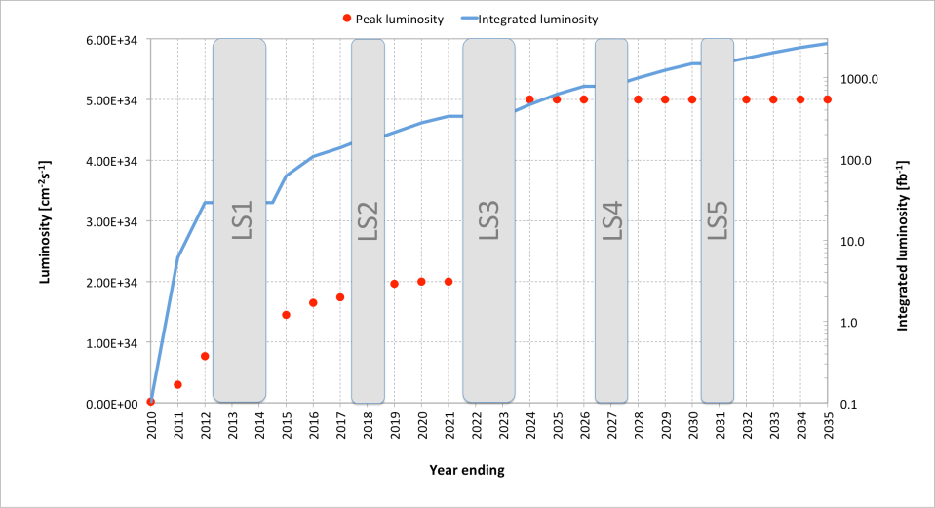
This goal would be reached in 2036
What to do make this jump ?
M. Lamont,
7th HL-LHC Coordination Group, Jul.2013

Slide 13
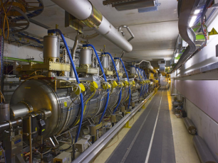
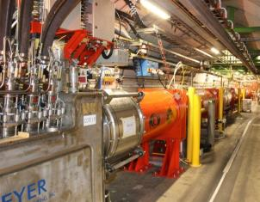
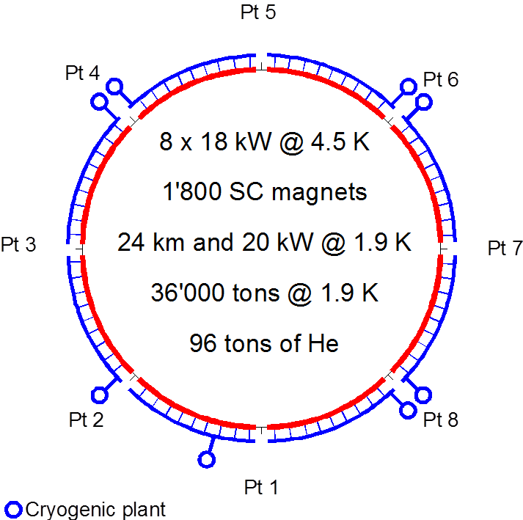
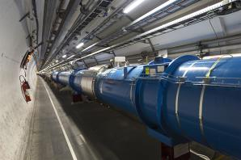
Technical bottlenecks
Cryogenics P4
IT
IT
RF
RF
Never good to couple RF with Magnets !
Reduction of availabe cryo-power and coupling of the RF wiht the Arc (thermal cycle requires > 2 months and many tests)
IT
IT
IT
IT
IT
IT

Slide 14
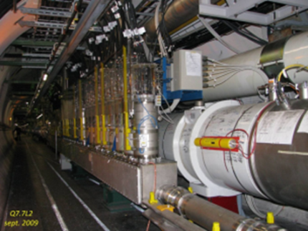
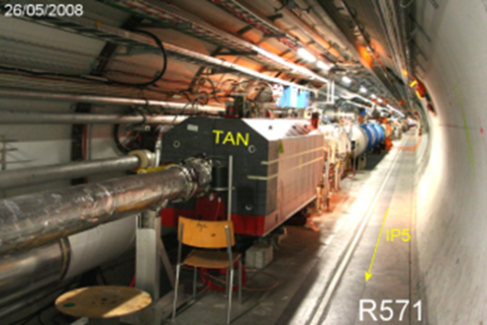
Triplet and MS connection to main arc
The cryoline is continous between the Continuous cryostat (Regular lattice Arc and DS Arc) and the MS-IT zones. This connections have consequences:
Makes a limitation in cryopower since the IT zone will increase the power deposited with the lumi increase
A stop in the MS or IT zone would entail a thermal cycle on the entire Sector

Slide 15
Cryogenic load: sector 4
L. Tavian
All existing margins already «used» at around 2 10³⁴
(like cryostat consumption 30% less than design)

Slide 16
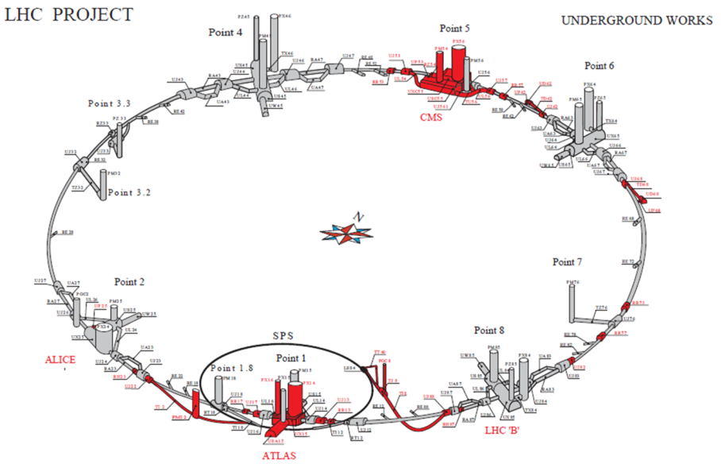
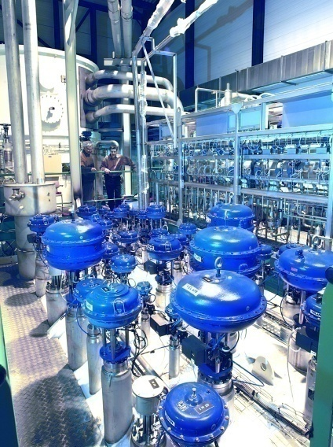
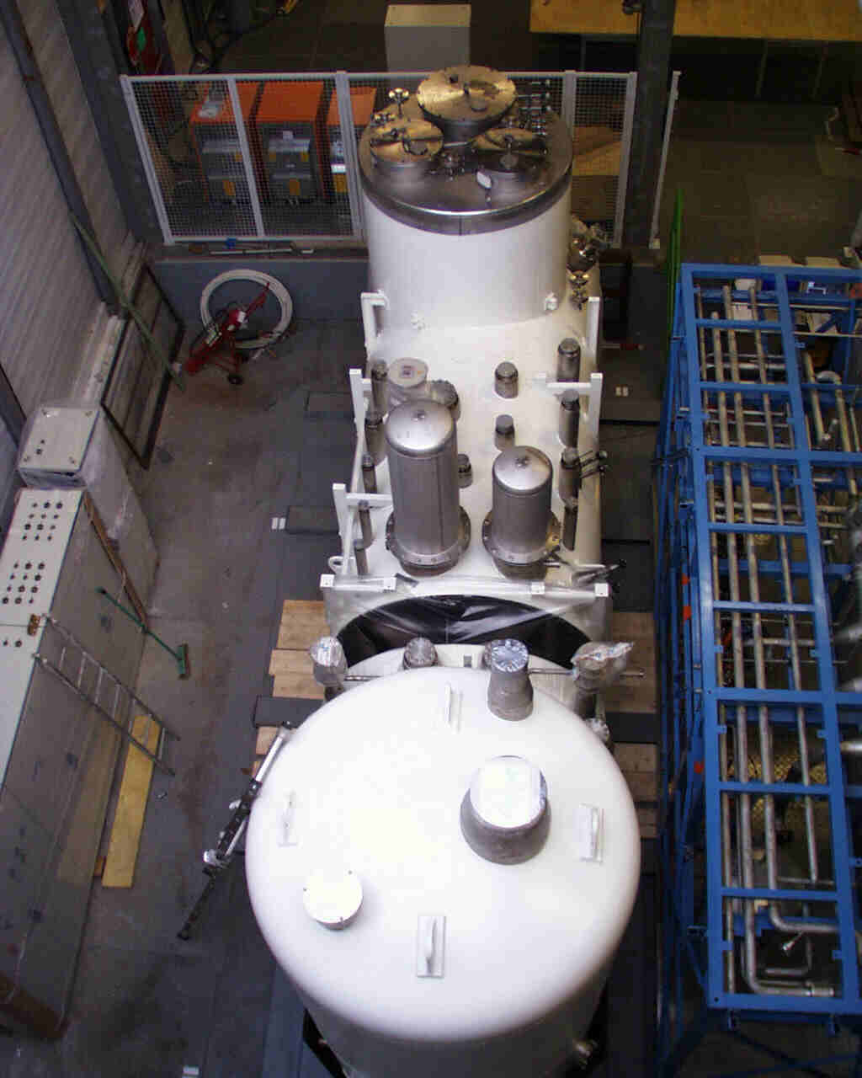
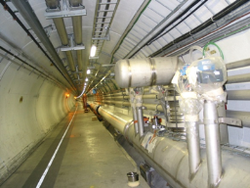
IT cryoplants and new LSS QRL
Availability: separation New Inner Triplets (and IPM in MS) from the arc cryogenics.
Keeping redundancy for nearby arc cryoplant
Redundancy with nearby Detector SC Magnets cryoplant

Slide 17
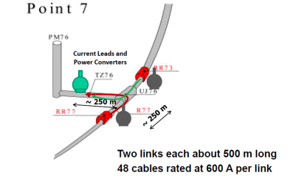
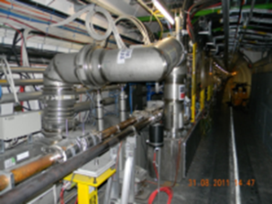
Displacing EPC and DFB in the adjacent TDZ tunnel (∼ 500 m away) via SC links
4.5 K
DFBA
DFBM
Q6
D4
D3
Q5
Q4
Q11, Q10…Q7
DQR
IP7
IP 6
8.75 m
∼1 m
Warm magnets (PCs in UJ 76)
RR 73
RR 73

Slide 18
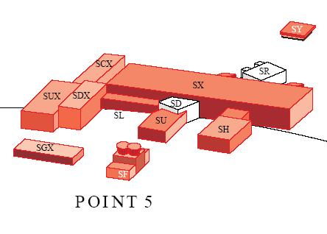
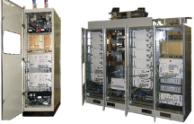
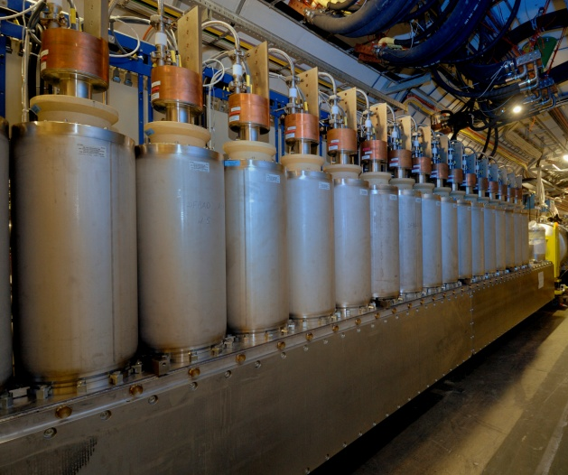
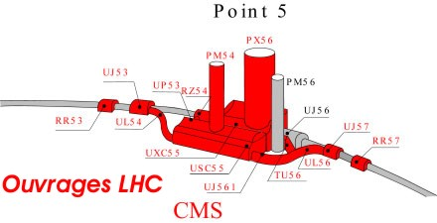
Availability: SC links ⇒removal of
EPCs, DFBs from tunnel to surface
1 pair 700 m 50 kA – LS2
4 pairs 300 m 150 kA (MS)– LS3
4 pairs 300 m 150 kA (IR) – LS3 tens of 6-18 kA CLs pairs in HTS
2×150 kA
A. Ballarino

Slide 19
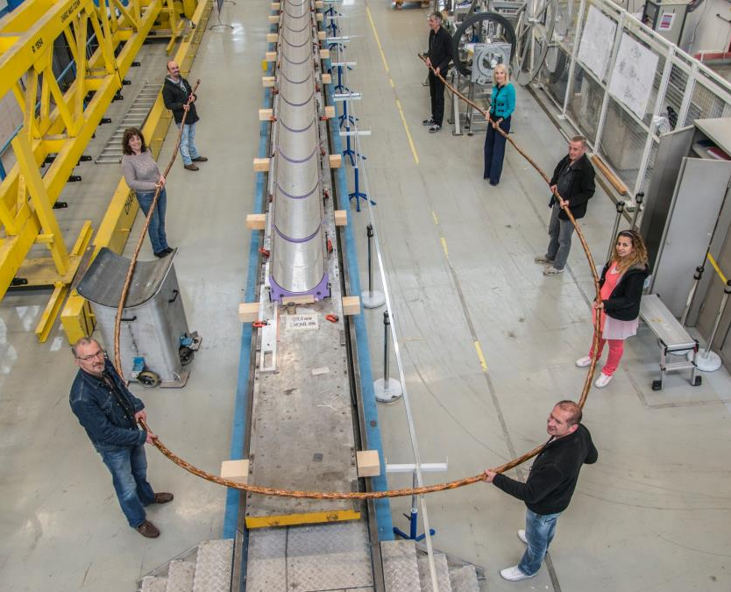
L = 20 m
(25×2) 1 kA @ 25 K, LHC Link P7

Slide 20
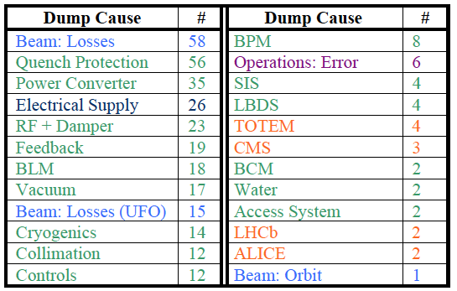
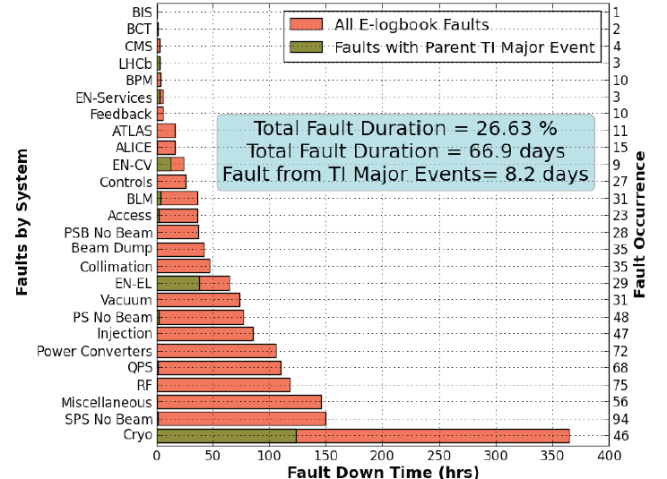
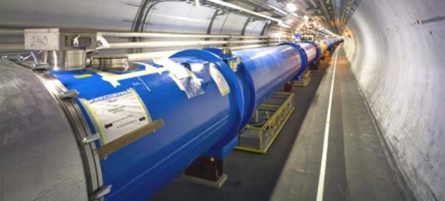
QPS boxes and intervention time
Consolidation of infrastructure !
But also new paradigma: remove from tunnel of QPS (as much as possible)

Slide 21
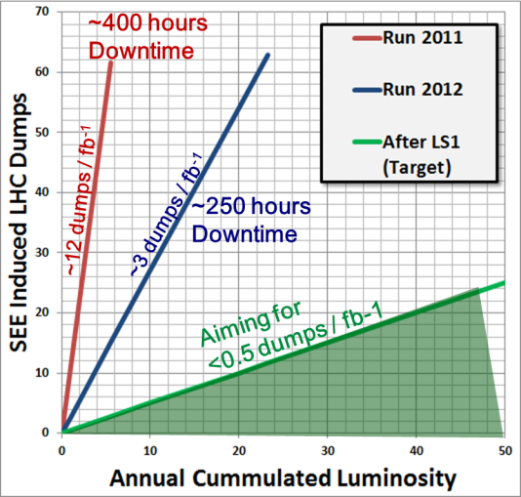
R2E improvement.
Need further for 1-3 fb⁻¹/day!
M. Brugger

Slide 22
The big technical bottleneck:
Radiation damage to triplet
Cold bore insulation
≈ 35 MGy
Q2
27 MGy
MCBX3 20 MGy

Slide 23
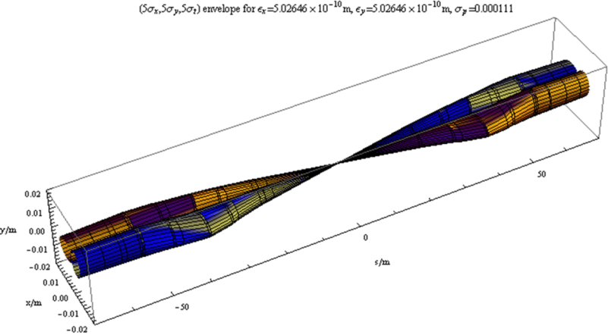
The most straight forward action: reducing beam size with a «local» action
LHC has better aperture than anticipated: now all margin can be used; however is not possible to have β∗ < 40 cm
Quadrupole triplet and D1
Smaller β∗ ⇒ larger IT aperture

Slide 24

Parameters (PLC web page)
Parameter | nominal​ | 25ns​ | 50ns
N_{b} | 1.15E+11 | ​2.2E+11 | ​3.5E+11
n_{b} | ​2808 | ​2808 | ​1404
N_{tot} | 3.2E+14 | 6.2E+14 | 4.9E+14
beam current [A] | ​0.58 | 1.11 | 0.89
x-ing angle [μrad]​ | 300 | 590 | 590
beam separation [σ] | 9.9 | 12.5 | 11.4
β* [m] | 0.55 | ​0.15 | ​0.15
ε_{n} [μm]​ | 3.75 | ​2.50 | 3
ε_{L} [eVs]​ | 2.51 | ​2.51 | ​2.51
energy spread​ | ​1.20E-04 | ​1.20E-04 | ​1.20E-04
bunch length [m] | ​7.50E-02 | ​7.50E-02 | ​7.50E-02
IBS horizontal [h] | ​80 -> 106 | 18.5 | 17.2
IBS longitudinal [h] | 61 -> 60 | 20.4 | 16.1
Piwinski parameter | ​0.68 | 3.12 | 2.85
Reduction factor 'R1*H1‘ at full crossing angle (no crabbing) | ​0.828 | 0.306 | 0.333
Reduction factor ‘H0‘ at zero crossing angle (full crabbing) | 0.991 | 0.905 | 0.905
beam-beam / IP without Crab Cavity | 3.1E-03 | ​3.3E-03 | 4.7E-03
beam-beam / IP with Crab cavity | 3.8E-03 | 1.1E-02 | 1.4E-02
Peak Luminosity without levelling [cm⁻² s⁻¹] | 1.0E+34 | 7.4E+34 | 8.5E+34
Virtual Luminosity: Lpeak*H0/R1/H1 [cm⁻² s⁻¹] | 1.2E+34 | 21.9E+34 | 23.1E+34
Events / crossing without levelling | ​19 -> 28 | 210 | 475
Levelled Luminosity [cm⁻² s⁻¹] | - | ​5E+34 | 2.50E+34
Events / crossing (with leveling for HL-LHC) | *​19 -> 28 | 140 | 140
Leveling time [h] (assuming no emittance growth) | - | 9.0 | 18.3
https://espace.cern.ch/HiLumi/PLC/default.aspx

Slide 25
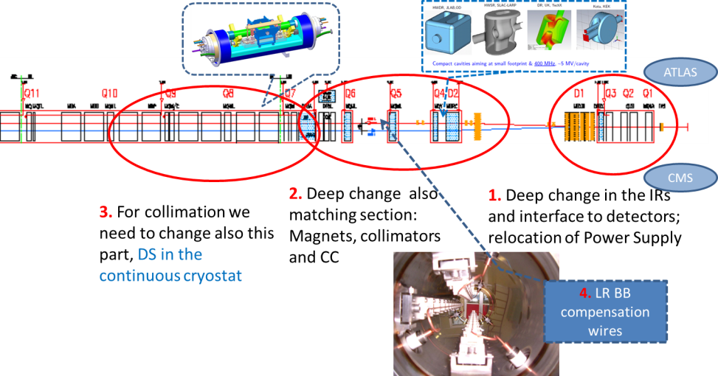
The critical zone around IP1 and IP5
1.2 km of LHC !!

Slide 26
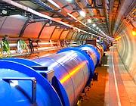
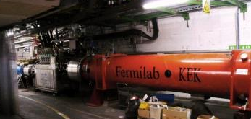
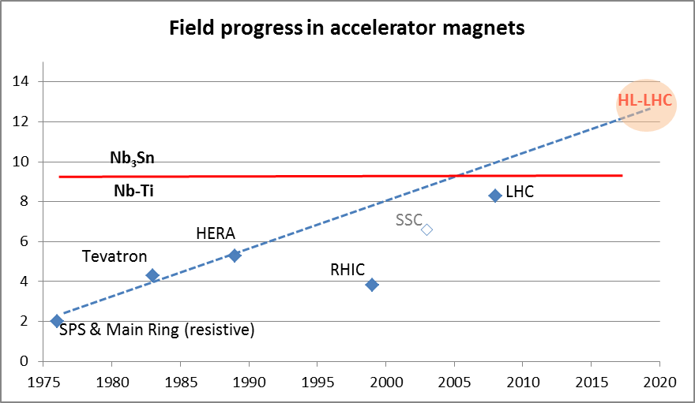
Magnet the progress
LHC dipoles features 8.3 T in 56 mm (designed for 9.3 peak field)
LHC IT Quads features 205 T/m in 70 mm with 8 T peak field
HL-LHC
  11 T dipole (designed for 12.3 T peak field, 60 mm)
  New IT Quads features 140 T/m in 150 mm > 12 T operational field, designed for 13.5 T).

Slide 27
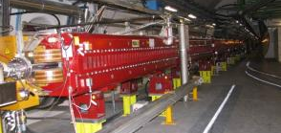
New Interaction Region lay out
Longer Quads; Shorter D1 (thanks to SC)
ATLAS
CMS
LHC
E. Todesco
ATLAS
CMS
HL LHC
Thick boxes are magnetic lengths -- Thin boxes are cryostats

Slide 28


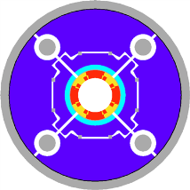
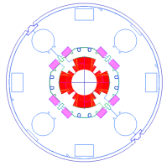
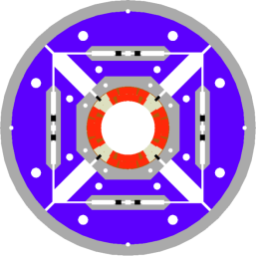
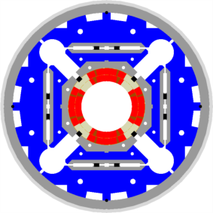

LHC low-β quads: steps in magnet technology from LHC toward HL-LHC
LHC (USA & JP, 5-6 m)
∅70 mm, B_{peak}∼ 8 T
1992-2005
LARP TQS & LQ (4m)
∅90 mm, B_{peak}∼ 11 T
2004-2010
New structure based on bladders and keys (LBNL, LARP)
LARP HQ
∅120 mm,
B_{peak}∼ 12 T
2008-2014
LARP & CERN
MQXF
∅150 mm,
B_{peak}∼ 12.1 T
2013-2020

Slide 29
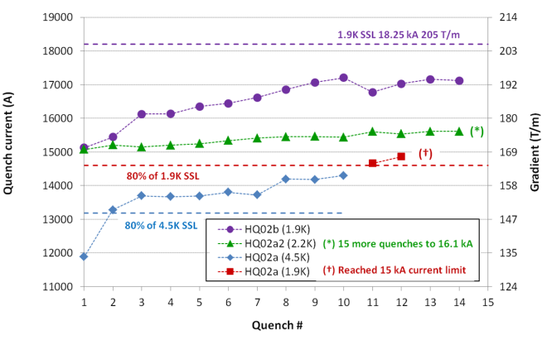


MQXF
(IT quads)
Test HQ02 (120 mm) – G. Sabbi
LARP short coil
with Nb₃Sn cable
CERN short coil
with Cu cable

Slide 30


The Achromatic Telescopic Squeezing (ATS) scheme
Small β* is limited by aperture but not only: optics matching & flexibility (round and flat optics), chromatic effects (not only Q’), spurious dispersion from X-angle,..
A novel optics scheme was developed to reach un-precedent β* w/o chromatic limit based on a kind of generalized squeeze involving 50% of the ring
(S. Fartoukh)
β*= 40 cm
β*= 10 cm
The new IR is sort of 8 km long !
Beam sizes [mm] @ 7 TeV from IR8 to IR2 for typical ATS
“pre-squeezed” optics (left) and “telescopic” collision optics (right)

Slide 31


The Achromatic Telescopic Squeezing (ATS) scheme (2/2)
→ Proof of principle demonstrated in the LHC down to a β∗ of 10-15 cm at IP1 and IP5
S-. Fartoukh

Slide 32


Effect of the crab cavities
RF crab cavity deflects head and tail in opposite direction so that collision is effectively “head on” and then luminosity is maximized
Crab cavity maximizes the lumi and can be used also for luminosity levelling: if the lumi is too high, initially you don’t use it, so lumi is reduced by the geometrical factor. Then they are slowly turned on to compensate the proton burning

Slide 33


Crab Cavity, for p-beam rotation at 10 fs level!
Elliptical type CC has been tested first in KEK 2008

Slide 34


And excellent results: RF dipole > 5 MV
¼ w and 4-rods also tested (1.5 MV) cleaning & vacuum issues: new test under way
2 K result
4.2 K result
Quench
Initial goal was 3.5 MV
5-6 MV may be at hand
JP Delahayen
We started downselection,
2 out of 3 design kept for test
5

Slide 35


Crab Cavities for fast beam rotation
Present baseline: 3 cavity /cyomodule
4 cavity/cryomod is under study for Crab Kissing
TEST in SPS under preparation (A. MacPherson)

Slide 36



Latest cavity designs toward accelerator
Coupler concepts
RF Dipole: Waveguide or
waveguide-coax couplers
Put in hold for the moment
Double ¼-wave: Coaxial couplers with
hook-type antenna
E. Jensen (CERN)
G. Burt (U.Lancaster, CI
R. Calaga (CERN, former LARP)
A. Ratti (LBNL, LARP)
4-rod: Coaxial couplers with different antenna types

Slide 37






P2 - DS collimators ions – 11 T (LS2 -2018)
Recommended by the Collimation Review
11 T Nb₃Sn
A. Zlobin (FNAL)
M . Karppinen (CERN)

Slide 38



Low impedence collimators(LS2 & LS3)
New material: MoGr
S. Redaelli
A. Bertarelli

Slide 39
SCRF 800 MHz harmonic: under study
P4
200 MHz system too recent to discuss integration

Slide 40

Halo control (hollow e-lens)

Slide 41



Controlling diffusion rate: hollow e-lens
Promises of hollow e-lens:
1. Control the halo dynamics without affecting the beam core;
2. Control the time-profile of beam losses (avoid loss spikes);
3. Control the steady halo population (crucial in case of CC fast failures).
Remarks:
- very convincing experimental experience in other machines!
- full potential can be exploited if appropriate halo monitoring is available.
S. Redaelli
Developed by Fermilab

Slide 42






The Crab-kissing (CK) scheme for pile-up density shaping and leveling (S. Fartoukh)
Crab-kissing & variants:
CC also in ||-plane
Baseline: CC in X-plane “only”
$\frac{∂μ}{∂z}$ [mm⁻¹]
z [m]
... Work on-going together with the machine experiments
(S. Fartoukh, A. Valishev, A. Ball, B. Di Girolamo, et al.)

Slide 43



Collaboration: the long way
DOE Nb3Sn R&D
2000
LARP
generic
FP6
CARE
Nb3Sn
The HL-LHC project formally started in 2010; however it is the focal point of 20 years of converging International Collaboration
2005
CERN-KEK R&D
LARP
HiField quads
FP7
sLHC PP
(INJ)
FP7
EuCARD
HiField Dip
2010
CERN-KEK D1 design
LARP
Demo
sLHC INJ implem.
today
FP7 DS
Hi-Lumi LHC
M
2015
Construction
Injector
upgrade
HL-LHC commissioning
2023

Slide 44



















High Luminosity LHC Participants

Slide 45







In-kind contribution and Collaboration for HW design and prototypes
ATLAS
CMS
Q1-Q3 : R&D, Design, Prototypes and in-kind USA
D1 : R&D, Design, Prototypes and in-kind JP
MCBX : Design and Prototype ES
HO Correctors: Design and Prototypes IT
Q4 : Design and Prototype FR
CC : R&D, Design and in-kind USA

Slide 46

In-kind contribution and Collaboration for HW design and prototypes
ATLAS
CMS
Q1-Q3 : R&D, Design, Prototypes and in-kind USA
D1 : R&D, Design, Prototypes and in-kind JP
MCBX : Design and Prototype ES
HO Correctors: Design and Prototypes IT
Q4 : Design and Prototype FR
CC : R&D, Design and in-kind USA
CC : R&D and Design UK

Slide 47

Implementation plan
All WP active, from diagnostics to Machine Protection;
Integration started with vigour as well as QA (workshop soon)
Cryo, SC links, Collimators, Diagnostics, etc. starts in LS2 (2018)
Proof of main hardware by 2016; Prototypes by 2017
Start construction 2017/18 from IT, CC, other main hardware
IT String test (integration) in 2019-20; Main Installation 2022-23
Though but – based on LHC experience – feasible
Cost: 810 MCHF (Material, CERN accounting)

Slide 48

2025 is tomorrow: what we can do for after 2025? Look at LHC timeline

Slide 49






Slide 50
FCC-Future Circular Coliders
HE-LHC :33 TeV
with 20T magnets
First studies on a new 80 km tunnel in the Geneva area
  42 TeV with 8.3 T using present LHC dipoles
  80 TeV with 16 T based
  on Nb₃Sn dipoles
  100 TeV with 20 T based
  on HTS dipoles

Slide 51

The main (but not unique) R&D
Looking at performance offered by practical SC, considering tunnel size and basic engineering (forces, stresses, energy) the practical limits is around 20 T. Such a challenge is similar to a 40 T solenoid (μ-C)

