Slide 1
Cooling Session Summary
Pavel Snopok, IIT/Fermilab
May 31, 2014
MAP Collaboration Spring Meeting

Slide 2
Overview
Review of current activities:
initial cooling;
charge separation;
6D cooling channels (VCC/HCC);
bunch merge;
final cooling.
Prioritized list of activities.
To be completed by the end of this fiscal year.

Slide 3
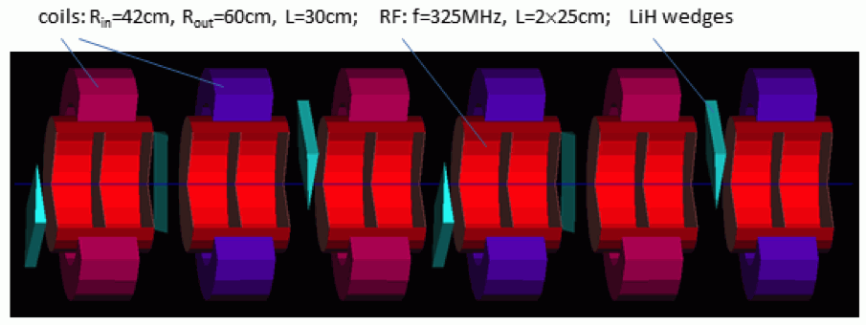
Review of current activities: initial cooling
New lattice for a gas-filled 325 MHz helical FOFO snake for initial 6D cooling working with both signs.
The effort is documented (see MAP tech note 4377), lattices are provided along with a detailed description.
Helps match HCC to the front end.
Charge separation will be much easier after initial 6D cooling.
Improved muon acceleration for NF compared to 4D cooling.
Length: 130 m, transmission: 68% (core of the beam) with decay on, 6D emittance reduced two orders of magnitude.

Slide 4
Review of current activities: charge separation
Conceptual design of the charge separator is done and published (NA-PAC’13, THPH019). Conceptual = aimed not to design a realistic charge splitter, but to obtain particle distribution that provide the starting point in designing the complete cooling channel.
Designing a realistic charge separator would imply resolving all the fringe field issues and potentially tilting the coils if the path difference for different signs will have a negative impact on performance.
Charge separator is designed with HCC in mind, but VCC can use it as well.
Transmission is 93% for μ⁺ and 95% for μ⁻, emittances within the acceptance of HCC.
(Preliminary) concepts for combining charge separation and matching into the HCC are being considered, can be applied to VCC as well.

Slide 5
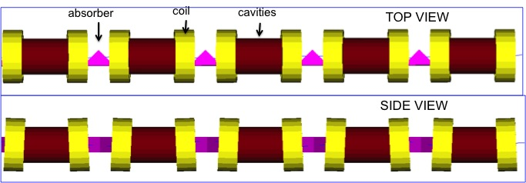
Review of current activities: 6D cooling (VCC)
Concept for 6D cooling based on a rectilinear channel is defined, lattices available. Magnets, cavities, and absorbers specified for the cooling channel before and after the merge.
End-to-end simulation (assuming certain bunch merge performance): final emittances 0.28 mm (T) [0.30 mm] and 1.57 mm (L) [1.50 mm].
Magnet feasibility study for the last stage with encouraging results.
Configuration with space for diagnostics/cryostats studied.
Cylindrical absorbers instead of wedges studied.
Mechanical and thermal analysis of RF windows initiated.
Some stages need modifications based on the outcomes of the recent VCC workshop.

Slide 6
Review of current activities: bunch merge (VCC)
Longitudinal merge using idealized RF field is done, matched to the transverse.
Trombone designed (without RF, transverse only), current concentration is on the funnel.
Overall transmission is ≈78%, transverse emittance 1.6->6.8 mm.
More realistic simulations are underway, end-to-end simulation soon.

Slide 7
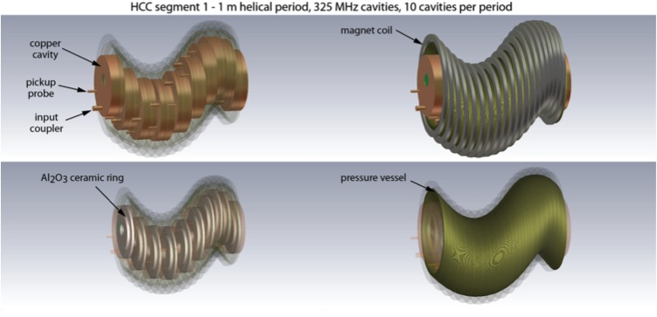
Review of current activities: 6D cooling (HCC)
Matching section design and simulation to improve transmission.
Design RF window, study beam loading effect.
Design HCC magnet, control helical dipole/gradient ratio via coil tilt, elliptical coils, other techniques.
Nb₃Sn helical solenoid prototype is being designed.
Dielectric-loaded gas-filled RF cavity test is being prepared.
Gas-plasma chemistry simulations are underway.
Simulations for complete helical bunch merge subsystem with parameters representative of current HCC designs are underway.

Slide 8
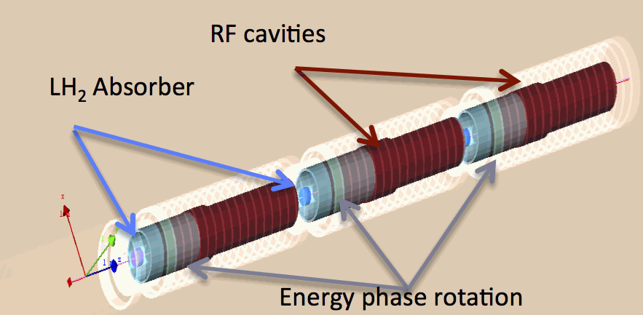
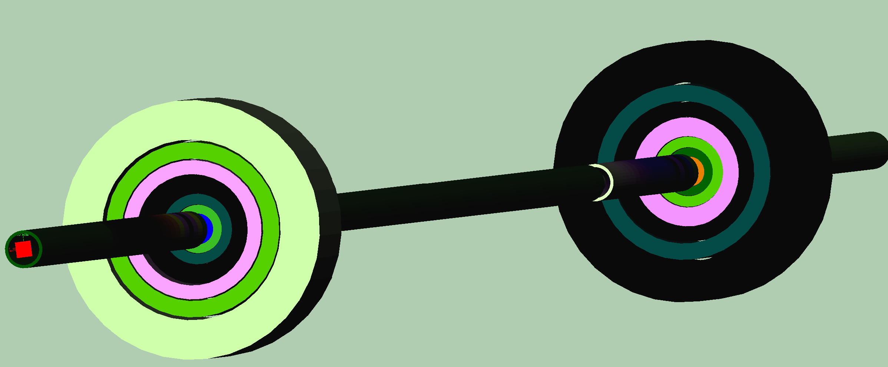
Review of current activities: final cooling
Channel design with 30-25 T focusing ﬁeld presented.
A ﬁrst pass of a complete design and simulation of a high ﬁeld cooling channel: transverse emittance 55 μm, longitudinal ≈75 mm.
Field flip frequency under study.
Various optimizations proposed.

Slide 9
Prioritized list of activities
Concentrate on 6D cooling and initial cooling.
Prepare technology specification document for 6D cooling, both VCC and HCC options (9/3/14).
Lattice files for initial cooling are available, validate, add to the repository (7/3/14).
Discuss and document the current status of charge separation, bunch merge, final cooling, and any matching sections present (concept specification deadline for charge separation and bunch merge is 10/1/14).

Slide 10
Completed by the end of this fiscal year
Technology specification document for 6D cooling, both VCC and HCC options.
Lattice specification for initial cooling.
Documents and/or references to all the relevant materials for charge separation, bunch merge, final cooling, and any matching sections (at least at the “concept specification” level, ideally, closer to the “lattice specification” document to the extent possible).

Slide 11
END

