Slide 1
Bunch merge status for VCC
Yu Bao
UC Riverside
MAP 2014 Spring Meeting

Slide 2
Outlines
Merge scheme and timeline
Longitudinal merge with ideal fields
Transverse merge:
  Kicker and matching
  Trombones
  Funnel
Remaining issues and possible improvements
Summary

Slide 3
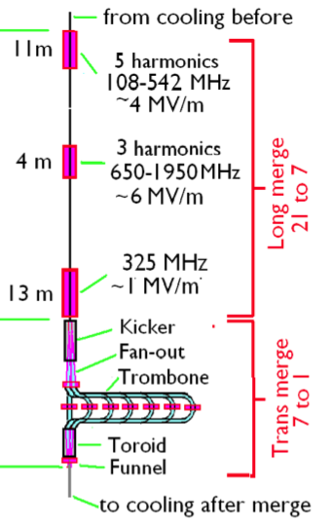
overview and timeline
October,2013: Longitudinal merge using ideal rf field finished.
December, 2013: Matching channel between Longitudinal merge and trombones optimized.
March, 2014: Trombone designed, EmitT conserved.
May, 2014: Funnel simulated.
October, 2013
December, 2013
March, 2014
May, 2014

Slide 4
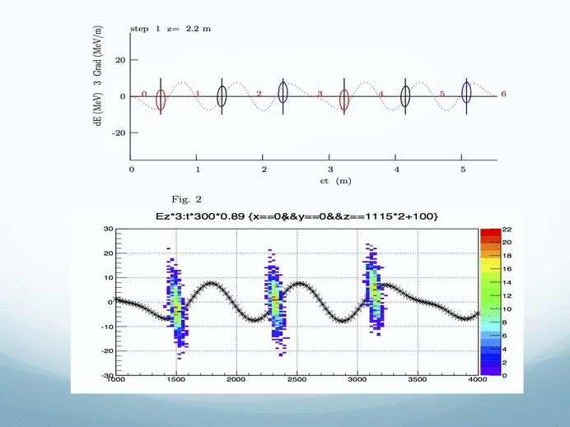

Longitudinal Merge
92% transmission
SigmaP = 8.9 MeV/c (input 7.51 MeV/c)
Sigma_ct = 134 mm (input 24.7 mm)
SigmaX=SigmaY=26 mm (input 21 mm)
SigmaX’=SigmaY’=0.03 (input 0.03)
EmitT=1.6 mm
EmitL=8.5 mm

Slide 5
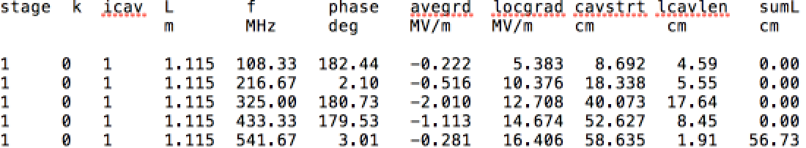
RF fields
The rf fields are simulated by analytic expressions. The harmonics are superpose on each other and the total field is:
Where avegrad_i, freq_i and phase_i are given in the table (only one cavity parameters are shown):

Slide 6
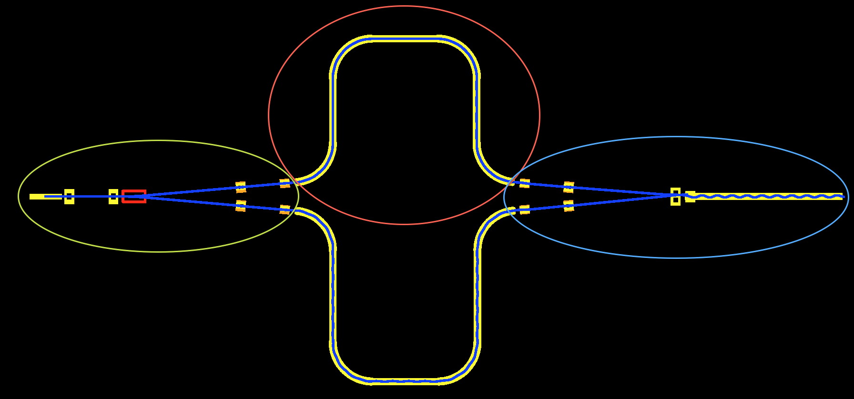
Transverse Merge
L1
L2
L3
L4
Kicker & Matching: kicks the beam to the trombones.
Trombones: lead the bunches to different paths.
Funnel: collect the bunches at the same time.

Slide 7
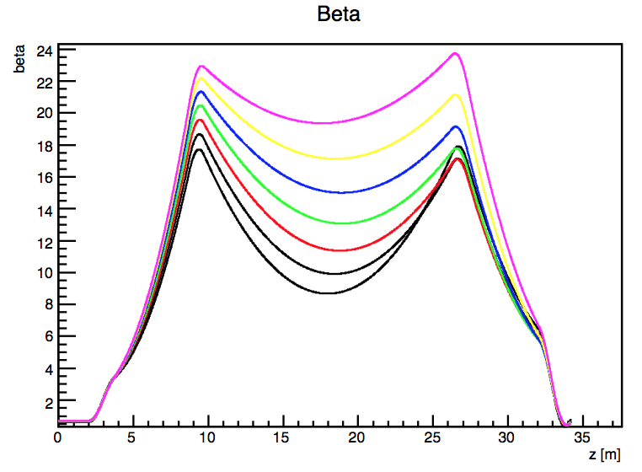
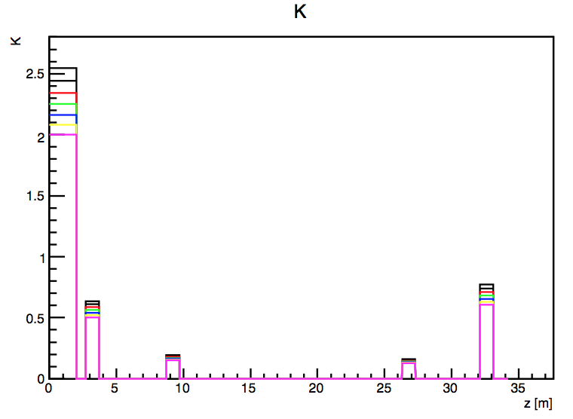
Matching channel (w/o kicker)
Matching the beam from longitudinal merge to the trombones.
Optimized by propagating the Courant-Snyder parameters.
Notes:
Space for the kicker, small kicking angle, Chromatic effects

Slide 8
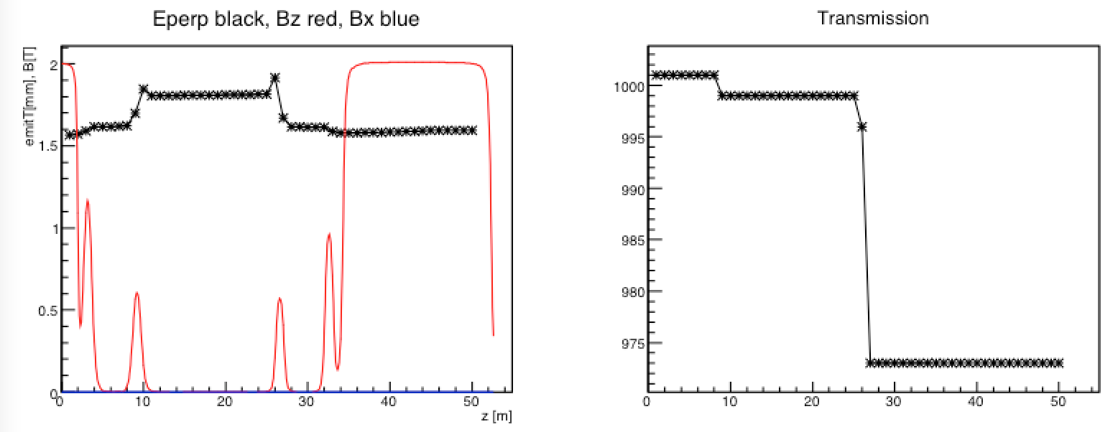
Performance
EmitT goes up to 1.8mm after the second lens for chromatic effect.
Beam matches well to the last straight solenoid.
Total transmission > 97%, beam loss due to small aperture of the third lens.

Slide 9
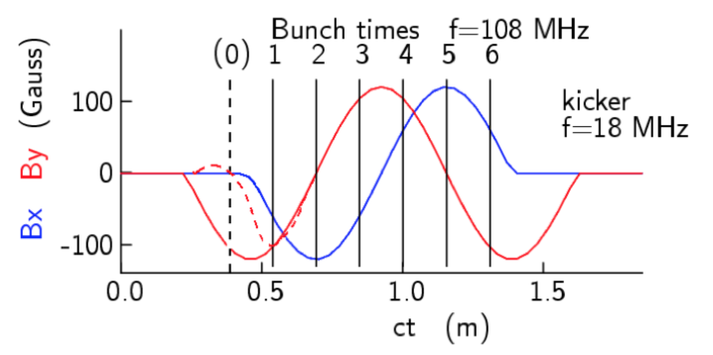
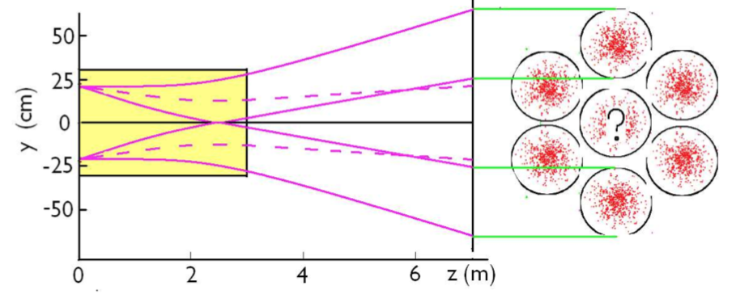
Kicker
Periodic magnetic fields in both x and y directions
Kicking bunches to 6(7) different Trombones with different lengths to bring them to the Funnel at the same time.
Kicker field = 220 Gauss, length = 3 m, angle = 5 degree

Slide 10
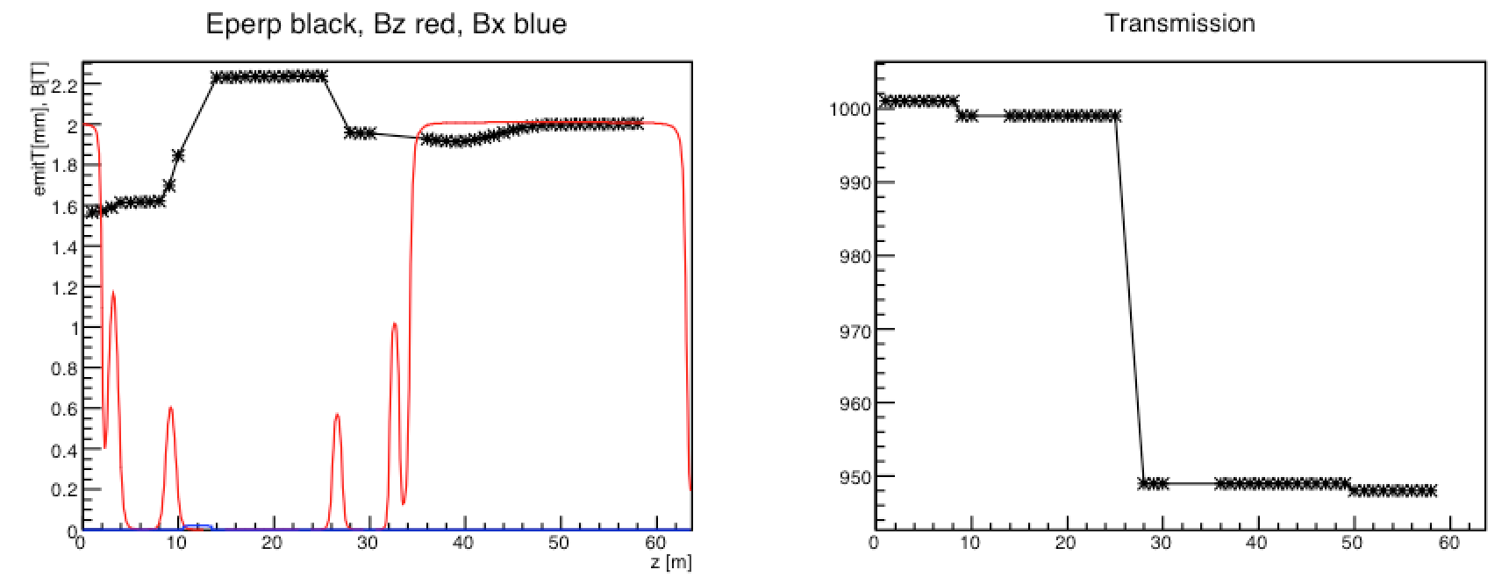
Performance
EmitT goes up to 2.2mm after the kicker.
Emittance grow mainly due to perpendicular kicking.
Total transmission ~ 95%.

Slide 11
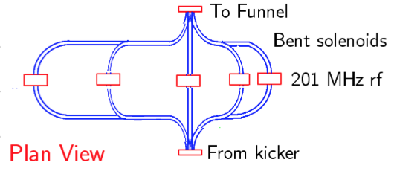
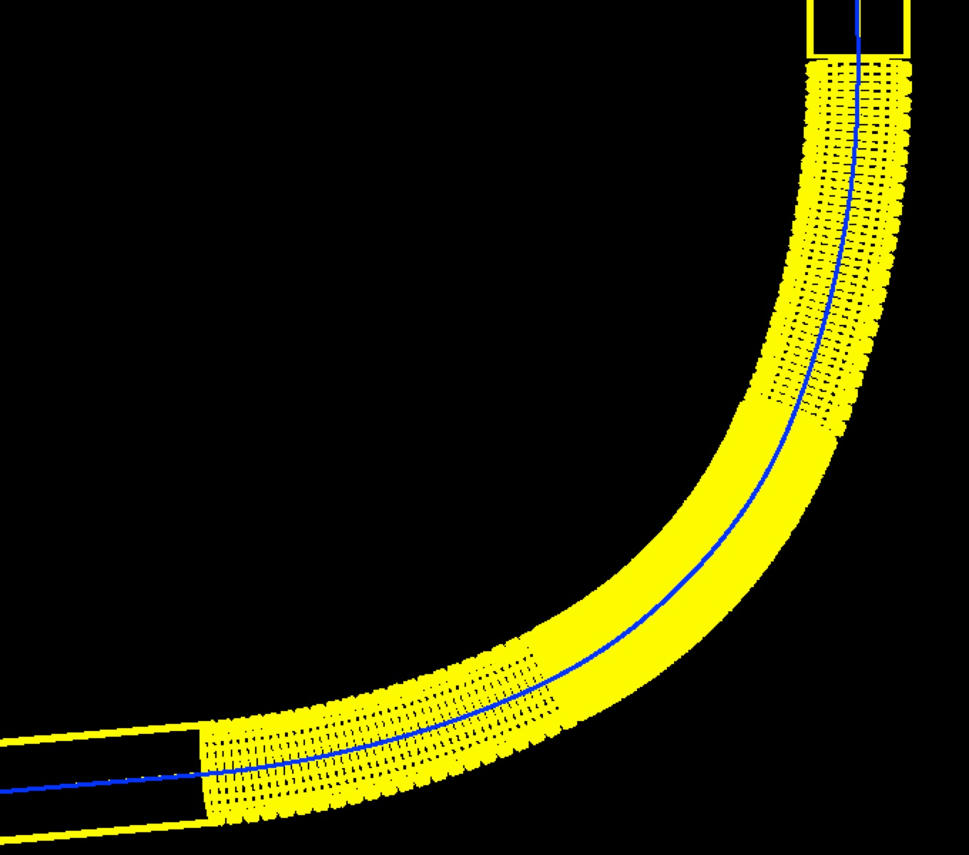
Trombones
Made of bent + straight solenoids.
The bent solenoid consists of short solenoids tilted by 6.5 degree.
Center B field: 2 T
Bending radius: 5.6 m

Slide 12
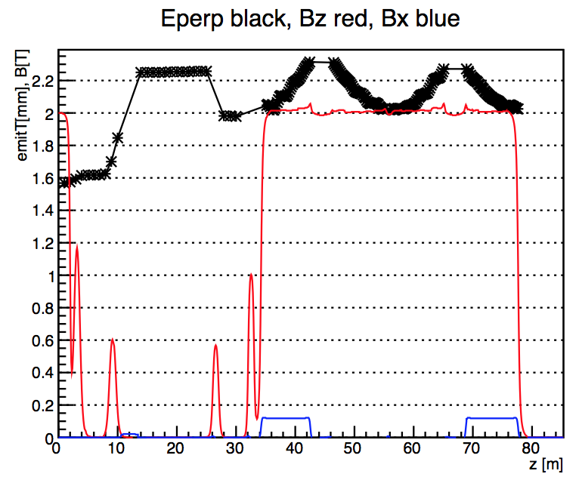
Performance
EmitT conserved after the trombone.
EmitT oscillating due to transverse dispersion and correction by a pair of bent solenoid.
No muon loss in the trombone.

Slide 13
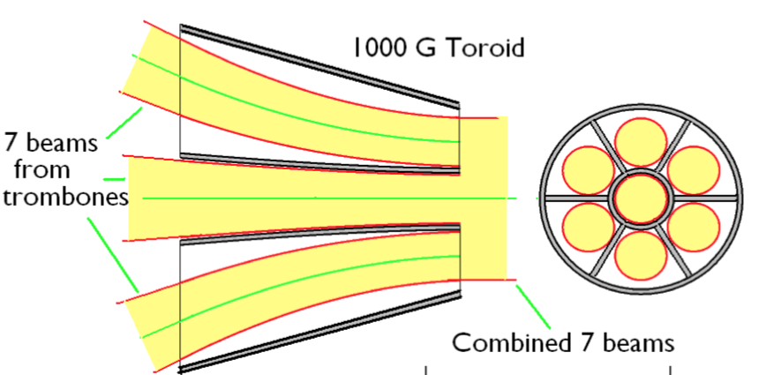
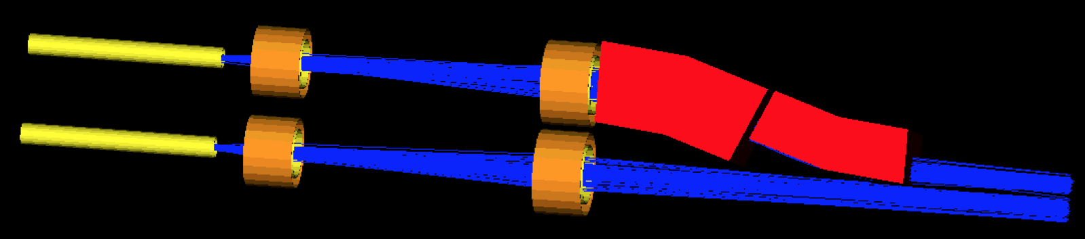
Funnel
Matching similar to pre-trombone matching.
Bending field: 900 G
Matching length: 7.5 m
Ideal dipole field used
Wall thickness = 2 cm
Funnel
B field

Slide 14
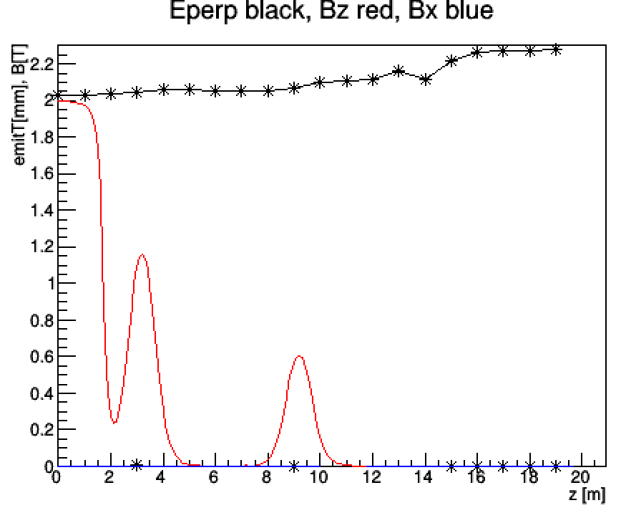
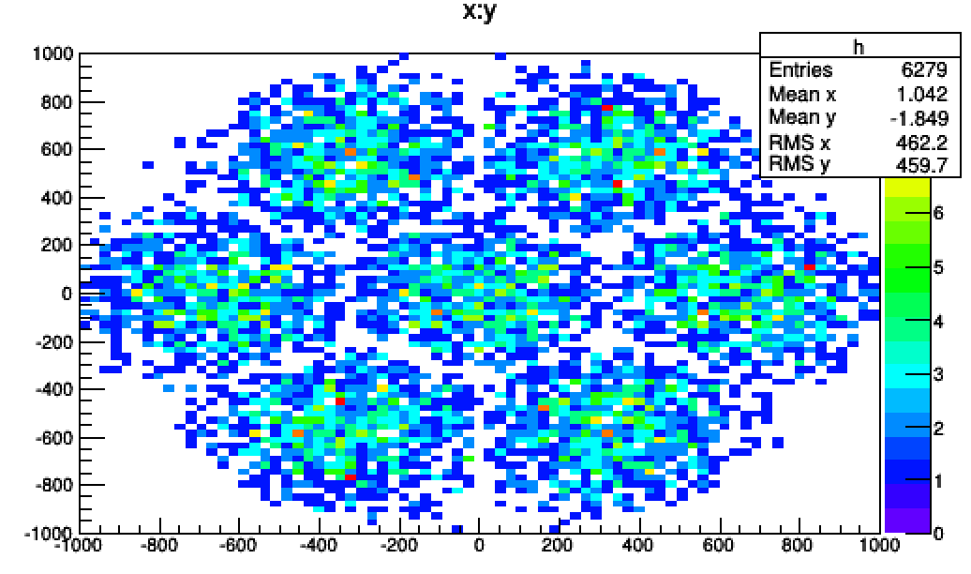
Performance
Single bunch EmitT = 2.2 mm
Total EmitT = 6.8 mm
Transmission 92%

Slide 15
Total performance
Final EmitT | 6.8 mm
Final EmitL | 8.5 mm ?
Longitudinal Merge | 97%
Kicker and Matching | 95%
Trombone | 99%
Funnel | 92%
Decay in 66+80=146m | 90%
Total Transmission | 78%

Slide 16
To Do List
Longitudinal Merge: to use individual cavities
Kicker: to add the 7th bunch and reduce the transverse kicking effect
Trombone: to reduce the length of the bent solenoid
Funnel: to shield the field interruption between neighbor solenoids and to use realistic field.
Transverse merge: to put RF cavities to control the longitudinal emittance
End-to-end simulation

Slide 17
Summary
Bunch merge for the VCC group has been mostly simulated in G4BL.
Possible improvements are outlined.
More realistic simulations are going on.
End-to-end simulation of the merge will come soon…

