Slide 1
Status of Partial Return Yoke

Slide 2
Overview
Introduction and Concept
Performance
Engineering
Timeline

Slide 3
Partial Return Yoke
MICE hall: solenoids cause large stray field
Aim of PRY: Reduce stray field in hall to tolerable level
Shielding plates
wall thickness 10 cm
weight: 55t
Performance
Reduces stray field outside of shield to 5-10 Gauss
H Witte. Step IV & VI: Local Flux Return. MICE CM 34, October 2012.
(Note: not to scale)

Slide 4
Principle

Slide 5
Partial Return Yoke
Shielding plates
8m
3m
Courtesy of Jason Tarrant / Steve Plate
Support Structure

Slide 6
Performance

Slide 7
5 Gauss Surface
PRY
5 Gauss Surface
MICE Solenoids
No iron

Slide 8
Iso-Surface 0.5 mT
No Shield
12 cm Shield
MICE Solenoids
9 m
Step IV
200 MeV Flip

Slide 9
240 MeV Solenoid/Flip Mode
Notes:
Redo plot

Slide 10
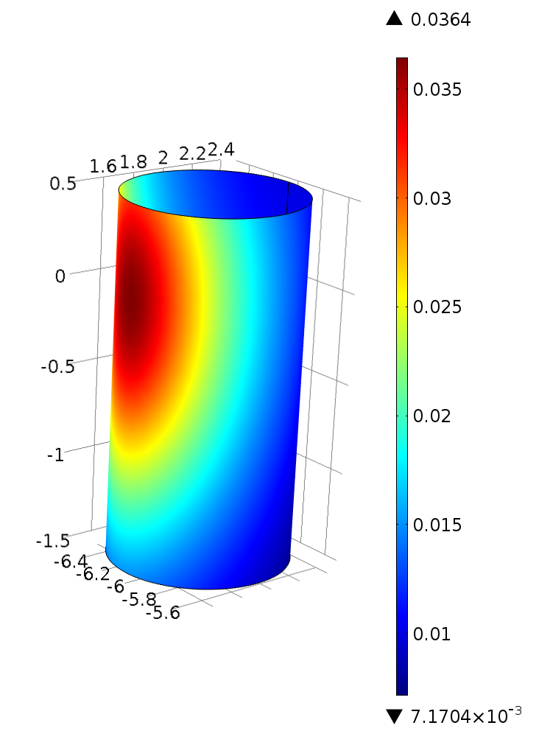
Field Tracker Cryostat
Tracker readout position:
Diameter 1 m
Just next to shield
Fields
No iron: 36.4 mT
Shield: 0.6 mT
Difference: factor 60
240 MeV Solenoid (12 cm shield)
Falls off quickly
No Shield
Shield

Slide 11
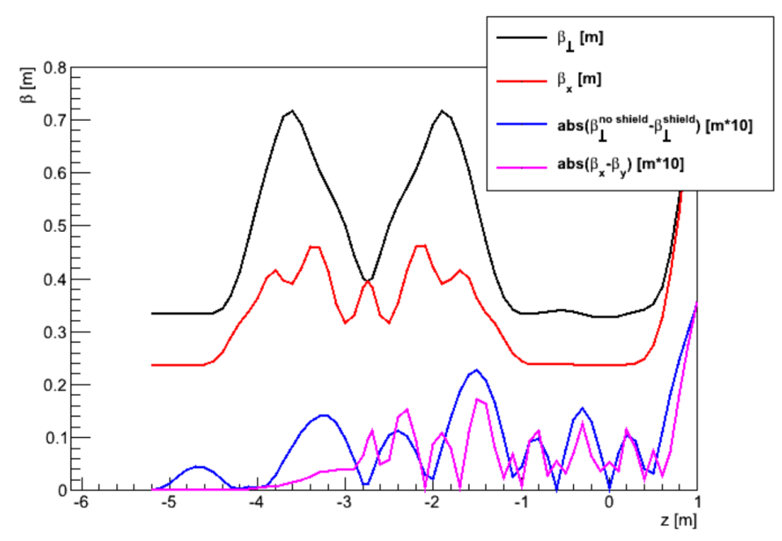
Effect on Beam
MAUS tracking study
200 MeV Flip
Error field map: all iron versus no iron at all (worst case)
Original and current geometry
Misalignments (1 mm + rotation)
Discussed at MICE analysis meeting 24/1/2013
Conclusion
…barely measurable effect on the beam travelling through MICE.
There is no reason, from a beam dynamics perspective, not to implement a shielding wall as described herein.
C. Rogers and H. Witte. Effect Of Iron Partial Return Yoke on the MICE Beam. 23/01/2013, http://micewww.pp.rl.ac.uk/issues/1161

Slide 12
Engineering

Slide 13
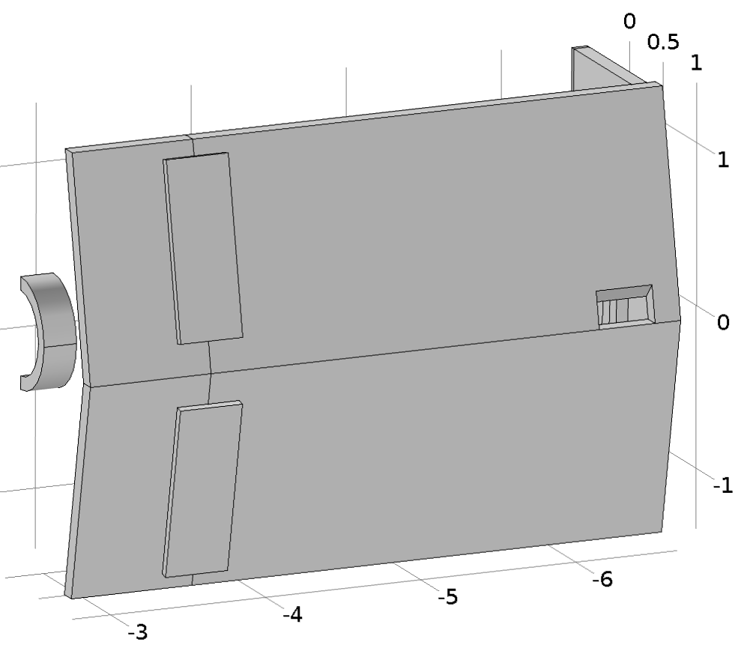
Connections
L-Seal
Backing plates
Waveguide
penetration

Slide 14
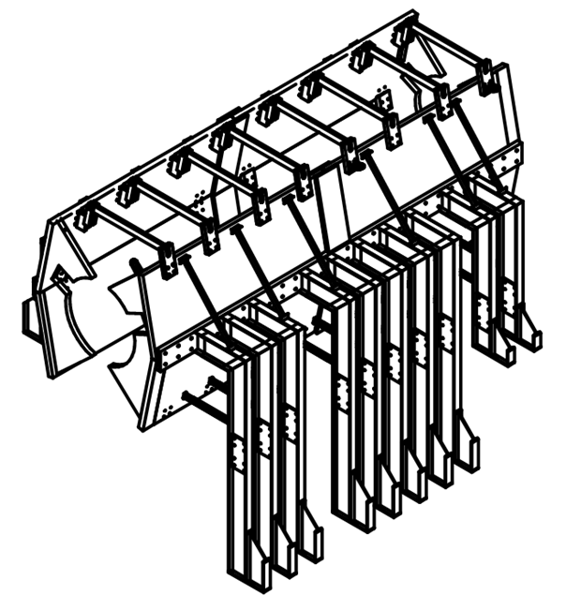
September 2013 Review
No access to absorber
Space for
Virostek Disc
Support anchored in ‘trench’
Courtesy of J. Tarrant / S. Plate

Slide 15
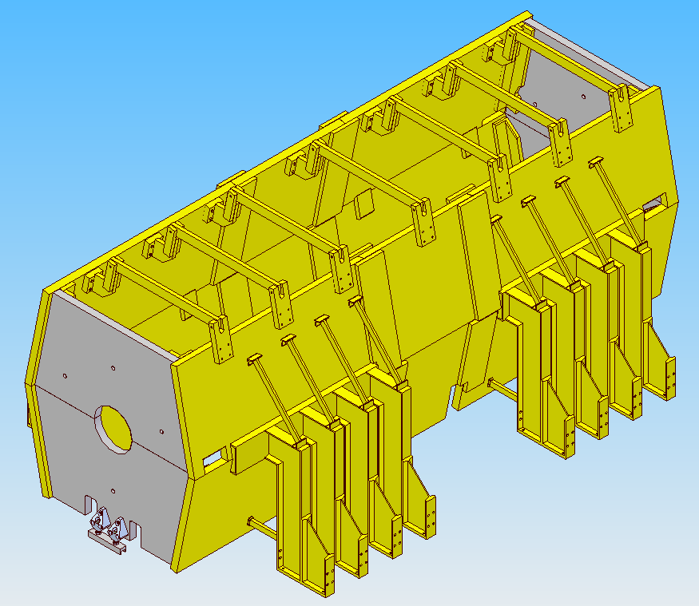
Present Status
Simplified end-plates
Reduced number of more compact legs now with symmetry S-N
6 Piece Design with central access to AFC for absorber changes
Courtesy of J. Tarrant / S. Plate

Slide 16
Absorber Change
Procedure in place (J. Tarrant)

Slide 17
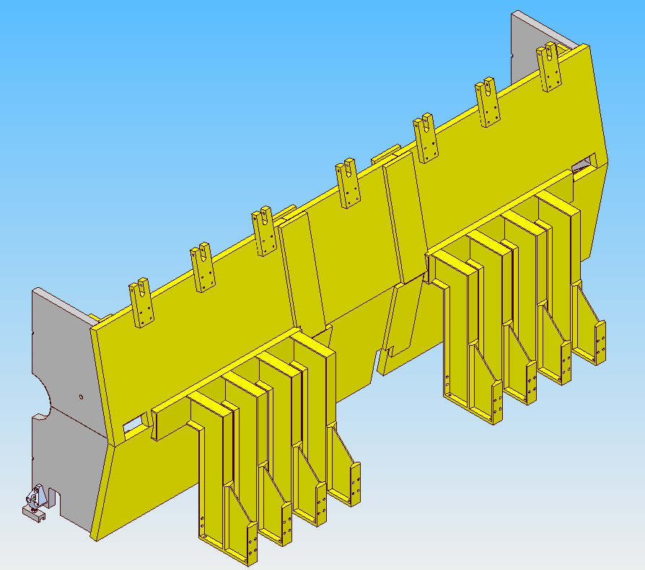
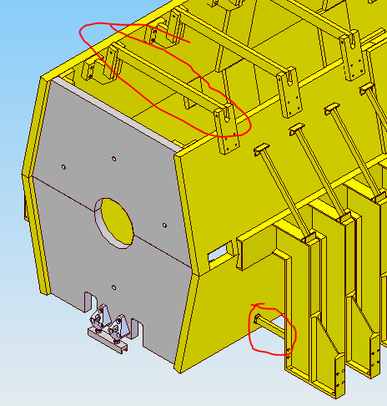
Forces
NO CAPACITY FOR SIGNIFICANT MAGNETIC LOAD IN FLOOR FIXING: Cross-bars, leg ties & link plates will take magnetic loads
~25 tonnes (self weight)
30 kN
Load trying to overturn PRY half
Floor Fixing
Compressive load
Tensile load

Slide 18
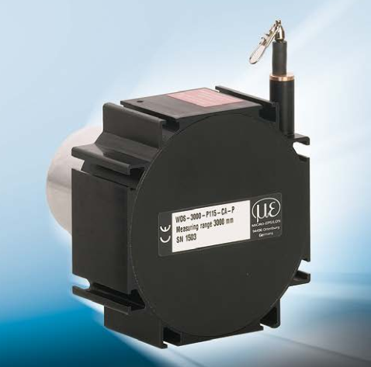
Force Scenarios
Nominal cases
200/240 MeV flip/solenoid mode
Commissioning
Single spectrometer powered
Both spectrometers powered
AFC powered
Worst case analysis
Increased forces by factor 5
Still very safe
Monitoring: draw-wire sensor
WDS-3000-P115-CA-P

Slide 19
Materials

Slide 20
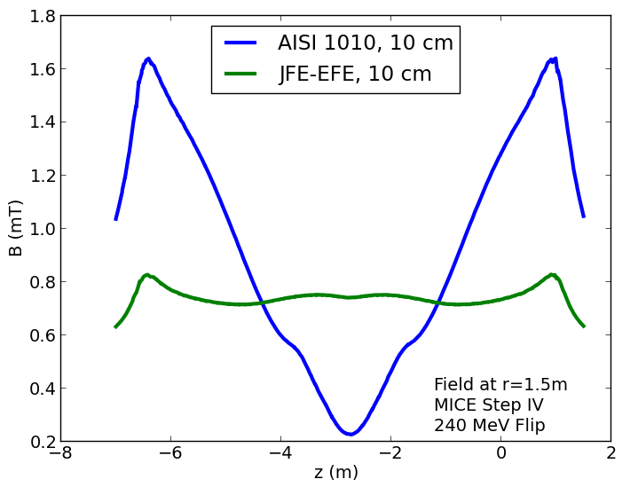
Material
Fiber Tracker
Readout location

Slide 21
Timeline
Production Readiness Review (PRR) for PRY Monday 28th April
Green light to proceed
Steel procurement: order placed May 5th
Framework and steel machining
RFQ: online May 14th (due June 5th)
Expect quotes from four vendors
Targeted award date: June 9th/16th
South Wall complete October, 2014
North Wall complete December, 2014

Slide 22
Summary
Performance
Reduces stray field to 5—10 Gauss (No shield: 300—600 Gauss = factor 50+)
Effect on beam: no issue
Engineering
Finished
Timeline
Procurement ongoing

Slide 23
Additional Slides

Slide 24
240 MeV Solenoid/Flip Mode

