Slide 1
Rapid Cycling Dipole Magnet

Slide 2
Overview
RCS Dipole Design
Materials
Losses
Performance
Engineering
Why do it this way?

Slide 3
Magnet Geometry
Good field region
Horizontal: 60 mm
Vertical: 10 mm
Aperture: 60x25 mm²
Geometry
Allows to use two different materials
Combine advantages of materials
Pole: 3% SiFe (FeCo)
Yoke: 6.5% SiFe
645 mm
463 mm
3% SiFe
6.5% SiFe
Coil
Gap: 25 mm
Pole width: 120 mm

Slide 4
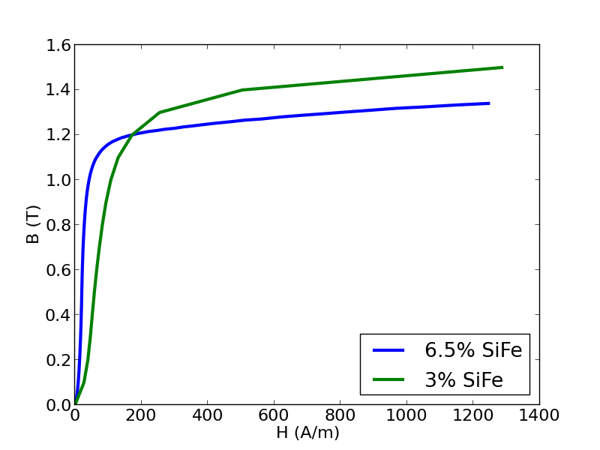
Materials
6.5% SiFe
Low losses at high frequencies
High permeability
Low saturation
3% SiFe
Higher saturation
Higher losses
J. Degauque and F. Fiorillo. Alliages magnétiques doux enrichis en silicium. Matériaux magnétiques en génie électrique 1, A. Kedous-Lebouc (ed.), Lavoisier, Chapter 4, pp. 227-286, 2006.

Slide 5
Losses – Frequency Effects
Loss mechanisms
Hysteresis + eddy current losses
Anomalous loss
Effect of frequency
All losses increase…
(includes Hysteresis)
Deformation of hysteresis loop
Need measured data
Core loss data available
From: Energy Savings with Thin Gage. Steve Constantinides, Arnold Technologies, 2009.

Slide 6
Materials - Core Losses

Slide 7
Coil
Eddy current losses
Conductor shape
Conductor geometry
Copper sheets
80 mm wide, 1 mm thick
Insulation: 25 μm thick
Coil position
Field leakage from yoke
Optimized to minimize dB/dt
Losses: evaluated using FEA
750 kW for all dipoles in ring (1.5T, 2.2 km length)
1 kHz pulse, 15 pulses per second
Cu sheet
Kapton
?

Slide 8
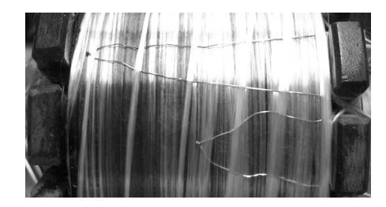
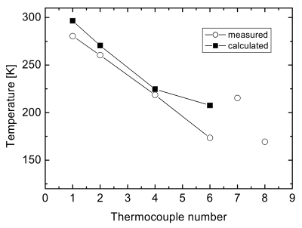
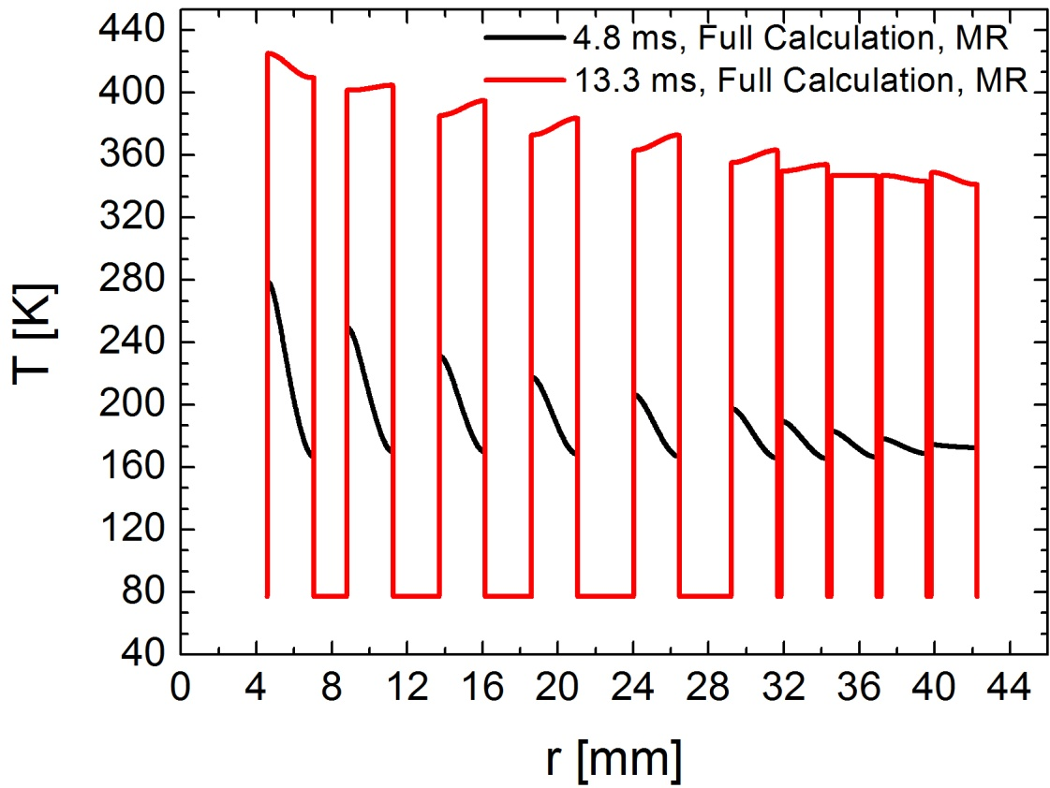
FEA: Eddy Current Simulation
Technique developed ~10a ago
Pulsed high field magnets (60-100T)
Normal conducting solenoids
10 ms pulse
Operate at 77K
DOI:10.1109/TASC.2005.864485
Verified experimentally
Herlach et al. DOI:10.1109/TASC.2005.864269

Slide 9
Total Power Loss

Slide 10
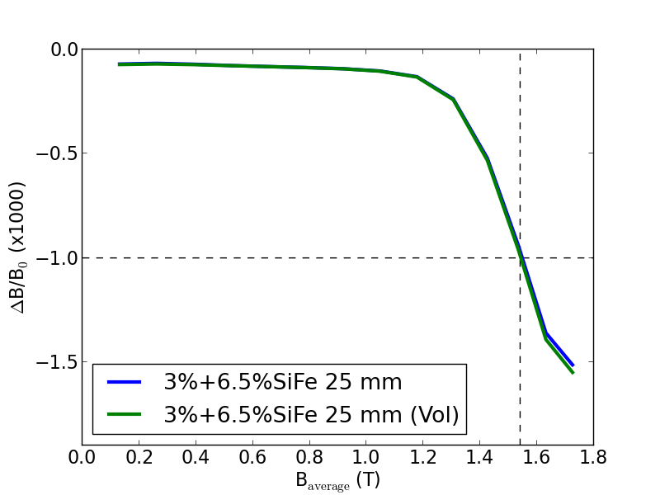
Field Quality
Dipole field: 1.53T
Gap: 25 mm

Slide 11
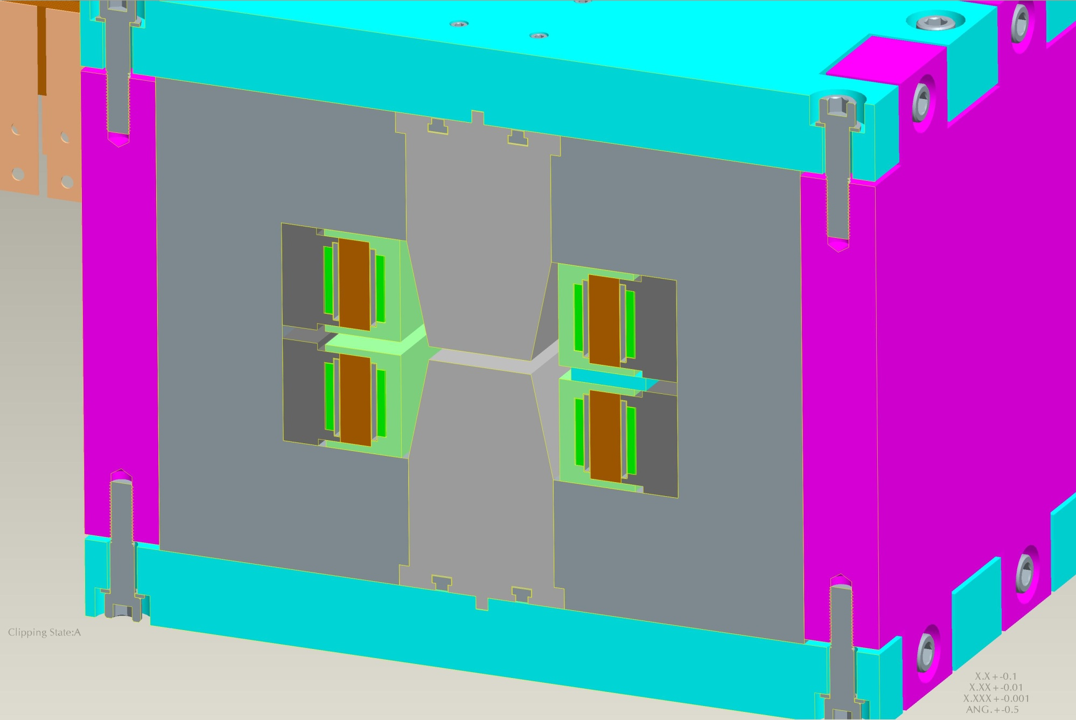
Engineering
I_{max}=15 kA
W = 3.65 kJ/m
240 kN
Courtesy of Paul Kovach
BNL Magnet Division

Slide 12
Cooling Excitation Coil
Coil
350 W/m in total (1.5T)
Cooling: outer faces
q < 0.1 l/s
Finite element simulations
Temperature gradient: <1K

Slide 13
Cooling Yoke
Total average power dissipation: 820 W/m
80 W/kg
20 W/kg
6.5%SiFe
3%SiFe

Slide 14
Heating Core
Worst case: all heating in pole
ΔT<8K
q < 0.3 l/s

Slide 15
Yoke 3% SiFe?
80%
80%
How much worse is a yoke made of 3% SiFe?

Slide 16
Power Loss
1 MW
30% difference
(yoke)

Slide 17
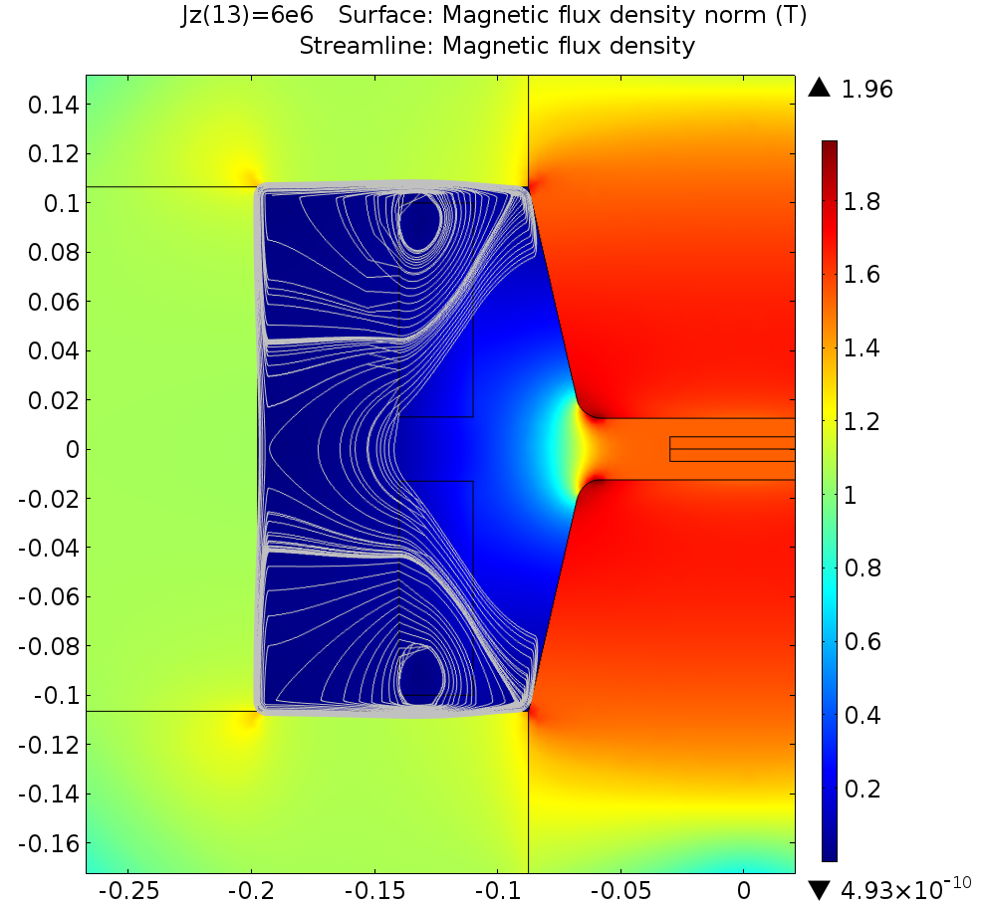
Comparison SiFe

Slide 18
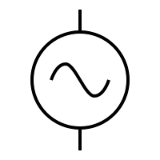
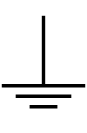
Power Supply
Required: 8m long dipoles
Challenge: voltage
Minimize inductance: 4 PS per dipole
Magnetic energy: 3.65kJ/m
AC voltage: 650 V/m (assuming 15 kA PS)

Slide 19
Superconducting Option
Wall plug power superconducting version?
How good does a SC dipole have to be?
Break even for SC version: 1.3W/m
Normal conducting loss: 800 kW (2.2 km)
P_{300K} = 360 W/m
P_{4K}: 1.3W/m (Carnot efficiency 280)
Additional heat losses
Power leads: P_{4K} = 3-5 W (20 kA lead, CERN/NHMFL)
Power loss conductor

Slide 20
Conclusion
Concept of dipole magnet
Combines strength of two materials
Performance
Good field quality up to 1.5T
Power losses
Acceptable losses at 1000Hz (1.5T: 2.75 MW for ring)
Engineering concept
External clamp to deal with forces
Cooling seems manageable

Slide 21
Acknowledgements
The authors would like to acknowledge fruitful discussion and support from
Carsten Bach, Vacuumschmelze
Hironori Ninomiya, JFE Steel Corporation
Rob Riley, Fermilab
Don Summers, University of Mississippi
John Zweibohmer, Fermilab

Slide 22
Additional Slides

Slide 23
Multipole Components
3D Finite Element Simulation
Time-harmonic
Evaluated for 1.5/0.75T
Table: normalized multipole components
Field quality not affected by eddy currents
N | 1 Hz | 50Hz | 400Hz
1 | 10000 | 10000 | 10000
2 | 0.00000 | 0.00000 | 0.00000
3 | -0.00021 | -0.00021 | -0.00021
4 | 0.00000 | 0.00000 | 0.00000
5 | 0.00000 | 0.00000 | 0.00000

Slide 24
Activation
Muons decay into electrons
Showers can produce neutrons that activate cobalt
Half-life ⁶⁰Co: 5.27 a
⁶⁰Co→ ⁶⁰Ni+e⁻+ν+γ
γ: 1.17/1.33 MeV
Decays occur in the midplane, avoid pole
Need simulations to determine activation
Need to design shielding to minimize activation
Determine whether residual activation is operationally tolerable

Slide 25
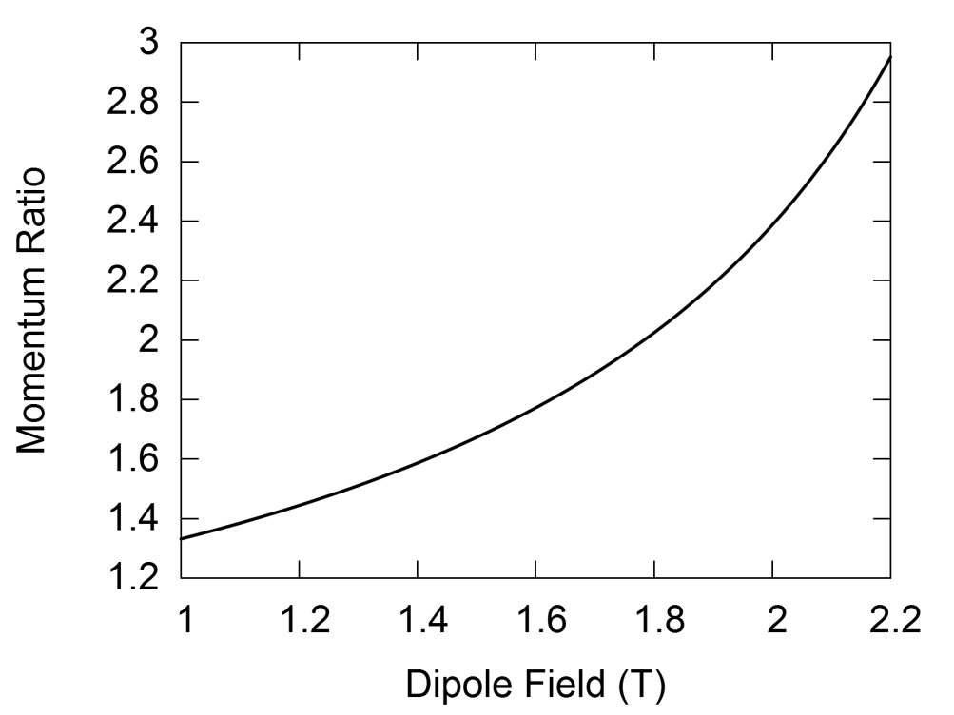
Rapid Cycling Synchrotron
Final acceleration Muon Collider: RCS
Interleaved cold and warm dipoles
Warm dipoles: correct average bend field
must change rapidly (>400 Hz)
Maximum warm dipole field: significant impact
Larger energy range
Higher maximum energy
Shorter circumference
Fewer accelerator stages

