Slide 1
Lepton Colliders for the Next Generation of High Energy Physics Experiments
Mark Palmer
Cornell LEPP Journal Club
March 7, 2014

Slide 2

Outline
Snowmass 2013 on the Mississippi
Introduction
Lepton and Photon Collider Options
from the CSS2013 Frontier Capabilities:
Energy Frontier Lepton & Gamma Colliders Sub-Group
  Circular e⁺e⁻
  ILC
  Other LC Concepts
  γ−γ Colliders
  μ⁺μ⁻ Collider
  And some comparisons
A Few Words About the Muon Accelerator Program (MAP)
Closing Comments

Slide 3
Introduction
The Working Group and Inputs
The Working Group Assessments
Comments on Making Comparisons

Slide 4
Frontier Capabilities: Lepton Colliders
Accelerator Capabilities Convener: Bill Barletta (MIT)
http://www-public.slac.stanford.edu/snowmass2013/SnowmassWorkingGroupReports.html
Lepton Colliders Sub-Group:
    Sub-conveners: Marco Battaglia (UCSC), Markus Klute (MIT), Kaoru Yokoya (KEK), & myself
    EF Liaison: Tor Raubenheimer (SLAC)
    Sub-Group Meeting at MIT:
    https://indico.cern.ch/conferenceDisplay.py?ovw=True&confId=233944
Submissions covered a broad range of capabilities and possibilities a many contributors to what follows

Slide 5
Working Group Assessment
The goal of the working group was to:
  Summarize the capabilities that can support the physics needs of Energy Frontier
  Evaluate the major technical challenges and cost drivers
  Identify the R&D path required to develop the necessary capabilities
It should be noted that:
  All of the options have some technical challenges
  None of the options under consideration is cheap
  But, there are real options with contrasting strengths and weaknesses (as well as varying states of readiness)
  a which makes the process of charting an optimal route forward challenging when we are discussing timescales of decades

Slide 6
Comment on Concept Maturity
It should also be noted that the concepts described here span a broad range of maturity
  R&D concepts requiring significant validation
  Full technical designs where performance has been explicitly sacrificed in order to achieve something that can be built
    And to fit within a specific budget profile
  Design extrapolations
    Based on well-understood individual technologies in many cases
    Where the detailed design studies are just ramping up
    a hence, not yet validated in full detail
Thus capabilities comparisons are non-trivial at this level
  Attention should be paid to “strategic” (ie, physics) benefits
  Audience should ask pointed questions about how realistic any individual plan is

Slide 7
Lepton & Photon Colliders
  e⁺e⁻ Circular Colliders:
  >100 GeV Scale
  Linear Colliders:
    e⁺e⁻ Colliders with
    E < 1 TeV & E1> 1 TeV
    γ-γ Colliders
  μ⁺μ⁻ Colliders: Up to 10 TeV

Slide 8
e⁺e⁻ Circular Colliders
Comments
LEP2 nearly reached the Higgs
Technical Issues
Synchrotron Radiation:
Trends in the Discussion
Re-use of the LEP tunnel (conflict w/LHC) as well as various site-filler options initially discussed
Rings are robust and well-understood technology
RF Efficiency
Energy Bandwidth
Takes a longer term view
Limits SR issues
Collective Effects
Beam Lifetime (~10³ sec) and Top-Up Injection
Current focus: 80-100km ring leading to a
100 TeV scale hadron collider (VHE-LHC/VLHC)
CERN and Chinese Inititatives

Slide 9
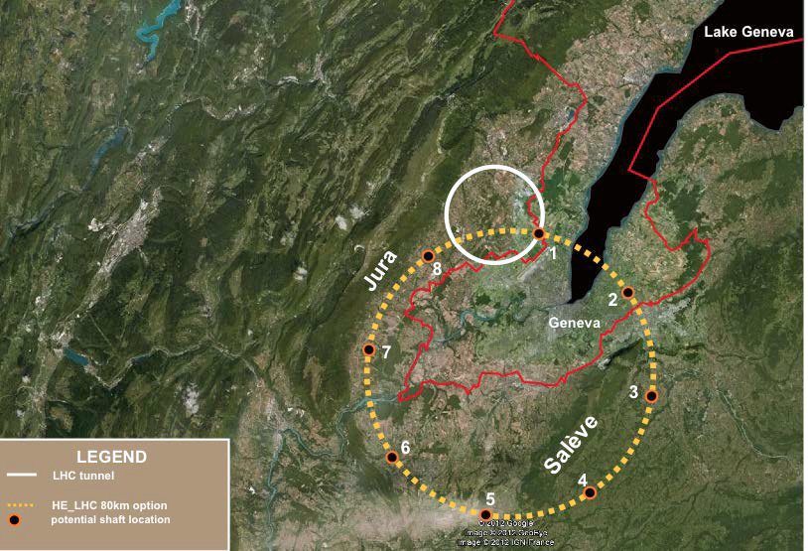
The TLEP Concept
350 GeV C.M. e⁺e⁻
a 100 TeV pp
J. Osborne, C. Waaijer

Slide 10
Electron-Positron Storage Rings:
Parameters for Selected Options
 | LEP2 | TLEP* – HZ | TLEP* - t | FNAL** - HZ
Beam Energy [GeV] | 104.5 | 120 | 175 | 120
Circumference [km] | 26.7 | 80 | 80 | 100
Beam current [mA] | 4 | 24.3 | 5.4 | 12.9
Number of bunches | 4 | 80 | 12 | 34
Bunch population [10¹²] | 0.575 | 40.8 | 9.0 | 0.79
Horizontal emittance [nm] | 48 | 9.4 | 10 | 16
Vertical emittance [nm] | 0.25 | 0.02 | 0.01 | 0.08
β_{x}* [mm] | 1500 | 500 | 1000 | 200
β_{y}* [mm] | 50 | 1 | 1 | 2
Hourglass factor | 0.98 | 0.75 | 0.65 | 0.81
SR power/beam [MW] | 11 | 50 | 50 | 20
Bunch length [mm] | 16 | 1.7 | 2.5 | 3.2
Momentum acceptance [%] | 1.25 | 2.5 | 2.5 | 3.0
Beam-beam parameter / IP | 0.07 | 0.1 | 0.1 | 0.1
Luminosity / IP [10³⁴ cm⁻²s⁻¹] | 0.0125 | 4.8 | 1.3 | 1.8
* Assumes 4 IPs ** Assumes 1 or 2 IPs

Slide 11
e⁺e⁻ Circular Colliders
Status
FCC Design Study now underway
Includes 100 TeV pp goal and TLEP as an intermediate step
R&D
Focus on detailed technical assessments
Challenges, but no obvious showstoppers
Time
TLEP: Conceptual Design Report by 2015
TLEP: Technical Design Report by 2018
TLEP: Aiming for construction readiness in 2020’s
Technical Statement

Slide 12
Linear Colliders
Luminosity
The strong fields at the interaction point result in
  A luminosity enhancement characterized by the disruption parameter
  Beamstrahlung emission gives rise to energy spread and backgrounds at the interaction point

Slide 13
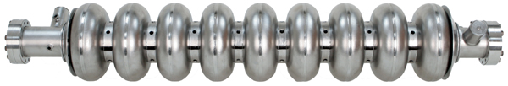
Linear Collider Options
A range of options have been explored
  ILC: Based on SRF technology
  Most mature concept for E_{CM}<1 TeV
  CLIC: Based on drive-beam and NCRF technology
  RF Gradients: 100 MV/m
  Could be applied for E_{CM}<1 TeV
  Designs up to 3 TeV are documented
Yield ’10 ~ ’12:
> 90% @ 25 MV/m
~ 80% @ 28 MV/m
~ 70% @ 35 MV/m

Slide 14
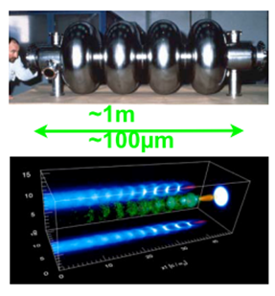
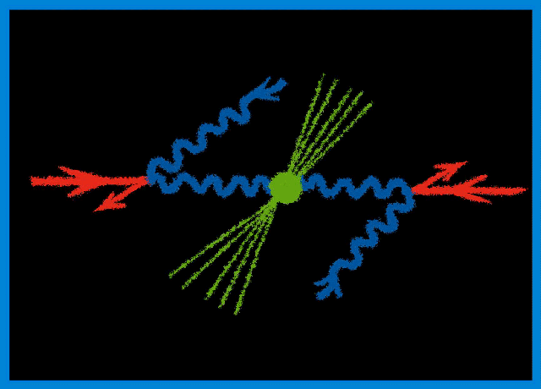
Linear Collider Options
Options (cont’d)
  Wakefield Accelerators:
  Potential for very high energies
  Possibly could be used for LC
  afterburner
  Significant R&D remains
  γ−γ: High power laser beams
  Compton backscattered from
  e⁻ or e⁺ beams
    γγaH cross section ~200fb
    Concept could be applied at an
    ILC or CLIC

Slide 15
M. Ross

Slide 16
A factor of
2.5 in L/P_{wall}
M. Ross

Slide 17
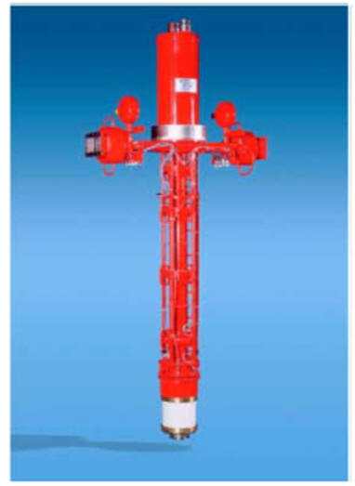
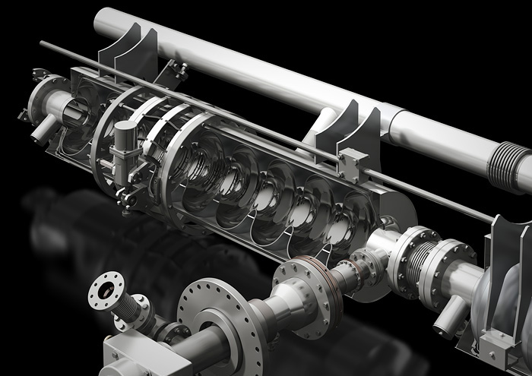
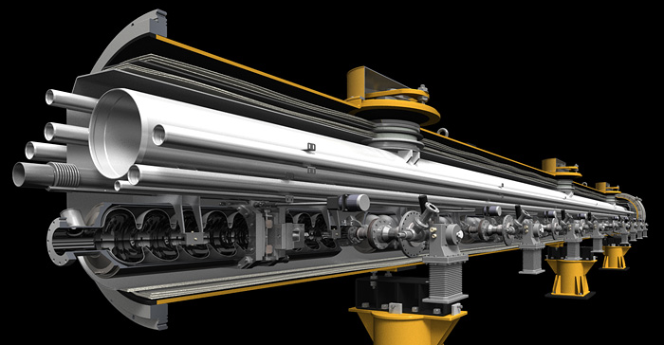
ILC SCRF Technology
M. Ross
10 MW MB Klystron
Graphics by Rey. Hori
17
Cornell University: LEPP Journal Club
March 7, 2014

Slide 18
M. Ross

Slide 19
Japanese Siting
M. Ross

Slide 20
ILC Parameters
Centre-of-mass energy | E_{cm} | GeV | 250 | 350 | 500 |  | 1000
Beam energy | E_{beam} | GeV | 125 | 175 | 250 |  | 500
Estimated AC power | P_{AC} | MW | 128 | 142 | 162 |  | 300
Collision rate | f_{rep} | Hz | 5 | 5 | 5 |  | 4
Electron linac rate | f_{linac} | Hz | 10 | 5 | 5 |  | 4
Number of bunches | n_{b} |  | 1312 | 1312 | 1312 |  | 2450
Bunch separation | Dt_{b} | ns | 554 | 554 | 554 |  | 366
Pulse current | I_{beam} | mA | 5.8 | 5.8 | 5.79 |  | 7.6
RMS bunch length | σ_{z} | mm | 0.3 | 0.3 | 0.3 |  | 0.250
Electron polarisation | P₋ | % | 80 | 80 | 80 |  | 80
Positron polarisation | P₊ | % | 30 | 30 | 30 |  | 20
Luminosity (inc. waist shift) | L | ×10³⁴ cm⁻²s⁻¹ | 0.75 | 1.0 | 1.8 |  | 3.6
Fraction of luminosity in top 1% | L_{0.01}/L |  | 87.1% | 77.4% | 58.3% |  | 59.2%

Slide 21
The ILC
Status
Technical Design Report now complete
Decision point on moving forward has been reached
R&D
Most significant R&D issues addressed during ILC Technical Design Phase [SRF cavity R&D, including industrialization; FLASH beam tests; damping ring studies, CESRTA; damping ring and beam delivery system studies at KEK-ATF]
Time
Some technical challenges remain (eg, complete ATF2 program), but no obvious showstoppers
Timescale contingent on decision process and international support
Team ready to move forward with detailed engineering and site-specific design
Japanese government formally evaluating whether to launch a project

Slide 22
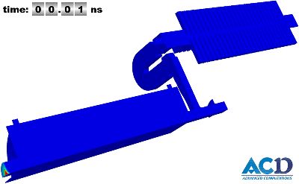
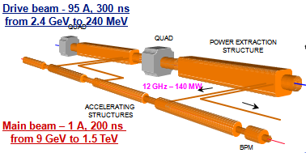
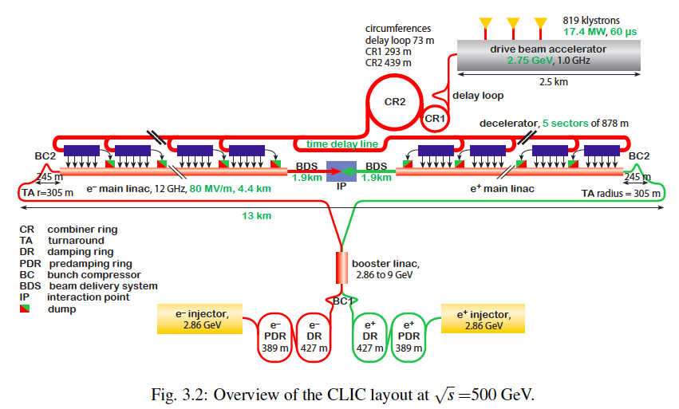
CLIC layout at 500 GeV

Slide 23
Potential Staged CLIC Parameters

Slide 24
Linear Colliders with E > 1 TeV
ILC is ~ 50 km at 1 TeV
    Possible to consider higher gradient SCRF materials or PWFA boost
CLIC design is aimed at upgradable design → 0.5-3 TeV
    Geographic gradient of 4x higher than ILC
Advanced acceleration options (plasma, dielectric)
    Plasma acceleration has made great progress however still huge challenges in beam quality and stability
    Extremely low charge dielectric-laser accelerators may provide only reasonable parameters in multi-TeV regime
    None of AARD options are close to being ready
Some plasma and dielectric options act as transformers taking high power beams → high energy beams
    Possible to develop upgrade options for ILC-like technology?

Slide 25
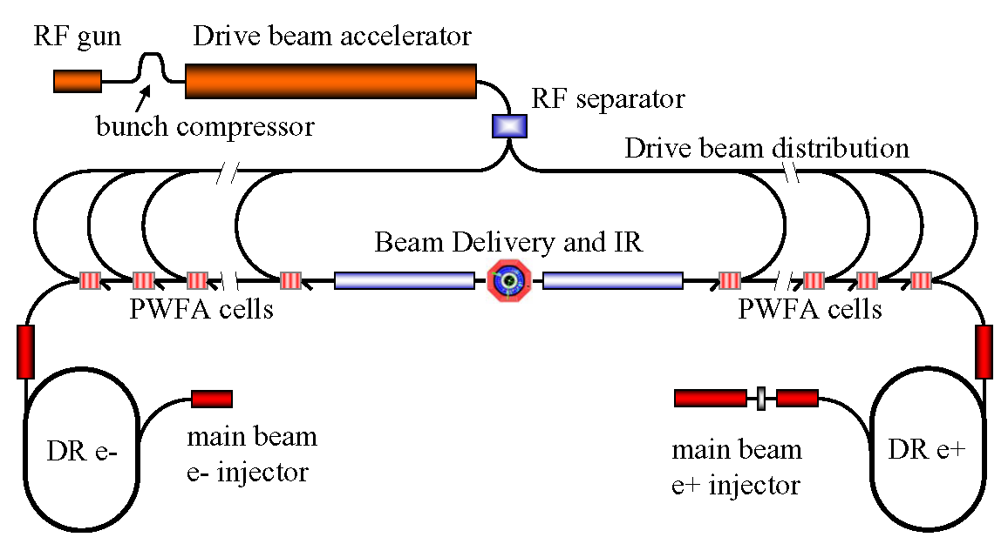
Concept of Beam-Driven Plasma Linac
Concept for a 1 TeV plasma wakefield-based linear collider
  Use conventional Linear Collider concepts for main beam and drive beam generation and focusing and PWFA for acceleration
    Makes good use of PWFA R&D and 30 years of conventional rf R&D
  Concept illustrates
  focus of PWFA
  R&D program
    High efficiency
    Emittance
    preservation
    Positrons
  Allows study
  of cost-scales
  for further
  optimization of R&D

Slide 26
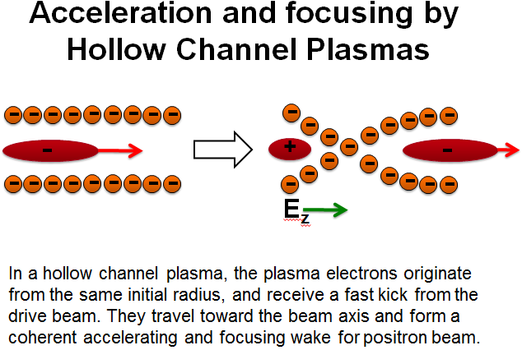
Challenges for Positron
Plasma Wakefield Acceleration
M. Hogan
Positron Witness Bunch
Electron Drive Bunch
+
+
+
+
+
+
Positive Ion Background
-
-
-
-
-
-
-
+
+
+
+
+
+
-
-
-
-
-
-
-
+
+
+
+
+
+
+
+
+
+
+
+
+
+
Accelerating and Defocusing
Field for Positrons
Decelerating and Focusing
Field for Electrons

Slide 27
Possible Linear Collider Parameters
ILC and CLIC parameters from design reports; 10 TeV DBA scaled from Wei Gai
communication; 10 TeV DLA and Plasma Accelerator from 2010 ICUIL/ICFA Workshop

Slide 28
CLIC and Wakefield LCs
Status
CLIC Conceptual Design Report complete
Wakefield Accelerator Concepts – Feasibility being assessed
R&D
CLIC: Focus on technology and advanced systems R&D
Time
Wakefield Accelerators:
CLIC: Timescale dependent on finalized technical design and physics needs
Ability to accelerate positrons
Demonstration of multi-stage acceleration
Understanding the extrapolation of all parameters to the regimes required for HEP accelerator use (emittance preservation, achievable energy spread, beam loading, repetition rate)
Wakefield LCs:
Expect non-HEP applications on the ~decade timescale
Collider R&D phase to fully assess feasibility is likely decades scale
First application might be an ILC “afterburner”

Slide 29
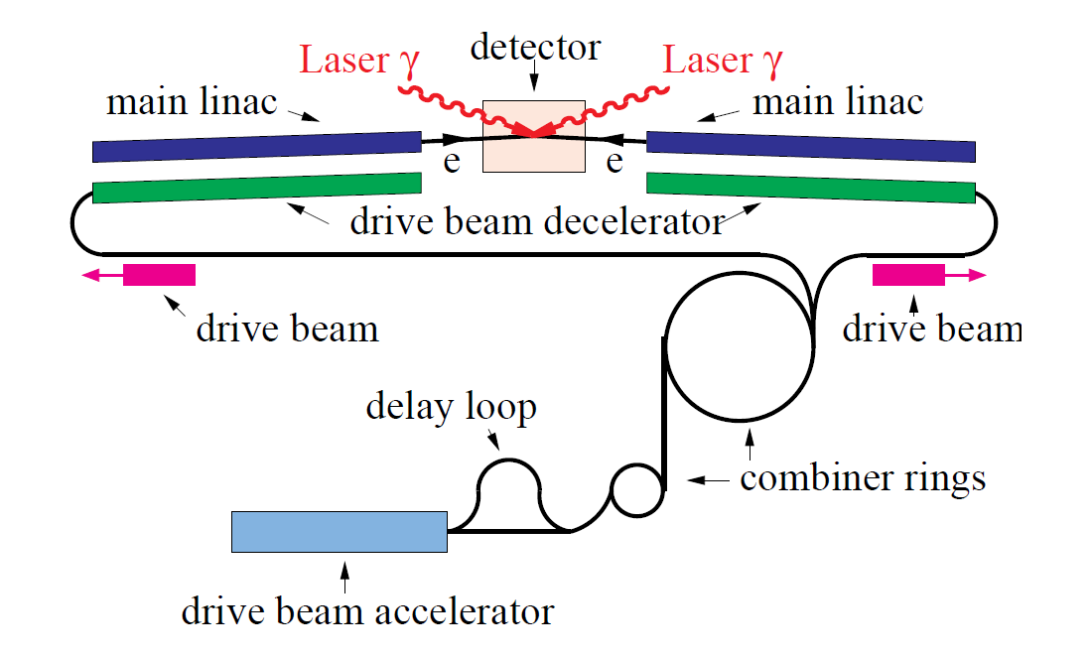
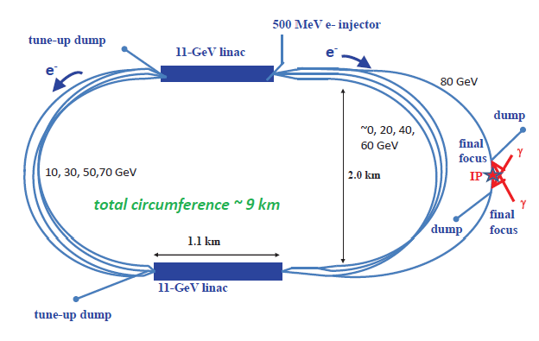
γ−γ Collider Concepts
CLICHÉ: CLIC Higgs Experiment
γ−γ Higgs Factory (E_{CM}~160 GeV, photons carry ~80% of CM E) might represent a `low cost’ option to demonstrate the technology
Relative to LC: No positrons, damping rings, bunch compressors,…
Laser parameters are challenging; requires optical cavity schemes
 | SAPPHiRE
Beam Energy | 80 GeV
Power Consumption | 100 MW
Polarization | 80%
Ave Beam Current | 0.32 mA
E-e- geometric luminosity | 2.2x10^34
Laser wavelength | 351 nm
Repetition rate | 200 kHz
Laser pulse energy | ~5 J

Slide 30
γ−γ Colliders
Status
Principal technical challenge is laser system
R&D
Would need to establish a full Technical Design
Time
In principle, a decision point could be reached in a few years
Validate feasibility of required laser – significant recent progress
Question: Would the community be interested in a standalone facility versus eventual companion capability with an e⁺e⁻ LC? Can this provide the required physics?

Slide 31
Muon Accelerator Concepts
Major Challenges

Slide 32
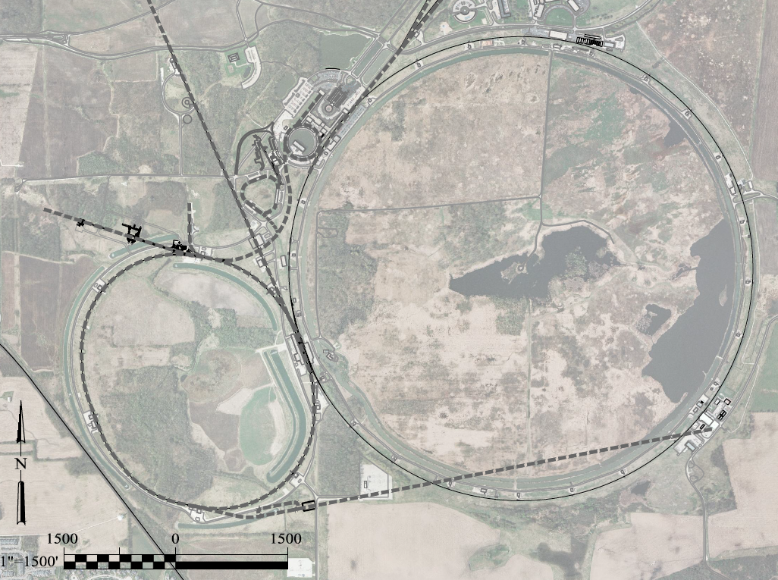
A Potential Muon Accelerator Complex at Fermilab:
νSTORM ➔ NuMAX
➔ Higgs Factory
1 GeV Proton
Linac
LBNE
Superbeam
Accumulator
&
Compressor
Rings
Front
End
1-3 GeV Proton
Linac
Remains fully compatible with the PIP-II staging option
To
SURF
Target
Final
Cool
NuMAX:
νs to SURF
6D
Cool
Initial
Cool
1 GeV Muon
Linac (325MHz)
RLA to 63 GeV
To Near Detector(s) for
Short Baseline
Studies
3-7 GeV Proton &
1-5 GeV Muon
Linac(s)
300m Higgs Factory
Muon Collider
Muon Beam
R&D Facility
νSTORM
A 6 TeV Muon Collider would have a similar circumference as the Tevatron Ring
ft
ft

Slide 33
A Potential Muon Accelerator Complex at Fermilab:
➔ Multi-TeV Collider
A TeV-Scale
Accelerator
System
SC Linac

Slide 34
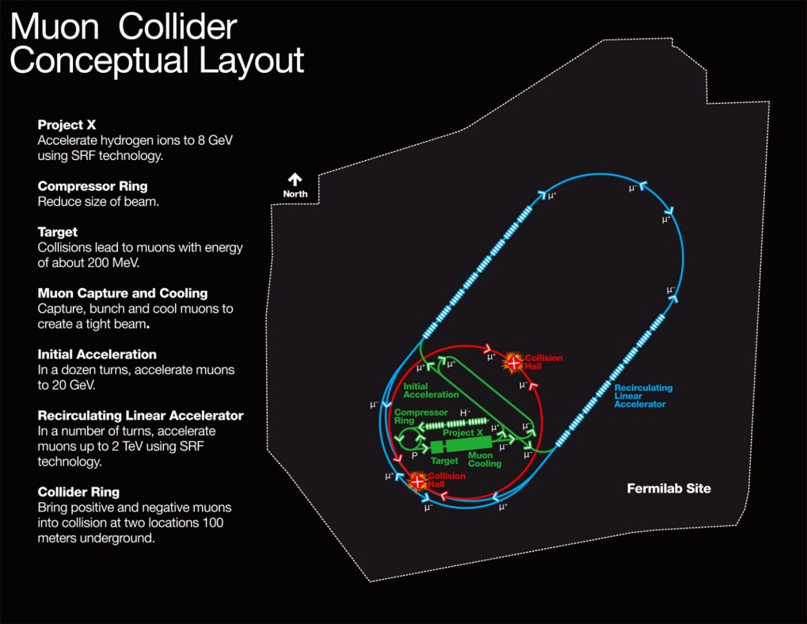
MAP Designs for a Muon-Based Higgs Factory and Energy Frontier Colliders
Range of Top Params:
δE/E ~ 0.01 - 0.1%
L_{avg} ~ 0.7 - 6 × 10³³
Exquisite Energy
Resolution
Allows Direct
Measurement
of Higgs Width
Site Radiation mitigation with depth and lattice design: ≤ 10 TeV
Success of advanced cooling
concepts a several × 10³²

Slide 35
Muon Colliders
Status
MAP Feasibility Assessment underway
R&D
Establishing Initial Baseline Design
Muon Ionization Cooling Experiment (MICE) at RAL
Time
Feasibility Assessment by end of decade
Staging Study: Physics + R&D + Demos required for next stage
Technology R&D: Cooling channel hardware, RF in B-fields, high field magnets (synergistic with high energy pp collider needs)
Completion of MICE by end of decade
NuMAX (initial long baseline NF): Informed Decision by ~2020
Collider Program: Informed Decision by mid-2020s
nuSTORM short baseline NF could begin CD process immediately (Sterile neutrino program)

Slide 36
Connections
Long-Term Perspective
Conclusions

Slide 37
Some Connections…
A theme in the capabilities discussions was that of upgrade paths
  Note that a number of “constrained” options didn’t even get mentioned in this presentation
There are many special synergies that also come into play:
  TLEP and a ~100 TeV hadron collider
  Muon Collider and the Neutrino Program
  Technology linkages (eg, MAP and high energy pp collider magnet development)
  γ−γ as a companion capability to an LC
  A wakefield accelerator upgrade to a conventional LC
  And this is not an exhaustive list…

Slide 38
Some Thoughts and Comparisons…
The LHC program for the next 20 years is well-defined
  Questions arise as to what comes next
    For example: Is an investment in a facility such as TLEP desirable on the 10 year timescale because it can lead to a VHE-LHC/VLHC capability in ~30 years?
There is little question that the ILC design is, at present, the most complete and well-studied design for a machine targeted at the Higgs
  But, what will we do if the next round of LHC data finally shows something at > 1 TeV?
  On the relevant timescale (assuming advances in the R&D program), we may want to consider comparisons such as the plot on the next page…

Slide 39
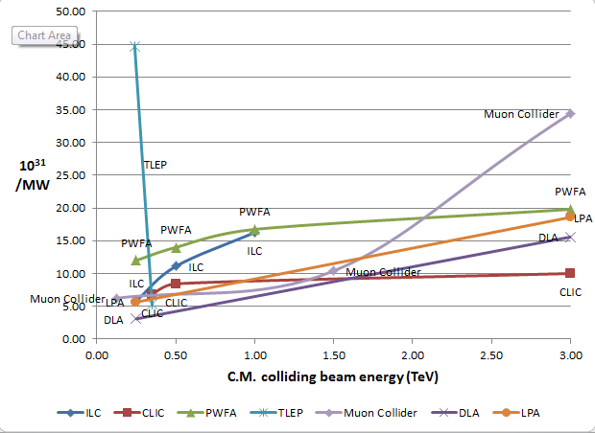
J-P. Delahaye
Luminosity
Metric:
N_{det} × L_{avg} / P_{tot}
What is the comparison between
TLEP with 2 IPs and ILC 250 at
full power?

Slide 40
A Few words on the Muon accelerator program (MAP)

Slide 41
Program Mission
The mission of the Muon Accelerator Program (MAP) is to develop and demonstrate the concepts and critical technologies required to produce, capture, condition, accelerate, and store intense beams of muons for Muon Colliders and Neutrino Factories. The goal of MAP is to deliver results that will permit the high-energy physics community to make an informed choice of the optimal path to a high-energy lepton collider and/or a next-generation neutrino beam facility. Coordination with the parallel Muon Collider Physics and Detector Study and with the International Design Study of a Neutrino Factory will ensure MAP responsiveness to physics requirements.
How we are executing this mission?
  By supporting the development of muon accelerator technologies for the full range of capabilities described:
  Short baseline neutrino factory:
    nuSTORM design, costing and proposal –
    a design for which no new technology requirements exist
  Long baseline neutrino factory:
    IDS-NF design – aimed at optimal physics reach
    Staged complex at Fermilab –
    aimed at a realistic (ie, staged) deployment of NF capabilities a NuMAX concept
      Starting with a 1 MW proton driver and no ionization cooling…
  Collider options:
    From a Higgs Factory to…
    A multi-TeV Collider (extending up to energy ranges that may be required by LHC results)
    Again utilizing a staged complex at Fermilab…

Slide 42
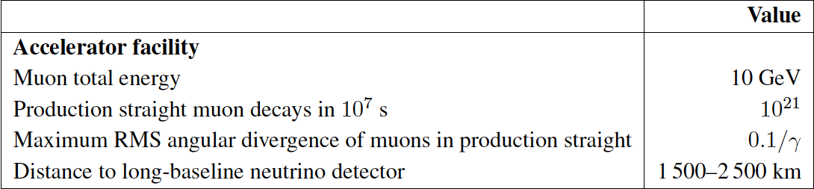
Long Baseline Neutrino Factory
IDS-NF
NuMAX aims for a staged facility at Fermilab with different technical and cost optimization

Slide 43
A Staged Plan with NuMAX at Fermilab
NuMAX+ targets equivalent sensitivity to CP violation in the ν sector as has been achieved in the flavor sector
GLoBES Comparison of Potential
Performance of the Various
Advanced Concepts (courtesy P. Huber)

Slide 44
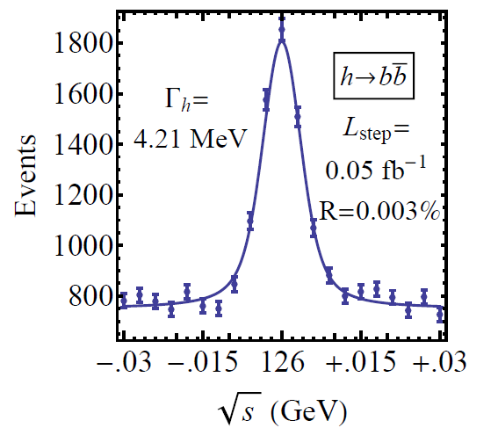
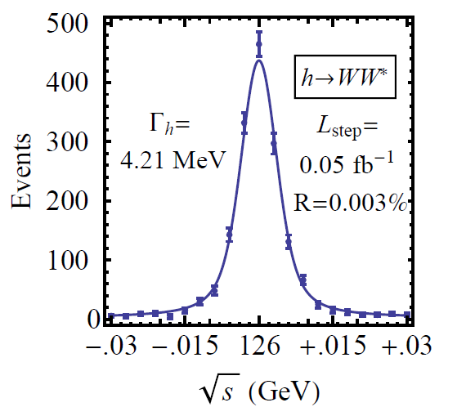

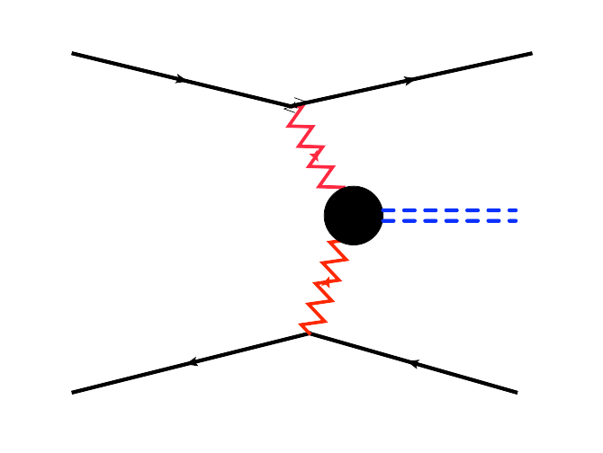
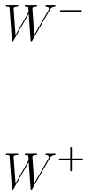


Physics Case for a Muon Collider
Superb Energy Resolution
  SM Thresholds and Higgs Factory operation
At multi-TeV
  Compact & energy efficient machine
  Luminosity > 10³⁴ cm⁻² s⁻¹
  Option for 2 detectors in the ring
  For √s > 1 TeV: Fusion processes dominate
  a an Electroweak Boson Collider
  a a discovery machine complementary to a
  pp collider with E_{pp}≈7E_{MC}
At > 5 TeV CoM, could provide Higgs
self-coupling resolutions of <10%
What if upcoming runs with the LHC shows
evidence for a multi-TeV particle spectrum?

Slide 45
Luminosity Production Metric
Muon
Collider
Luminosity
Metric:
N_{det} × L_{avg} / P_{tot}

Slide 46
MAP Timeline a Provide Informed Decision Points
 | 2010 |  | ~2020 |  | ~2030
Muon Accelerator R&D Phase
Proton Improvement Plan @ FNAL
Intensity Frontier
Energy Frontier
MAP Feasibility Assessment
Advanced Systems R&D
Indicates a date when an informed decision should be possible
Muon Ionization Cooling Experiment (MICE)
PIP-II
And Further Proton Source Improvements
IDS-NF RDR
Proposed Muon Storage Ring Facility (νSTORM)
Option for Long Baseline ν Factory (NuMAX)
Collider Conceptual ➔ Technical Design
Option for μ Collider

Slide 47
R&D Effort
Scope – Note that MAP is constituted as a
directed Accelerator Technology R&D Effort
to demonstrate feasibility
  Provide:
    Specifications for all required technologies
    Baseline design concepts for each accelerator system (see block diagram to follow)
  For novel technologies:
    Carry out the necessary design effort and R&D to assess feasibility
    Note: a program of advanced systems R&D is anticipated after completion of the feasibility assessment
  Ongoing Technology R&D and feasibility demonstrations include:
    MuCool Test Area experimental program (FNAL): RF in high magnetic fields
    The Muon Ionization Cooling Experiment (MICE@RAL):
      Demonstration of emittance reduction
      Validation of cooling channel codes
    Advanced magnet R&D
      Very high field magnets (cooling channel and storage rings)
      Rapid cycling magnets for acceleration of short-lived beams

Slide 48
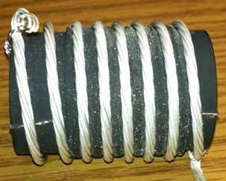
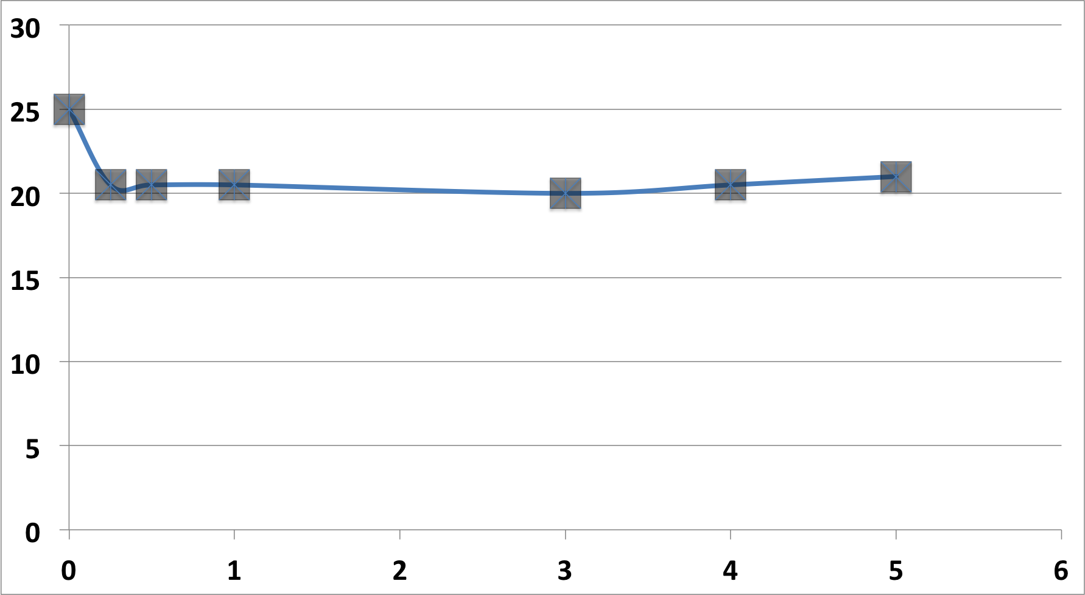
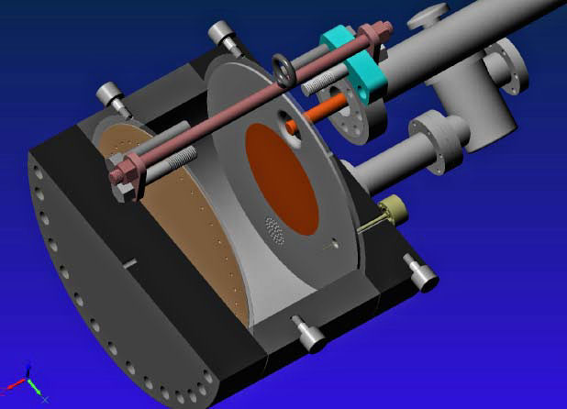
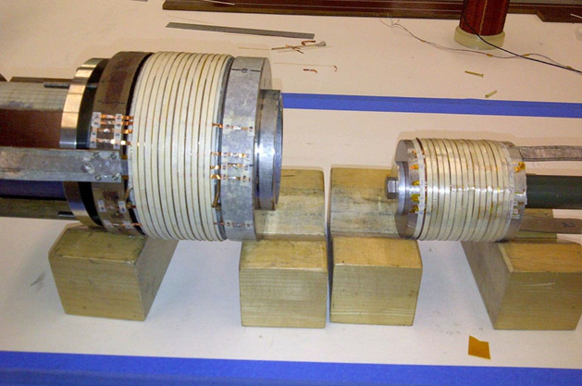
Cooling Channel R&D Effort
>20MV/m operation
in up to 5 T B-field
Successful Operation of 805 MHz “All Seasons” Cavity in 5T Magnetic Field under Vacuum
MuCool Test Area/Muons Inc
World Record
HTS-only Coil
15T on-axis field
16T on coil
PBL/BNL
Demonstration of High Pressure RF Cavity in 3T Magnetic Field with Beam
Extrapolates to
μ-Collider Parameters
MuCool Test Area
Breakthrough in HTS Cable Performance with Cables Matching Strand Performance
FNAL-Tech Div
T. Shen-Early Career Award
The Path to a Viable
Muon Ionization
Cooling Channel
1% Dry Air (0.2% O2) in GH2
Pure GH2
1% Dry Air
(0.2 % O2)
in GH2 at
B = 3T
~50X reduction in
RF power dissipation
E₀ = 25 MV/m

Slide 49
The Key Choices
The breadth of science that can be supported by a muon accelerator capability argues for continued support of the directed national accelerator R&D program (integrated with a global R&D effort) which is now in its 3rd year
  Feasibility Assessment available by the end of the decade – in time for the next P5 round
NF:
The R&D would support future high precision capabilities with well-understood systematics
MC:
The R&D would prepare for the possibility that LHC running reveals the lowest states of a new particle spectrum
Note that the MC may be the only viable route to a several TeV lepton collider capability in the next 20 years

Slide 50
Closing Comments

Slide 51
Maintaining A Long-Term
Perspective
US-HEP
Energy Frontier
Research Program
Support Strong
Global Connections
Develop the Next Generation(s) of Accelerator Specialists
Nurture a Vibrant and Cutting Edge
Accelerator R&D Program
Maintain Investment in World Class Domestic
HEP Accelerator Capabilities and Infrastructure

Slide 52
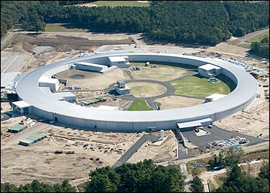
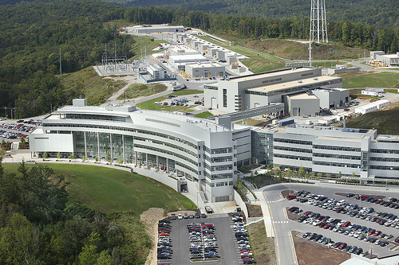
What do you get for a Billion Dollars?
NSLS-II: $0.9B, 0.8 km storage ring
SNS: $1.4B, 1 GeV Linac, Ring, high-power target, 1km
S. Henderson
HF2012

Slide 53
P5 Is Underway: But it’s still worth remembering the boundary conditions that were stated at the start of the process…
Jim Siegrist, CPM2012
https://indico.fnal.gov/getFile.py/access?contribId=4&sessionId=2&resId=3&materialId=slides&confId=5841
It’s imperative to make the case for the physics we need,
But we must also develop a coherent plan that is realistic if we want to preserve the health and vitality of the U.S. HEP program
The challenges for all of the options presented here go beyond the technical

Slide 54
Conclusions
The necessity of US engagement in the ongoing LHC program is clear
As is maintaining global connections if the next collider facility is off-shore
At the same time we cannot ignore other elements of the US HEP program
  Investing in our domestic facilities which support non-collider portions of HEP
  Maintaining a robust R&D program which benefits both our global connections and can open the door to additional world class capabilities in the US
  And continue to train the experts to support the next generation of facilities

Slide 55
Backup Slides Follow

Slide 56
Optics Challenges for TLEP
Bernhard Holzer
at the recent FCC Kick-Off Meeting
There is only one real challenge ...
the parameter list
design & optimise a lattice
for 4 different energies
 | Z | W | H | tt
Beam energy [GeV] | 45.5 | 80 | 120 | 175
Beam current [mA] | 1450 | 152 | 30 | 6.6
Bunches / beam | 16700 | 4490 | 1360 | 98
Bunch population [10¹¹] | 1.8 | 0.7 | 0.46 | 1.4
Transverse emittance e Horizontal [nm] Vertical [pm] | 29.2 60 | 3.3 7 | 0.94 1.9 | 2 2
Momentum comp. [10⁻⁵] | 18 | 2 | 0.5 | 0.5
Betatron function at IP b* Horizontal [m] Vertical [mm] | 0.5 1 | 0.5 1 | 0.5 1 | 1 1
Beam size at IP s* [mm] Horizontal Vertical | 121 0.25 | 26 0.13 | 22 0.044 | 45 0.045
Bunch length [mm] Synchrotron radiation Total | 1.64 2.56 | 1.01 1.49 | 0.81 1.17 | 1.16 1.49
Energy loss / turn [GeV] | 0.03 | 0.33 | 1.67 | 7.55
Total RF voltage [GV] | 2.5 | 4 | 5.5 | 11
Interaction Region layout
for a large number of bunches
Δs = 6m (LHC = 7.5m)
small hor. emittance
increasing with reduced energy
ε_{y} / ε_{x} =10⁻³
extremely small vert. beta
β_{y}=1mm
→ high chromaticity
→ challenging dynamic aperture
high synchrotron radiation losses
include sophisticated
absorber design in the lattice

Slide 57
Muon Collider Parameters
Exquisite Energy Resolution
Allows Direct Measurement
of Higgs Width
Success of advanced cooling
concepts a several × 10³²
Site Radiation mitigation with depth and lattice design: ≤ 10 TeV

Slide 58
MAP Initial Baseline Selection Process
Now to 2016:
  Explore, develop, and select the Initial Baseline Design (IBS) of all accelerator subsystems
    Clear specifications are absolutely critical to the technology demonstrations that are being undertaken to establish the feasibility of high intensity muon accelerators
    The coupling between design and technology is clearly iterative
    However, given the knowledge that we presently have, it is crucial to clearly define the design concepts for individual systems
  To enhance the quality of the designs, the IBS process will focus primarily on a site-specific implementation at Fermilab which would build on the superconducting linac upgrade presently being planned
    It will also focus on specifications that are compatible with the conclusions of the Muon Accelerator Staging Study (MASS)
In the 2016-2020 timeframe, will launch the next set of feasibility R&D activities (on the basis of the IBS-specified designs)

Slide 59
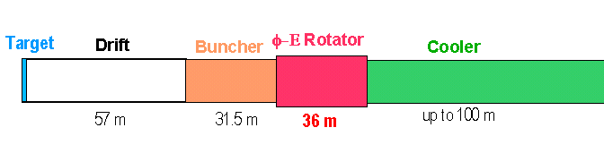
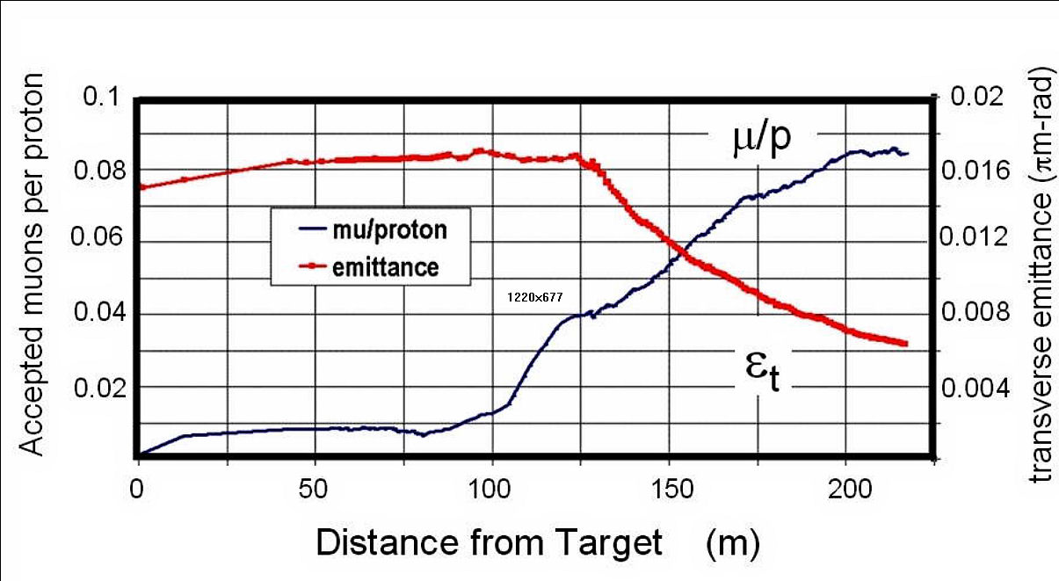
Technology Challenges – Tertiary Production
Neuffer
A multi-MW proton source, i.e., the extension of PIP-II, will enable
O(10²¹) muons/year to be produced, bunched and cooled to fit within the acceptance of an accelerator.

Slide 60
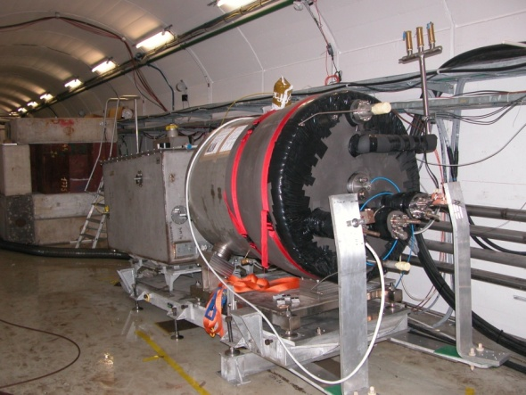

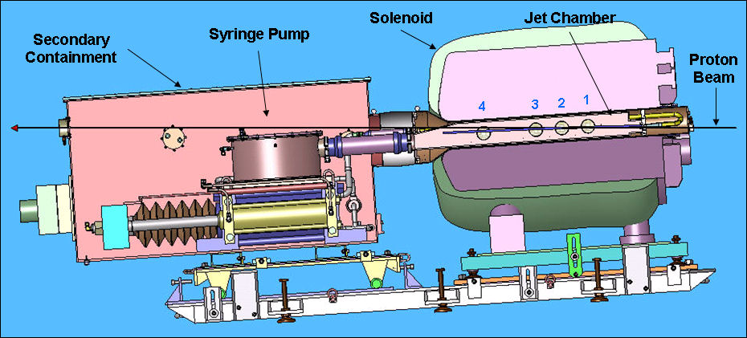
Key Technologies - Target
The MERIT Experiment at the CERN PS
  Demonstrated a 20m/s liquid Hg jet injected
  into a 15 T solenoid and hit with a
  115 KJ/pulse beam!
  Jets could operate with beam powers up to
  8 MW with a repetition rate of 70 Hz
MAP staging aimed at initial 1 MW target
1 cm
Hg jet in a 15 T solenoid
with measured disruption length ~ 28 cm

Slide 61
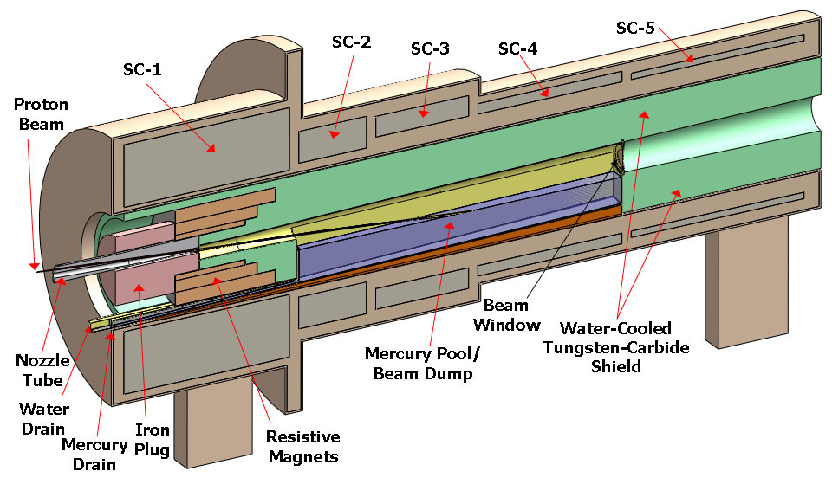
TechnoIogy Challenges – Capture Solenoid
A Neutrino Factory and/or Muon Collider Facility requires challenging magnet design in several areas:
  Target Capture Solenoid (15-20T with large aperture)
  E_{stored} ~ 3 GJ
  O(10MW) resistive
  coil in high radiation
  environment
  Possible application
  for High Temperature
  Superconducting
  magnet technology

Slide 62
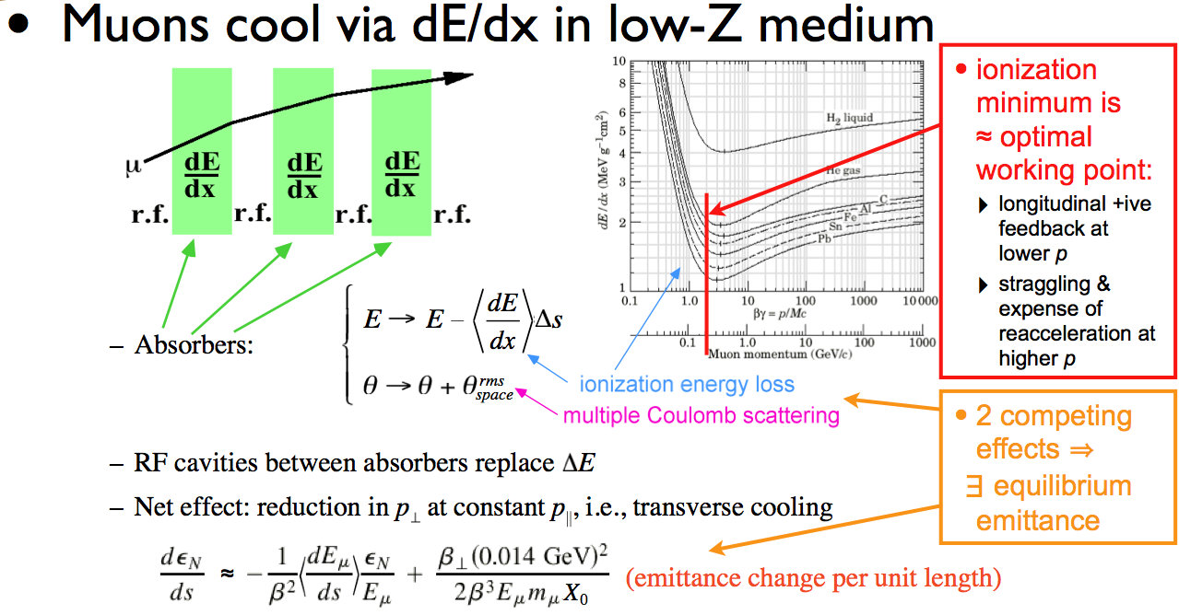
Ionization Cooling
D. Kaplan

Slide 63
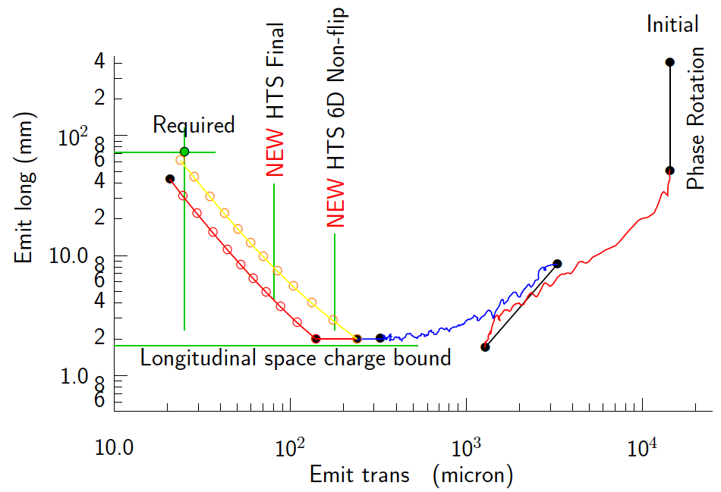
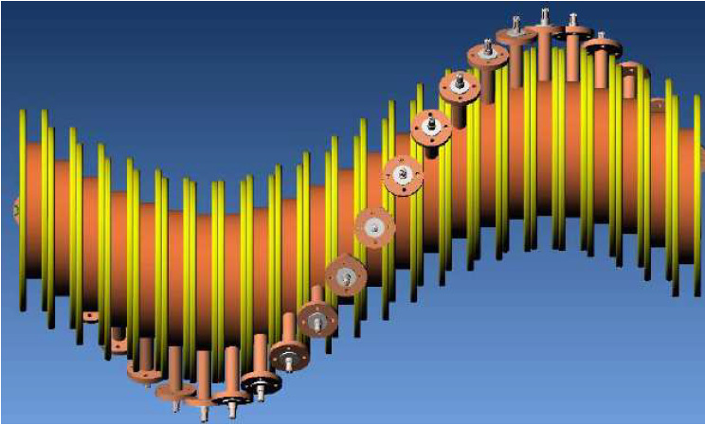
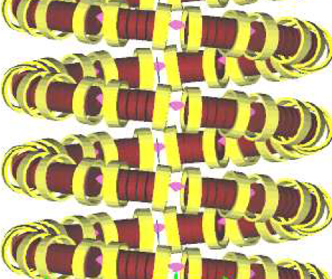
Technology Challenges - Cooling
Development of a cooling channel design to reduce the 6D phase space by a factor of O(10⁶) → MC luminosity of O(10³⁴) cm⁻² s⁻¹
R. Palmer
Emittance Reduction
via Ionization Cooling
Some components beyond state-of-art:
  Very high field HTS solenoids (≥30 T)
  High gradient RF cavities operating in multi-Tesla fields
The program targets critical magnet and cooling cell technology demonstrations within its feasibility phase.
Cooling
Channel
Concepts
HCC
Guggenheim

Slide 64
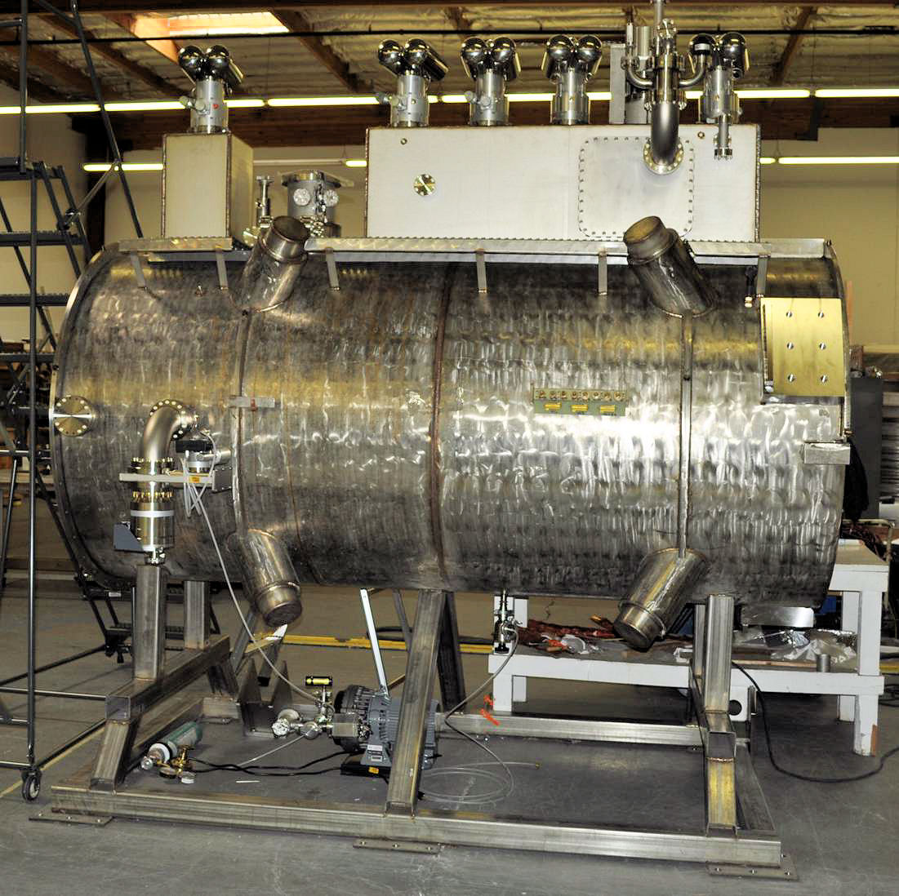
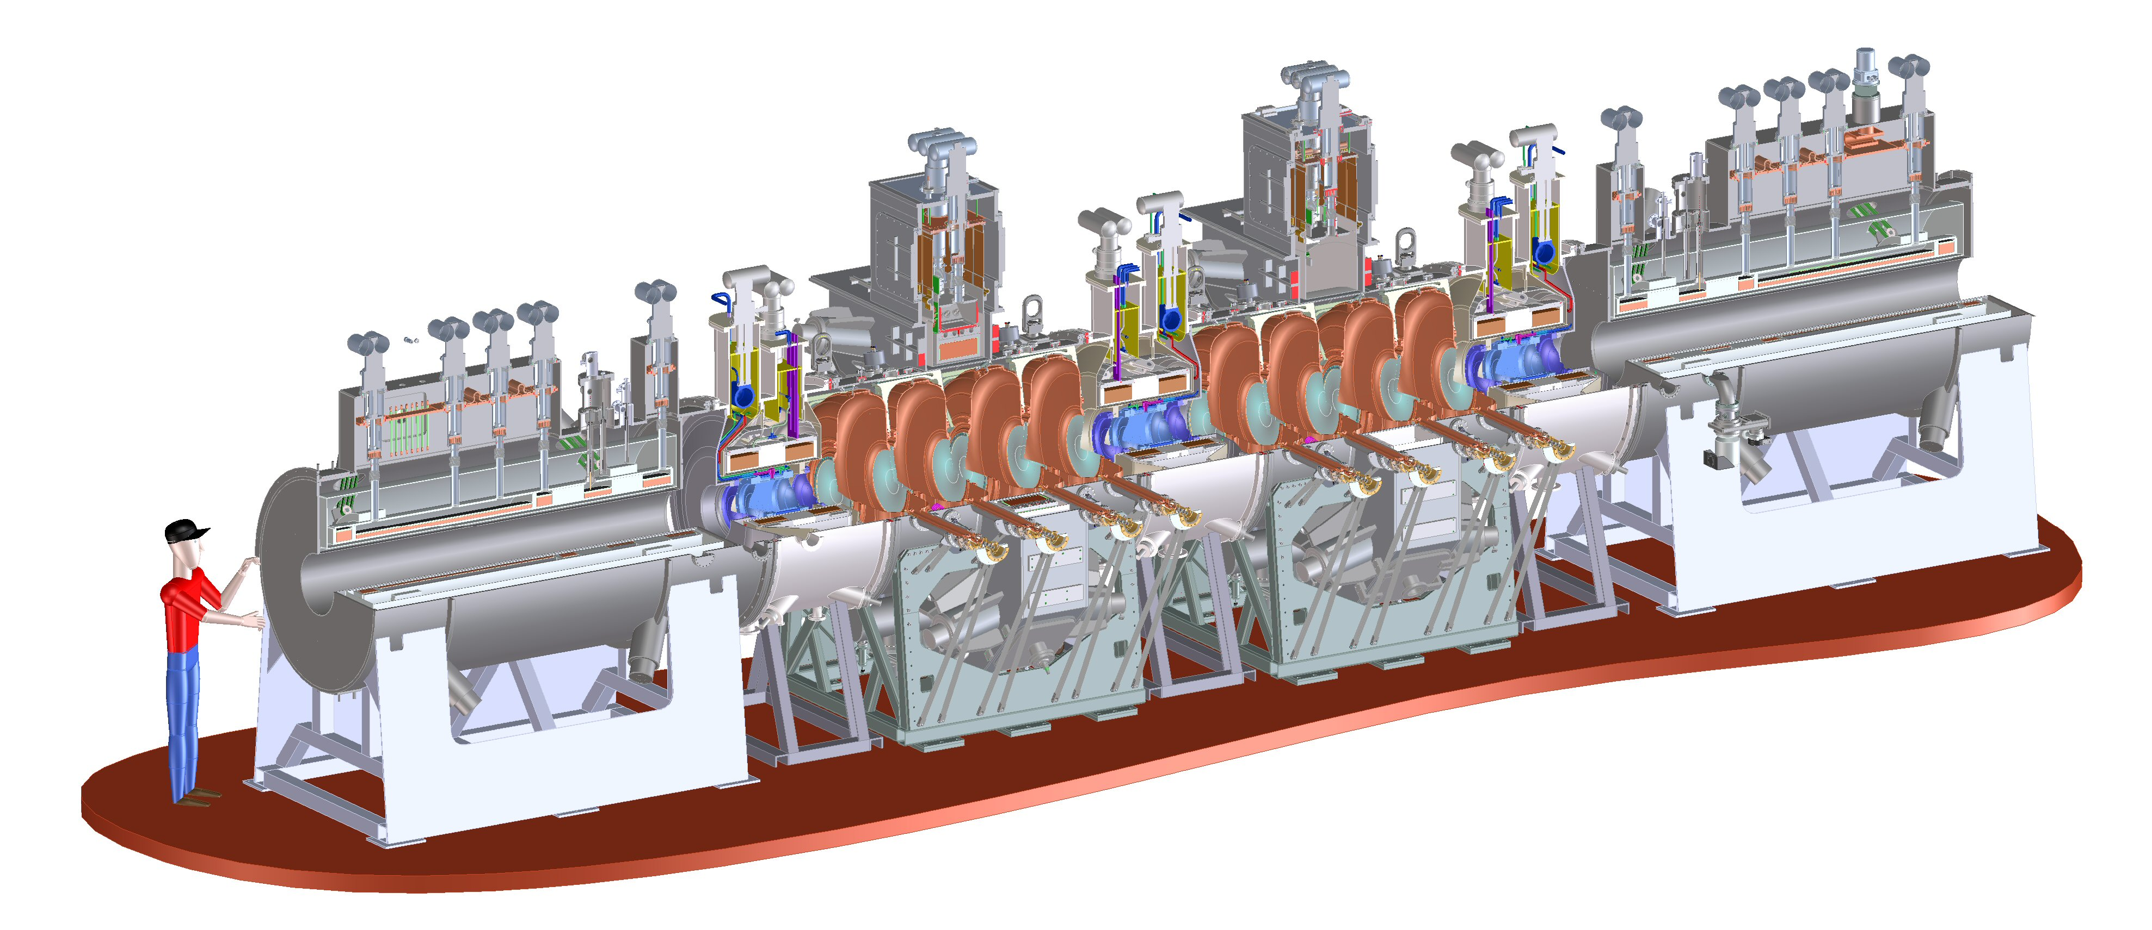
Technology Challenges - Cooling
Tertiary production of muon beams
  Initial beam emittance intrinsically large
  Cooling mechanism required, but no
  radiation damping
Muon Cooling a Ionization Cooling
    dE/dx energy loss in materials
    RF to replace p_{long}
First SS delivered
to RAL for Step IV
Experiments in 2015
MICE
  The Muon Ionization
  Cooling Experiment:
  Demonstrate the
  method and validate
  our simulations
RF-Coupling
Coil (RFCC)
Units
Spectrometer
Solenoids

Slide 65
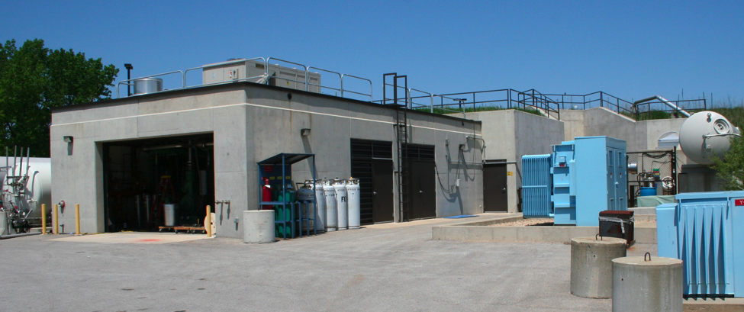
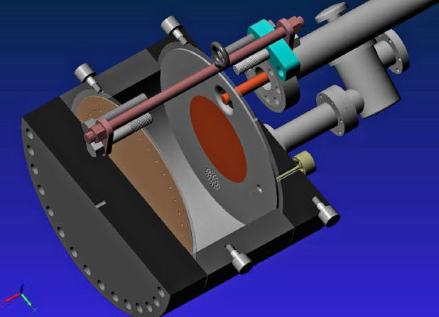
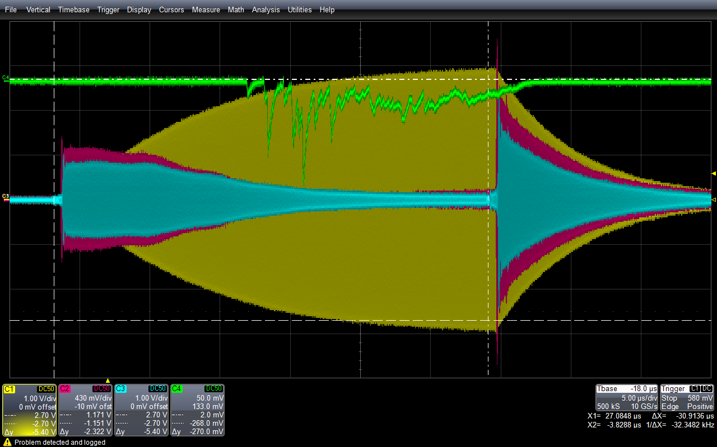
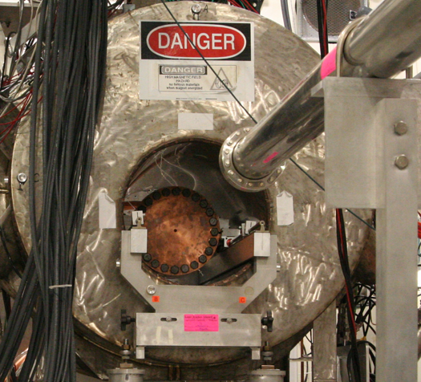
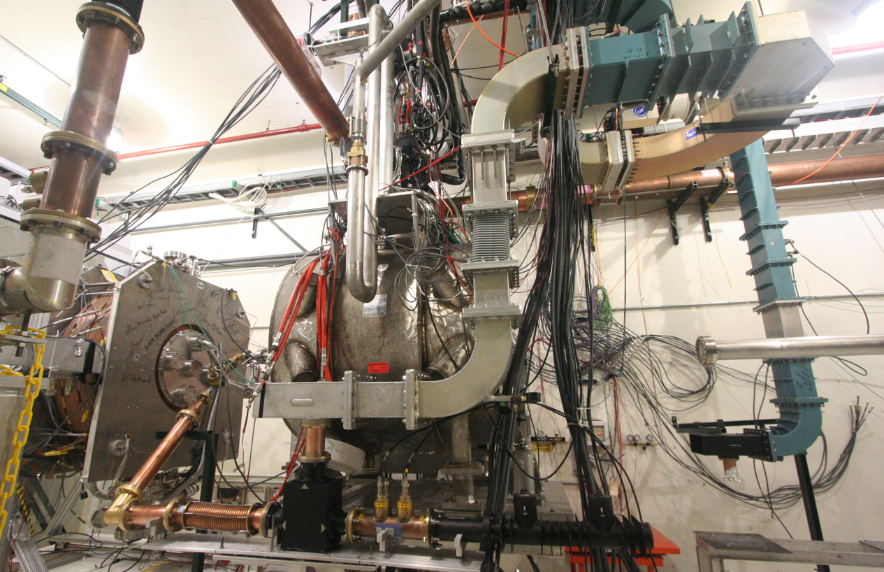
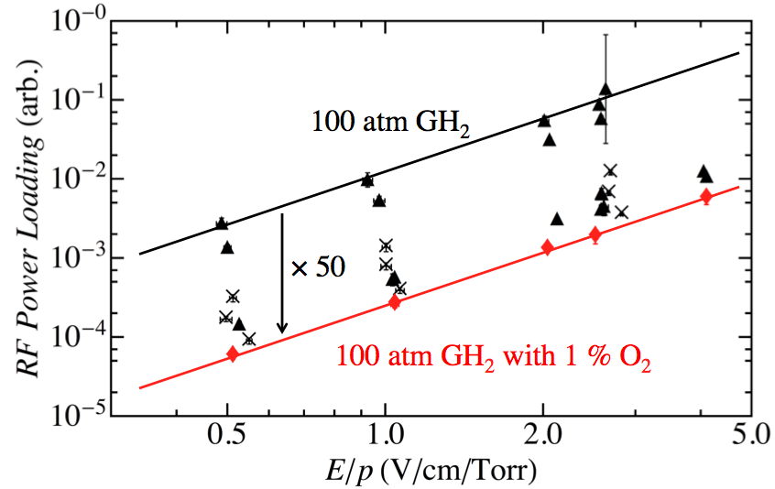
Elements of the R&D Program
MuCool Test Area
Vacuum RF Cavity –
now operational in 5T B-field
Entrance of
MTA exp. hall
Compressor + refrigerator room
400 MeV
H⁻ Beam
20 MV/m in 3 Tesla
MTA Hall
Gas-Filled RF cell
201 MHz cavity
SC magnet
400 MeV H⁻ beam

Slide 66
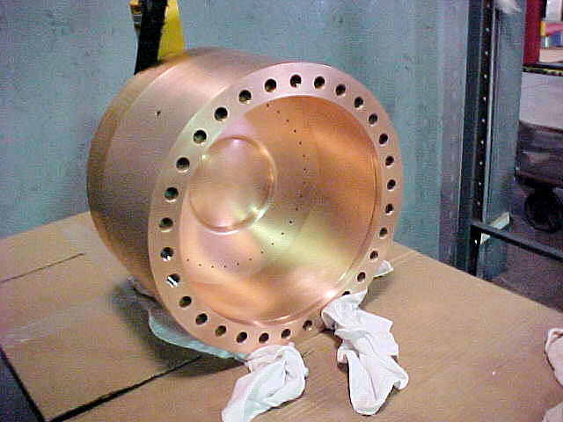
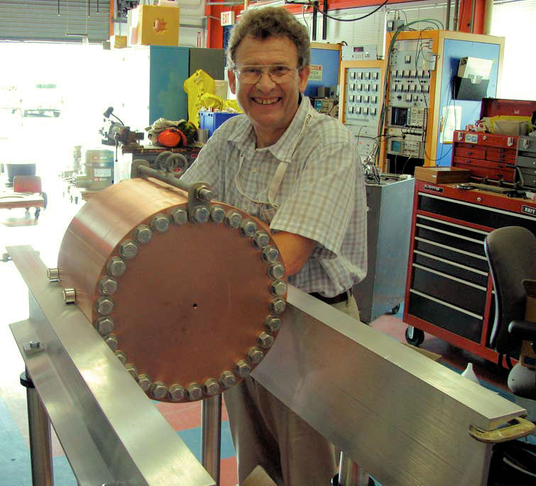
Recent Progress – Vacuum RF
All-Seasons
Cavity
(designed for both
vacuum and high
pressure operation)
Now operated in magnetic fields up to 5T:
  Gradients > 20 MV/m
Demonstrates possibility of successful operation of vacuum cavities in magnetic fields with careful design
Successor design (the 805 MHz Modular Cavity) will be ready for testing during FY14
Also progress on alternative cavity materials

Slide 67
Recent Progress - High Pressure RF
Gas-filled cavity
  Can moderate dark current and breakdown currents in magnetic fields
  Can contribute to cooling
  Is loaded, however, by beam-induced plasma
Electronegative Species
  Dope primary gas
  Can moderate the loading effects of beam-induced plasma by scavenging the relatively mobile electrons
1% Dry Air (0.2 % O2) in GH2
Pure GH2
1% Dry Air
(0.2 % O2)
in GH2 at
B = 3 T
Beam on
~50× change in
RF dissipation
5/22/12
E₀ = 25 MV/m
67
E₀ = 25 MV/m

Slide 68
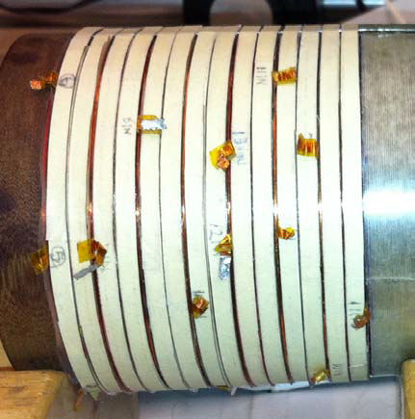
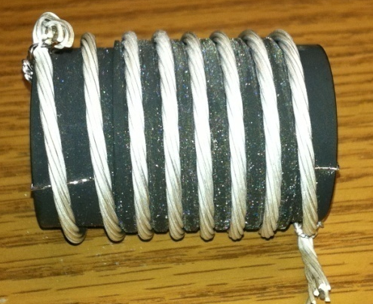
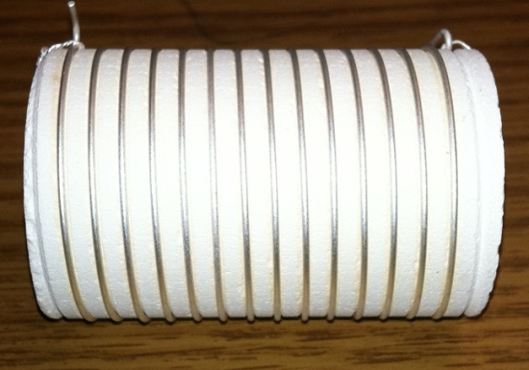
Recent Progress - High Field Magnets
Progress towards a demonstration of a final
stage cooling solenoid:
Demonstrated 15+ T (16+ T on coil)
  ~25 mm insert HTS solenoid
  BNL/PBL YBCO Design
  Highest field ever in HTS-only solenoid (by a factor of ~1.5)
Developing a test program for operating HTS insert + mid-sert in an external solenoid a >30 T
BSCCO-2212 -
New cable fabrication methods with demonstrated J_{E}
Hyperbaric processing to avoid strand damage
Multi-strand cable utilizing chemically compatible alloy and oxide layer to minimize cracks

Slide 69

Technology Challenges - Acceleration
Muons require an ultrafast accelerator chain
a Beyond the capability of most machines
Solutions include:
  Superconducting Linacs
  Recirculating Linear Accelerators (RLAs)
  Fixed-Field Alternating-Gradient (FFAG) Machines
  Rapid Cycling Synchrotrons (RCS)
  RCS requires
  2 T p-p magnets
  at f = 400 Hz
  (U Miss & FNAL)
EMMA – FFAG
JEMMRLA Proposal:
JLAB Electron Model of
Muon RLA with Multi-pass
Arcs

Slide 70


Superconducting RF Development
201 MHz SCRF R&D
Major dia.: 1.4 m
Cavity going into test pit
in Newman basement
(Cornell University)
400mm BT
Cavity length: 2 m
Pit: 5m deep X 2.5m dia.

Slide 71



Technology & Design Challenges – Ring, Magnets, Detector
Emittances are relatively large, but muons circulate for ~1000 turns before decaying
  Lattice studies for 126 GeV,
  1.5 & 3 TeV CoM
High field dipoles and
quadrupoles must
operate in high-rate
muon decay backgrounds
  Magnet designs under study
Detector shielding & performance
  Initial studies for 1.5 TeV, then 3 TeV
  and now 126 GeV
  Shielding configuration
  MARS background simulations
MARS energy deposition studies for Higgs Factory
magnets and IR

Slide 72


Backgrounds and Detector
Much of the background is soft and out of time
Nanosecond time resolution can reduce backgrounds by three orders of magnitude
Requires a fast, pixelated tracker and calorimeter.
Non-ionizing background ~ 0.1 x LHC
But crossing interval 10μs/25 ns a 400x
 | Cut | Rejection
Tracker hits | 1 ns, dedx | 9x10⁻⁴
Calorimeter neutrons | 2 ns | 2.4x10⁻³
Calorimeter photons | 2 ns | 2.2x10⁻³
GeV/c
ns

Slide 73
Overview of MAP Magnet Pull
Muon Ionization
6-Dimensional Cooling Channel
Acceleration to the TeV Energy Scale for Muon Colliders
Muon Collider Magnet Needs
Muon Ionization Final Cooling Channel
HTS Magnet Development
Capture Solenoid for Simultaneous mu+ & mu- Beams
High field (15-20T)
Large bore (meter-scale)
Intense radiation environment – NC or HTS insert coil
Characteristics:
Characteristics:
Solenoid-based cooling channel (LH₂/LiH absorbers)
RF cavities integral to focusing channel
Fields ranging from LTS to HTS conductor regime
Characteristics:
Emittance exchange channel for TeV-scale colliders (trade increased longitudinal beam emittance for smaller transverse emittance
Baseline: 30T class HTS solenoids with a>25mm
Characteristics:
Present baseline based on the use of Rapid Cycling Synchrotrons
Requires magnets capable of ~400Hz operation with >1.5T peak fields
Characteristics:
Decaying muon beams mean that luminosity is inversely proportional to circumference
10T dipole a 15-20T dipoles improves luminosity
Radiation environment
Challenging IR magnets
Characteristics:
A MC (w/decaying beams) obtains the greatest performance enhancement of any HEP collider from HTS magnet technology
High quality HTS cables and magnets must be a priority
Feasibility R&D through End of Decade

Slide 74
A Muon Accelerator Capabilities Technical Decision Tree
| Thru ~2020 | ~2020 | ~2025 | Late 2020s |
Success with NF cooling demo (MICE)
a Begin full technical design for a NF-based upgrade to LBNE
If decide to pursue precision ν sector capabilities
a Begin the NF upgrade path
If LHC finds evidence for Supersymmetry AND when MC Engineering Design ready
a Decision point on a return to the EF with a Muon Collider
(which would build on the infrastructure deployed for a NF)
MAP Feasibility Study
Failure a No path to NF and/or MC capabilities
a STOP NF/MC R&D Effort
CDR Completion and success Advanced Systems Tests
a Begin full MC Engineering Design
Success with MC Concepts
a Begin the MC CDR and Advanced Systems Tests
Failure of Advanced Systems Tests
a Terminate MC development

