Slide 1
Booster 20 Hz
PIP II
Bill Pellico
Todd Sullivan

Slide 3
Booster 20 Hz Outline
Motivation
Recent Upgrades
Booster Systems
Pulsed
Magnets
Power System
RF
Cost Summary
Summary

Slide 4
Motivation - 20Hz Operation
Motivation for increasing 15Hz at 20Hz
Increasing from 15 to 20 Hz will allow more flexibility in the program.
MI/RR could load faster and increase Slip Rate*
MI could consider different extraction energies and not use all Booster cycles, Booster Neutrino Beam (BNB)
More experiments to run simultaneously. Total beam power ~1.2MW, supporting LBNE, Mu2e, Muon g-2 plus 5 Hz for BNB experiments.
Increase flux by increasing cycle rate and not pulse intensity due to limited number of cycles (BNB).

Slide 5
Proton Plan and PIP
Proton Plan (PP) – ~8 year program to get the complex ready for NuMI and BNB experiments
Booster Correctors, Collimators, ORBMP/Injection…etc.
Proton Improvement Plan (PIP) Objectives
Increase the beam repetition rate from ~7Hz to 15Hz
Eliminate major reliability vulnerabilities and maintain reliability at present levels (>85%) at the full repetition rate
Eliminate major obsolescence issues
Increase the proton source throughput, with a goal of 2.2E17 pph, enabling 700kW to NOѵA
Ensure a useful operating life of the proton source through 2025
Estimated completion date for PIP is 2018/19

Slide 6
Booster Systems - Upgrades
Upgraded Injection (ORBMP)(PP) – PIP-II
Pulsed Systems (need 20Hz testing)
Extraction System
Kickers: 5 for extraction, 3 for beam dump (PP)
Septa: Added cooling and modified design (PP)
Utilities
All Booster transformers will all be upgraded (PIP)
Booster 95 LCW system has been upgraded (PIP)
Vacuum systems will all be upgraded (PIP)
Correctors
All new correctors ready for 20 Hz operation (PP)

Slide 7
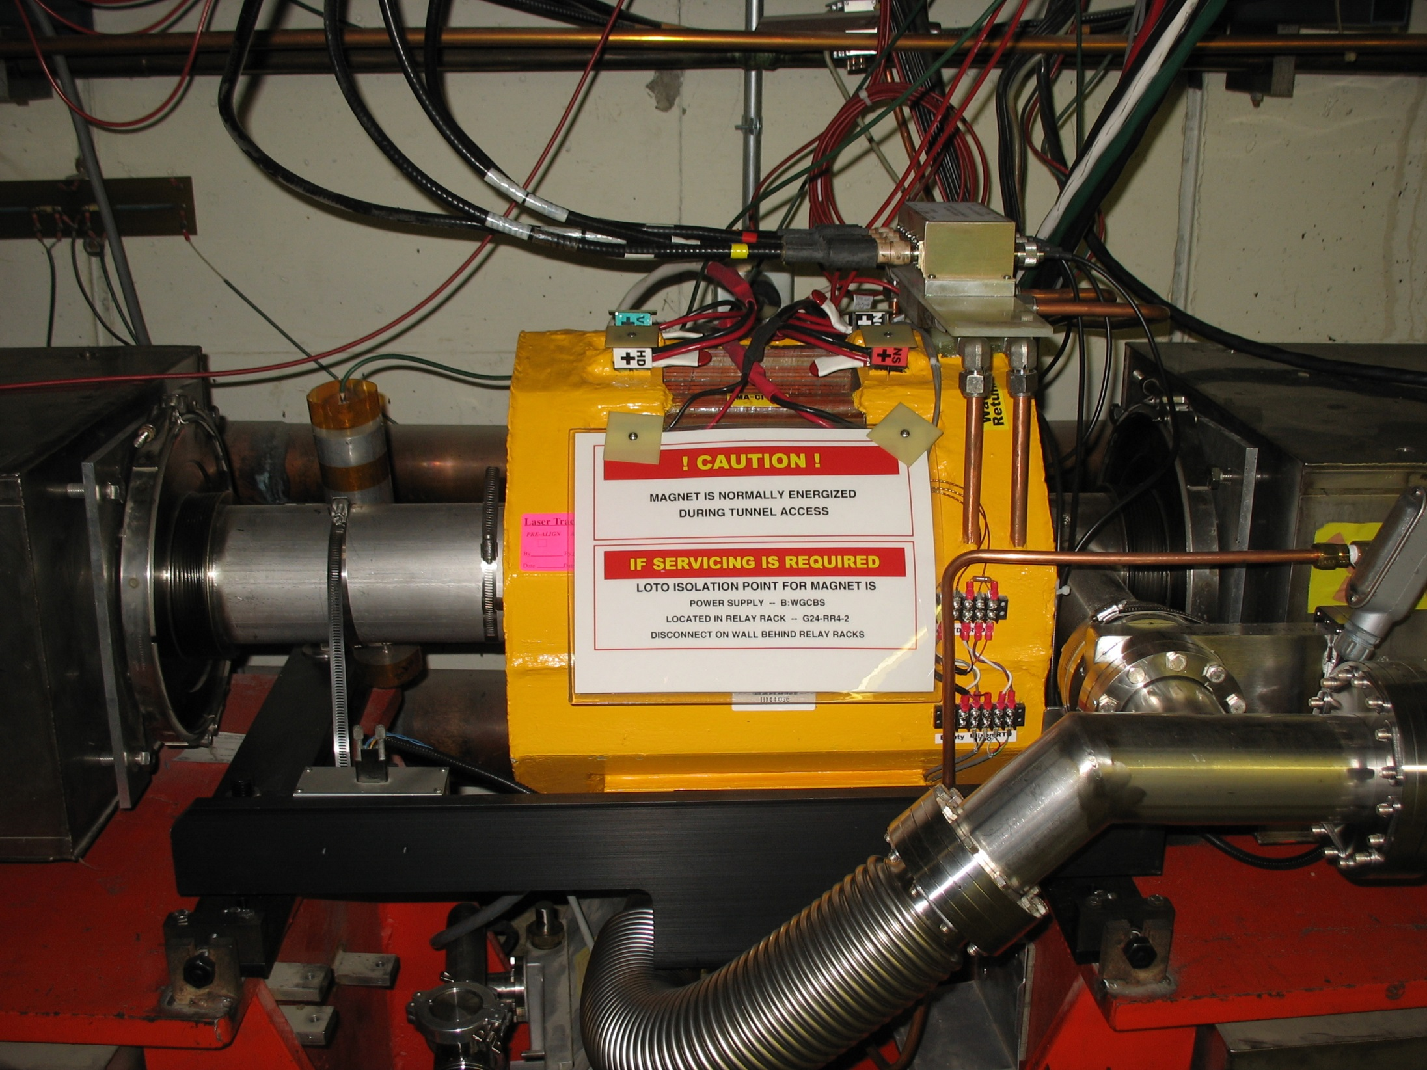

Slide 8
Booster RF Cavities and Supplies
Current Status:
RF Cavities are undergoing a refurbishment process to pulse at 15Hz (PIP)
This requires removing cavities from tunnel and cycling tuners & cavities through a rebuilding process.
All cavities are tested at a 15 Hz rate for a minimum of 7 days of which 5 days at full gradient before reinstallation in Booster tunnel.
Refurbished 11 of 19 cavities.
Bias supplies are being upgraded to run 15 Hz (PIP)
New solid state modulators and power amplifiers have been run at 15 Hz (PIP)

Slide 9
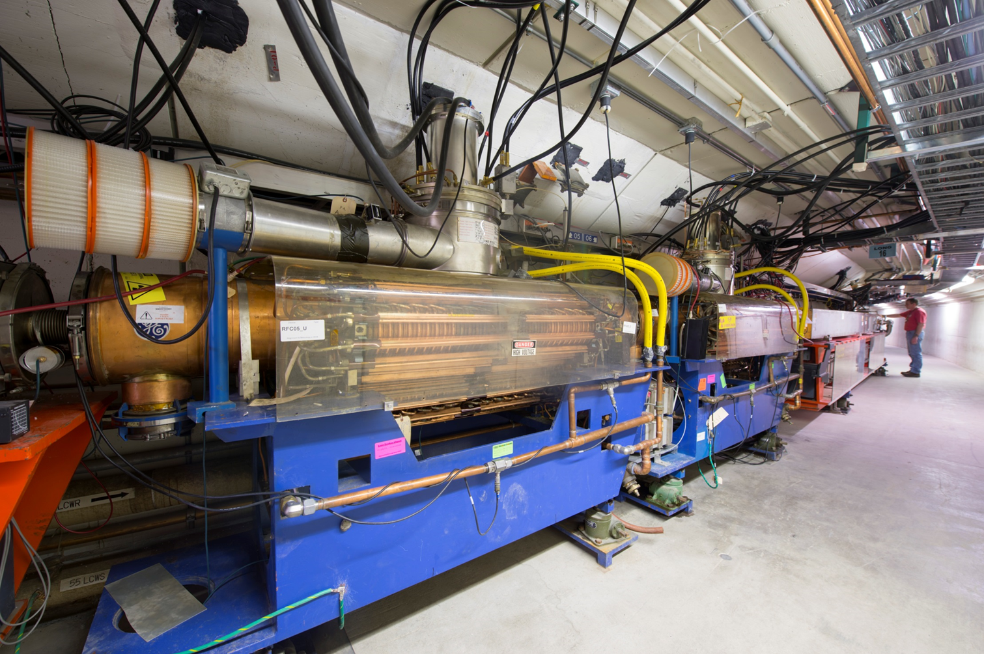
Booster RF cavities

Slide 10
Required RF Voltage during PIP-II era in the Booster
Parameters | Current | PIP-II (15Hz) | PIP-II (20Hz)
KE_{i} & KE_{f} (GeV) | 0.401 & 8.0 | 0.8 & 8.0 | 0.8 & 8.0
P_{i} & P_{f} (GeV/c) | 0.955 & 8.888 | 1.463 & 8.888 | 1.463 & 8.888
Cycle Rate (Hz) | 15 | 15 | 20
$\frac{dP}{dt}$(max)(GeV/c/sec) | 373.84 | 349.92 | 466.52
f_{RF}(MHz) | 37.895-52.813 | 44.705-52.813 | 44.705-52.813
Vpeak|required (MV) | 0.85 | 0.9 | 1.0
with 10% safety | 0.94 | 1.0 | 1.1
Number of RF cavities | 19 | 20 | 20?
Preliminary simulations without beam-loading & with (Bucket Area)/(Bunch Area) ~ 3 suggests that we need Vpeak≈1.0 MV. A safety margin of 10% demands Vpeak~1.1 MV during PIP-II era.

Slide 11
RF – 20 Hz continued
Current Cavities - this is likely the biggest concern…
PIP RF refurbishment/upgrades were for 15 Hz operation and when all done will they work for 20 Hz? Not likely – due to lifetime/not all components replaced! The other systems (modulators, bias supplies and solid state drives…) will need to be looked over.
The cavities will be a concern over the long run – new tuners will help but failures of ceramic windows, cooling lines and weak points in mechanical design/structure will cause issues.
New cavities part of PIP – start with 2 or 3 (good for PIP) but not good enough for longer term PIP II operations. It is highly desirable to have new cavities for reliable PIP II operations.

Slide 12
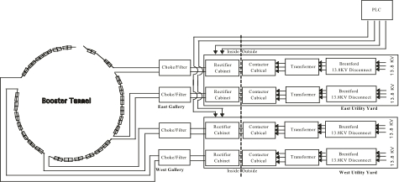
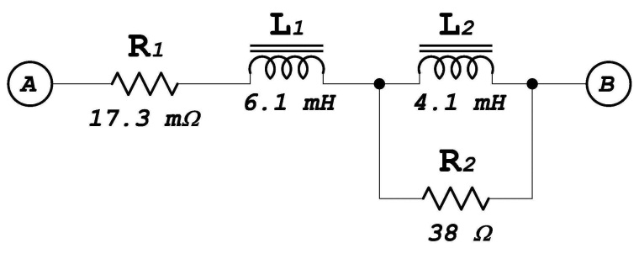
Booster Magnet System Gradient Magnet Power Supply (GMPS)
The present system has 96 magnets in a 48 cell arrangement. This is a 15 Hz resonant charging system with a distributed capacitor bank. The 4 power supplies are MR style 720 Hz update rate SCRs. Regulation is done via a reference magnet with B-dot coil and transductor electronics. A sinusoidal drive signal excites the system. Corrections for losses and line voltage variations are done by a card in a VXI crate. Regulation is good to about a part in 4000. The conversion of GMPS controls from 15 to 20 Hz does not look difficult.
Gradient Magnet Model

Slide 13
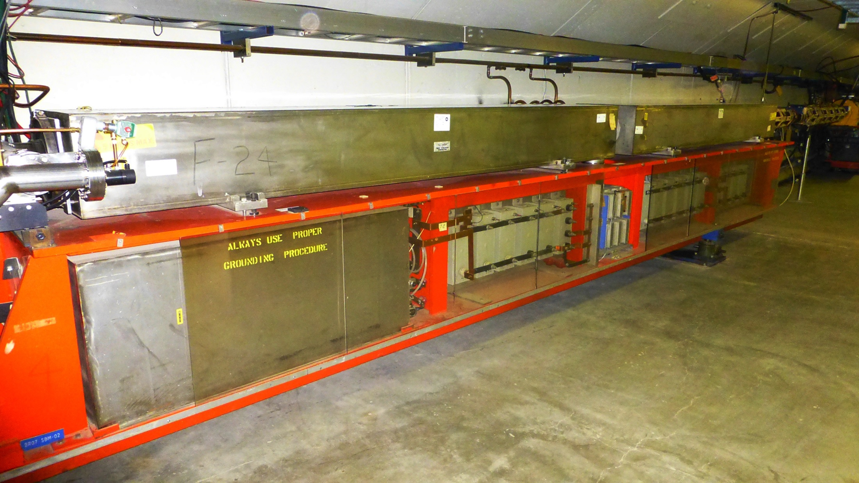
Typical Booster Cell

Slide 14
Booster Magnets - 20 Hz
We have looked at Booster 20 Hz operations several times….most recently by EE support (George Krafczyk)
‘Measurements were performed on both a Booster gradient magnet and a Booster choke with the intent to compare the 15 Hz losses with the 20 Hz losses for a proposed Booster upgrade.’
This analysis suggests that running the booster at 20 Hz with a current equal to the present 15 Hz Booster will require about 3.9% more power. Capacitor voltage will increase by about 32% and the resonant capacitor at each “Girder” must decrease from ~8.33 mF to ~4.69 mF. This also carries the implication that the RMS current per µF will also increase as well.

Slide 15
Booster Magnets - 20 Hz
Summary
Girder drive voltage increases by about 9.2 v (p-p).
Capacitor voltage increases by 32%.
Slight increase in RMS current for Choke, magnets and caps.
Designed to run at 10 GeV (did extract for a brief period at higher energy) the gradient magnet power system is capable of higher voltage operation. Present magnet power system runs on 4 power supplies but can operate with only 3 supplies. Booster at 20 Hz would require all 4 PS to operate.
= 32.4 Watts
Data from G. Krafczyk

Slide 16
Kicker Systems
Kickers/Notchers
The average anode current for the Extraction Kickers will go from ~15mA at 15 hertz at 55KV on the PFL and a 1.8 µS pulse width to ~20mA at 20 hertz. These currents are well within the allowed 2 Amps max average anode current limit for the cx-1168 thyratron. These current levels would also indicate that there will be no excessive heating losses in the RG-220 cables or of the Kicker magnets themselves.
In general one would expect that with the increased rep rate that PFL cable and connection failure rates will also increase.
Average power into the resistive loads will rise from ~400 watts to ~540 watts under the same conditions. The present load resistors are already water cooled and are rated wattage-wise to be able to work without problems with this power increase, but will need further testing.

Slide 17
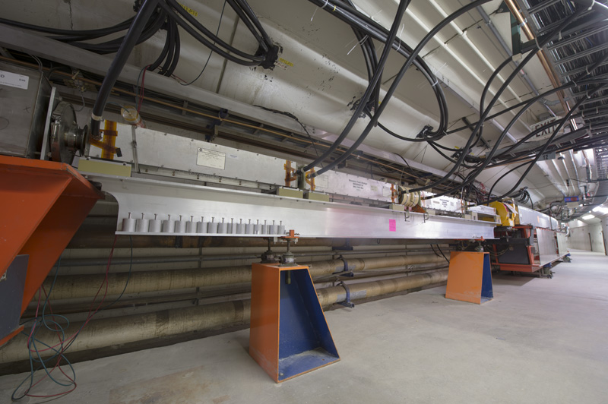
L12
Booster Kickers/Notchers

Slide 18
Septa Systems
Septa Magnets
Thermal testing was done on the two spare septa, BSE-105 and BSE-106. The testing on BSE-105 was the most thorough and included 15hz equivalent runs at 200, 400, 600 and 800 Amps rms.
Testing showed that all the monitored temperatures plateaued within a reasonable time with one exception. This point is on the magnet skin where the power feed-throughs enter and exit the magnet.
External cooling plates were clamped around this area of the magnet. The additional cooling plates showed that the magnet skin temperature in this area plateaued nicely with a temperature reduction of ~8 deg C at the 2.5 hour point.
The present pulse power supplies were designed to handle these higher operating voltages. The ability to run at higher voltage means one could entertain the idea of reducing the output pulse width to reduce the rms current.

Slide 19
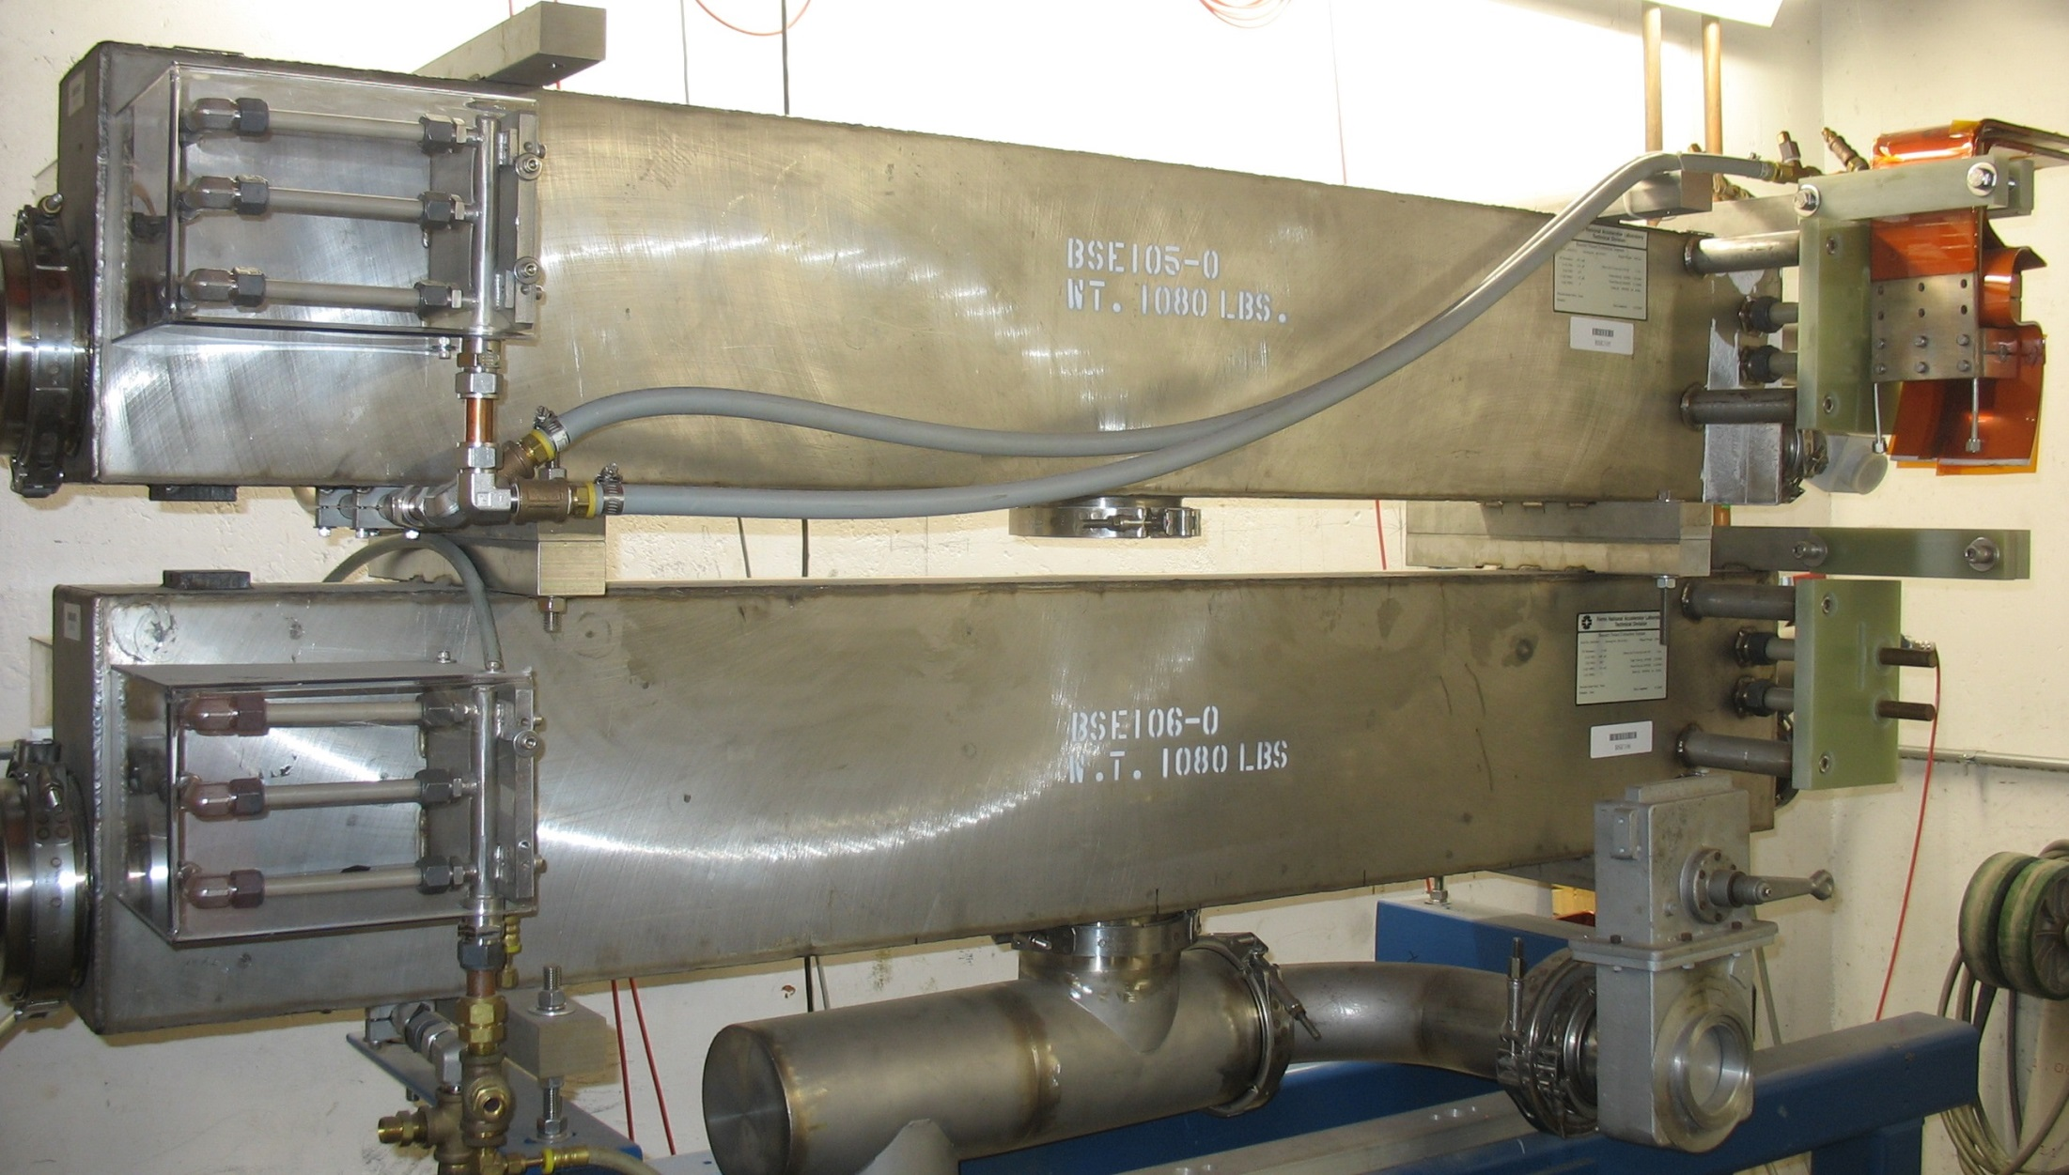
Booster Spare Septa Magnets

Slide 20
Misc - 20Hz Operation
Controls software & hardware systems for 20Hz need to be upgraded and/or modified. The entire clock system is based on 15Hz. The following would have to be modified.
Time Line Generator (TLG), Tevatron Clock System (TCLK), IRM’s, Frontends, Beam Budget Monitor
What is required for just Booster to operate vs the rest of AD systems?
Data collection, data sampling impacting other accelerator controls systems
Electrical Feeder
Would need to look at feeder situation – already being discussed as a add-on to PIP I or PIP II.
Have rough cost estimates from FESS HV personnel
Review electrical power, transformers, panels, and cabling to run at 20Hz
Not expected to be an issue
Safety
A new shielding assessment will have to be performed.

Slide 21
So - what do we need to think about/do?
Booster RF System Review for 20 Hz
New Cavities to accommodate higher voltage and beam
Review controls system
Testing of a magnet girder system at E4R
Septa PS operations review
Review feeder system situation/backup
Review safety system/envelope
Booster magnet – replacement/repair

Slide 22
Rough Cost Estimate (but better than most)
New Cavities – depending upon what PIP I does and what is determined to be the long term cavity:
A full 20 cavity replacement ~ $22 M
Keep much of the current Booster RF supplies upstairs
Septa supply upgrade 600 – 800 $k each (2 supplies)
Pull new feeder ~ $1M (duct and cable)
Controls upgrade – not certain – mostly labor
Power Systems
Injection Front Porch and ramp control ~ $1M (PIP II)
New Caps ~ $1M (required for 20 Hz)

Slide 23
Conclusion
Could we make Booster operate at 20 Hz? Yes
Advantages
More Beam
Cleaner stacking in RR
Issues
RF cavities, RF drive systems, controls … need to be looked at
If done by PIP I then most of cost is covered – solution preferred by S. Holmes
Elephant in room not discussed here: Booster Magnets
Concern for PIP II at 15 or 20 Hz
We have spares but this was just to get through to Booster eventual replacement (Goal is through 2025!)
Why not new magnets – then you have a long term solution!
If this is a serious plan - there is work to be done: specifications/testing/reviews/understanding timeline and goals

Slide 24
Extra Slides

Slide 25
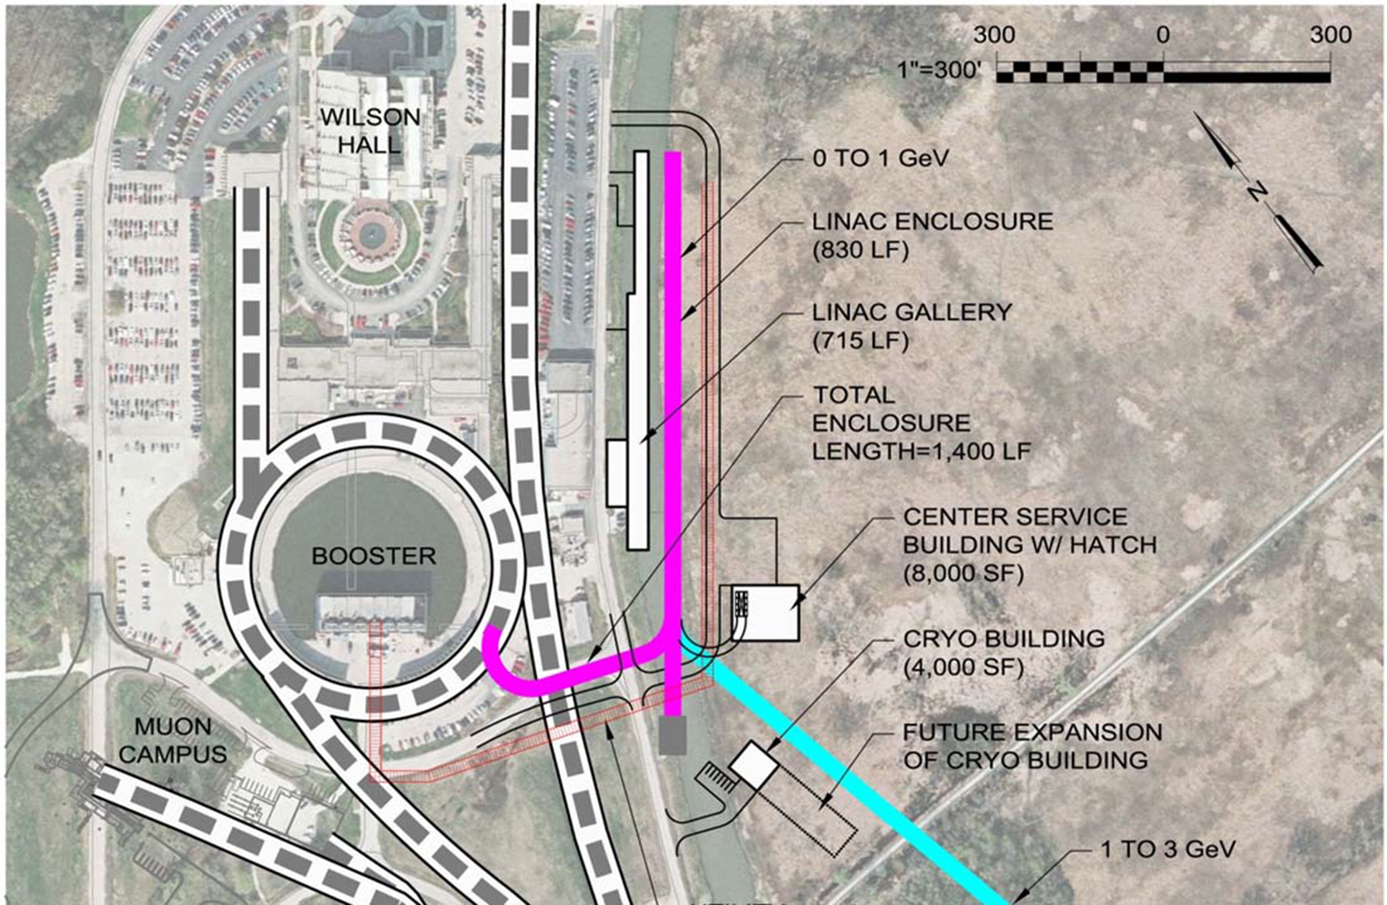
Site layout of the SC Linac

Slide 26
Proton Improvement Plan
The Proton Improvement Plan supports NOvA, Muon g-2, Mu2e, and short-baseline neutrino goals by doubling the Booster beam repetition rate to 15 Hz
Goals
4.2×10¹² protons per pulse at 15 Hz (2.2E17/hour)
Linac/Booster availability > 85%
Residual activation at acceptable levels
Useful operating life through 2025
Scope
Increase Booster beam rep rate to 15 Hz
RF upgrades/refurbish
Replace components with high availability risk
DTL rf ⇒200 MHz klystrons/modulators
Additional Booster rf cavities
Double proton flux while maintaining current levels of activation
RFQ, dampers, collimators/absorbers
700 kW to NOvA at 120 GeV

Slide 27
PIP-II Strategy
Increase Booster/Recycler/Main Injector per pulse intensity by ~50%.
Requires increasing the Booster injection energy
Select 800 MeV as preferred Booster injection energy
30% reduction in space-charge tune shift w/ 50% increase in beam intensity
Provides margin for lower beam loss at higher intensities
Modest modifications to Booster/Recycler/Main Injector
To accommodate higher intensities and higher Booster injection energy
Cost effective solution:
800 MeV superconducting pulsed linac, extendible to support >2 MW operations to LBNE and upgradable to continuous wave (CW) operations
Builds on significant existing infrastructure
Capitalizes on major investment in superconducting rf technologies
Eliminates significant operational risks inherent in existing linac
Siting consistent with eventual replacement of the Booster as the source of protons for injection into Main Injector

Slide 28
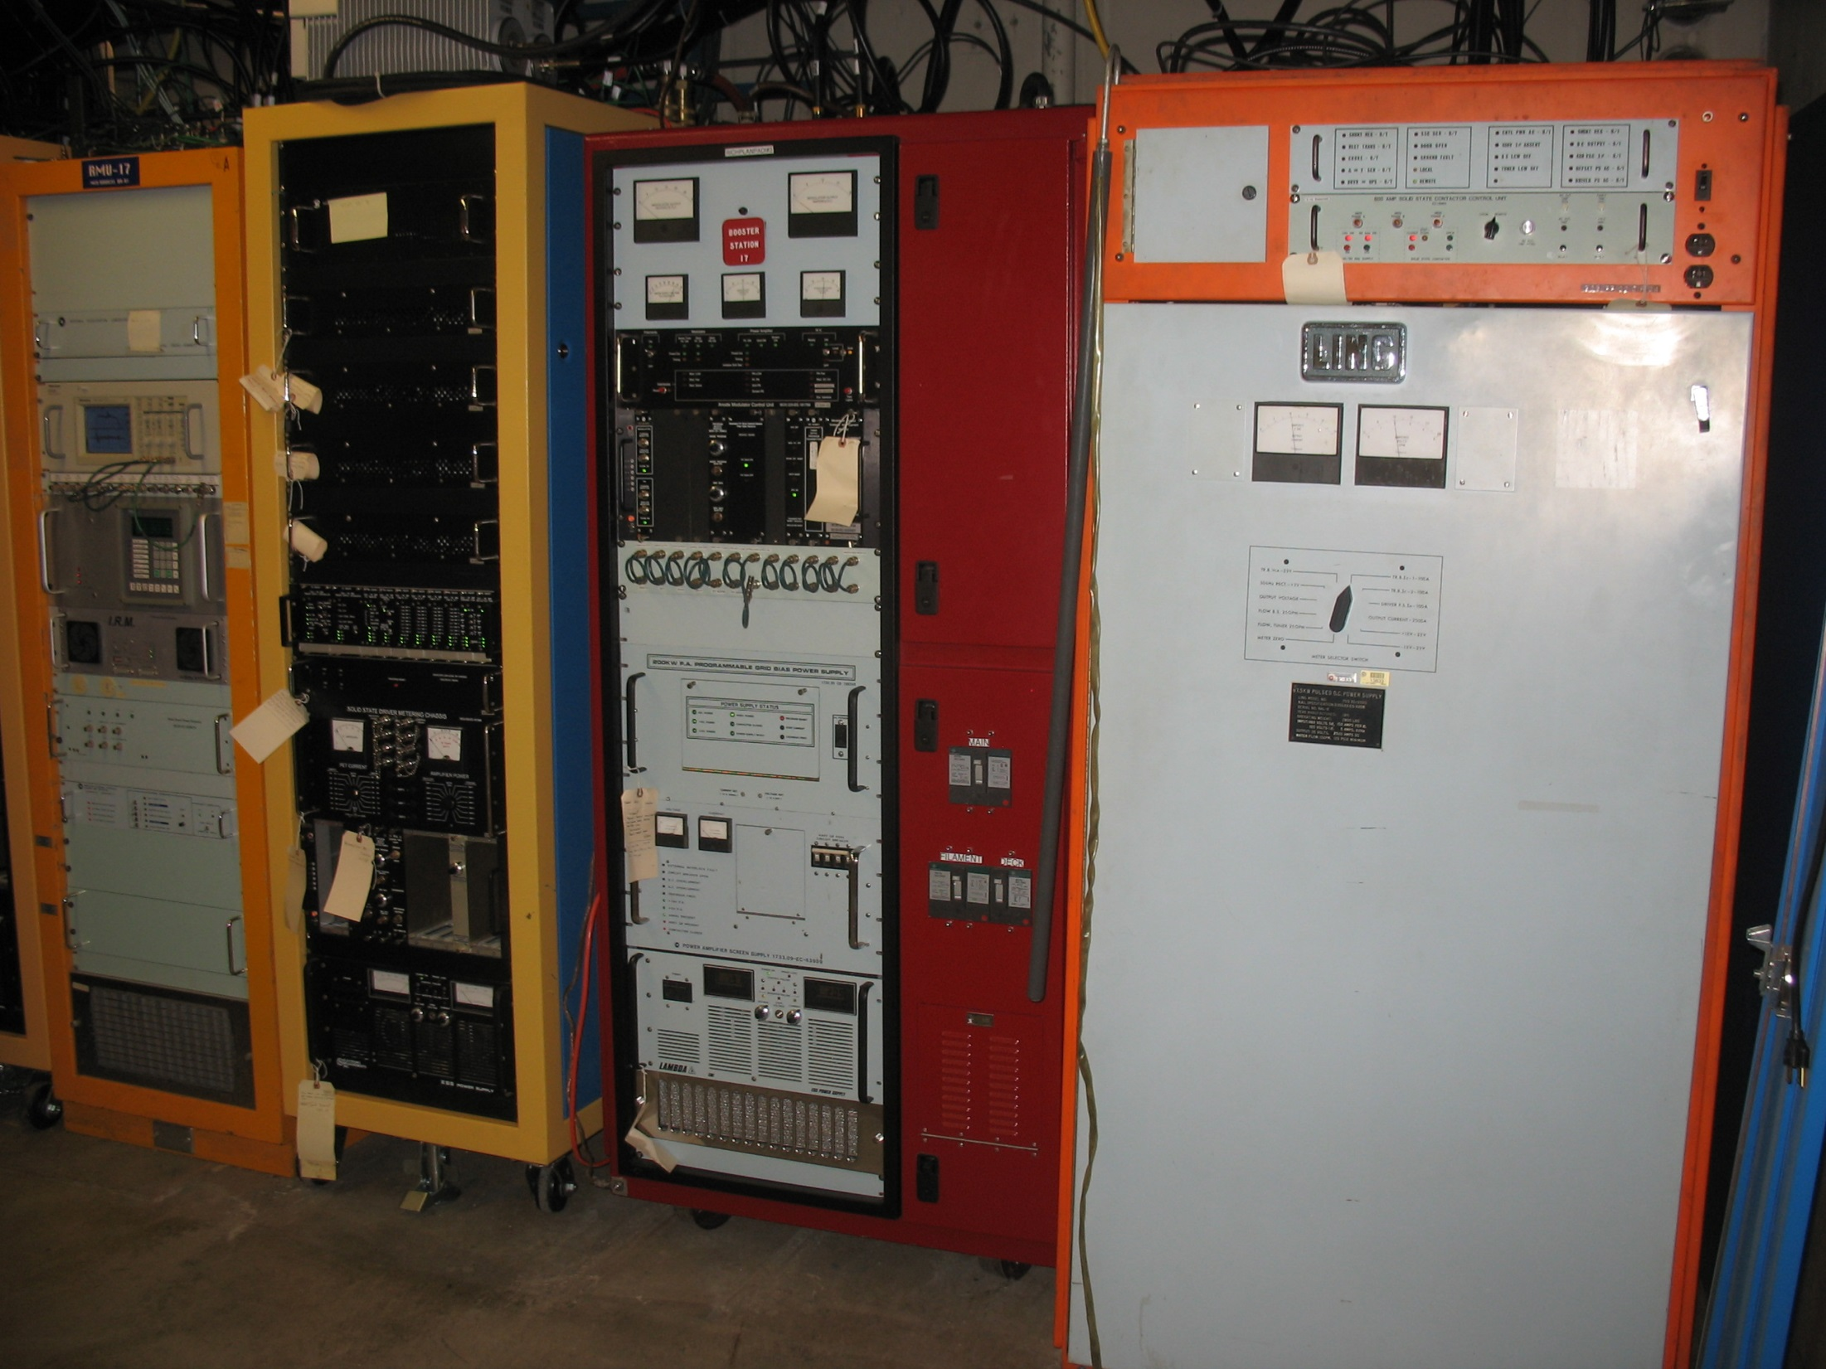

Slide 29
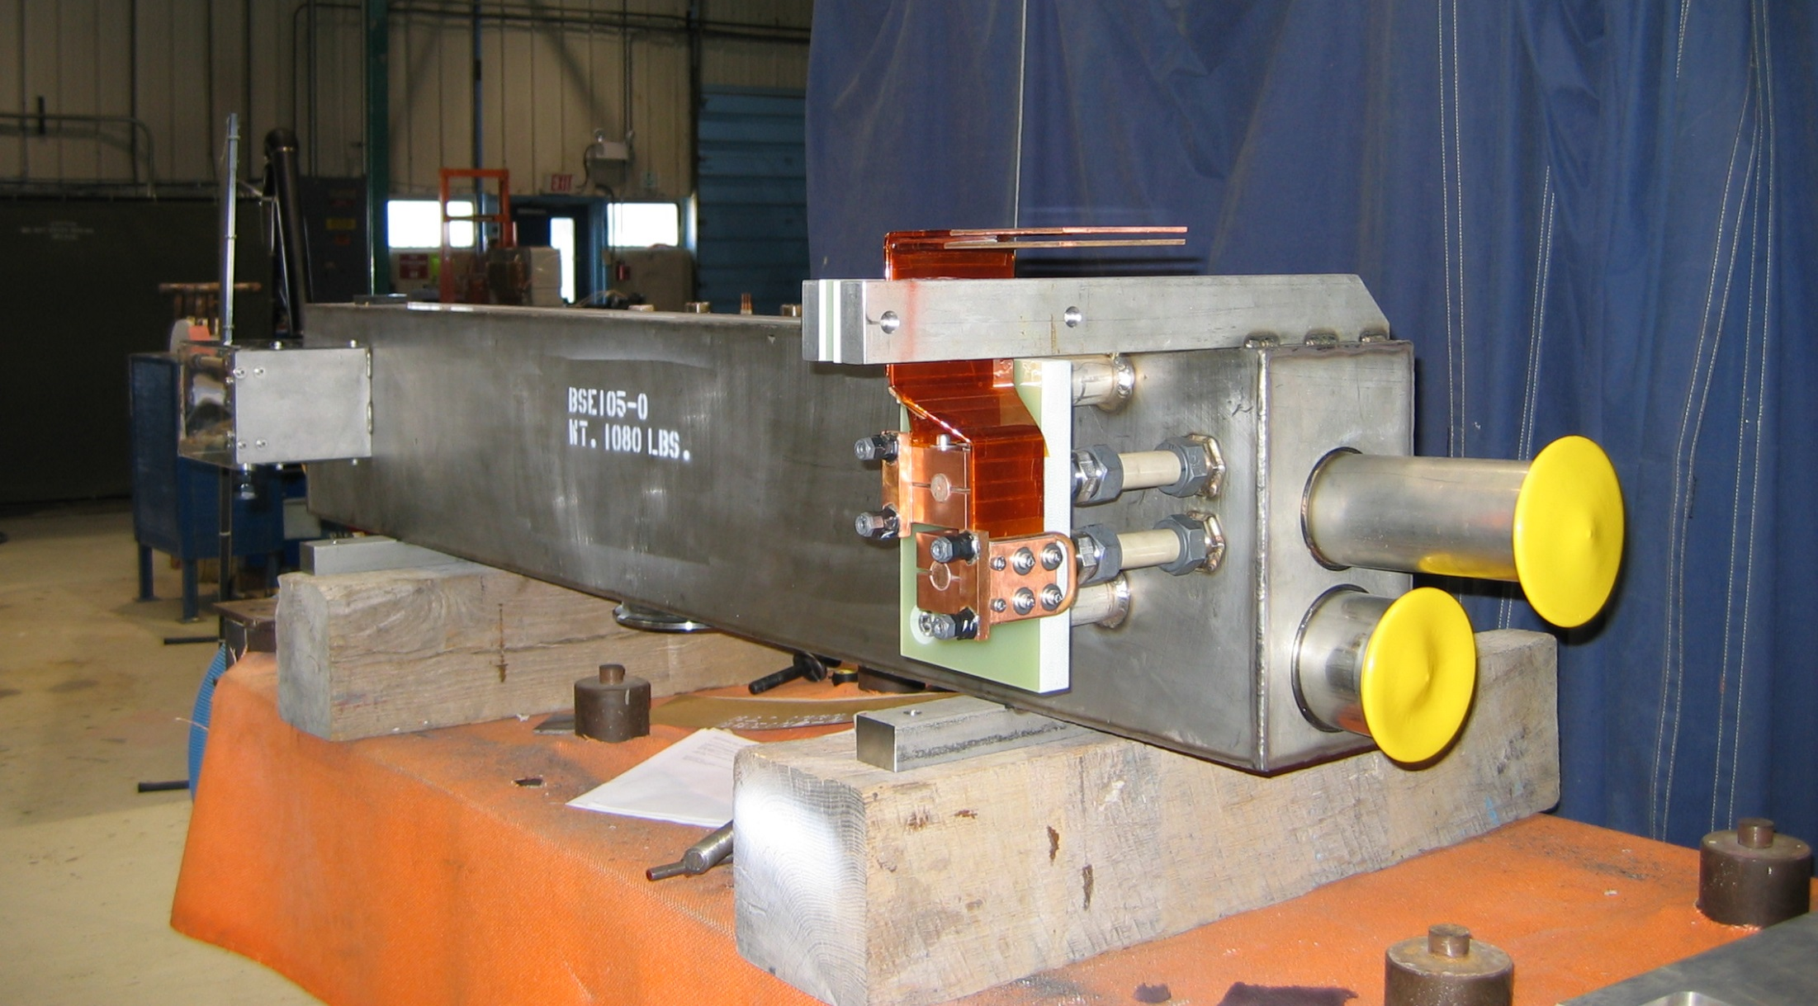
Booster Septum

