Slide 1
Neutrino Beamline Scaling Robert Zwaska Fermilab June 4, 2014 PIP-II Collaboration Meeting

Slide 2
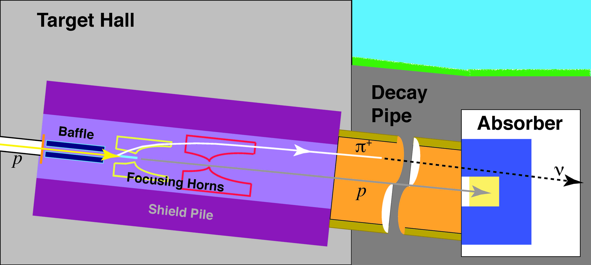
LBNE
“Recent” scope changes
Upgrade Issues
Primary Beamline: transport p 60-120 GeV/c.
Beam power of 1.2 MW, allowing for upgradeability of the facility to 2.3 MW
Neutrino Beamline: wide band, sign selected beam (focusing on E_{ν} in the 0.5-5 GeV range)

Slide 3
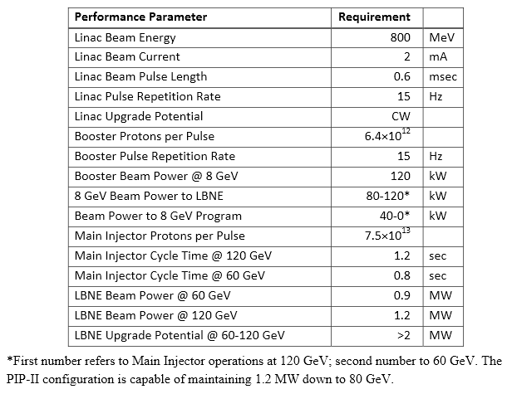
Proton Improvement Plan-II Performance Goals
PIP-II doc: 1232
S. Holmes et al.
- 80 GeV

Slide 4
What will need to be re-evaluated or replaced at 1.2 MW
Primary beam window
Baffle and target, and their carrier
Horns
Horn power supply (we were using the NuMI one)
Horn stripline
Cooling panels for target chase
Water cooling at the bottom of support modules for target/baffle and horns
Upstream decay pipe window in the Helium filled decay pipe
Raw systems (Target, Horns, Cooling Chase Panels, Absorber, Decay Pipe windows)
Chillers for air handling and RAW Water systems
Water evaporators
Hadron Monitor
Additional interlock system in the Absorber Hall (on top of thermocouples) to protect from primary beam accident
Target chase shielding roof thickness
Radioactive air releases
Preliminary
Additional $30-35 M in $FY13

Slide 5
Sequence of work needed for designing for 1.2 MW
Primary beam window
Hadron Monitor
Done
Target chase cooling panels
US and DS decay pipe windows
Target
Baffle
Baffle and Target
carrier
We are here
80% Done
MARS & ANSYS
SIMULATIONS
NECESSARY
Horn 1
Stripline
Horn 2
RAW systems
Horns
Power Supply
Target chase shielding roof thickness
Done
Will use pre-reconfiguration design

Slide 6
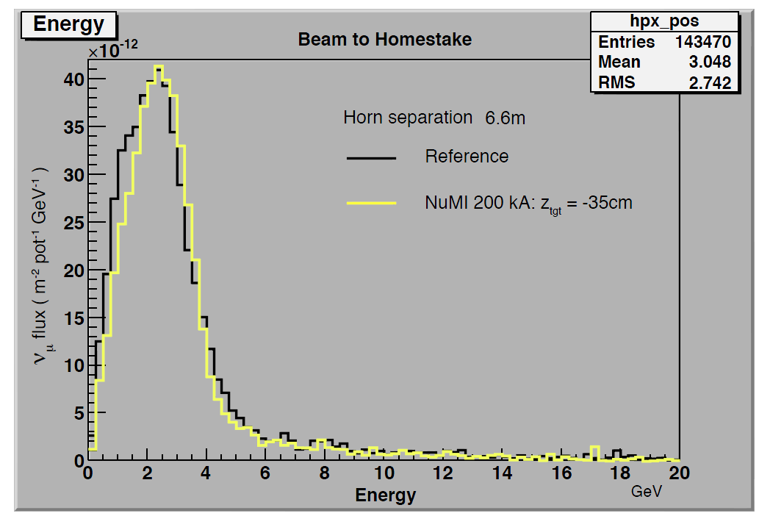
1.2 MW Target/Horn Considerations
When LBNE was reconfigured in 2012, in order to save money we abandoned our LBNE optimized target and horn designs and opted for NuMI designs with small modifications. (e.g. we were able to verify the NuMI horns up to 230 kA instead of their 200 kA design value).
CD1
~ 25% less flux on the 2nd oscillation max.
~ 3% more flux on the 1st oscillation max.
 | LBNE Sept. 2012 | LBNE March 2012
Beam Power | 708 kW | 708 kW
Horn 1 shape | Double Parabolic | Cylindrical/Parabolic
Horn current | 200 kA | 300 kA
Target | Modified MINOS (fins) | IHEP cylindrical
Target “Carrier” | NuMI-style baffle/ target carrier | New handler, target attaches to Horn 1
March 2012
September 2012
Tunable E_{ν} spectrum

Slide 7
1.2 MW Target/Horn Considerations
Our current plan is to check if modest modifications to the CD-1 (NuMI-like) designs can get us to 1.2 MW,
Minimize the redesign effort and the increase in cost.(Targets and horns are consumables).
As a first attempt reduce stress by increasing beam spot size. Use NuMI target as a base but increase the fin width to 10mm and beam sigmas to 1.7mm.
Minor loss of neutrino efficiency
Increased heating in target and horn
For the horns try to reduce the joule heating to make room for more beam heating (shorter pulse – cannot use the NuMI power supply).
New supply implements some design innovations

Slide 8
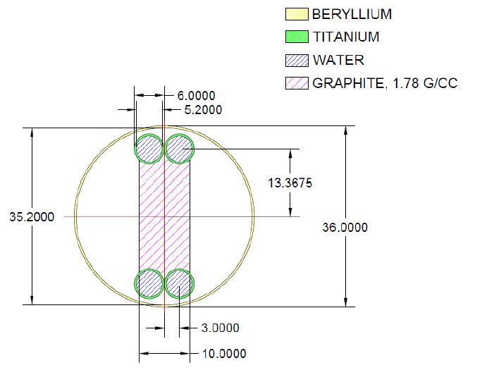
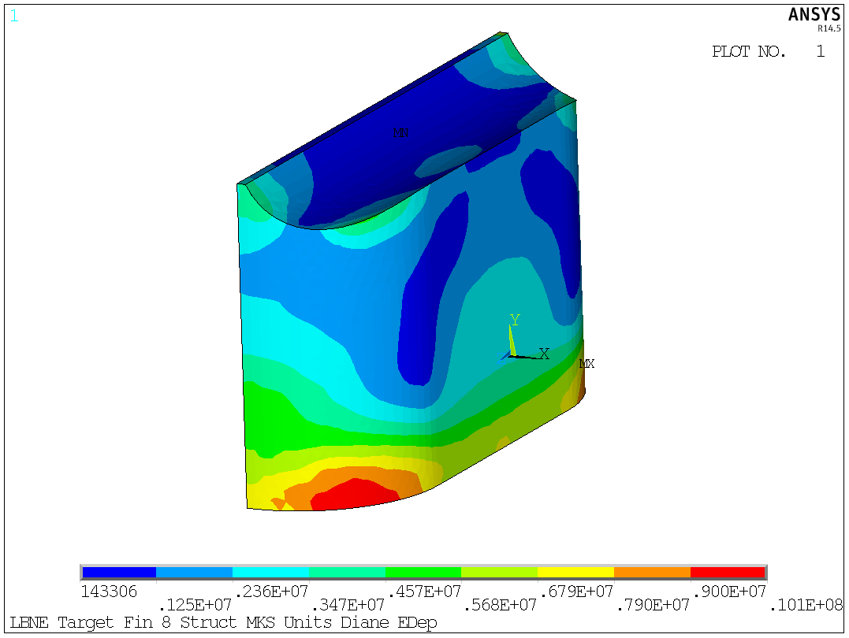
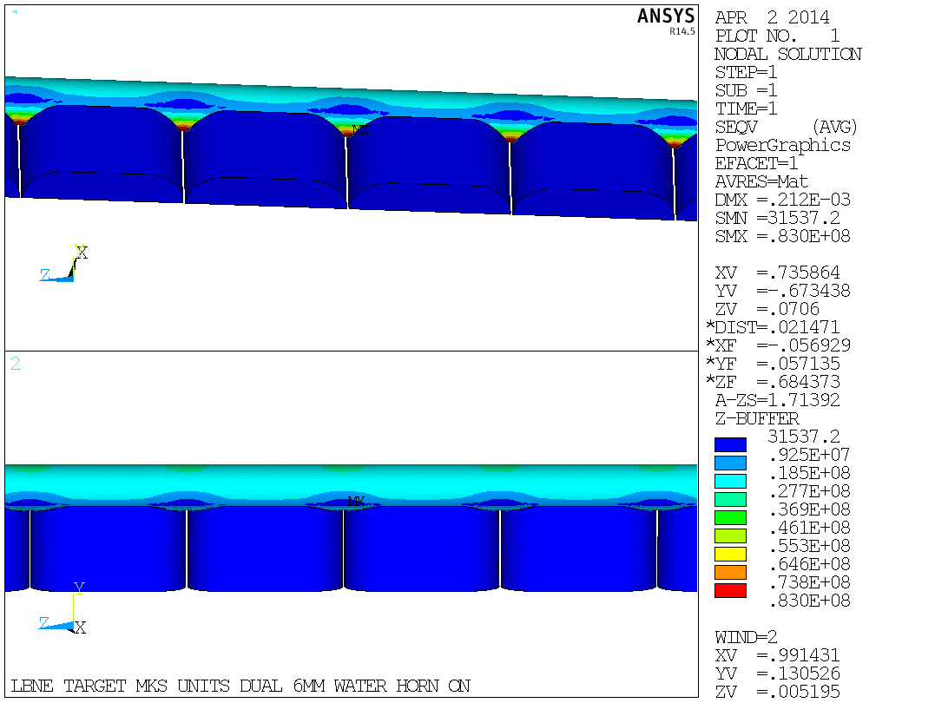
Preliminary target design for 1.2 MW
We are simulating this target design and the NuMI horns with MARS and GEANT. It will take a couple more iterations but we see no show stoppers for this design to work.
Graphite fin stress
mm
47 graphite segments, each 2 cm long
Water line stress

Slide 9
Preliminary target design for 1.2 MW
Target critical safety factors
Water hammer effect still to be analyzed
Expect to change graphite target ~2-3 a year for 1.2 MW operation
Limited lifetime due to radiation damage of graphite
Option remains for Be as target material pending validation.
Radiation damage a factor of 10 less than graphite (subject of R&D)
Target is a system that needs R&D in addition to engineering development in order to improve its lifetime and increase operational efficiency

Slide 10
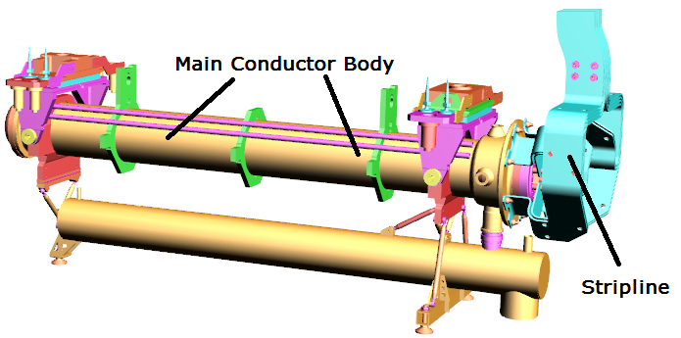
Horn Operation at 1.2MW
Parameters | 700 kW | 1.2 MW
Current Pulse Width | 2.1ms | 0.8ms
Cycle Time | 1.33s | 1.20s
Horn Current | 230kA | 230kA
Target Width | 7.4mm | 10mm
Protons Per Spill | 4.9 X 10¹³ | 7.5 X 10¹³
Water Tank
Beam heating and joule heating on horn 1 generate unacceptable power input into the horn inner conductor with the new target design and the NuMI horn power supply (2.1ms pulse width).
Higher energy depositions from the target can be offset by reducing the current pulse width to 0.8ms (requires a new horn power supply).
These changes allow the design current to remain at 230kA which is the upper current limit for a NuMI conductor design. We still need to analyze the horn stripline for 230 kA.
Increasing the radius of horn 1 neck transitions and moving the upstream weld further upstream may bring the safety factors to comfortable levels.

Slide 11
Lower Beam Energy
Certain agitators prefer LBNE operation at energies lower than 120 GeV
If the power can be preserved, may produce a slightly improved neutrino beam for certain analyses
More protons are required in these scenarios
Radiation damage and heating of target/horns scales more as the number of protons, rather than the beam power
These devices become more challenging with shortened lifetimes, but not impossible
Expect reduced uptime in order to replace components
Consumes beam from other users
Shorter Cycle time
Increased heating of pulsed elements
Magnets, horns
Complicated trade-off
Gains in neutrino flux can easily be offset by fewer operational hours and design compromises to deal with greater heating and radiation damage

Slide 12
Proton Improvement Plan-IV Performance Goals
S. Holmes et al., P5 presentation
Linac
Particle Type H⁻
Beam Kinetic Energy 8.0 GeV
Pulse rate 10 Hz
Pulse Width 6 × 4.3 msec
Particles per cycle to Recycler/MI 2.5×10¹³
Beam Power @ 8 GeV 320 kW
Main Injector/Recycler
Beam Kinetic Energy (maximum) 60/120 GeV
Cycle time 0.6/1.2 sec
Particles per cycle 1.5×10¹⁴
Beam Power at 60-120 GeV 2400 kW
LBNE “Facility” built for 2.3 MW
Shielding, Cooling channels, air channels, etc.
Beam items
Need to replace target, horns, windows
Challenging designs all around – LBNE expends no effort on these items
Incremental upgrade to cooling, air handling systems, etc.

Slide 13
NuMI High-Power Studies
Issues with extended running at high beam power
For 700 kW, most of the issues are only continued running with a few major vulnerabilities
Higher beam powers raise many concerns that need to be addressed
A upper limit of beam power in NuMI exists – likely somewhere between 1.5 and 2.0 MW
There have been a number of studies for higher power
The SNuMI effort (which spans the NOvA upgrades)
Considered upgrades of 1.2 and 2.0 MW
Project X upgrades
Continued, extended running just for NOvA
Reports to LBNE reconfiguration panel and Fermilab PAC
Bottom line is that NuMI could likely run at 1.2 MW if PIP-II came online before LBNE
Several uncertainties in facility (radionuclides, cooling)
Need 1.2 MW designs for target & horns from LBNE

Slide 14
Summary
LBNE is now being re-reconfigured to run at 1.2 MW from Day 1
Expect at least one more re-re-reconfiguration
Design work is ongoing, but challenges appear tractable for 1.2 MW
Modified target design
Modified horn pulse (and possibly horn itself)
60 – 80 GeV operation of LBNE
May be efficient in terms of neutrinos / kW
Has costs in terms of radiation damage, heating, and capability for other users
LBNE facility designed for 2.3 MW
Unreplaceable items designed from the start for high-power
Replaceable items have no designs
NuMI could also run at higher power (1.2 MW), if the timing dictated
Some different challenges from LBNE, but same issues with consumables
Thanks to Jim Hylen and Vaia Papadimitriou for slides and thoughts for this talk.

Slide 15
Neutrino Beamline Scaling Robert Zwaska Fermilab June 4, 2014 PIP-II Collaboration Meeting

Slide 16
The NuMI Beam “Neutrinos at the Main Injector”
Absorbs ~ 40 % of beam power
Allows high-energy muons to penetrate
2 m diameter
Roughly decay length for 10 GeV π⁺
He-filled
2 interaction length, C target
Produces π⁺, K⁺ mesons
400 kW design average power
700 kW upgrade for NOvA
σ ∼ 1 mm
Pulsed focusing horns
Toroidal magnetic field
Parabolic inner conductor profile
Focuses meson momentum band
Measure hadron & muon fluxes
Arrays measure distributions
Notes:
Go light on horn description, other details

Slide 17
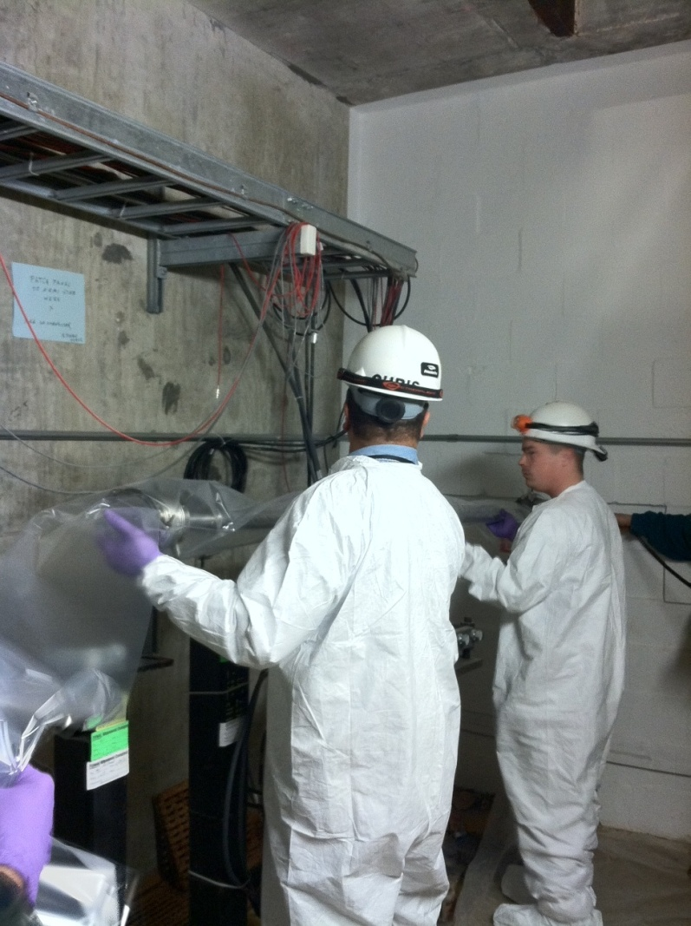
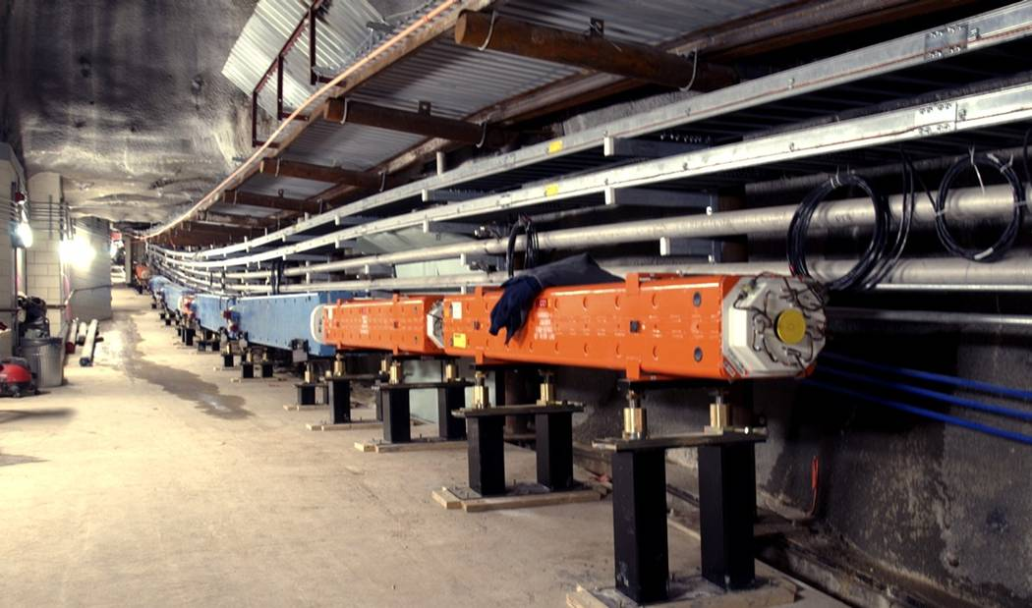
Primary Proton Beamline
Primary beamline is in mostly good shape
Continued maintenance of magnets, instrumentation, and utilities underground
Pre-target window did need replacement
Corrosion around brazing area – hopefully mitigated, but could occur again
Good procedure now exists for the replacement
Higher beam power would likely require replacement of some instrumentation and the beam window

Slide 18
Targets
700 kW target will exist from NOvA
Not suitable for low-energy running
Will have lifetime of ~ 1 year
LBNE 700 kW low-energy target could be adopted
Will require additional design and prototyping work if not pursued on LBNE
Concepts exist for higher power targets (up to 2 MW)
Often need to compromise in yield with a larger spot size and/or wider target
R&D and design work needed to advance any of these designs

Slide 19
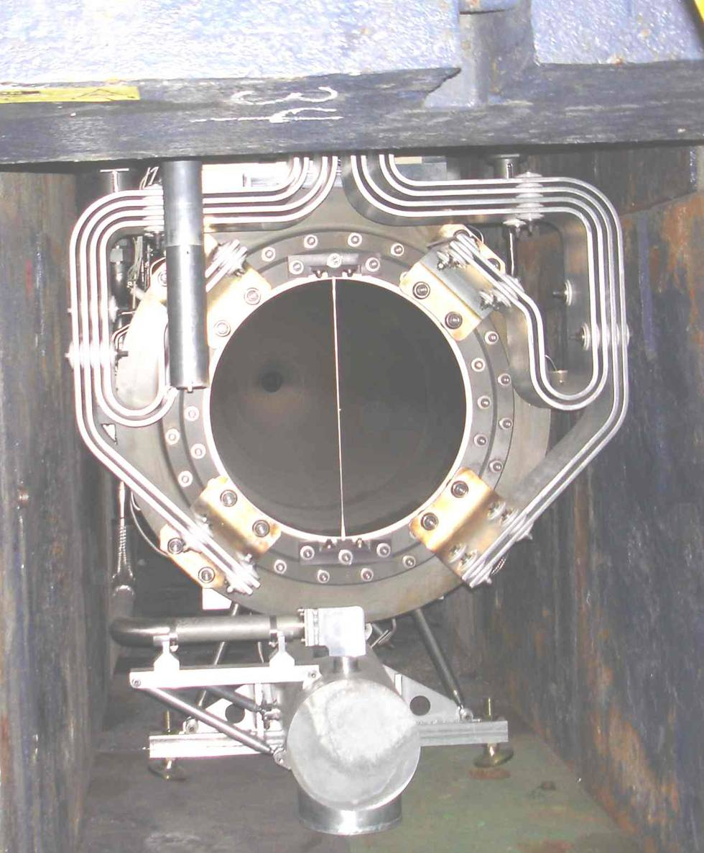
Horns
NuMI horns 1 & 2 for 700 kW will be operating for NOvA
Expect to last a few years each
Horn 2 is in medium-energy position
Relocation to the low-energy position is possible, but a big job
Low-energy “nest” exists for a possible 3rd horn installation
Would need study – material interactions may offset any focusing advantage
Horn 1 would require some upgrading of cooling capacity to accommodate a low-energy target position
Being pursued within LBNE
Horn 1 would require substantial redesign for higher-power operation

Slide 20
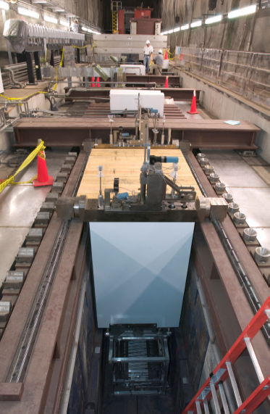
Target Shield Pile
Will be operating well for 700 kW
Requires air-cooling at present. Air-handling has been a difficulty in NuMI because of the corrosive, radioactive environment, but it is mostly in-hand now
Much higher beam powers would require water cooling. It has been investigated, but is expensive
Radionuclide inventory
Tritium and Na-22 are being handled by an extensive system within NuMI. Challenging, but working well now.
Both will almost be plateauing by 2020.

Slide 21
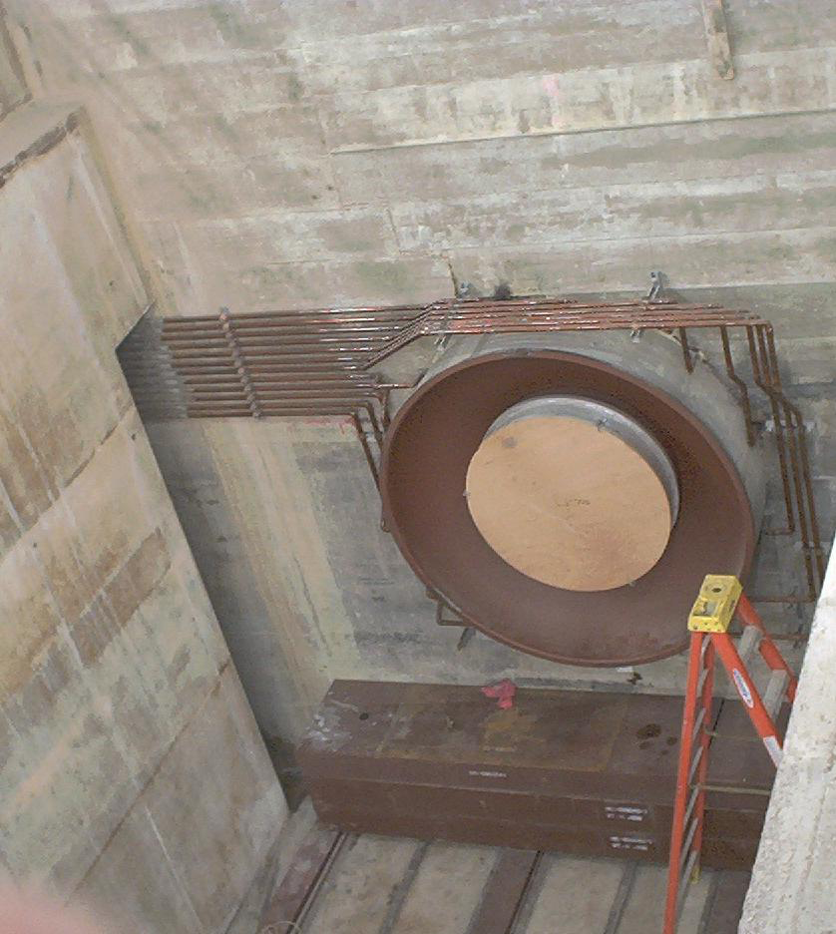
Decay Pipe
Decay pipe cooling operates very well at 700 kW and could likely accommodate higher-powers with only minor upgrades
Beam absorber can be similarly upgraded
Both are quite difficult to repair if major problems arise
One major issue is the decay pipe window
Possibility of corrosion build-up
Not designed for replacement
Replacement or mitigation would be costly and time-consuming
Replacement would be thicker

Slide 22
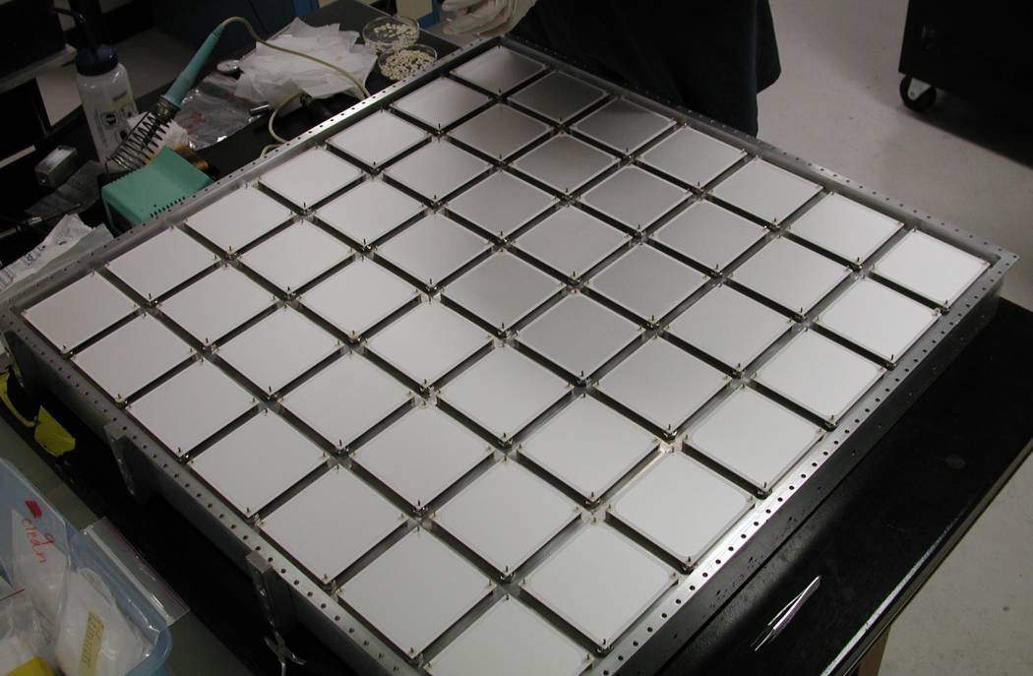
Instrumentation
NOvA hadron monitor is designed for 700 kW
Likely to require replacement every few years
Higher-power would require redesign of a difficult system
Muon monitor systems are insensitive to beam power
However, they are ageing and could use replacement at some point

