Slide 1
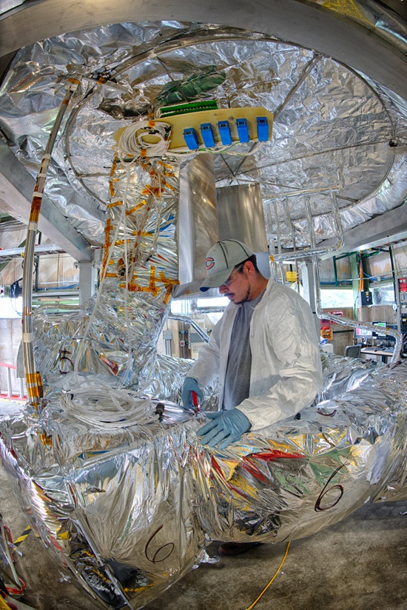
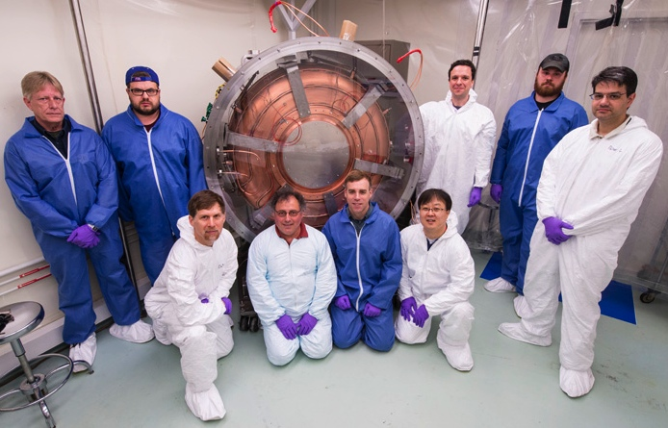
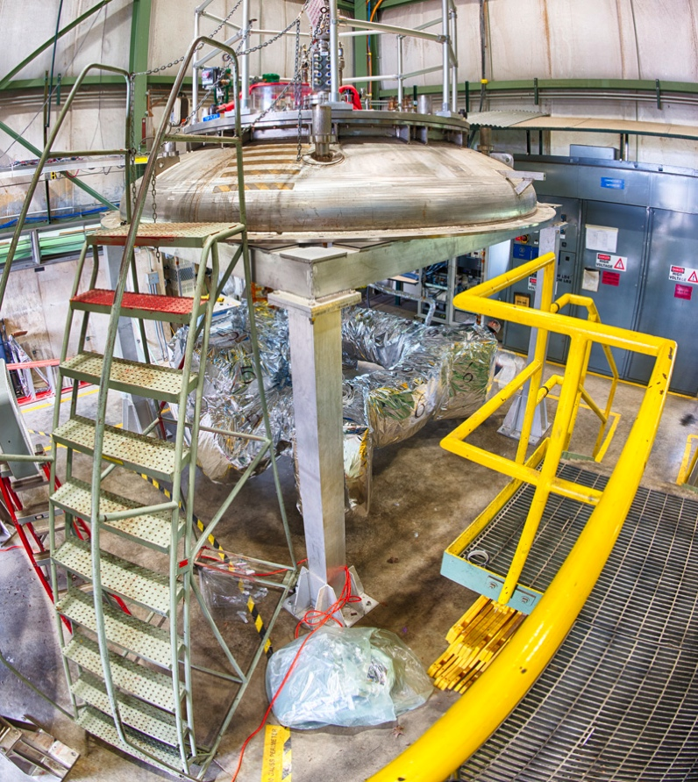
The Muon Accelerator
Staging Study (MASS)
Mark Palmer
PIP-II Collaboration Meeting
FNAL, June 3-4, 2014

Slide 2
Introduction and Context
The focus of the Muon Accelerator Program (MAP) is on the R&D required to demonstrate feasibility of muon accelerators for HEP applications
  Neutrino Factories (NF)
    Both long and short baseline
  Muon Colliders (MC)
    Higgs Factory to multi-TeV Scale
  Also muon accelerator concepts that can support ongoing/planned experiments (eg, narrow band neutrino beam line & cooled muon source)
The NF and MC Muon Accelerator capabilities are strongly linked
  With key synergies that can be exploited to control technical risk and cost
  A unique breadth of physics that can be supported
Program scope spans near- to long-term facility concepts!

Slide 3
Physics Case for the Neutrino Factory
Short Baseline Neutrino Factory
  nuSTORM
    Definitive measurement of sterile neutrinos
    Precision ν_{e} cross-section measurements (systematics issue for long baseline SuperBeam experiments)
    Would serve as an HEP muon accelerator proving ground…
Long Baseline Neutrino Factory with a Magnetized Detector a CP Violation
  IDS-NF (International Design Study for a Neutrino Factory)
    10 GeV muon storage ring optimized for 1500-2500km baselines
    “Generic” design (ie, not site-specific)
  NuMAX (Neutrinos from a Muon Accelerator CompleX)
    Site-specific: FNAL a SURF (1300km baseline)
    4-6 GeV beam energy
    Can provide an ongoing short baseline measurement option
    Detector options
      Magnetized LAr is the goal
      Magnetized iron provides equivalent CP sensitivities using ~3x the mass
  Both options provide a route to high precision measurements in the ν sector with very well understood systematics
  a The advantage of high intensity “precision beams” capable of sensitive probes for new physics

Slide 4
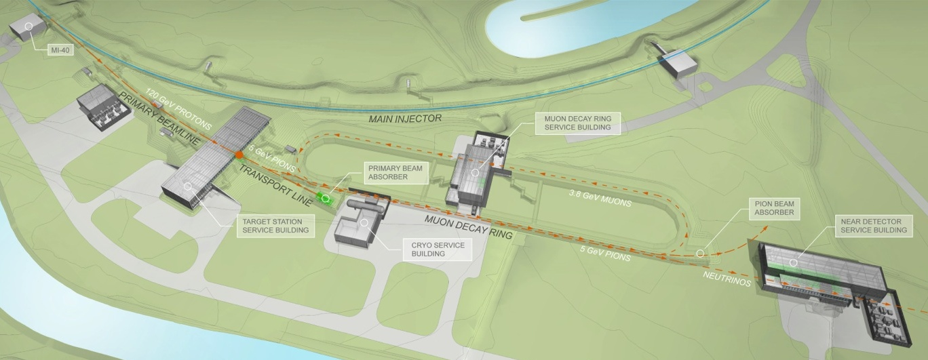
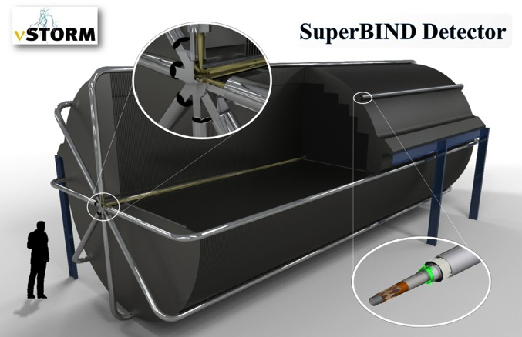
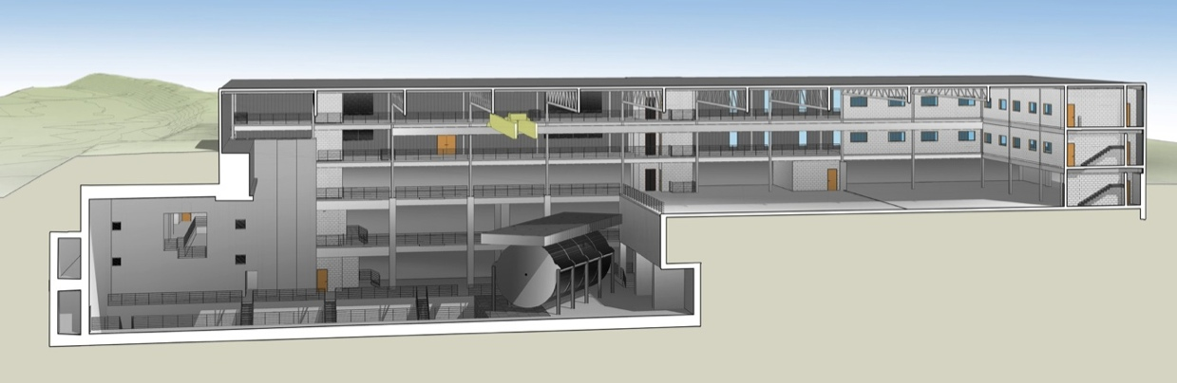
νSTORM
μ decay ring: P = 3.8 GeV/c ± 10%
To Far
Hall
Near Hall
Far Hall @1.9km
Far Detector

Slide 5
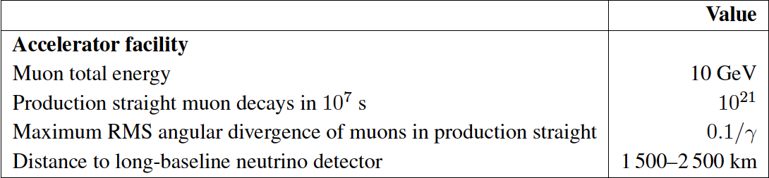
The Neutrino Factory
IDS-NF: the ideal NF
  Supported by MAP
MASS working group: A staged approach -
NuMAX@5 GeVaSURF

Slide 6
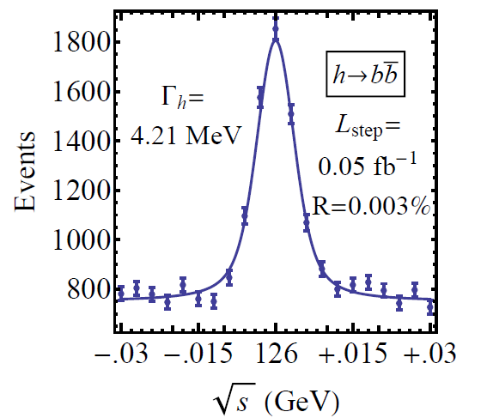
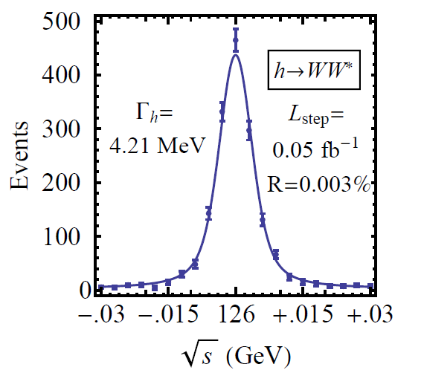

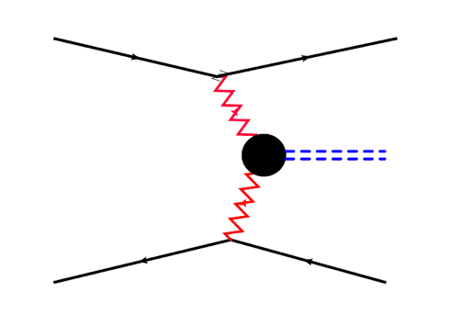



Physics Case for a Muon Collider
Superb Energy Resolution
  SM Thresholds and Higgs Factory operation
At multi-TeV
  Compact & energy efficient machine
  Luminosity > 10³⁴ cm⁻² s⁻¹
  Option for 2 detectors in the ring
  For √s > 1 TeV: Fusion processes dominate
  a an Electroweak Boson Collider
  a a discovery machine complementary to a
  pp collider with E_{pp}≈7E_{MC}
At >5TeV CoM, could provide Higgs
self-coupling resolutions of <10%
What if upcoming runs with the LHC shows
evidence for a multi-TeV particle spectrum?

Slide 7
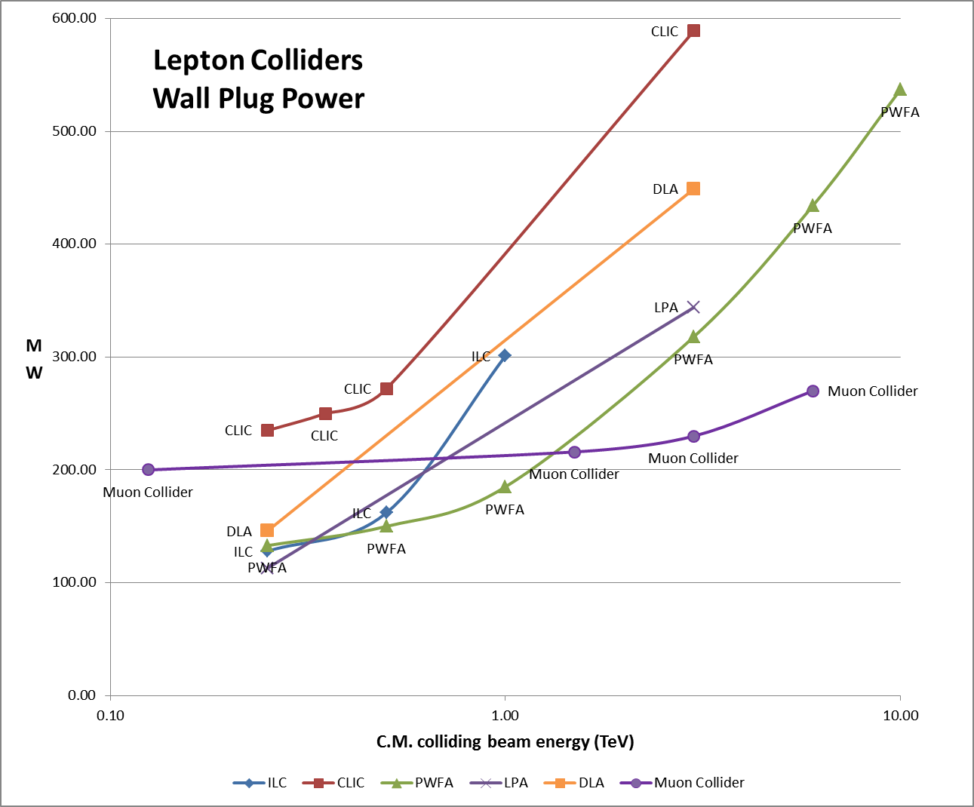
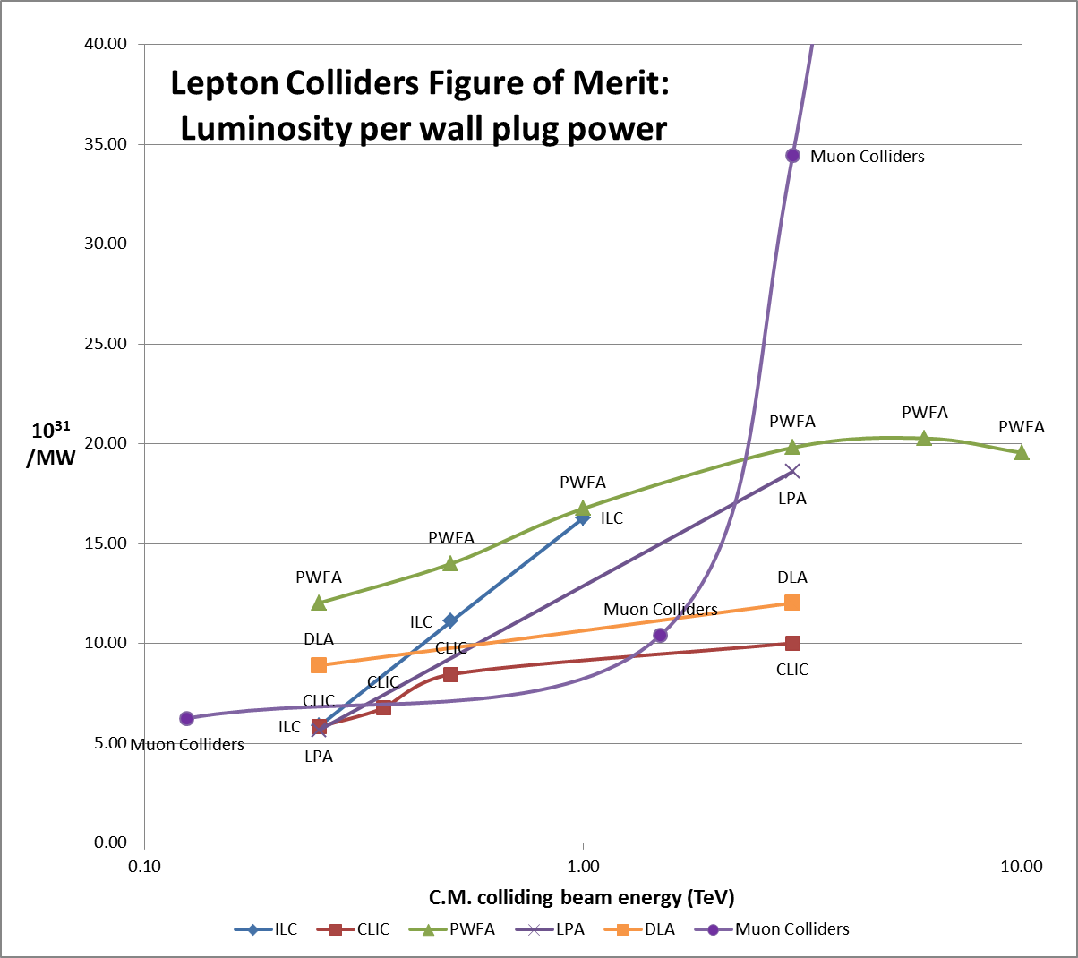
Muon Colliders extending high energy frontier with potential of considerable power savings
Muons colliders do everything that e+/e- colliders do,
but with better performance and more efficiently
(at high CoM energy)
Muon Colliders are an ideal technology
to extend high energy frontier in the multi-TeV range
with reasonable footprint, cost and power consumption
a Requires Feasibility Demonstration!

Slide 8
The Muon Accelerator Staging Study (MASS) and Initial Baseline Selection Process (IBS)
MASS is a MAP working group charged with:
Developing a realistic staging plan for a muon accelerator facility
Examining synergies and optimizations for a facility that could support both NF and MC capabilities
a new design approaches
Identifying critical R&D demonstrations that are required
The recommendations from MASS have been incorporated in the MAP IBS process to establish a baseline configuration for deploying staged muon accelerator capabilities

Slide 9
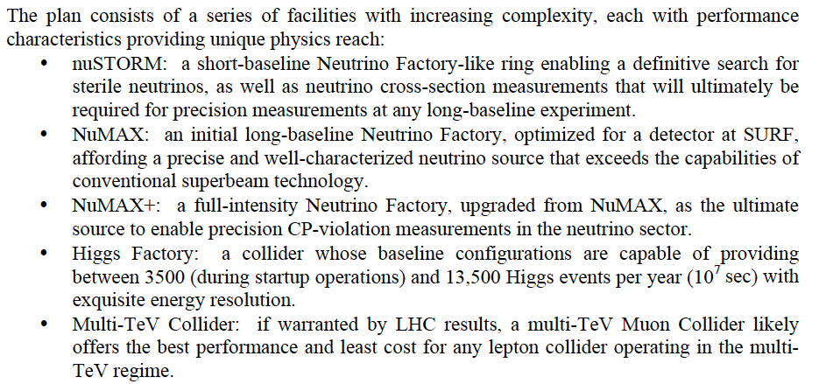
MASS Contribution to Snowmass
Enabling Intensity and Energy Frontier Science with a Muon Accelerator
Facility in the US - http://arxiv.org/pdf/1308.0494

Slide 10
MC/NF Synergies

Slide 11
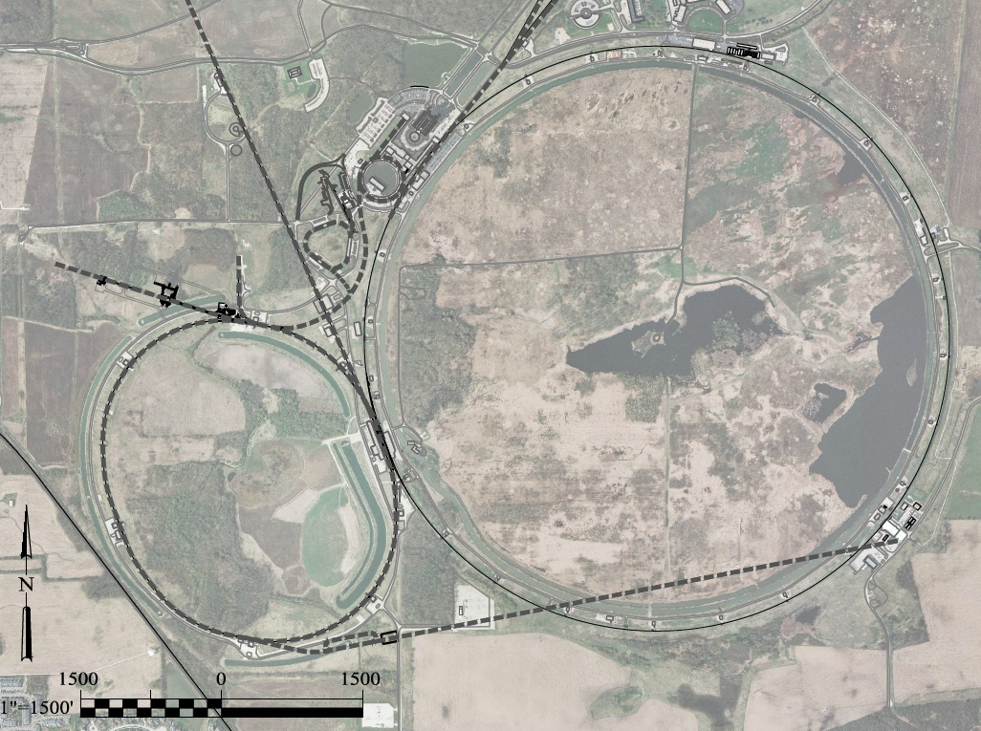
A Potential Muon Accelerator Complex at Fermilab:
νSTORM ➔ NuMAX
➔ Higgs Factory
1 GeV Proton
Linac
LBNE
Superbeam
Accumulator
&
Compressor
Rings
Front
End
1-3 GeV Proton
Linac (PIP-III)
Remains fully compatible with the PIP-II a III staging option
To
SURF
Target
Final
Cool
NuMAX:
νs to SURF
6D
Cool
Initial
Cool
1 GeV Muon
Linac (325MHz)
RLA to 63 GeV
To Near Detector(s) for
Short Baseline
Studies
3-7 GeV Proton &
1-5 GeV Muon
Dual Species Linac
300m Higgs Factory
Muon Collider
Muon Beam
R&D Facility
νSTORM
A 6 TeV Muon Collider would have a similar circumference as the Tevatron Ring
ft
ft

Slide 12
CP Violation Sensitivity
NuMAX+ targets equivalent sensitivity to CP violation in the ν sector as has been achieved in the flavor sector
nuSTORM + T2HK offers significantly improved sensitivity vs T2HK alone
GLoBES Comparison of Potential
Performance of the Various
Advanced Concepts (courtesy P. Huber)

Slide 13
A Staged Plan with NuMAX at Fermilab
GLoBES Comparison of Potential
Performance of the Various
Advanced Concepts (courtesy P. Huber)

Slide 14
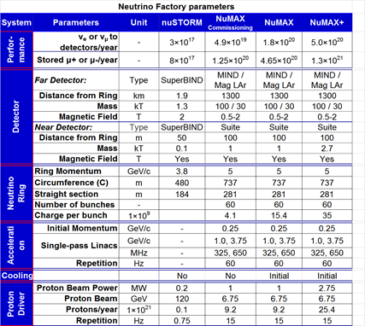
NF Staging (MASS)
6D

Slide 15
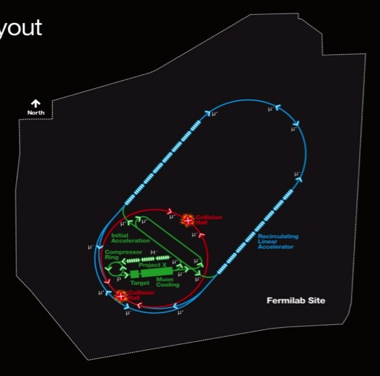
Muon Collider Parameters
Exquisite Energy Resolution
Allows Direct Measurement
of Higgs Width
Success of advanced cooling
concepts a several × 10³²
Site Radiation mitigation with depth and lattice design: ≤ 10 TeV

Slide 16
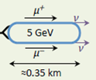
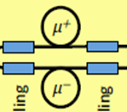

Progressive installation in stages with Physics and technology validation at each stage
NumAX
commissioning
Sub-TeV Collider
Higgs or Top Factory
NuMAX
Multi-TeV Collider
PIPII
NuMAX & NuMAX+
0.8GeV
Post-cooling
Accelerator
PIPIII
Dual use
Linac
Higgs
Factory
Final Cooling
Test Facility
2.2GeV
0.25 GeV
μ
Preinjector
3.75GeV
650MHz
125GeV
300 m
Final cooling
1.0 GeV
325MHz
RLA
6.75 GeV
Protons
6D cooling
Bunch
merge
6D cooling
255MeV/c
Muons
RCS
Charge separator
To MI for
LBNE upgrade
1.5 to 6 (10) TeV
2.5 to 6km
Target
Muon
Collider
Front-end
Buncher
6D Cooling
Initial Cooling
Test Facility
Combiner
6D Cooling
Test Facility
Initial Cooling
Accumulator

Slide 17
Critical Elements of the MASS Recommendations
Just a few key highlights…
Cooling – Initial Cooling should utilize a 6-dimensional scheme
  Best performance, greatest flexibility in the acceleration systems, and most cost effective solution for any high intensity facility
  Nonetheless, NuMAX initial operations can begin and will produce useful physics in the absence of cooling on day 1
Proton power trade-offs
  NuMAX + TeV-scale collider schemes do not necessarily require 4MW class targets – rather powers no greater than that already proposed for LBNF
A dual-use linac design for both proton and muon acceleration should be pursued. Concept appears reasonable and would offer a cost effective route from superbeams to much higher quality neutrino beams

Slide 18

MAP Timeline a Provide Informed Decision Points
 | 2010 |  | ~2020 |  | ~2030
Muon Accelerator R&D Phase
Proton Improvement Plan @ FNAL
Intensity Frontier
Energy Frontier
MAP Feasibility Assessment
Advanced Systems R&D
Indicates a date when an informed decision should be possible
Muon Ionization Cooling Experiment (MICE)
PIP-II
And Further Proton Source Improvements
IDS-NF RDR
Proposed Muon Storage Ring Facility (νSTORM)
Option for Long Baseline ν Factory
Collider Conceptual ➔ Technical Design
Option for μ Collider

Slide 19
Conclusions I
Muon accelerators can provide unique options for facilities at the intensity and energy frontiers
  Precision neutrino measurements and corresponding sensitivity to new physics
  A promising path to a multi-TeV lepton collider:
    if required by (new) Physics
    with reasonable footprint, cost & power consumption
  A TeV-scale collider has complementary discovery potential to a 100TeV pp FCC
    See talk by Estia Eichten: https://indico.fnal.gov/getFile.py/access?contribId=16&sessionId=0&resId=0&materialId=slides&confId=8326)
  MAP Program Execution Plan endorsed by DOE Review in Feb 2014 for completion of feasibility assessment by 2020.

Slide 20
Conclusions II
An attractive Staging Path for Muon Accelerators:
  A series of facilities with increasing complexity and physics reach – with manageable budget and risk for each stage
  Provides an integrated R&D platform at each stage for validation of the technologies required by subsequent stages
  Informed technical decisions for specific facilities would be by the early 2020s for a long-baseline Neutrino Factory (NuMAX) and by late 2020s for a Muon Collider
  A facility capable of flexibility adapting to a range of physics requirements
Such a facility would be uniquely suited to the accelerator complex at Fermilab
  A natural extension of the LBNF concept
  Ability to respond to various physics thrusts

Slide 21
Conclusions III
Where are we heading now? P5 Recommendations…
  Had already presented a plan for an expedited conclusion to MICE to the MICE Project Board in April – endorsed
    Includes Step IV measurements in 2015-16 and deployment of
    Step V configuration by 2017 (demonstration of “cooling with RF”)
  Have been requested by DOE to prepare a ~3 year transition plan
    Strong sensitivity to prior investment
    Strong sensitivity to international commitments
    3 Major Thrusts:
      MICE Conclusion
      Critical activities that should be preserved within the GARD program
      Lower priority items that will be deferred
    Review planned for July
      Serves as input to the Accelerator R&D Panel and will determine FY15 budget while waiting for the panel’s report

Slide 22
BACKUP SLIDES:
MAP R&D Efforts

Slide 23
R&D Effort
Scope of the MAP Feasibility Assessment:
  Provide:
    Specifications for all required technologies
    Baseline design concepts for each accelerator system
  For novel technologies:
    Carry out the necessary design effort and R&D to assess feasibility
    Note: a program of advanced systems R&D is anticipated after completion of the feasibility assessment
  Ongoing Technology R&D and feasibility demonstrations include:
    MuCool Test Area experimental program (FNAL): RF in high magnetic fields
    The Muon Ionization Cooling Experiment (MICE@RAL):
      Demonstration of emittance reduction
      Validation of cooling channel codes
    Advanced magnet R&D
      Very high field magnets (cooling channel and storage rings)
      Rapid cycling magnets for acceleration of short-lived beams

Slide 24
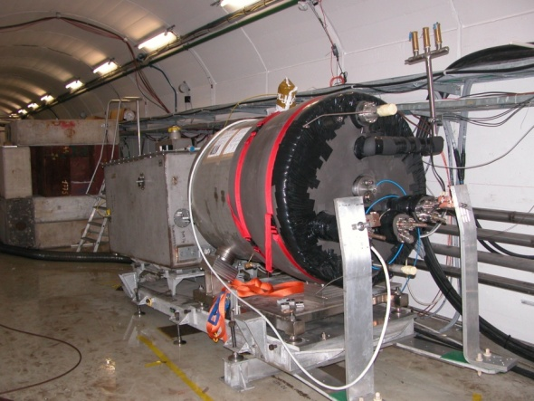

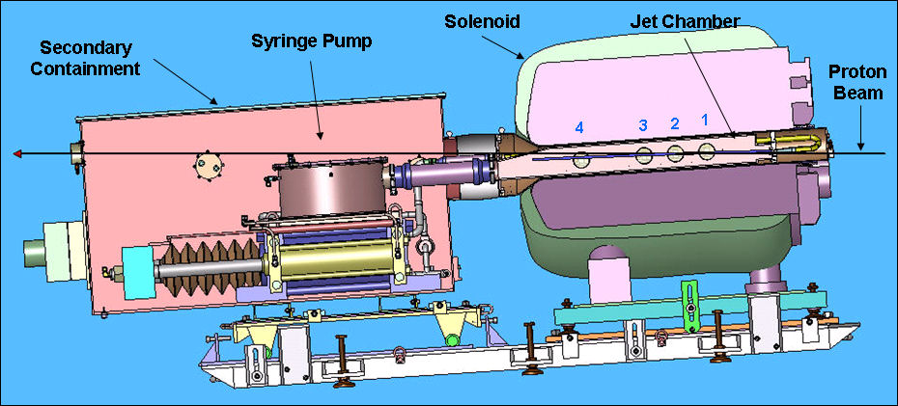
Key Technologies - Target
The MERIT Experiment (2007@CERN PS)
  Demonstrated a 20m/s liquid Hg jet injected
  into a 15 T solenoid and hit with a
  115 KJ/pulse beam!
  Jets could operate with beam powers up to
  8 MW with a repetition rate of 70 Hz
MAP staging aimed at initial 1 MW target capability (carbon)
1 cm
Hg jet in a 15 T solenoid
with measured disruption length ~ 28 cm

Slide 25
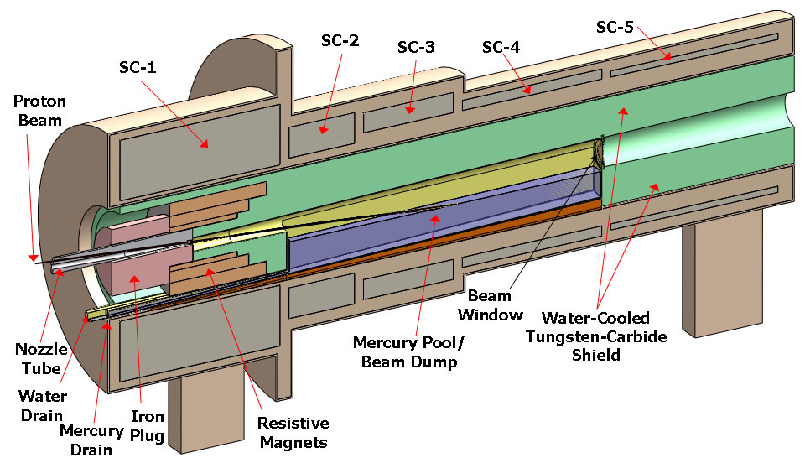
TechnoIogy Challenges – Capture Solenoid
A Neutrino Factory and/or Muon Collider Facility requires challenging magnet design in several areas:
  Target Capture Solenoid (15-20T with large aperture)
  E_{stored} ~ 3 GJ
  O(10MW) resistive
  coil in high radiation
  environment
  Possible application
  for High Temperature
  Superconducting
  magnet technology

Slide 26
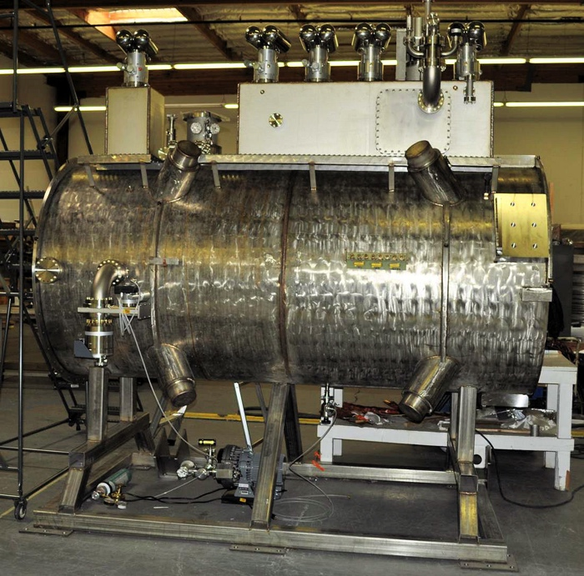
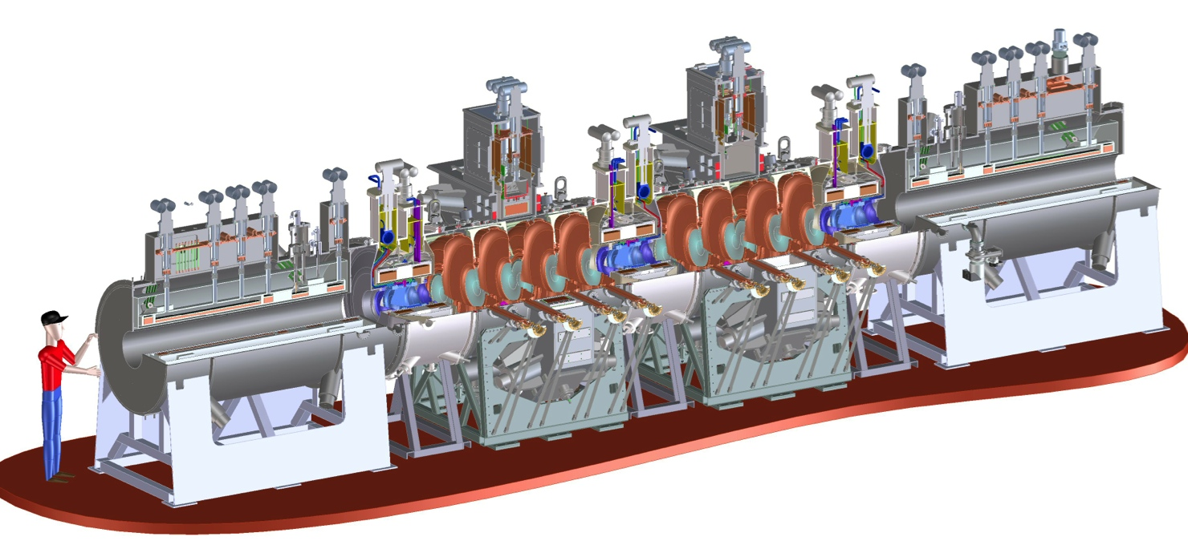
Technology Challenges - Cooling
Tertiary production of muon beams
  Initial beam emittance intrinsically large
  Cooling mechanism required, but no
  radiation damping
Muon Cooling a Ionization Cooling
    dE/dx energy loss in materials
    RF to replace p_{long}
First SS delivered
to RAL for Step IV
Experiments in 2015
MICE
  The Muon Ionization
  Cooling Experiment:
  Demonstrate the
  method and validate
  our simulations
RF-Coupling
Coil (RFCC)
Units
Spectrometer
Solenoids

Slide 27
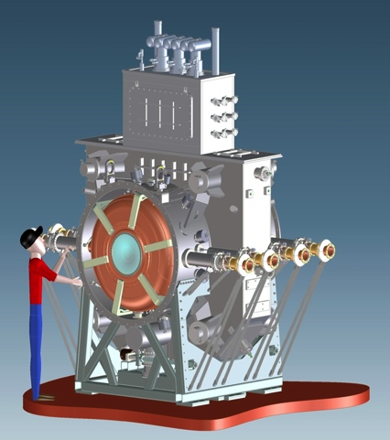
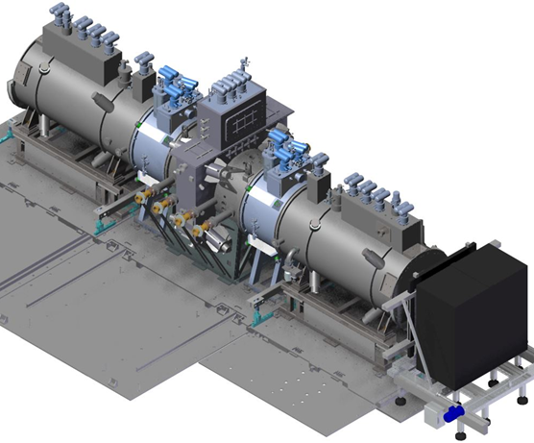
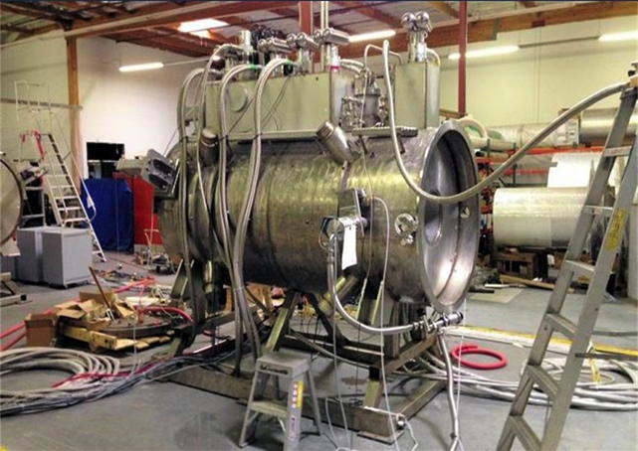
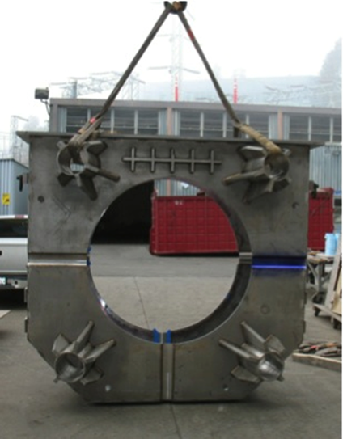
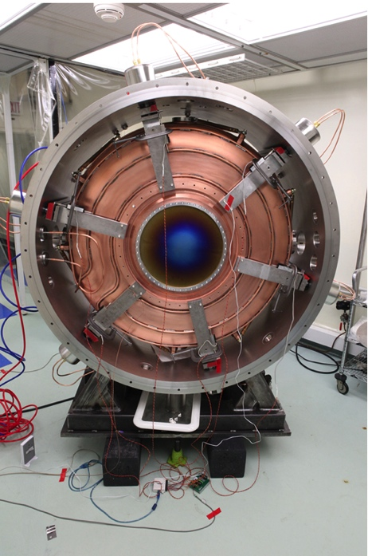
Progress on MICE @ RAL
All detectors have been built and tested
Step IV Magnets delivered
Step V beamline hardware under construction
Construction Milestones:
Step IV without acceleration completed by March 2015
Step V with acceleration completed by 2017
17

Slide 28
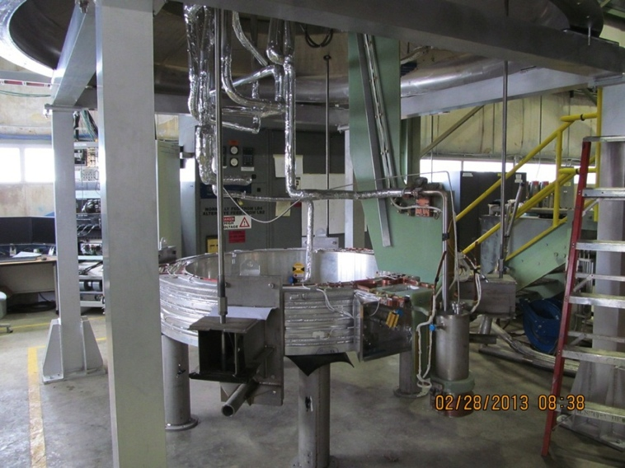
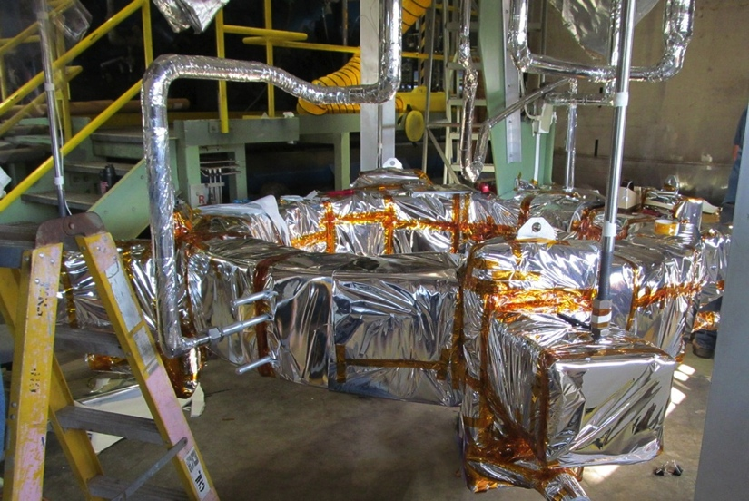
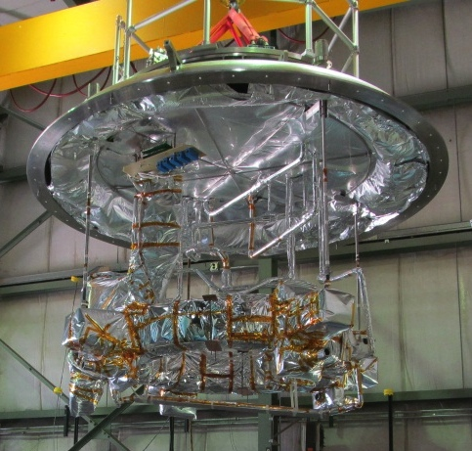
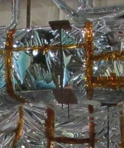
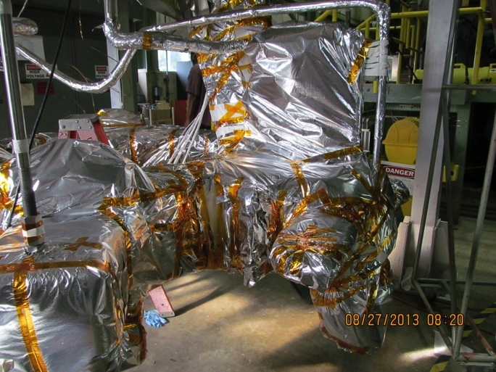
MICE CC Cold Mass #1 (Step V) Successfully Tested at the FNAL Solenoid Test Facility (STF)

Slide 29
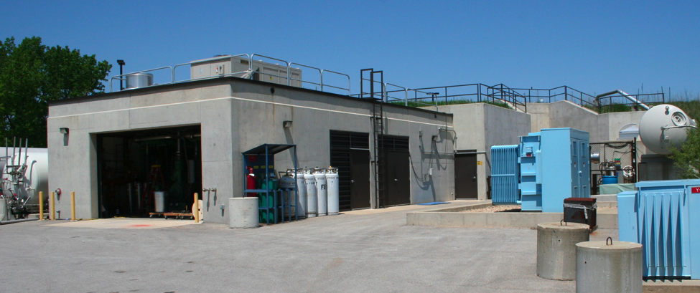
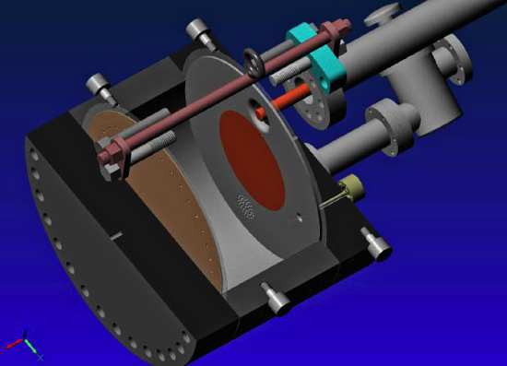
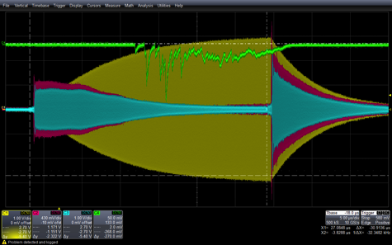
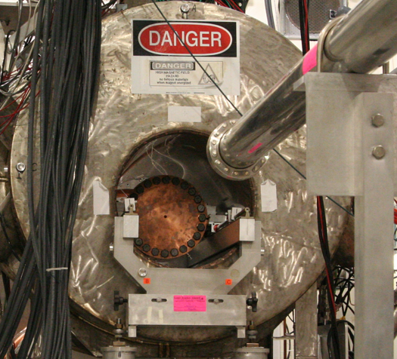
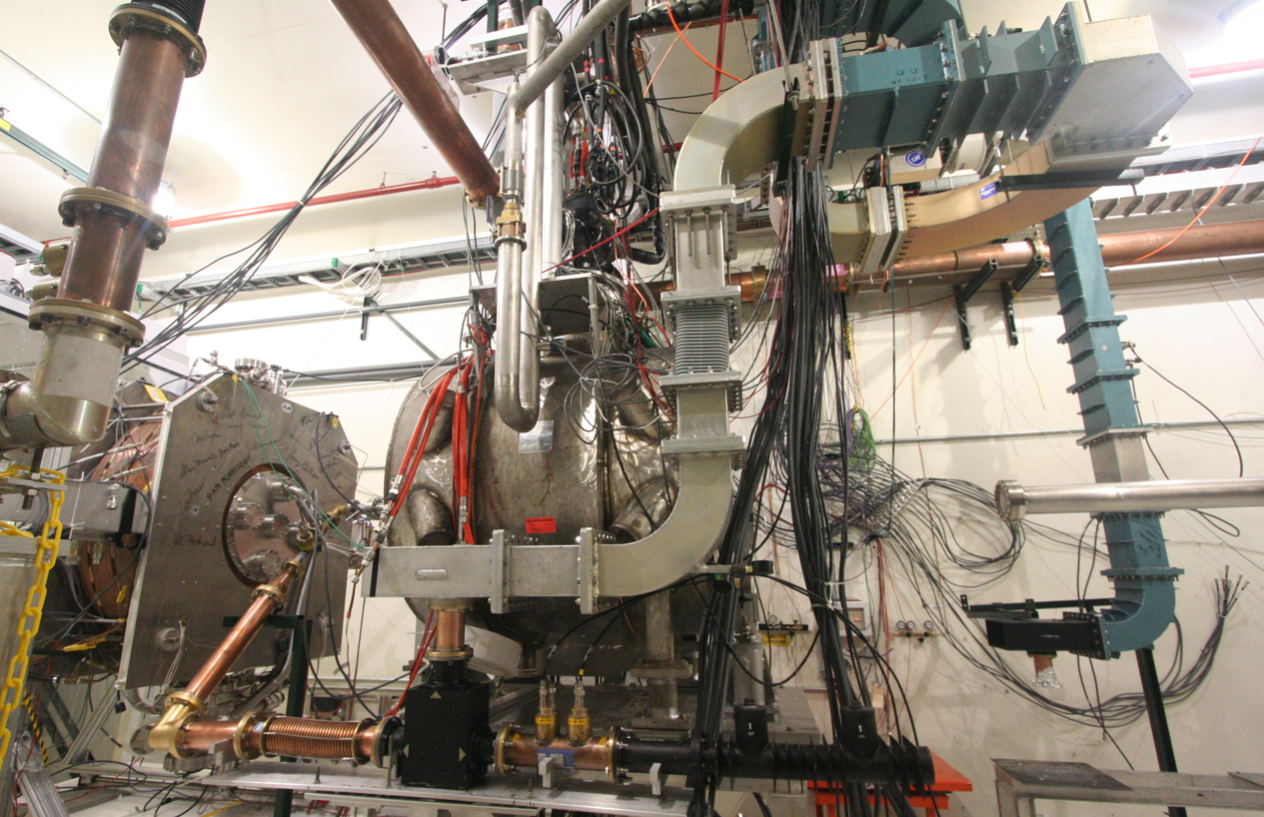
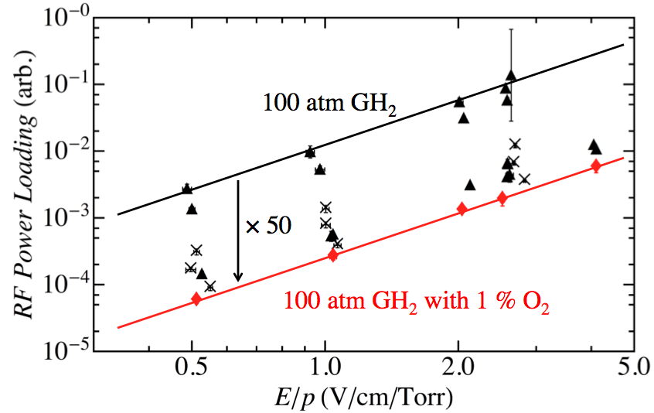
The RF R&D Program
MuCool Test Area
Vacuum RF Cavity –
now operational in 5T B-field
Entrance of
MTA exp. hall
Compressor + refrigerator room
400 MeV
H⁻ Beam
20 MV/m in 3 Tesla
MTA Hall
Gas-Filled RF cell
201 MHz MICE cavity
SC magnet
400 MeV H⁻ beam

Slide 30
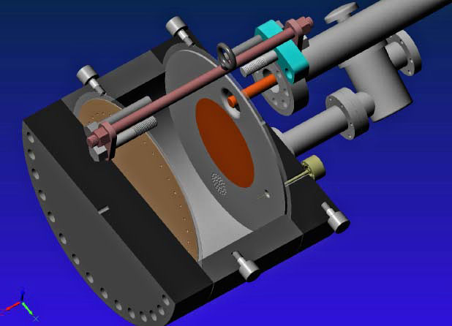
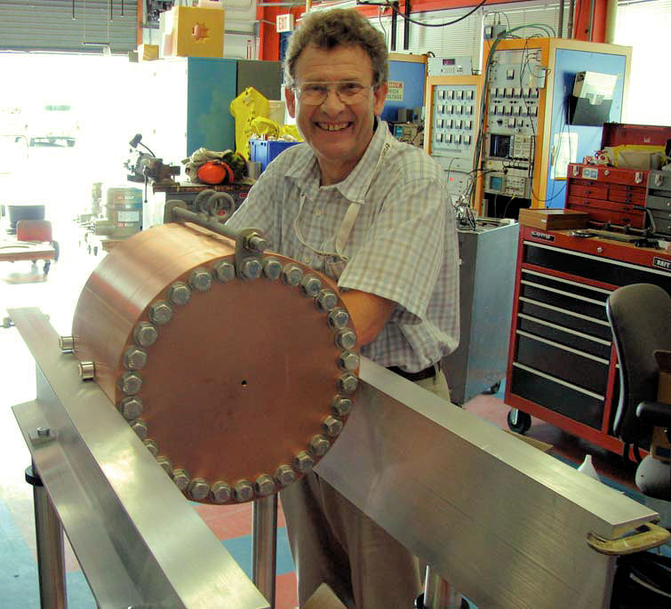
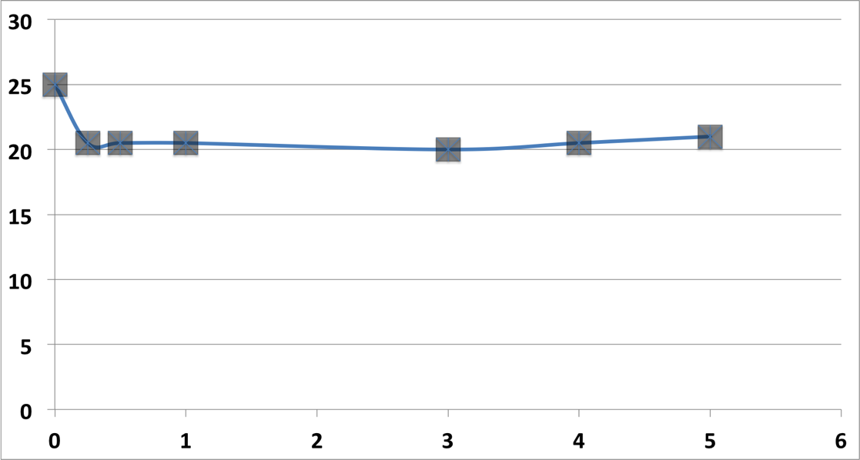
Recent Progress – Vacuum RF
All Seasons Cavity
(designed for both vacuum and high pressure operation)
Now operated in magnetic fields up to 5T:
  Gradients > 20 MV/m
Demonstrates possibility of successful operation of vacuum cavities in magnetic fields with careful design
Successor design (the 805 MHz Modular Cavity) will be ready for testing during FY14
Also progress on alternative cavity materials
Max. Stable Operating gradient (MV/m)
Preliminary Data

Slide 31
Recent Progress - High Pressure RF
Gas-filled cavity
  Can moderate dark current and breakdown currents in magnetic fields
  Can contribute to cooling
  Is loaded, however, by beam-induced plasma
Electronegative Species
  Dope primary gas
  Moderates the loading effects of beam-induced plasma by scavenging the relatively mobile electrons
1% Dry Air (0.2 % O2) in GH2
Pure GH2
1% Dry Air
(0.2 % O2)
in GH2 at
B = 3 T
Beam on
~50× change in
RF dissipation
5/22/12
E₀ = 25 MV/m
31
E₀ = 25 MV/m
Results extrapolate well to NF operation and a range of MC beam parameters

Slide 32
Overview of MAP Magnet Pull
Muon Ionization
6-Dimensional Cooling Channel
Acceleration to the TeV Energy Scale for Muon Colliders
Muon Collider Magnet Needs
Muon Ionization Final Cooling Channel
HTS Magnet Development
Capture Solenoid for Simultaneous mu+ & mu- Beams
High field (15-20T)
Large bore (meter-scale)
Intense radiation environment – NC or HTS insert coil
Characteristics:
Characteristics:
Solenoid-based cooling channel (LH₂/LiH absorbers)
RF cavities integral to focusing channel
Fields ranging from LTS to HTS conductor regime
Characteristics:
Emittance exchange channel for TeV-scale colliders (trade increased longitudinal beam emittance for smaller transverse emittance
Baseline: 30T class HTS solenoids with a>25mm
Characteristics:
Present baseline based on the use of Rapid Cycling Synchrotrons
Requires magnets capable of ~400Hz operation with >1.5T peak fields
Characteristics:
Decaying muon beams mean that luminosity is inversely proportional to circumference
10T dipole a 15-20T dipoles improves luminosity
Radiation environment
Challenging IR magnets
Characteristics:
A MC (w/decaying beams) obtains the greatest performance enhancement of any HEP collider from HTS magnet technology
High quality HTS cables and magnets must be a priority
Feasibility R&D through End of Decade

Slide 33
Final Cooling Channel
Final Cooling
  Requires > 30T Class Solenoids
  Demonstration program
  exploring critical magnet issues
  (R. Gupta at BNL)
    High J_{E}
    Quench Protection
    Stress
    Piece Length Constraints
Anticipate a Final Cooling
concept review in 2016
HTS (1&2, funded) and LTS (3, not funded)
HTS solenoids – built and individually tested

Slide 34
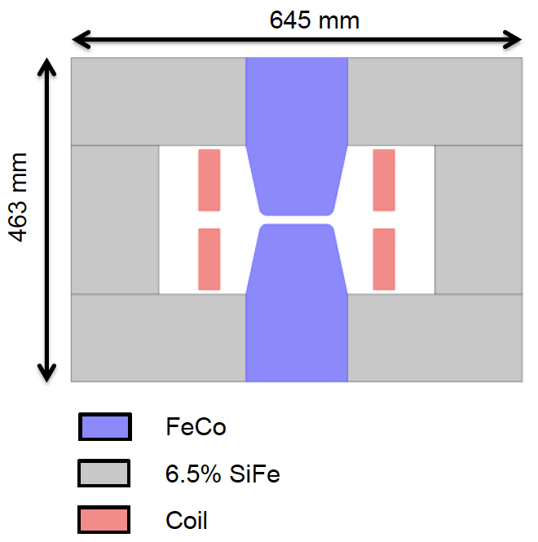
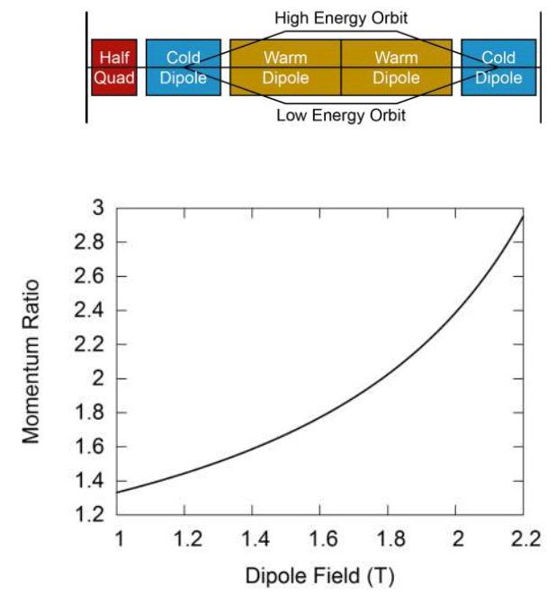
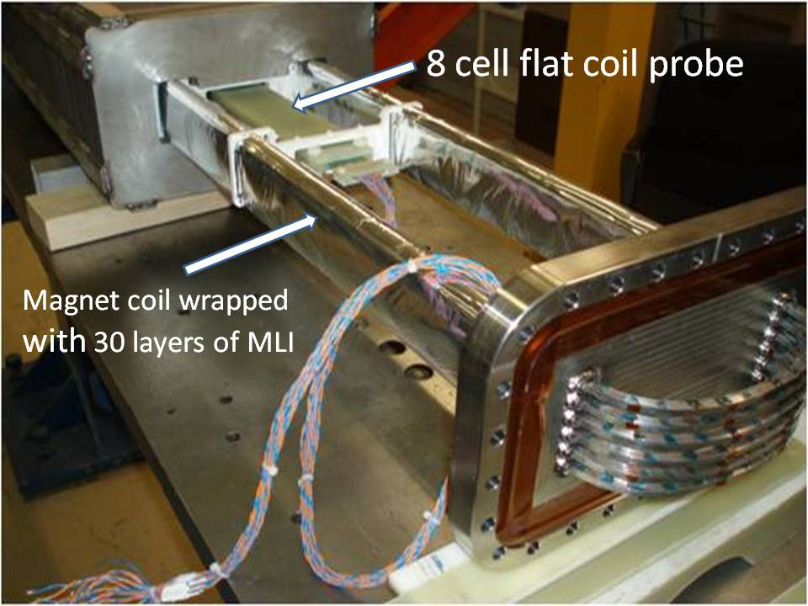
Magnets for the Acceleration Chain
Muons require an ultrafast accelerator chain
a Beyond the capability of
most machines
    For 100’s of GeV to
    the TeV-scale, Rapid
    Cycling Synchrotrons
    (RCS) offer the most
    efficient scheme
NC Coil
Concept
HTS Test
Magnet
  RCS requires ~2 T p-p magnets
  at f = 400 Hz (BNL, U Miss & FNAL)

Slide 35
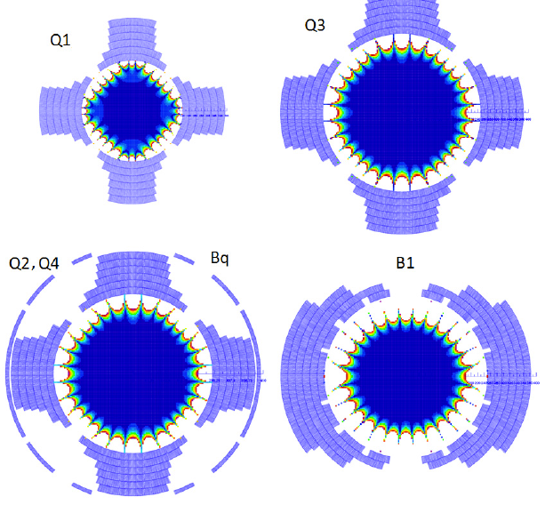
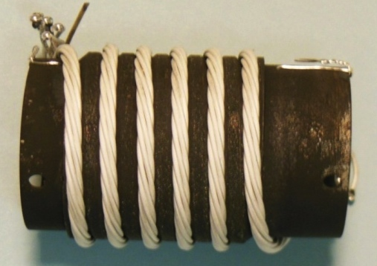
Collider Ring Magnets
Magnet design R&D for collider ring and IR magnets that have to deal with the expected high level of energy deposition from μ decay electrons
Pursuing design concepts that allow for suitable shielding
As with the LHC, pushing the field limits for magnets can impact the energy reach. For the MC, this also directly impacts the luminosity performance!
Requires high field quality designs and hence the necessary cable development. Substantial progress in Bi2212 over the past year.
Higgs Factory IR Magnet Designs
20 T Class Bi2212 Cable

Slide 36
The MAP Collaboration
Participants in FY14
  People:
  ~150 individuals
  ~50 FTEs
  International Efforts:
    International Design Study for a Neutrino Factory (IDS-NF)
    Muon Ionization Cooling Experiment (MICE at RAL)
  Participating Institutions (21)
    FNAL (host), ANL, BNL, Cornell, CMU, Chicago, ICL, IIT, JLAB, LBNL,
    Mississippi, Muons Inc, ORNL, PBL, Princeton, SLAC, SUNY-SB, UC-Berkeley, UCLA, UC-Riverside, VT
MAP supports a broad accelerator R&D effort
a Many opportunities exist for expanded collaboration

Slide 37
MC: Luminosity Production Metric
Muon
Collider
Luminosity
Metric:
N_{det} × L_{avg} / P_{tot}

Slide 38
A Potential Muon Accelerator Complex at Fermilab:
➔ Multi-TeV Collider
A TeV-Scale
Accelerator
System
SC Linac

