Slide 1

PIP-II Design Overview and R&D Strategy
Valeri Lebedev
Fermilab
PIP-II Collaboration Meeting
June 3-4, 2014

Slide 2
Outline
PIP-II objectives
Review of linac technology and beam dynamics
Pulsed operation of SC linac and cryogenic requirements
Booster intensity limitations
Recycler and MI intensity limitations
Conclusions

Slide 3
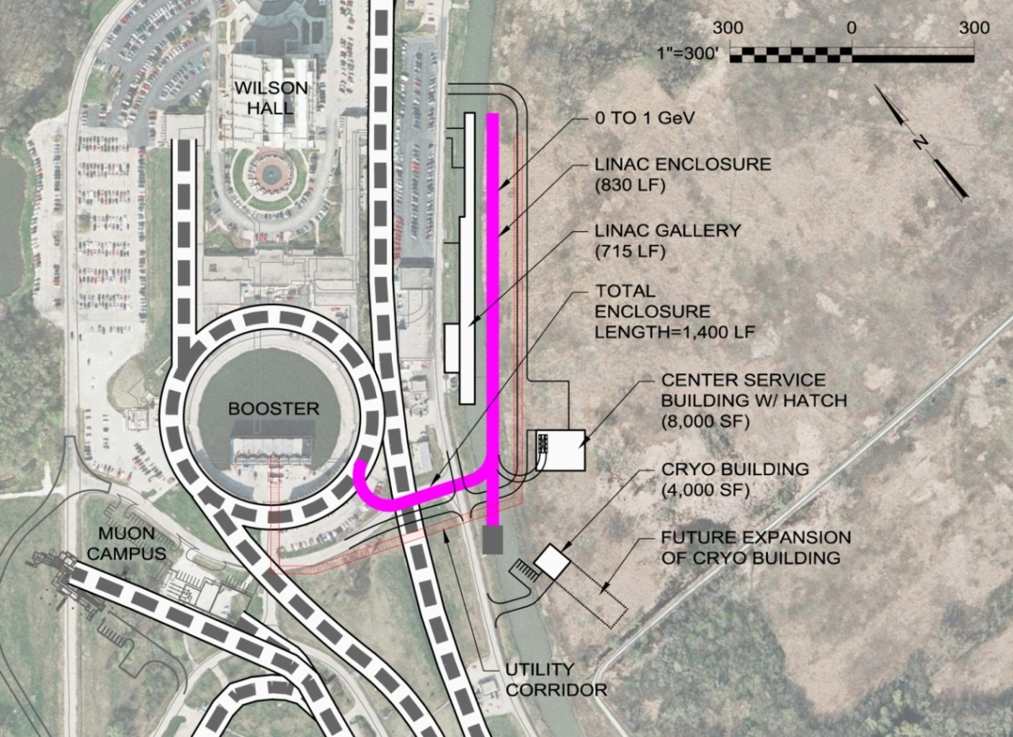
Fermilab Accelerator Complex at PIP-II Era
New SC Linac
  800 MeV
  15 Hz, 0.6 ms & 2 mA
Booster
  Rep. rate: 7 → 15 Hz
  N_{p}: (4.5 → 6.4) 10¹²
  300 turns injection
  @ 800 MeV
Recycler - MI
  12 batch slip-stacking
  Cycle duration
    0.8 s @ 60 GeV
    1.2 s @ 120 GeV
  Beam power 1.2 MW @ 120 GeV

Slide 4
PIP-II Major Parameters
Performance Parameter | Requirement
Linac Beam Energy | 800 | MeV
Linac Beam Current | 2 | mA
Linac Beam Pulse Length | 0.6 | msec
Linac Pulse Repetition Rate | 15 | Hz
Linac Upgrade Potential | CW
Booster Protons per Pulse (extracted) | 6.4×10¹²
Booster Pulse Repetition Rate | 15 | Hz
Booster Beam Power @ 8 GeV | 120 | kW
8 GeV Beam Power to LBNE | 80‐120* | kW
Beam Power to 8 GeV Program | 40‐0* | kW
Main Injector Protons per Pulse (12 batches; extr.) | 7.5×10¹³
Main Injector Cycle Time @ 120 GeV | 1.2 | sec
Main Injector Cycle Time @ 60 GeV | 0.8 | sec
LBNE Beam Power @ 60 GeV | 0.9 | MW
LBNE Beam Power @ 120 GeV | 1.2 | MW
LBNE Upgrade Potential @ 60‐120 GeV | >2 | MW
*1st number refers to MI operations @ 120 GeV; 2nd number to 60 GeV.
The PIP-II configuration is capable of maintaining 1.2 MW down to 80 GeV.

Slide 5
Project X Stage I → PIP-II
(Changes to the SC Linac)
Similar to the Project X Stage I (1 GeV SC linac)
the PIP-II includes
  warm frontend – operating in CW
    MEBT chopper capable to chop out bunches coming to Booster at the RF buckets boundary
  HW & SSR1 cryomodules – operating in CW
    Contribute ~8% of cryo-load at 2 K
  Other cryo-modules (SSR2, LB650, HB650)
    Initially pulsed operation only
      limited by power of the cryo-plant
        ~5% duty factor for cryo
    Reduced number of HB-650 cryo-modules (7→4)

Slide 6
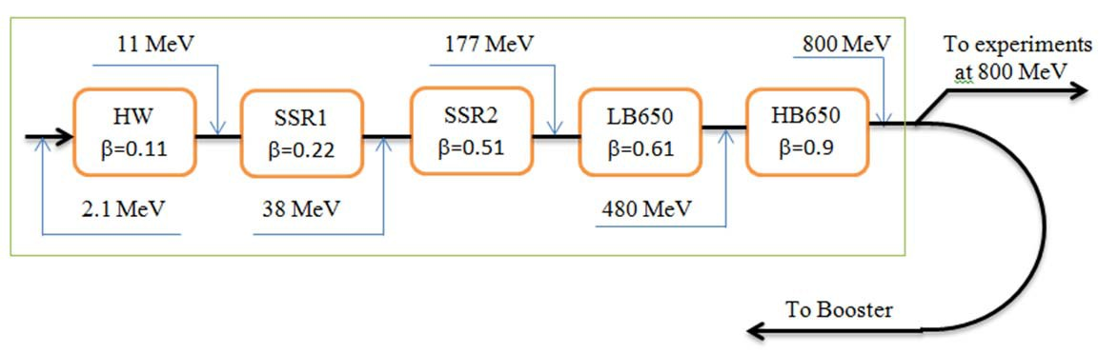
Structure of PIP-II Linac
Section | Energy (MeV) | ΔE* (MeV) | R/Q (W) | Cav/CM | CM Config. | CM length (m)
HWR | 2.1‐11 | 1.7 | 272 | 8 / 1 | 8 x (sc) | 5.8
SSR1 | 11‐38 | 2.05 | 242 | 16 / 2 | 4 x (csc) | 5.2
SSR2 | 38‐177 | 5.32 | 275 | 35 / 7 | sccsccsc | 6.5
LB650 | 177‐480 | 11.6 | 378 | 30 / 5 | ccc‐fd‐ccc | 7.1
HB650 | 480‐800 | 17.7 | 638 | 24 / 4 | cccccc | 9.5
* ΔE is reduced at section-to-section transitions and due to flight factors

Slide 7
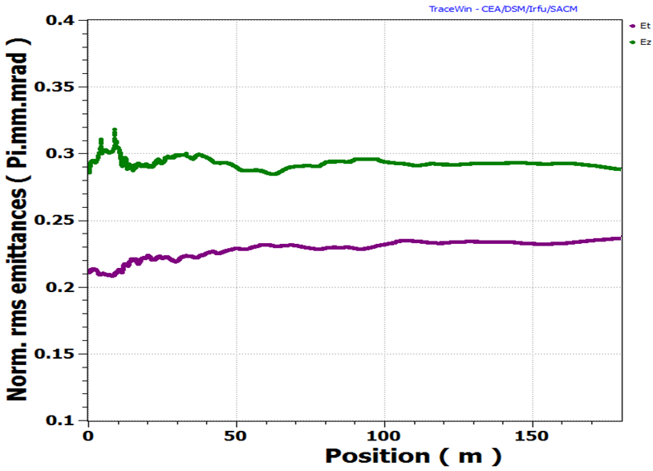
PIP-II Beam Dynamics
All simulations performed for Project X are directly applicable to PIP-II
Place for RF separator has to be reserved at the linac end to avoid adverse effect of bunch lengthening on the future RF separation
Normalized transverse (magenta) and longitudinal (green) emittances along the linac (from MEBT entrance to the end of linac (800 MeV)).

Slide 8
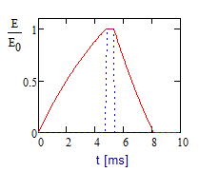
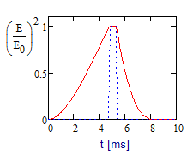
PIP-II Duty Factors
The average RF power has 2 contributions:
  the energy transferred to the beam (~10%)
  the energy required to fill and discharge the accelerating cavities (90%)
    It does not depend on the peak RF power
For a fixed average power the cost of RF increases with peak power
  therefore its cost achieves minimum with minimum peak power
    i.e. power equal to the power required for beam acceleration
    => duty factor for the RF power amplifiers ≈12%
    In this case the cost savings associated with the pulsed power amplifiers is modest and therefore CW capable RF amplifiers are planned from the beginning
♦ Details of cavity field stabilization are under a study.
♦ LFD & microphonics represent serious issues due to small cavity bandwidth (small current).
♦ Fast tuners are the must
♦ See details in XMAC-14

Slide 9
PIP-II Cryogenics*
To minimize the cost a system will be assembled using existing Tevatron cryogenic infrastructure
    including the Central Helium Liquefier (CHL)
    transfer line
    compressors
  Cryogenic duty factor is ~5%
  The total cryogenic heat load at 2K is dominated by the static load, and is about 16% of the CW load
Future upgrade to CW operation would require a new 2K cryogenic plant
Rms pressure
fluctuations have
to be <0.1 mbar!!!
Total CM Heat Loads [W]
 | 70 K | 5 K | 2 K
Pulsed | 2,860 | 895 | 256
CW | 2,860 | 895 | 1819
* More details in the presentation of A. Klebaner at XMAC-14

Slide 10
PIP-II Cryogenics (continue)
 |  | Static Load per CM [W] |  |  | Dynamic Load per CM [W]
Type | # of CM | 70 K | 5 K | 2 K | 2 K CW | 2 K Pulsed, 5%DF
HWR | 1 | 250 | 60 | 14 | 10 | 10*
SSR1 | 2 | 195 | 70 | 16 | 11 | 11*
SSR2 | 7 | 145 | 50 | 8.8 | 43 | 2.2
LB 650 | 5 | 145 | 45 | 8.1 | 145 | 7.3
HB 650 | 4 | 120 | 30 | 6.2 | 147 | 7.4
Total |  | 2860 | 895 | 173 | 1646 | 114
Cryo-plant |  | 5720 | 1250 | 490 (margin of 1.7 times)
* CW operation

Slide 11
Limitations on Operation in Pulsed Regime
The Lorentz force detuning represent a problem which needs to be diligently addressed
  Cavity design with suppressed sensitivity to microphonics and LFD
  Fast tuner (piezo-based) & Low level RF
  Over coupling and additional RF power
 | E_{acc} (MV/m) | LFD (Hz/(MV/m²) | Δf_{LFD} [Hz] | Q_{loaded} opt. for CW | Δf=f/2Q [Hz] | Microphonics ampl. [Hz]
HWR | 8.2 | - | - | 3.4∙10⁶ | 24 | 20
SSR1 | 10 | 1.5* | 150 | 5.8∙10⁶ | 27 | 20
SSR2 | 11.2 | No data |  | 7.2∙10⁶ | 23 | 20
LB 650 | 16.5 | <1♦ | <272 | 1.4∙10⁷ | 23 | 20
HB 650 | 17.5 | <1♦ | <306 | 1.4∙10⁷ | 23 | 20
* Measured
♦ Estimated

Slide 12
Limitations on Operation in Pulsed Regime (continue)
All cavities with the exception of HWRs will have fixed coupling
Operation in pulsed regime with coupling adjusted for CW requires ideally working fast tuner which suppresses the LFD
  Adaptive digital feedback with feedforward controlling the fast tuner operation is the must
Presently we assume
  that external stub tuners are used for Q_{loaded} decrease (if required)
    Couplers are capable to operate at required (increased) power levels
  Increased priority for the R&D directed at LFD compensation with fast tuner
  Excessive RF power for LFD and microphonics compensation
Final adjustments of cavity coupling values and RF power requirements will be done later
  More details of LFD compensation are in the B. Chase presentation @XMAC14

Slide 13
Requirements to Booster Operation
~1.5 times bunch intensity increase
  Two times larger energy to mitigate the space charge at injection (ΔQ_{SC} smaller by 30%)
Smaller longitudinal emittance for loss reduction at MI slip-stacking (~30% for Gaussian beam; beam loss: 5% → 2%)
Performance Parameter | Present | PIP-II
Input (H‐) Beam Energy (Kinetic) | 400 | 800 | MeV
Output Beam Energy (Kinetic) | 8.0 |  | GeV
Protons per Pulse (injected) | 5×10¹² | 7×10¹²
Protons per Pulse (extracted) (10% loss @ acc.) | 4.5×10¹² | 6.4×10¹²
Beam Pulse Repetition Rate | 15 |  | Hz
RF Frequency (injection) | 37.9 | 44.7 | MHz
RF Frequency (extraction) | 52.8 |  | MHz
Injection Time | 30 | 600 | μsec
Injection Turns | 13 | 315
Beam Emittance (95%_{(2.45σ)}, normalized; ε_{x} =ε_{y}) | 15 |  | π mm‐mrad
SC tune shift at injection (Gaussian, ε_{n95}=10 μm) | -0.47 | ‐0.34
Delivered Longitudinal Emittance (97%) | 0.012 | 0.08 | eV‐sec

Slide 14
Booster Injection
H⁻ foil strip-injection
  2 mA, 315 turns
Large number of turns allows both transverse and longitudinal painting
Radiation generated due to injection loss about an order of magnitude larger than for present Booster
  2 times larger energy
    ⇒ 4 times larger radiation per particle
  1.7 times larger beam current
  30 times larger number of injection turns
Injection is similar to the SNS
  Detailed analysis was carried out for the Project X RCS (1000 turns, 2 GeV) – No major concerns found

Slide 15
Booster Intensity Limitations
Incoherent tune shift at injection (ΔQ_{SC}~0.3-0.4)
  Beam loss
Transition crossing
  Longitudinal quadrupole oscillations excited after transition
  Beam loss
Instabilities
  Impedance of laminated magnets
  Impedance of HOMs in RF cavities
  Cures
    Present
      Longitudinal – narrow band dampers
      Transverse – Operation at large chromaticities
    Future
      active damping for both ⊥ and ||

Slide 16
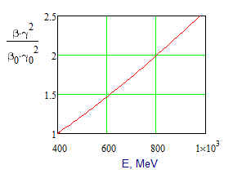
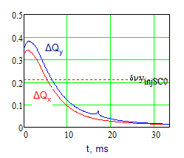
Incoherent tune shifts
Energy increase addresses the space charge related problems
Beam emittance, ε_{n95%}≈15 mm mrad is determined by MI acceptance

Slide 17
Transition Crossing
Linear model predictions
TC excites longitudinal quadrupole oscillations
  SC makes major contribution
Cures
  Quadrupole damper (present)
  RF voltage jump
    Simulations show that it is more effective than Q-jump
      Requires additional RF voltage (800→850 kV)
      Good time resolution for voltage manipulations
    Present operations use similar approach
Measurements (2005)

Slide 18
Transition Crossing with RF Voltage jump
Two pulses. Length and time of the second pulse depends on intensity;
for 5∙10¹²
  First pulse - duration of ~300 μs just before transition
  Second pulse – duration of ~80 μs, 530 μs after transition

Slide 19
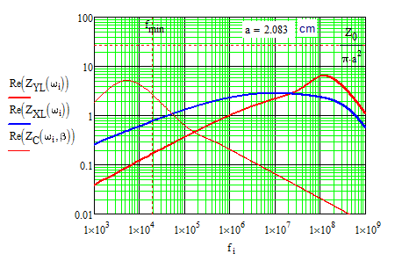
Booster Impedances
Laminated chamber greatly
increased impedances at high frequency
  Magnetic permeability reduces the skin depth
  Laminations amplify
  impedance by more than an order of magnitude ~(a/d)
  Transverse wake at
  ~10 MHz is responsible
  for the instability
    Horizontal plane is more unstable than vertical
Careless limit = Z₀/(πa²)

Slide 20
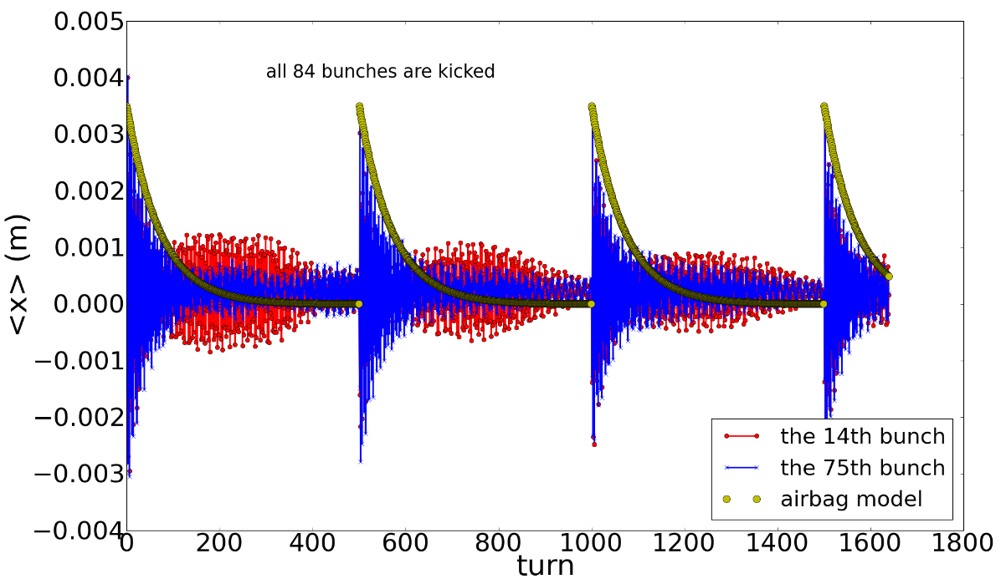
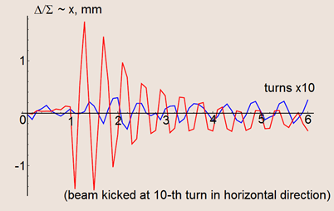
Study of Transverse Instabilities
Good understanding the instability mechanism will help to damp it (space charge greatly complicates theory)
Experimental, theoretical and computational studies of the beam stability are carried out
Simulations by A. Macridin, measurements T. Zolkin; at the injection energy

Slide 21
Developments at PIP-I
  PIP-I effort (related to Booster improvements) is greatly helpful for PIP-II
  Addressing hardware limitations: RF, etc.
    major effort and money
  Realignment, aperture scans and “golden” orbit – done
  Linear optics correction – done
    Quite reproducible machine
    additional work is required to make it easy for operations
  Non-linear optics – the required effort is not quite clear
  New cogging (magnetic) is under development
    Creates better conditions for
      More effective collimation
      Optics control
  Transverse dampers
    Reduced chromaticity -> reduced loss
  Longitudinal dampers
    new digital damper is coming soon

Slide 22
Recycler – Main Injector
Operation of Recycler and MI will look similar to the present operation but with ~1.5 times larger beam current
  Slip-stacking in Recycler looks as a substantial problem
    Reduced loss (5%→3%) requires smaller ε|| (~30-40%)
    It additionally affect beam stability (both ⊥ & ||)
Performance Parameter | Requirement
Injection Beam Energy (kinetic) | 8.0 | GeV
Extracted Beam Energy (kinetic) | 60‐120 | GeV
Protons per Pulse (extracted) | 7.5×10¹³
Cycle Time | 0.8‐1.2 | s
Beam Power | 0.9‐1.2 | MW
Beam loss at injection | <3 | %
Beam loss at transition | <0.2 | %
Beam emittance (95%, normalized) | 20 | π mm‐mrad
Longitudinal emittance (98%) | 0.08 | eV s
Bunching factor | 0.5
Laslett tune shift (Injection) | ‐0.06
  Electron cloud is expected to be suppressed by scrubbing
  Optimal ways of transition crossing are under study

Slide 23
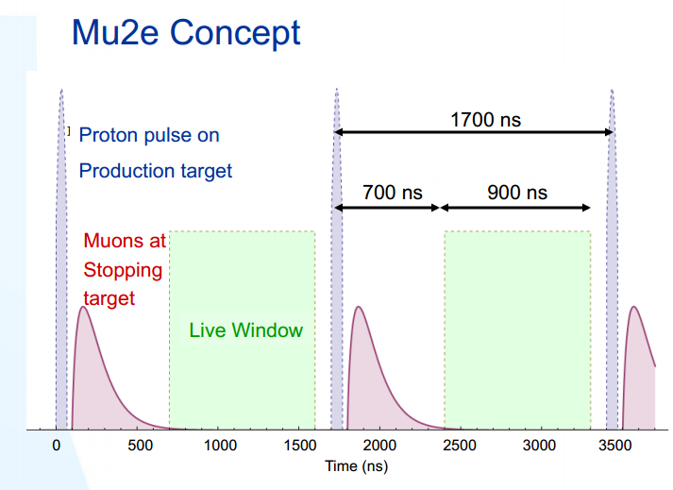
“Second” PIP-II experiment: μ-to-e upgrade
Present μ-to-e
experiment:
  7 kW
  duty factor – 30%
    Limited by:
      rebunching
      in Recycler
      NOVA operation
      Booster flux
μ-to-e upgrade:
  ~100 kW
  duty factor = (15 – 30)% - depends on success of high Q₀ program
  Flexible time structure
    ~100 ns, ~1.5 MHz (depends on the target)

Slide 24
Cryogenic Requirements for μ-to-e Operation
Q₀ presented in the Project X RDR is quite conservative
Success of high Q₀ program should allow us to achieve (15-30)% duty factor with the proposed cryo-plant (built for pulsed operation)
Cryogenic loads at 2 K
Type | # of CM | Static load per CM [W] | Q₀ @ 2K, 10¹⁰ | Dynamic load/CM, 5%DF [W] | Dynamic load/CM, with 2Q₀ & 21%DF [W]
HWR | 1 | 14 | 0.5 | 10* | 10*
SSR1 | 2 | 16 | 0.5 | 11* | 11*
SSR2 | 7 | 8.8 | 1.2 | 2.1 | 4.6
LB 650 | 5 | 8.1 | 1.5 | 7.2 | 15.3
HB 650 | 4 | 6.2 | 2.0 | 7.4 | 15.6
Total |  | 173 |  | 112.7 | 204
Cryo-capacity 490 W
Cryo-margin =1.3: (490/1.3) W ≈ 377 W = (173 +204) W )

Slide 25
Present Standing on Major Directions for PIP-II SC Linac
All RF is CW compatible from the very beginning. Coupling is fixed. Coupling adjustments are performed with stub tuner.
  Simple and reliable coupler
First three cryomodules (HW and SSR1) are ran in CW.
Other cryomodules are run in the pulsed regime
  The longitudinal dynamics after 2 cryomodules is forgiving enough to allow machine operation without significant penalties when a small percentage of cavities is broken or cannot be used for other reason.
We have to pay serious attention to the design of fast tuners (for all cryomodules) to warranty their long term reliability
  Otherwise operation in the pulsed regime is impossible without large margin in the RF power

Slide 26
Present Standing on Major Directions for PIP-II SC Linac (continue)
For the same peak RF power a suppression of Lorentz Force Detuning (LFD) is more difficult in the pulsed regime than in CW
  Mechanical design of SSR2, LB650 and HB650 cavities has to be done to minimize LFD.
  Special attention has to be paid to the work on optimization of hardware and software for piezo-tuner based feedbacks aimed on microphonics and LFD suppression
Choice of RF parameters (power and coupling) implies reliable operation of fast tuners required to suppress LFD.
Low level RF has to be built so that it would support both pulsed and CW operation

Slide 27
Status and Plans
Linac beam dynamics calculations are finished
  Complete report is expected soon
Beam transport to Booster
  Straightforward
LFD
  thoughtful work is required
  A group in TD is working on the problem
  PXIE will be a good place for testing new ideas in SRF in general and for LFD suppression in particular
Beam acceleration of 1.5 times larger current in Booster and MI requires additional R&D
  Significant number of studies can be done before PIP-II is operational

Slide 28
Primary Technical Risks
Linac
  Warm front-end
  LFD
Booster
  Injection
  Transition crossing
Main injector
  Slip stacking
  Transition crossing

Slide 29
Conclusions
PIP-II is aimed at the long-time program in the accelerator based HEP intensity frontier
A required cost reduction at the first stage is achieved by
  Reduction of CW linac energy
  transition to pulsed regime
  and reuse of existing infrastructure
Reuse of Booster creates a cost effective way to increase power for the neutrino experiments
For LBNE it should yield a power increase of ~1.7 times
SC PIP-II can be used for the μ-to-e upgrade with reasonably large duty factor
Transition to the CW regime will require new cryo-plant
  All other major system will be CW compatible

Slide 30
Backup Slides

Slide 31
SC Linac Parameters
Performance Parameter | Requirement
Particle species | H‐
Input beam energy (Kinetic) | 2.1 | MeV
Output beam energy (Kinetic) | 0.8 | GeV
Average beam current | 2 | mA
Bunch repetition rate | 162.5 | MHz
Beam pulse length | 0.6 | msec
Pulse repetition rate | 15 | Hz
RF pulse length | 7 | msec
Delivered transverse emittance (rms, norm; ε_{x} =ε_{y}) | <0.3 | mm‐mrad
Delivered longitudinal emittance (rms, norm) | <1.1 | keV‐nsec
Delivered bunch length (rms) | 4 | psec

Slide 32
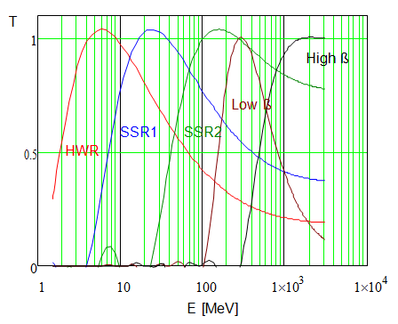
Other Parameters of SC Cryomodules
Name | β_{G} | β_{opt} | Freq (MHz) | Type of cavity | B_{peak} (mT) | E_{peak} (MV/m) | E_{acc} (MV/m) | ΔE (MeV)
HWR | 0.094 | 0.112 | 162.5 | Half wave resonator | 41 | 38 | 8.2 | 1.7
SSR1 | 0.186 | 0.222 | 325 | Single‐spoke resonator | 58 | 38 | 10 | 2.05
SSR2 | 0.431 | 0.515 | 325 | Single‐spoke resonator | 70 | 40 | 11.2 | 5.32
LB650 | 0.61* | 0.647 | 650 | Elliptic 5‐cell | 70 | 37.5 | 16.5 | 11.6
HB650 | 0.9* | 0.95 | 650 | Elliptic 5‐cell | 64 | 35.2 | 17.5 | 17.7

Slide 33
Other Parameters of SC Cryomodules (continue)
 | E_{acc} (MV/m) | ΔE (MeV) | Q₀@2K (10¹⁰) | Static loss per CM @2 K, W | Total loss per CM @2 K in CW, W
HWR | 8.2 | 1.7 | 0.5 | 14 | 24
SSR1 | 10 | 2.05 | 0.5 | 16 | 27
SSR2 | 11.2 | 5.32 | 1.2 | 8.8 | 52
LB 650 | 16.5 | 11.6 | 1.5 | 8.1 | 153
HB 650 | 17.5 | 17.7 | 2.0 | 6.2 | 153

Slide 34
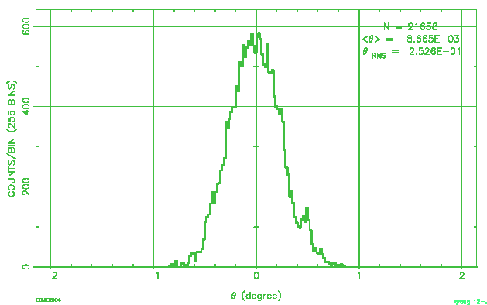
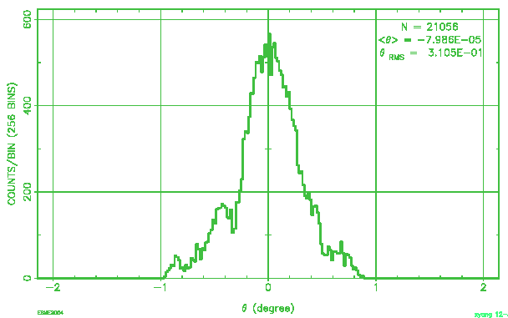
Numerical simulations of Transition Crossing with Voltage jumps
RF manipulation or not | charge at injection | charge at extraction | 95% emittance at 8GeV (eVs) | rms deltaP (MeV)
yes | 5*10^12 | 4.55*10^12 | 0.07052 | 3.357
no | 5*10^12 | 4.42*10^12 | 0.09315 | 3.608

Slide 35
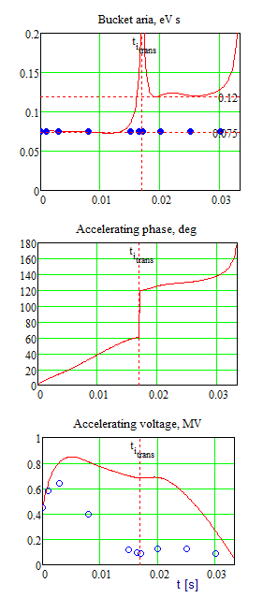
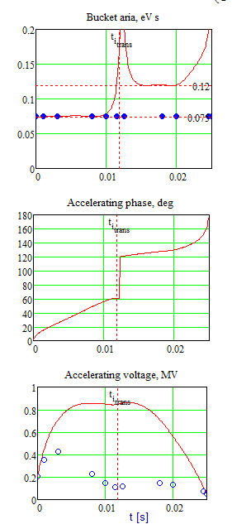
Left
  15 Hz, 400 MeV
  V_{max}=848 kV
  With Voltage jump ΔV=200 kV
  V_{max}=950 kV
Right
  20 Hz, 800 MeV
  V_{max}=862 kV
  With Voltage jump ΔV=200 kV
  V_{max}=1050 kV
The difference in V_{max} is negligible in the absence of voltage jump

Slide 36
PIP-II versus Project X Stage I
What was changed?
  Beam energy: 1 GeV→ 0.8 GeV. It is large enough
    to avoid problems with beam SC and
    To have high enough efficiency of pion and muon production
  Beam current: 1 mA → 2 mA
    Reduces number of turns for Booster injection
    Large enough to support ~ 100 kW for μ-to-e upgrade (long pulse)
  At the beginning: a single purpose facility with the only goal
    Support of power increase for LBNE by ~1.7 times
  Operational mode: CW → Pulsed (15 Hz, 0.6 ms)
  No RF separation in near plans (has to be possible in the future)
Why? - Cost reduction: Cryogenics & Use of existing infrastructure
Long-term goal is the same (but not specified in PIP-II docs)
  CW operation for intensity frontier experiments
  Design has to support future CW operation and >2 MW in MI

Slide 37
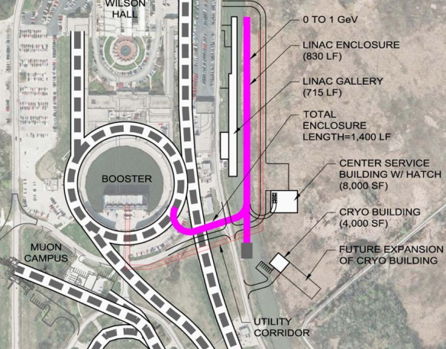
PIP-II Future and Staging
Present choice of PIP-II and its technology does not make much sense without future staging
  μ-to-e upgrade
  Other 0.8 GeV
  experiments
    n-nbar
    Proton EDM
    Neutron EDM
    Nuclear energy
    …
  3 GeV upgrade?
    Kaons
There is enough space
inside Tevatron ring for
future developments

Slide 38
μ-to-e at PIP-II
Possible beam structure for CW (micro scale)
  17 consecutive pulses take 100 ns
  Rep. time 1.5 μs (244 buckets)
  => duty factor = 86/1500=0.07
  Peak current = RFQ current = 6 mA
    => Average current = 0.421 μA (aver. over 1.5 μs)
  Average power 0.8 GeV * 0.421 μA = 334 kW
Operation with 30% duty factor => 100 kW
Can we support 30% duty factor with PIP-II
  Bunch-by-bunch operation should not be a problem
    Extinction is infinite because only one experiment is running (both LEBT and MEBT choppers are used)
  RF is not a problem

Slide 39
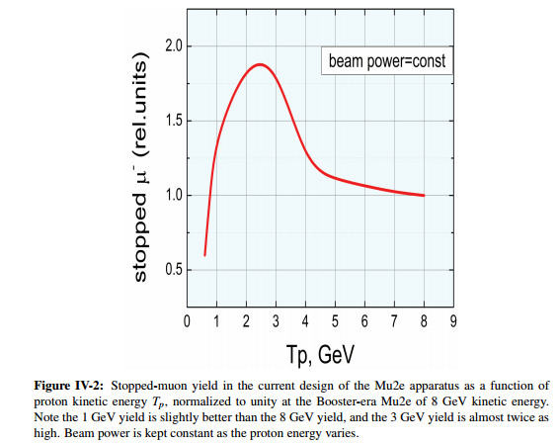
Efficiency of Muon Production to μ-to-e
Production efficiency at 0.8 GeV is about the same as for 8 GeV
  But no antiproton background

