Slide 1
PIP-II Overview:
Goals, Status, Strategy
Steve Holmes
PIP-II Collaboration Meeting
June 3, 2014

Slide 2
Outline
Update since Last Meeting (November 2012)
PIP-II Status and Strategy
FY14-15 Budgets and goals
Meeting Goals and Agenda
Our websites:
(projectx.fnal.gov under re-construction)
https://indico.fnal.gov/categoryDisplay.py?categId=168
http://projectx-docdb.fnal.gov
Meeting website:
https://indico.fnal.gov/conferenceDisplay.py?confId=8365

Slide 3
News Since November (2012)
DOE/SC Facilities Plan
Snowmass
XMAC
Project X -> PIP-II
P5
PXIE Progress
SRF Progress
Indian Collaboration
LCLS-II
Personnel Changes
Notes:
Test
3

Slide 4
DOE/SC Facilities Plan
HEPAP Facilities Subpanel convened December 2012
Whitepapers + presentations on Project X Physics Program and accelerator facility (February)
  indico.fnal.gov/conferenceDisplay.py?confId=6381)
Report (March 2013)
  science.energy.gov/~/media/hep/hepap/pdf/Reports/HEPAP_facilities_letter_report.pdf
  The importance and breadth of the research program that the Project X accelerator facility enables and enhances leads the accelerator facility to be classified as absolutely central. Although R&D is still required for the spallation target needed by some experiments, all stages of the Project X accelerator facility are ready to initiate construction.
  Project X experiments that compose the research program range from important to absolutely central, but scientifically the Project X research program as a whole is classified as absolutely central. Being in the planning phase, the construction readiness of the Project X research program is classified as mission and technical requirements not yet fully defined, although some experiments are beyond this phase.
Notes:
Test
4

Slide 5
Snowmass
Snowmass
  Conveners assigned in relevant groups
    S. Nagaitsev, J. Galambos, M. Bai: Frontier Capabilities/High Intensity Secondary Beams Driven by Protons
    R. Tschirhart: Intensity Frontier – Frontier Capabilities liaison
Participation in pre-Snowmass Workshops
  Frontier Capabilities/HISBDP/BNL
  indico.bnl.gov/conferenceDisplay.py?confId=617
  Intensity Frontier Workshop/ANL
  indico.fnal.gov/conferenceDisplay.py?confId=6248
Notes:
Test
5

Slide 6
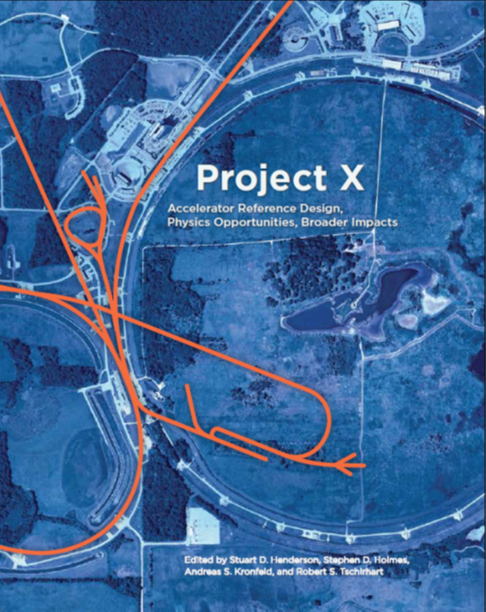
Snowmass
Project X Book
  Reference Design Report
    arxiv.org/abs/1306.5022
  Physics Opportunities
  Broader Impacts
  600 copies printed
    ~200 distributed at Snowmass
    ~70 distributed to collaborators
    ~150 since to community
Snowmass on the Mississippi
arXiv:1401.6075, arxiv:1401.6077
  Project X Session
  Colloquium: Opportunities with High Intensity Accelerators Beyond the Current era
  Project X opportunities highlighted in the Intensity Frontier Summary Presentation (JoAnne Hewett)
Notes:
Test
6

Slide 7
Project X Machine Advisory Committee (X-MAC)
Convened for initial meeting in March 2013
  Second meeting in February 2014
Committee
  R. Garoby (CERN, Chair)
  J. Galambos (SNS)
  K. Hasegawa (J-PARC)
  D. Raparia (BNL)
  R. Baartman (TRIUMF)
  J. Wei (MSU)
  H. Weise (DESY)
  S. Kim (SNS)
Closeout reports available upon request

Slide 8
Project X → PIP-II
Nigel Lockyer assumed Fermilab Director position in September 2013
Asked (almost immediately) for two things:
  A plan for upgrading the accelerator complex to provide >1 MW capability at the time of LBNE startup (2024-25);
    At a cost to DOE of ~$400M or less;
  A new name
Task force produced a whitepaper outlining strategy and estimated cost
  Proton Improvement Plan-II, aka PIP-II
  http://projectx-docdb.fnal.gov/cgi-bin/ShowDocument?docid=1232
  Basis of the PIP-II presentation to P5
In parallel Nigel established an internal (to Fermilab) task force to develop the laboratory strategy
  Presented to P5
  https://indico.fnal.gov/getFile.py/access?sessionId=9&resId=0&materialId=0&confId=7485

Slide 9
Proton Improvement Plan-II
Goals
Proton Improvement Plan-II supports longer term physics research goals by providing increased beam power to LBNE while providing a platform for the future
Design Criteria
  Deliver 1.2 MW of proton beam power from the Main Injector to the LBNE target at 120 GeV, with power approaching 1 MW at energies down to 60 GeV, at the start of LBNE operations
  Continue support for the current 8 GeV program, including Mu2e, Muon g-2, and the suite of short-baseline neutrino experiments; provide upgrade path for Mu2e
  Provide a platform for eventual extension of beam power to LBNE to >2 MW
  Provide a platform for extension of capability to high duty factor/higher beam power operations
  At an affordable cost to DOE

Slide 10
PIP-II Performance Goals
Performance Parameter | PIP-II
Linac Beam Energy | 800 | MeV
Linac Beam Current | 2 | mA
Linac Beam Pulse Length | 0.6 | msec
Linac Pulse Repetition Rate | 15 | Hz
Linac Beam Power Capability (10-15% DF) | ~200 | kW
Mu2e Upgrade Potential (800 MeV) | >100 | kW
Booster Protons per Pulse (extracted) | 6.4×10¹²
Booster Pulse Repetition Rate | 15 | Hz
Booster Beam Power @ 8 GeV | 120 | kW
Beam Power to 8 GeV Program (max) | 40 | kW
Main Injector Protons per Pulse (extracted) | 7.5×10¹³
Main Injector Cycle Time @ 120 GeV | 1.2 | sec
Main Injector Cycle Time @ 80 GeV | 0.8 | sec
LBNE Beam Power @ 80-120 GeV | 1.2 | MW
LBNE Upgrade Potential @ 60-120 GeV | >2 | MW

Slide 11
Proton Improvement Plan-II
Linac Technology Map
IS
LEBT
RFQ
MEBT
β=0.11
β=0.22
β=0.51
β=0.61
β=0.9
RT
SC
162.5 MHz
0.03-11 MeV
325 MHz
11-177 MeV
650 MHz
177-800 MeV
Section | Freq | Energy (MeV) | Cav/mag/CM | Type
RFQ | 162.5 | 0.03-2.1
HWR (β_{opt}=0.11) | 162.5 | 2.1-11 | 8/8/1 | HWR, solenoid
SSR1 (β_{opt}=0.22) | 325 | 11-38 | 16/8/ 2 | SSR, solenoid
SSR2 (β_{opt}=0.51) | 325 | 38-177 | 35/21/7 | SSR, solenoid
LB 650 (β_{G}=0.61) | 650 | 177-480 | 30/20/5 | 5-cell elliptical, doublet
HB 650 (β_{G}=0.9) | 650 | 480-800 | 24/10/4 | 5-cell elliptical, doublet

Slide 12
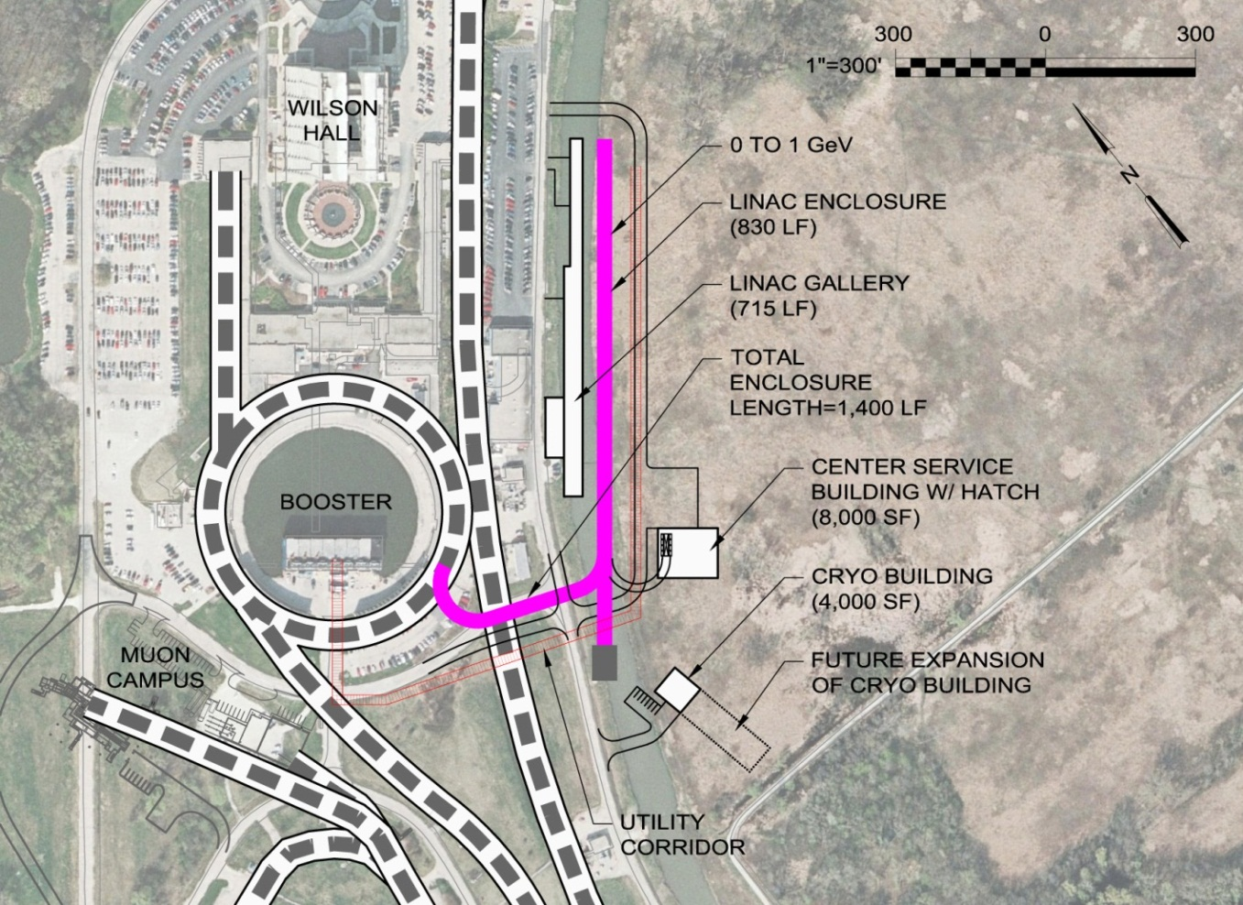
PIP-II Site Layout (provisional)

Slide 13
P5 http://usparticlephysics.org/p5
Particle Physics Project Prioritization Panel established in fall 2013 “…to develop an updated strategic plan for U.S. high energy physics that can be executed over a ten year timescale, in the context of a 20-year global vision for the field.”
Multiple interactions with P5
  PIP-II whitepaper and presentation at BNL meeting
    https://indico.bnl.gov/getFile.py/access?contribId=11&sessionId=5&resId=0&materialId=slides&confId=680
  Costing information and a budget plan, integrated within the Fermilab program
    $400M cost to DOE, assuming $160M international in-kind contribution
    $80M of off-project costs for SRF development and AIPs
    FY19-23 construction period
Strong endorsement in the P5 Report publicly released and accepted by HEPAP on May 22
  Recommendation 14: Upgrade the Fermilab proton accelerator complex to produce higher intensity beams. R&D for the Proton Improvement Plan II (PIPII) should proceed immediately, followed by construction, to provide proton beams of >1 MW by the time of first operation of the new long-baseline neutrino facility.
    This recommendation applies in all budget scenarios considered.
  I have been asked by the Director to establish an organizational plan for PIP-II at Fermilab.

Slide 14
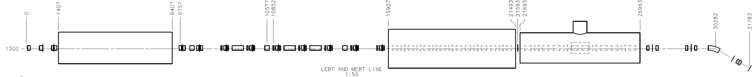
R&D Status: PXIE
LEBT
RFQ
MEBT
HWR
SSR1
HEBT
40 m, ~25 MeV
PXIE will address the address/measure the following:
  LEBT pre-chopping
  Vacuum management in the LEBT/RFQ region
  Validation of chopper performance
  Bunch extinction
  MEBT beam absorber
  MEBT vacuum management
  Operation of HWR in close proximity to 10 kW absorber
  Operation of SSR with beam
  Emittance preservation and beam halo formation through the front end

Slide 15
R&D Status: PXIE, SRF
PXIE Hardware
  Ion source operational and being characterized (LBNL→FNAL)
  Beam in LEBT through first solenoid and emittance scanner (downstream of solenoid)
    LEBT emittance scanner operational (SNS →FNAL)
  LEBT solenoids delivered (FNAL)
  RFQ fabrication underway (LBNL) →FNAL in Q2FY15
  HWR cavity design complete and procurements initiated; CM design in process (ANL)
  Nine qualified SSR1 cavities now in hand; CM design in process (FNAL)
  Chopper proof-of-principle prototypes and driver development (FNAL)
    50, 200 Ω prototypes in fabrication
SRF
  Major progress on HWR, SSR1, 650 MHz ellipticals, and high Q₀

Slide 16
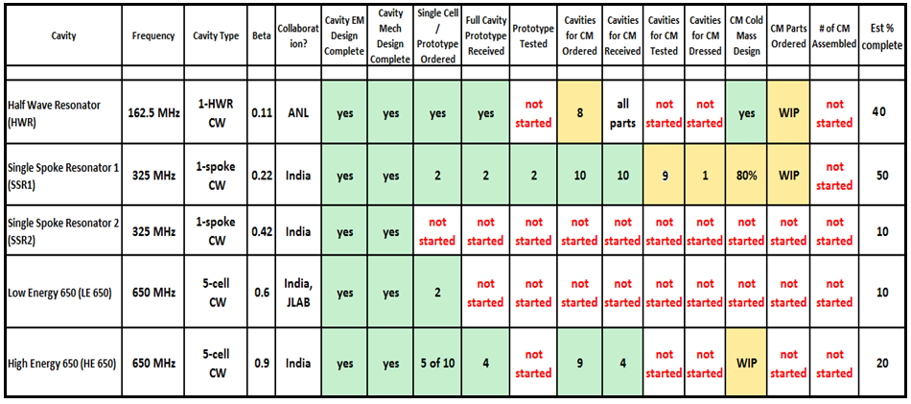
SRF Development Status (2-11-14)
⇒ Also, major progress on Q₀

Slide 17
Indian Collaboration
Significant R&D collaboration for >5 years covering:
  SC accelerating structures
    SSR1, HB650
  RF sources
    Solid state sources at 325 and 650 MHZ
  Instrumentation and LLRF
  Magnets
    MEBT magnets
DOE-DAE Implementing Agreement for Cooperation in Accelerator and Particle Detector R&D for Discovery Science signed July 2011
  Annex I prepared to cover Indian participation in PIP-II
    Under review by new Indian government

Slide 18
LCLS-II
Fermilab has joined the laboratory consortium that will carry out the LCLS-II construction project at SLAC.
Major responsibilities include:
  Development, design, and fabrication of half (17) 1.3 GHz cryomodules
  Development, design, and fabrication of two 3.9 GHz cryomodules

Slide 19
Personnel Changes
New Fermilab Director: Nigel Lockyer
  Replace Pier Oddone (to retirement)
New Accelerator Division Head: Sergei Nagaitsev
  Replace Roger Dixon (to FNAL staff)
New Technical Division Head: Hasan Padamsee
  Replace Giorgio Apollinari (to FNAL/LHC Upgrade)
New Project Scientist: Valeri Lebedev
  Replace Sergei Nagaitsev (to FNAL/Accelerator Division Head)
New Project Engineer: Don Mitchell
  Replace Marc Kaducak (to FNAL/LCLS-II)
New SRF Program Management Team: Hasan and Don
  Replace Bob Kephart (to FNAL/IARC) and Rich Stanek (to FNAL/LCLS-II)
Departure of Associate Laboratory Director/Accelerators: Stuart Henderson (to ANL)

Slide 20
PIP-II Status and Strategy
PIP-II remains pre-CD-0
  However, strong support from P5, OHEP, and Fermilab director
Plan presented to P5 and DOE proposes five year construction period starting in FY2019
Goals for FY2105
  Prepare for CD-0
    Expand PIP-II Whitepaper into a complete Reference Design Report
    Flesh out Plan for CD-3
    Maintain current cost estimate
      Perhaps flesh out areas in which there is little detail
    Start developing a resource loaded schedule
  Receive RFQ (from LBNL) and initiate commissioning at PXIE
  Keep HWR and SSR1 fabrication on schedule
  Develop deliverables strategy with India and Europe
  Support DOE/OHEP in development of Mission Needs Statement
  Establish PIP-II Office
    Hosted by Accelerator Division

Slide 21
Preliminary Working Schedule

Slide 22
PIP-II Organization
Proton improvement Plan - II
Project Manager S. Holmes
Deputy PM/Development & Accelerator Integration
Deputy PM/Construction Coordination
Project Scientist V. Lebedev
Project Engineer D. Mitchell
Associate PM/Planning & Reporting
Associate PM /Civil Construction
Associate PM/ESHQ
Procurements Manager
Financial Officer C. Jacobsen
SRF Program Manager H. Padamsee
Experimental Liaison R. Tschirhart
Project Management
SC Linac
Civil Construction
Accelerator Improvement Projects

Slide 23
Goals & Budgets:
FY2014-2015
Issue PIP-II RDR
Receive and start commissioning PXIE RFQ
Continue progress on PXIE HWR and SSR1
Support DOE in development of Mission Needs Statement
 | FY2014 | FY2015
PIP-II | $8.7M | $8.3M
GARD/SRF | $8.3M | $7.2M
SRF Ops & Infra | $5.4M | $4.3M
TOTAL | $22.4M | $19.8M
PIP-II/SRF activities only

Slide 24
Collaboration Meeting Goals
Get everyone on the same page with the PIP-II plan
  Discuss unique technical aspects/issues as compared to PX
Prepare for September release of updated RDR
Connect with related activities elsewhere in the world
Discuss near term plans for PXIE
Overview of balance of R&D program, including direct integration of srf development
Explore long-term opportunities utilizing the PIP-II platform
Meeting of Collaboration Council to discuss evolution of the collaboration in the PIP-II context

Slide 25
Collaboration Meeting
Agenda
Tuesday, June 3
  Session 1: Overview 8:30-10:05
  Break
  Session 2: Other Int’l Projects 10:20-12:30
  Lunch
  Session 3: R&D/PXIE 13:30-15:10
  Break
  Session 4: R&D/Other 15:25-16:35
  Discussion 16:35-17:00
Wednesday, June 4
  Session 5: Future Options 8:30-10:10
  Break
  Session 6: Future Options (cont) 10:40-12:00
  Adjourn 12:00
  https://indico.fnal.gov/confRegistrantsDisplay.py/list?confId=8365

