Slide 1
Report from the
5th High Power Targetry Workshop
HPT14
Robert Zwaska
Fermilab for Pat Hurh, Conference Chair, and Conveners

Slide 2
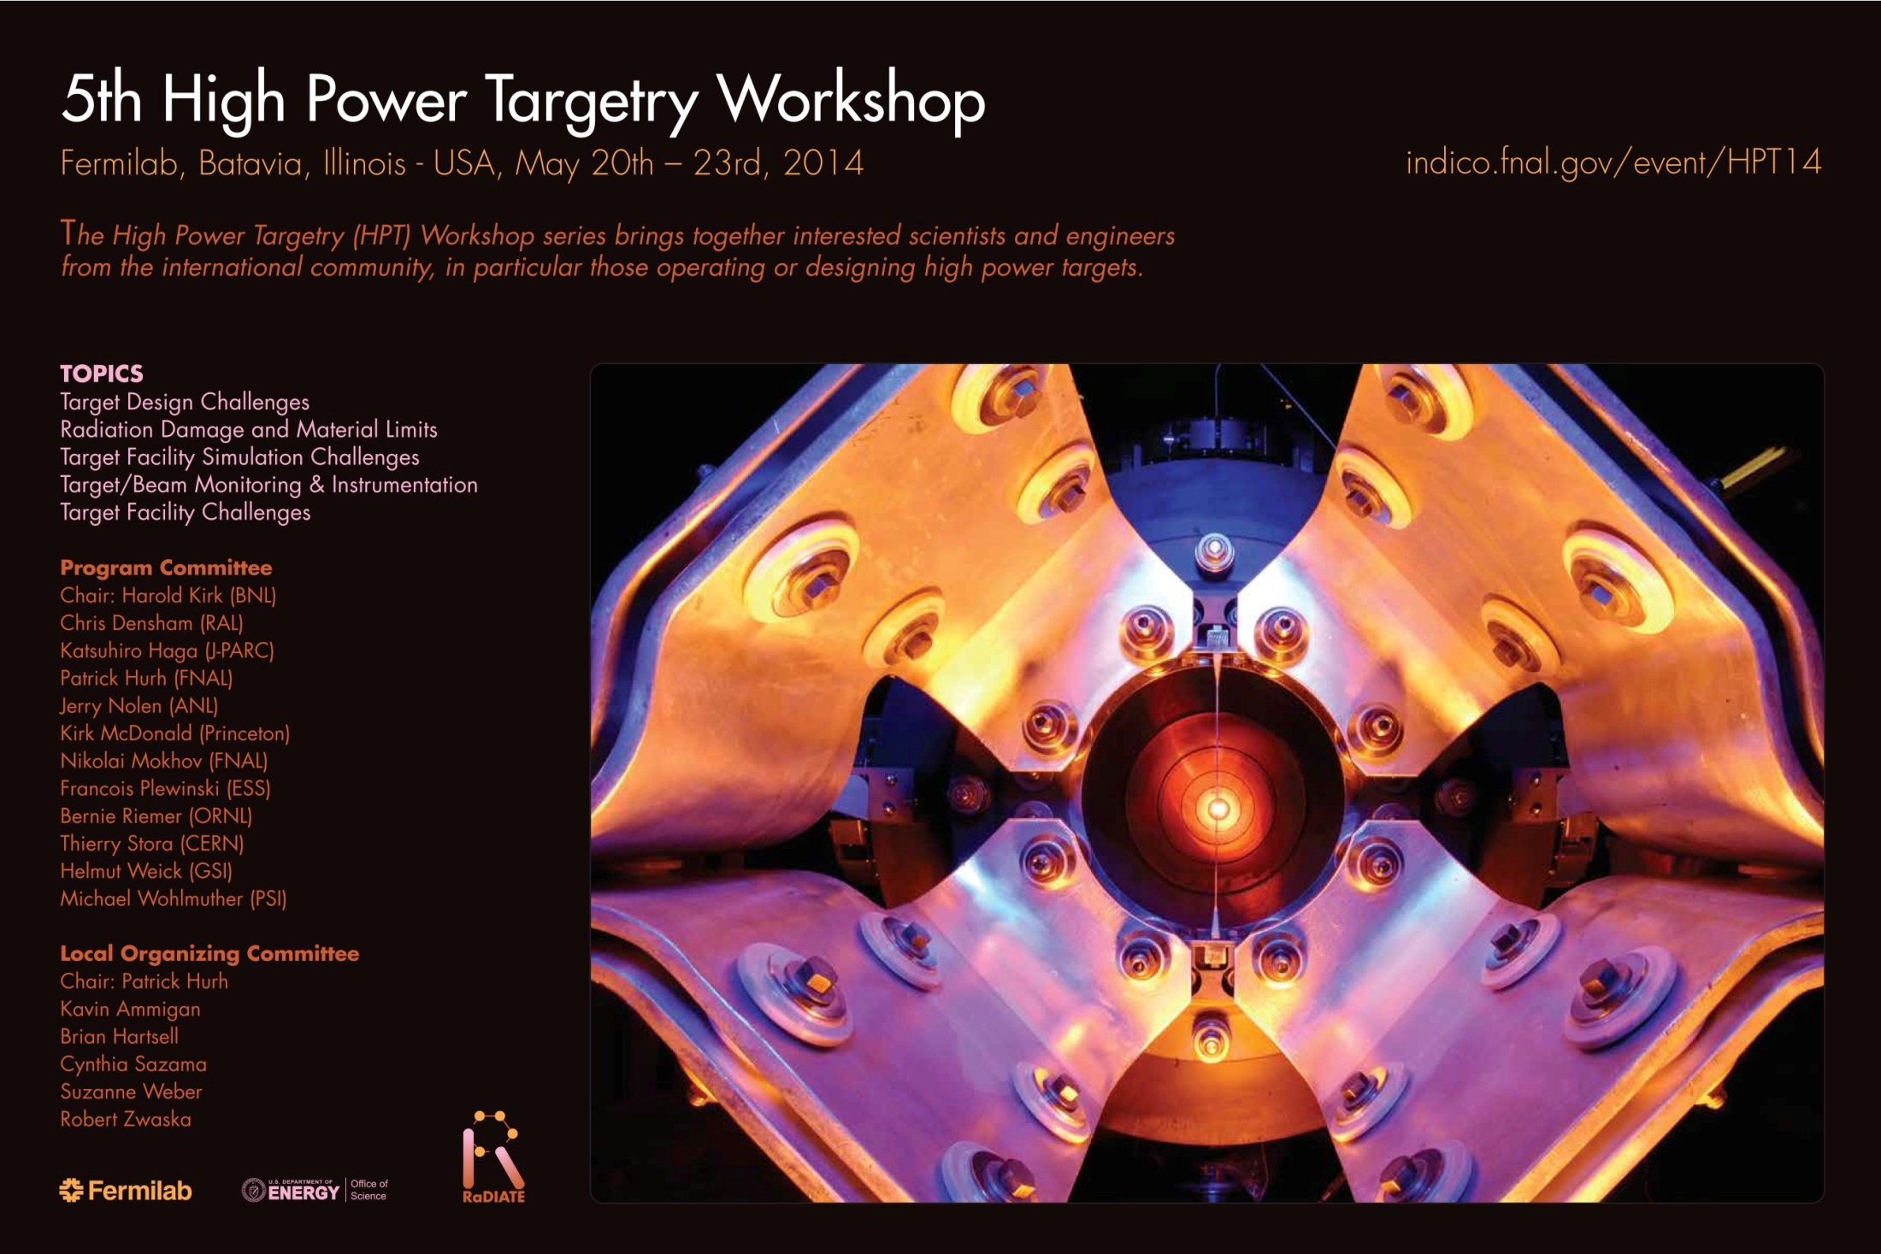

Slide 3
Broad Participation
98 Registrants
34 Institutions represented from 12 countries!
37 Posters
40 Talks over 3.5 days
  Discussion sessions peppered throughout
Tours of MI-8 and MINOS

Slide 4

Focus Sessions / Conveners
Target Design Challenges
  C. Densham, B. Riemer
Radiation Damage and Material Limits
  Y. J. Lee, S. Maloy
Target Facility Simulation Challenges
  O. Caretta, N. Mokhov
Target/Beam Monitoring & Instrumentation
  T. Shea, K. Thomsen
Target Facility Challenges
  K. Haga, R. Losito

Slide 5
Target design challenges session
- summary -
Technology progression with beam power –> fluidized tungsten powder development (Otto Caretta)
Rotating beam dump for FRIB – very high power density (Mikhail Avilov)
CERN fixed target playground – high power density of anti-proton target (Marco Calviani)
ISIS TS-2 target engineering (Dan Wilcox)
Development of granular target for CADS – rapid progress (Lei Yang)
ESS rotating target – reserve/backup (Yongjoong Lee)
The (outrageous?) cost of a neutron! (Franz Gallmeier)

Slide 6
Heat Removal and Thermal Stress Summary
Flowing or rotating targets
Segmented
Peripherally cooled monolith
T.Davenne

Slide 7
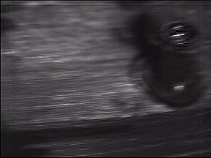

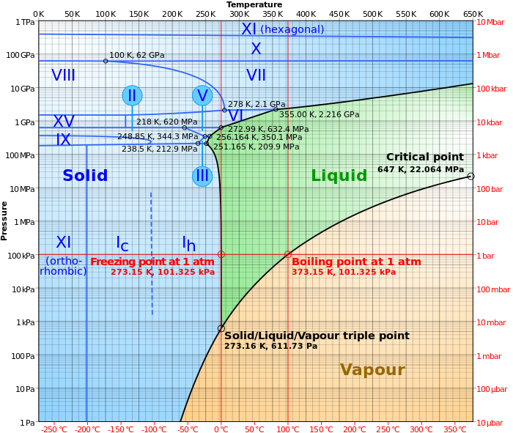
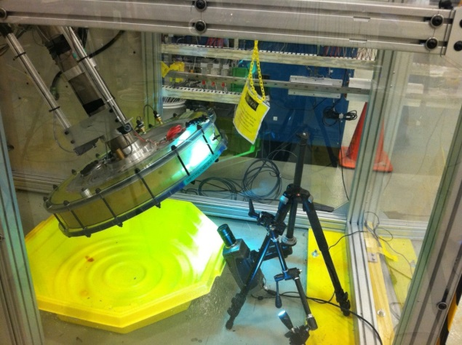
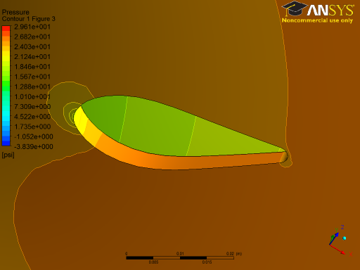
Fluid Challenges
Bubble Formation: Boiling and Cavitation
Boiling – bubble formation due to high power deposition in water and in the shell
Cavitation – bubble formation due to rapid change of pressure
Bubble formation -> bubble collapse -> shockwave -> possible BD shell damage
  Study of bubble formation on the shell is in progress
  Cavitation study – simulation and test
    Simulation showed no critical pressure changes
    BD mockup flow test did not reveal cavitation
A movie from the test
boiling
cavitation
Flow test with transparent
(acrylic) beam dump
Water phase diagram
Pressure drop simulation

Slide 8
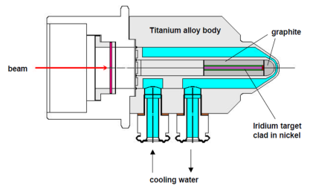
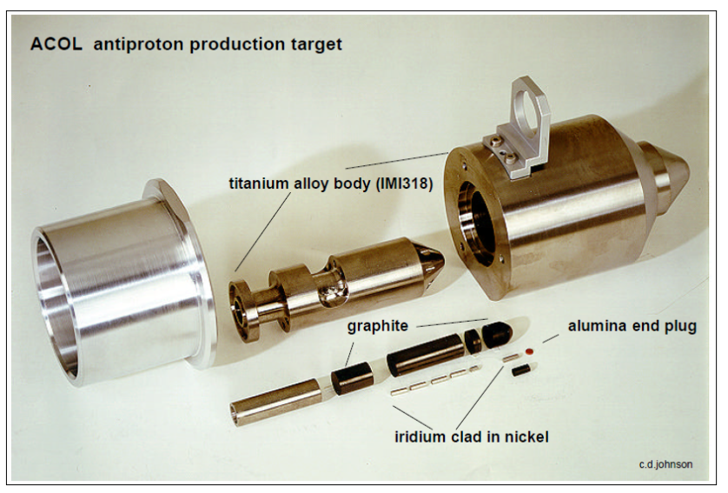
Antiproton Decelerator (AD)
Antiproton production for CERN’s antimatter physics
  ELENA ring under construction (100 keV pbars)
  Operation foreseen for the next 20 years
26 GeV/c primary beam
0.5x1mm 1σ
1.5*10¹³ p/pulse
430 ns pulse length
Rep rate ~60 s
Iridium core

Slide 9
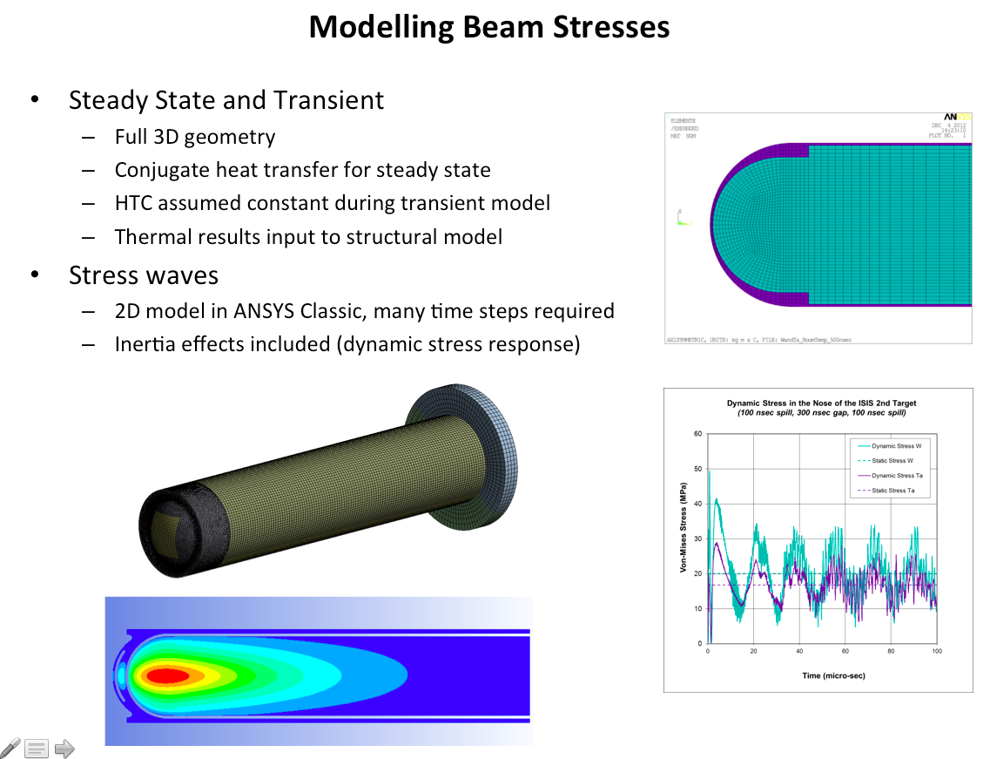
ISIS TS-2 Engineering

Slide 10
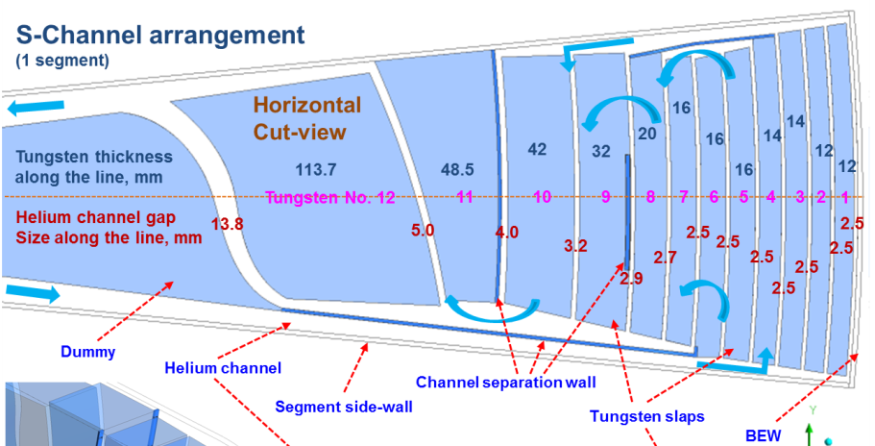
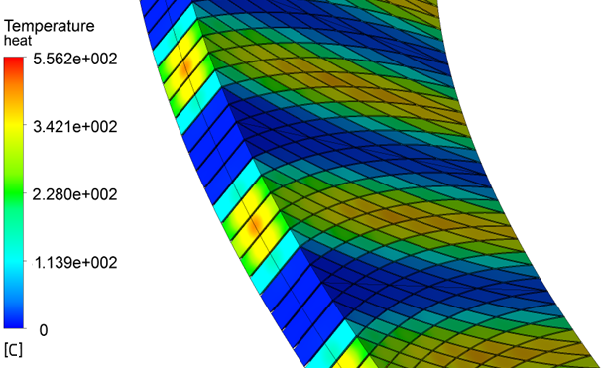
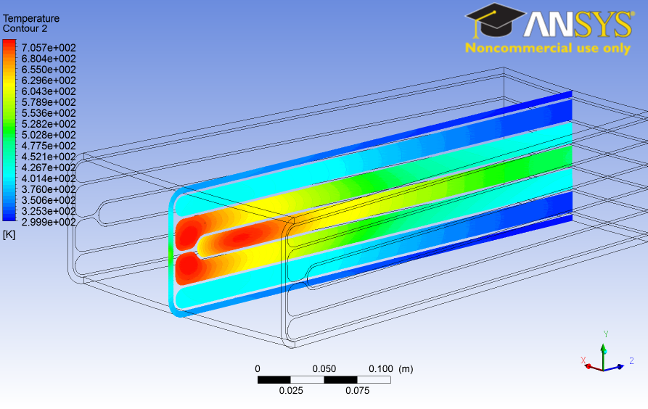
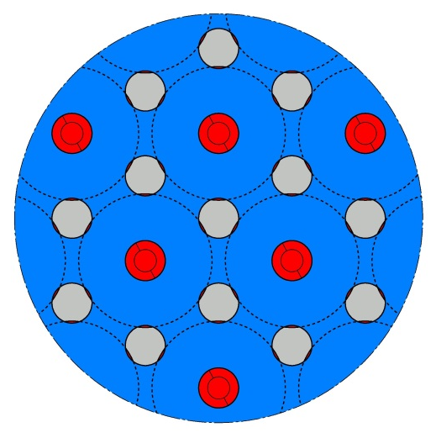
ESS Target Designs (Yongjoong Lee): Convergence?
Baseline (He)
Alternative? (He )
New proposal (He )
Backup (Water)

Slide 11
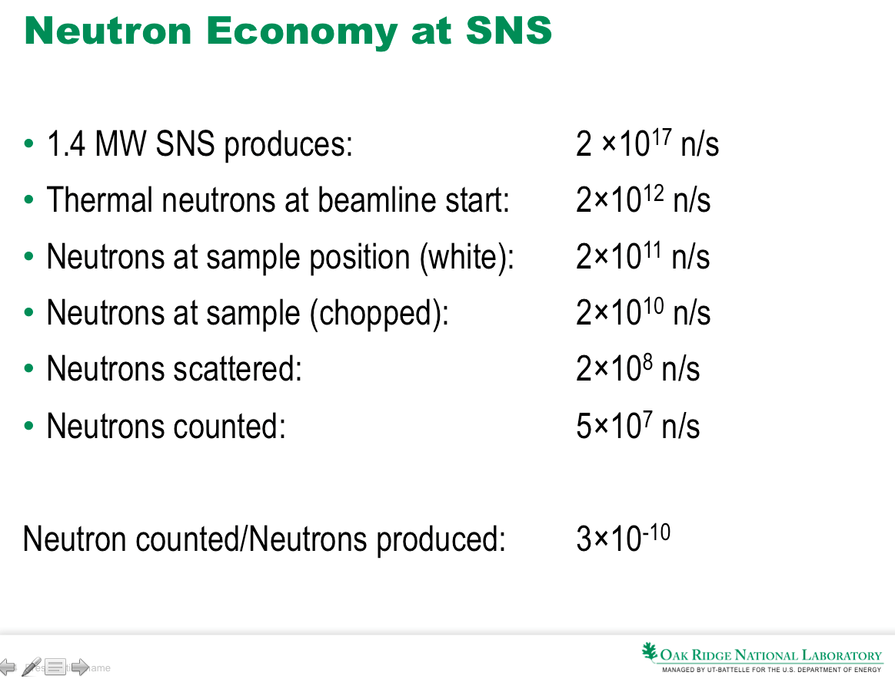

Slide 12
Target design challenges session
- collaboration opportunities -
RaDIATE (Radiation Damage in an Accelerator Target Environment)
  PIE of tungsten, titanium alloys, graphite, beryllium
  New irradiation possibilities
Neutron target, reflector, moderator concepts and design optimization
  Parallel paths for new target stations
Neutrino SuperBeam targets:
  Synergies between US (LBNF), Japan (Hyper-K), Europe (ESS-SB?) requirements and solutions

Slide 13
RaDIATE
1st Annual Collaboration Meeting May 19 2014
Radiation Damage In Accelerator Target Environments

Slide 14
Collaboration Meeting

Slide 15
Collaboration Meeting

Slide 16
Radiation Damage and Materials Limits: Highlights
9 presentations, topics of:
Design Limits
  Simulation of radiation damage
  Measurement capabilities (PIE)
Design and Target Development
  Concepts for target materials and assemblies
  Test facilities for targets (HiRadMat)
Radiation Effects
  Enormous parameter space of:
    Radiation particles, energies, time structures
    Materials (including grades and preparation)
    Environments (temperature, pressure, chemistry)

Slide 17
Radiation Damage and Materials Limits: Challenges and Solutions
Common Challenge 1:
  Development of a uniform design code used by all target/beam stop/window designers
    Generally use operational experience to determine design limits.
    Properties vary significantly across component from variation in dose distribution and irradiation temperature.
Proposed Solutions:
  Develop a collaboration among designers to share code rules applicable to high dose irradiated materials.
Common Challenge 2:
  High cost of performing post irradiation examination
    Some irradiated components aren’t even analyzed (e.g. ISIS target, LANSCE targets)
    Facilities for analyzing targets remotely are limited and expensive.
Proposed Solution:
  Share data from analysis of spent targets. Develop international collaborations to enable analysis of valuable components

Slide 18
Radiation Damage and Materials Limits: Challenges and Solutions
Common Challenge 3:
  Need for data after prototypic exposure conditions
    Limited alloys have been tested. So, typically use established engineering materials.
    Very little data on advanced alloys
    Limited test facilities available for testing under controlled irradiating conditions
Proposed Solutions
  Develop an open handbook containing data on irradiated materials.
  Perhaps sections could be taken from APT materials handbook and reviewed for open distribution to start an open handbook.
Common Challenge 4:
  Need for small scale testing techniques among the target materials community
    Each group performs testing with slightly different specimen designs
Proposed Solutions:
  Summarize standard specimen designs for small scale testing of irradiated materials.

Slide 19
Radiation Damage and Materials Limits
Recommendations for Future Growth:
  The largest challenge ripe for collaboration is the development of an open sharable database. I believe that the fusion community started something like this. Perhaps we can follow their lead.

Slide 20
Target Facility Simulation Challenges
Summary
Nikolai Mokhov and Ottone Caretta
5th High Power Targetry Workshop
Fermilab
May 20-23, 2014

Slide 21
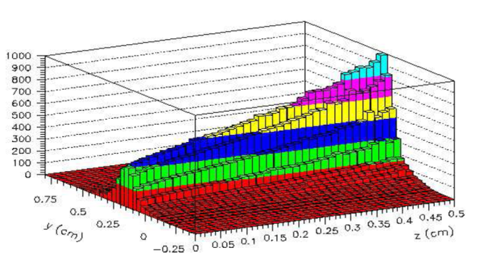
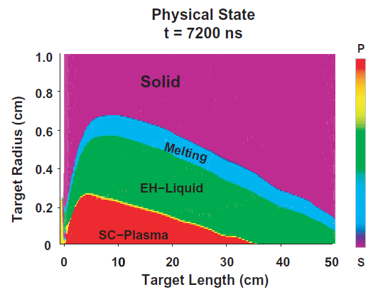
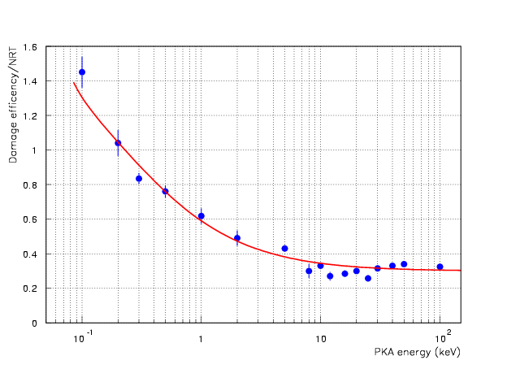
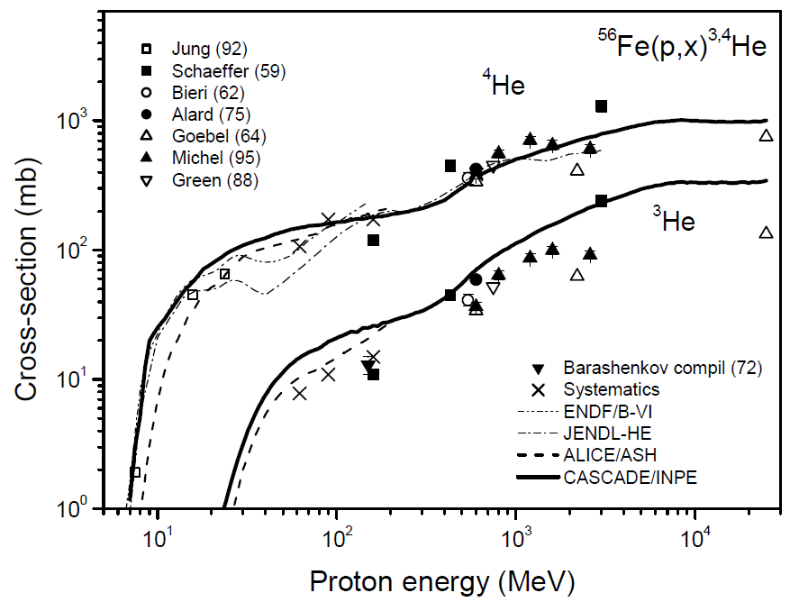
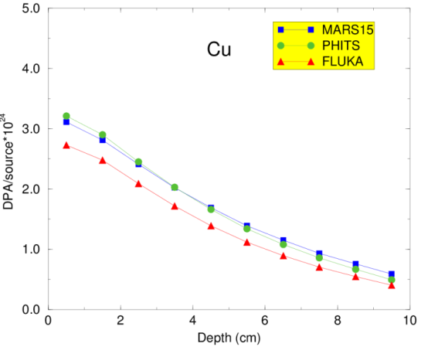
Nikolai Mokhov (Fermilab):
Beam-Induced Effects in Targets and Uncertainties in Modeling
Thermal shocks and quasi-instantaneous damage
Insulation property deterioration due to dose buildup
Radiation damage to inorganic materials due to atomic displacements (DPA) and helium production
Capabilities (impressive) and uncertainties (steadily decreasing) of modern simulation codes used to study these effects
Link of calculated quantities (DPA, dose, fluence etc.) to observable changes in critical properties of materials remains on the top of the wish-list. Mission impossible?
Discussion
Displacement efficiency k(T)
K(T)=0.8

Slide 22
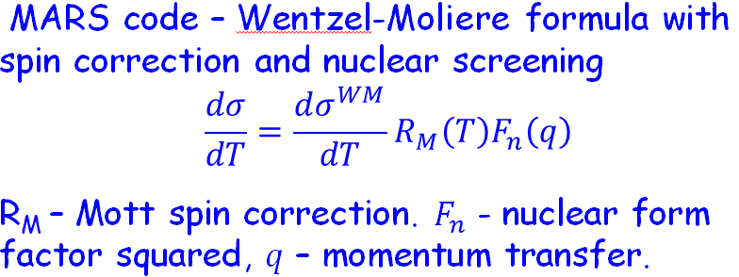
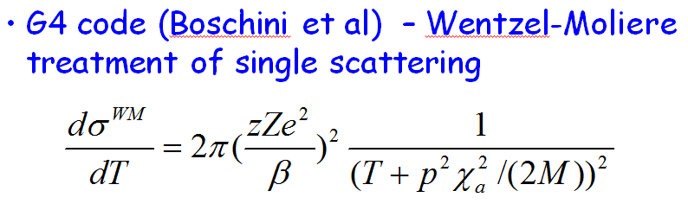
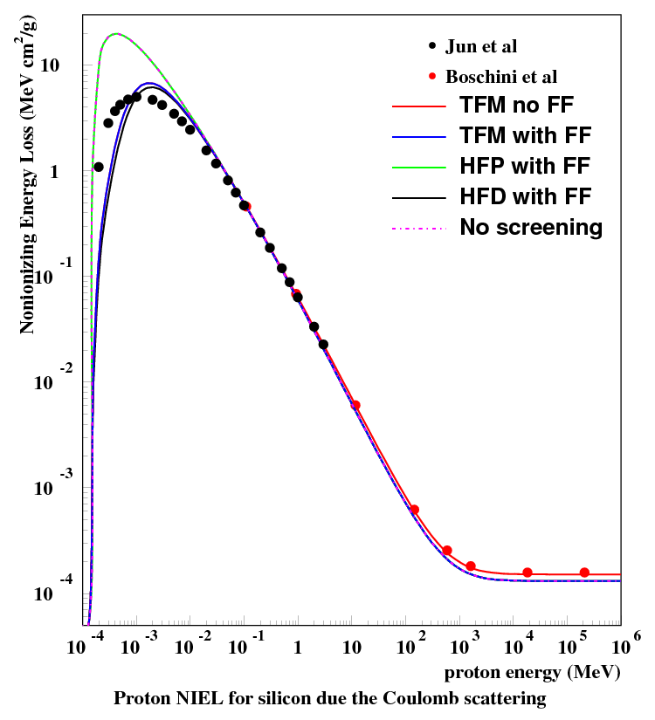
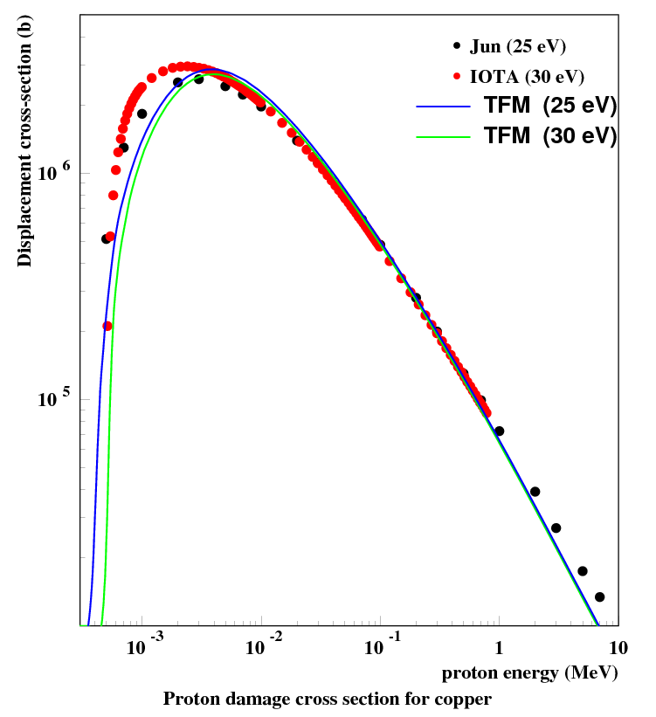
Sergei Striganov (Fermilab):
Modified Moliere’s Screening Parameter and its Impact on Calculation of Radiation Damage
Models of Elastic Coulomb Scattering:
DPA Calculations:
Based on classical and quantum mechanic approaches are in reasonable agreement for protons with energy larger than a few keV
Not very sensitive to atomic screening model. Energy dependence of a screening parameter is important
Using precise description of atomic form factor improve accuracy at very low proton energies
With target and projectile nuclear form-factors noticeably decrease DPA, especially for heavy nuclei
Discussion suggested to add results for heavy ion projectiles and demonstrate model sensitivity of DPA calculations in thick targets

Slide 23
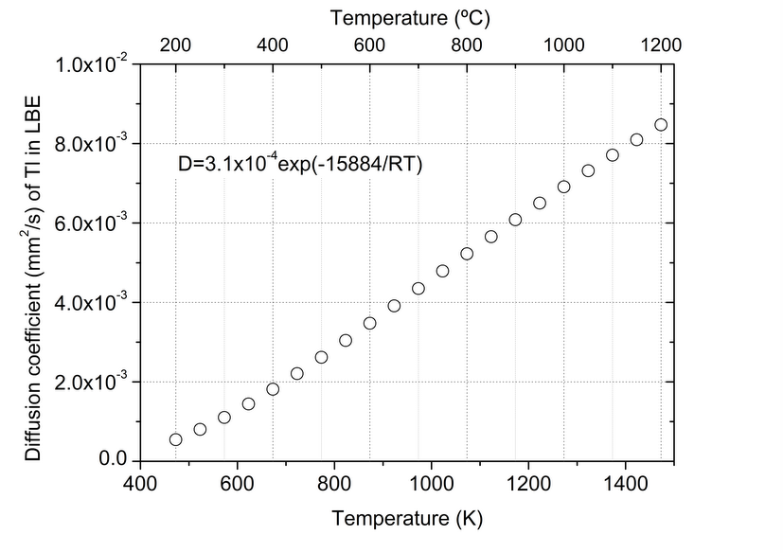
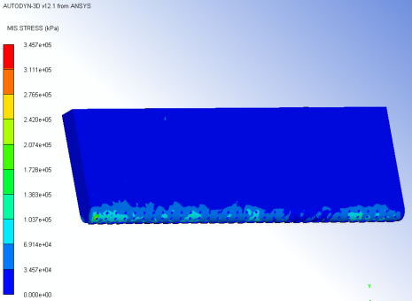
Melanie Delonca (CERN):
Design and modeling of a Pb-Bi target for ISOLDE
Improvement of diffusion with temperature
Presented the design of a retrofit Pb-Bi liquid metal alternative target to the ISOL solid target for ISOLDE.
The design is optimised to maximise diffusion of desired isotopes within the existing stringent spatial constraints
Modelling of the proposed target highlighted beam induced high amplitude stress waves and possible rarefaction in the liquid
The design is in the advanced stage and a prototype is in the pipeline
Discussion suggested that beam nucleation may induce advent of cavitation earlier than expected
Diffusion of isotopes
Maximum operating temperature limited by vapor pressure of LBE
Stress waves in the container walls and possible cavitation
Shock waves deposit energy onto the weakest point of the container (grid part).
Stresses up to 350 MPa (Yield = 390 MPa) in less than 1 ms.

Slide 24
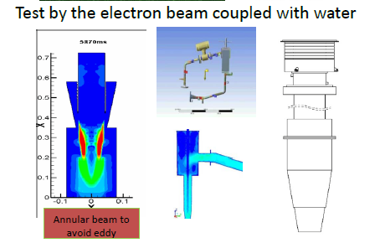
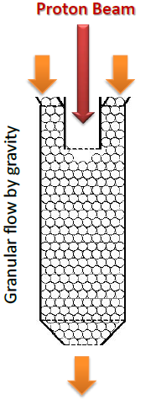
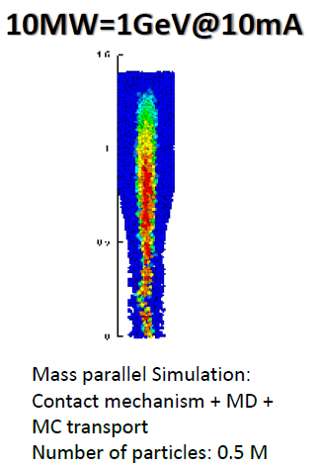
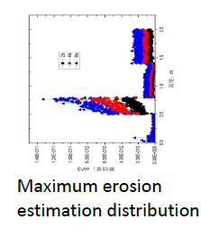
Lei Yang (IPM, CAS):
High power target studies for ADS including proposal for a gravity fed granular target
Stability of a free surface liquid metal target for ADS can be improved with rotation of the liquid and spreading of the beam onto an annular shape.
At high powers however cavitation, shock waves and splashing may be show stoppers for this technology.
Proposed a new gravity fed granular system.
Modelling and tests suggest the technology is an appealing candidate.
Erosion tests on the nozzle suggest it is within acceptance.
Discussion highlighted the rapid progress on the granular design and the fact that there are 60 scientist working on the case @ the IMP in China!
Windowless Liquid metal
Gravity fed granular

Slide 25
Simulation Challenges Summary
DPA is perceived as a very useful metric to give an indication of radiation damage in the material.
For unambiguous DPA normalization and code intercomparison, ED codes should provide standardized NRT DPA values in addition to the state-of-the art MD and experiment/temperature corrected DPA.
Link of calculated quantities (DPA, dose, fluence etc.) to observable changes in critical properties of materials remains on the top of the wish-list. Explore a possibility to launch a (Ph.D.?) project to merge ED/DPA codes to Molecular Dynamics. Any outcome here would be invaluable.
Identify existing or future experiments which can be used for calculated DPA benchmarking and normalization to observable defects.

Slide 26
Simulation Challenges Summary
Well-thought experiments – covering various regions of the parameter space - are extremely desirable, including measurements with charged particle beams, their relation to neutron data and degradation measurements at cryogenic temperatures. Heavy ion beams look very promising.
Move from occasional comparisons of calculated radiation-damage related quantities to a comprehensive code intercomparison with “standardized” DPA models and well defined irradiation conditions including temperature, dose rate, H₂/He gas production, etc.
Request: generate a FOM for target design including useful particle production, target integrity, lifetime, etc.
Other challenges: Annealed versus non-annealed defects; low-energy neutron DPA in compounds; Standardized approach to modeling of soft errors (e.g., SEU) in electronics, certainly at high-energy accelerators and spacecrafts.

Slide 27
Comment from Otto:
There exists a variation in material properties between different batches of a given grade and even within the same batch. The nuclear industry avoids this problem by isolating a batch and extensively testing a large pool of samples.
Existing variations in the material properties might be exacerbated by radiation damage and account for some scattering in the material testing results?

Slide 28
Instrumentation –
Conveners' Observations
Shea
Thomsen
Compared to the accelerator upstream, no target station appears to have a comprehensive instrumentation suite
Desires (many perceived to be too difficult to pursue):
  More extensive thermal instrumentation
  Improved beam profile and position monitoring
  More robust inputs to target protection system (rastering example)
  More…
Limited collaboration between target facilities and across broader community
Significant opportunity here.

Slide 29
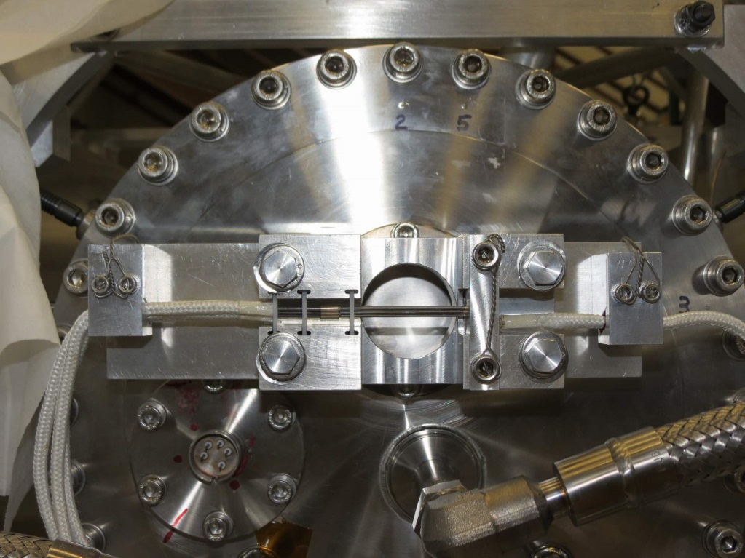
Thermocouple Device at NuMI
Hylen
New device to monitor proton beam position on NuMI target
Beryllium rods and thermocouples demonstrated ability to monitor beam position to better than 0.1 mm accuracy
Simple, robust device that many attendees could see during the tour.

Slide 30
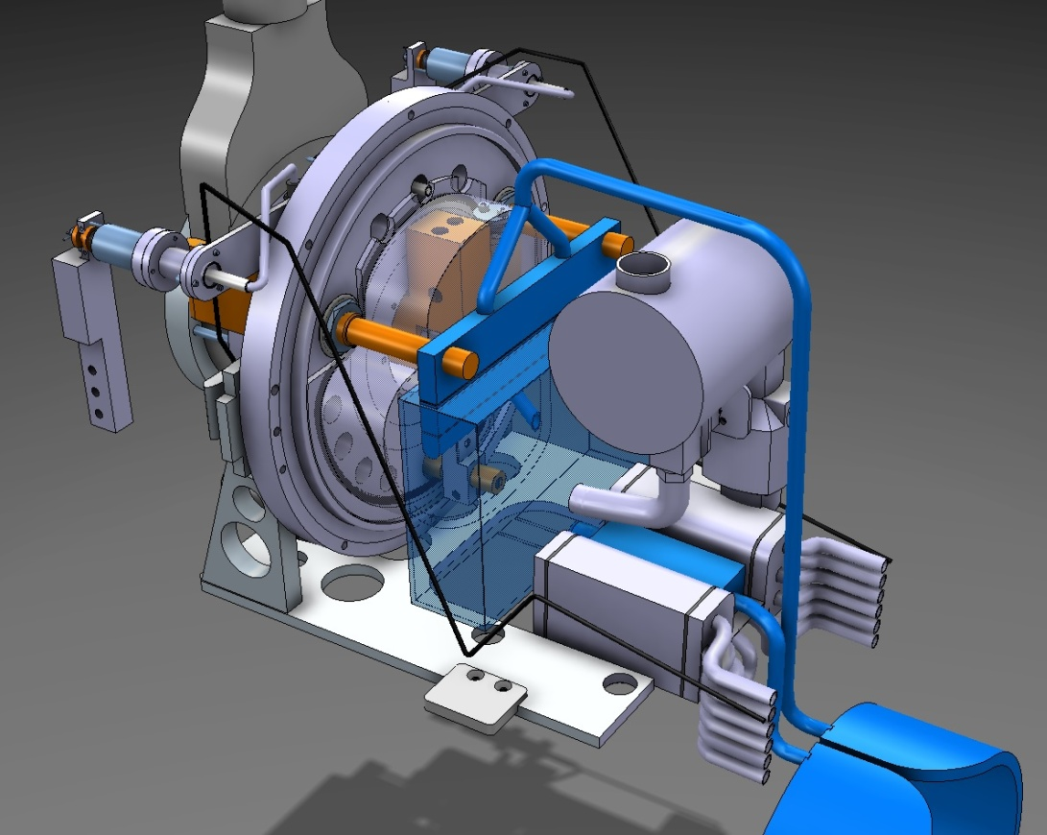
Safety in New ISOLDE Target
Bernardes
From a container with static liquid metal (LBE) to a circulating loop: dramatic increase in safety-relevant instrumentation.
Ambient vessel
Thermocouple Locations
Transfer line and chimney: 2x
Diffusion chamber
Inlet irradiation
Container : x2
Outlet diffusion chamber: 2x
LBE filling tank
Heat exchanger: x3
Outlet pump: 2x
Inlet pump
Pump: 3x

Slide 31
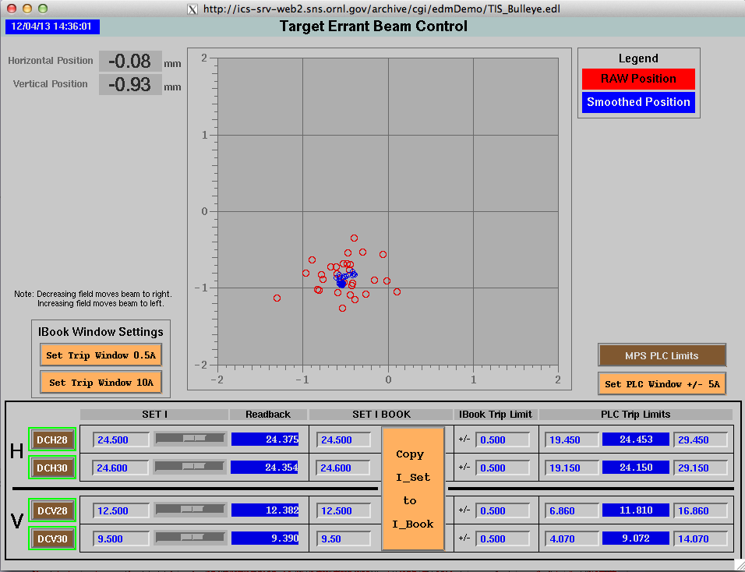
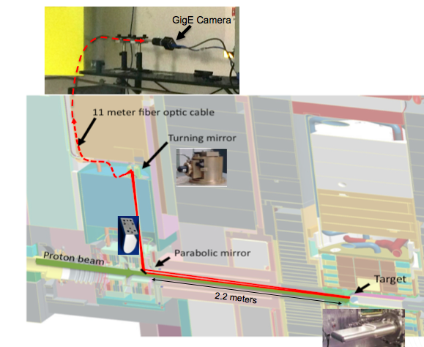
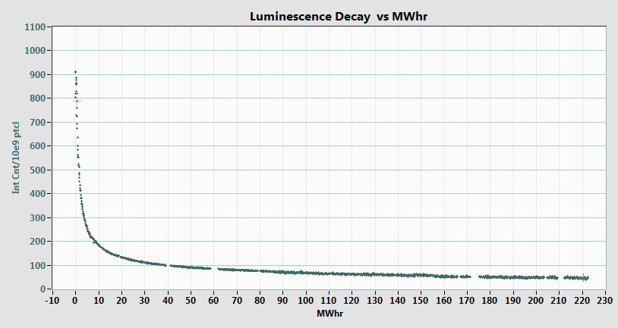
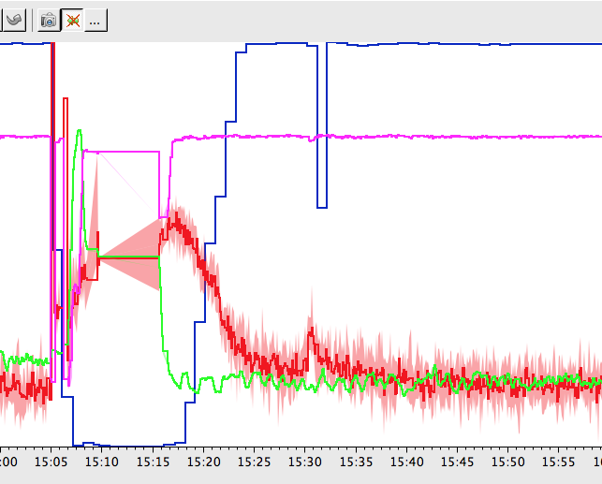
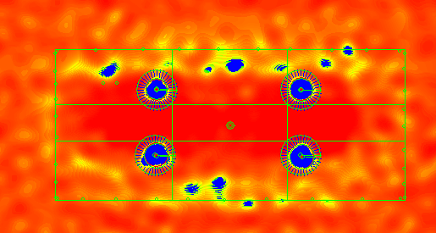
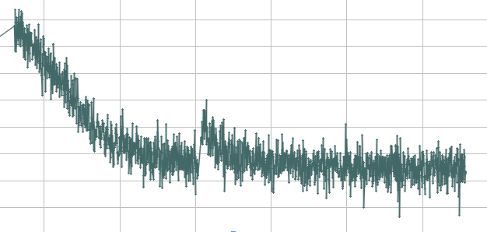
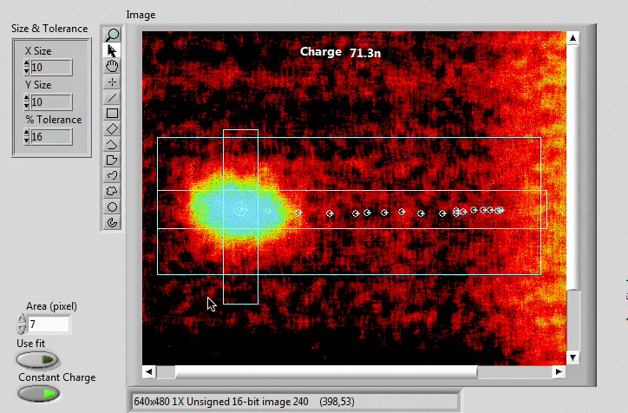
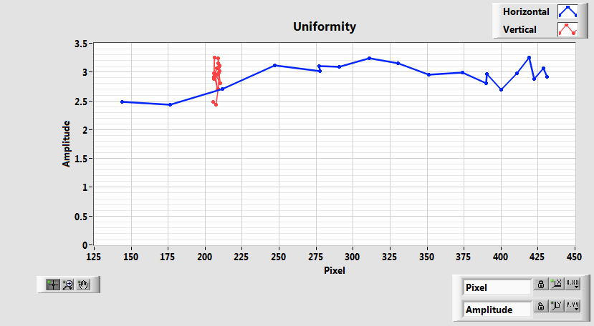
Target Imaging at SNS
Blokland
On-line monitor
Coating luminescence rapidly radiation damaged, then more stable
Target Imaging System: Cr:Al₂O₃
Coating on target.
Auto-cal data suggests heat stress on mirror
Future:
Better optics
R&D on coating
Auto correction of image movement
Uniformity Scan (±12.5%)

Slide 32
Target Facility challenges
K. Haga, R. Losito

Slide 33
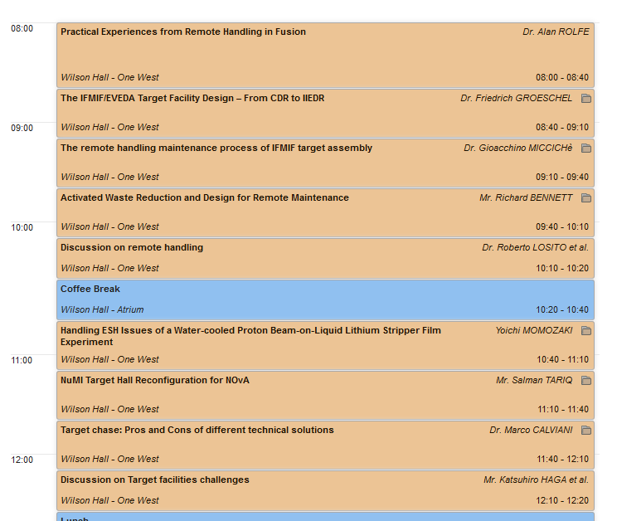

Slide 34
Challenges and Solution
Remote Handling:
  Embed into design to save money/time
  Recovery from accidental situation
  If components designed for RH, then operations take the same time or less then with human
  If not, 5 to 10 times more!
  Simplify design
Solution
  Share experience: show your examples
  Failure analysis before starting the RH; prepare back-up solutions
  Code of practice?

Slide 35
Challenges and solutions
Environmental issues
  Reduce waste
  Tritium confinement
  Short lived isotopes
  Flexibility necessary to solve early problems
  He, air or vacuum?
Solutions
  Try to declassify waste as much as you can
  Tritium creation and migration need to be studied more. Simulations and benchmarking needed
  Good to have flexibility: Remote vision, remote handling, ALARA approach: flexibility costs!
  He/air/Vacuum depend on specific layout of facilities and local legislation. Each have advantages/disadvantages. Chose the priority!

Slide 36
Summary
High-Power Targetry now spans several communities
  HEP
  NP (RIB)
  Spallation
  ISOL
  AdS
  Fusion Irradiation
Also tangentially connected communities:
  Nuclear Fission / Fusion Power & Test Rectors
  Aerospace
  Material Science
  Accelerator systems (collimators, windows, strippers, etc.)
Fruitful cross-pollination, but there is a long way to go
  Comparisons are difficult and few
  Most information is proprietary
  Lack of standards in tests, simulations, quantities, materials, …
Difficult to build a blue-sky target based on basic information
  New facility concepts must build a knowledge base
Opportunities to organize and build the community
  Generalized expertise will be a valued commodity

Slide 37
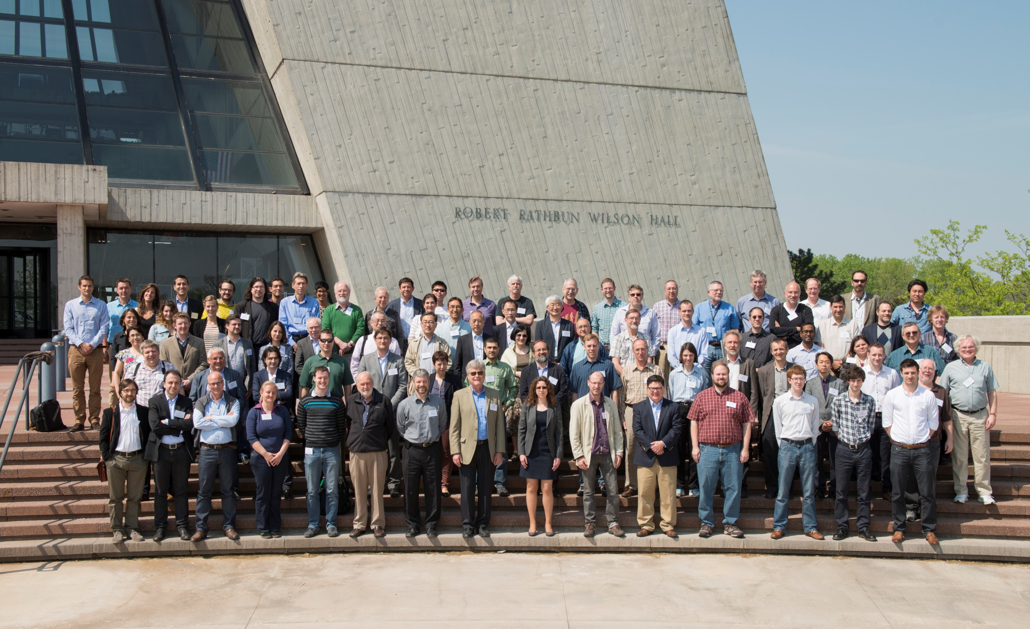
HPT14

Slide 38
Radiation Damage and Materials Limits: Highlights
Mini-session 1: Design Limits
  C. Petesch:
    The scope, philosophy and applications of the RCC-MRx code were presented, especially on the neutron irradiated materials.
    It addresses an issue on whether the RCC-MRx code can be further extended up to the level that it can be applied to determining stress allowables for target and window design.
  D. McClintock:
    The principles and philosophies in determining design lifetimes for the TMR and window systems at SNS were presented.
    For the window, SNS is moving toward changing from Alloy 718 to Al6061-T6.
    It raises a fundamental questions in guiding principles in defining lifetime determining criteria for targetry systems.

Slide 39
Radiation Damage and Materials Limits: Highlights 2/3
Mini-session 2: Design and Target Development
  C. Densham
    The R&D and design activities of a radiation cooled tungsten target for Mu2e were presented.
    All pieces are made of tungsten.
    Performing testing to obtain fatigue data under prototypic temperatures.
  A. Fabich
    This presentation summarized a dedicated in-beam facility HiRadMat at CERN.
    The in beam test facility will be used for performing high heat deposition experiments on materials and instruments, rather than investing accumulated radiation damage in materials.
    Facility can perform very high energy pulse irradiations on prospective materials or instruments.
    The needed steps from making in beam test applications to dismantling the test set up were provided.

Slide 40
Radiation Damage and Materials Limits: Highlight 3/3
Mini-session 3: Radiation Effects
  F. Pellemoine
    Summarized initial irradiation data on materials for FRIB beam dump and graphite production target.
    No showstoppers but more testing is underway.
  V. Kuksenkov
    Presented plans for Be irradiations.
    Be will accumulate helium at a very fast rate (>4000 appm He/dpa)
  M. Tomut
    Summarized the facilities at GSI for high energy/high dose ion irradiations.
    Experiments can be performed with heavy elements such as Bi and U at energies up to 1 GeV.
    In situ measurements are capable with SEM, XRD and IR spectroscopy.
  M. Toloczko
    Summarized miniature test specimen geometries for tensile testing and fracture toughness testing and non-standard techniques such as shear punch and hardness testing.
  S. Maloy
    Summarized recent results from PIE analysis of an annealed Alloy 718 window through performing shear punch testing and microstructural examination with TEM.

Slide 41
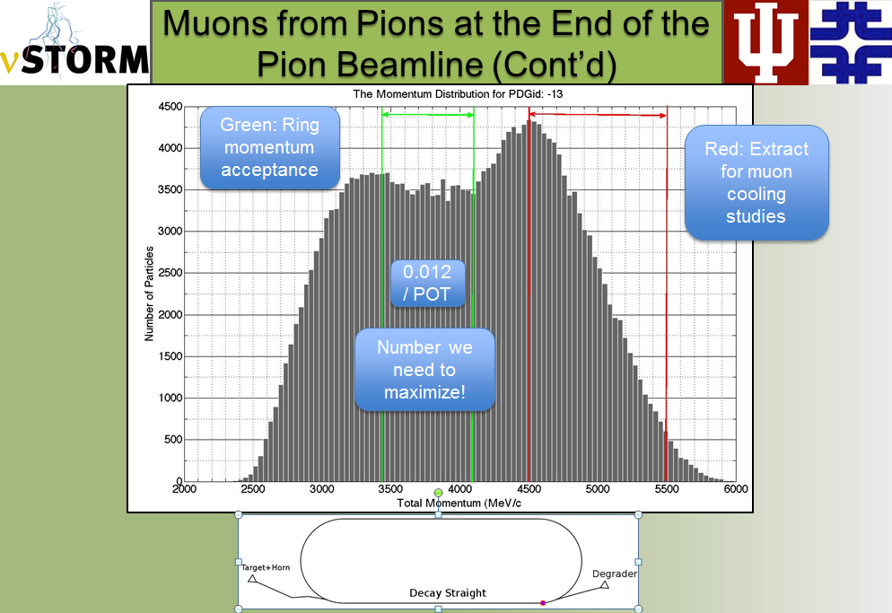
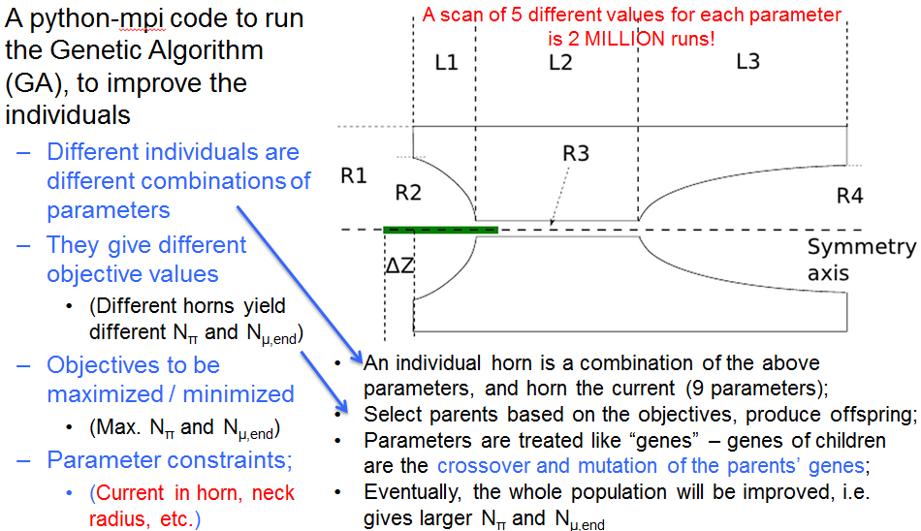
Ao Liu (Fermilab, Indiana University):
Horn Optimization for nuSTORM
1. nuSTORM benefits from the optimization:
  Expect 8.3% more neutrino flux, with a 38 cm Inconel target;
  Expect 16% more flux, with a 46 cm Inconel target.
2. Other horn-based projects – e.g. LBNE:
  Algorithm is expected to work if the objectives are known;
  Algorithm may be less complicated and faster, if no beamline tracking is needed;
  MOGA allows adding other constraints to obtain a more realistic design + optimization

Slide 42
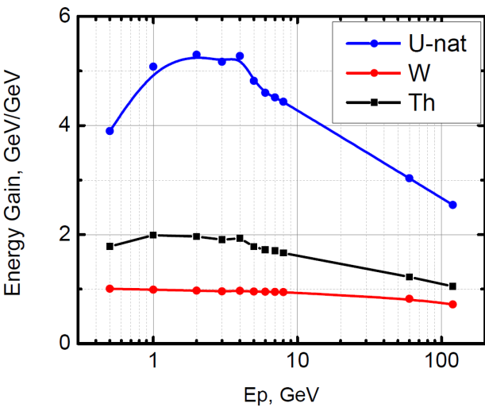
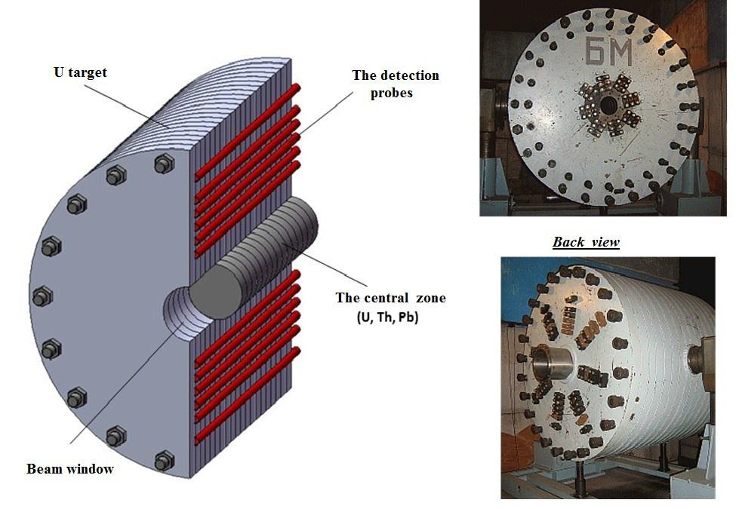
Vitaly Pronskikh (Fermilab)
MARS Optimization of High-Z Solid Targets for ADS
Natural Uranium is shown to be superior to W and Th for fission ignition in an ADS.
A 5cm radius, 1-2mA, 2-4GeV beam results in approx 1GW output from a 60cm diameter, 110cm long uranium target (0.3m^3).
A U-target of similar specification exists at JINR in Dubna but has not been tested with a high power beam
Discussion highlighted that dissipation of 1GW of heat from a volume of ~0.3m^3 might be a show stopper for this technology

Slide 43
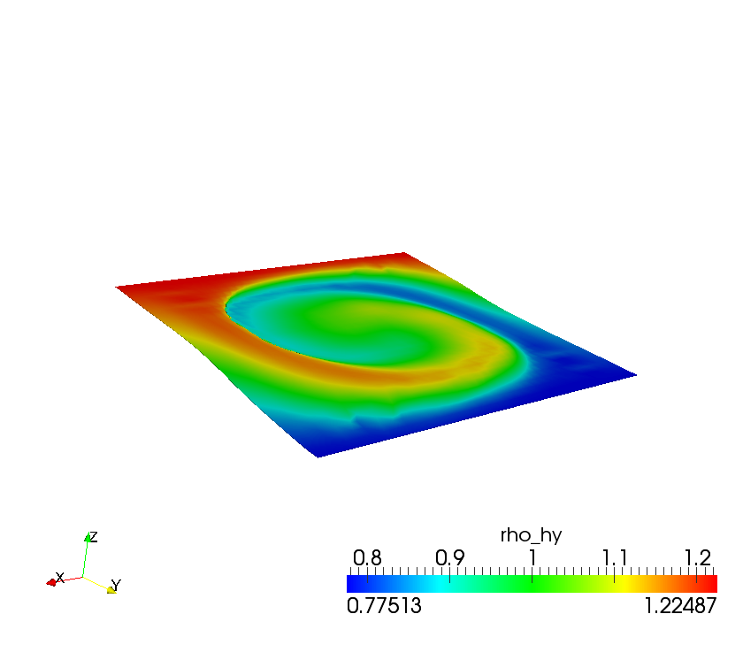
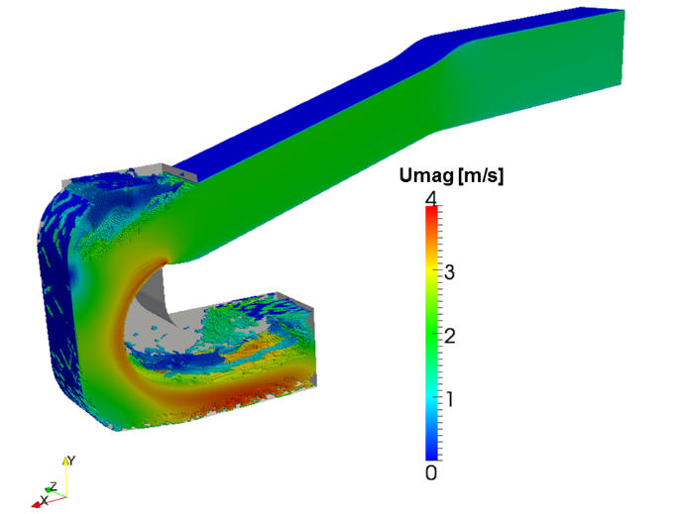

Jana Fetzer (KIT):
Developing an MPV method in OpenFoam to model a liquid metal backup target for ESS
Multiple Pressure Variables (MPV) approach is required to model the interaction of flow phenomena with beam induced acoustic phenomena which otherwise require wildly different computational time scales.
The model developed shows good agreement with aero-acoustic validation case.
The model will be applied to simulate beam induced effects on the free surface liquid metal backup target for ESS.
Discussion highlighted that most of the simulation work on targetry is performed using ANSYS as opposed to other viable options such as COMSOL and OpenFoam which is an free, open source FE/CFD code.
Validation of MPV model on aero-acoustic case
Free surface liquid metal backup target for ESS

Slide 44
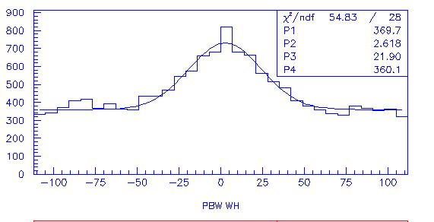
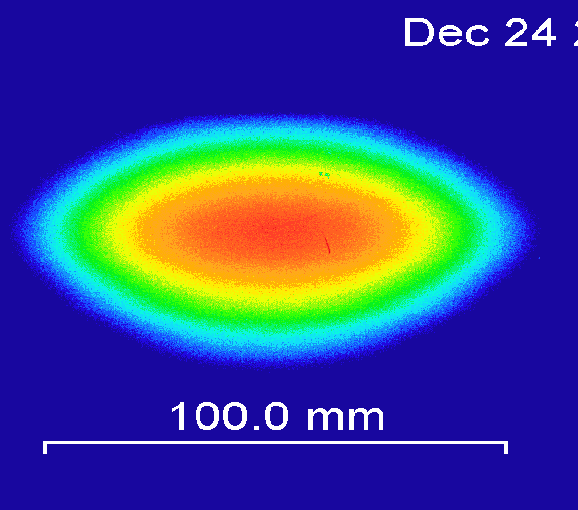
J-PARC
Meigo
Many diverserse sensors measure impact of new octupoles, Most are applicable to other facilities.
One highlight
Online 2-D measurement by IP
Offline 2-D measurement by MWPM
Both results by MWPM and IP show good agreement
Anomaly beam parameters observed by MWPM,
beam stopped by MPS

Slide 45
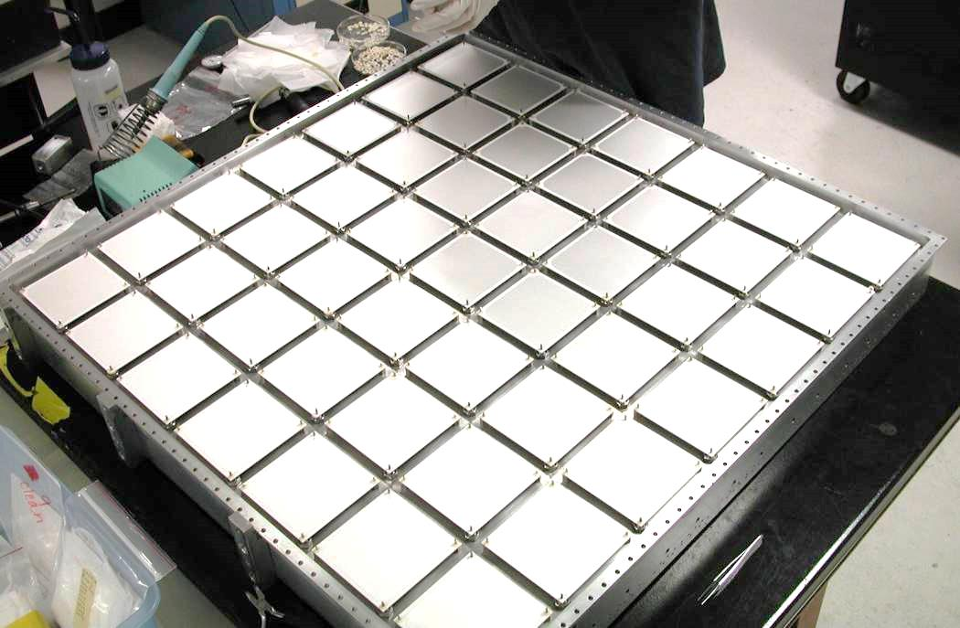
Secondary instrumentation in neutrino beams
Zwaska
Needed for operation and alignment but subject to enormous particle fluxes and radiation damage
Remedy weakness in electrical components and response stability
Radiochemical detector would measure the presence of reaction products from beam ionization of a known mixture.
  Purely passive components in the beam
  Limited shielding penetrations
Alternative fluids and techniques discussed

Slide 46
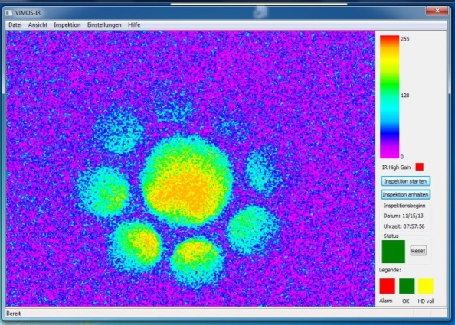
Imaging Solution at PSI
Thomsen
Issue transporting short wavelengths in fiber bundle
Fiber
Beam splitters
Camera 3 (IR)
80%
Long wavelengths
20%
Short wavelengths
Safety channel unchanged
Camera 1 (safety)
Camera 2 (visual)
Diagnostics’ short-wavelength camera removed, but Filter left in place.
IR - Signal with reduced short-wavelength contamination alone serves as basis for diagnostics
Increased sensitivity for lower temperatures / currents
More linear response could still be reached
Try to do all optics with mirrors only

