Slide 1
12 GeV CEBAF Upgrade
Project Status
Claus H. Rode
12 GeV Project Manager
Fermilab
June 2, 2014

Slide 2
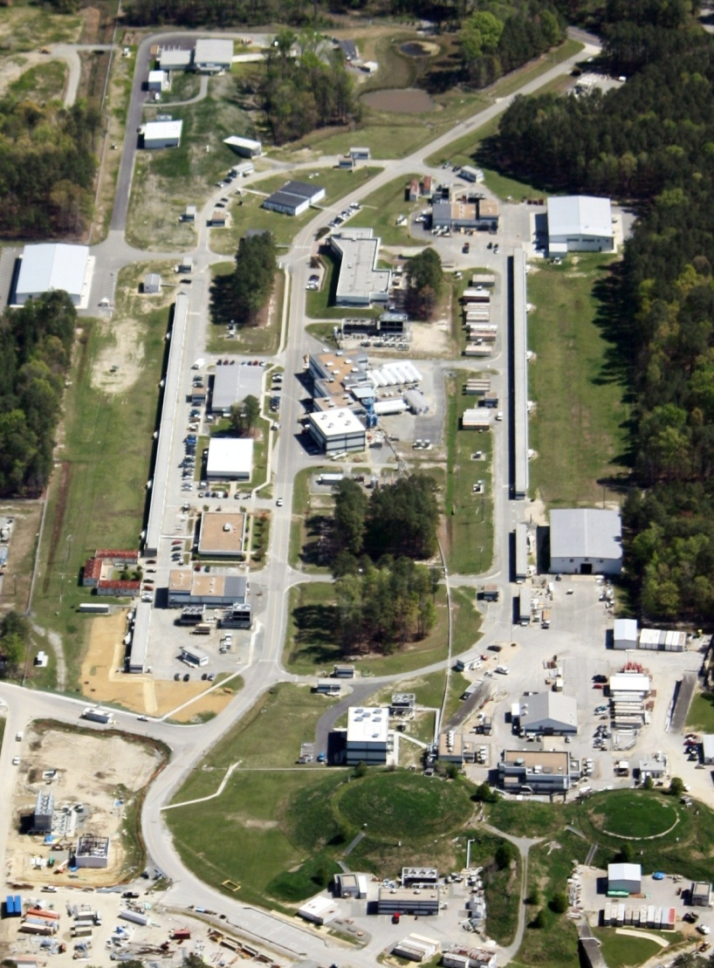
OUTLINE
Background
Construction Status
  Civil
  Accelerator
  Physics
Path Forward
  ETC
  CD-4A/CD4B
  Rebaseline
Summary
D
A
B
C

Slide 3
DOE CRITICAL DECISION SCHEDULE
LEVEL 1 MILESTONES
CD-0 Mission Need | MAR-2004 (A)
CD-1 Preliminary Baseline Range | FEB-2006 (A)
CD-2 Performance Baseline | NOV-2007 (A)
CD-3 Start of Construction | SEP-2008 (A)
CD-4A Accelerator Project Completion and Start of Operations | DEC-2014 - REQUESTED
CD-4B Experimental Equipment Project Completion and Start of Operations | JUN-2015 Re-baseline SEP-2017
CD-4 split to ease transition into Operations Phase

Slide 4
12 GeV FUNDING PROFILE
FY11 Funding
Limited

Slide 5
FUNDING OVERVIEW
Since CD-2, the project was funding limited in 3Q and 4Q FY11. This was the reason the original baseline only had 6 months of schedule contingency for Halls B & C.
ARRA funds moved forward FY10 & FY11 funding, but did not change the integral thru FY11.
The $16M funding cut in FY12 made it impossible for Halls B & C to achieve CD-4B on time.
Balance of the FY12 funding cut arrives in 1QFY15.
Initial installment of the $28M TPC increase (rebaseline) arrives in late 1QFY15.

Slide 6
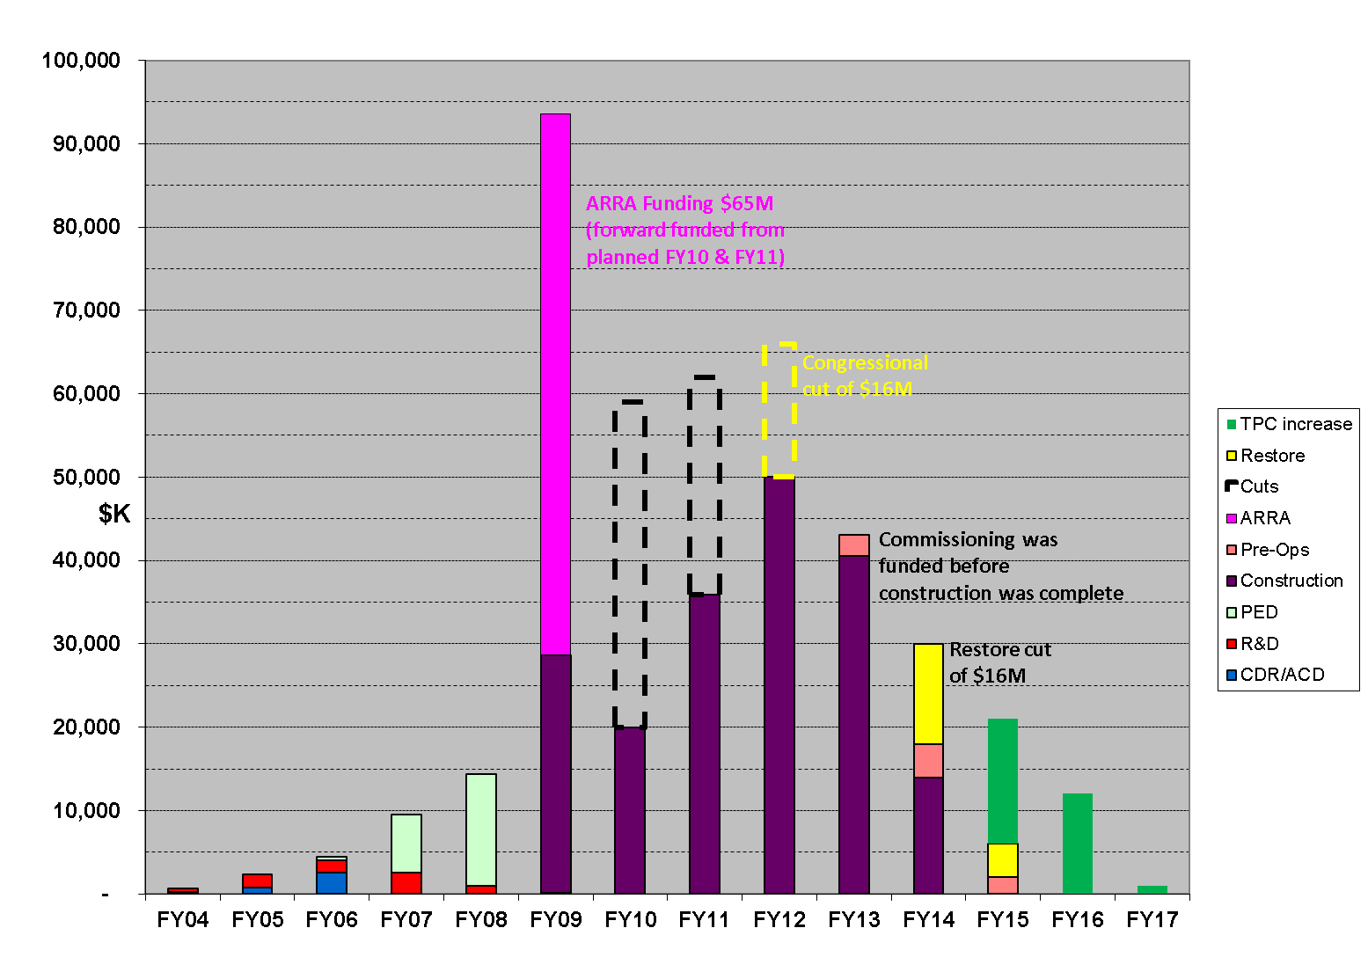
FUNDING PROFILE COMPARISON
$310M TPC (Apr 2013) and $338M TPC (Sep 2013)

Slide 7
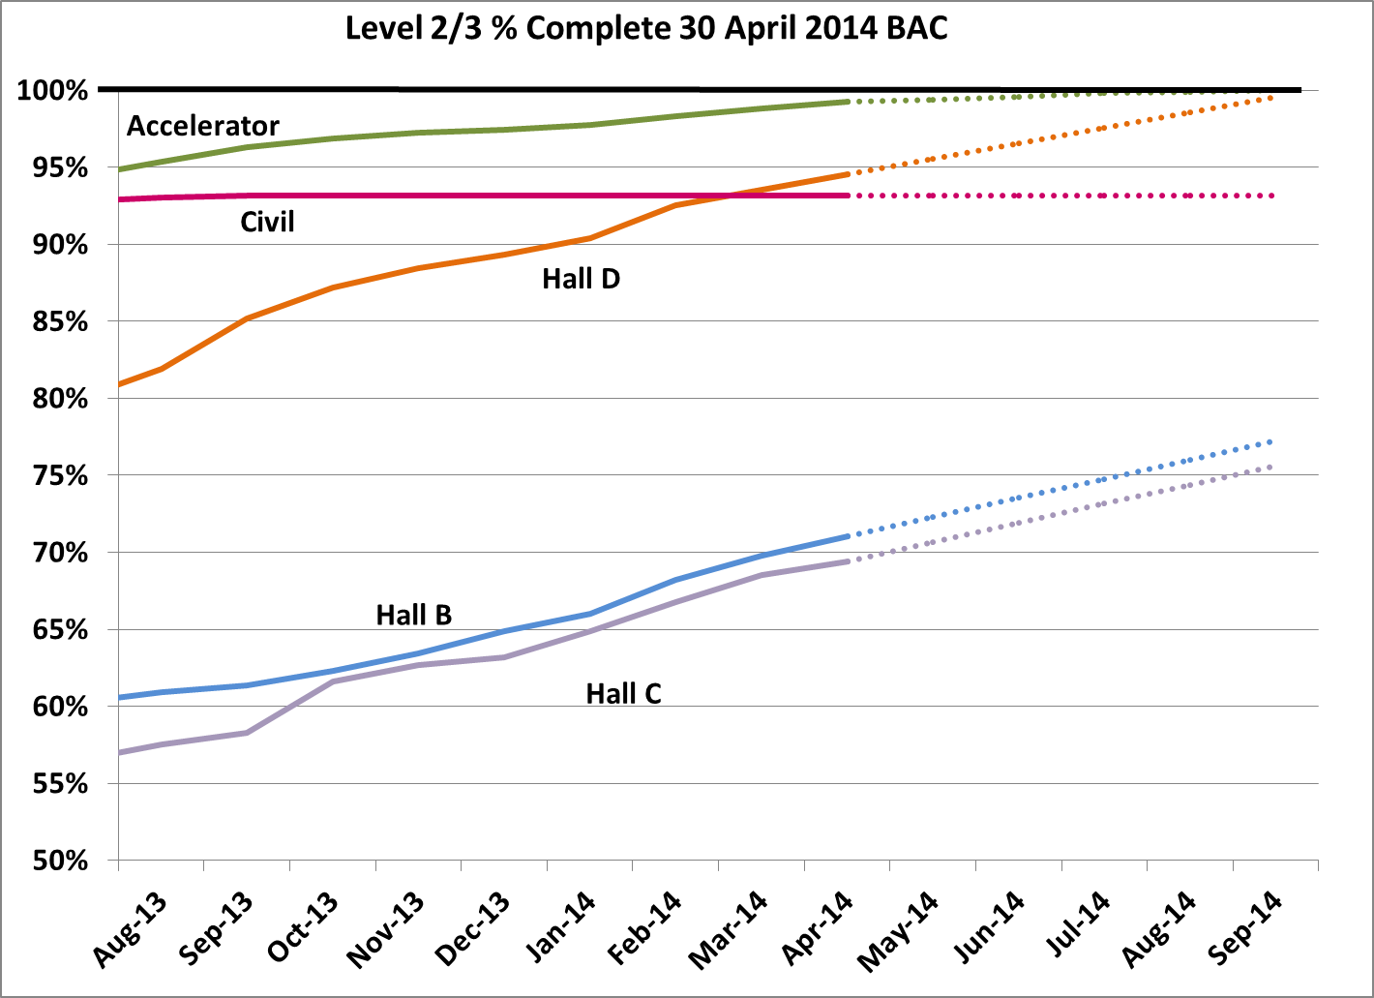
NP LEVEL 2 - % COMPLETE
88% COMPLETE
91% OBLIGATED

Slide 8



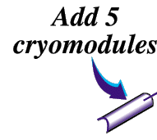



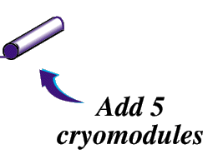
12
6 GeV CEBAF
11
Upgrade magnets and power supplies
CHL-2
Two 0.6 GV linacs
1.1
New cryomodules get new rf zones
Notes:
help me

Slide 9
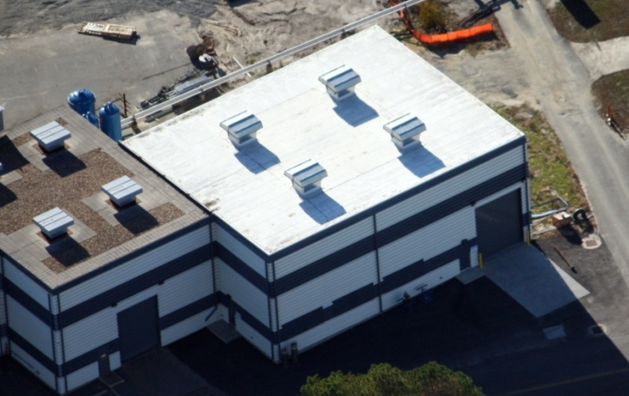
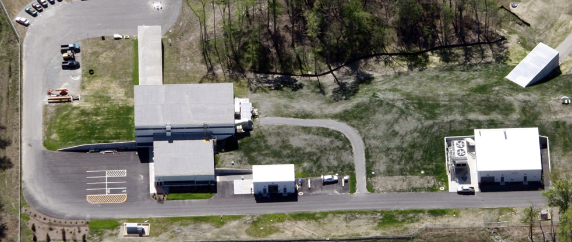
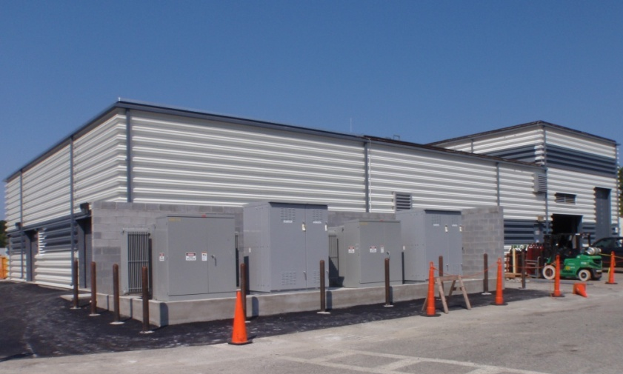
CIVIL CONSTRUCTION: 93% Complete
CHL Building Addition
Hall D Complex
North Access Building Addition
SCOPE:
New Construction ~10,080 sq ft
Add to Existing Buildings ~8,400 sq ft
Expansion of existing utilities
FY13 task complete: N&S Access Bldg AC
Two FY15 tasks remain: Tunnel AC;
Back-up cooling towers

Slide 10
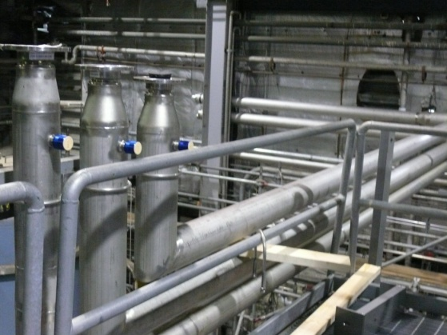
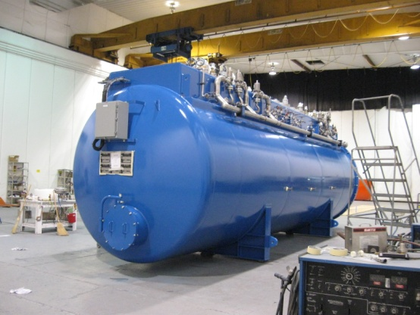
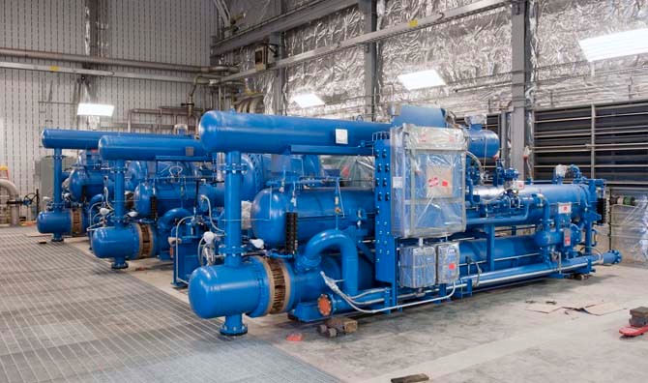
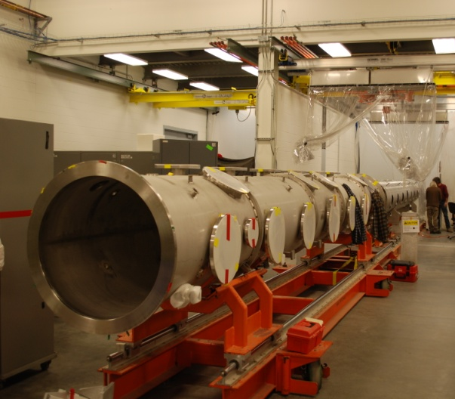
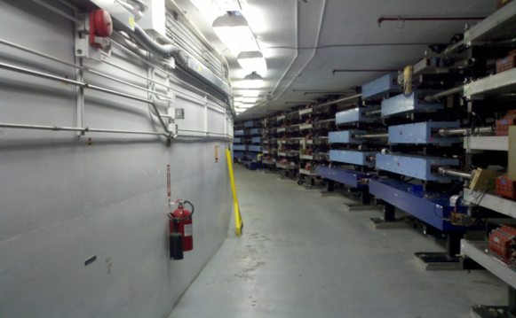
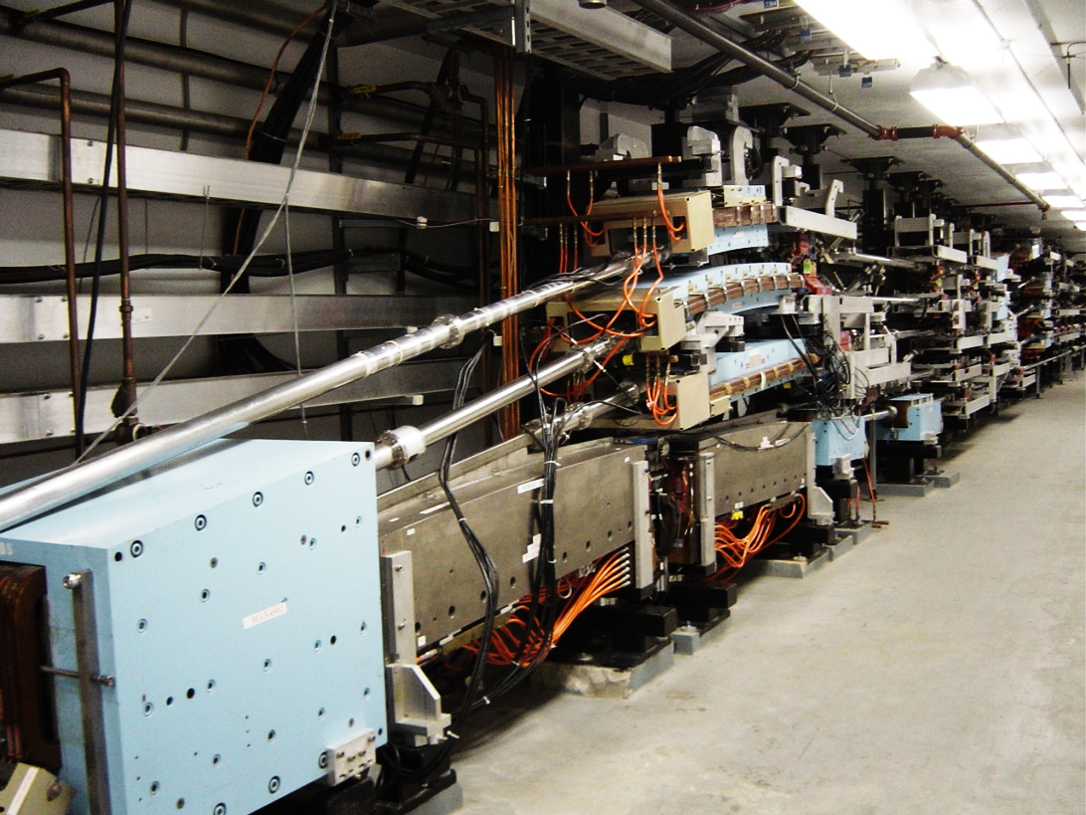
ACCELERATOR CONSTRUCTION: 99.3% Complete
Cryomodules: 10 (of 10) high-gradient CMs complete
Power: RF 10 zones complete; Magnet complete this month
Cryogenics: Central Helium Liquefier-2 complete
Beam Transport: 10 ARC & 4 beam lines complete
Extraction: RF components complete
I&C / Safety Systems 93%):
  Complete: beam diagnostics; control system; safety system
  In progress: Hall D nA BPMs; fast feedback

Slide 11
CRYOMODULE PERFORMANCE
 | Checked out in tunnel | With beam
 |  | Low current | High current
#1 | 104 MV | 98MV | 90MV
#2 | 122 MV | 108MV | 108MV
#3 | 108 MV | 77 MV
#4 | 93 MV | 100 MV
#5 | 121 MV | 79 MV
#6 | 111 MV | 102 MV
#7 | 103 MV | 104 MV
#8 | 110 MV | 100 MV
#9 | 105 MV | 101 MV
#10 | 104 MV | 88 MV
Avg | 108 MV | 95 MV
Check-out voltages met the goal of 108 MV average
Initial running with beam was close to 98MV target:
  Still learning how to optimize the fully integrated (cm + cryo + rf + interlocks) system

Slide 12
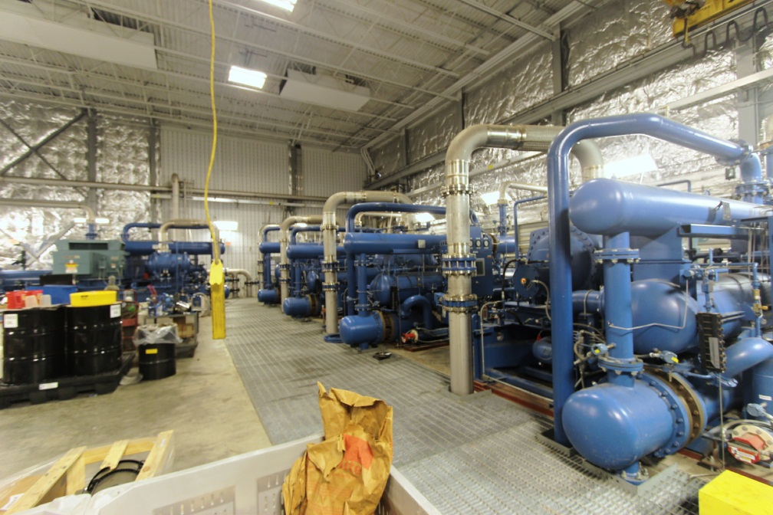
CRYOGENICS: COMPLETE
Warm
Compressors

Slide 13
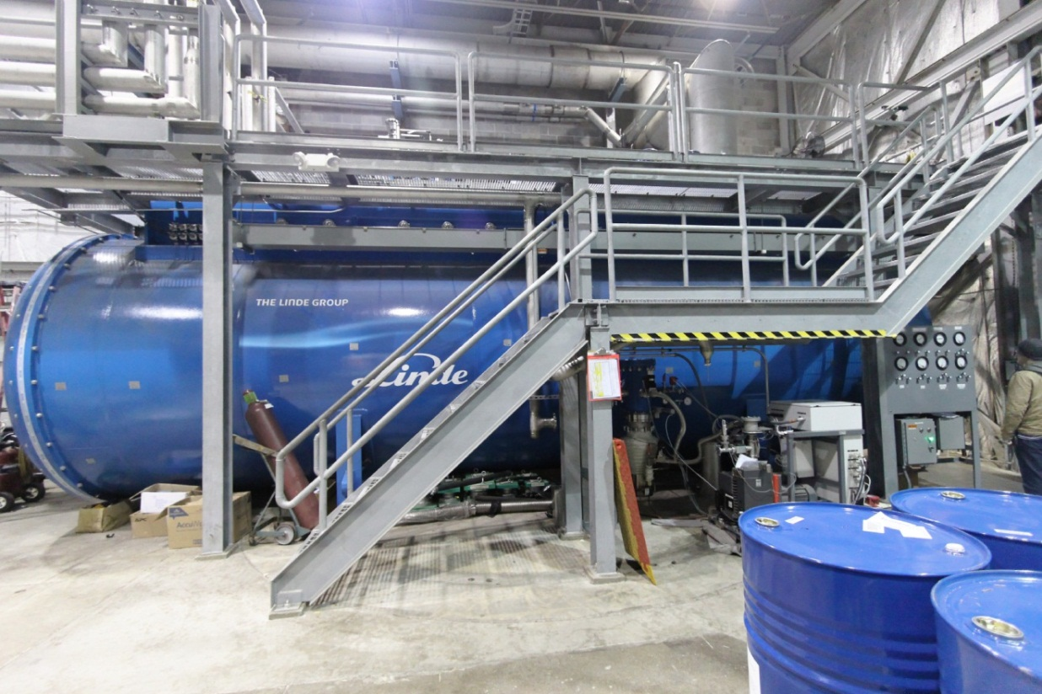
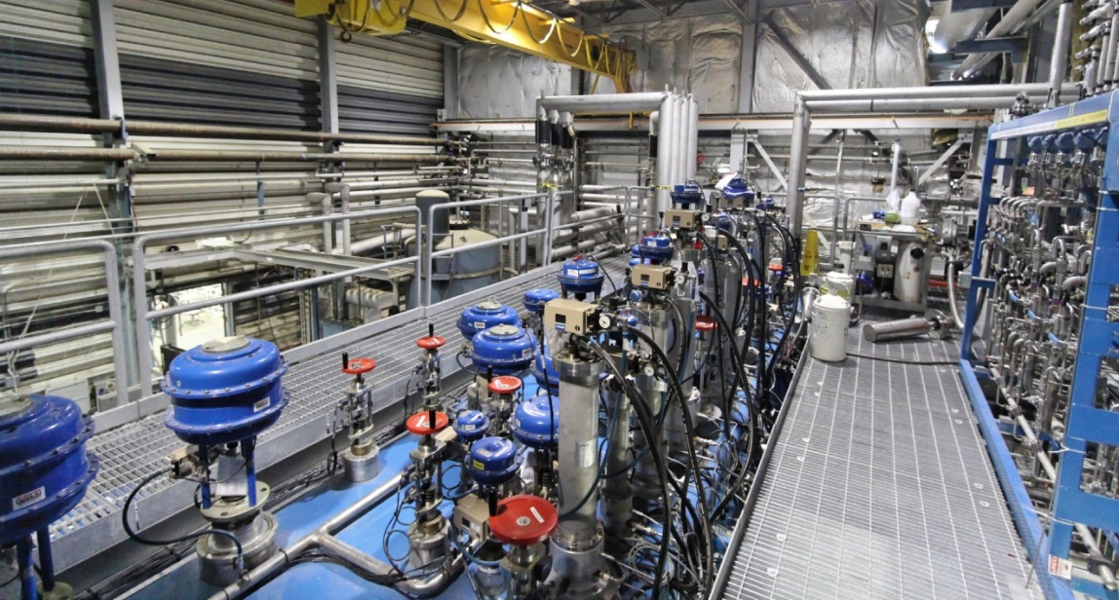
CRYOGENICS: COMPLETE
80K-5K
Coldbox

Slide 14
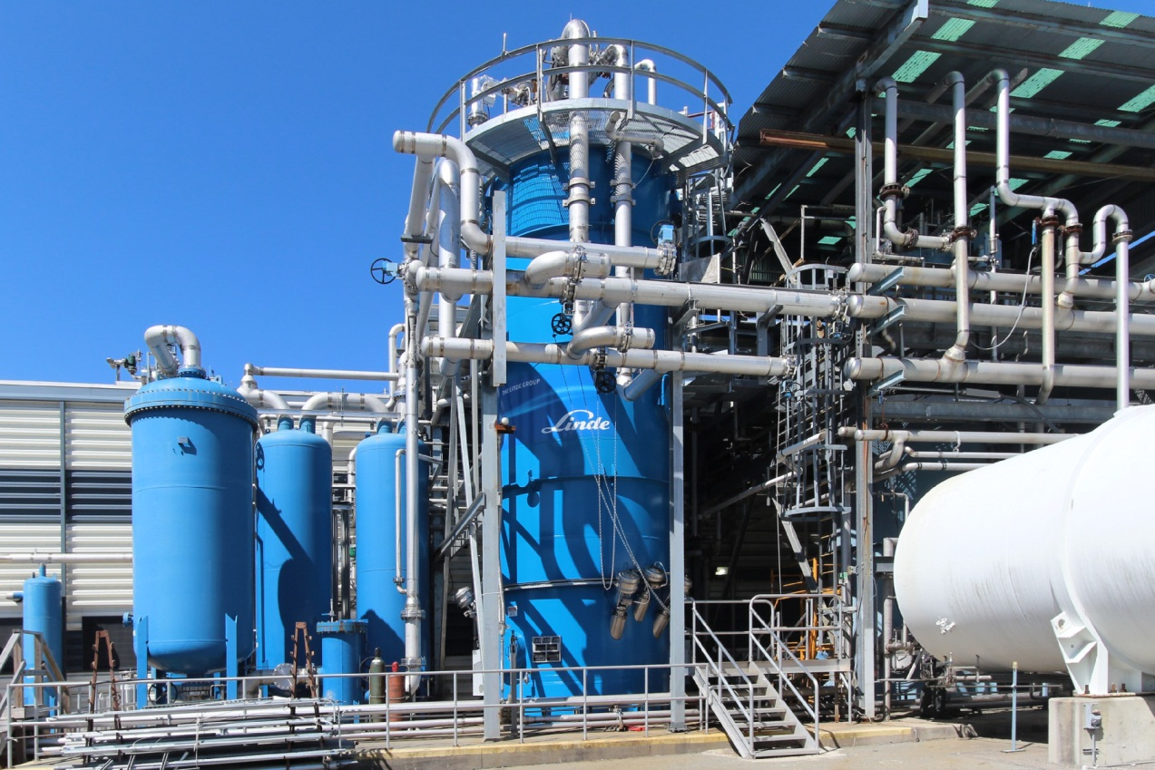
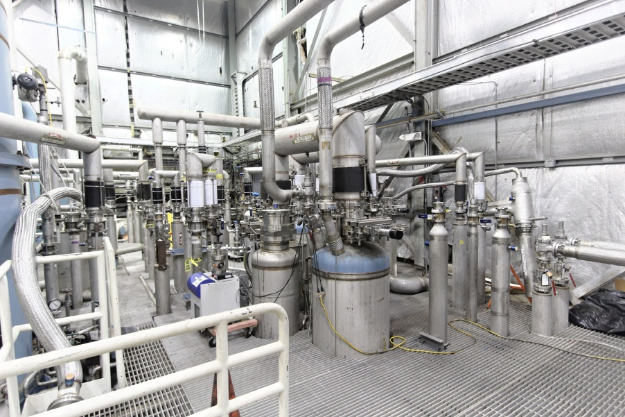
CRYOGENICS: COMPLETE
300K-80K
Coldbox
Interconnects
to linacs

Slide 15
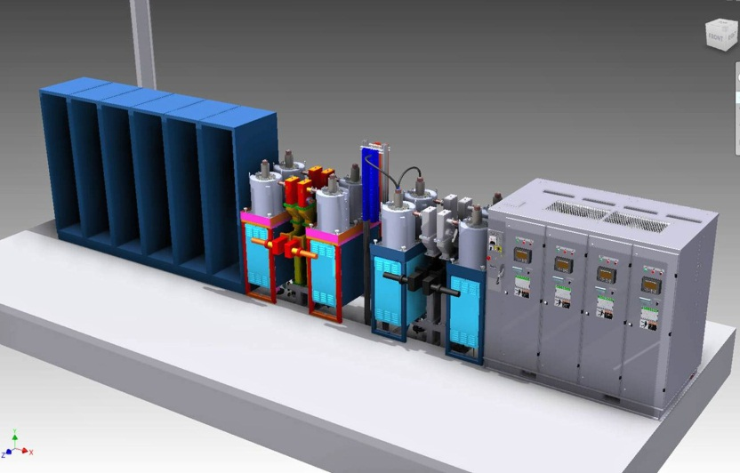
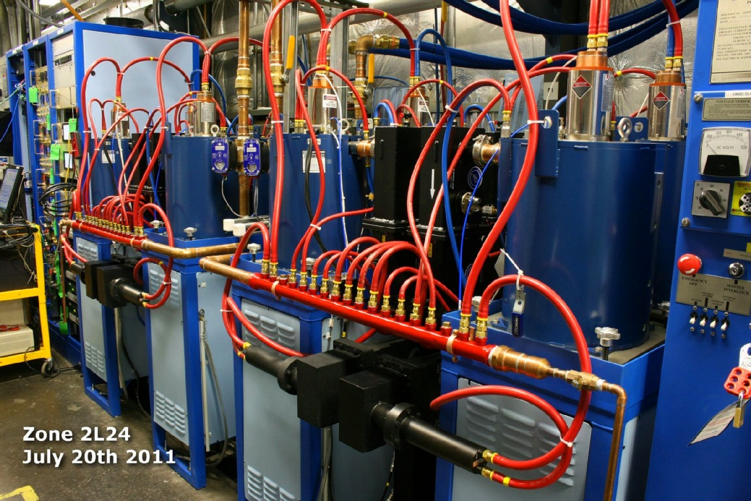
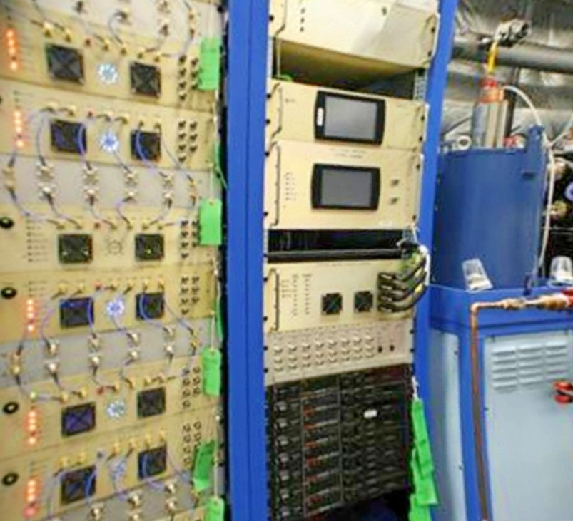
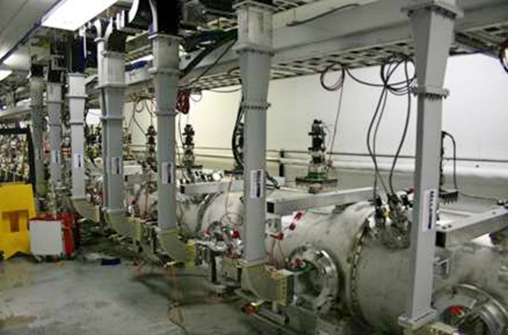
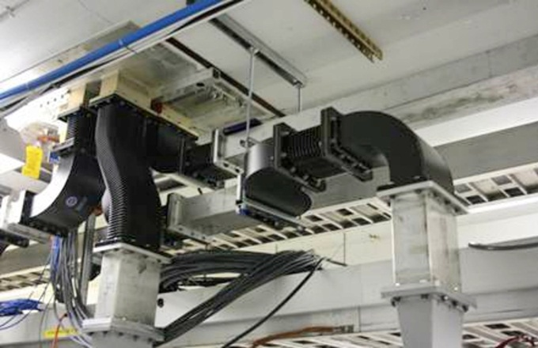
POWER: RF COMPLETE – 10 ZONES ONLINE
Klystrons
Low-level controls
Waveguides

Slide 16
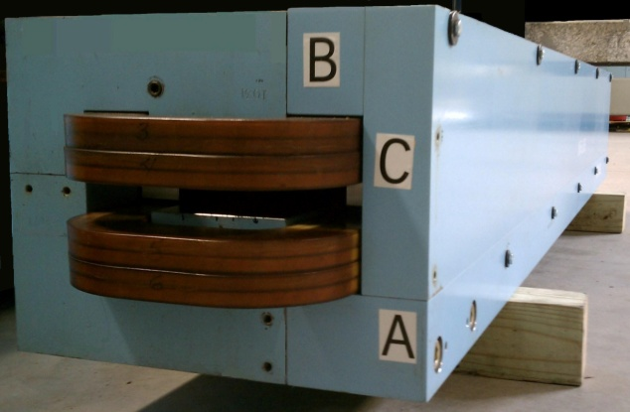
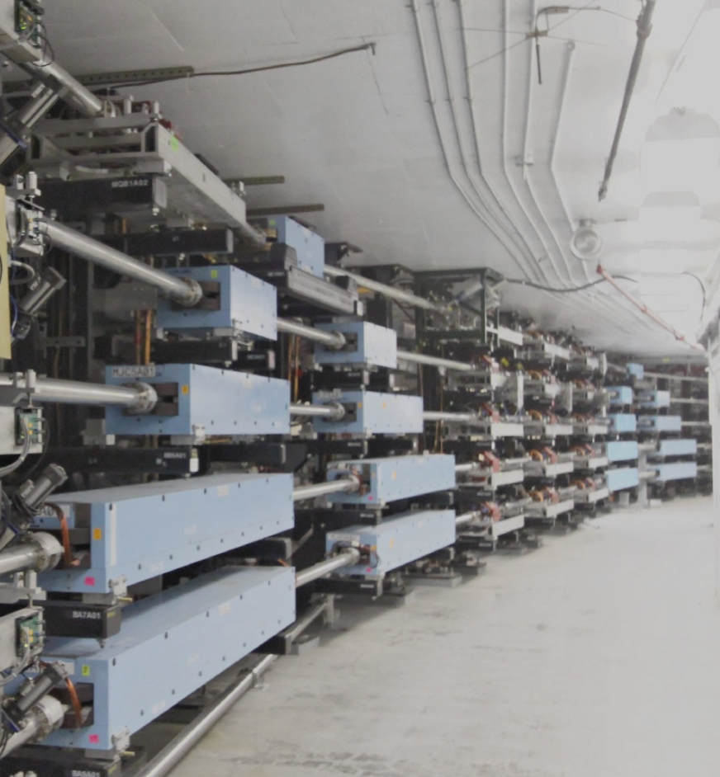
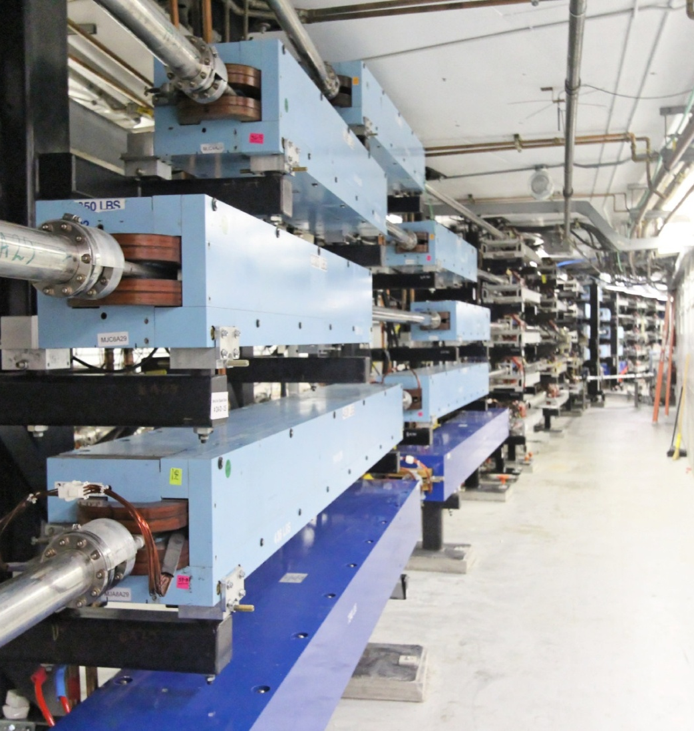
ARCS & HALL TRANSPORT: COMPLETE
Arc dipole with added H-Steel
East Arc
West Arc

Slide 17
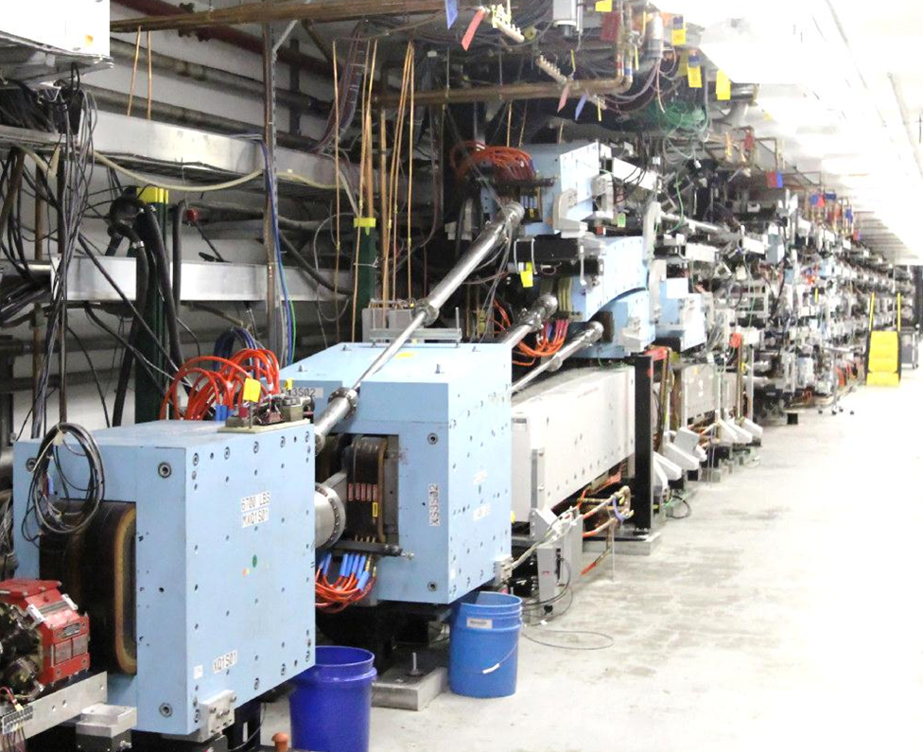
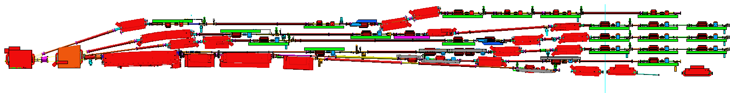
SPREADER & RECOMBINERS: COMPLETE
Five 12 GeV
Spreaders &
Recombiners Installed
NE Spreader has additional 6th pass line to Hall D
Hall D Transport

Slide 18
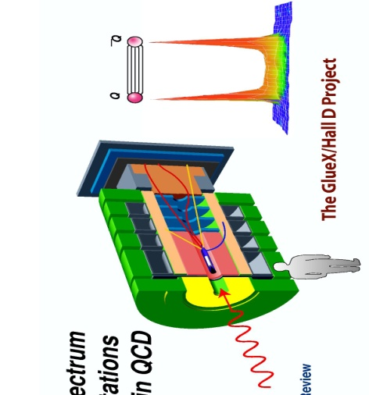
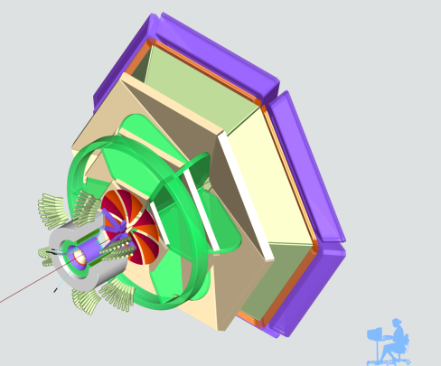
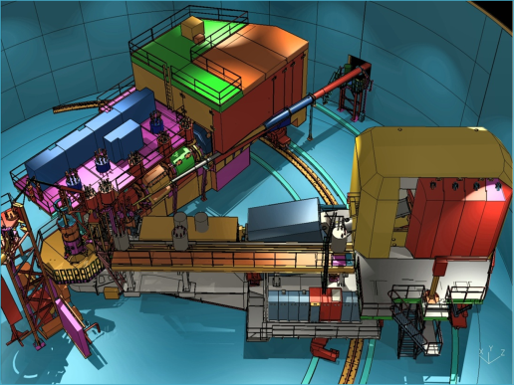

OVERVIEW OF TECHNICAL PERFORMANCE REQUIREMENTS
Hall D | Hall B | Hall C | Hall A
excellent hermeticity | luminosity 10 x 10³⁴ | energy reach | installation space
polarized photons | hermeticity | precision
E_{g}~8.5-9 GeV | 11 GeV beamline
10⁸ photons/s | target flexibility
good momentum/angle resolution |  | excellent momentum resolution
high multiplicity reconstruction |  | luminosity up to 10³⁸
particle ID
Notes:
Don’t dwell on this too long, they can read it quickly

Slide 19
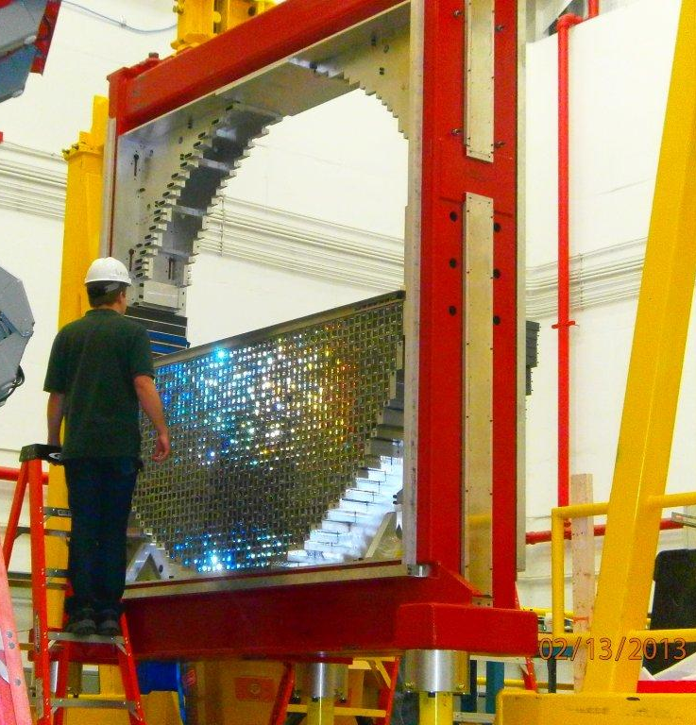
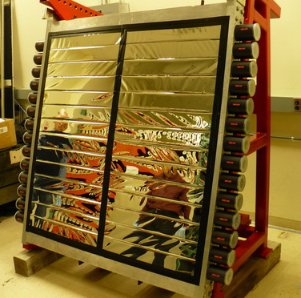
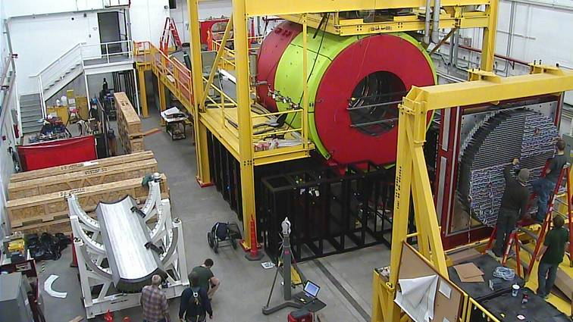
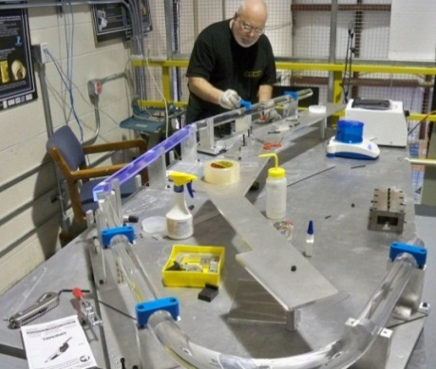
PHYSICS CONSTRUCTION:
71% (Halls B&C) and 95% (Hall D) Complete
All major detector systems under construction
  8 installed (Halls B & D)
7 (of 7) new superconducting magnets making good progress
  US universities, US Labs, US, UK, France
Hall D:
  Solenoid testing complete
  All five major detectors installed and being commissioned
Hall C:
  Detectors funded thru NSF-MRI / NSERC grants complete
  Support carriage installed
Hall B:
  SVT module production underway (FNAL)
  Forward carriage and detectors installed and being commissioned
Hall D FCAL Installation
Hall D
Hall B CTOF
Hall C Pre-Shower

Slide 20
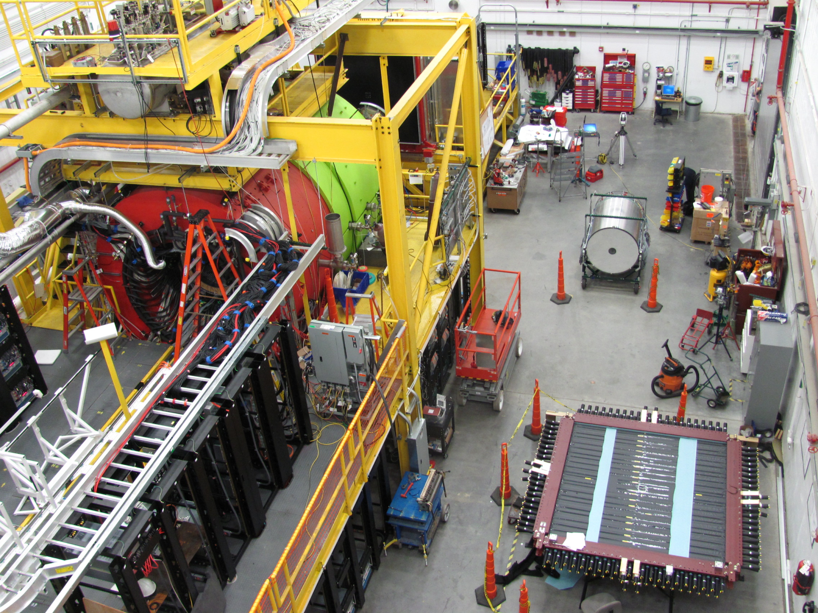

HALL D SOLENOID OPERATIONAL,
ALL FIVE DETECTORS BEING COMMISSIONED
CDC
BCAL
FDC
TOF

Slide 21
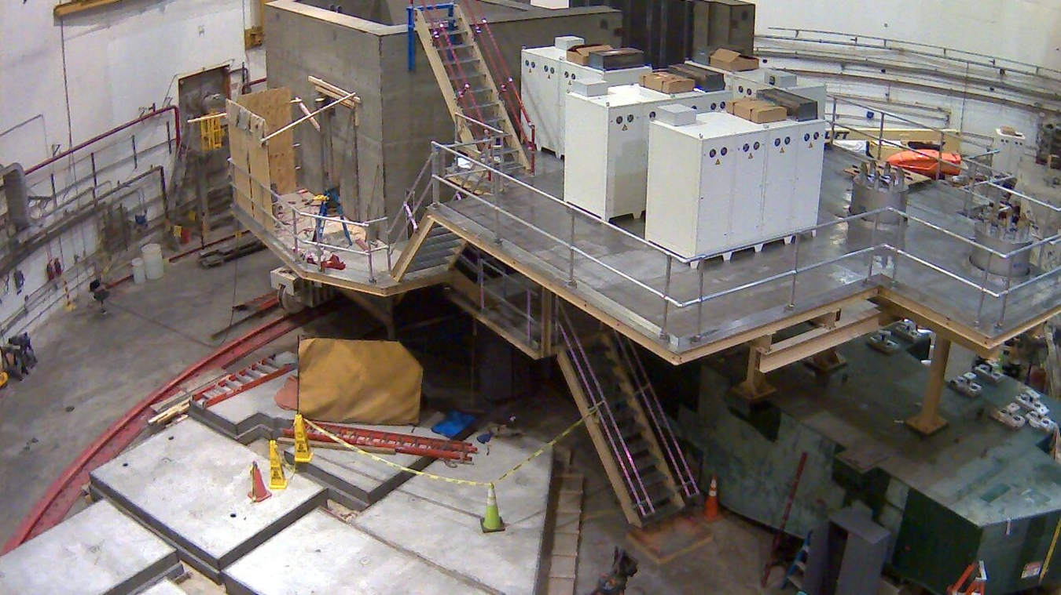
HALL C – SHIELD HOUSE COMPLETED,
POWER SUPPLIES ON SHMS CARRIAGE

Slide 22
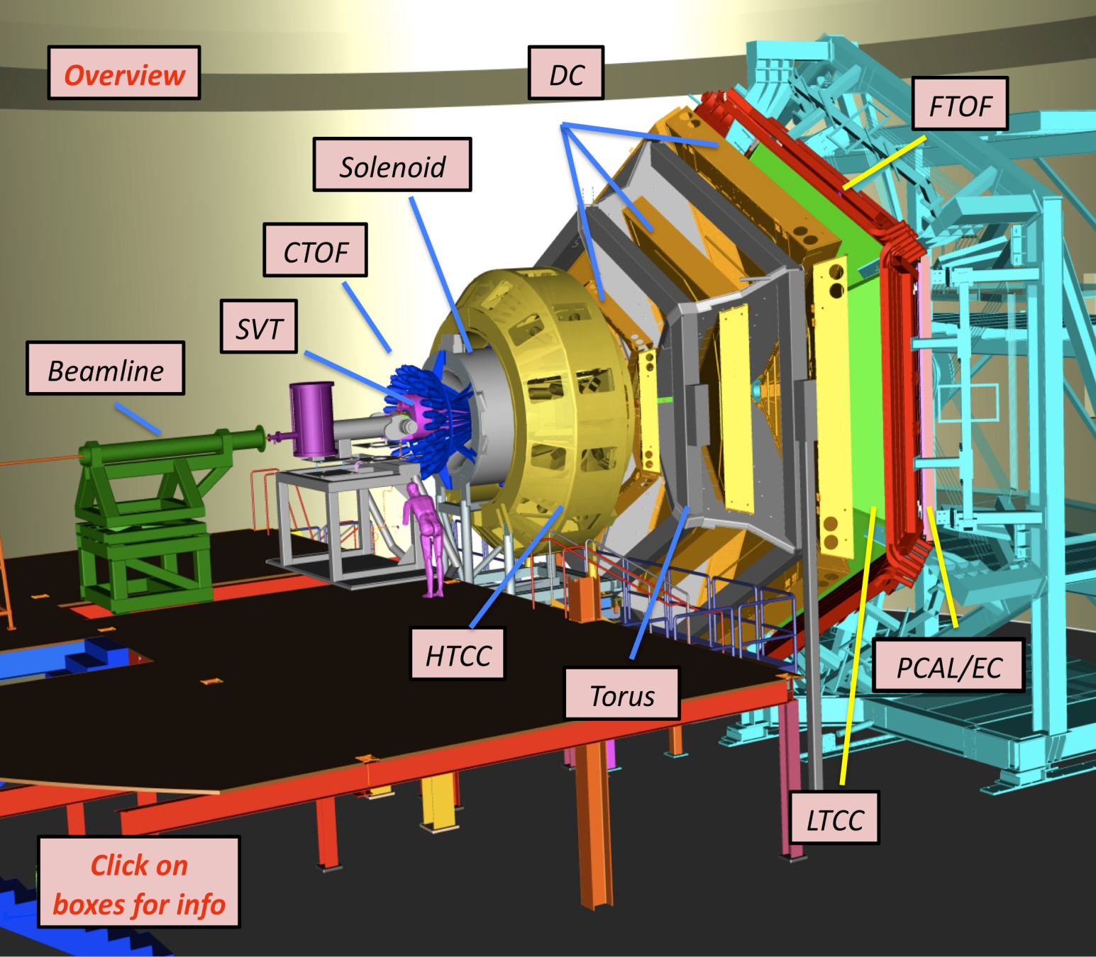
HALL B: TECHNICAL SCOPE
Forward Detector (FD)
TORUS magnet (6 coils)
HT Cherenkov Counter
Drift chamber system
LT Cherenkov Counter
Forward ToF System
Pre-shower calorimeter
E.M. calorimeter
Central Detector (CD)
SOLENOID magnet
Barrel Silicon Tracker
Central Time-of-Flight
Beamline
Infrastructure
Electronics

Slide 23
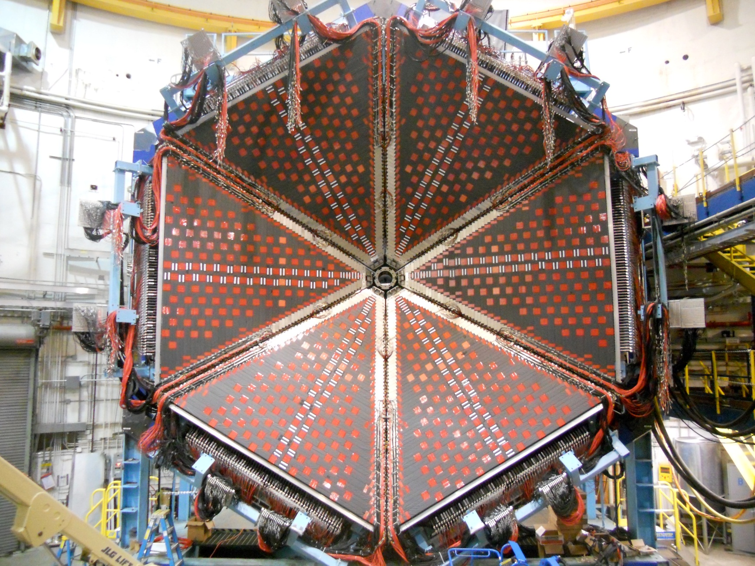
HALL B – STEELWORK COMPLETED,
FORWARD DETECTORS BEING COMMISSIONED
PCAL

Slide 24
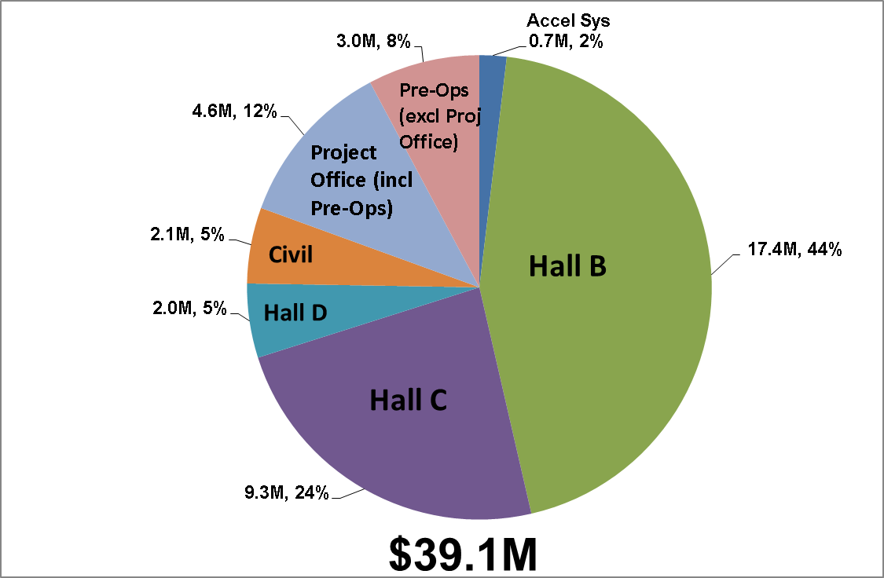
ETC_{COST} ($K) (30-Apr-2014)
OPEN OBLIGATION
$9.8M

Slide 25
CD-4A DELIVERABLES/KEY PARAMETERS
# | System | Technical Definition | PEP Date | Actual
1 | Accelerator | 12 GeV capable 5.5 pass machine installed | Dec 2014 | May 2014
2 | Accelerator | 11 GeV capable beamline to Halls A/B/C installed | Dec 2014
3 | Accelerator | 12 GeV capable beamline to Hall D tagger area installed | Dec 2014 | May 2014
4 | Accelerator | Accelerator commissioned by transporting a > 2 nA electron beam at 2.2 GeV (1 pass) | Dec 2014 | Feb 2014
5 | Civil | New experimental Hall and Counting House: > 10,500 sq. ft. | Dec 2014 | Jun 2012

Slide 26
CD-4B DELIVERABLES/KEY PARAMETERS
# | System | Technical Definition | PEP Date | Projected
6 | Hall B | Detector operational: events recorded with a > 2 nA electron beam at > 6 GeV beam energy (3 pass) | Sep 2017 | Jun 2016
7 | Hall C | Detector operational: events recorded with a > 2 nA electron beam at > 6 GeV beam energy (3 pass) | Sep 2017 | May 2016
8 | Hall D | Detector operational: events recorded with a > 2 nA electron beam at > 10 GeV beam energy (3 pass) | Sep 2017 | Nov 2014
NOTE: >6 GeV beam was delivered to Hall A in April.
>10 GeV beam was delivered to Hall D tagger vault in May.

Slide 27
REBASELINE SCHEDULE: STATUS
CD-4A was retained at Dec 2014 with >6 months of schedule contingency. APPROVAL REQUESTED
CD-4B was shifted 21 months to Sep-2017.
  Hall A Beam Commissioning – Apr 2014
  Hall D Beam Commissioning – 1QFY15
  Halls B & C Beam Commissioning was shifted to 2QFY16 with ~18 months of schedule contingency; being driven by the SC magnets

Slide 28
SUMMARY
May-2014: Summer shutdown, finish installing Hall D for 1QFY15 >10 GeV beam run.
Halls B & C: Get Halls ready for SC Magnet delivery
  Hall B: Forward Detector Carriage is complete
  Hall C: SHMS Carriage is being readied for magnets;
  Two magnets arrive this summer
  Push on the last five magnets

Slide 29
BACK-UP

Slide 30
12 GeV UPGRADE REBASELINE SCHEDULE
CD-4A
Unchanged,
6-Months Schedule
Contingency
18-Months
Schedule
Contingency

Slide 31
CAUSE OF DELAYS
While all 7 Hall B & C SC magnets were allocated FY09 funding, all have had major schedule slips since CD-3.
Cause of delays (# of magnets effected):
  Procurement process (7)
    University contract approval (1)
  Shortage of JLab SC magnet engineers (6+)
  Stabilizer Cu and soldering (5)
  Conflicts with other projects (3+)
  Loss of Key Staff (2)
  Bankruptcy (1+)
  Factory relocation (1)
Two magnet contracts have been canceled.
The SC magnets are the critical path for both Halls B & C.

Slide 32
12 GeV FY08-FY14 FTEs BY AWP SKILL PER PAY PERIOD

