Slide 1
Collaboration Meeting
Fermilab 3-4 June 2014
https://indico.fnal.gov/conferenceDisplay.py?confId=8365
SPL R&D at CERN
R. Garoby for
S. Atieh, I. Aviles Santillana, G. Arnau Izquierdo, R. Bonomi, O. Brunner, S. Calatroni, O. Capatina, J. Chambrillon, F. Gerigk, M. Guinchard, T. Junginger
P. Maesen, M. Malabaila, L. Marques Antunes Ferreira, A. McPherson,
S. Mikulas, E. Montesinos, V. Parma, F. Pillon, J. Plouin, T. Renaglia, K. Schirm, T. Tardy, M. Therasse, A. Vacca, N. Valverde Alonso,
A. Vande Craen, M. Vretenar etc.

Slide 2
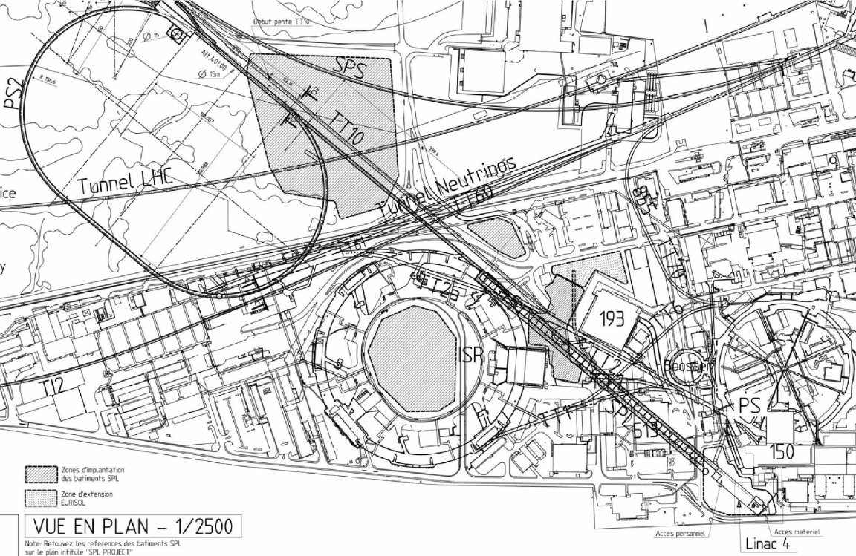
CERN Motivation for the SPL R&D (1/5)
⇒ Possibility of new injectors in the future (HE-LHC…)
Present
Typical Future
e.g.: Plan until 2010
1978
Proton flux / Beam power
50 MeV
Linac2
Linac4
SPS
160 MeV
1975
PS2
1.4 GeV
PSB
LP-SPL
4 GeV
1959
26 GeV
PS
PS2
PS
50 GeV
SPL
450 GeV
SPS
2008
LHC
7 TeV
LP-SPL: Low Power-Superconducting Proton Linac
PS2: High Energy PS (~ 5 to 50 GeV – 0.3 Hz)
LINAC4

Slide 3
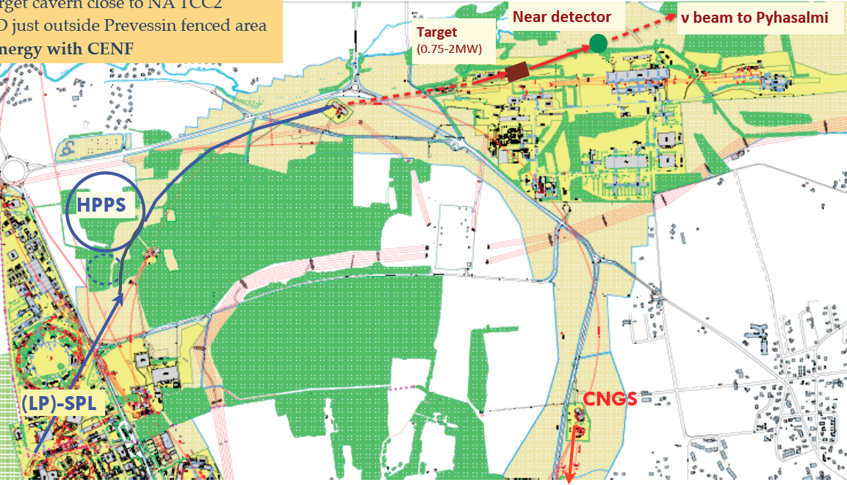
CERN Motivation for the SPL R & D (2/5)
⇒ Options for neutrino physics (Conventional ν Superbeams)
Low energy ν beam
Medium energy ν beam
Accumulation of HP-SPL beam in a fixed energy Accumulator
(4-5 GeV, 4MW beam power)
Fast ejection onto target(s)
LP-SPL as 4 GeV injector of a High Power 50 GeV synchrotron
(50 GeV, 2 MW beam power)
Phase 1: SPS (400 GeV -700 kW)
Phase 2: HP-PS (50 GeV – 2 MW)

Slide 4
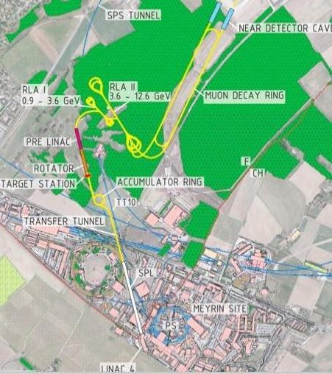
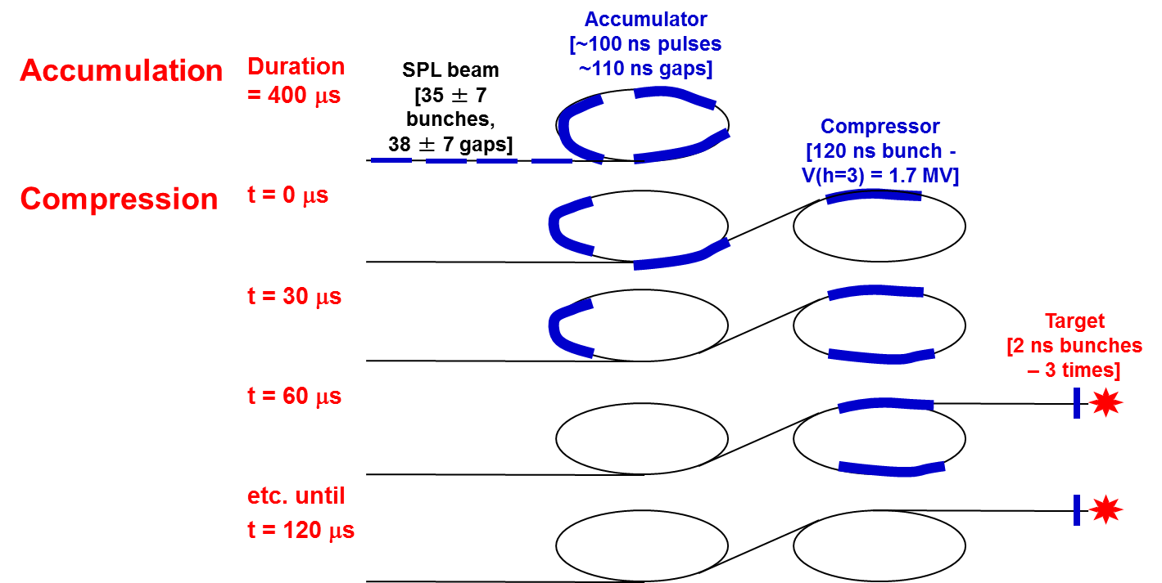
CERN Motivation for the SPL R & D (3/5)
⇒ Options for neutrino physics (ν Factory)
Accumulation of beam from the High Power SPL in a fixed energy Accumulator (4-5 GeV, 4MW)
Bunch compression («rotation») in a separate Compressor ring
Fast ejection of few (3-6) short (2 ns) bunches to target

Slide 5
CERN Motivation for the SPL R & D (4/5)
⇒ Next generation Radioactive Ion Beam Facility (~EURISOL)
TARGETS
RADIOACTIVE IONS LINAC
EURISOL EXPERIMENTAL HALLS
ISOLDE OR
EURISOL HIGH ENERGY EXPERIMENTAL HALL
TRANSFER LINE SPL to ISOLDE
TRANSFER LINES SPL to EURISOL

Slide 6
CERN motivation for the SPL R&D (5/5)
⇒ Synergy with other applications at CERN (FCC-hh, -ee, -eh…) as well as outside of CERN (ESS, ADS…)
⇓
Need to update CERN capacity in superconducting RF:
Update of staff competencies
Upgrade of infrastructure (SM18 clean room, High Power RF, High Pressure Water Rinsing facility, Diagnostics for SC RF, New e-beam welding machine, Electro-polishing installation, etc.)

Slide 7
SPL main characteristics
General features
Required for low loss in accumulator
Ion species H⁻
Output Energy 5 GeV
Bunch Frequency 352.2 MHz
Repetition Rate 50 Hz
High speed chopper < 2 ns
(rise & fall times)
Required for muon production (Neutrino Factory)
Re-use of LEP RF components in Front-end (Linac4)
Required for flexibility and low loss in accumulator
Options
 | Option 1 | Option 2
Energy (GeV) | 2.5 or 5 | 2.5 and 5
Beam power (MW) | 2.25 MW (2.5 GeV) or 4.5 MW (5 GeV) | 5 MW (2.5 GeV) and 4 MW (5 GeV)
Protons/pulse (x 10¹⁴) | 1.1 | 2 (2.5 GeV) + 1 (5 GeV)
Av. Pulse current (mA) | 20 | 40
Pulse duration (ms) | 0.9 | 1 (2.5 GeV) + 0.4 (5 GeV)
RIB facility
ν facility
2 × beam current ⇒ 2 × nb. of klystrons etc .

Slide 8
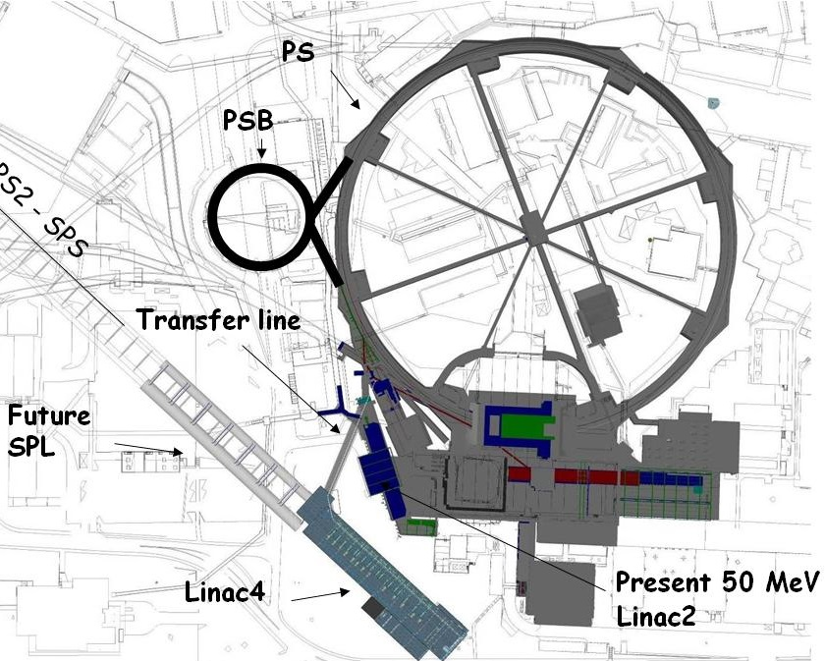
SPL potential front end: Linac4!
(Construction Project started in January 2008)
New 160 MeV H- linear accelerator, will replace Linac2 as injector to the PS Booster.
First step of the LIU upgrades.
Bunch Frequency 352.2 MHz
Max. Rep. Frequency 2 Hz
Max. Beam Pulse Length 0.4 ms
Max. Beam Duty Cycle 0.08 %
Chopper Beam-on Factor 65 %
Chopping scheme: 222 transmitted /133 empty buckets
Source current 80 mA
RFQ output current 70 mA
Linac pulse current 40 mA
Tr. emittance (source) 0.25 π mm mrad
Tr. emittance (linac exit) 0.4 π mm mrad
Max. repetition frequency for accelerating structures 50 Hz
Doubled beam brightness for LHC luminosity: reduced space charge (factor 2 in βγ² ) with a higher PSB injection energy
Long term reliability using modern design, (concerns for Linac2 vacuum ).
Flexible operation and reduced loss with new technologies (chopping, H⁻ injection).
Higher intensity for non-LHC users.
Prepare for a possible high-intensity upgrade (neutrino facility).
Test stand
Notes:
No space for energy upgrade – parallel to the present Linac2

Slide 9
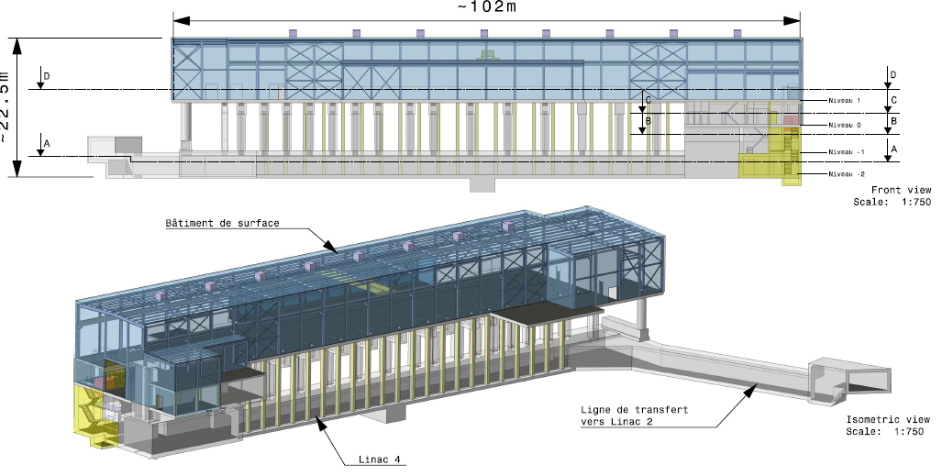
Linac4
45keV
3MeV
3MeV
50MeV
103MeV
160MeV
H-
RFQ
CHOPPER
DTL
CCDTL
PIMS
RF volume
source
(DESY)
45 kV
Extrac.
Radio
Frequency
Quadrupole
3 m
1 Klystron
550 kW
Chopper
& Bunchers
3.6 m
11 EMquad
3 cavities
Drift Tube
Linac
18.7 m
3 tanks
1+2 klystrons
4.7 MW
111 PMQs
Cell-Coupled Drift Tube
Linac
25 m
21 tanks
7 klystrons
7 MW
21 EMQuads
Pi-Mode Structure
22 m
12 tanks
4+4 klystrons
~12 MW
12 EMQuads
H⁻ ion current:
40 mA (avg.),
65 mA (peak)
Length: 80 m
19 klystrons [13 x 1.3 MW (LEP), 6 x 2.8 MW (new)]
Normal conducting accelerating structures of 4 types: RFQ, DTL, CCDTL, PIMS
Single frequency: 352.2 MHz
Duty cycle: 0.1% phase 1 (Linac4), 3-4% phase 2 (SPL), (design: 10%)

Slide 10
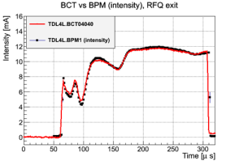
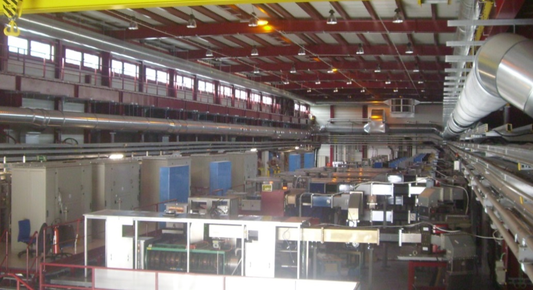
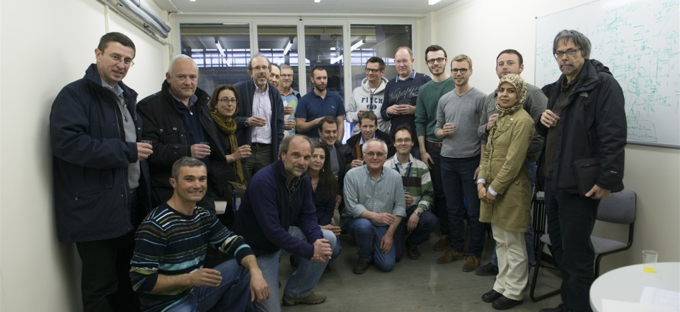
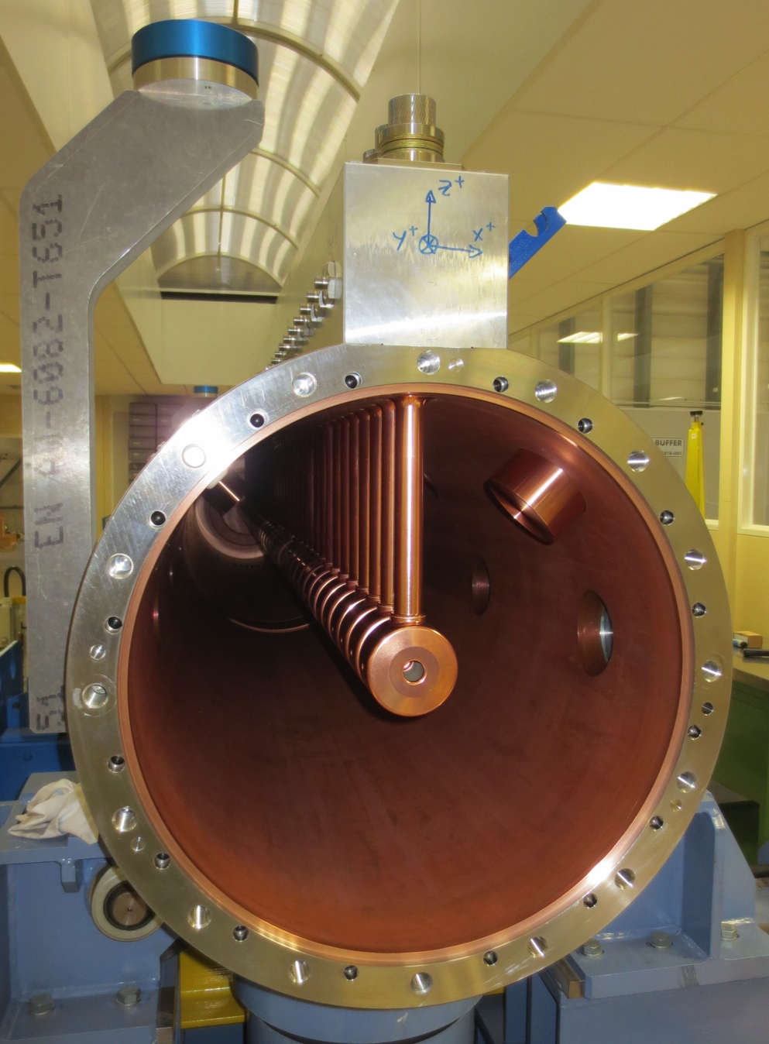
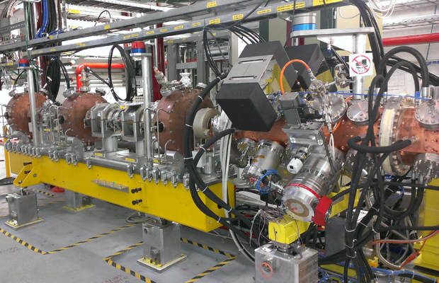
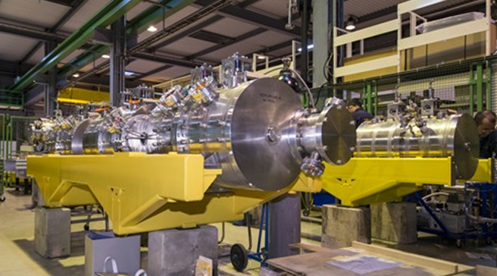
Linac4 status
Klystrons and modulators in the Linac4 Hall
Celebration of the first beam acceleration by the RFQ in the Test Stand (13.3.13)
DTL tank 1
CCDTL structures
RFQ & MEBT section in the Linac4 tunnel

Slide 11
SPL block diagram
SC-linac [160 MeV ® 5 GeV] with ejection at intermediate energy
Medium beta cavities: β = 0.65
High beta cavities: β = 1
“Up-to-date” CDR to be published in 2014
0 m
0.16 GeV
129 m
0.73 GeV
280 m
2.5 GeV
505 m
5 GeV
From Linac4
Medium β cryomodule
High β cryomodules
Ejection
High β cryomodules
Debunchers
5 GeV – 4 MW
20 x 3
β=0.65 cavities
10 x 8
β=1 cavities
13 x 8
β=1 cavities
2.5 GeV
Length: ~500 m

Slide 12
SPL cavities development
Collaboration with ESS (Lund) with contributions from IN2P3 and CEA and support from the E.U.
Medium beta cavities β = 0.65
1 designed and ordered from industry by IPN Orsay (Guillaume Olry et al.) to be tested in 2014 at CEA Saclay in vertical cryostat and later in Cryho-lab (Horizontal test cryostat)
High beta cavities β = 1
1 designed and ordered from industry by CEA Saclay (Guillaume Devanz et al.) to be tested in 2014 at CEA Saclay in vertical cryostat and later in Cryho-lab (Horizontal test cryostat)
5 designed and ordered (4 from industry, 1 from CERN workshop) by CERN for tests at CERN (SM18) in Short cryo-module of 4 cavities

Slide 13
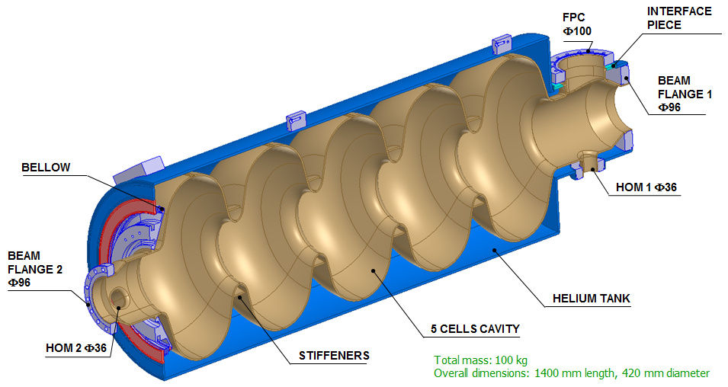
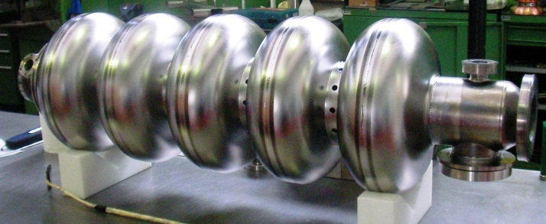
SPL cavity β = 1 at CEA
Parameters | Value | Units
Frequency | 704.42 | MHz
Number of gaps (Ngaps) | 5 | -
Beta | 1 | -
Eacc | 25 | MV/m
Epeak/Eacc | 1.99 | -
Bpeak/Eacc | 4.20 | mT/(MV/m)
Lacc (Ngaps.βλ/2) | 1.0647 | m
r/Q | 566 | Ohms
G | 270 | Ohms
Operation temperature | 2 | K
Q₀ at 2K (R_{BCS}=3.2nW) | 8.4.10¹⁰ | -
Lorentz force detuning K_{L} | 1 | Hz/(MV/m)²
Cavity design and tests performed at CEA-Saclay
Cavity manufactured by E. Zanon
J. Plouin (SLHiPP-4)

Slide 14
First test in vertical cryostat (CEA)
April 2014
@ Saclay
The cavity has been cleaned in ultrasound bath and slightly chemically treated using a standard BCP mixture.
Two tests at 1.6 K
Previous tests
J. Plouin (SLHiPP-4)
Some processing has been necessary from 10 to 12MV/m
Tests have been stopped 17.6 MV/m because high dose rate was measured out of the bunker (> acceptable rate in the Supratech area)

Slide 15
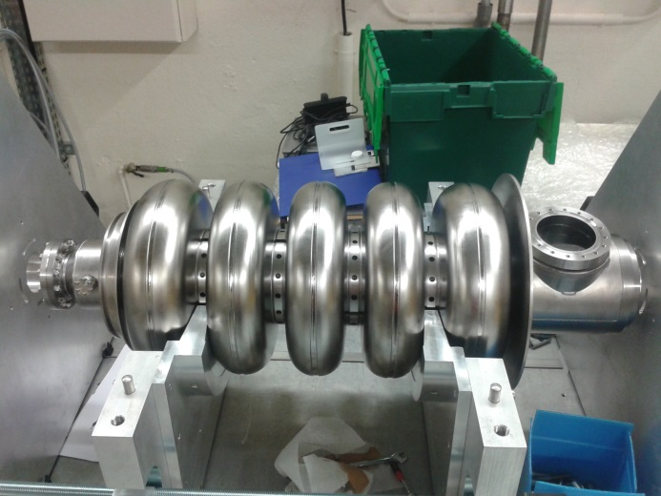
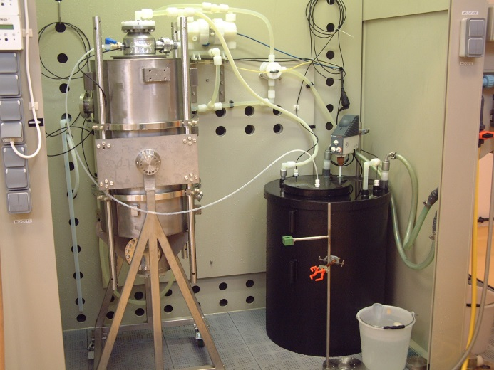
SPL cavity β = 0.65 at IPN-Orsay
J. Plouin (SLHiPP-4)
FABRICATION
Kick-off meeting: Nov. 2011
Delivery #1 for field flatness tuning done @ IPN Orsay: March 2013
Cavity sent back to RI
Then final delivery after He tank welding: June 2013 (fabrication time=19 months!)
CAVITY PREPARATION
1st etching (BCP): 200 µm
Field flatness tuning
2nd etching (BCP): 20 µm
2-hour HPR through beam tubes only (6 passes)
No 600°C annealing nor 120°C baking
Test at 2 K in June 2014
Cavity w/o He tank before field flatness tuning
2nd etching pass: cavity with He tank

Slide 16
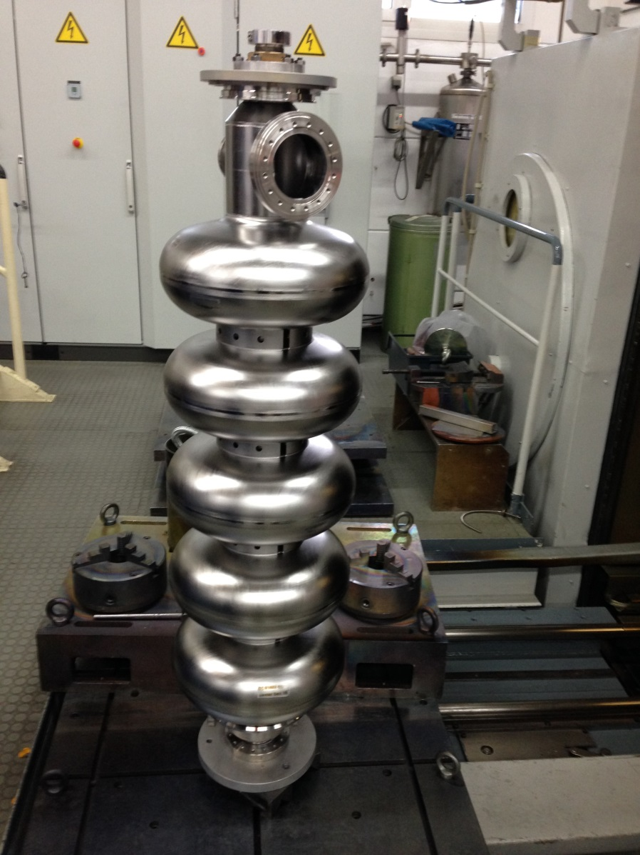
Niobium cavities from industry (RI)
4 Niobium cavities fabricated and delivered by RI (December 2013)
Test at 2 K in June 2014

Slide 17
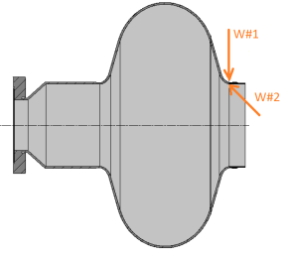
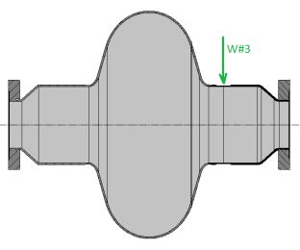
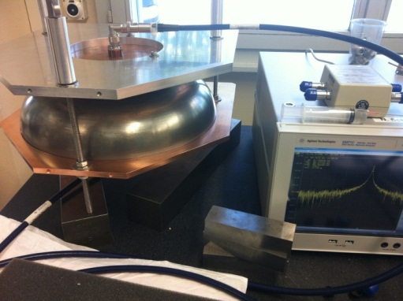
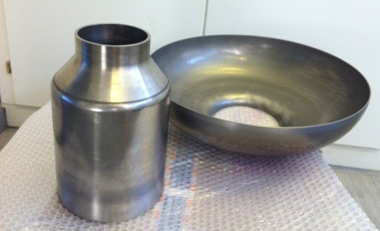
Niobium cavities at CERN
Repair of first monocell
Material defects observed after electro-polishing.
Repaired with new e-beam welding machine from outside (W#1 and W#3) and inside (W#2)
cavity fabrication at CERN
Tooling for EB welding of Nb cavity is fabricated.
Half-cells and beam tubes fabricated by spinning.
RF measurements.

Slide 18
SPL mono-cell β =1 at CERN
A. Macpherson (SLHiPP-4)

Slide 19
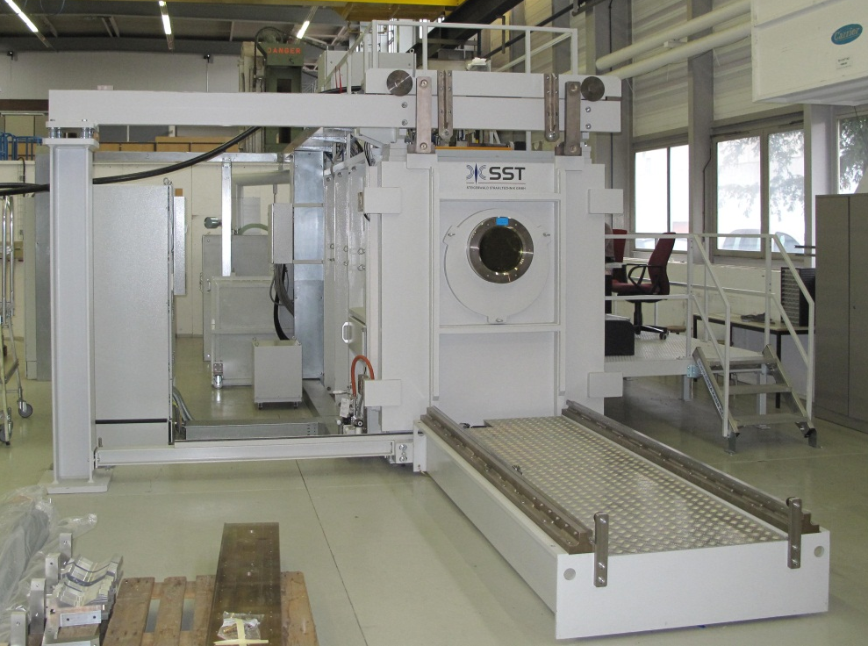
New e-beam welding machine

Slide 20
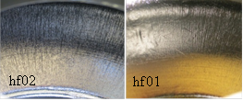
Electro-Polishing (EP)
Tooling for EP
- 5 Cell electropolishing preparation:
Cathode and tooling manufacturing
Improve main pump flow control and compressed air connection
Allow crane direct acces to the electropolishing hut
- Monocell TESTS:
A second set of electropolishing sessions were done to bring the total removed thickness to 200 microns.
It was possible to set different working temperatures and compare them with the simulation data
Working at lower temperatures results in less pitting.
Cavity is currently undergoing RF test
Paper TUP047 bat SRF with all multiphysics simulation details
Temperature | Total current inward / A
 | Simulation | Real cavity
10 °C | 21 | 18
15 °C | 37 | 36
25 °C | 70 | 57

Slide 21
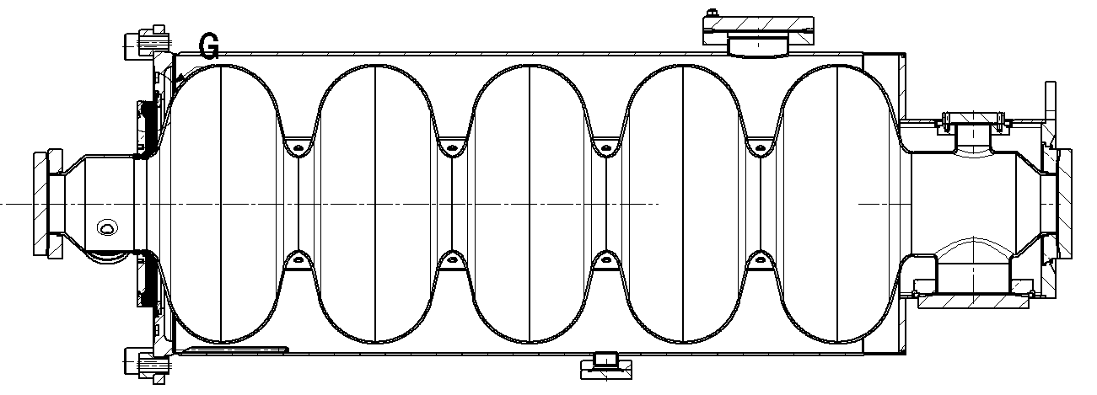
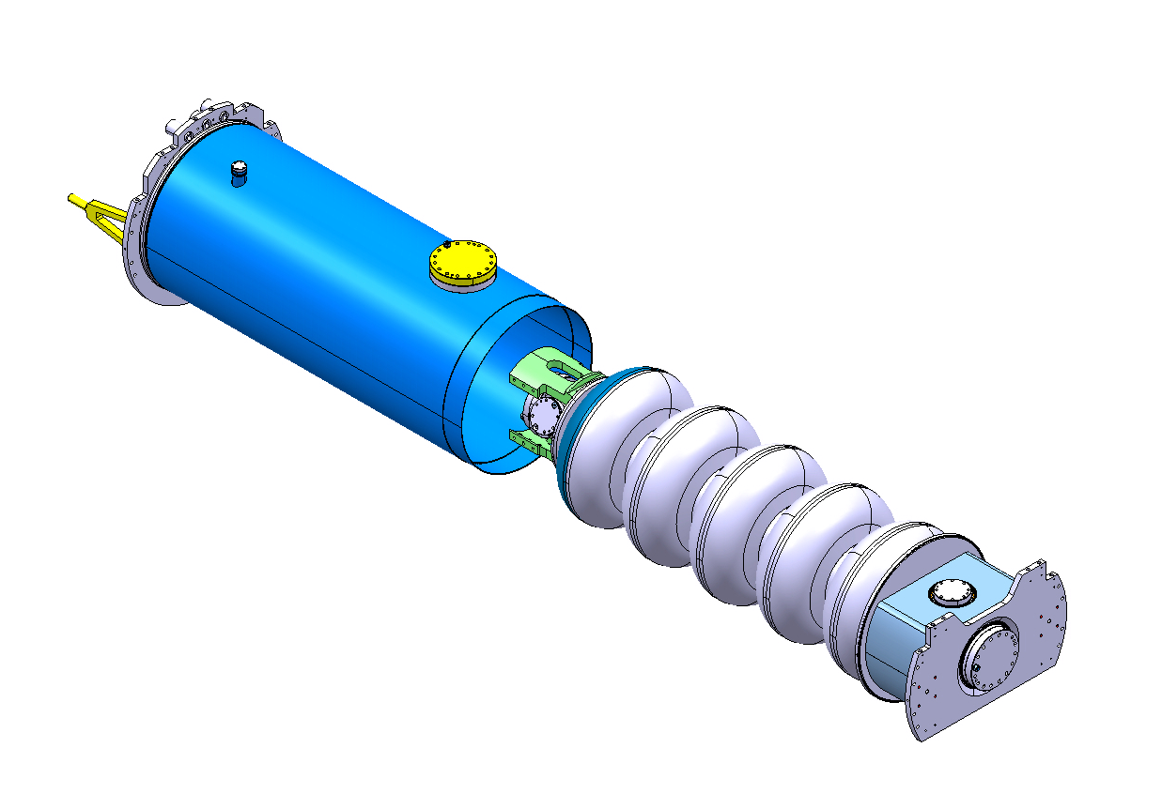
Helium tank
Stainless Steel He tank (CEA)
Helium tank designed by CERN (Stainless steel).
5 items under fabrication by CEA (with SDMS).

Slide 22
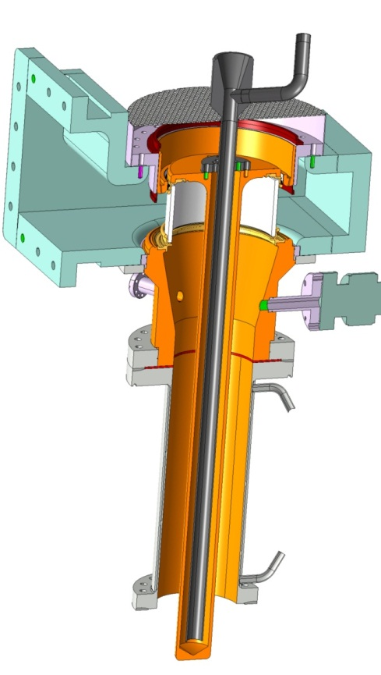
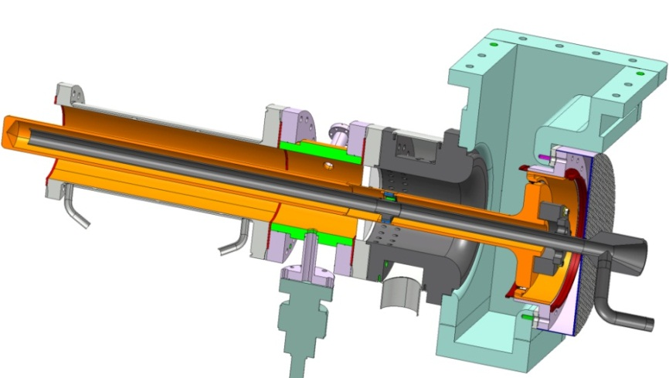
SPL Fundamental Power Coupler
E. Montesinos (SLHiPP-4)
Two designs with the same:
Double walled tube
Matching waveguide without doorknob
Contacts ring including DC capacitor
Interface to
cryomodule flange &
RF + vacuum gasket
Cylindrical window Coupler
Disk window Coupler

Slide 23
Power Couplers Test program
E. Montesinos (SLHiPP-4)
A number of issues remain pending and will continue to be investigated/solved (!)
Initial test program has been modified (eased) accordingly
Nevertheless the available couplers remain fully compatible with SM18 tests program
Yesterday evening (6 pm, May 15, 2014), tests of the second pair of couplers were successfully completed!
Test Repetition rate 50 Hz | Initial kW | New kW
TWC | 1000 | 1000
SW 100 µs | 1000 | 1000
SW 200 µs | 1000 | 500
SW 500 µs | 1000 | 250
SW 1 ms | 1000 | 250
SW 2 ms | 1000 | 250

Slide 24
Power Couplers: Next steps
E. Montesinos (SLHiPP-4)
EBW
We now have to EBW the couplers at the DT flange level to the cryomodule ‘flanging system’
Very delicate step in the process as it can destroy 4 years of construction and tests
Mock-ups are under construction to train the specialist
Last critical operation on couplers before assembly onto cryomodule

Slide 25
Power Couplers: Next steps
E. Montesinos (SLHiPP-4)
Integration onto the cryomodule in CERN SM18 clean room
FPC TD being the support of the cavities

Slide 26
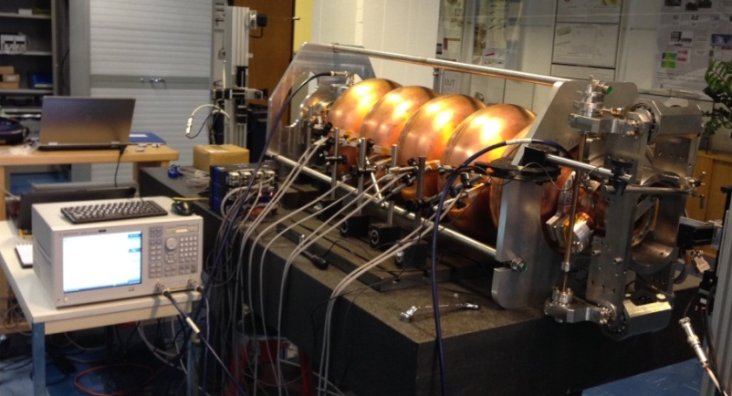
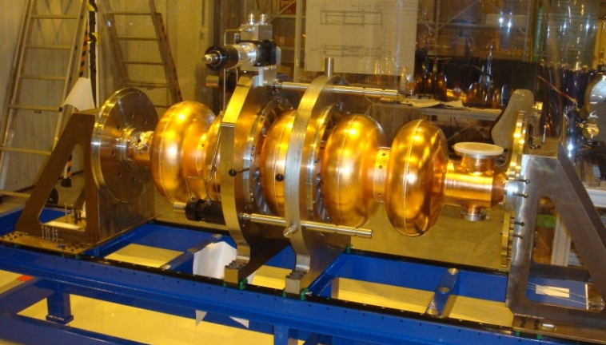
Tests systems and cavity reception area (Bdg. 252)
Reception area in bdg.252
Tooling for test in vertical cryostat: fabricated and available at CERN
Cavity tuner: measurement of cavity detuning versus mechanical deformation.
Cell-by-cell tuning system with RF bead-pull and mechanical measurements.

Slide 27
SPL cryomodule
27
Collaboration with ESS (Lund) with contributions from IN2P3 and CEA
He tank
Design: CERN
Production: Industry (CEA)
Intercavity supports
Design: CERN
Production: CERN
Test: CERN (N₂)
SC Cavities
Design: CERN
Production: 5-cells, 1-cell in Nb and Cu produced by CERN and industry
Mag. Shield
Design: CNRS (CERN spec)
Production: Industry
Tuner
Design: CEA
Production: CEA
Vacuum vessel
Design: CNRS
Production: Under procurement
(construction before April 2015)
RF Power Coupler
Design: CERN (BE-RF, TE-MSC)
Production: CERN
Test: CEA (He, RF); CERN (N₂)
R. Bonomi (SLHiPP-4)

Slide 28
Mock-up: T Distribution
28
Test results, typical *
No gas flow, steady state, cavities filled with LN₂
77 K
77 K
77 K
77 K
103 K
147 K
93 K
207 K
80 K
256 K
288 K
(10 W)
* Data from April 2014.
R. Bonomi (SLHiPP-4)
Notes:
Lets start from a typical temp distribution obtained last month during the test:
Cavities were kept cold, whereas dwt were not actively cooled
For example, we can highlight the t distrib obtained for the ics and for the dwt => ..

Slide 29
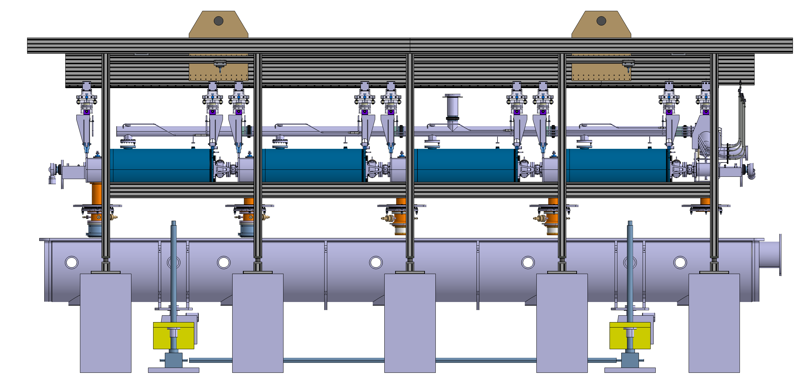
Cryo-module Assembly tooling
Supports de réglage
Poutre principale
Cadre de manutention
CNRS-IPNO
Système de levage
Vérins LHC
Blocs Bétons

Slide 30
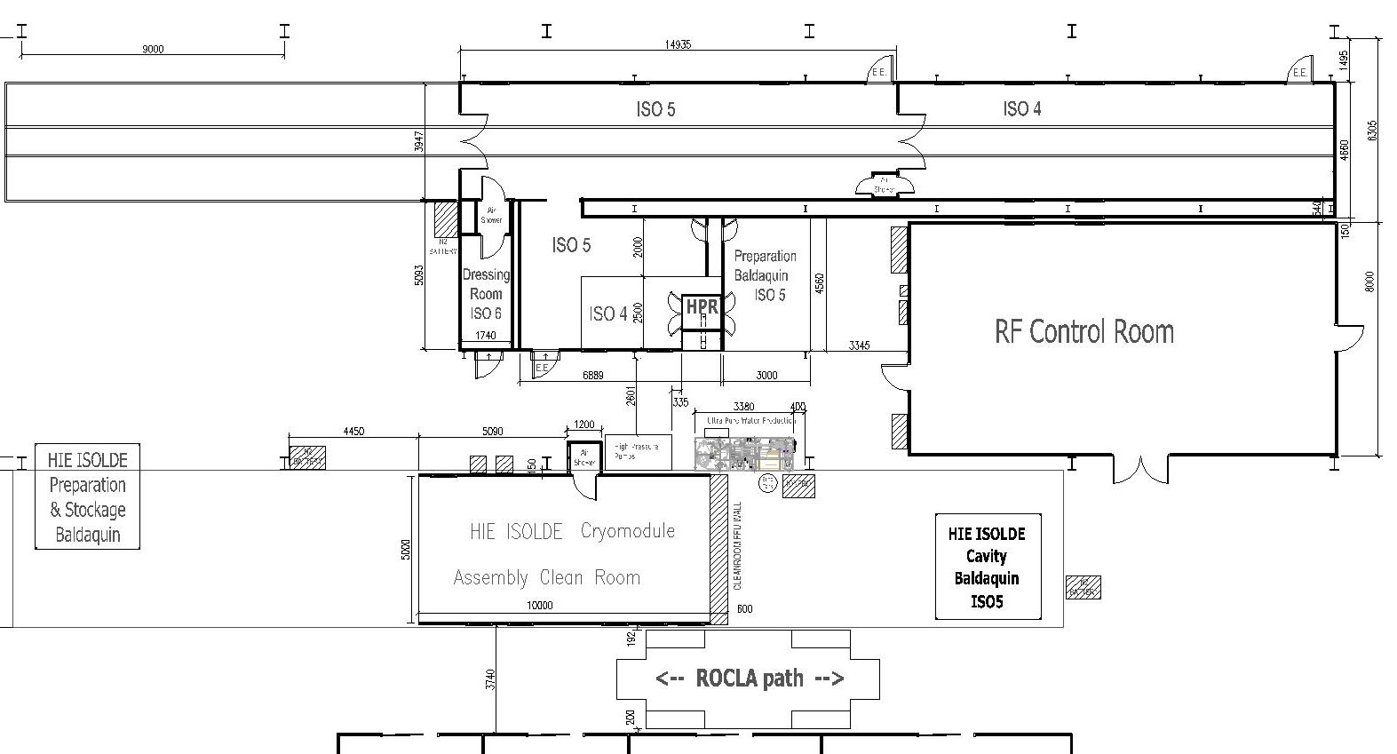
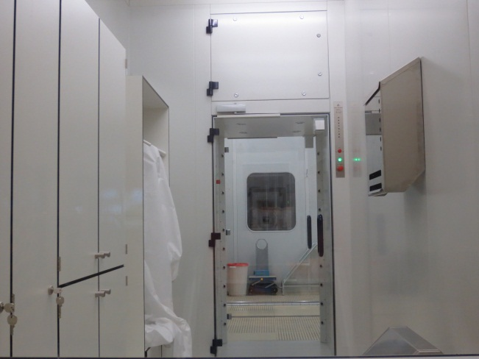
SM18: new Clean Rooms & HPR
P. Maesen (SLHiPP-4)
15m long grey room for cryomodule preparation
15m long Cleanroom for cryomodule assembly
Cavity HPR & drying
Personnel entrance

Slide 31
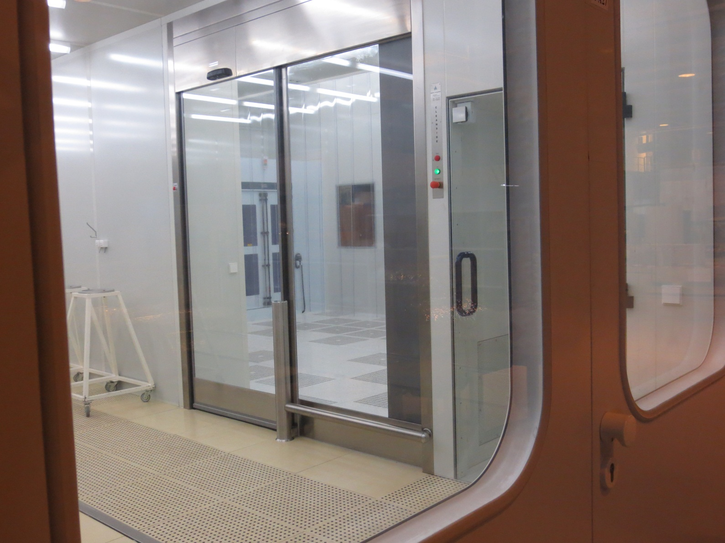
SM18: New Clean Rooms & HPR
P. Maesen (SLHiPP-4)

Slide 32
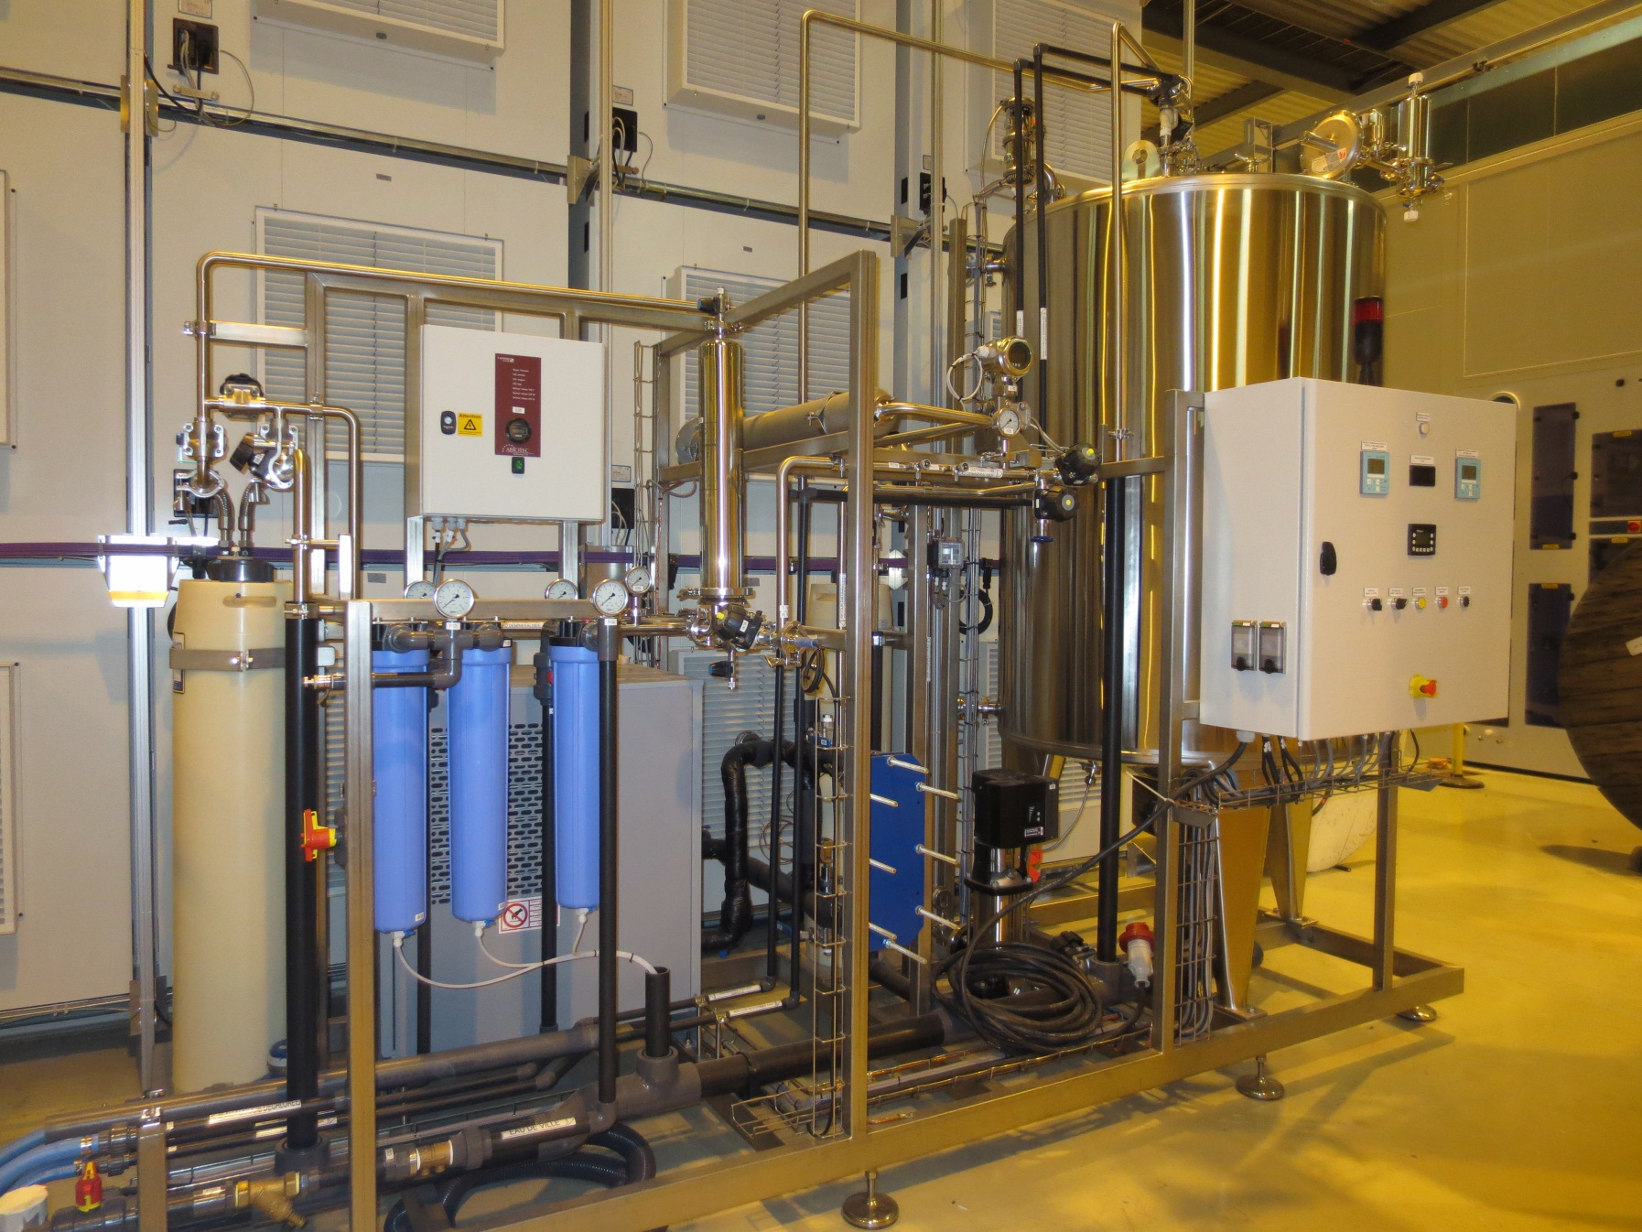
SM18: ultra pure water production
P. Maesen (SLHiPP-4)
Delivered and commissioned in Oct’13
To be placed in final position and restarted…

Slide 33
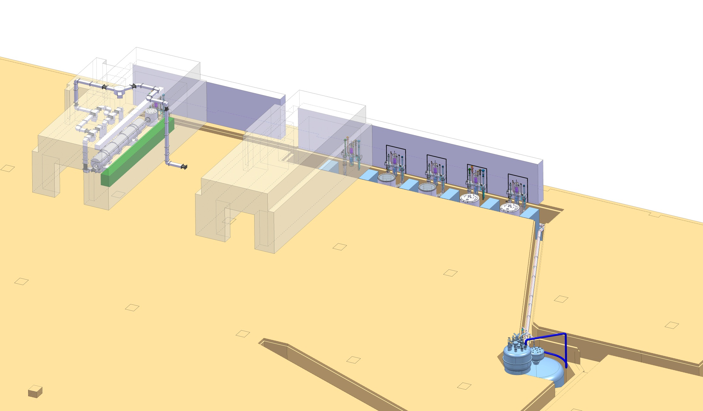
SM18: Horizontal bunkers and vertical cryostats
P. Maesen (SLHiPP-4)
V3
M7
V4
V5
V6
M9

Slide 34
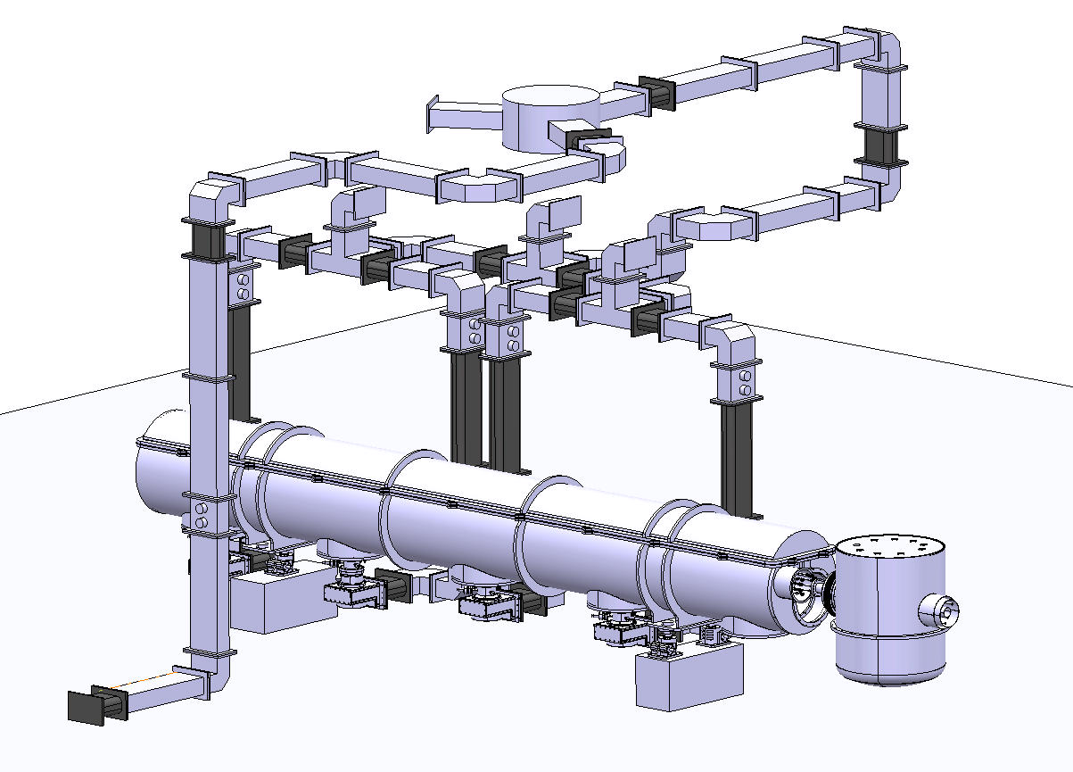
SM18: waveguide network
Integration in M7 well advanced (BE/RF, EN/MME (drawing office))
Power distribution
Cryomodule (incl. slope)
New standard 2 K service module
Still to be done:
Detailed integration of cryomodule repair scenarios
(i.e. how to lift the top cover of the CM?)
Cabling (RF and Cryo)
Cryogenic valve box under design
P. Maesen (SLHiPP-4)

Slide 35
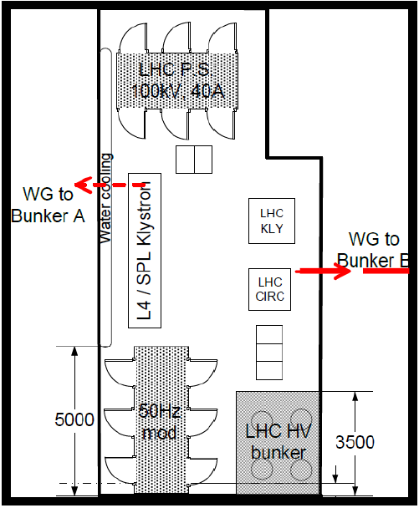
SM18 High Power RF upgrade (704 MHz)
Collaboration with ESS (Lund)
1.5 MW Thales klystron – delivery beginning 2014
Klystron modulator – delivery beginning 2014
New Low Level RF at 704 MHz – by end of 2014

Slide 36
High Power IOT development (704 MHz)
Collaboration with ESS (Lund)
Two 1.5 MW IOTs being ordered by ESS
Test set-up in preparation at CERN
Full characterization in 2015-2016 (joint ESS-CERN)

Slide 37
SPL R&D schedule
Preparation of components
Assembly of CM
2014
2015

Slide 38
Summary
Linac4 in construction. Fully operational at the end 2016.
Design and development of a new type of multi-cavity cryomodule,
Design and development of “cheap” high power couplers (8 built; 2 successfully tested today).
Extensive investment for superconducting cavities fabrication and test (e-beam welding machine, ep bench, optical bench…)
2 five-cell copper cavities, one bulk-niobium monocell produced,
4 five-cell bulk Niobium manufactured by industry (RI),
One five-cell bulk Niobium in fabrication at CERN with an R&D approach,
Equipment for testing at high RF power (704 MHz) a string of 4 cavities cooled at 2 K in SM18
A string of four SPL 704 MHz β =1 cavities will start being tested in a short cryo-module at the end of 2015.
Update of CERN competencies
in superconducting RF.

Slide 39
THANK YOU
FOR YOUR ATTENTION!

