Slide 1
LCLS-II Activities at FNAL
Rich Stanek on behalf of the FNAL-LCLS-II Team
June 3, 2014

Slide 2
Outline
LCLS-II – General Information
LCLS-II/Fermilab Perspective and Our Project Team
Fermilab LCLS-II Scope of Work
Benefits and Interferences with PIP II R&D
CW Design Modifications
High Q0 R&D
Cryomodule Assembly Plan and Facility Usage
Schedule
Resources
Summary

Slide 3
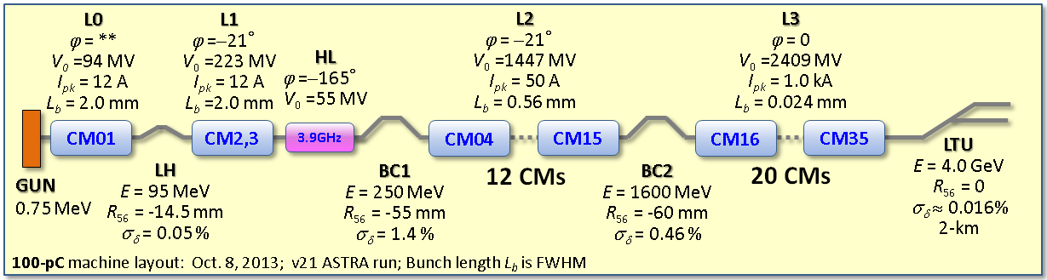
What is LCLS-II?
  Linear Coherent Light Source (LCLS)
  Light source located at SLAC; an upgrade to the existing LCLS-I
    LCLS-II will add two new X-ray laser beams and room for additional new instruments, greatly increasing the number of experiments carried out each year.
  4 GeV superconducting electron linac
Supported by DOE-Basic Energy Sciences
Fermilab has project responsibility for cryomodule design, one-half of CM fabrication and the cryogenic distribution system

Slide 4
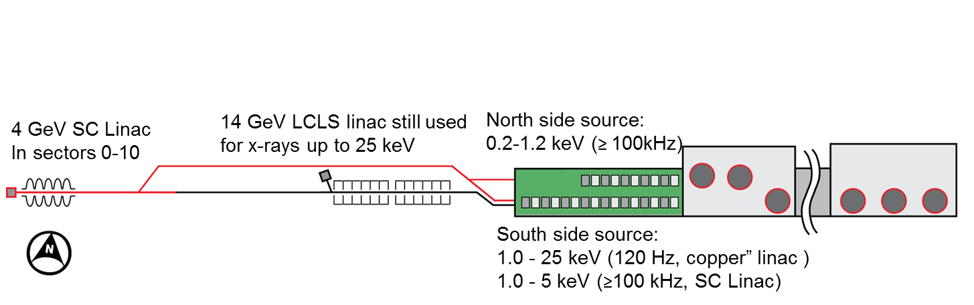
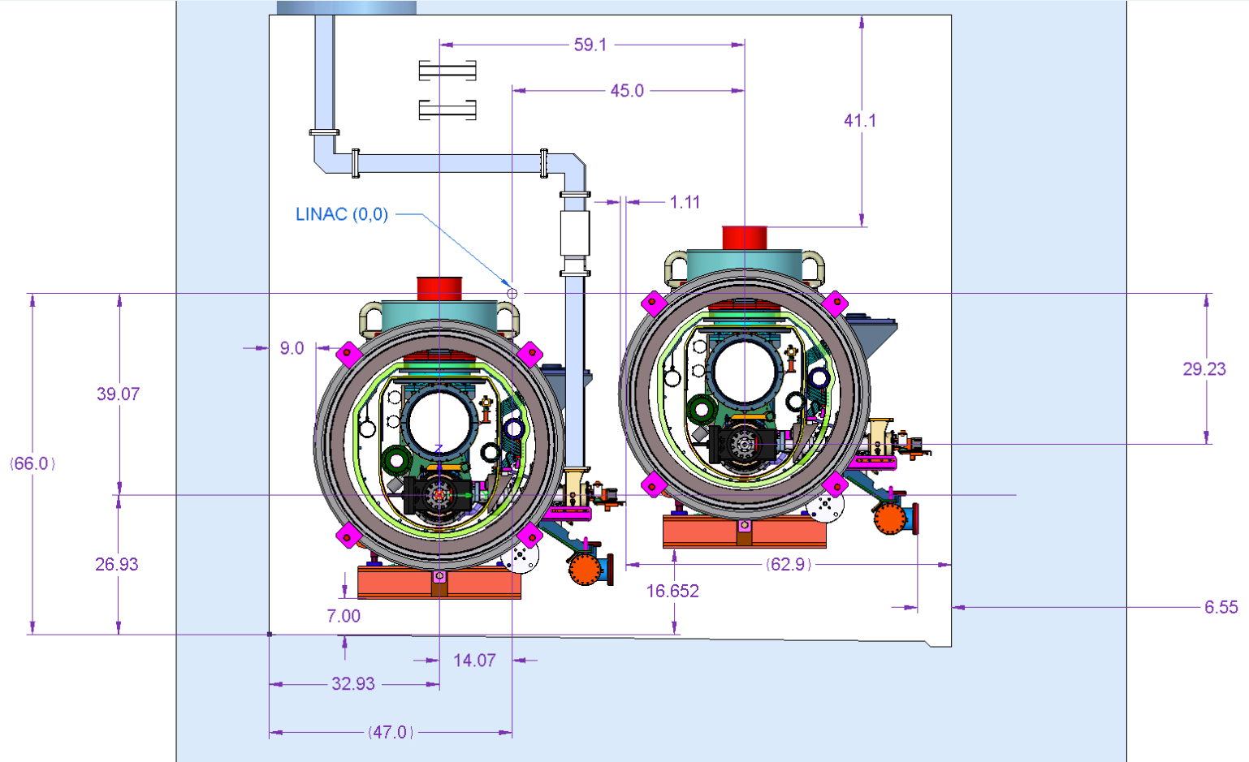
Uses Existing SLAC Tunnel for Linac

Slide 5
BESAC Subcommittee
Outcome: July 25, 2013
Galayda
Committee report & presentation to BESAC:
  “It is considered essential that the new light source have the pulse characteristics and high repetition rate necessary to carry out a broad range of coherent “pump probe” experiments, in addition to a sufficiently broad photon energy range (at least ~0.2 keV to ~5.0 keV)”
  “It appears that such a new light source that would meet the challenges of the future by delivering a capability that is beyond that of any existing or planned facility worldwide is now within reach. However, no proposal presented to the BESAC light source sub-committee meets these criteria.”
  “The panel recommends that a decision to proceed toward a new light source with revolutionary capabilities be accompanied by a robust R&D effort in accelerator and detector technology that will maximize the cost-efficiency of the facility and fully utilize its unprecedented source characteristics.”

Slide 6

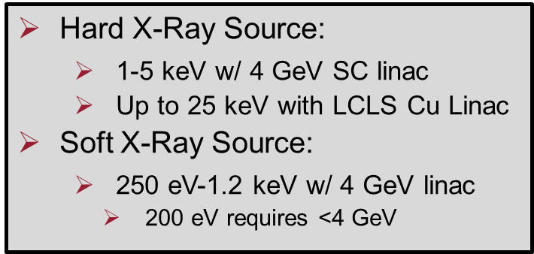
LCLS-II was re-configured to align with BESAC Subcommittee Recommendations
Galayda
Recommendation |  | Implementation
High repetition rate |  | CW Linac with MHz capability
Broad energy range |  | SC and Cu Linacs with variable gap undulators
Transform limited |  | Self seeding narrows bandwidth; add monochomator to control bandpass
Ultra-bright |  | High average brightness w/ SC linac High peak brightness w/ Cu linac
Multiple undulator sources |  | Two undulators operating simultaneously
Accelerator | Superconducting linac: 4 GeV
Undulators in existing LCLS-I Tunnel | New variable gap (north) New variable gap (south), replaces existing fixed-gap und.
Instruments | Re-purpose existing instruments (instrument &detector upgrades needed to fully exploit)

Slide 7
LCLS II Collaboration (Fermilab Perspective)
  FNAL is committed to the successful execution of the LCLS II project
    Strong internal support (Directorate to shop floor)
  Opportunity to participate in collaboration for cavity, cryomodule, RF and cryogenic work
    FNAL, JLab, Cornell, ANL, LBNL and SLAC
      Opportunities to learn from projects JLab/12 GeV, DESY/XFEL and MSU/FRIB
      Each organization brings a different level of expertise to the collaboration with complimentary experiences
    FNAL is well versed in large collaborative projects (US and international initiatives) and has a certified EVMS System (Jan 2010) with annual surveillance
      Experienced in production projects (LHC Quad magnets, various detector subsystems…)
      First project to use certified EVMS system was NOvA, which has CD-4 November 2014.
      Other projects such as CMS Detector Upgrade, Muon g-2, and mu2e all have CD-2 scheduled in FY14.
  FNAL’s involvement in LCLS-II design and construction leverages considerable investment and capability, and is well-aligned with our long term goals (PIP II)

Slide 8
LCLS II Collaboration (Fermilab Perspective – cont’d)
  FNAL has been building our SRF Program since 2006
    Extensive infrastructure – can be used for LCLS II
      Inspection, EP, tumbling, HPR, VTS, HTS, assembly, CMTS…
      Ongoing SRF Program supports facility maintenance
    Cavity & cryomodule design and fabrication (low β and 1.3 GHz)
    Originally focused on ILC (XFEL CM design, starting point for LCLS II)
      Now focused on CW applications (PIP II) => complements LCLS II
    Material & Cavity Processing R&D – now pursuing High Q₀ R&D
  Built three cryomodules of “LCLS II type” (pulsed operation)
    CM1 successfully tested
    CM2 currently being tested (most cavities reached 31.5 MV/m)
    3.9 GHz (successfully being operated in FLASH)
    PIP II designs build off this experience
  Well positioned to begin LCLS II work

Slide 9
Scope of Work
  FNAL’s scope of work for LCLS II
    Work on High Q0 development
      Goal is to establish that the parameter choice of 2.7 E10 (in production) is valid, and that the cryoplant design capacity (JLab) is correct
    Design, fabricate & test seventeen 1.3 GHz cryomodules
      8 cavities and one SC magnet/BPM per cryomodule (CW)
    Design, fabricate & test two 3.9 GHz cryomodules
      16 cavities total (opportunity for Value Engineering)
    Design & fabricate cryogenic distribution system
      Interfaces with both JLab (cryoplant) and SLAC (tunnel)
    For above deliverables provide installation and commissioning support at SLAC
    Assistance with linac accelerator physics and LLRF control (as requested)

Slide 10
Organization Chart

Slide 11
How LCLS II Benefits PIP II SRF R&D
Exercises designs needed for CW cavity/cryomodules
Major breakthrough for increasing Q0 (N2 doping)
  Anna Grassellino/Alex Romanenko and team
  So far very positive results but need to work through details
  Reinforces need to control residual magnetic fields and cool down rate through transition
Moves FNAL from R&D to production mode
  Proof of readiness for PIP II
  Sharpens skill set of FNAL SRF staff (repetition)
Completes CMTS1 ahead of schedule (partially LCLS II funded)
Demonstrates ability of Labs/Institutions to jointly work in production of large SRF projects
  Co-engineering/Co-production

Slide 12
How LCLS II Interferes with PIP II SRF R&D
SRF Facilities
  Dominates Clean Room and CM Assembly Facilities
  Could monopolize HPR facilities (depending on first pass yield)
  EPF should be OK given fab. model (procuring proc./dress cav.)
  VTS should be OK given VTS 1/2/3 (qualified labor limitation)
SRF Labor
  Both projects (LCLS II/PIP II R&D) pull from current SRF /Cryo staff
What is being done to eliminate the pinch points?
  Procure soft walled portable Clean Room (HAB)
  Increase labor force
    Change model for assembly of SSR1 CM (use Eng./Sci. more)
    Help from ANL colleagues
    Temporary/contract workers
    Selective permanent hires

Slide 13
1.3 GHz Cryomodule Modifications for LCLS-II
Start with the TESLA Type 3+, XFEL, and ILC/Type 4 designs
Modifications for high heat loads
  Larger chimney pipe from helium vessel to 2-phase pipe
  Larger 2-phase pipe (4 inch OD)
Closed-ended 2-phase pipe
  Separate 2 K liquid levels in each cryomodule
  2 K JT valve on each cryomodule
End lever tuner and helium vessel design for minimal df/dP
Two cool-down ports in each helium vessel for uniform cool-down of bimetal joints
No 5 K thermal shield
  But retain 5 K intercepts on input coupler
Input coupler design for 7 kW CW plus some margin

Slide 14
Engineering and Design Tasks
Helium vessel design
  Design of the helium vessel and end-tuner mount
Cryostat design
  Detail the modifications of the piping and vacuum vessel
  Reliability of tuners and possibilities for repair of tuners will be evaluated (e.g., possible ports in vacuum vessel for access to tuners and drive mechanism)
Magnetic shielding
  Improved cold magnetic shielding on the helium vessel
  Additional layer of cold or warm magnetic shielding
Magnet
  Conductively-cooled, split magnet prototypes have been tested
  LCLS-II will include a quad / corrector dipoles / BPM package
System venting analyses, relief valve schemes

Slide 15
High Q0 Development
As of Dec.2013, the LCLS-II SRF CM’s could be cooled by a single 18kW @ 4.5K equiv. cryoplant, of existing JLab design, if <Q0>=2.7E10
    ILC data, using standard EP: <Q0>=2E10
Single-cell data from Fermilab (Grassellino et al.) using nitrogen-doping demonstrated better than <Q0>=2.7E10
    FNAL High Q0 R&D work being done for PIP II was synergistic with LCLS II
FNAL/JLab/Cornell/SLAC are collaborating on migration of the FNAL “High Q₀” technique from R&D to a robust production process
General program: Demonstrate transferability of recipe, demonstrate effectiveness on 9-cells, evaluate parameter space for reproducibility; demonstrate maintenance of high-Q0 in a cryomodule (horizontal test)
  Scope of work and number of tests defined for VTS on 1-cell and 9-cell and HTS on dressed 9-cell cavities at the labs
  Cryoplant a major cost and schedule driver

Slide 16
FNAL High Q0
Grassellino, Romanenko, Rowe
TE1AES10 and AES15 2 and 1.5K curves for 1 min N2 injection, as a function of post gas EP removal

Slide 17
FNAL High Q0
Grassellino, Romanenko, Rowe
TB9AES011 04/18/14 (fast cooldown) and 04/21/14(slow cooldown) tests, 2K curves

Slide 18
Current Results of High Q0 R&D
Grassellino, Romanenko, Rowe
Very good progress in meeting High Q0 Goal => still some ways to go

Slide 19
Overall CM Workflow
  Plan for designing & building 19 CM
  => (17) 1.3 GHz and (2) 3.9 GHz
    Finalize requirements specifications and interface control documents
    Design the modified 1.3 GHz CM (CW operation)
      Strong collaboration with JLab
        Common 3d model and 2D drawings
        Shared procurements
    Start fabrication of prototype CM (1st Article – goes in machine)
    Design the modified 3.9 GHz CM (incorporating features from 1.3 GHz design)
    Fabricate next two additional 1.3 GHz CM (Prod 2)
      During this time we ramp up the workforce and train as appropriate
    Fabricate fourteen 1.3 GHz CM (Prod 14)
    Fabricate two 3.9 GHz CM (Prod 2)
Efficient use of design concepts, parts, and staff
Fabrication plan incorporates learning curve and training

Slide 20
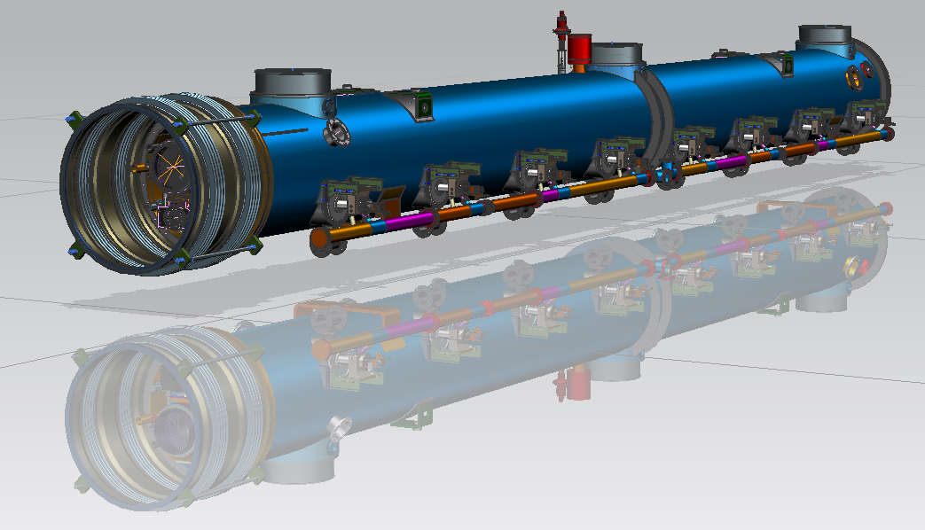
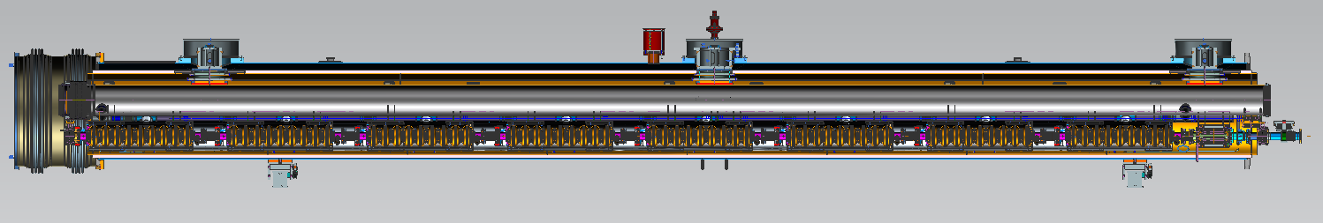
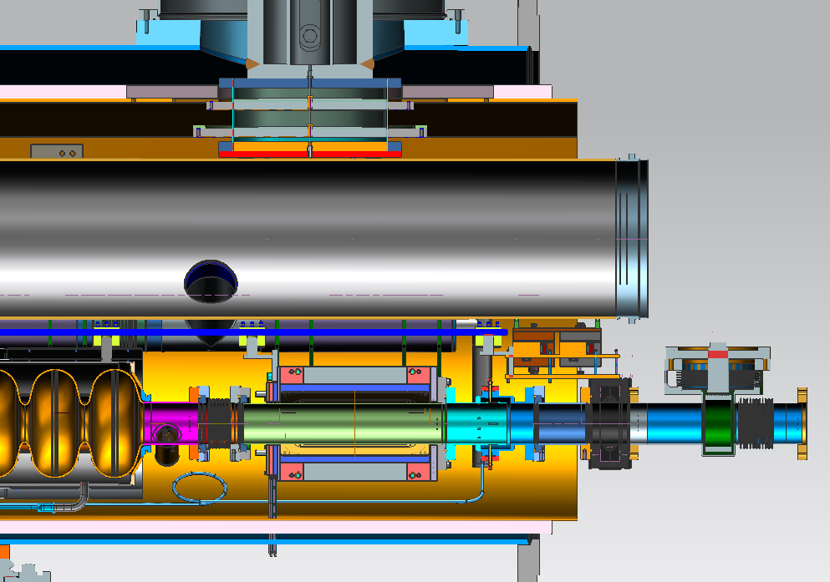
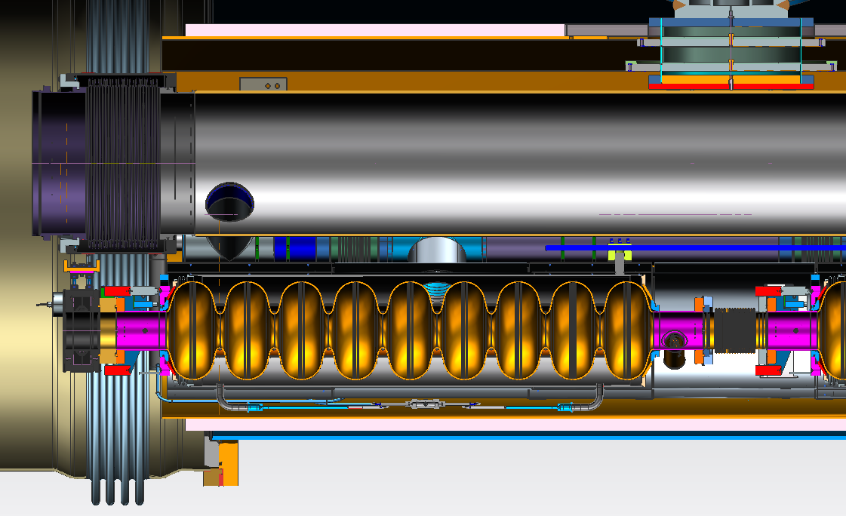
Prototype CM Design
T. Peterson, Y. Orlov

Slide 21
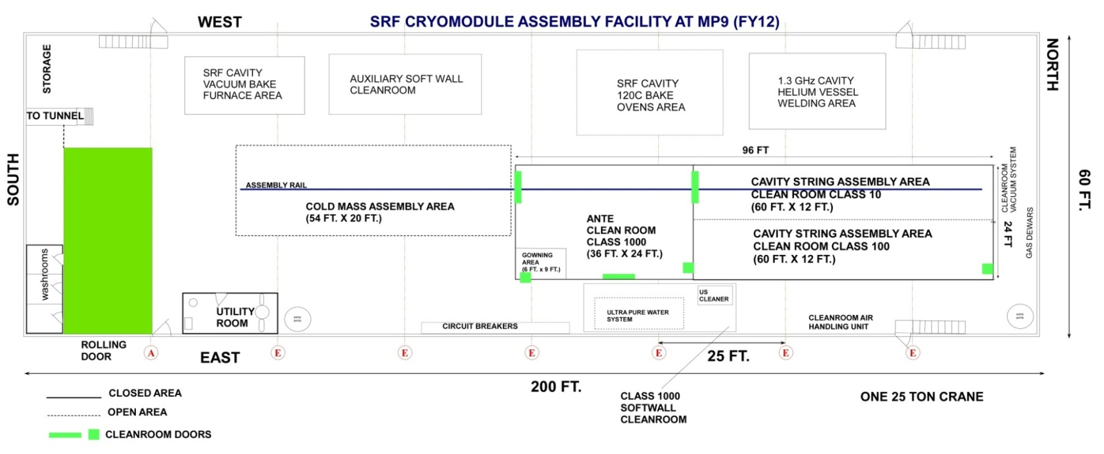
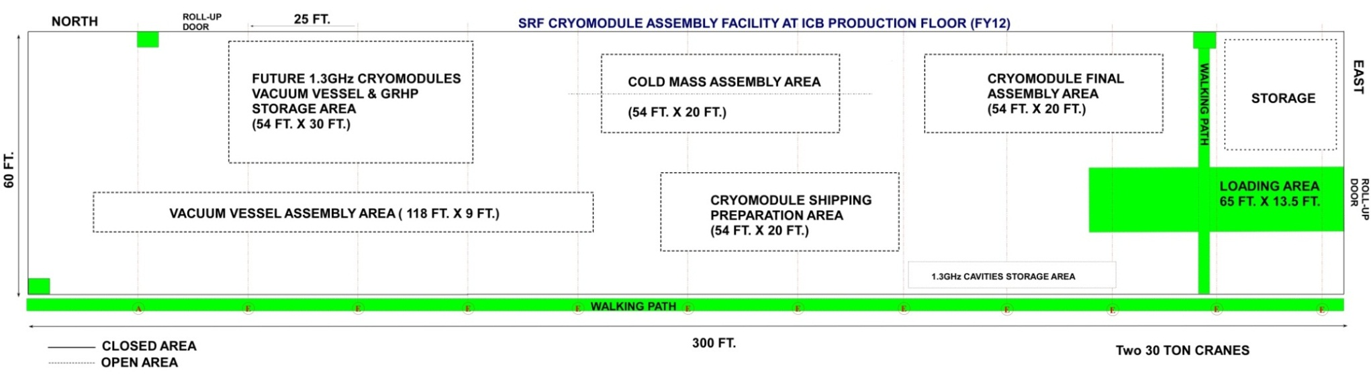
Capabilities and Infrastructure: FNAL 1.3 GHz CM Ass’y
Arkan
WS2:7d (7)
WS1: 9d (6)
WS0: 5d (2)
WS3: 5d (10)
WS5: 10d (8)
WS4:5d (10)
WS6: 4d (4)
Total = 45 days
Workstation: duration (#people)

Slide 22
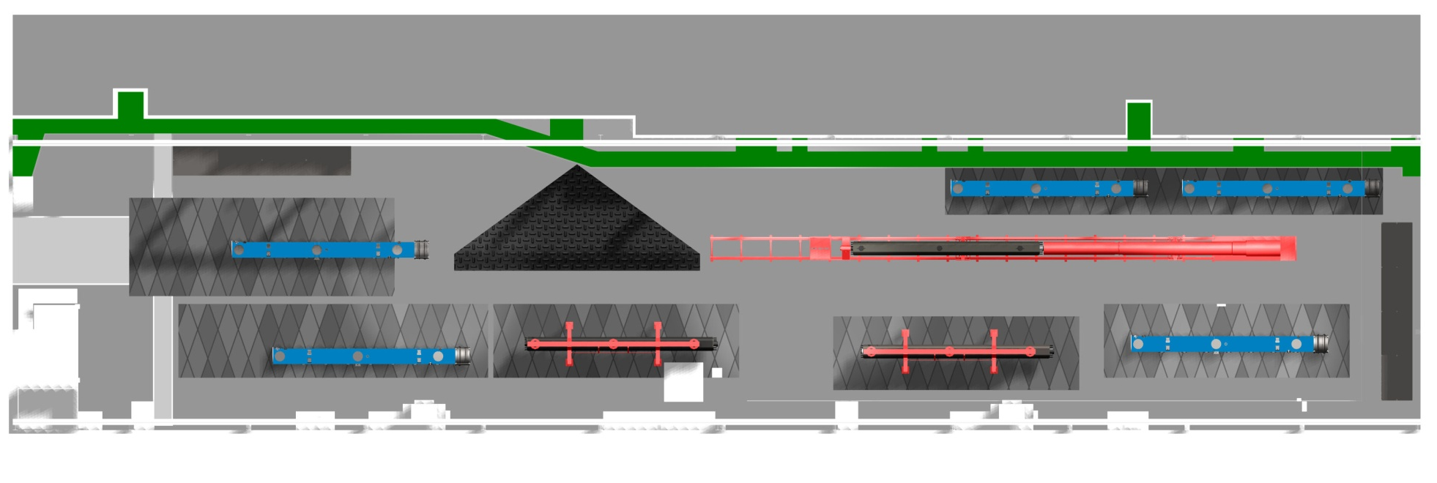
ICB: estimated space usage (Arkan)
LCLS-II COLD MASS ASSEMBLY:
WS – 3
LCLS-II MODULE SHIPPING &
PREPARATION: WS-6
LCLS-II ALIGNMENT
(LASER TRACKER)
COMPLETED CRYOMODULES
WAITING TO BE TESTED
LCLS-II COLD MASS ASSEMBLY:
WS – 4
LCLS-II COLD MASS REPAIR
STATION -2
LCLS-II COLD MASS ASSEMBLY:
WS – 5
LCLS-II COLD MASS REPAIR
STATION -1

Slide 23
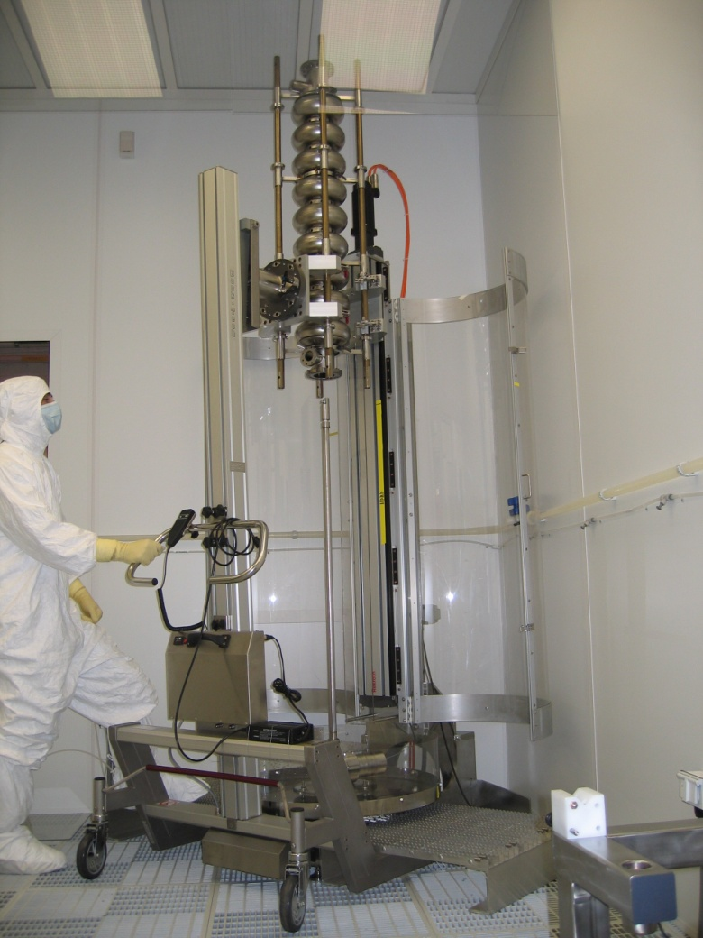
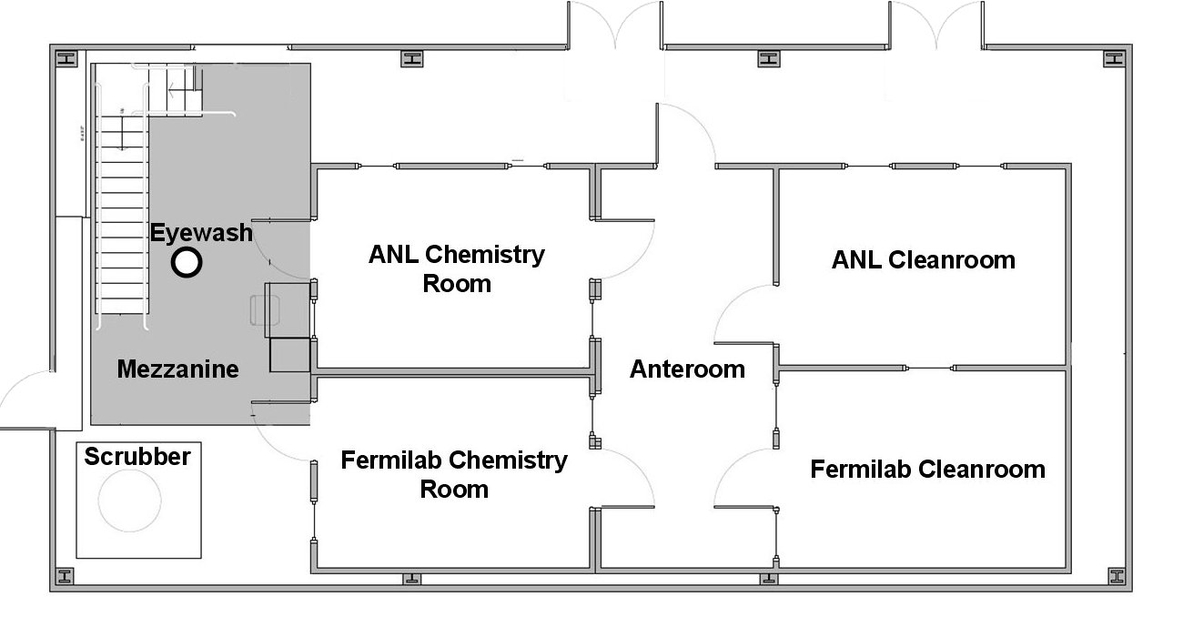
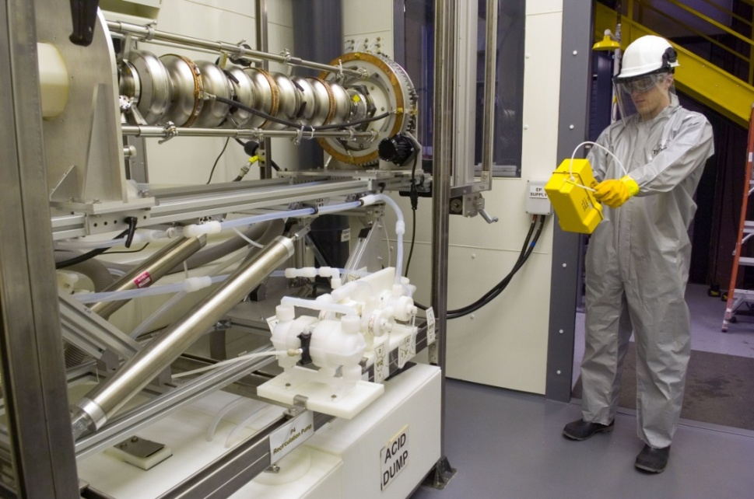
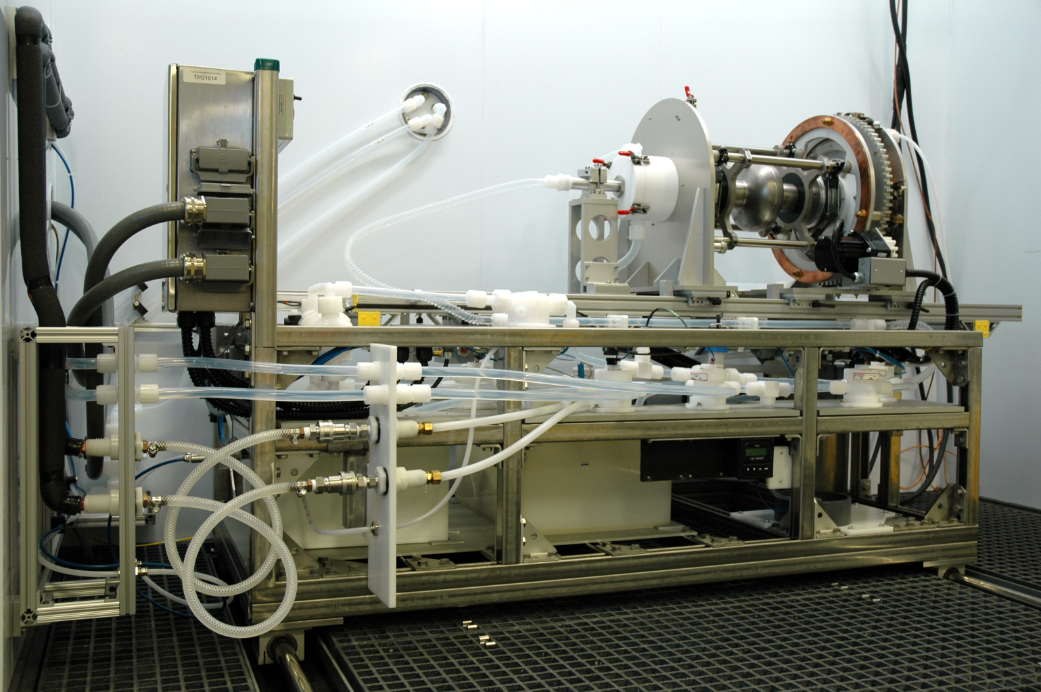
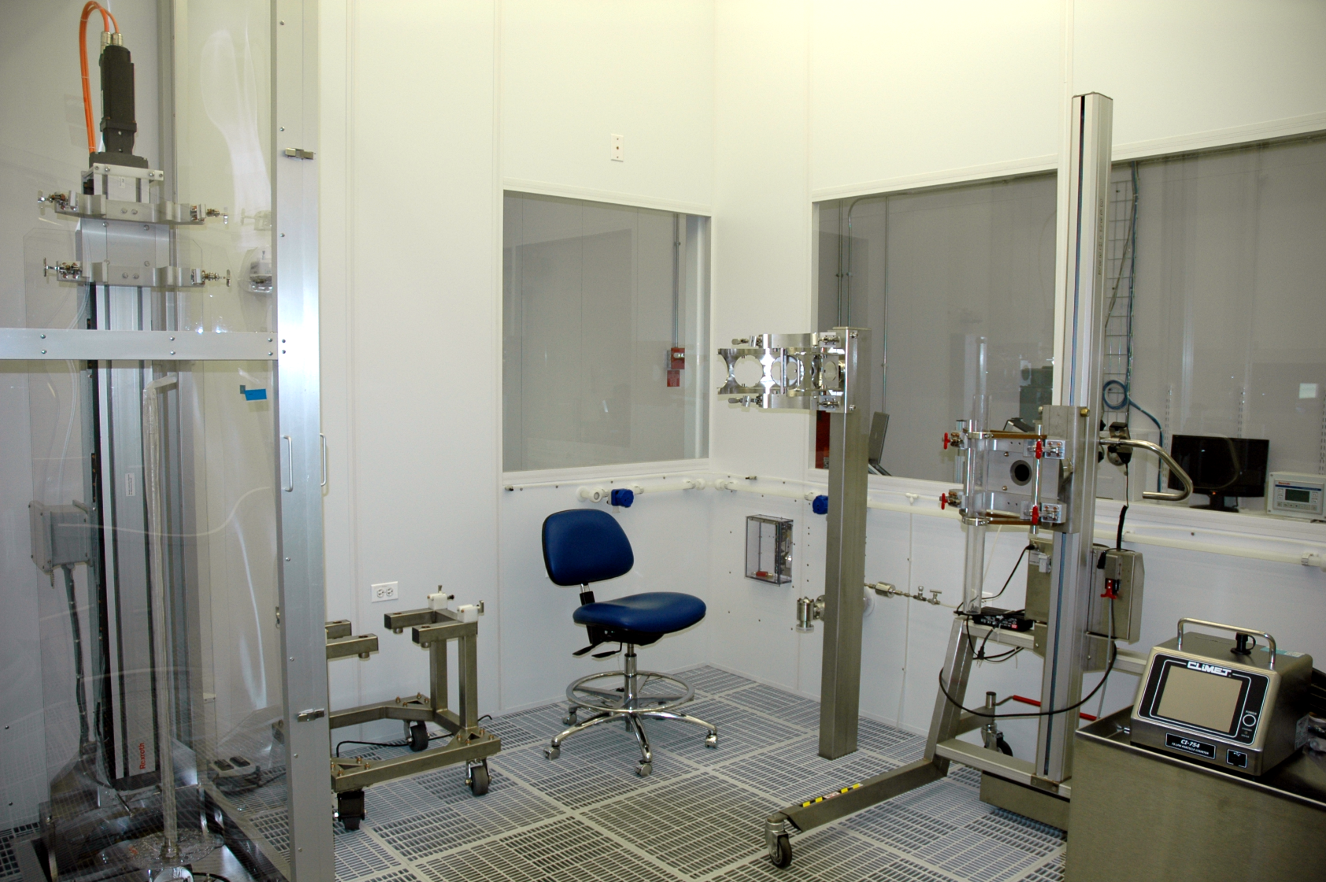
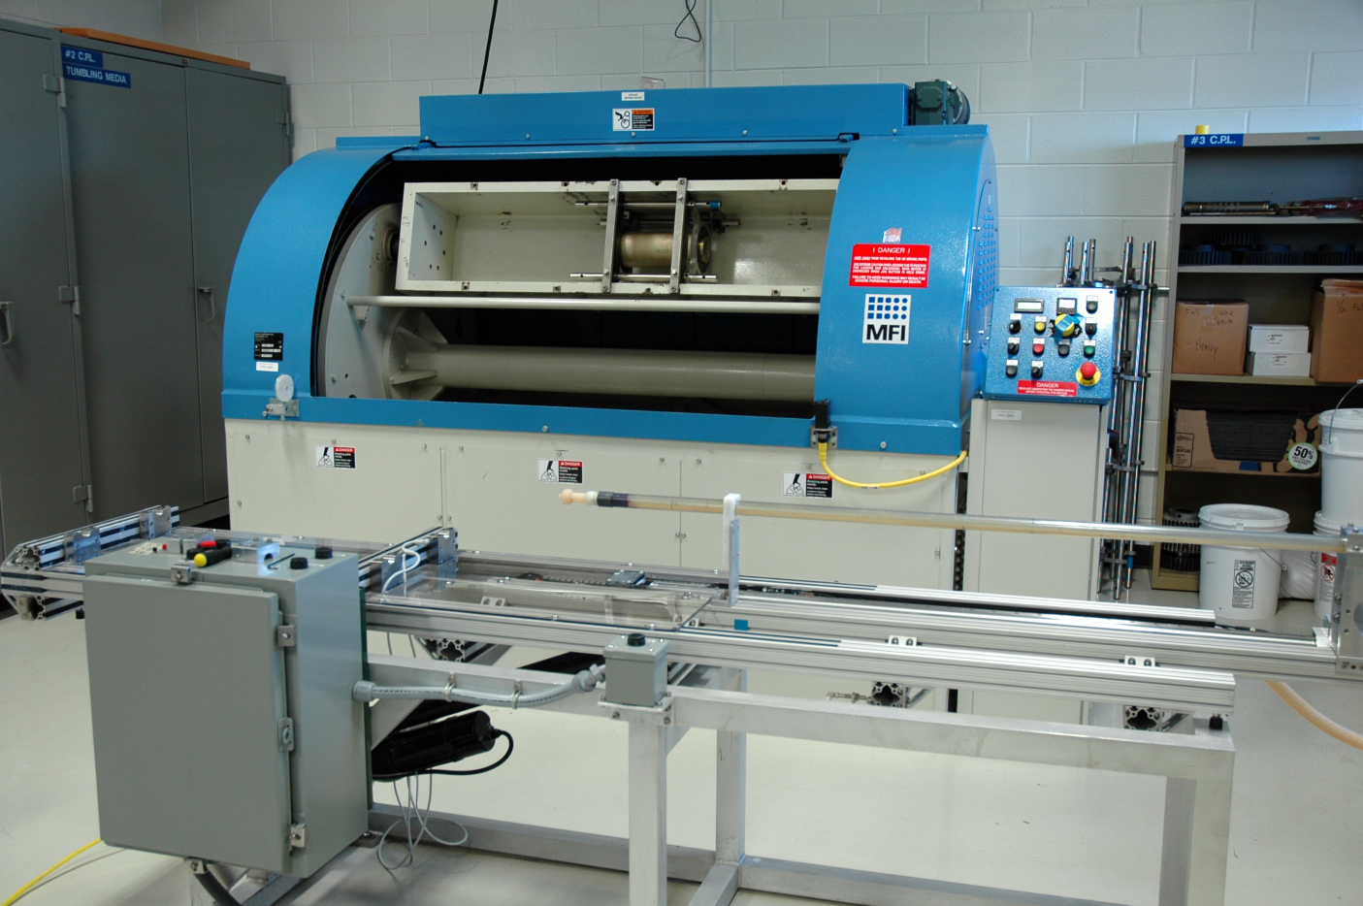
Capabilities and Infrastructure: Cavity Processing
Joint Argonne-Fermilab Processing Facility
1.3 GHz EP/BCP Tool (Joint ANL/FNAL)
High pressure rinse tool: 1.3 GHz Cavity (Joint ANL/FNAL)
IB4 Cavity Proc. Lab EP Tool
IB4 Cavity Proc. Lab Class 10 Cleanroom
1.3 GHz Tumbler

Slide 24
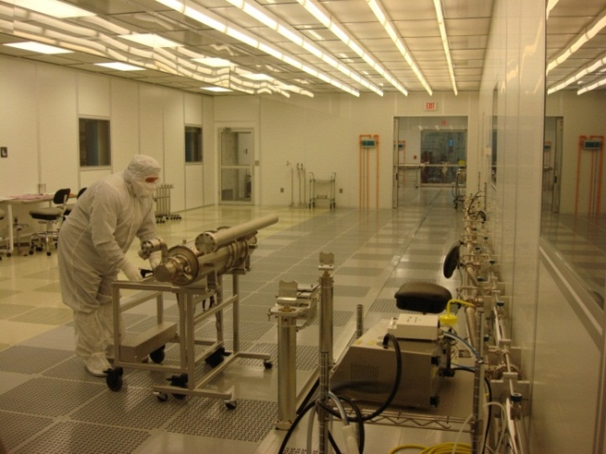
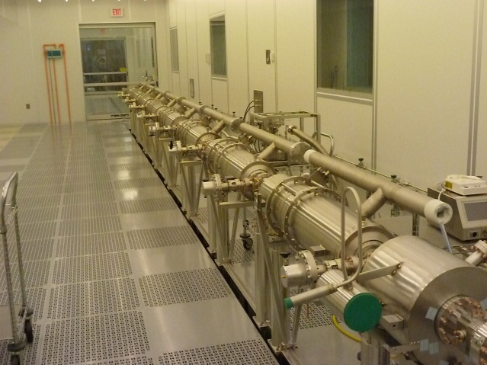
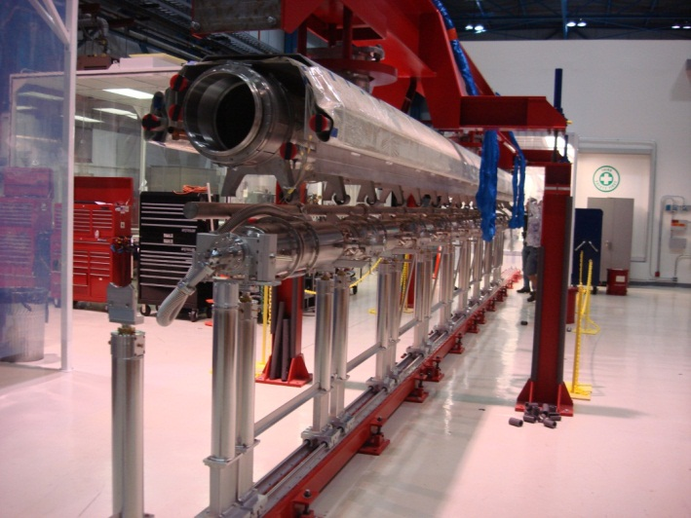
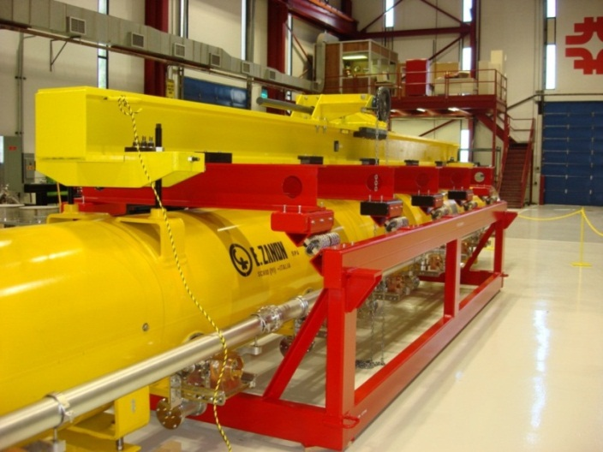
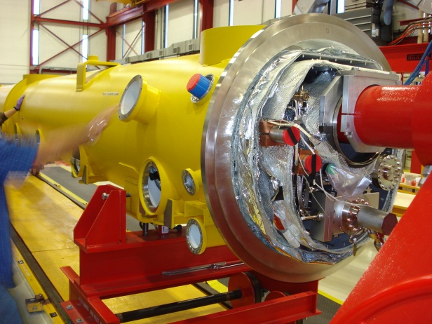
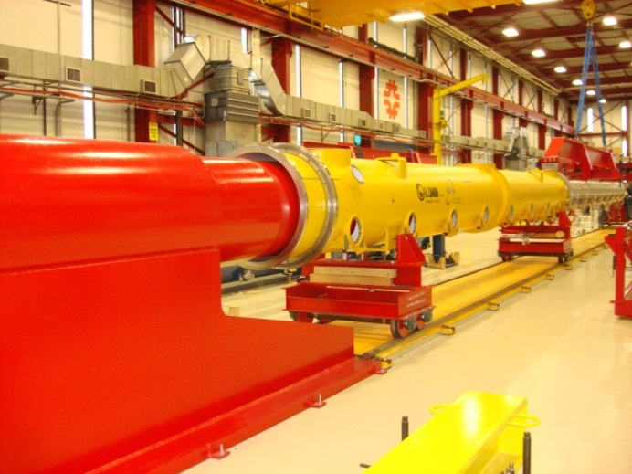
Capabilities and Infrastructure: Cavity String, Cold Mass, Cryomodule Assembly
Class 100
Class 10
Cavity String Assembly Clean Room
Cavity String Assembly
Cold Mass Assembly
Cryomodule Transport
Final Assembly
Final Assembly

Slide 25
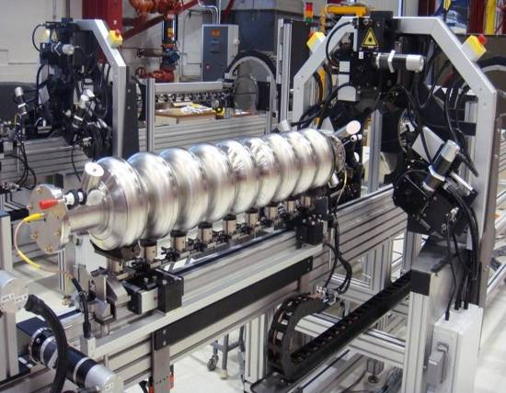
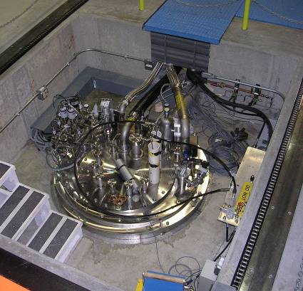
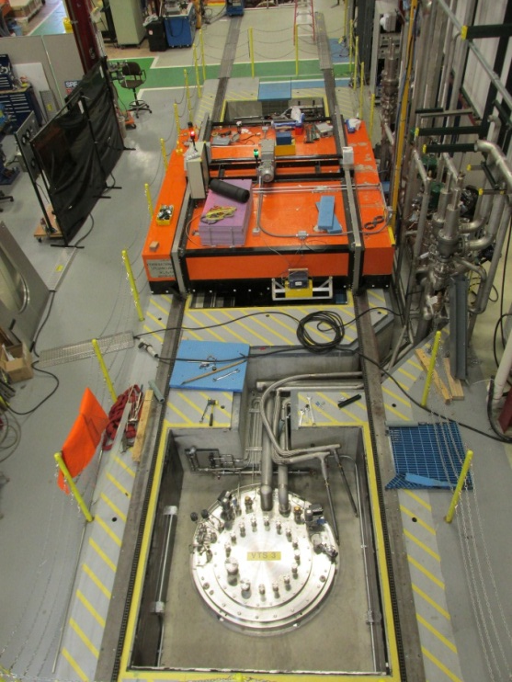
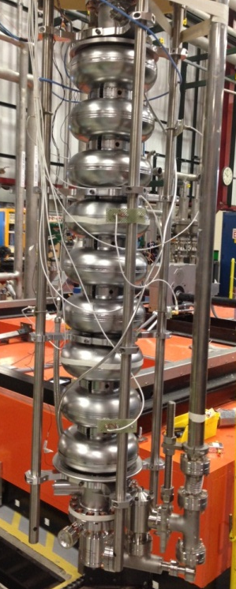
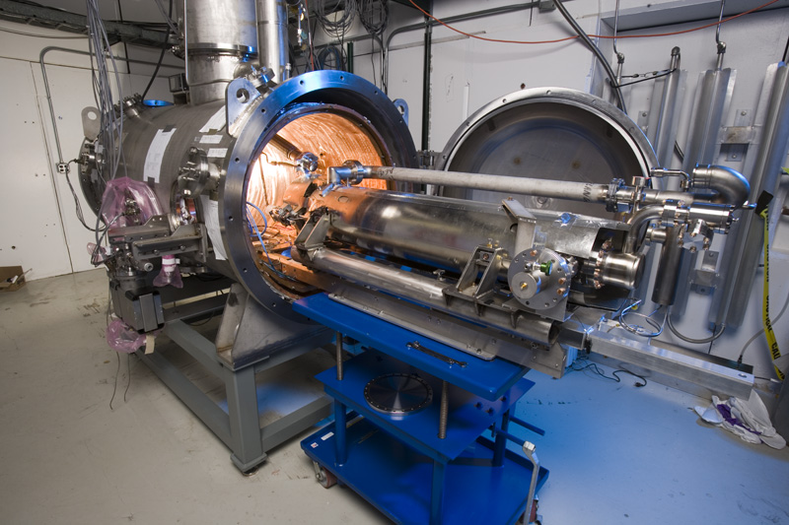
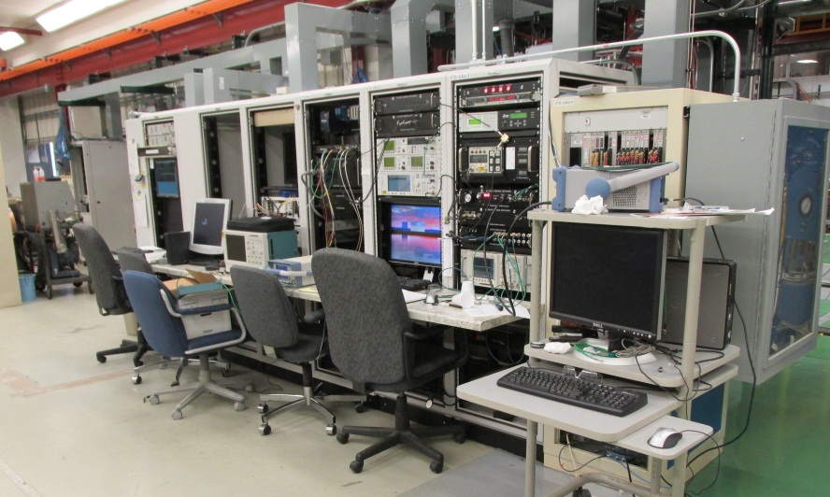
Capabilities and Infrastructure: Cavity Testing, Tuning
ILC/XFEL Cavity Tuning Machine
Vertical Test Stand
Vertical Test Stands 1, 2 and 3
9-cell TESLA-style cavity
Vertical Cavity Test Facility Control Room
1.3 GHz installation into Horizontal Test Stand 1

Slide 26
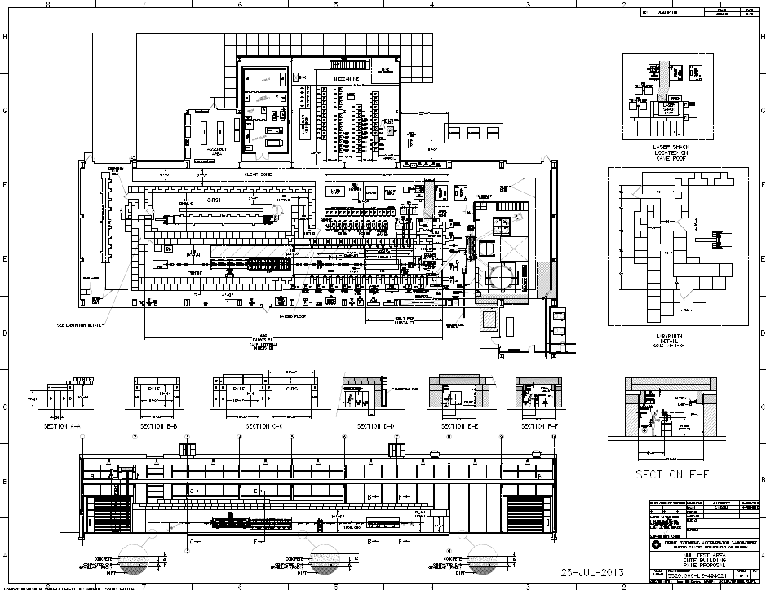
Cryomodule Test Facility (CMTF)
Leibfritz
Cryoplant (blue)
Distribution box (silver)
Cryomodule Test Stand (CMTS)
H⁻ beam test cave

Slide 27
Summary
  FNAL has world-class capabilities in all aspects of SRF technology, from R&D to design to construction to testing
    Expertise and capabilities in both the technical and project management aspects of DOE projects
  LCLS II scope of work is well defined and aligned with our current capabilities and long term goals (PIP II)
    Many advantages in doing LCLS II while PIP II is still in R&D stage
    Also interferences between LCLS II and PIP II activities
      This will take active/coordinated management to minimize impact
  Committed to making LCLS-II a success and to preparing FNAL for a PIP II project

