Slide 1

R&D Status/PXIE
Ion Source/LEBT
Lionel Prost
Fermilab
PIP-II Collaboration Meeting
June 3-4, 2014

Slide 2
Outline
Beam line design
Ion Source commissioning at Fermilab
Configuration with one solenoid
  First measurements
Present configuration
  Status
Plans

Slide 3
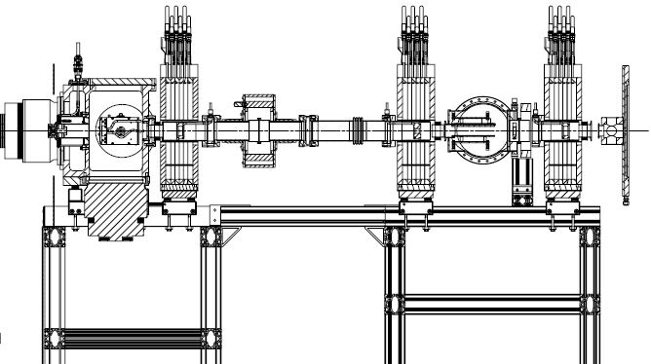
Beam line design
Ion Source commissioning at Fermilab
Configuration with one solenoid
  First measurements
Present configuration
  Status
Plans

Slide 4
PIP-II IS & LEBT beam line
Optics have not changed since Fall 2012 Collab. Mtg.
  Space-charge dominated transport after chopper (in DC mode)
  Details of components evolve as their design progresses
Combined kicker and absorber i.e. when deflected, the beam impinges onto one of the kicker electrodes
No isolated diaphragm in solenoid #3 anymore

Slide 5
Beam line design
Ion Source commissioning at Fermilab
Configuration with one solenoid
  First measurements
Present configuration
  Status
Plans

Slide 6
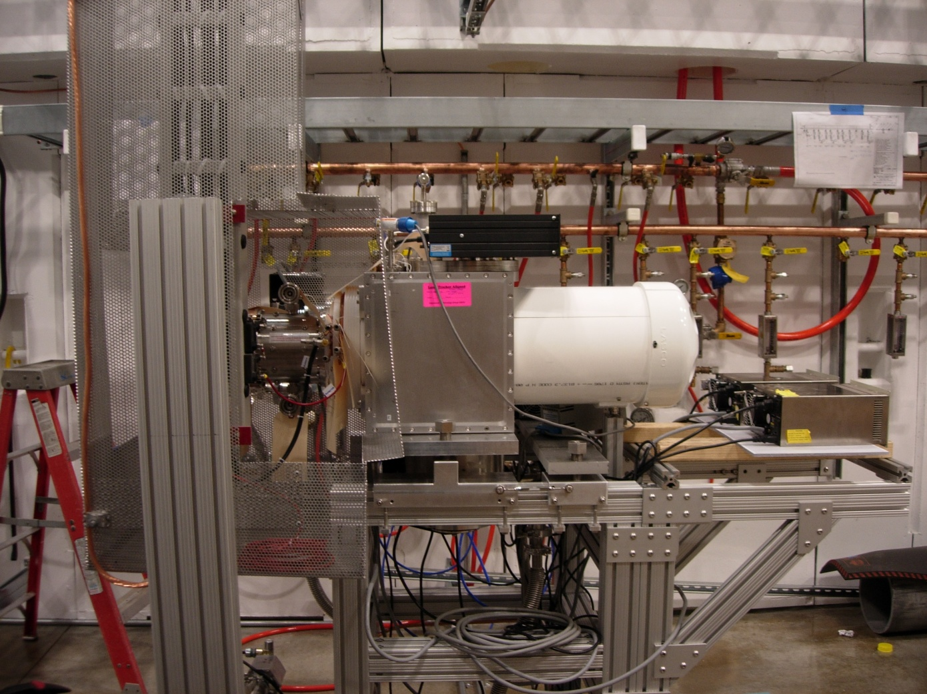
Ion source assembly at CMTF
Authorization to operate at CMTF on 11/22/13
Qing Ji
came
to help with
the startup
Isolated cable tray (from HV cabinet to IS)
Water distribution system
IS vacuum chamber
Faraday cup (inside)
IS body

Slide 7
Ion source commissioning
Typical learning curve for a new machine i.e. unforeseen issues (mostly)
  HV sparks leading to Filament PS trips
  Isolation transformer failure (manufacturing defect ⇨ replaced by vendor + bought 1 spare)
  Mass flow controller mis-located at ground instead of HV
Duplicated many of the measurements
made at TRIUMF and LBL
  Except emittance
  (scanner not ready)
E.g.: Beam current as a function of the Arc power
Ion Source characteristics measured at CMTF are
consistent with both TRIUMF
and LBNL data
Not all IS parameters are the same for all data sets

Slide 8
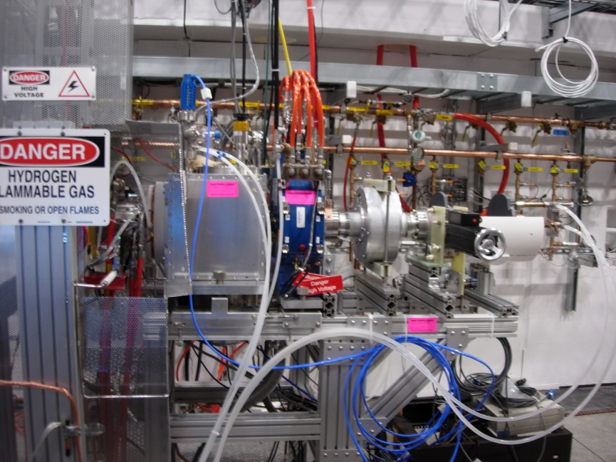
Beam line design
Ion Source commissioning at Fermilab
Configuration with one solenoid
  First measurements
Present configuration
  Status
Plans

Slide 9
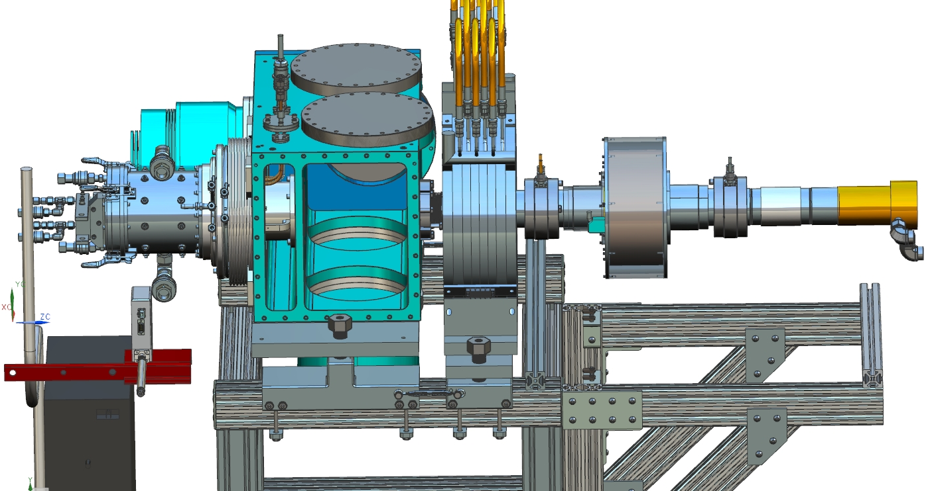
First configuration with one solenoid
Includes:
  A ‘stand-alone’ isolated diaphragm between the DCCT and the Faraday cup for beam size measurements
  Capability to pulse the extraction electrode
‘Stand-alone’ isolated diaphragm a.k.a. donut
Solenoid
Faraday Cup
DCCT
Solenoid isolated diaphragm connectors

Slide 10
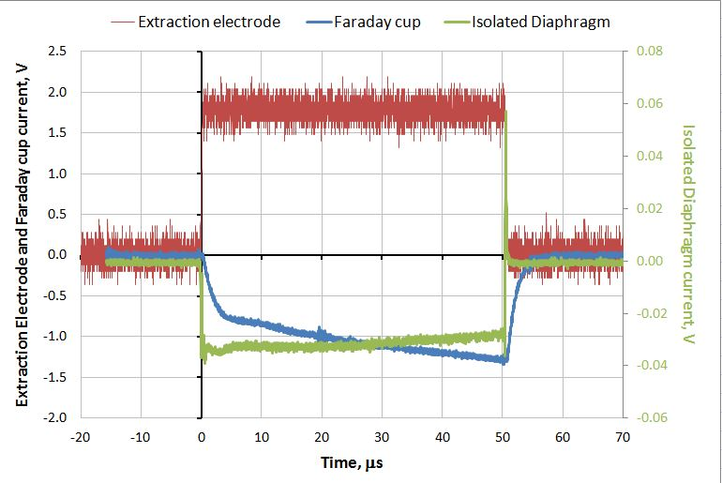
Measurements
Beam size
  Mostly in pulsed mode
    Pulse width: 1 μs < τ_{pulse} < 2 ms
      Long pulse ⇨ DC-like (near the end)
    Frequency: 0.25 Hz < f_{pulse} < 10 Hz
Emittance
  Estimated from beam size vs. solenoid current scans
  Neutralization effect
    Data taken within the beam pulse
Neutrals
  Estimates with calorimetric data
    DC beam

Slide 11
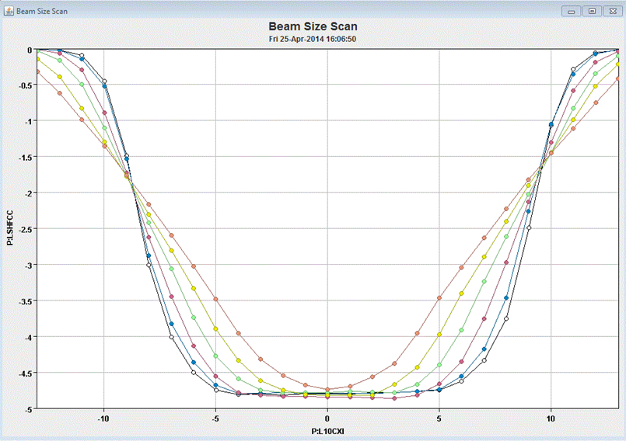
Beam size measurement method
Beam size is obtained by moving the beam across the donut aperture
  Beam current in FC vs. Solenoid corrector current
  Long pulses
  (typically 200 μs)
  or DC
Donut aperture
Solenoid corrector current [A]
Beam
Faraday cup current [mA]
04/25/14
Current to FC as a function of the solenoid correctors for 6 solenoid currents, from 168 to 148A.
Data were taken with B. Marsh’s Java application.

Slide 12
Data analysis procedure
Fit entire curves (i.e. from extinction to extinction) assuming a Gaussian or constant current density (a.k.a. Flat) distribution being sampled across a round aperture
  Fitting with up to 4 parameters
    Beam current
    Correctors calibration
    coefficient (i.e. mm/A)
    Center position
    Rms beam size
  All parameters but the beam
  size can be measured
  independently or as a
  subset of the ensemble
  of curves
    Then, can fit with only one
    parameter,
    i.e. the rms beam size
  ‘Goodness’ of the fit may
  indicate which distribution is a
  closer representation of the
  real distribution
Example of fitting of the curves for the solenoid current of 168 A with Gaussian distribution
Solenoid corrector current, A

Slide 13
Solenoid scans
Beam size measurements in pulse mode acquiring data for several ‘time slices’ within the pulse
  10, 30, 50, 100 and 180 μs from the leading edge (delay)
Fitting with both distributions give
similar results
  Typically within
  10%
Displacement of
the minimum
beam size with
the delay is a
good indication of
neutralization
  Neutralization
  time >100 μs
Results of fitting the data to Flat (solid lines) and Gaussian (symbols) distributions. Series are labeled by the delay in µs.
Beam current = 5 mA (DC-equivalent)

Slide 14
Emittance estimation
The beam size as a function of the solenoid current is fitted to a model of a thin lens without space charge
  Not self-consistent approach
Emittance calculated with this procedure is higher by a factor of ~2 at the beginning of the pulse
  Emittance value consistent with previous data taken at TRIUMF and LBNL
Emittance vs. delay
For reference: Emittance measurements from acceptance tests at TRIUMF (DC beam)
~5 mA
Beam current = 5 mA (DC-equivalent)

Slide 15
Estimation of the amount of energetic neutrals (H₀)
With the beam well centered in the donut, its temperature still rises significantly
  Indicates particles loss
Thermal characteristics of donut (measured) & measurements of the sum of currents (FC + donut) with solenoid on and off
  Neutrals amount to ~7% of the total beam current
  Assuming a Gaussian distribution, ~10% of these propagate downstream
    The longer the LEBT the smaller this number
DCCT
Neutrals
Red and blue lines: Primary beam envelope (simulation)
Donut

Slide 16
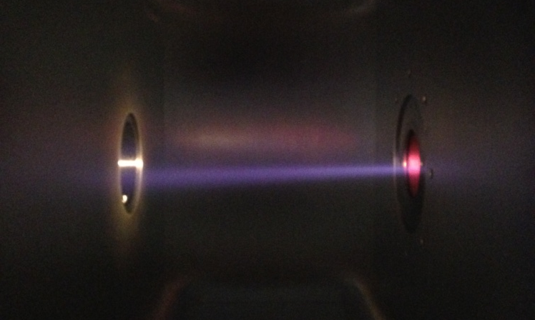
Beam line design
Ion Source commissioning at Fermilab
Configuration with one solenoid
  First measurements
Present configuration
  Status
Plans
Picture of the beam after spoiling vacuum (04/15/14)

Slide 17
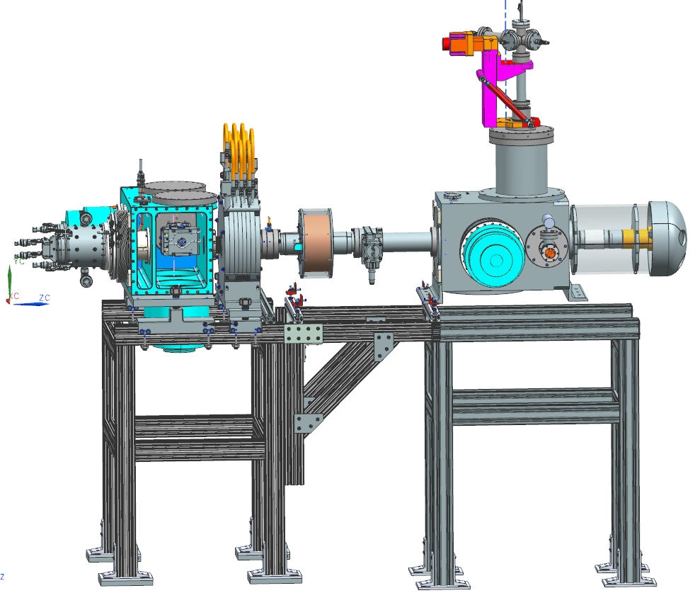
Present configuration
Installation of the emittance scanner
(05/12)
  Design and fabrication
  in collaboration
  with
  SNS

Slide 18
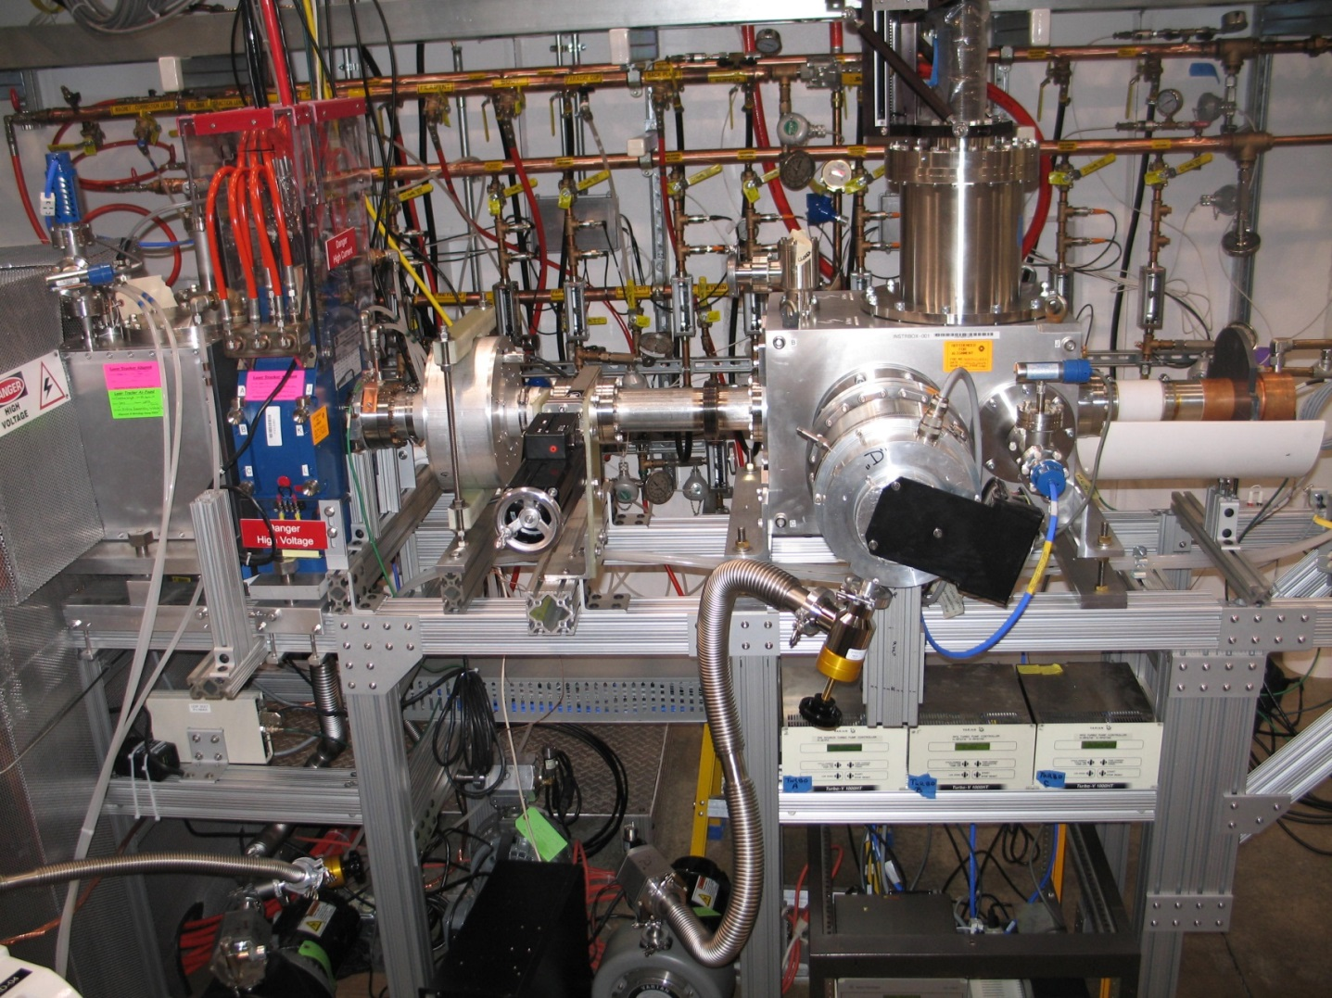
Current setup in picture
‘donut’
Gate valve
Faraday Cup
DCCT
Turbo pump
Emittance scanner probe

Slide 19
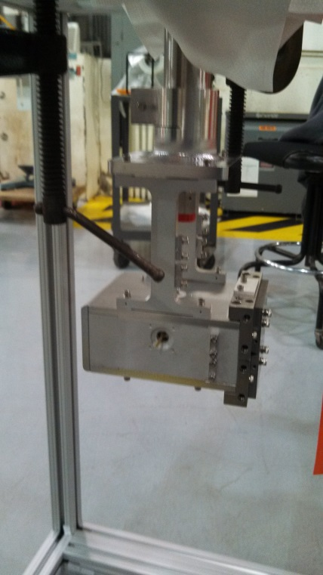
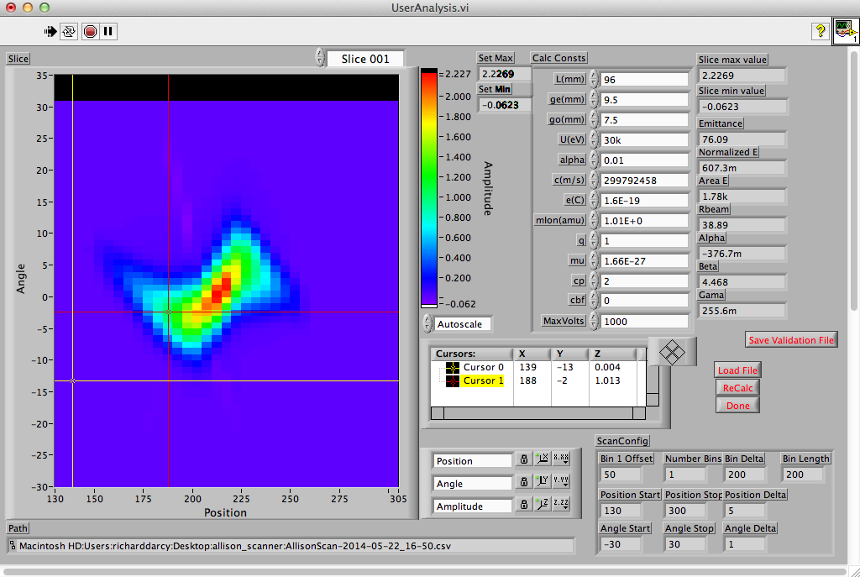
Emittance scanner commissioning
Current emphasis of shift work
  ‘Mechanics’ of data acquisition work
  Expect to start sensible measurements this week or next
    Some calibration factors and other details need to be ironed out
Emittance scanner on assembly rig
Labview GUI

Slide 20
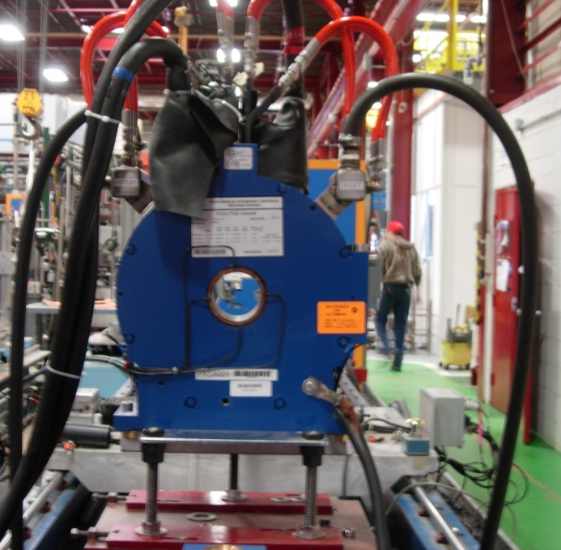
Beam line design
Ion Source commissioning at Fermilab
Configuration with one solenoid
  First measurements
Present configuration
  Status
Plans
Solenoid #1 setup for magnetic measurements in TD

Slide 21
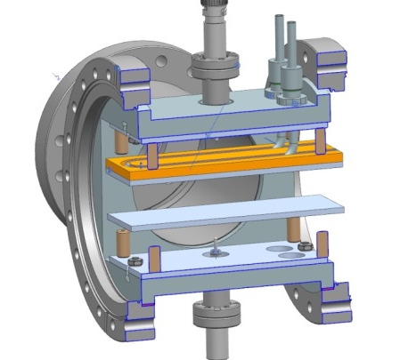
Plan (FY14)
Finish characterization of the beam through ~1m of the LEBT (including beam dynamics through one solenoid)
  Emittance scanner commissioning
Installation of the full length LEBT
  Goal is to start commissioning mid- to late July
    All solenoids have been delivered and
    are being measured
    A lot of the infrastructure is ready or nearly
    ready (e.g.: water distribution system)
    Current ‘push’ on the design of the chopper

Slide 22
Backup slides

Slide 23
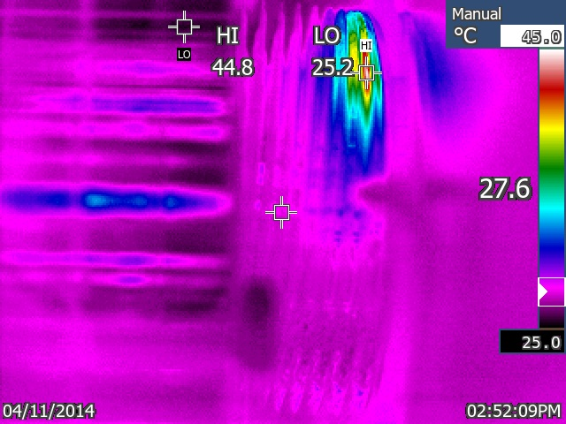
Issue
The beam size and angle of
propagation of the beam exiting the
ion source results in losses in the
bellow preceding the first solenoid
  Bellow ID smaller than expected
  Beam centroid output angle larger
  than expected
Beam loss estimated to
correspond to ~10 W
  Not a thermal issue but may
  cause sputtering/blistering
  Added a ‘shield’ at the exit
  of the IS vacuum chamber
Picture of the beam after spoiling vacuum (04/15/14)
04/11/14
5 mA
I_{Sol} = 160 A
With shield

Slide 24
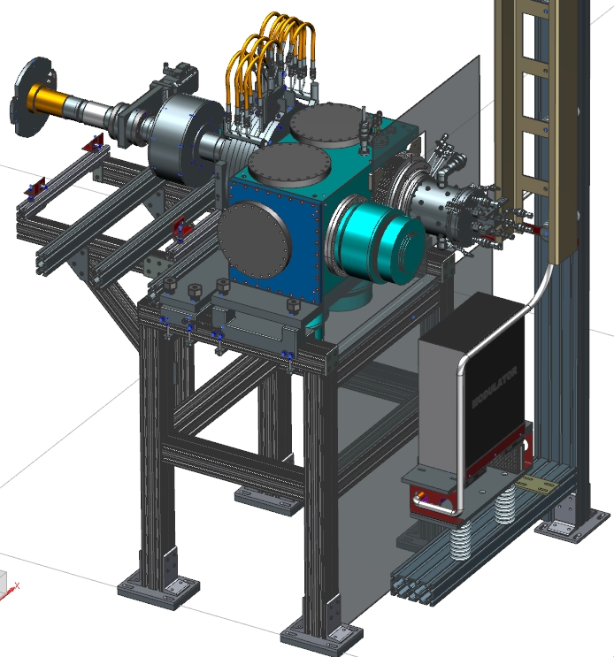
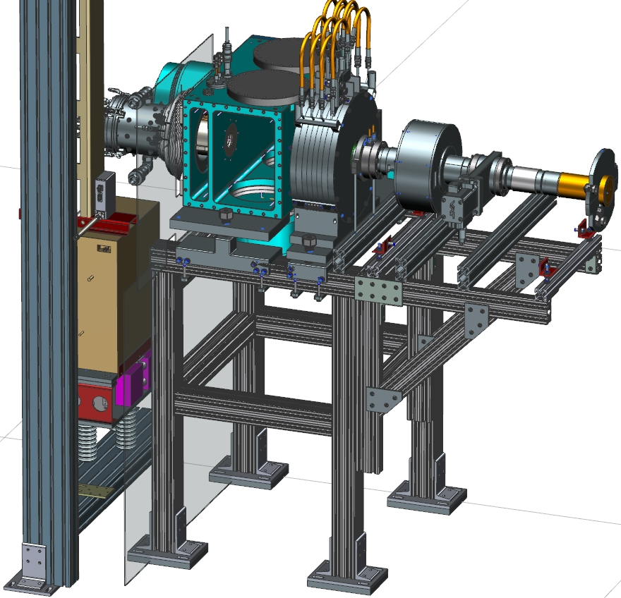
(Very) First configuration with one solenoid
Faraday Cup
Solenoid
DCCT
Gate valve
Turbo pump
Isolated diaphragm connectors
Pulser

