Slide 1
PXIE Overview: Goal, Status, Strategy
Paul Derwent
for all of those who have been working on PXIE
Notes:
change template to match Steve’s suggestion

Slide 2
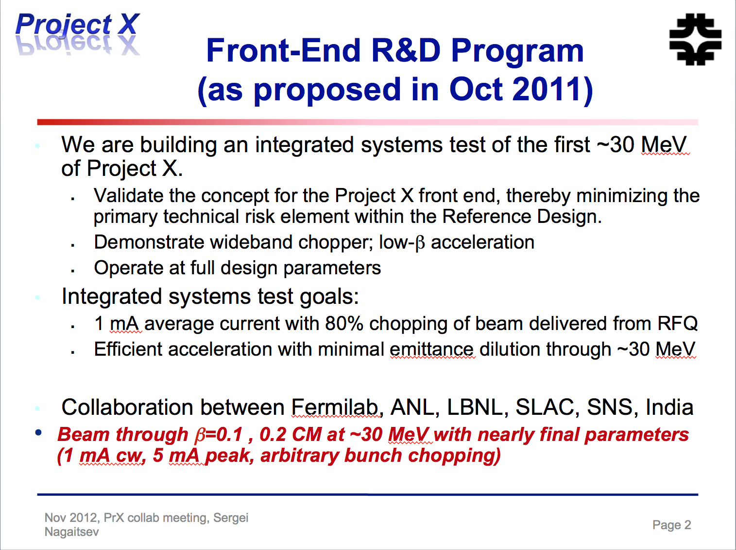
The Goals: stable and consistent

Slide 3
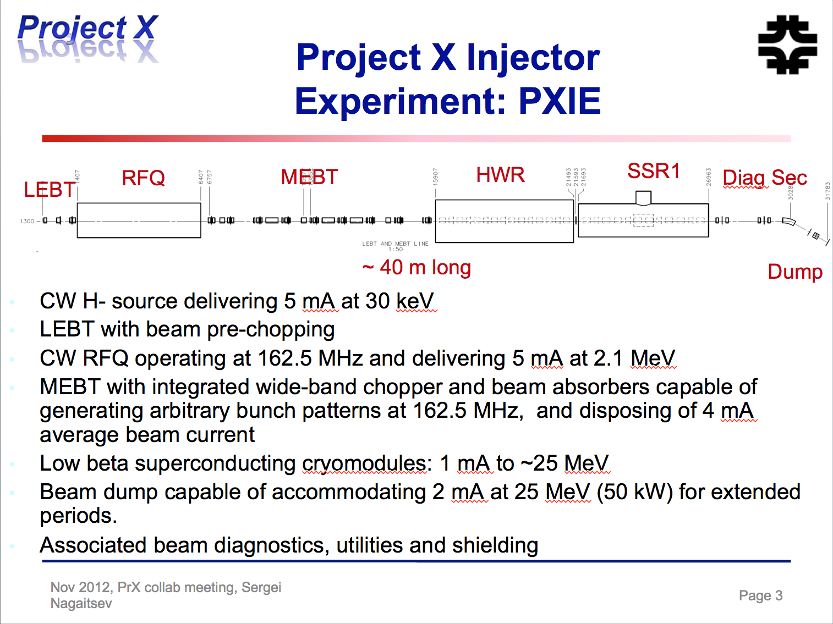
The Hardware Layout

Slide 4
PIP-II vs Project X
PIP-II as specified still points towards CW operation
  800 MeV superconducting pulsed linac, extendible to support >2 MW operations to LBNE and upgradable to continuous wave (CW) operations
Primary challenges from the CW capability:
  a CW RFQ
  bunch by bunch chopper in the MEBT
    flexibility in pulse train for experiments
  warm to cold transition near the MEBT dump
  low β, high power SRF acceleration
operation of SRF in both pulsed and CW modes
Notes:
build in CW and understand risks, do the R&D at PXIE
warm to cold: vacuum, losses and SRF

Slide 5
The Current Focus: being ready for the RFQ
Anticipate RFQ delivery in February 2015
  Goal to be prepared operate RFQ when it arrives
  Building the LEBT and support infrastructure
  Ion Source/LEBT : minimal beam characterization
    know the input beam to RFQ!
  Diagnostics and equipment downstream to characterize
Goal in FY15: to characterize the RFQ beam
Notes:
energy, energy spread, transverse emittance
beam measurements limited by available resources

Slide 6
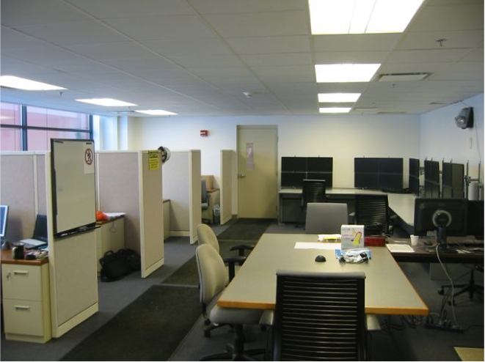
Infrastructure: Well underway
Water, power, and other utilities
Cave and shielding blocks
Shielding assessment for operation
Network and controls
Control Room at CMTF
Ready for a working accelerator!

Slide 7
Ion Source & LEBT
Have these elements installed as of 2 June
Lionel Prost will fill in the details next
Specifications:
  30 keV
  Emittance: < 0.25 mm mrad RMS
  5-10 mA beam current
Notes:
parts are being sent and will do assembly here

Slide 8
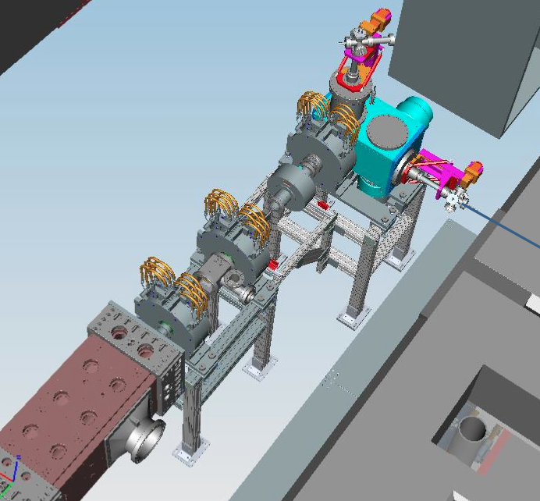
Ion Source & LEBT 3D Model
Solenoid
Ion Source
DCCT
Solenoid
Solenoid
RFQ

Slide 9
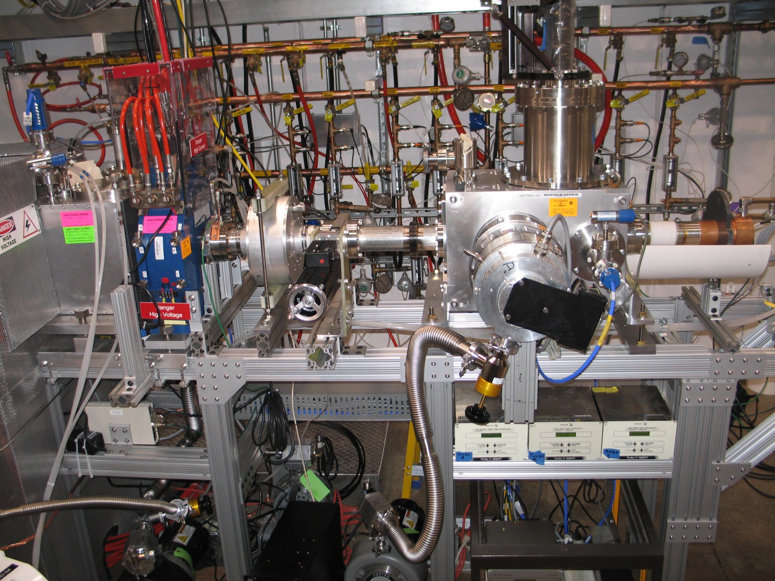
Current setup at CMTF
‘donut’ a.k.a. TID
Gate valve
Faraday Cup
DCCT
Turbo pump
Emittance scanner probe
(SNS)

Slide 10
Ion Source & LEBT
The entire line on track for RFQ installation
Need to demonstrate pulsed mode for RFQ commissioning
Specifications:
  30 keV
  Emittance: < 0.25 mm mrad RMS
  5-10 mA beam current

Slide 11
RFQ
LBNL making good progress:
  bead pull measurement on 2nd section
  getting ready to go out for brazing
  delivery anticipated in spring 2015
Derun will fill in on more details

Slide 12
RFQ Power Sources
Amplifiers and Circulators are at CMTF!
  Customs delay of a month
Detailed Testing Plan: DocDB 1293
  Amp and directional couplers to a fixed load
    Full power test to measure the amplifer performance with respect to specifications
  Circulators
  Testing to start ~ late June
  Should be ready for coupler tests in the fall
Ralph Pasquinelli
Notes:
most of infrastructure ready !!!!

Slide 13
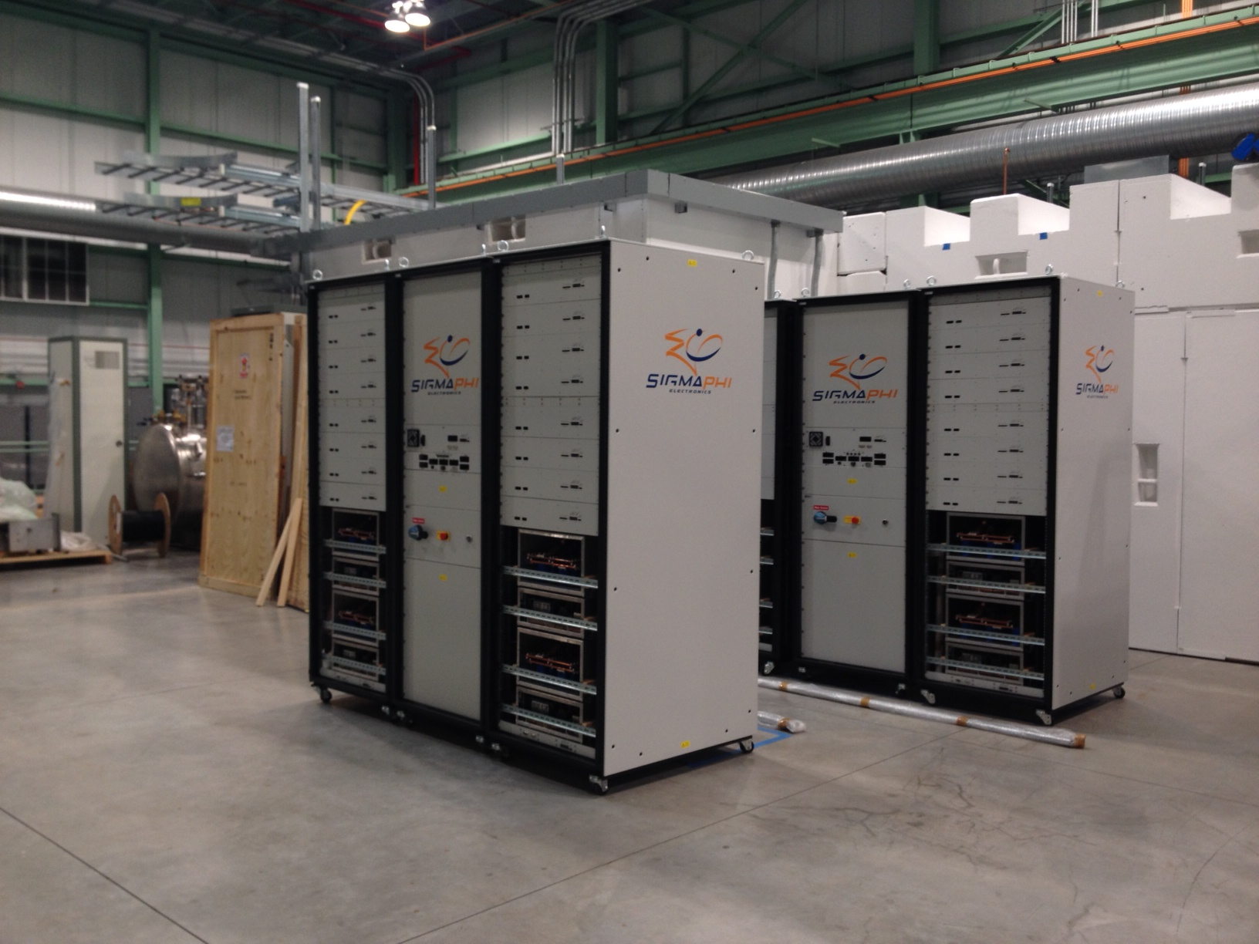
RFQ Power Sources
Amplifiers and Circulators are at CMTF!
  Customs delay of a month
Detailed Testing Plan: DocDB 1293
  Amp and directional couplers to a fixed load
    Full power test to measure the amplifer performance with respect to specifications
  Circulators
  Testing to start ~ late June
  Should be ready for coupler tests in the fall
Ralph Pasquinelli
Notes:
most of infrastructure ready !!!!

Slide 14
MEBT
FY15 goal: to characterize the beam coming out of the RFQ
  Energy (±1%)
  Longitudinal emittance: estimation with Faraday Cup (from SNS)
  Transverse emittance: estimation with quadrupole scan (quads and trims fabricated by our collaborators at BARC)
  test high average power operation mode
    either high current pulsed or low current CW
  prepare for more detailed measurements in 2016
  Making the best use of our resources
    no dedicated diagnostics
    use only those that are part of final MEBT
Notes:
resources, especially people, are limited so only making stuff plan on using later!

Slide 15
MEBT in FY15
driven by resource limitations, doing work that is directly related to RFQ beam characterization
RF commissioning of RFQ 10 kW (average) power
Estimation of beam emittances and energy
Hardware
  4 quad, 2 correctors fabricated at BARC – being prepared for shipping now!
  1 bunching cavity (FY14)
  BPMs prototyped in FY14
Test Section: available for diagnostic tests, absorber tests, specific measurements (e.g., Faraday cup)
Sasha Shemyakin will discuss in more detail
Bunching
Cavity
Toroid
BPM
BPM
RFQ
Quads
Trim
Quads
Trim
Notes:
Faraday cup originally from SNS, it was used here at HINS also
Sasha also investing this year on the kicker and hardware of the MEBT

Slide 16
SRF Systems
SC cryomodules operating at 2 K
  Solenoidal focusing
  Warm gap between cryomodules
  Fast vacuum valves at both sides of the cryomodules
2 Systems: 1 CM apiece for PXIE
  Half Wave Resonator (β_{G}=0.11) at 162.5 MHz
  SSR1 (β_{G}=0.22) at 325 MHz

Slide 17
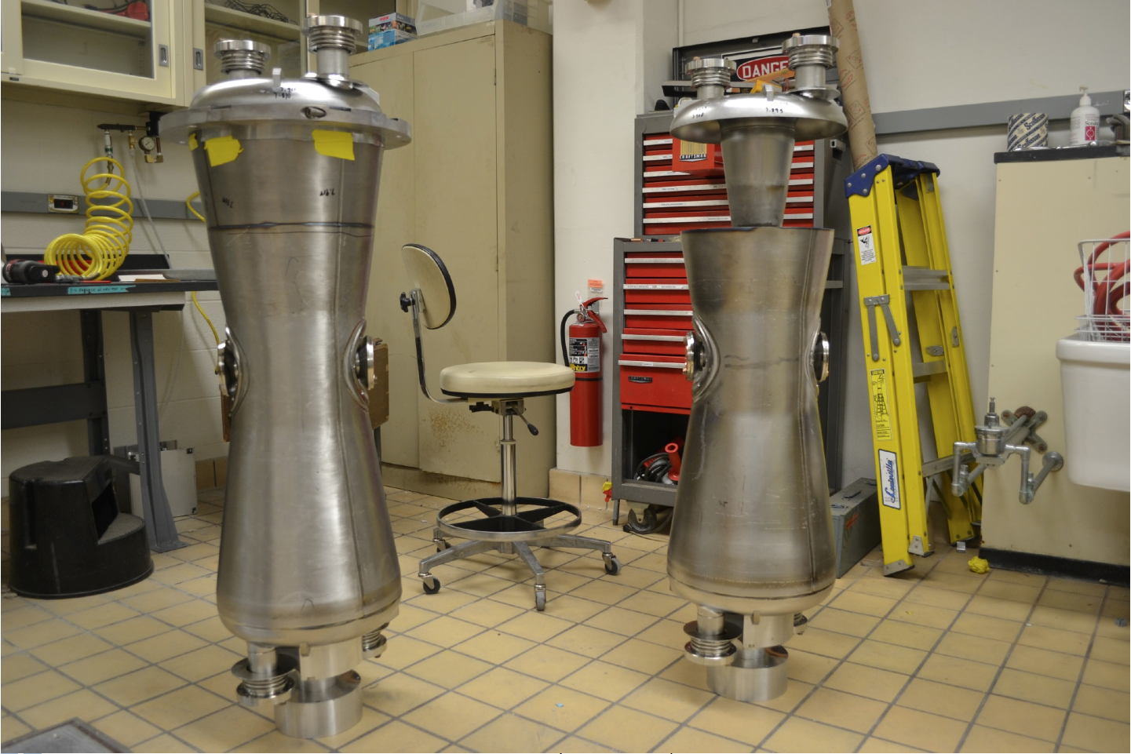
SRF Systems
HWR Cryomodule: β_{G}=0.11
  2.1 MeV -> 11 MeV
  8 cavities, 8 SC solenoids (x,y correctors) and 8 BPMs
  Argonne design
    Prototype cavities and couplers have been fabricated
  Peter Ostroumov will discuss in more detail
Prototype cavities Dec 2013

Slide 18
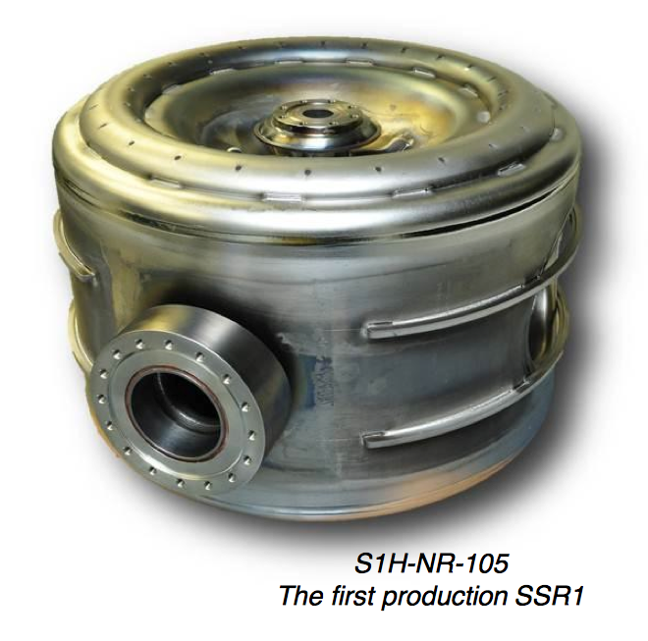
SRF Systems
SSR1 Cryomodule: (β_{G}=0.22)
  11 MeV -> 25 MeV
  8 cavities, 4 SC solenoids (x,y correctors) and 4 BPMs
  Have production cavities
  Test bed
    to learn how to compensate Lorentz Force Detuning for pulsed operation in PIP-II

Slide 19
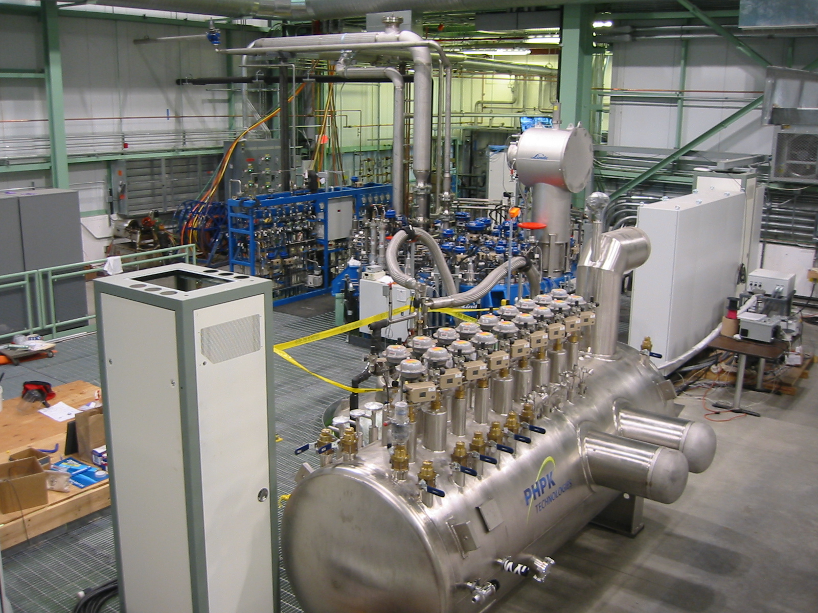
Cryogenic Plant
Superfluid cryoplant is fully operational
Cryomodule Test Stand ready - Q1 FY16 (LCLS-II)
PXIE cryogenic system is in design phase

Slide 20
Summary
Short Term Goal: ready for RFQ spring 2015
  Infrastructure being put in place
  Ion Source and LEBT installation ongoing
  RF Power amplifiers and couplers will be in place
  MEBT hardware to characterize RFQ being prepared
  working with available funding to keep these on schedule
Long Term Goals
  2016: Beam delivered to the end of MEBT with nearly final parameters (2.1 MeV, 1 mA CW, 80% arbitrary chopping)
  2018: 1-mA CW beam 25 MeV beam delivered to the dump

