Slide 1

RFQ Status
Derun Li
Lawrence Berkeley National Laboratory
PIP-II Collaboration Meeting
June 3, 2014 at Fermilab

Slide 2
Outline
Overview of the PXIE RFQ Design
  Specifications
    162.5 MHz Normal-conducting CW four-vane RFQ
    30 keV H⁻ beam at 5-mA (injection) and 2.1 MeV output energy
Current status and schedule
  RFQ and accessory components fabrication
  RFQ measurement and tuning
    Low power RF measurement of Module 2
  Delivery of the RFQ to Fermilab early Q3-FY2015
Summary

Slide 3
Beam Dynamics Specifications
Parameters | PXIE | Unit
Ion Type | H-
Output Energy | 2.1 | MeV
Duty factor | 100 | %
Frequency | 162.5 | MHz
Beam current | 5 (nominal); 1-10 | mA
Transverse Emittance | < 0.25 (norm. rms) | πmm-mrad
Longitudinal Emittance | 0.8-1.0 | keV-nsec
Input energy | 30 | kV
Emittance Growth | 10 | %
Transmission | 95 | %
TWISS Parameter αs (transverse) | α_{T} < 0.2; α_{z} < 0.1
Very robust beam dynamics design; meets/exceeds the specifications

Slide 4
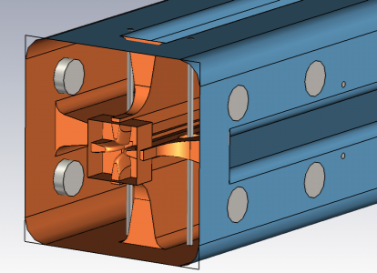
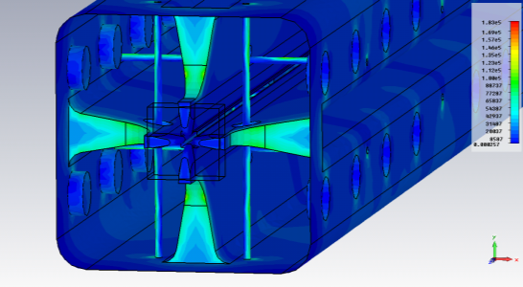
RF Design of the RFQ
3D model includes:
Pi-mode stabilization rods
Radial matcher and two
terminations at the RFQ ends
Tuners
Simulation results verified by LBNL using ANASYS and ACE3p
Parameters | PXIE | Units
Frequency | 162.493 | MHz
Frequency of dipole mode | 181.99 | MHz
Q factor | 14660
Q factor drop due to everything | -14.7 | %
Power loss per cut-back (In/Out) | 336/392 | watts
Max power loss density at cut-back | 7.9 | W/cm²
Total power loss | 74.6 | kW
H (1/2 of the inner width of the RFQ) | 172.73 | mm

Slide 5
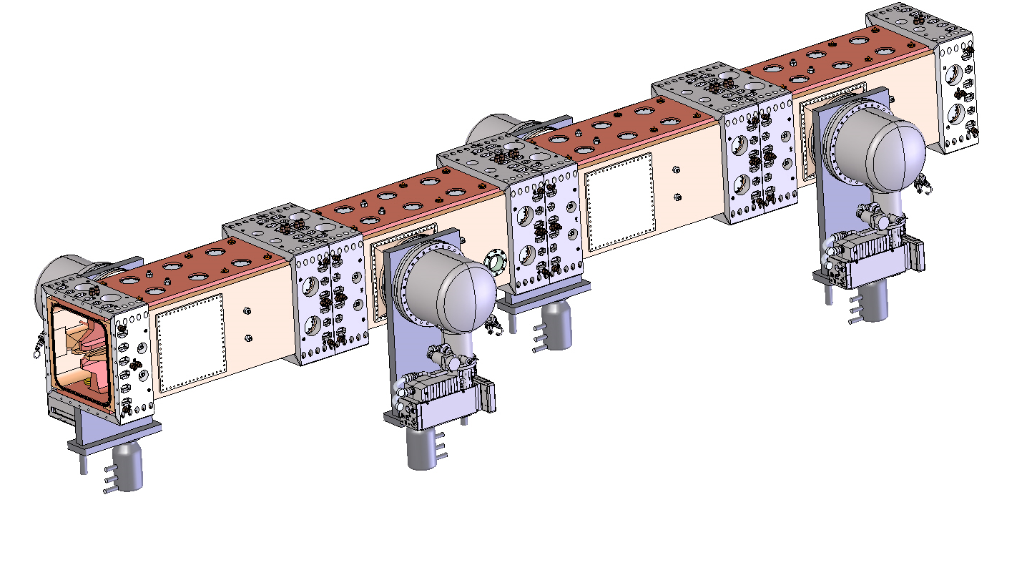
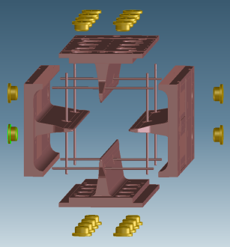
Mechanical and Structure Design
Summary of the PXIE RFQ structure design:
  RFQ: 4.45 meters long consists of four modules;
  32 Pi-mode stabilization rods;
  2 RF power couplers;
  80 slug-tuners (20 per module);
  48 RF probes.
Use proven, low risk techniques and experiences from the SNS RFQ design
  Four vane copper-to-copper braze
  Fly cut modulated vane tips
  Brazed, water cooled pi-mode rods
  Low profile, bolted module joints
  Removable fixed slug tuners
+ Fabrication tests to validate techniques

Slide 6
RFQ Fabrication and Accessory Components
Fabrication of the RFQ and accessory components
  RFQ fabrication started Q4-FY2013
    Four modules: 16 vanes
  20 temporary tuner design & fabrication complete & tested
  Sensing loop design complete (ready for PO)
  2 temporary cut-backs and end-plates fabricated & tested
  Water cooling circuit design complete
  RF power coupler design complete and fabrication in progress
    Prototype and high power testing this summer
  RFQ support structure design complete
  Lifting and assembly fixtures designed/approved/fabricated
First RF measurements of Module #2 complete
Braze of Module #2 mid-June 2014
Transit analysis started and will continue

Slide 7
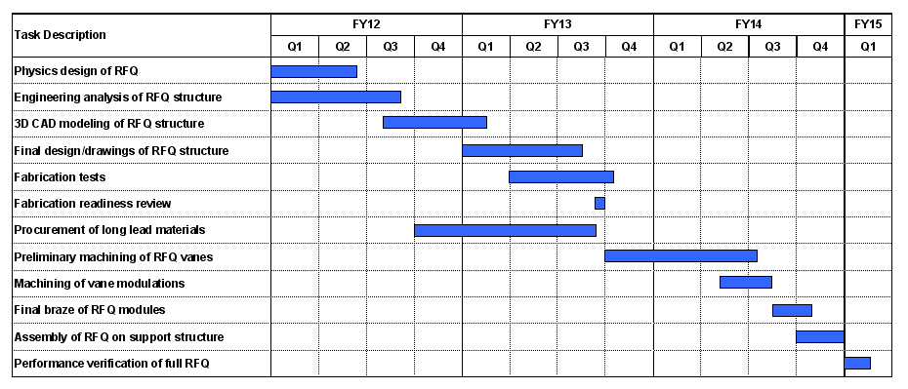
Production RFQ Status & Schedule
Production RFQ started Q4-FY13 after fabrication readiness Review
Fabrication progressing well and on schedule
Schedule presented at PXIE RFQ fabrication readiness review (June 26-27, 2013)

Slide 8
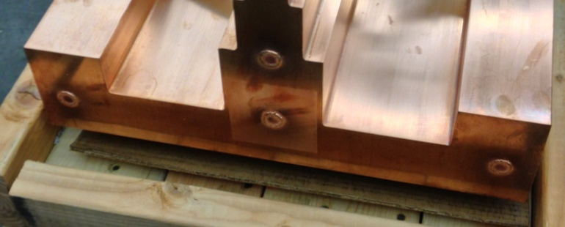
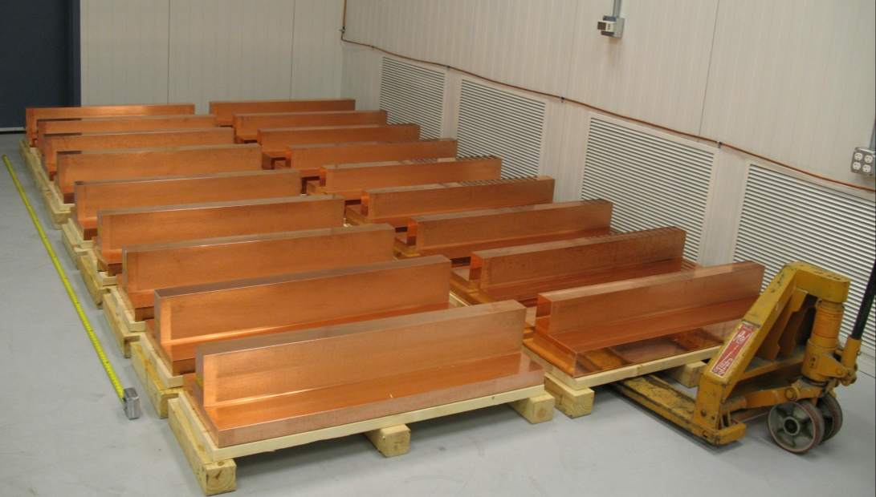
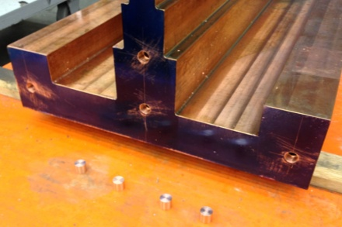
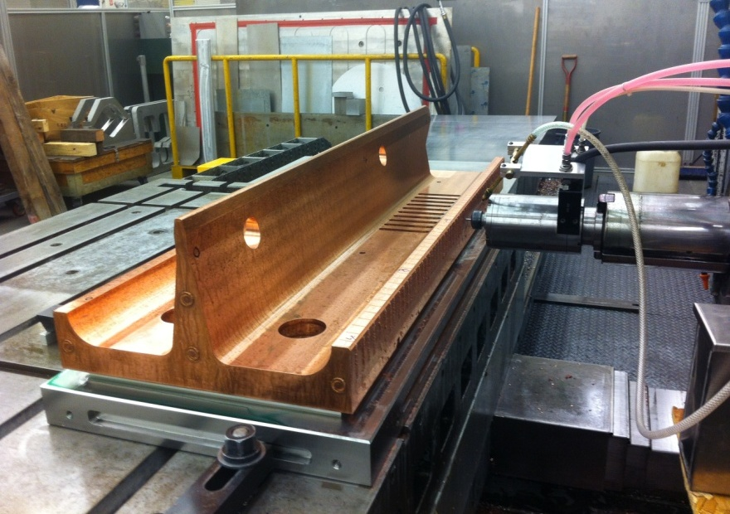
Major Fabrication Steps
Gun-drill of water cooling channels & e-beam welding
  Flow and leak check
Rough machining of vane profile
  CMM measurement
Final vane machining
  Vane modulation and wire grooves
  CMM measurement
Gun-drill and plug (e-beam)
welding (outside vendor)
Production copper for 18 vanes (2 spares)

Slide 9
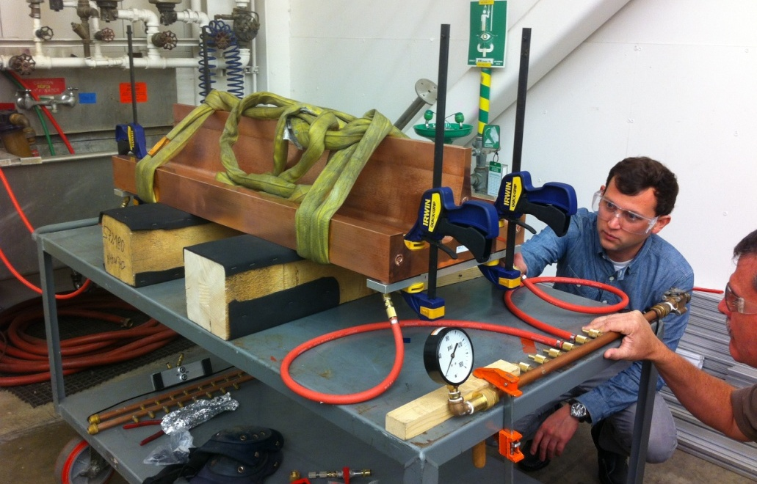
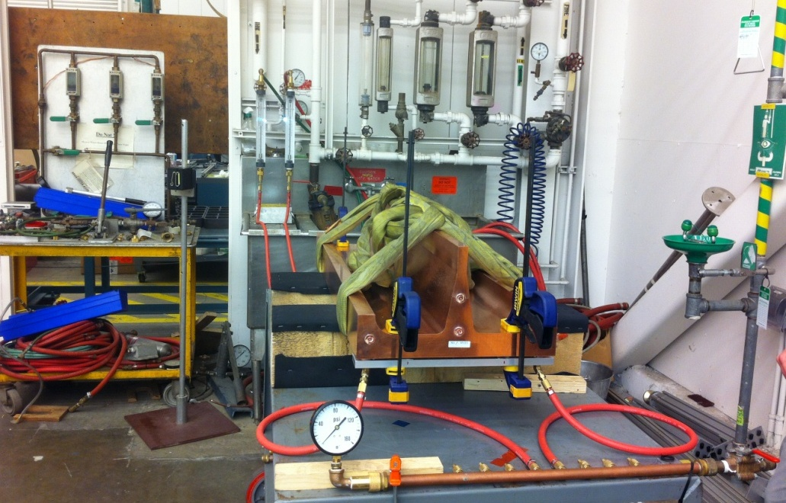
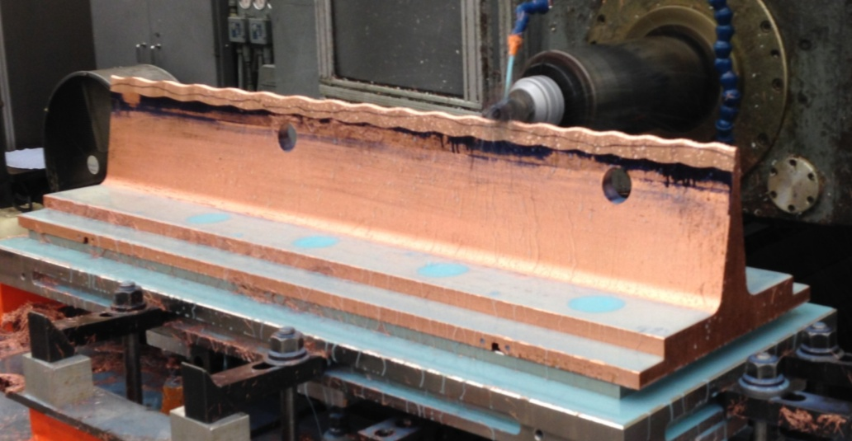
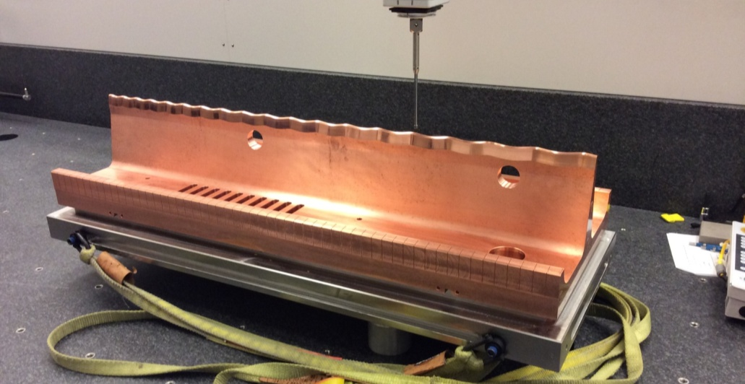
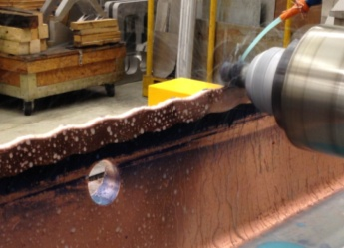
RFQ Fabrication Progress
Flow check
apparatus
Flow check
Modulation cut
CMM measurement

Slide 10
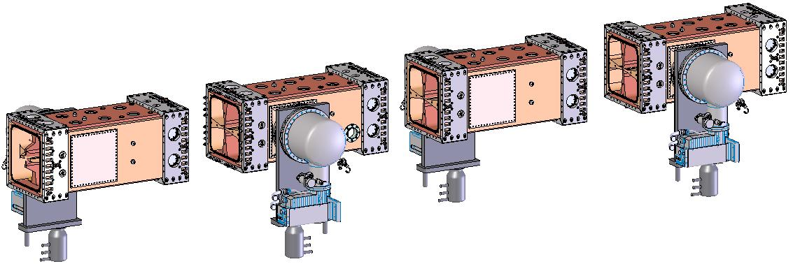
Fabrication of Module #2
M2 fabricated first to validate fabrication precision & RF design
Module #2 and #3 forms the major part of the RFQ waveguide
  No radial matcher and exit section
  Need temporary cutbacks to form an RFQ cavity for RF measurements
The RFQ cavity field distribution needs to be tuned flat to measure the waveguide frequency
  Need 20 temporary tuners per module
Beam-pull apparatus (Fermilab)
Module 2
Module 1
Module 4
Module 3

Slide 11
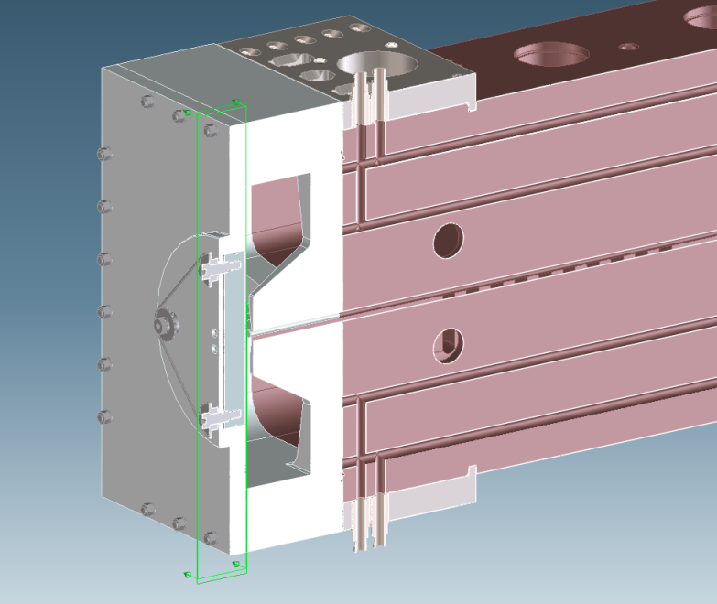
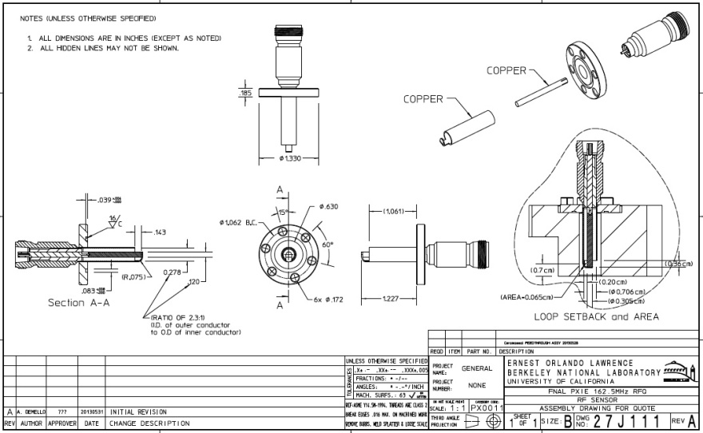
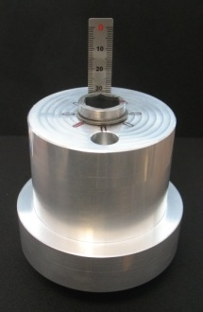
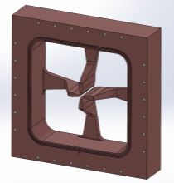
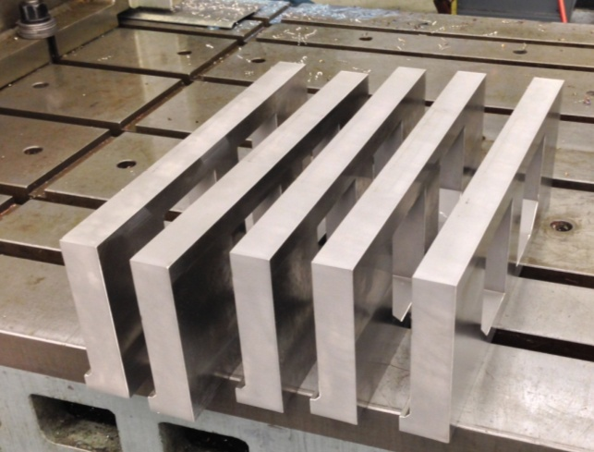
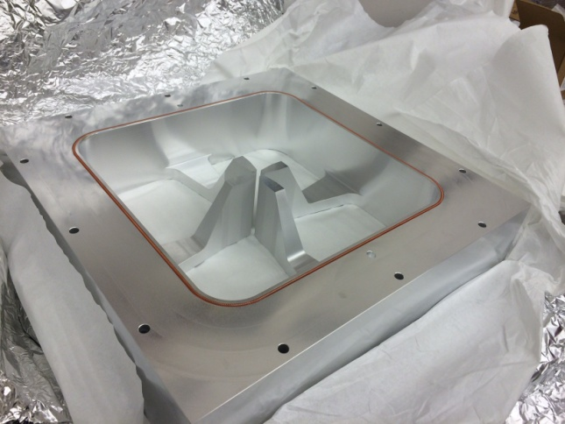
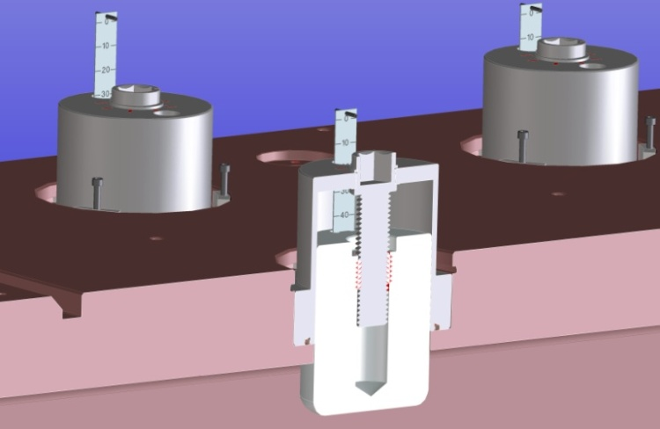
Accessory Components
Sensing loop
(ready for PO)
Movable end-plate
Joint plates

Slide 12
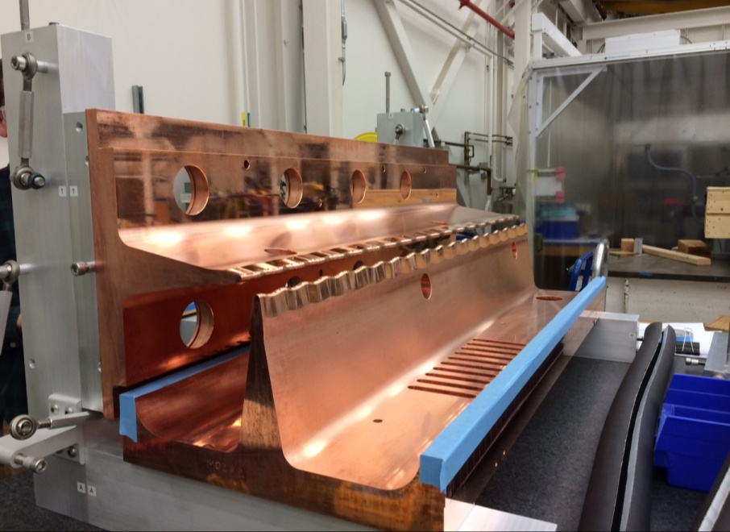
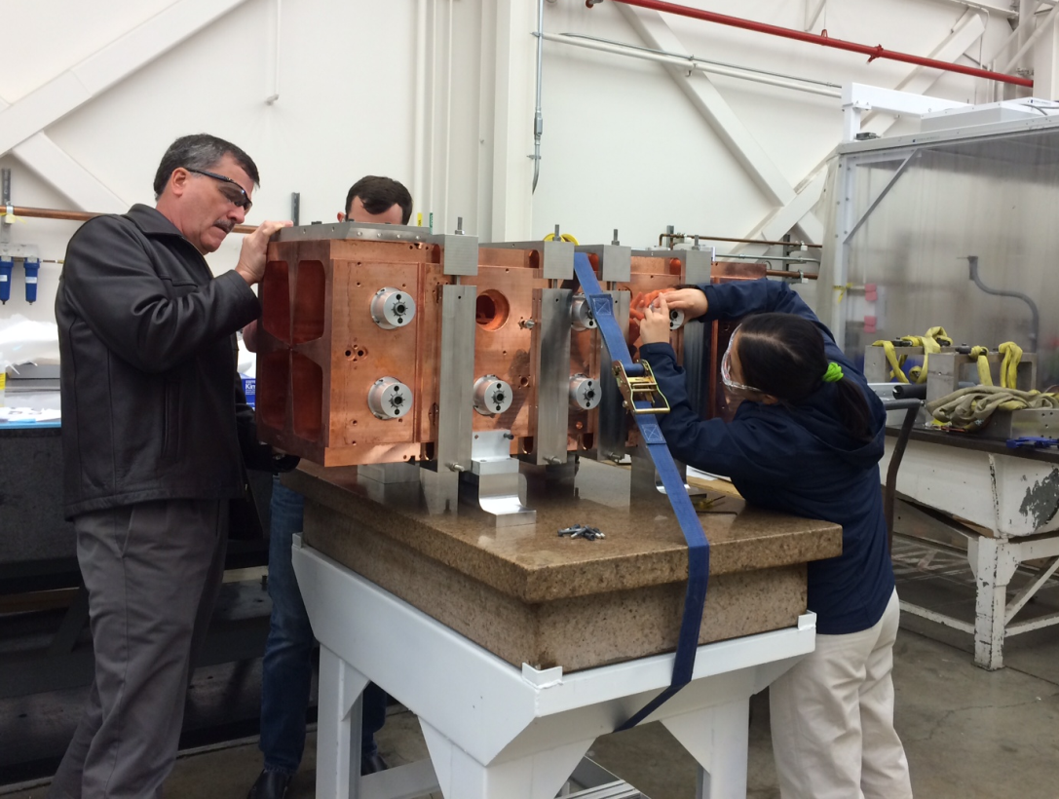
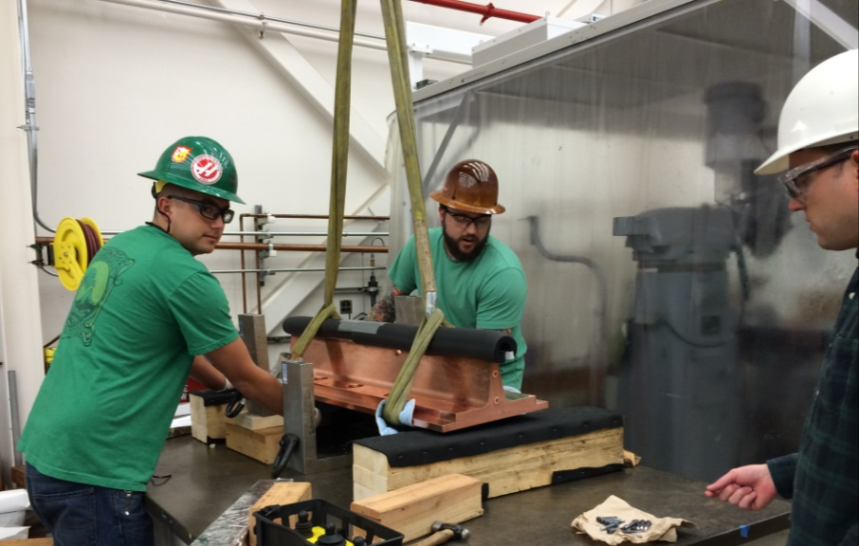
RF Measurement/Tuning: M2 Assembly
April 1, 2014
Vanes to module;
Module clamps;
Joint plates, tuners, pi-mod rods, temporary cut-backs, end-plates, RF probes on bead-pull table
Vertical vane
Horizontal vane
Assembly stand
Bead-pull stand/table
April 3, 2014

Slide 13
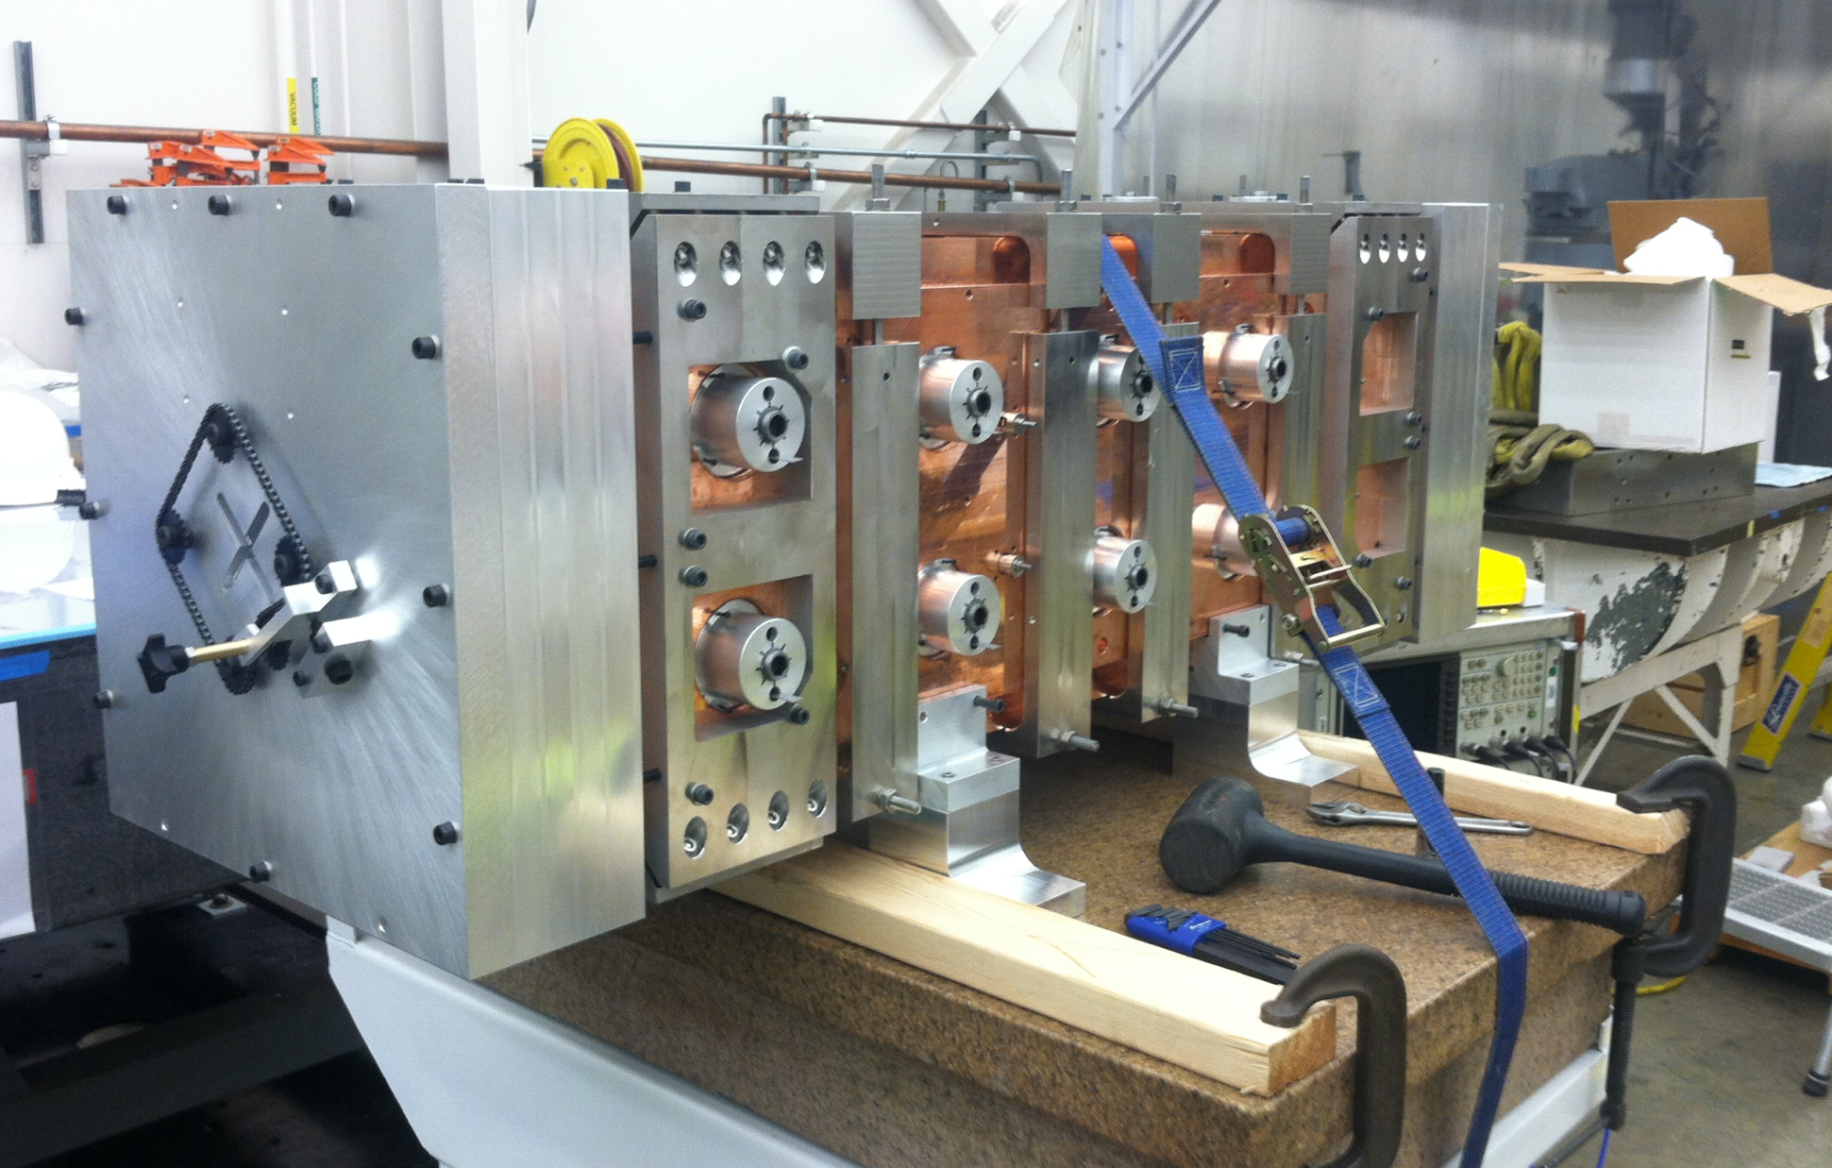
RF Measurement/Tuning: M2 Assembly
April 4, 2014
Assembly complete and ready for RF measurement !

Slide 14
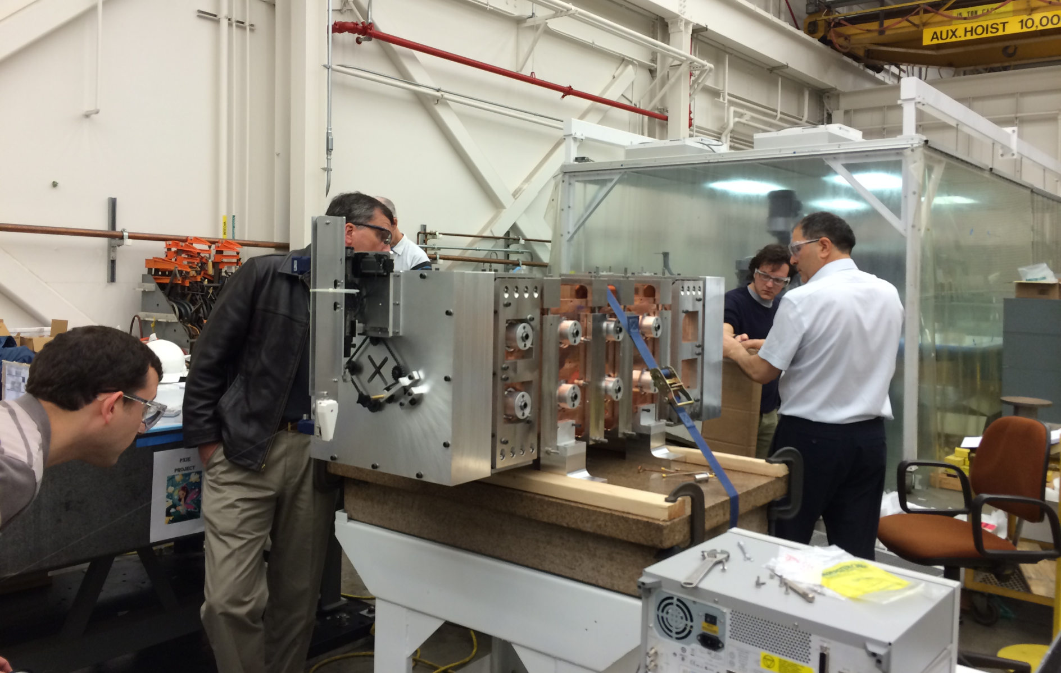
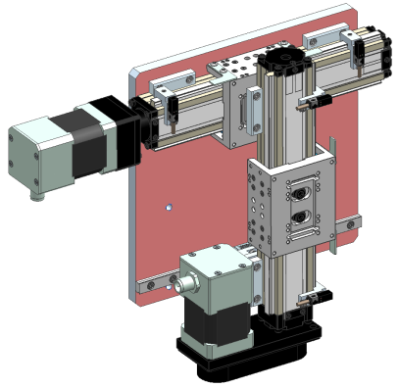
Bead-Pull Apparatus Setup
April 9, 2014 (Wednesday)

Slide 15
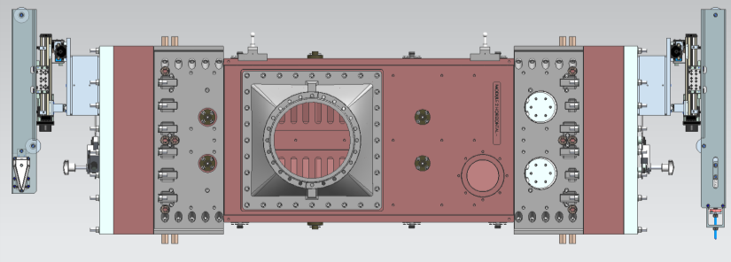
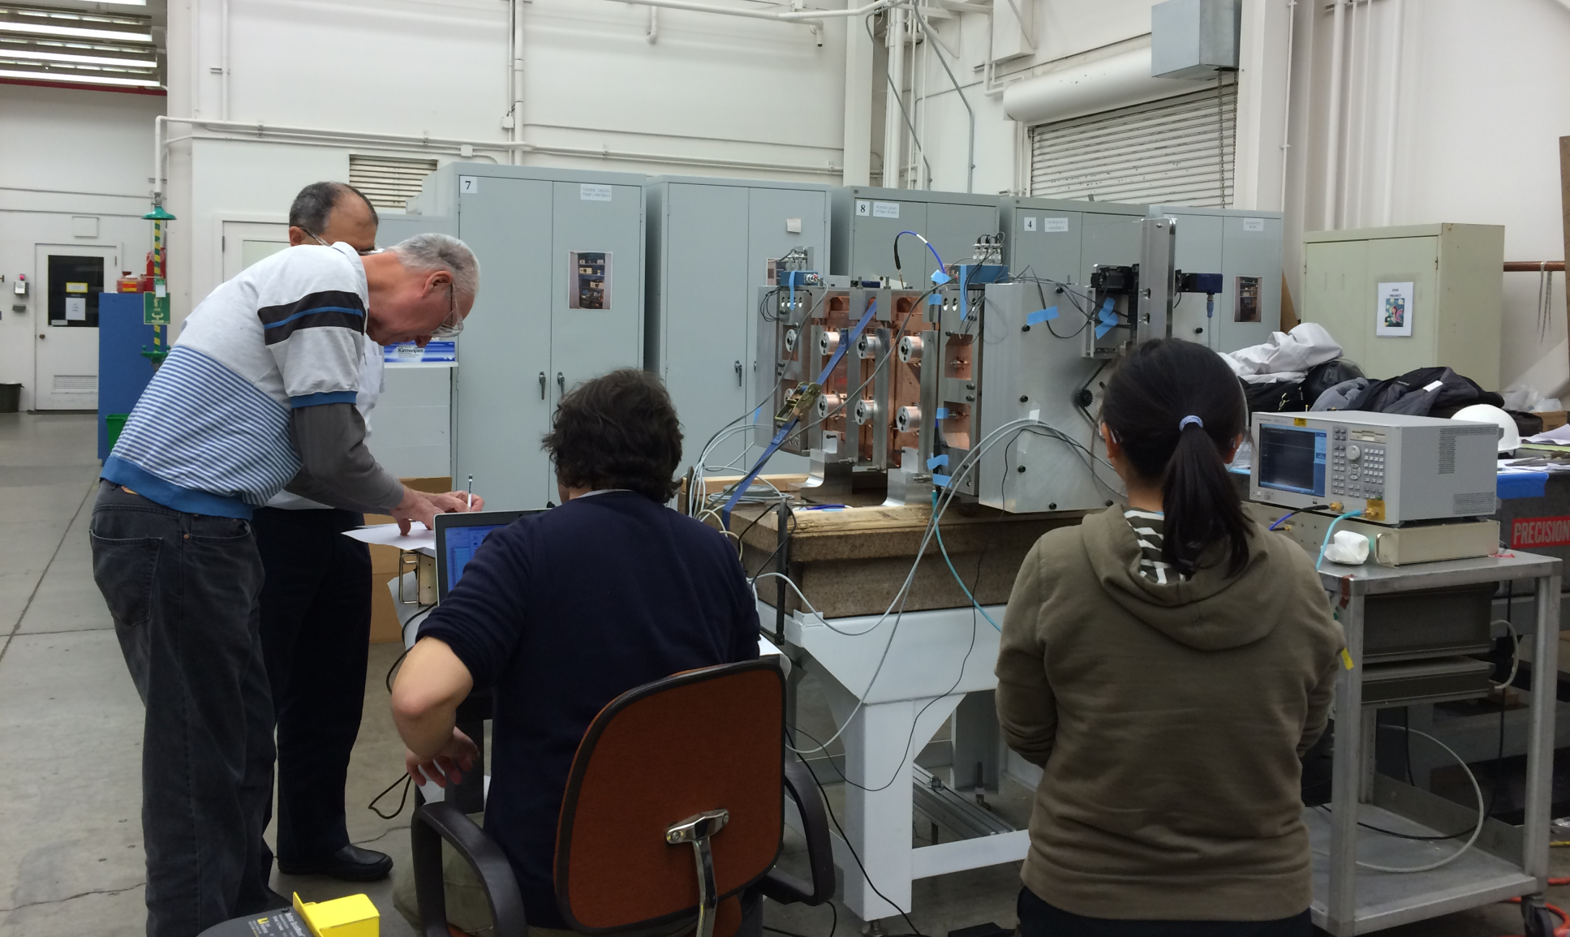
Bead-Pull Measurements
April 9, 2014 at LBNL

Slide 16
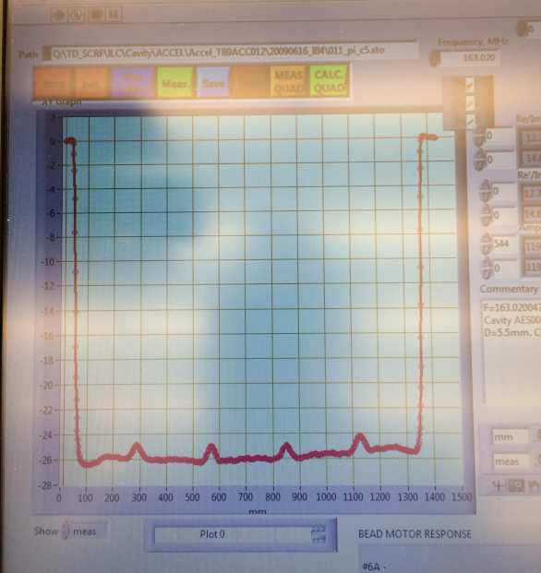
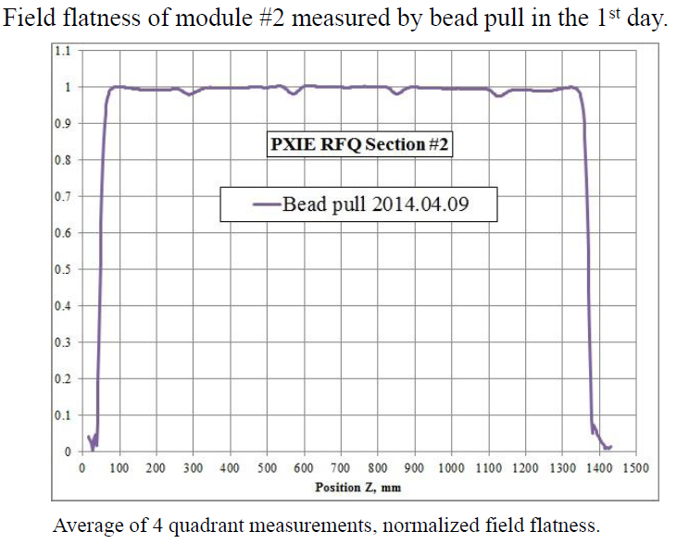
Measurement Results
Snap shot of
1st PB measurement
Measured M2 resonant frequency: 163.02 MHz and Q ∼ 7000 with 20 mm intrusion of all 20 tuners,
10 mm gap in both ends
Δf = 162 kHz
(measured – simulation)
Agree well with simulations
Measurements conducted at 30 mm
(45 degrees) away from center

Slide 17
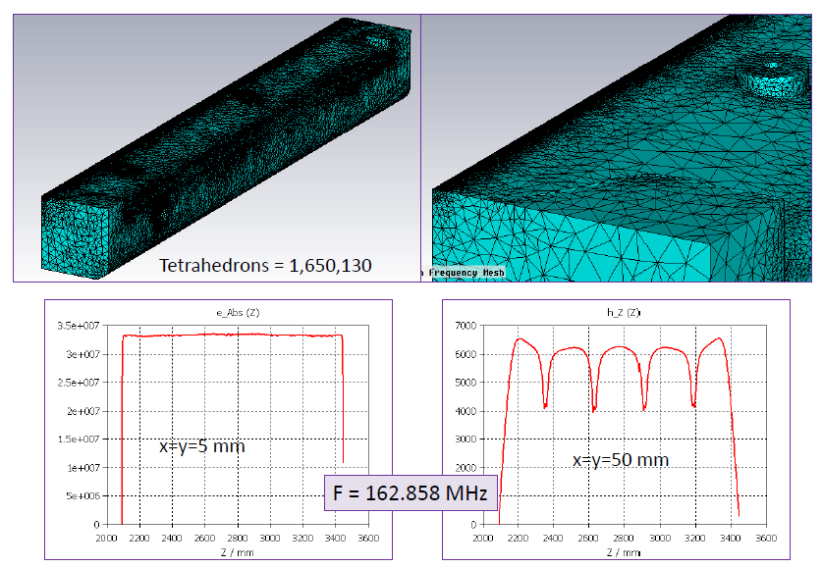
RF Simulation Results of Module 2 with the Same Configuration as Measured

Slide 18
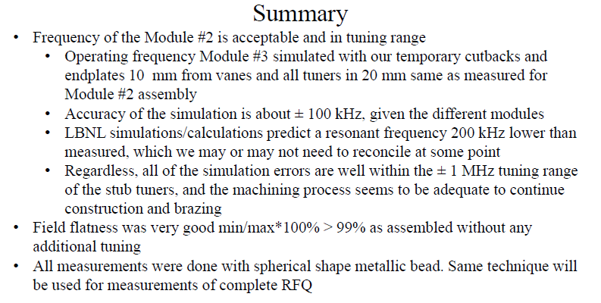
Summary of Bead-Pull Measurements
Assembly fixtures and procedure, bead-pull apparatus and software worked very well → very successful and productive collaboration!
Measurement results agree well with simulation predictions
Fabrication continues as planned and BP apparatus ready for final tuning
From T. Khabiboulline’s
presentation on 4/25/2014

Slide 19
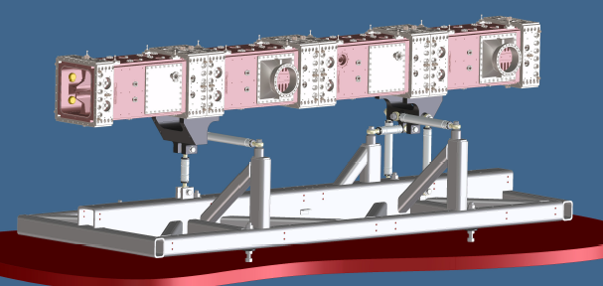
RFQ Support Structure and Cooling
RFQ support structure design complete
  Should schedule a fabrication readiness
  review very soon
Water cooling circuits design complete
  Cooling circuit for modules
  Cooling circuit for pi-rods
PXIE RFQ support design

Slide 20
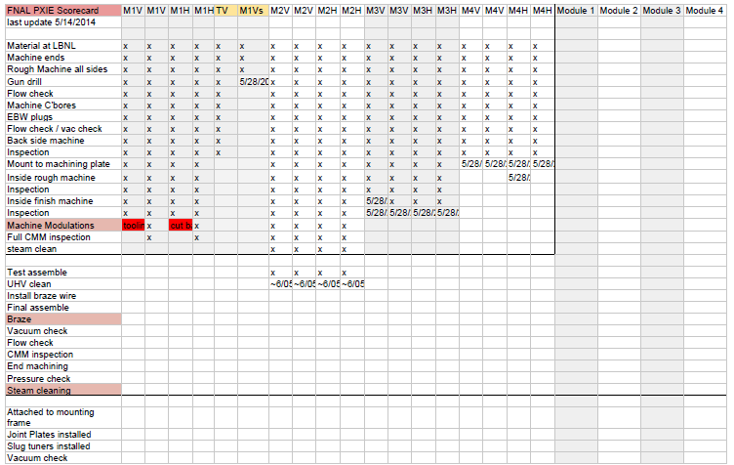
RFQ Fabrication Scoreboard
Updated on May 28, 2014

Slide 21
Summary
PXIE RFQ fabrication progressing well
  Module #2 complete
  Braze of Module #2 in mid-June 2014
    New retort base for the furnace at Bodycote complete
  Module fabrication sequence: M2, M3 (M1), M1 (M3) and M4
  Accessory components design and fabrication nearly complete
Bead-pull RF measurement
  Module #2 measurement in early April 2014
    Good agreement between measurement and simulation
    BP apparatus and software work very well
  Final tuning with whole RFQ
Schedule
  Completion of the RFQ fabrication and accessory components Q1 FY15
  RF power coupler testing Q3 FY14
  Assembly and tuning Q2 FY15
  Delivery of the RFQ to Fermilab early Q3 FY15

