Slide 1

Overview of Booster PIP II upgrades and plans
C.Y. Tan
for Proton Source group
PIP II Collaboration Meeting
03 June 2014

Slide 2
PIP II Booster parameters
50% higher flux than the planned PIP operations which is expected to double present flux level. (4.3e12 protons @15 Hz at the end of PIP I)
30% decrease in space charge tune shift @ 800 MeV.
Longitudinal emittance determined by Recycler slip stacking requirements.

Slide 3
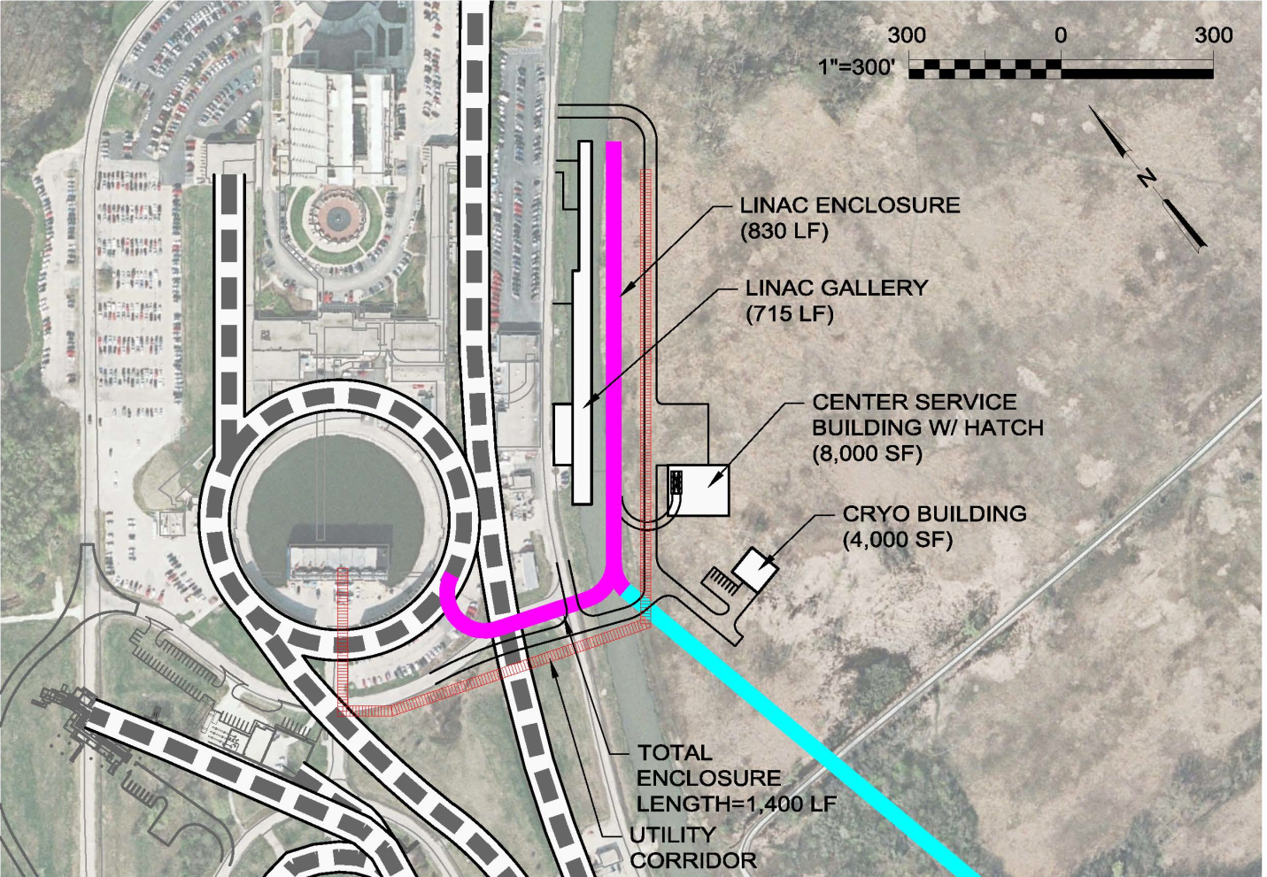
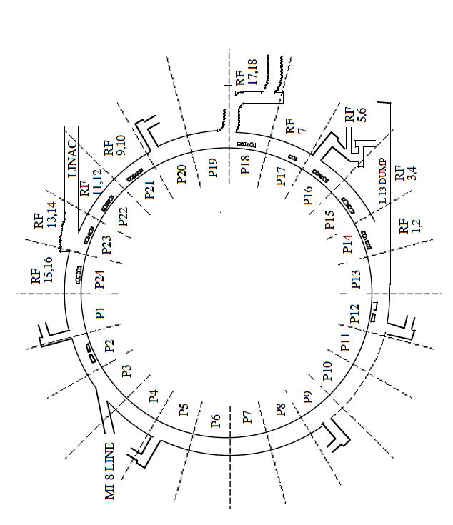
New injection point into Booster
New injection point at L11.
Old injection point at L1

Slide 4
Overview of required R&D
  New injection point at L11.
    New injection girder.
    Space charge mitigation: painting.
    New stripping foil.
    H⁰ , H- absorber
  RF capture
    capture scheme: paraphasing or direct injection into buckets
    2nd harmonic cavities (considered but probably unnecessary).
  Transition crossing
    RF focusing method.
    RF focus free method (flattening of RF amplitude)
      2nd or 3rd harmonic cavities. (can also be used in RF focusing method)
    γt jump system
      requires resurrection/rebuild of old system.

Slide 5
Overview (cont’d)
Damper upgrades and collimation system
    longitudinal quadrupole damping when going through transition.
      Will require voltage overhead in RF system
    longitudinal coupled bunch mode damping at high field.
      Will require an increase in RF power
    Transverse dampers for coupled bunch modes.
      Higher intensity may require more power for kickers.
    Evaluation of present collimation system w.r.t. expected PIP II loss
Beam quality at extraction
  emittances determined by Recycler admittances.
    18 π mm mrad (6 σ normalized)
    0.08 eV s (97%)

Slide 6
New injection girder
Beam can enter either horizontally or vertically.
A new 3 bump system that can take 800 MeV beam (2x stronger)
Beam painting to mitigate space charge effects because of longer injection time (0.6 ms)
Carbon foil for stripping (15 turns vs 315 turns)
  Lifetime effects.
New beam absorber for H⁰ and H⁻
  Build inside a gradient magnet.
  Design new stronger and shorter gradient magnets to make space for an absorber. (Preferred)

Slide 7
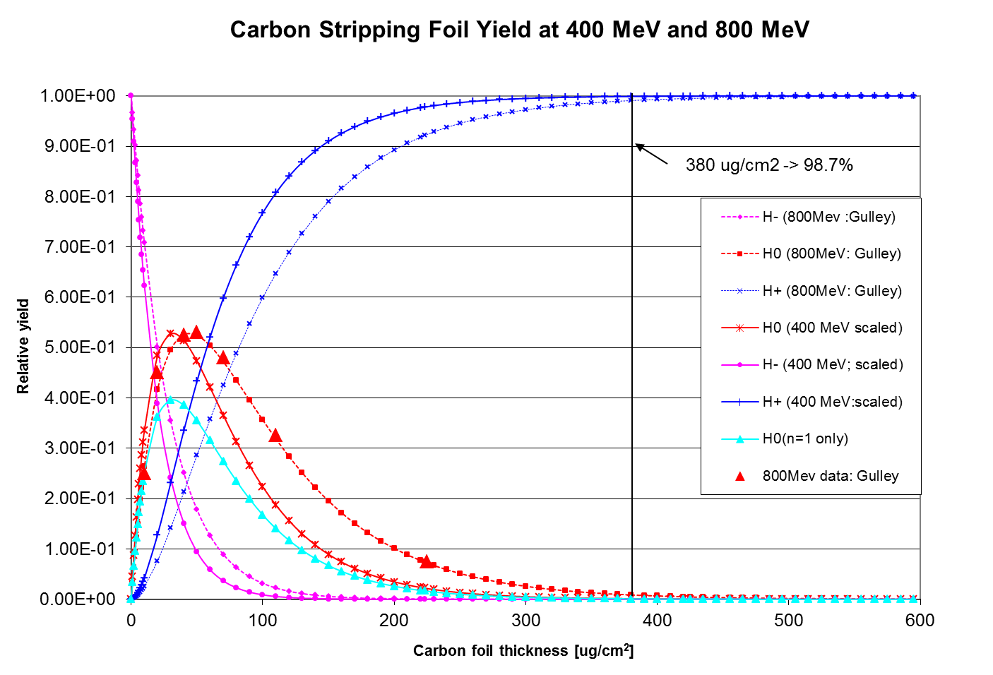
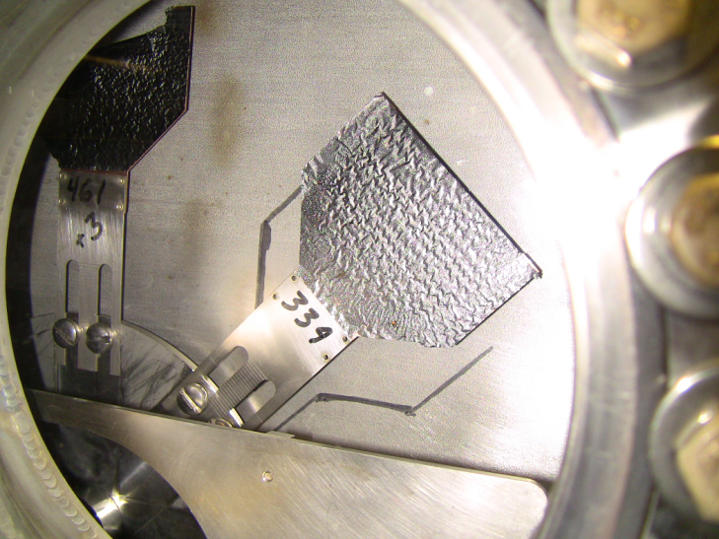
Foil
For a std. foil thickness 380 μg/cm² (1.15 μm)
400 MeV -> 99.9% efficiency to protons
800 MeV -> 99.1% efficiency to protons
To match 400 MeV efficiency at 800 MeV foil thickness needs to increase to ~545 μg/cm²
current foil holder
current foil
At 800 MeV with 7E12 injected at 15 Hz
Injection power increases to ~ 13 kW.
For a 2% loss -> 260 Watts on downstream gradient magnet.
-> Need to provide injection absorber

Slide 8
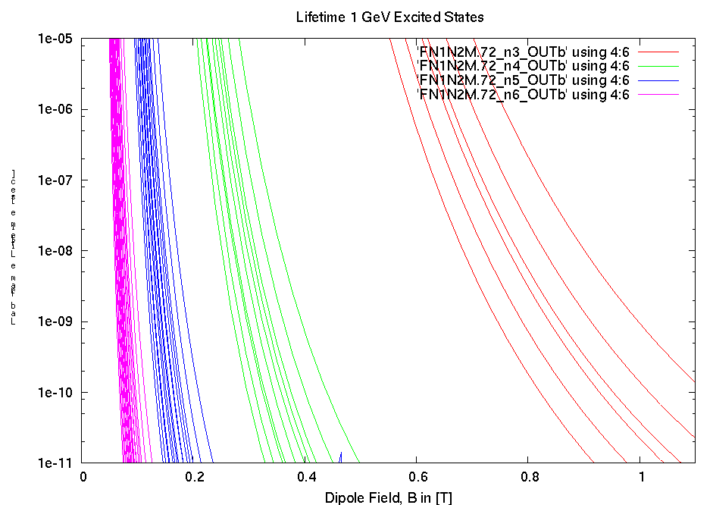
Stripping efficiencies at 800 MeV
Field in 4th chicane
Strip immediately
stable

Slide 9
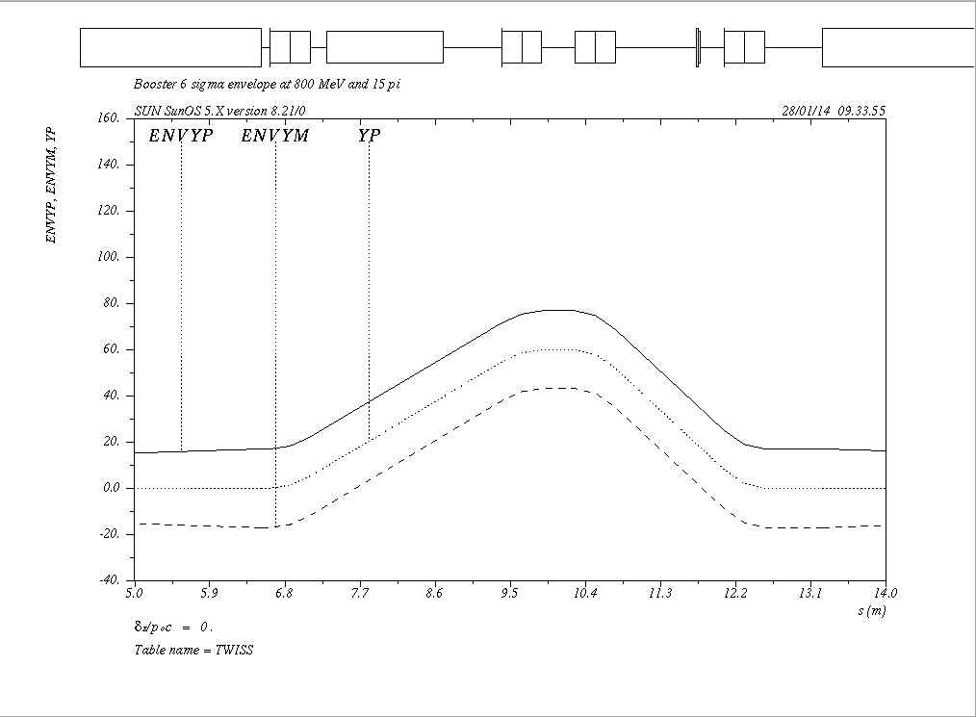
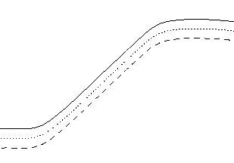
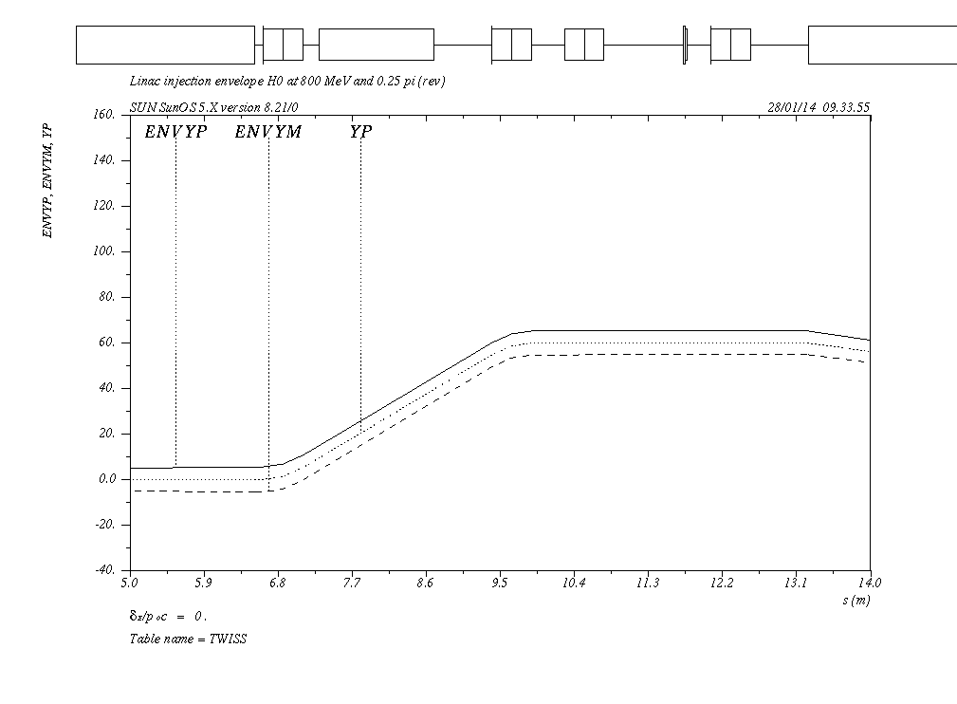
Vertical Injection Concept
1
sep
2
3
foil
4
ORB 1-2: 22 mr
ORB 3-4: 33 mr
DC sep: 78 mr
H-
H-
H0
aperture

Slide 10
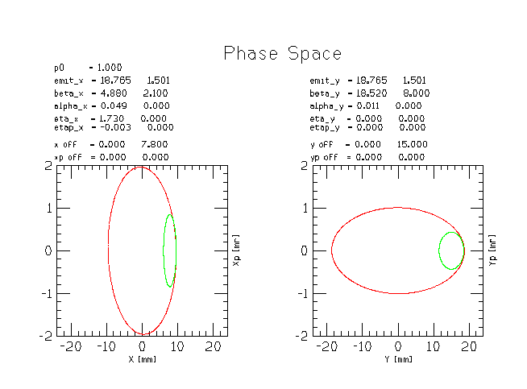
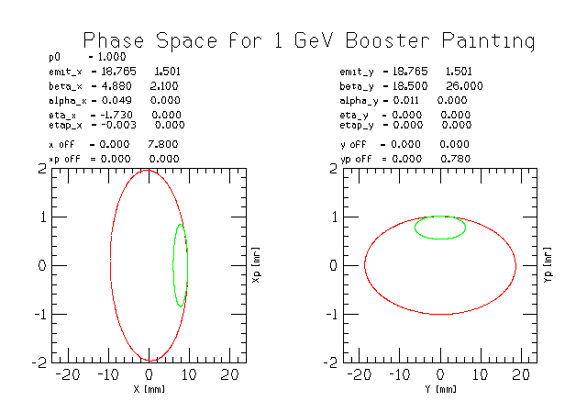
Injection painting for space charge mitigation
Green: injected beam.
Red: phase space after painting.
Beam line matching conditions for two painting scenarios. Left paint in both planes in the ring (SNS) and right paint horizontal in ring and steer (angle mismatch) from beam line (JPARC).
Note: ellipses were calculated for 1GeV injection.

Slide 11
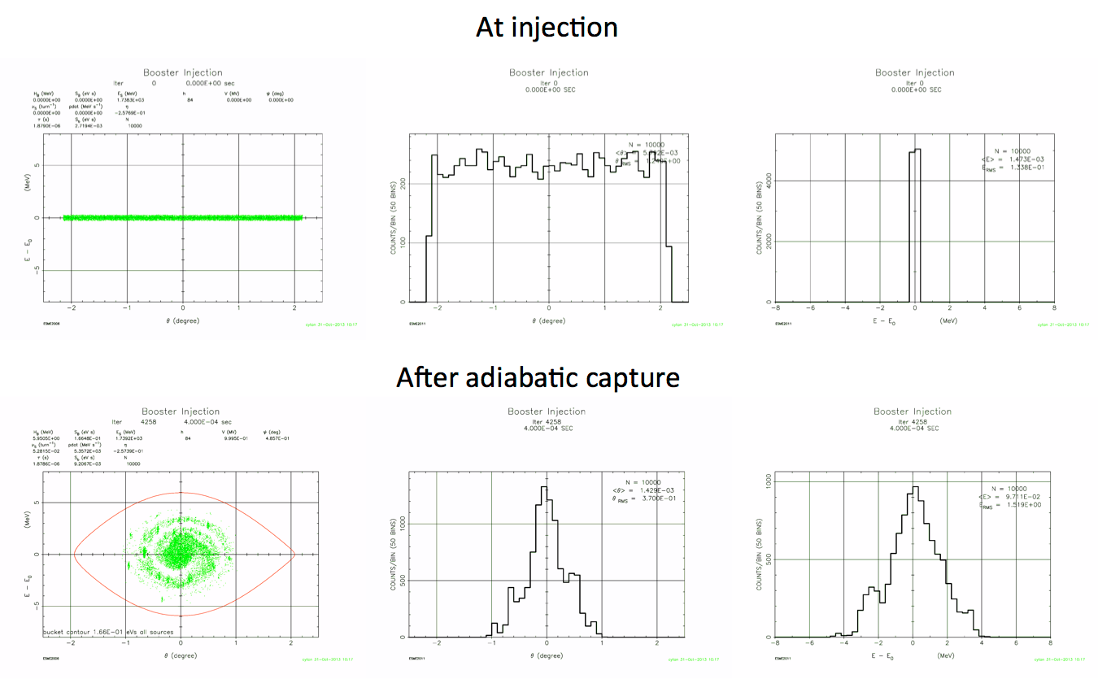
Capture (adiabatic at 800 MeV)
0.6 ms injection time.
0.4 ms adiabatic ramp to full voltage (1 MV)

Slide 12
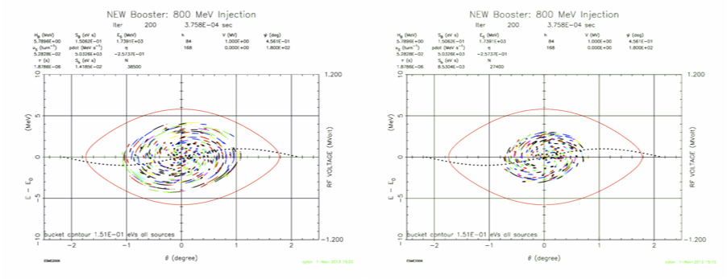
Capture (bucket to bucket injection)
Chopping 180 deg
Chopping 120 deg
0.6 ms injection time.
Chopping is required to get the correct bunch pattern into the bucket.
2 mA for 0.6 ms gives 7.5e12 particles.
May need flattened front porch for injection

Slide 13
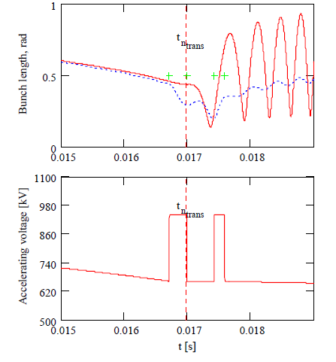
Transition crossing
Transition crossing at 4.2 GeV
More RF for focusing during transition.
~25% more RF implies 3 – 4 more RF cavities using present design. (22 – 23 cavities)
Example shown here is the compensation of the effect of space charge that is defocusing before transition & focusing after transition.
Increase RF voltage before transition
Increase RF voltage again to damp out quadrupole oscillation.

Slide 14
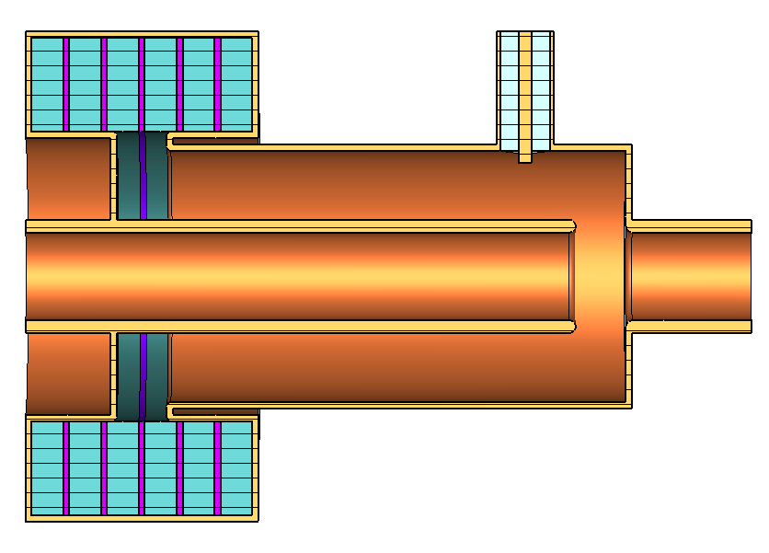
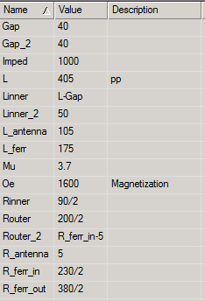
Perpendicular biased cavities
Simulations of use at injection for PIP I and possible use as main RF cavity is underway.
Units in mm
195
Ferrite
200
70
390
220
40
BeO
490
Designed by G. Romanov
Example here: 2nd harmonic cavity

Slide 15
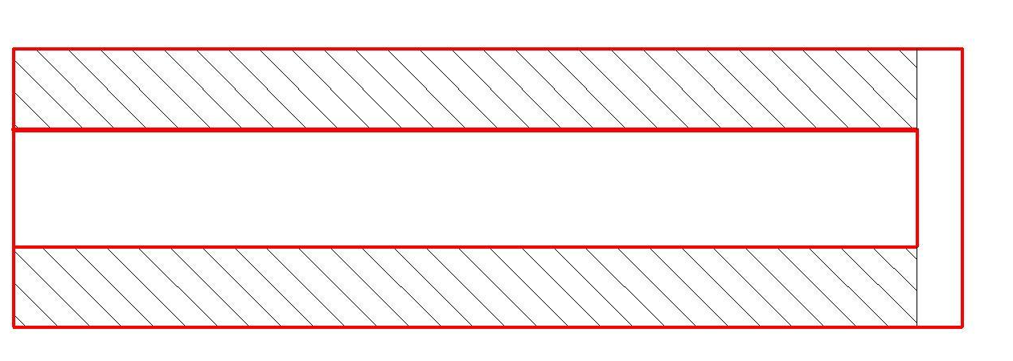
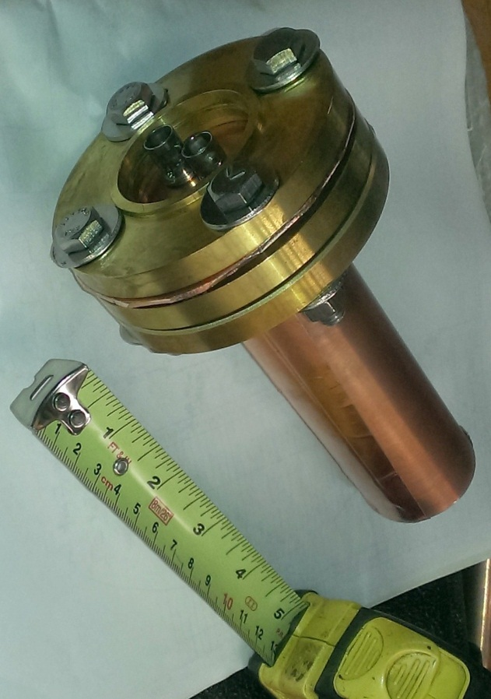
What was done recently
Measured μ and Q (tan δ) resonantly with a 1.5” OD sample of AL400: measure f_{res}, then with c = f λ
L = 5”
λ/4 = L * √(με)
center conductor
1.5”
short
outer conductor
AL400
Work done by D. Wildman and R. Madrak

Slide 16
Old (S11) and New(Resonant) Measurements
Work done by D. Wildman and R. Madrak

Slide 17
Dampers
Longitudinal coupled bunch and quadrupole mode dampers
  More RF volts is required whatever scheme is chosen.
    E.g. Increase the number of RF cavities from 18 to 21 using present design will give ~150 kV.
    Change from parallel biased cavities to perpendicular biased cavities could potentially increase volts/cavity from ~50 kV to ~60 kV and give 180 kV increase.
  PIP I is working on improving present cavity design and perpendicular cavity design.
Transverse and longitudinal dampers
  PIP I upgrading analog dampers to digital dampers.

Slide 18
Collimators
PIP I plan is to reinvestigate present collimation operations and issues related to PIP I goals.
  No upgrade of collimation is presently planned.

Slide 19
Loss requirements
Historically Booster losses is maintained <= 525 W ring wide.
Independently set beam loss monitor trip points at each long and short straight sections.
For PIP II
  Keep ring wide activation at the present level would be recommended
  Control loss points to be at collimators and beam dump
  Notching in Linac will help reduce losses. Presently 3 bunches are kicked out => 95% efficient.
    Ability to keep notch clean after multiple turns
    Synchronization of Linac and Booster for extraction kickers and notch

Slide 20
Summary
There is an R&D effort in place. Preliminary work has been started to find solutions to potential problems that we have identified:
  New injection girder
  RF capture
  Transition
  RF cavities
Beam quality
  Determined by keeping instabilities under control.
  Constrained by Recycler requirements.

