Slide 1
HWR Status
Speaker: Peter N. Ostroumov
Contributors: Z.A. Conway, A. Barcikowski, S. Gerbick,
M.P. Kelly, M. Kedzie, R. Murphy, and T. Reid
PIP-II Collaboration Meeting
June 3-4, 2014, Fermilab

Slide 2
Content
ANL’s scope and challenges, technical specs, deliverables
Recent experience with high performance SRF cryomodule at ANL
Half Wave Resonators for PXIE (status)
Two prototypes
Final Welding/Helium Jacketing
Slow Tuner
Bulk EP
H-Degassing
Measured Electromechanical Performance
Production cavities
Outer Conductor/Reentrant Nose
Toroids
Center Conductors
Sub-systems (RF coupler, tuners, solenoids, BPMs)
Cryomodule
Summary
Nearest plans

Slide 3
Scope and Challenges
Goals and associated scope of work
Develop, design, build, provide off-line pre-commissioning, deliver and install a cryomodule comprising 8 SC solenoids, 8 half wave resonators (HWRs) and 8 BPMs plus one spare HWR
Satisfy all functional requirement specifications (FRS) and Interface Document
Primary technical challenges
When completed and tested with beam, HWR cryomodule will be the first in the world to operate at superfluid helium T for TEM-class cavities and solenoids
Compact lattice suitable for acceleration several tens of mA of proton beam in CW regime: roadmap to ADS
Novel design of HWRs: double conical structure
Advanced RF surface processing techniques
SC solenoid with steering coils in both focusing planes, no magnetic shielding is required
“Cold” Beam Position Monitors

Slide 4
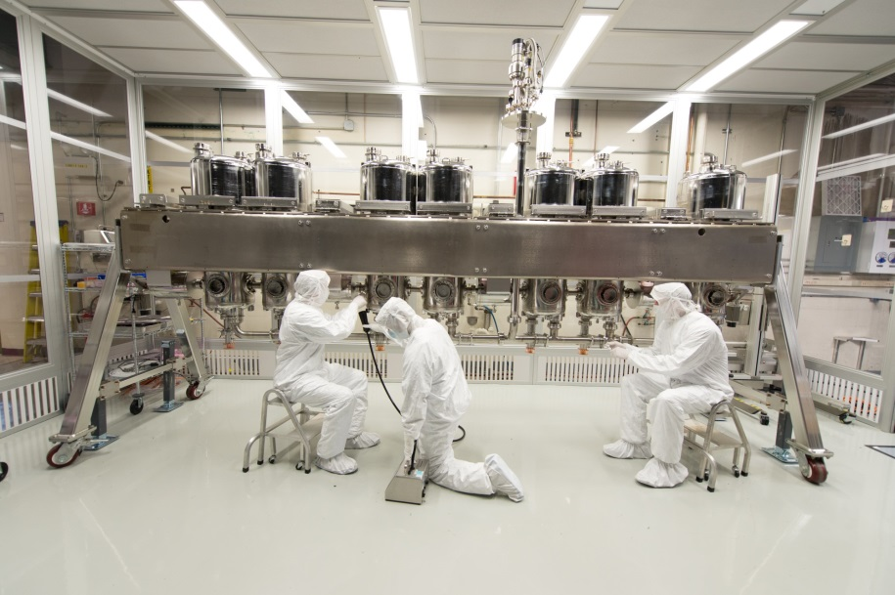
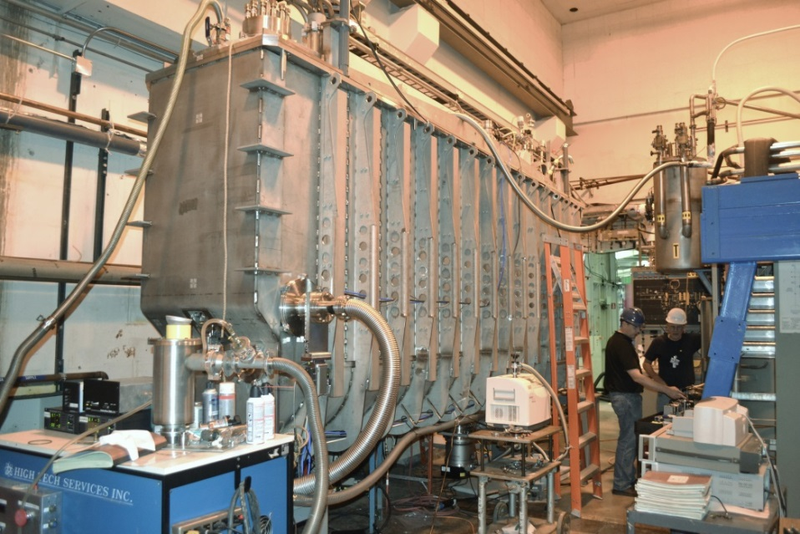
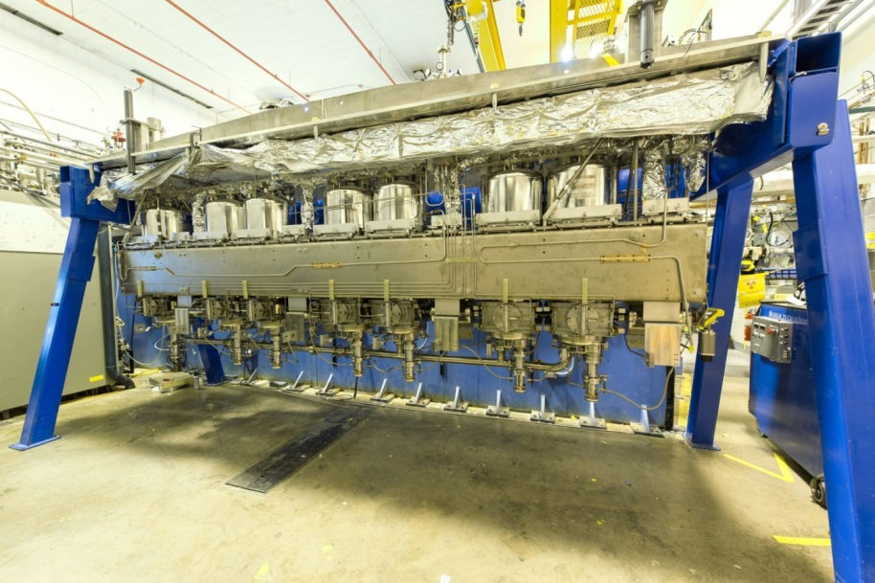
Recent Experience with New Cryomodule
4K cryomodule has been built and commissioned off-line
Installed in the tunnel in December 2013
Beam commissioning is completed on February 18, 2014
7 QWRs and 4 9T solenoids
January 2013
July 2013
May 2013

Slide 5
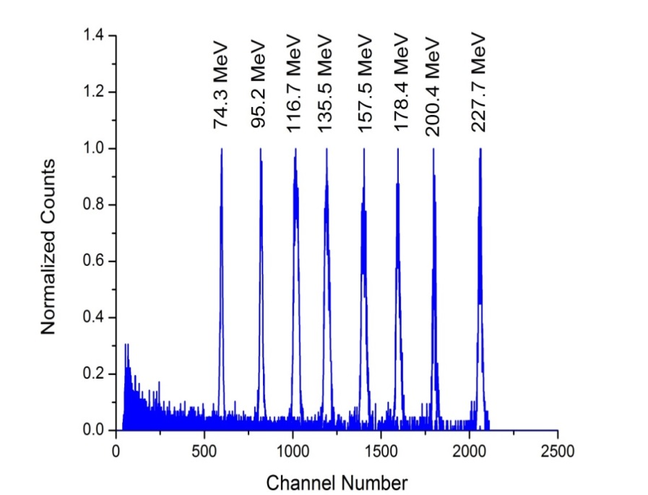
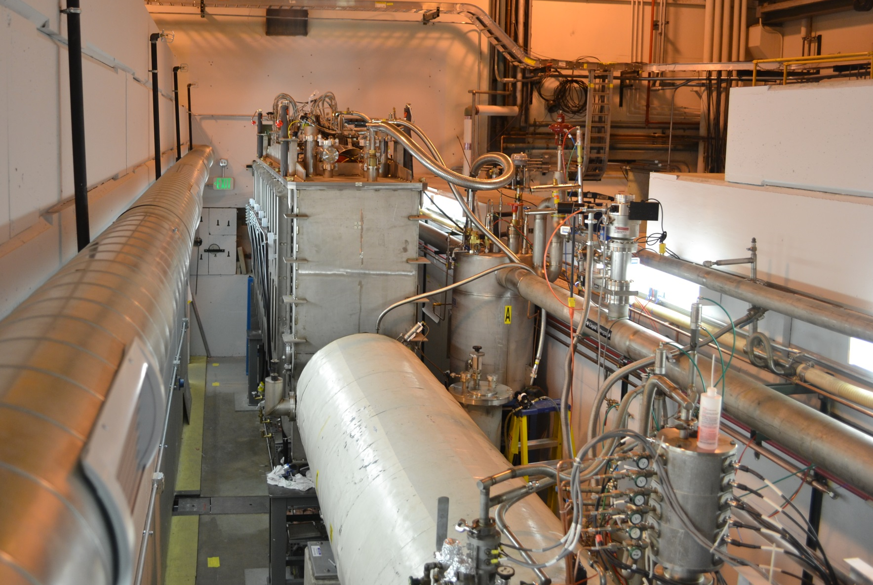
Many Ion Beams Were Successfully Accelerated since January 18, 2014
December 2013
100% operational reliability
Average | Operational | Available
V_{EFF} | 2.5 MV | 4.1 MV
E_{PEAK} | 40 MV | 66 MV/m
LHe, 4.5K | 5 W | 14 W

Slide 6
Recent Progress: Cavities
2 HWRs are ready for RF testing in the test cryostat
Several key Nb fabrication technologies have been developed
EB welding of central conductor halves, re-entrant noses
Key-hole welding of the central conductors to toroids
Closure welds parameters
Took slightly longer than expected due to significant development work
First complete HWR electropolished
7 production cavities are in advanced stage of fabrication
Bare niobium cavities will be completed by the end of calendar year 2014 or earlier
By this time next year helium vessels will be installed in all production cavities

Slide 7
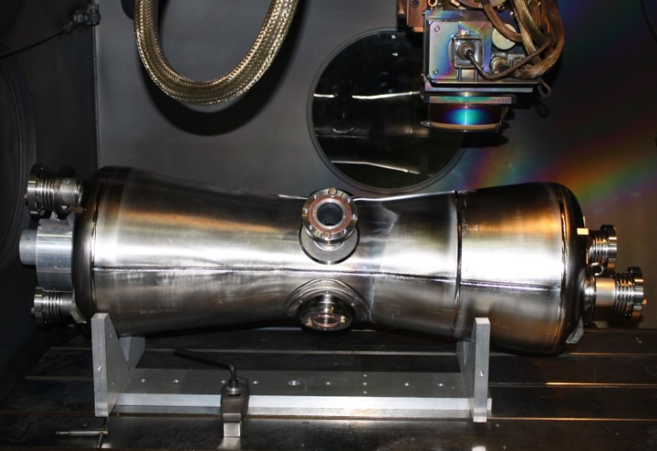
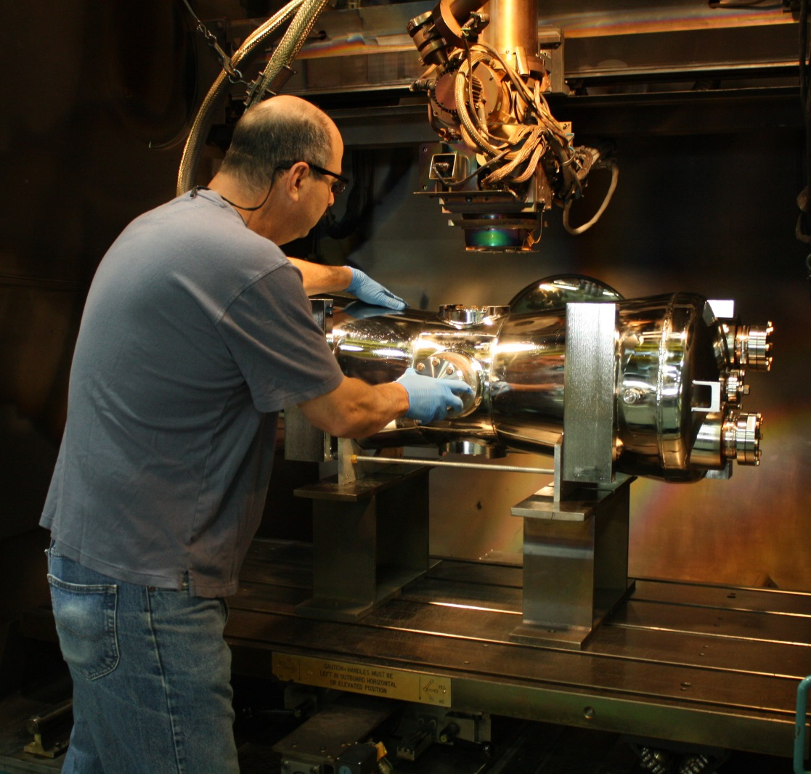
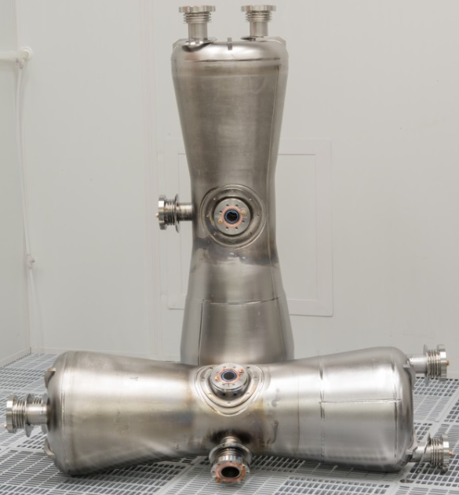
Prototype Half-Wave Resonator Final Welding
HWR0 Final Niobium Welding
HWR1 Final SST Welding
HWR0 & HWR1 Nb Cavities

Slide 8
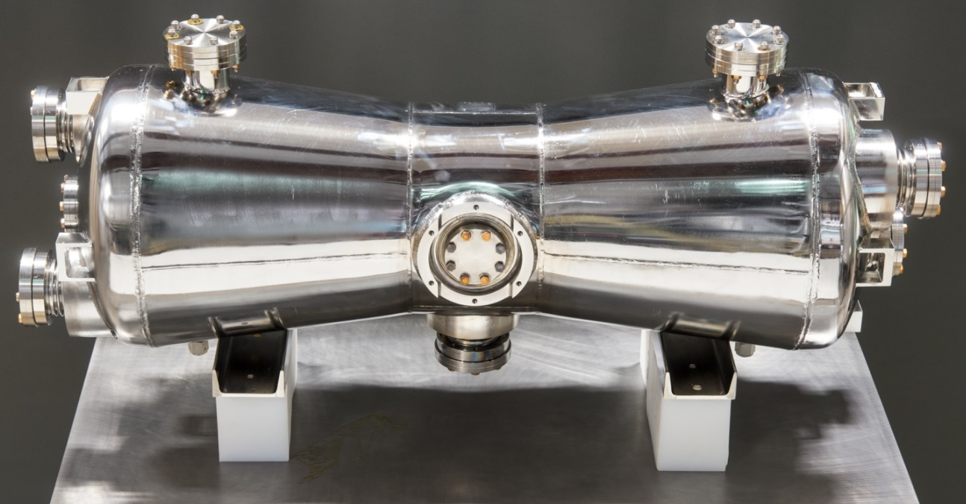
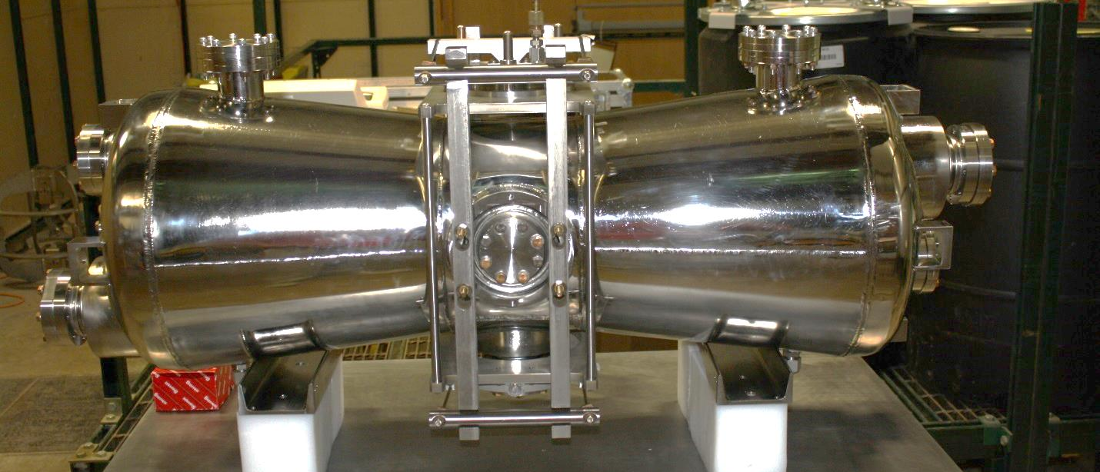
Prototype Resonator 04/30 & 05/22 Pictures
HWR0
Fabrication Finished
5-22-2014
HWR1 w/ Slow Tuner
Fabrication Finished
4-30-2014

Slide 9
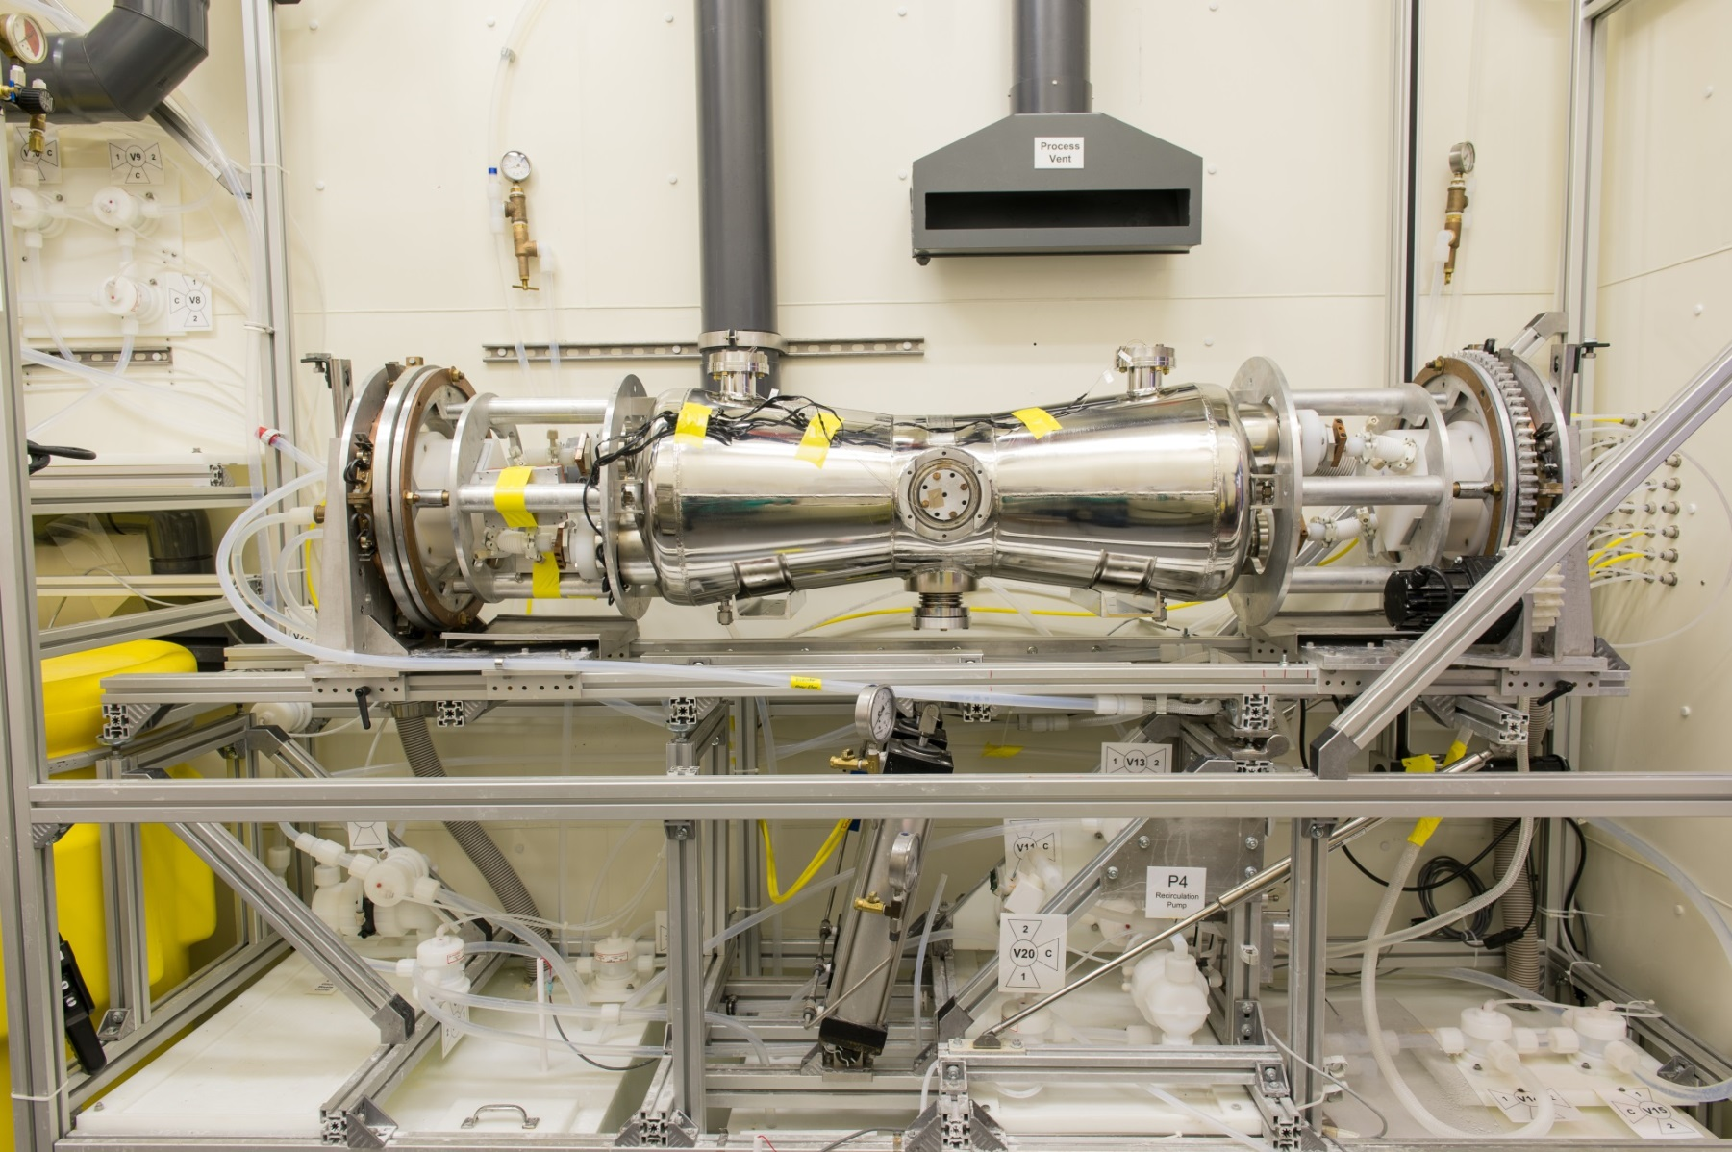
Prototype Half-Wave Resonator Electropolishing

Slide 10
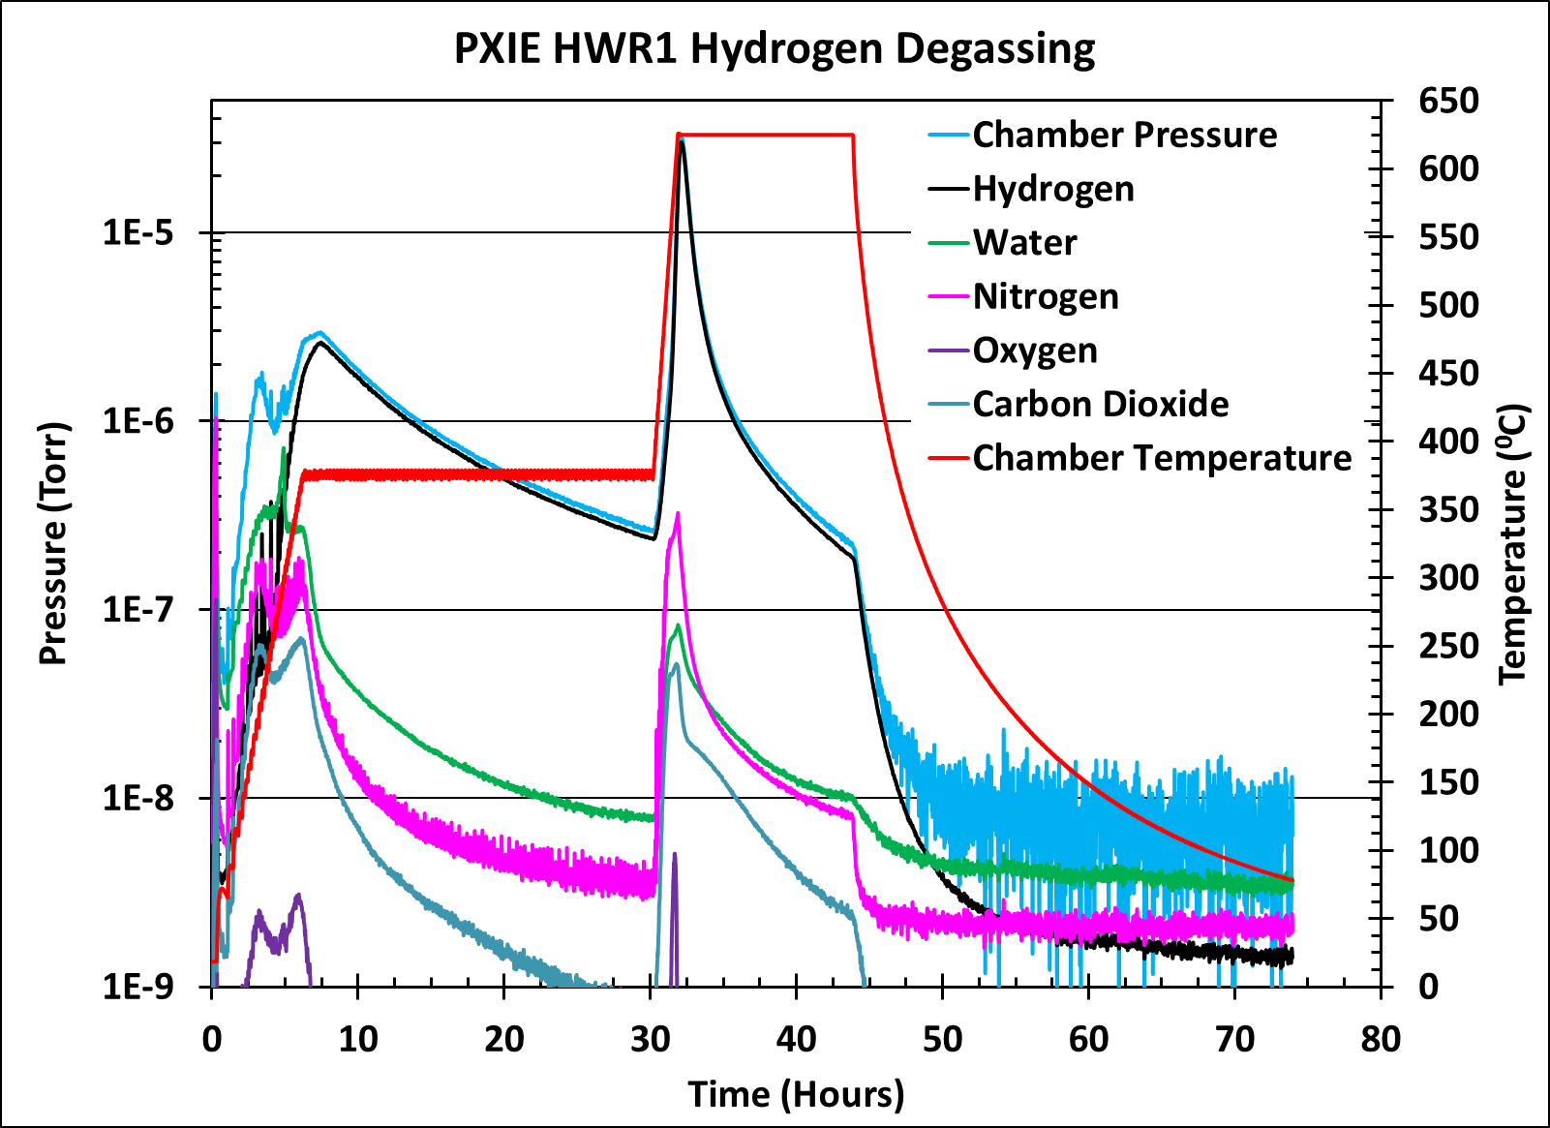
Parameters During EP and HT Baking

Slide 11
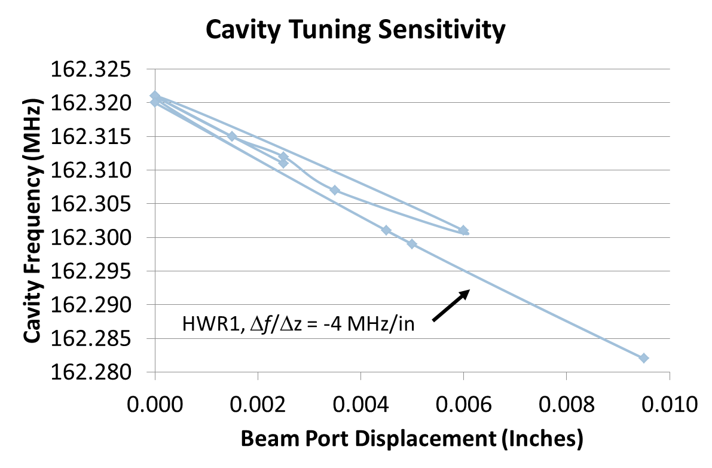
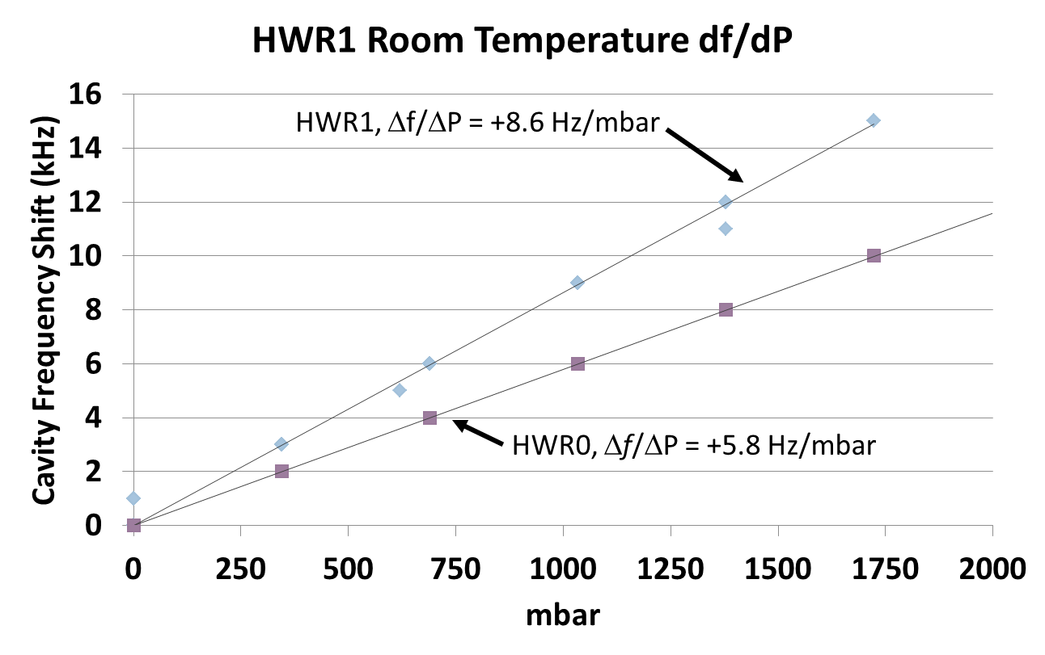
First HWR Parameters
Prototype Half-Wave Resonator Δf/ΔP
Prototype Half-Wave Resonator Slow Tuner Sensitivity
ANSYS prediction is
Δf/ΔP = 6 Hz/mbar.

Slide 12
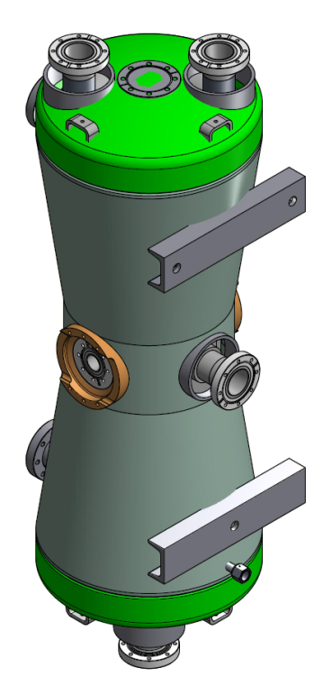
Prototype Cavities, Remaining Work
Cold testing of the first prototype cavity will take place next month
First with adjustable RF coupler, 3” stroke
Later with 15 kW RF coupler, 1” stroke
Slow tuner will be installed and tested
Currently the cavity is being installed into the test cryostat
RF Coupler

Slide 13
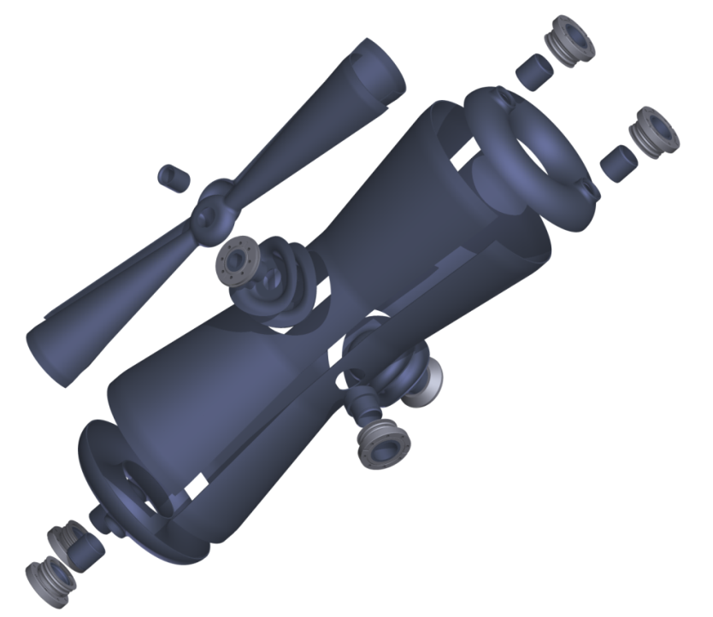
Production Cavities Status Update
We are preparing for the final stages of Nb welding. This requires 3 main sub-assemblies per cavity:
Toroids – Finished
Outer Conductors – In progress.
Inner Conductors – Finished.
Outer Conductor Fabrication Details:
The reentrant nose beam ports are at AES for final machining to fit the outer conductors.
After this work is complete the reentrant noses will be welded into the outer conductors.
Once this work is complete we will begin tuning the cavities.

Slide 14
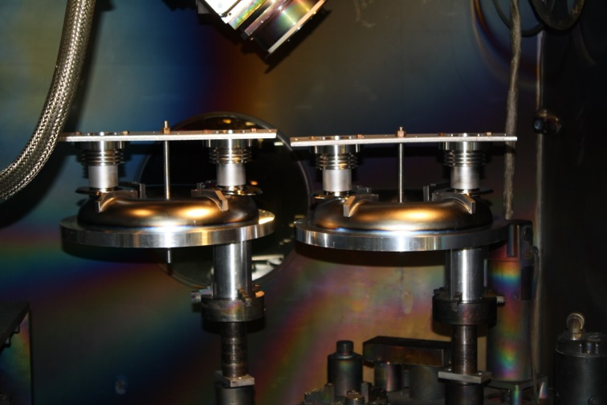
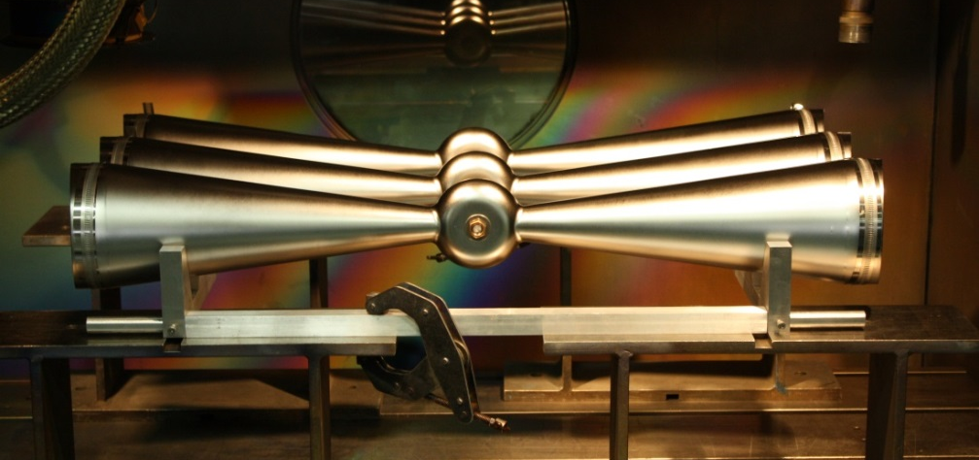
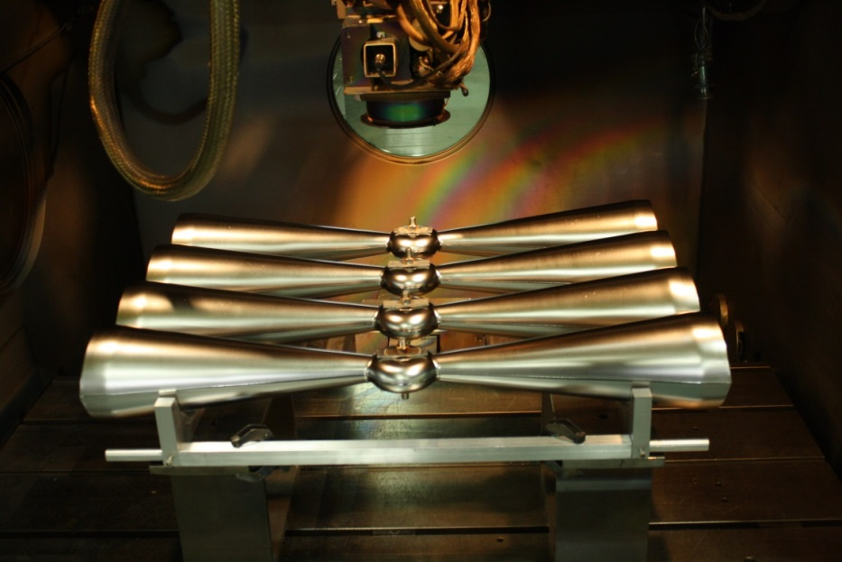
Production Cavities Status Update – Toroids, Central Conductors
Welding Port Braze Assemblies to Toroids
Welding Center Conductor Halves (Top), Welding Beam Spools (Bottom)

Slide 15
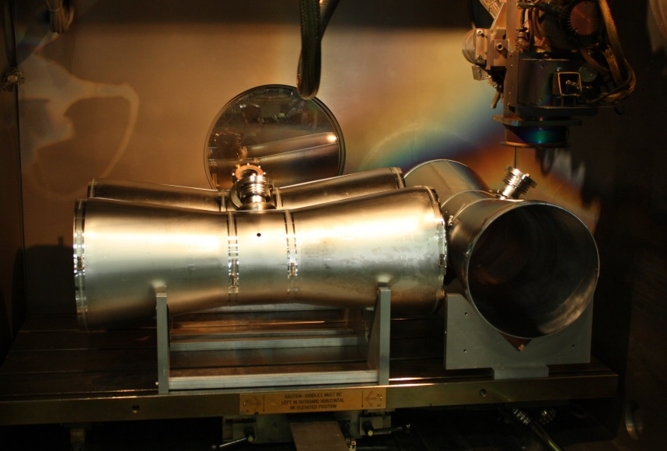
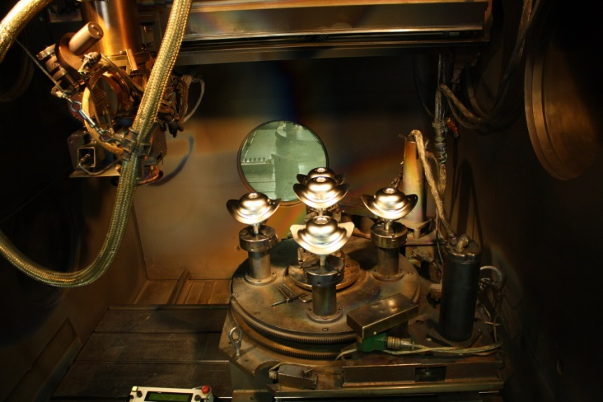
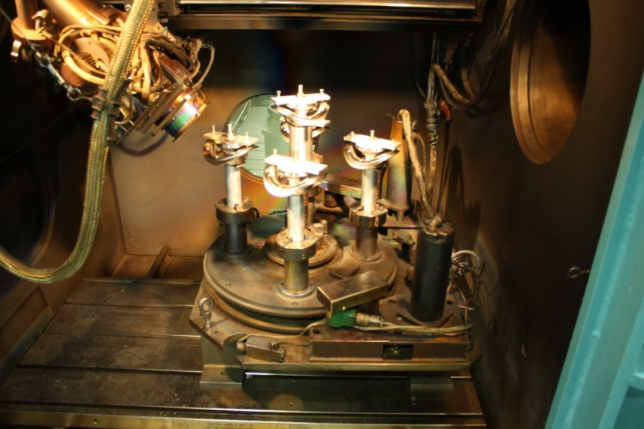
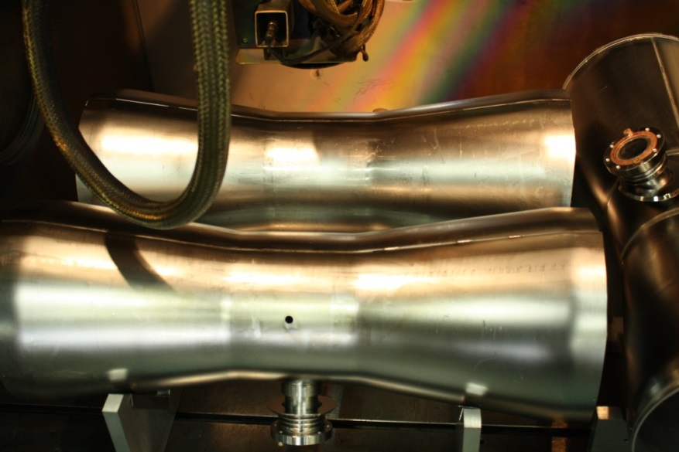
Production Cavities Status Update – Outer Conductors
Outer Conductor Half Welding
Reentrant Nose Final Welding
15

Slide 16
Recent Progress: Cryomodule and Sub-Systems
Cryomodule design is complete
Detailed structural analysis has been performed, documented and reviewed by the ANL/FNAL technical and safety reviews
The cryostat vacuum vessel is being fabricated at Meyer Tool
Detailed drawings for all components of cold mass are ready for procurement and fabrication
10-kW RF coupler cold testing up to 9 kW at 162.5 MHz RF power has been performed
SC solenoid includes a return coil and X-, Y- dipole coils
Prototype solenoid has been built and tested in TC3 together with 72 MHz QWR
Beam Position Monitor: fabrication complete and RF testing demonstrated design performance
Ready for fabrication

Slide 17
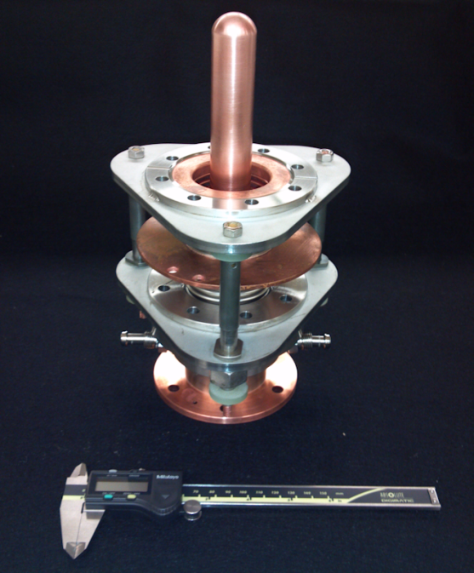
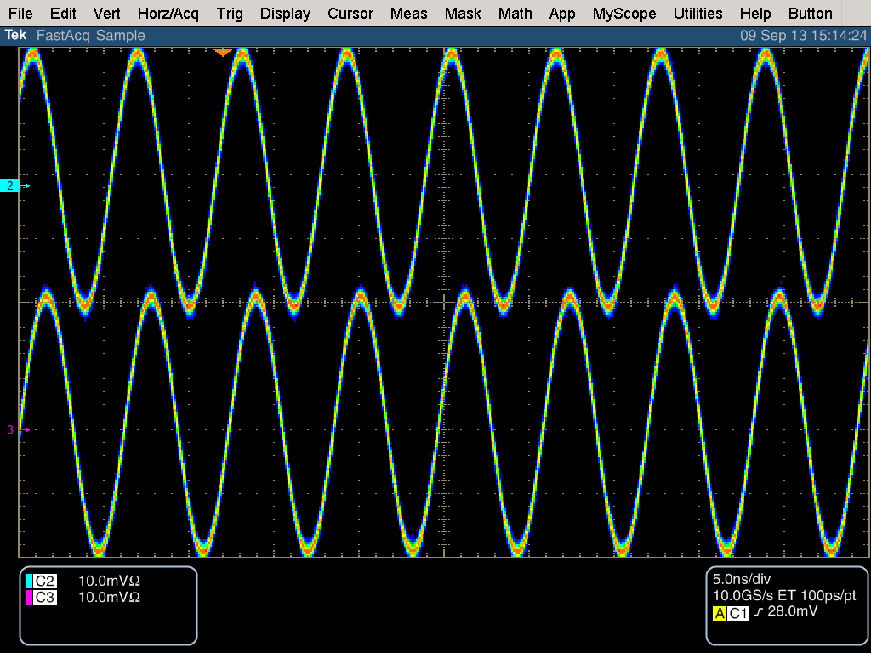
15-kW Variable Coupler
Based on successful development of 4-kW input coupler (1-5/8” coax) for 72 MHz cavities
2” diameter of the outer conductor,
1” stroke, 70K cooled alumina window, 5K intercept
Testing has been performed at 72 MHz and 162.5 MHz
No multipacting was observed in full reflection regime in the power range of 0 - 9 kW

Slide 18
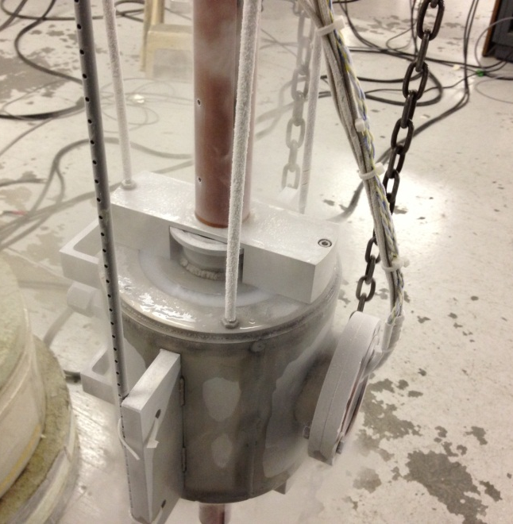
SC Solenoids with Dipole Coils
Magnetic axis measurements
Prototype solenoid (main coil, dipole coils) has been tested together with QWR in the test cryostat
Rotating rod: Bakelite (Hall sensor attached)
Rotation guide:
Aluminum
Magnetic centers at flanges (unit: mm)
 | x | y
Flange 1 | -0.30 ± 0.07 | 0.17 ± 0.04
Flange 2 | -0.08 ± 0.02 | 0.26 ± 0.07
Solenoid housing:
Stainless steel 304

Slide 19
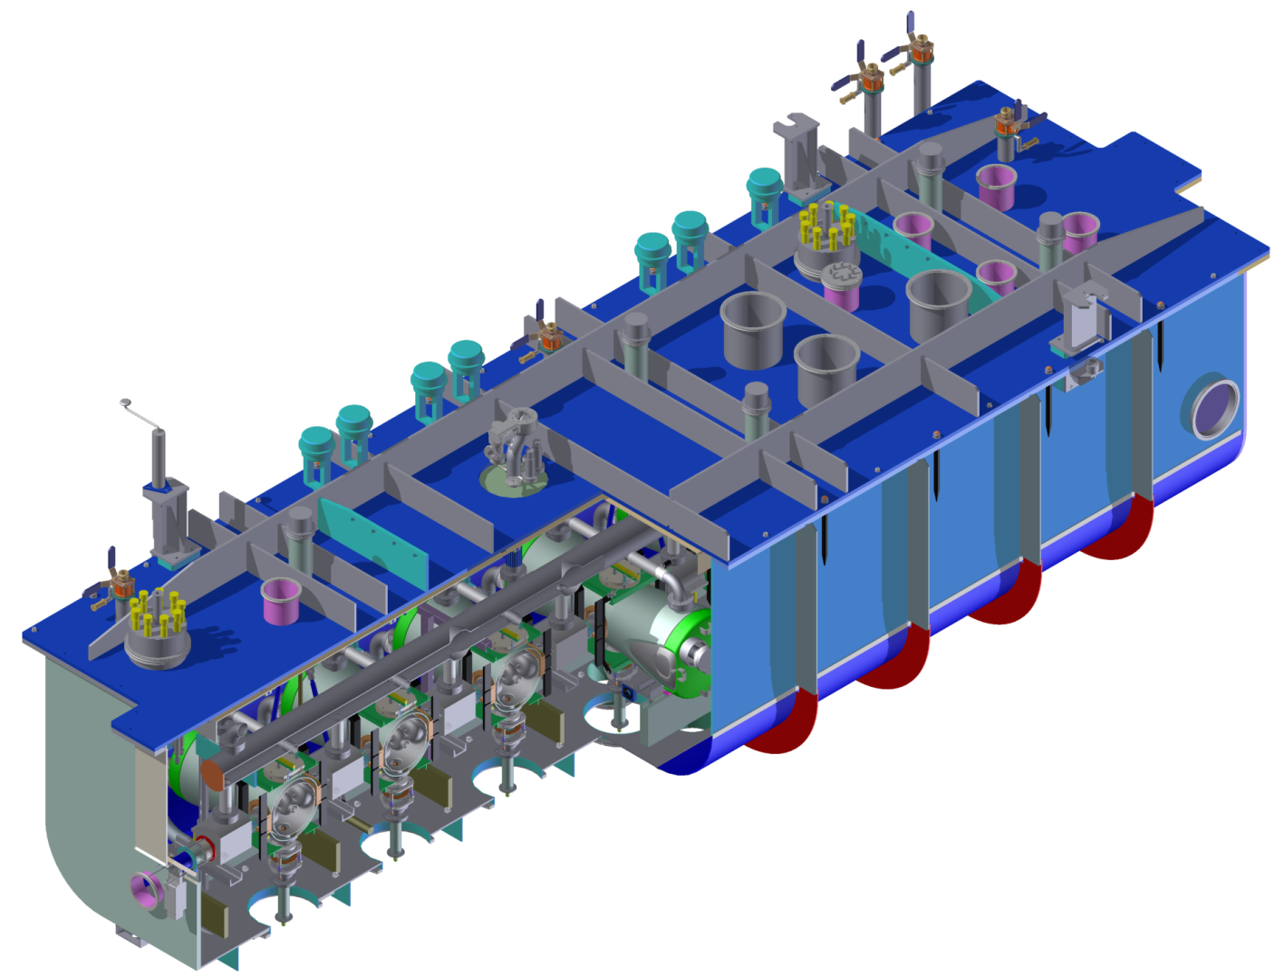
HWR Cryomodule
The vacuum vessel is being fabricated
Design of sub-systems and components of cold mass is completed
Fabrication will start as soon as funding is
available
Parameter | Value
Length (beam ports) | 5.93 m
Length (overall) | 6.3 m
Width | 2.1 m
Height | 2.2 m

Slide 20
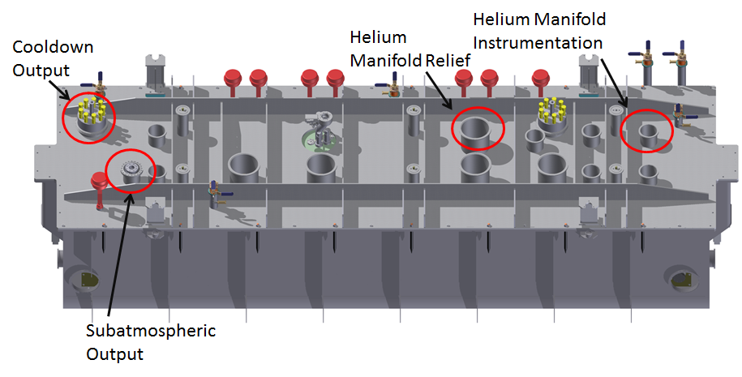
Interface Document ~30 pages, Table of Content
1. Scope of Work.
2. Beam Line Connections
3. Alignment
4. Magnet Leads
5. Thermometry and Heaters
6. He System Instrumentation and Bayonets
7. Cavity and Cryomodule Vacuum Systems
8. RF System Connections
9. Slow Tuner Connections
10. BPM Connections
11. Lifting Attachment Points
12. Cryomodule Location in the PXIE Tunnel
After discussions at FNAL, the document has been modified and approved several months ago

Slide 21
Near Future Plans
Cold testing of two prototype cavities by the end of FY14
Includes tuner, high power coupler, SC solenoid
Production cavities: complete EBW on all 7 Nb cavities by the end of 2014 calendar year
Fabrication is in advanced stage
Install SS helium vessel on all production cavities by June 2015
Cryostat vacuum vessel, thermal shield are being fabricated
Production solenoids are being fabricated
If funding is available we are ready to start procurement of all cold mass components
BPMs, vacuum system, helium distribution system, RF couplers, gate valves, beamline spools, cryogenic instrumentation, slow tuners,..

Slide 22
Components To Be Procured
Sub-system | Sub-system
Magnetic Shield | Lifting Spreader Bar and Hardware
Helium Manifold | Cool Down Manifolds
Alignment Hardware | Slow Tuner Gas Line Feedthrough
Cavity Vacuum System | 5 K and 70 K Thermal Intercepting & Cooling
Cryomodule Vacuum System | RF Cables
Vacuum Manifold | Clean Assembly Hardware
Instrumentation | Misc. Dirty Assembly Hardware
Beam-Line Gate Valves and Spools | Cavity Helium Jackets
BPM Packages (9 units) | RF couplers
MLI | Tuners
Helium Safety Relief Port | Solenoid’s helium vessels
Sub-Atmospheric Output Assembly | Up-to-air system

Slide 23
Assembly and Commissioning Plans
We are buying large clean room using DOE/ONP funds for our Group in Physics Division
The clean room will be installed in bldg.366 which belongs to HEP
The building has large floor space and 30T crane
The HWR cavity string will be assembled in this clean room
Off-line cold test of the cryomodule will be performed with LN2
Cryomodule will be transported and installed into the PXIE tunnel at FNAL
2K testing will be performed in the PXIE tunnel

Slide 24
Summary
Our focus on the following main tasks this year
Testing of fully dressed prototype cavities
Complete niobium fabrication of production cavities by the end of CY14
Work with vendors for fabrication of the cryostat vessel and solenoids
Start installation of the clean room in bldg. 366
Delivery of the cryomodule to FNAL in 2017 is realistic if funding is provided

