Slide 1

SRF Program
Slava Yakovlev
Fermilab Technical Division, SRF Development Department
PIP-II Collaboration Meeting – Spring 2014
June 3-4, 2014

Slide 2
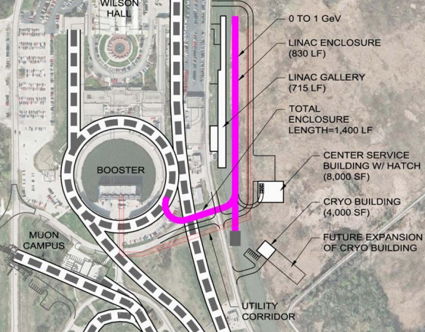
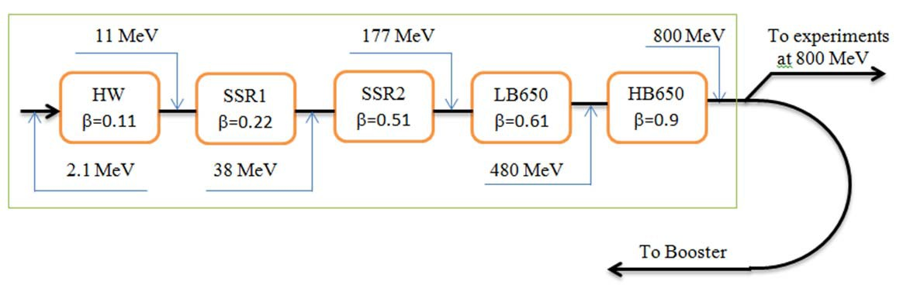
PIP-II Requirements:
Linac Beam Energy | 800 | MeV
Linac Beam Current | 2 | mA
Linac Beam Pulse Length | 0.6 | msec
Linac Pulse Repetition Rate | 15 | Hz
Linac Upgrade Potential | CW
Low beam loading;
Long filling time compared to pulse length;
Low efficiency at pulse mode.

Slide 3
SRF system Requirements
Maximal energy 800 MeV;
Beam current 2 mA;
Same linac scheme as for Project X:
- same frequencies,
- same types of the cavities,
- same break points.
Pulsed operation at the initial stage,
CW operation in future.

Slide 4

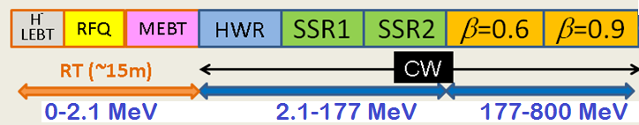
PIP II
SRF Linac Technology Map
SRF Cavity Type | Freq, MHz | Energy (MeV) | Cav/mag/CM | CM type, length
HWR (β_{G}=0.11) | 162.5 | 2.1-11 | 8 /8/1 | scscscscscscscsc, 5.3m
SSR1 (β_{G}=0.22) | 325 | 11-38 | 16 /8/ 2 | csccsccsccsc, 4.8m
SSR2 (β_{G}=0.51) | 325 | 38-177 | 35 /21/ 7 | sccsccsc, 6.5m
LB 650* (β_{G}=0.61) | 650 | 177-480 | 30 /20/5 | cccfdccc, 7.1m
HB 650 (β_{G}=0.9) | 650 | 480-800 | 24 /6/ 4 | cccccc, 9.5m
*3-cavity option is under consideration; CM has no focusing elements.

Slide 5
Accelerating cavity types and
characteristics for the SC linac.
Name | β_{G} | β_{opt} | Freq (MHz) | Type of cavity | B_{peak} (mT) | E_{peak} (MV/m) | E_{acc} (MV/m) | ΔE (MeV)
HWR | 0.094 | 0.112 | 162.5 | Half wave resonator | 41 | 38 | 8.2 | 1.7
SSR1 | 0.186 | 0.222 | 325 | Single‐spoke resonator | 58 | 38 | 10 | 2.05
SSR2 | 0.431 | 0.515 | 325 | Single‐spoke resonator | 70 | 40 | 11.2 | 5.32
LB650 | 0.61 | 0.647 | 650 | Elliptic 5‐cell | 70 | 37.5 | 16.5 | 11.6
HB650 | 0.9 | 0.95 | 650 | Elliptic 5‐cell | 64 | 35.2 | 17.5 | 17.7
E_{peak} ≤ 40 MV/m, for CW (Field emission);
B_{peak} ≤ 75 mT, for CW (medium field Q-slope)

Slide 6
Cryogenic losses in the PIP II
cryo-modules
In CW regime the total loss is 410 W;
Pulsed operation limited by power of the cryo-plant;
5% duty factor for cryo, or 20.5 W.
 | Energy (MeV) | CM | Cav per CM | E_{acc} (MV/m) | ΔE (MeV) | Q₀@2K (10¹⁰) | Static loss per CM @2 K, W | Total loss per CM @2 K in CW, W
HWR | 2.1-11 | 1 | 8 | 8.2 | 1.7 | 0.5 | 14 | 24
SSR1 | 11-38 | 2 | 8 | 10 | 2.05 | 0.5 | 16 | 27
SSR2 | 38-177 | 7 | 5 | 11.2 | 5.32 | 1.2 | 8.8 | 52
LB 650 | 177-480 | 5 | 6* | 16.5 | 11.6 | 1.5 | 8.1 | 153
HB 650 | 480-800 | 4 | 6 | 17.5 | 17.7 | 2.0 | 6.2 | 153
*3-cavity option is under consideration; CM has no focusing elements.

Slide 7
Primary Technical Risks
Future CW operation → cryo-losses → high Q₀ is desired;
Low beam loading → microphonics;
High-Order Modes → “to damp, or not to damp?”
Lorentz Force Detune (LFD) may be an issue in a pulsed mode, and should be analyzed.

Slide 8
High Q0 Program for CW SRF linacs:
For future CW operation high Q0 is critical;
Basic SRF physics researches towards Q0 improvements (instead of gradient improvement as before);
Development of new SRF cavity processing technique for high Q0;
Processing recipes optimization and industrialization;
The program is very well aligned to the LCLS II.
SRF investigations were re-directed from HG to High Q0;
This new direction is now well - recognized worldwide.
New effective processing method (Nitrogen doping) were developed, successfully tested and understood.

Slide 9
Single Cell Cavity Tests:
Nitrogen Treatment during vacuum bake
Surface doping: baseline strategy to improve R_{BCS} and allow high Q for LCLS-II at 2K
Current R&D Goal:
Develop a robust surface processing recipe based on Nitrogen Treatment for LCLS-II
Spec Q>2.7e10 at 2K, 1.3 GHz, 16 MeV/m
  and transfer to industry
LCLS-II
*A.Grassellino et al, 2013 Supercond. Sci. Technol. 26 102001
<Q0>(FG) = 4.2e10*

Slide 10
Typical bake cycle – small deviation from standard XFEL degassing cycle*
Gas injection, ~10 min
Standard 800C degassing cycle
*A Grassellino et al 2013 Supercond. Sci. Technol. 26 102001

Slide 11
Nine cell TB9ACC015 – world record Q nine cell at mid E_{acc}
T=2K
f=1.3GHz
Q
LCLS-II spec
E [MV/m]

Slide 12
Nine cells N doped vs typical 120C bake: comparison at 2K, mid field: 2-3 times higher Q
Q
Eacc [MV/m]

Slide 13
Cavity Detuning in the PIP-II Linac
Pulsed operation but upgradable to CW operation
  0.6 ms Flattop
  15 Hz repetition rate
Narrow bandwidths will require active stabilization of the cavity
resonance frequencies
Current state of the art for single cavities:
    LFD ~10 Hz residual vibration (1.3 GHz 9-cell elliptical at FNAL and DESY)
    Microphonics (<1Hz RMS at BESSY and FNAL)
Pulsed operation of narrow bandwidth cavities leads to
significant complications
  LFD drives mechanical resonances
  Only able to measure detuning accurately when RF in cavity
Need to combine state of the art LFD control with state of the
art microphonics control and make it work consistently and
reliably for every cavity in the machine

Slide 14
Cavity Detuning in the PIP-II Linac
Cryomodule Type | Frequency | E_{Acc} | ΔE | κ_{LFD} | Q_{L} | f_{1/2} | Δf_{Microphonics} | Δf_{LFD}
 | MHz | MV/m | MeV | Hz/(MV/m)² |  | Hz | Hz | Hz
HWR | 162.5 | 8.2 | 1.7 | TBD | 3.3x10⁶ | 24.6 | 20 | TBD
SSR1 | 325.0 | 10 | 2.05 | 1.5 | 5.8x10⁶ | 28.0 | 20 | 150
SSR2 | 325.0 | 11.2 | 5.32 | TBD | 7.2x10⁶ | 22.6 | 20 | TBD
LB 650 | 650.0 | 16.5 | 11.6 | <1 | 1.4x10⁷ | 23.2 | 20 | 272
HB 650 | 650.0 | 17.5 | 17.7 | <1 | 1.4x10⁷ | 23.2 | 20 | 306

Slide 15
Cavity Detune, Possible Solutions (W. Schappert)
PIP-II detuning requirements are extremely demanding
Possible solution
  Low-power CW excitation between pulses to provide continuous sensitivity to cavity detuning
  Kalman-Ho system identification to characterize electro-mechanical response in-situ of individual cavities
    Variant of current adaptive LFD compensation procedure
    Extract low-order electro-mechanical model
  Combined model-based digital electro-mechanical piezo/LLRF controller
    Kalman filter for optimal state estimation
    Linear Quadratic Gaussian Regulator controller for optimal control

Slide 16
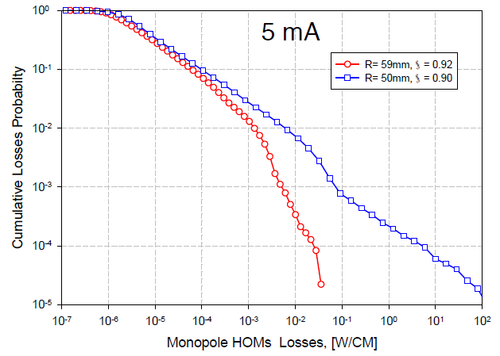
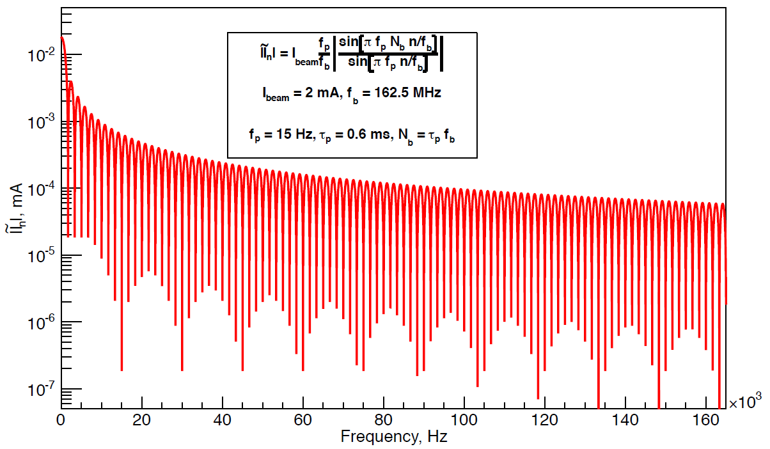
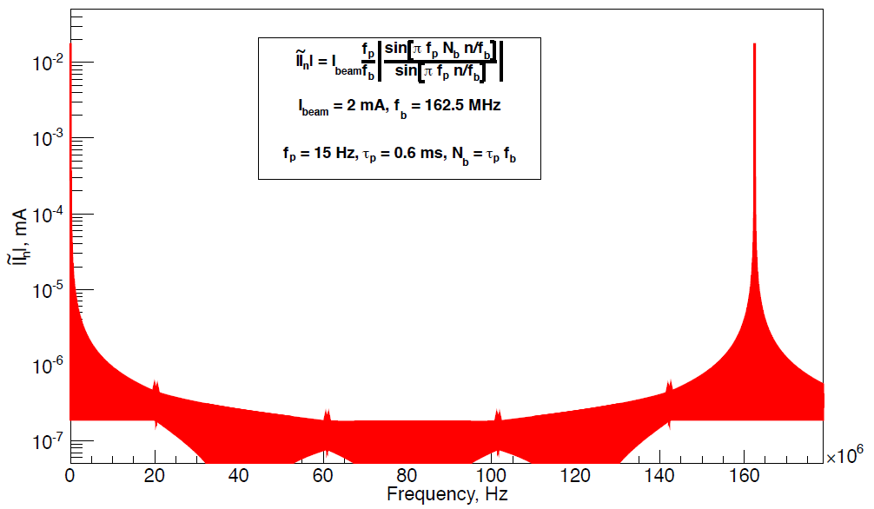
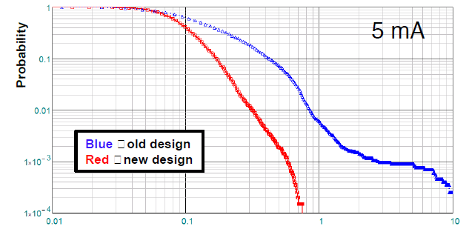
High-Order Modes
CW regime:
Probability of HOM excitation is very small. BBU is not an issue.
Incoherent losses: 2.8 W/CM compared to 200 W/CM
of RF load (beam current is 2 mA).
Pulsed regime:
Duty factor is 0.9%, incoherent losses are 25 mW/CM.
Spectrum is much more dense because of sidebands
(15 Hz separation), but the sideband amplitude is small.
CW
CW
HOMs should not be an issue.

Slide 17
  Status of the PIP II cavity
  and CM design
  SSR1
  10 SSR1 325 MHz, low-beta cavities are manufactured;
  9 of them are processed, tested and qualified;
  New He vessel with reduced df/dP is designed, one SSR1 cavity is dressed.
  Tuner design is in progress;
  RF coupler design is completed, 3 couplers will be ready in a month.
  Design of the focusing solenoid is completed, the 1st solenoid is manufactured and is tested.
  Concept design of the CM is ready, main parts (vacuum vessel, strong back and supports) are ordered.
  SSR2
  EM design is finished,
  mechanical design is in progress.

Slide 18
R&D Deliverables
PXIE:
  - SSR1 CM (December 2016)
Research Programs:
High Q0
Microphonics and LFD mitigation
HOMs
Infrastructure:
  - VTS2, VTS3 (May 2014)
  - HTS2 (Collaboration with India, March 2015)
  PIP II 800-MeV linac:
  SSR2, LB 650, HB 650 CMs
  plans are in process of reconsidering
  Collaboration with India

Slide 19
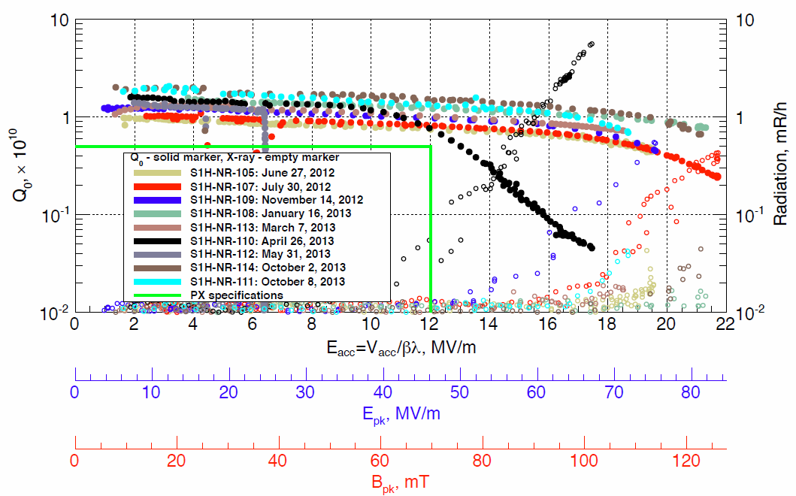
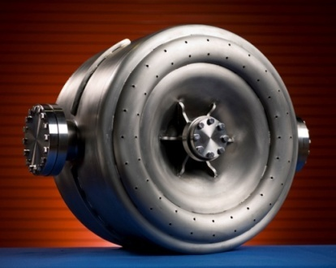
325 MHz beta=0.22 SSR1 cavity
120-150 micron BCP and HPR at ANL/FNAL processing facility then 120 C bake
Low FE depends on optimized nozzle design for effective HPR of surface
Two previous SSR1 spoke resonators performed very well in bare cavity tests;
Above are the tests of 9 cavities from U.S. Vendor (Roark) production of 10 cavities;
Performance at 2 K is above requirements for Project X in both Q₀ and gradient.
SSR1 Prototypes Exceed PX Performance Specs.

Slide 20
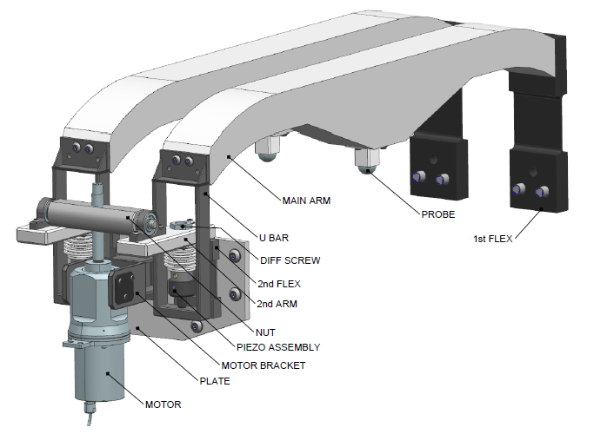
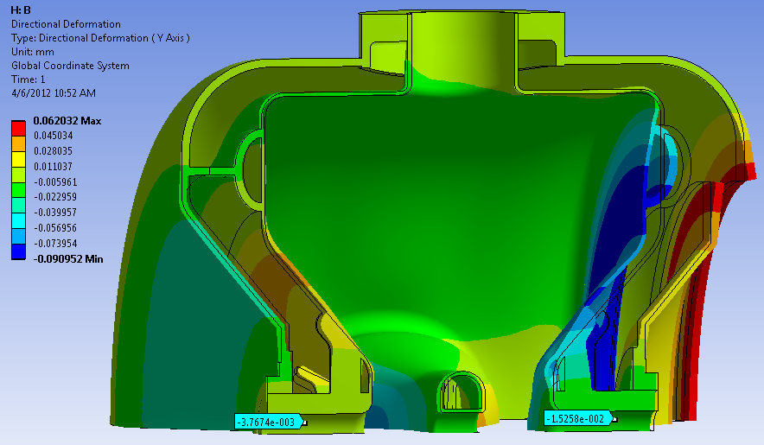
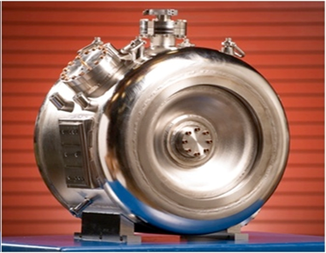
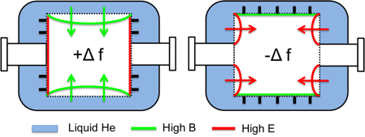
SSR1 He Vessel and tuner
Pressure of L_{He} can vary by ± 0.1 Torr in the cryomodule
SSR1 must operate within a small bandwidth ± 20 Hz
A self-compensating design was developed allowing low sensitivity
Despite non-negligible deformations (see picture), net shift is very low
Bare cavity ~ 600 Hz/Torr, with He vessel ~ 10 Hz/Torr (measured)
Ease of tuning 39 N/kHz (bare), 40 N/kHz (with He vessel)
Actuating elements of the tuning system
Dressed SSR1

Slide 21
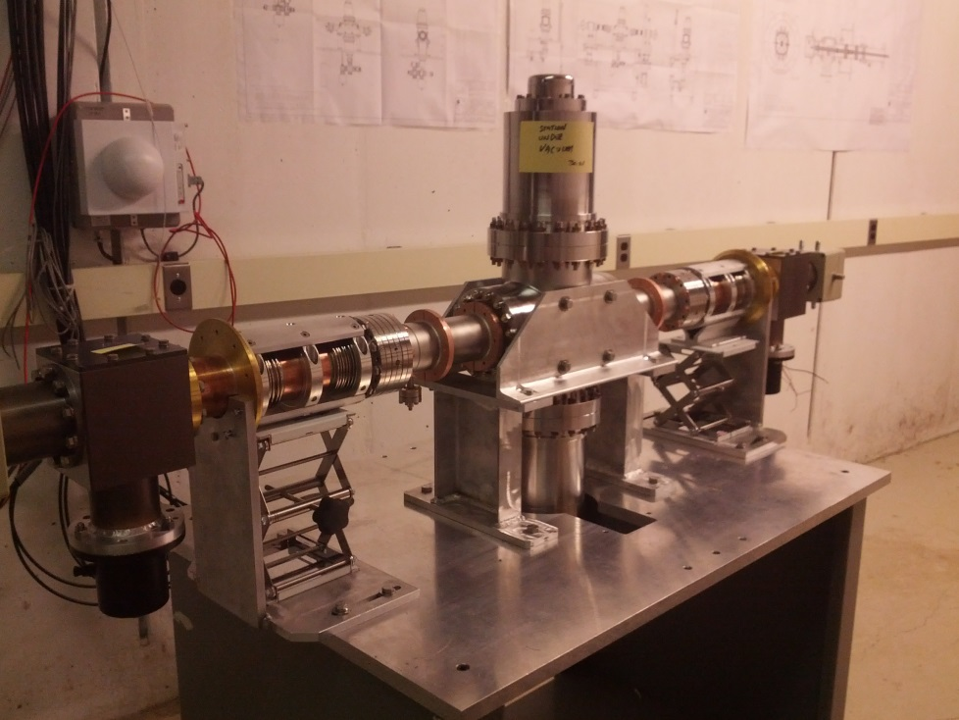
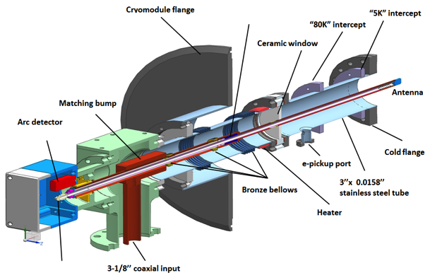
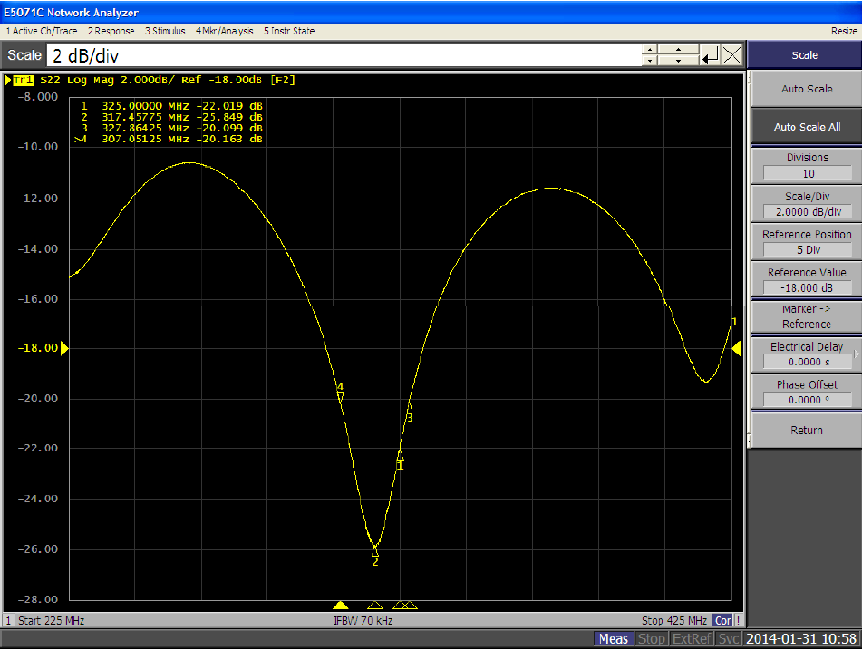
SSR1 Couplers:
Coupler test stand
The coupler is designed for 30 kW traveling wave (TW) at full reflection
Three couplers are manufactured, measured (reflection -22 dB at 325 MHz) and will be tested in few weeks.
The test stand is ready

Slide 22
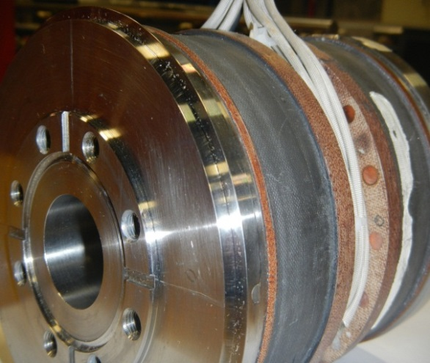
SSR1 Solenoids:
Number, total | 4
Operating temperature, K | 2
Maximum current, A | <100
∫B²dL, T²m | 4.0
Alignment precision, RMS: center position [mm] | ±0.5
Alignment precision, RMS: angle [mrad] | ±1
Magnetic field on the walls of the cold cavity should not decrease its quality factor by the factor of more than | 2
Prototype lens PXIE_SSR1_L01P has been tested for performance on February 5, 2014.
The lens reached quench current without training both at 4.58 K and 2.15 K. At 4.58 K, the quench current was 68 A. At 2.15 K, the quench current of ~92 A was measured. This coincides to the model prediction.

Slide 23
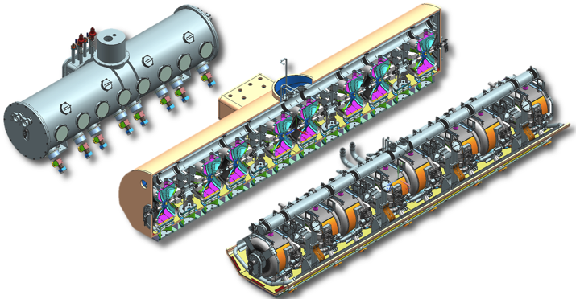
The SSR1 cryomodule
The concept design is complete
Procurement is started

Slide 24
SSR1 Schedule:

Slide 25
  LB/ HB 650
  EM design of both LB and HB 650 is ready.
  Two singe-cell LB 650 cavities are manufactured, processed and tested (JLAB);
  Six single-cell cavities HB 650 are manufactured by AES, processed and tested at Fermilab.
  Two HB 650 cavities are processed and tested.
  Four 5-cell HB 650 cavities are manufactured by AES and ready for processing and tests.
  Five additional single cell and five five-cells HB cavities ordered from industry (PAVAC) on ARRA funds
  Design of He vessel for HB 650 with low df/dP and the tuners (slow and fast) are completed.
  Concept design of the CM for HB 650 is ready.

Slide 26
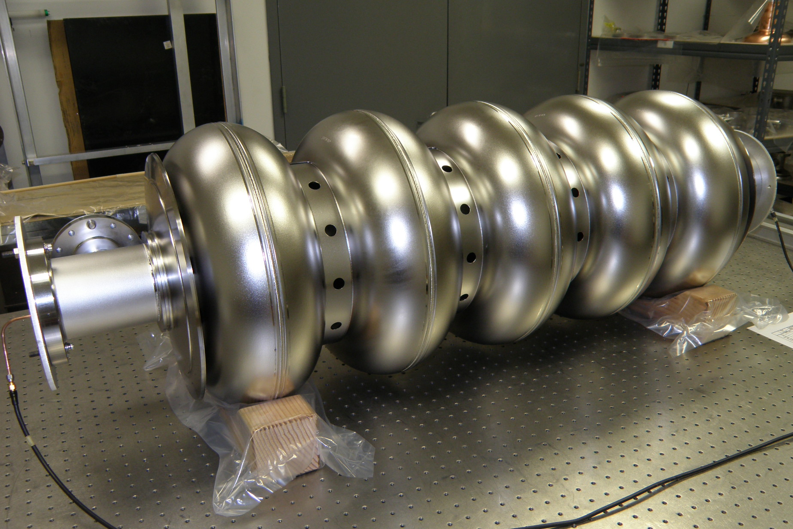
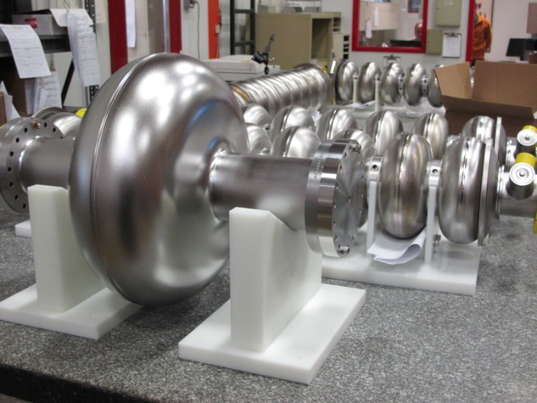
650 MHz cavities
Currently Available Cavities:
Expected Cavities:
1-Cell 650 MHz
1. B9AS-AES-001*
2. B9AS-AES-002*
3. B9AS-AES-003
4. B9AS-AES-004
5. B9AS-AES-005
6. B9AS-AES-006
5-Cell 650 MHz
1. B9A-AES-007
2. B9A-AES-008
3. B9A-AES-009
4. B9A-AES-010
1-Cell 650 MHz
Pavac, Inc.
Six to be delivered
late spring 2014.
5-Cell 650 MHz
Pavac, Inc.
Five to be delivered
early summer 2014.
*VTS Tested

Slide 27
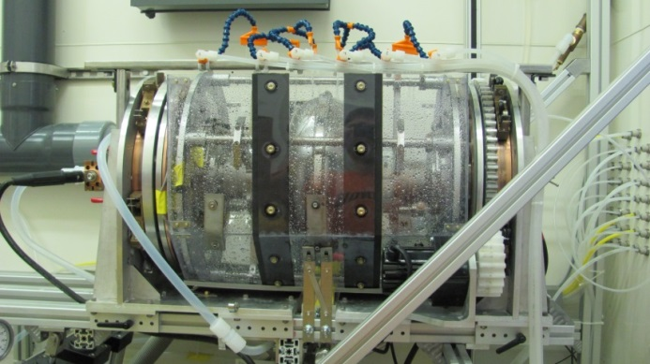
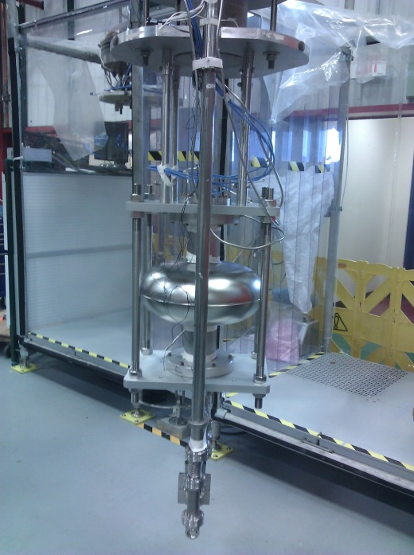
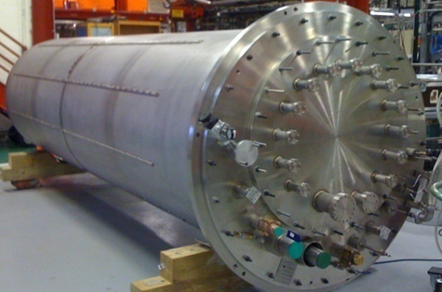
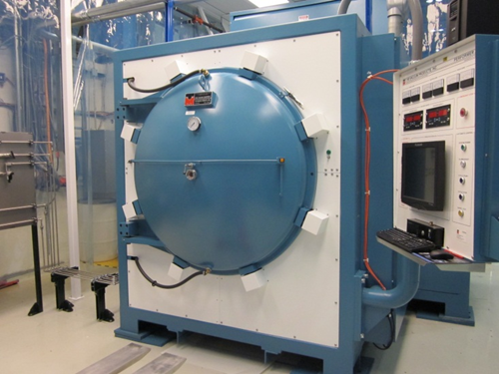
650 MHz testing/processing infrastructure
120-300C ovens--ready
High temperature furnace -- ready
EP, HPR tools, ready for 1-cell, not for 5-cell 650 MHz
VTS1—ready for 1-cell 650 MHz
VTS2,3—will be commissioned in few weeks, needed for 5-cell 650 MHz
HTS2 is in progress (collaboration with India)

Slide 28
Surface processing studies
Explored several different surface processing techniques on 650 MHz single cells
All cases largely exceed the PIP-II specs of Q ~ 2e10 at 17 MV/m

Slide 29
650 MHz 5-cell Infrastructure Prep
EP tool at ANL—new cathode required plus tool testing and evaluation. External cooling implemented.
HPR—requires adapters to accommodate multi-cell cavities.
Transport tooling—requires adapters to accommodate multi-cell cavities.
4-bar frames—designed, need to be procured.
VTS hardware—several sets in-hand. More to be ordered including new RF feethroughs.
~$100k in hardware/tooling required for multi-cell testing.

Slide 30
650 MHz Testing Plan 2014
2-3 AES 1-cell cavity tests. High Q0 studies in VTS.
2-3 AES 5-cell cavities for baseline processing after VTS2-3 are ready and HPR/cleanroom infrastructure procured. Vendor qualification.
2-3 Pavac single-cell cavities for vendor qualification purposes.
2 Pavac multi-cell cavities for vendor qualification.

Slide 31
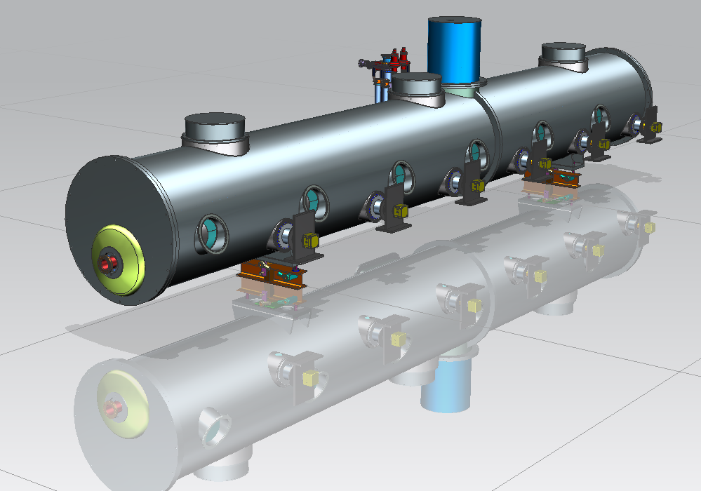
650 MHz Cryomodule, β=0.9.
(DESY Style-Stand alone)
Cold Mass supports
Vacuum vessel
Power Coupler
Beam Pipe
Tuner Motor Access Port

Slide 32
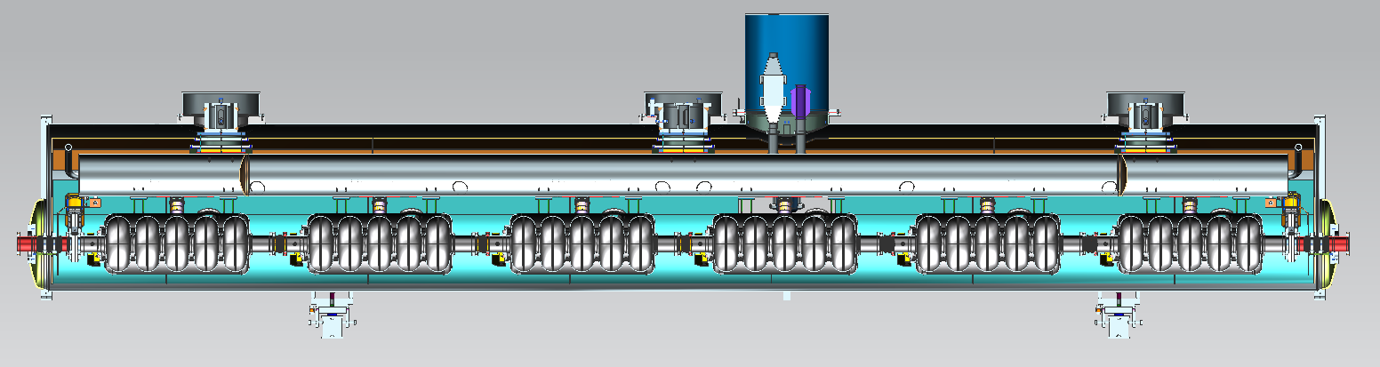
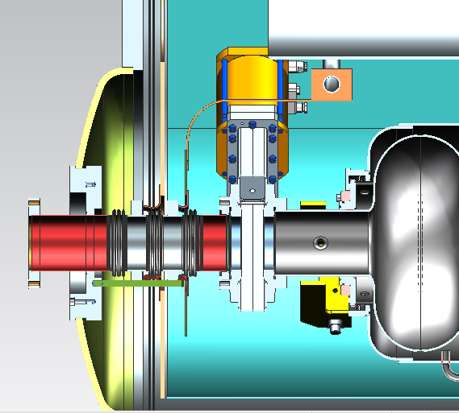
650 MHz Cryomodule.
Sliding cold mass support (x2)
Fix cold mass support (x1)
Heat exchanger
Check valve
300mm pipe
Cavity string
5K Intercept
70K Intercept
70K shielding with pipe
5K Pipe

Slide 33
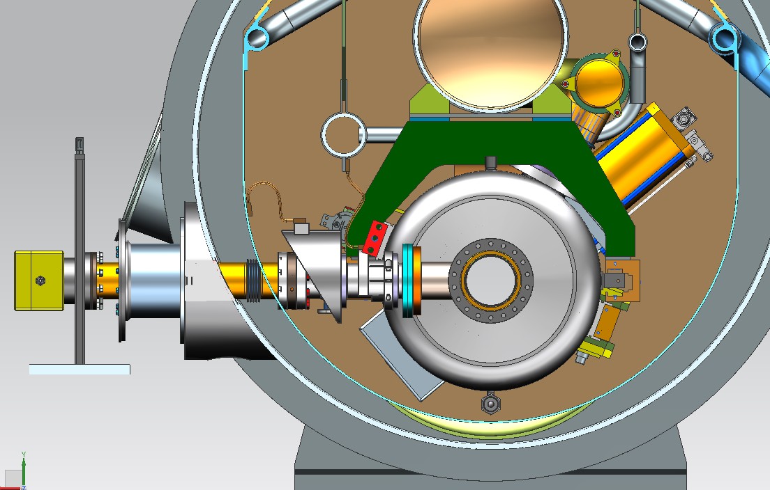
650MHz Cryomodule. Power coupler thermal intercepts
5K cicuit
5K Intercept
70K Intercept
70K shield with
70K circuit

Slide 34
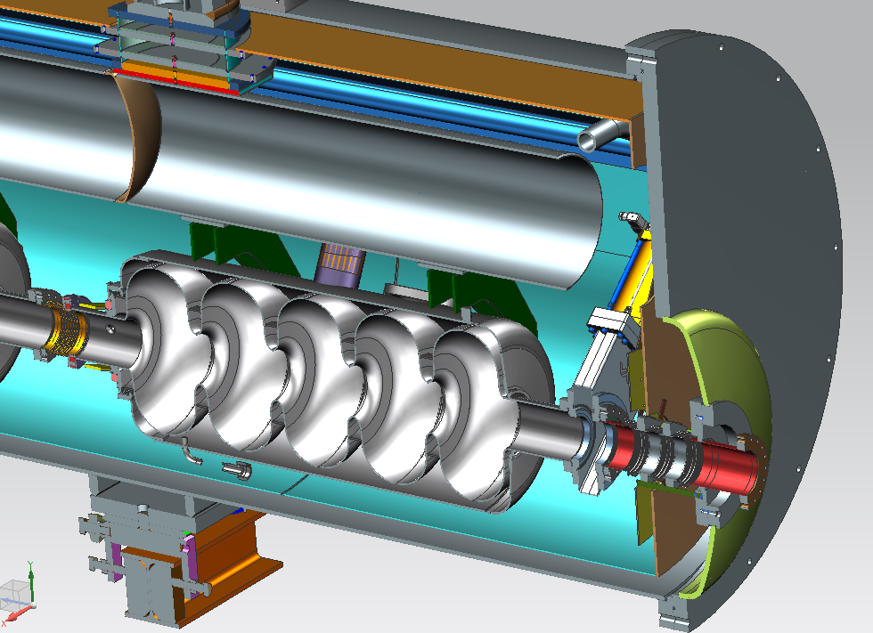
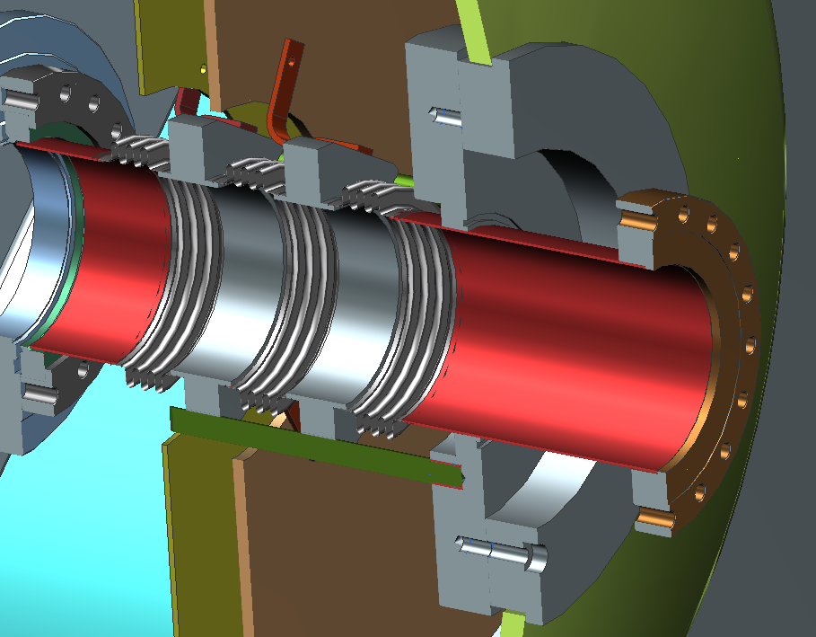
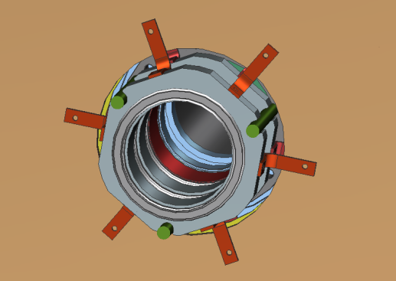
650 MHz CM. 70K & 5K beam pipe intercepts.
5K Pipe
70K Shielding
5K Intercept (copper braids)
70K Intercept
Beam pipe

Slide 35
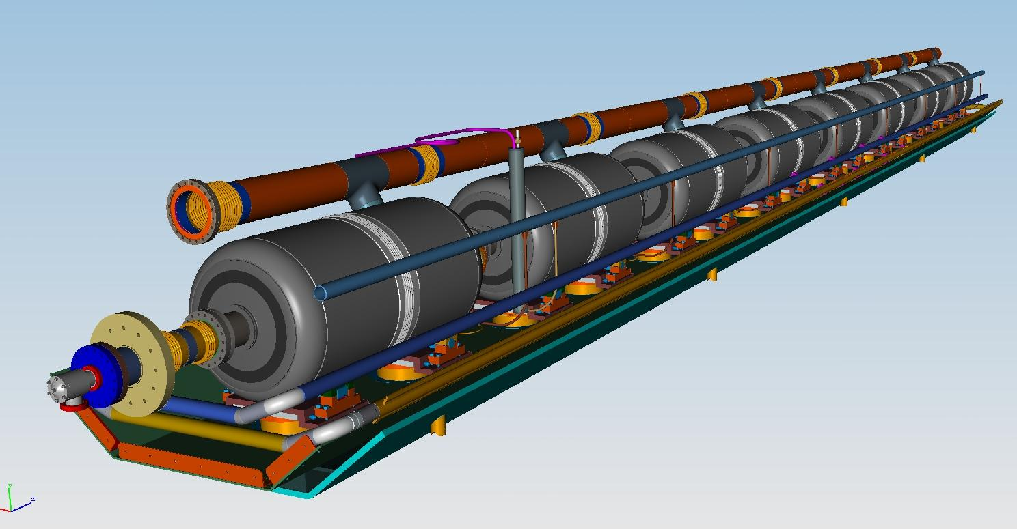
650 MHz Cavity, β=0.9.
String version with strong back
He reservoir
with level sensor
650 Cavity with 2-phase pipe
Warm up cool
down pipe
Strong back
(Tray) with 2
supports for each
cavity
5K circuit (to MC)
70K circuit (shield)
Used scheme of SSR1, by T. Nicol
35

Slide 36
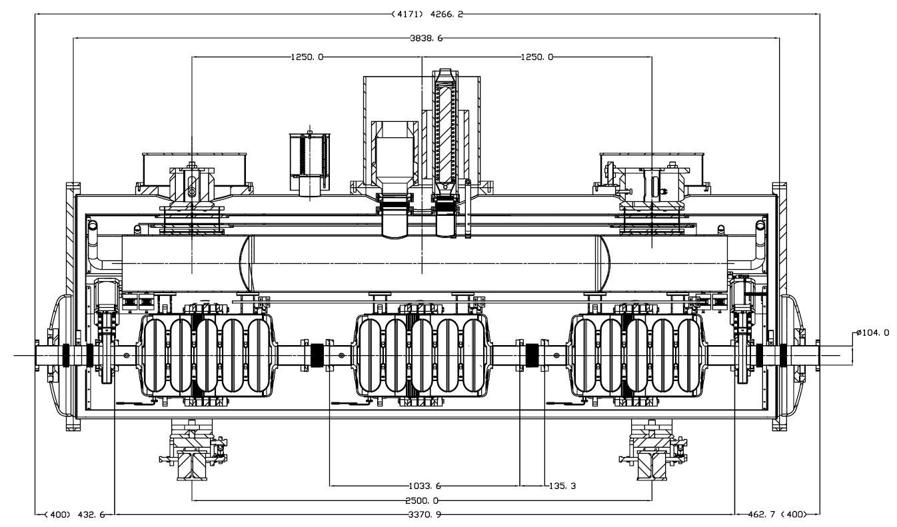
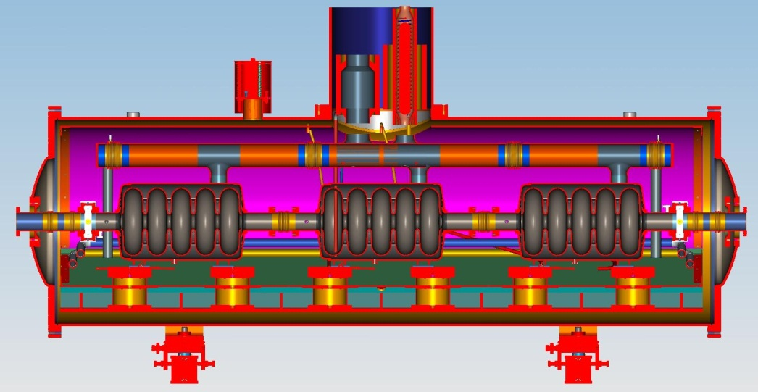
650 MHz 3-cavity Cryomodule, β=0.61.
SSR1 & DESY Style (stand alone)
Overall length (CS-Flange to Flange)~4200mm
Number of Cavitis-3 (shorter approx. 300mm)
Distance between couplers-1468.9mm
Interconnection bellows length-135.3mm
Gate valve (cold) for each end of Beam Pipe (2)
Number of Support posts-2 (1-Fix, 2-Sliding) or 6 (SSR1)
Cavity string support: 300mm pipe serves as strong back, as the 2-phase
helium pipe (DESY St.), or strong back (SSR1 St.)

Slide 37
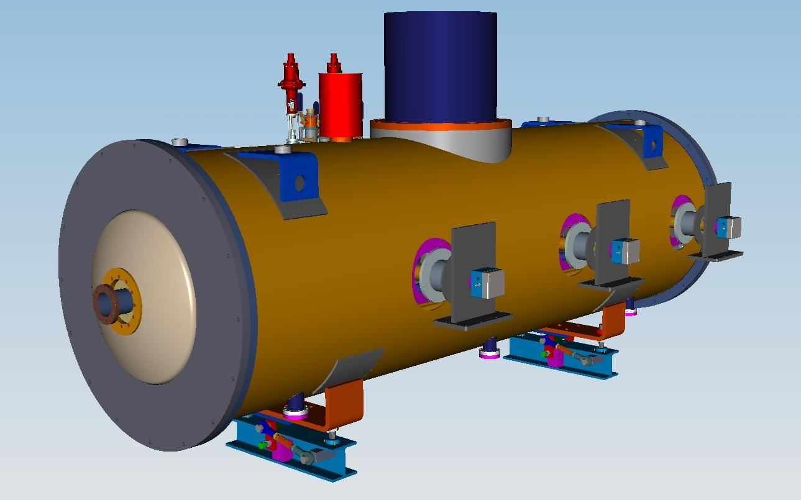
650 MHz Cryomodule, β=0.61.
(SSR1 Style, stand alone)-3 cavity concept
Heat Exchanger
Cryogenic stuff:
bayonets connections (He supply
and return), Cryogenic valve
control system
Power couplers (3)
Beam pipe
Vacuum Vessel
(pipe: 48”-OD, .375”-wall)

Slide 38
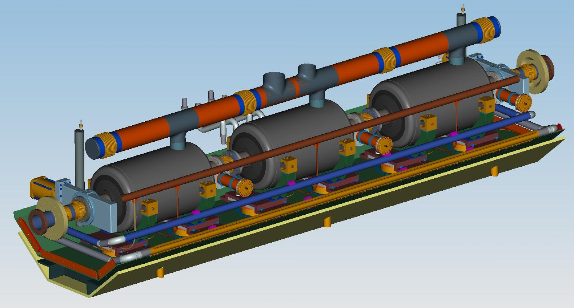
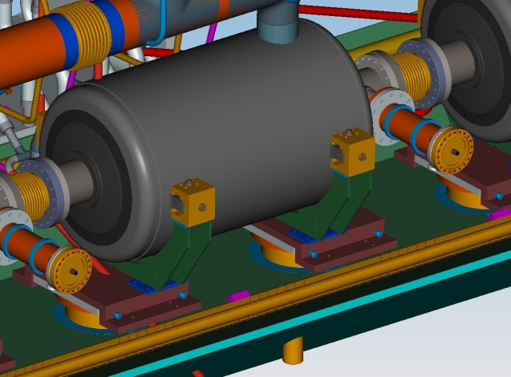
650 MHz Cryomodule, β=0.61.
Cold Mass (SSR1 Style)-3 cavity concept
-650 MHz, β=0.61, cavity with lever tuner (not shown)
-Cavity Bearing supports
-2-phase pipe (ID= 16.3cm)
-He level
-Gate valve
-Strong Back
-Cryogenic piping
-Cavity alignment
supports
-Support posts
(2 per cavity)

Slide 39
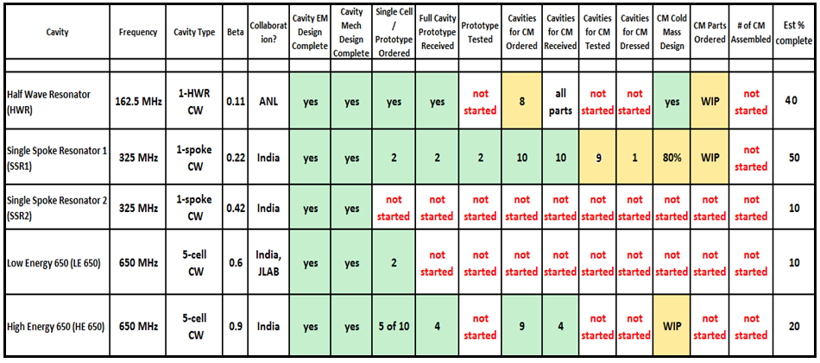
PIP II Cavity and CM development

Slide 40
Conclusions
Design of the cavities, input couplers and cryo-modules for all the sections of CW linac
- SSR1;
- SSR2;
- LB650;
- HB650
is in progress;
Investigations of HOM influence on the accelerator
operation are completed;
“High Q₀ program” is developing;
Microphonics and LFD investigations are in progress.

