Slide 1
LAr1-ND Cryostat and Cryogenics
Jul 8, 2014
Slides prepared by
Barry Norris and David Montanari

Slide 2
Outline
Introduction
Cryostat
Cryogenic System
Outstanding issues
Summary

Slide 3
Introduction
The Short-Baseline Neutrino Program (SBN) at Fermilab will study neutrino properties using a combination of detectors:
  existing MicroBooNE
  new LAr1-ND (Near Detector)
  a refurbished ICARUS T600 (Far Detector)
These slides described the current thoughts on the cryostat and cryogenic system for the LAr1-ND detector.
The base design is a membrane cryostat of 129 m^3 (LAr volume) or 180 ton LAr Mass.
The cryostat will be housed in a new dedicated building next to the SciBooNE enclosure, where the cryogenic system will be located. The two buildings will be connected with a tunnel through which interconnecting lines will connect the cryostat to the cryogenic system.
It may be possible to increase the sensitivity by increasing the LAr volume. We have looked into extending the width to 7.9 m (from 4.4) , that is 231 m^3, or 80% more than the original one of 129 m^3.

Slide 4
Layout for LAr1-ND Similar to 35 Ton
(Imagine LAr1-ND as Experiment Connected to Purification/Filtration)
LBNE 35 ton Cryostat
LAPD
LAPD/LBNE LAr purification/filtration vessels/system
1.3-2.4 vol change/day
LAr/GAr transfer lines
  This is the 3D model of PC-4 with the LBNE 35 ton and LAPD.
  We plan to do the same with LAr1-ND and the cryogenic system.

Slide 5
Cryostat

Slide 6
Cryostat Current Design Parameters
Parameter | Value
Type of structure | Membrane cryostat
Outside reinforcement | Concrete enclosure with embedded heaters (Floor + Sides)
Fluid | Liquid Argon (LAr)
LAr Volume/Mass | 129 m^3 / 180 ton
Inner dimensions (flat plate to flat plate) | 4.4 m (W) x 6.1 m (L) x 4.8 m (H)
Depth of liquid argon | 4.8 m (All the gas in the “neck” region)
Insulation thickness | 0.45 m (everywhere)
Primary membrane | SS 304/304L
Operating gas pressure | 1.0 psig (~70 mbar)
Vacuum | No vacuum
Design Pressure | 3.0 psig (~207 mbar)
Design Temperature | 77 K (liquid Nitrogen temperature for convenience)
Metal surfaces in the ullage in ops | < 100K (to reduce outgassing)
LAr pumps for continuous purification | Outside tank
Penetrations | One (HV) through the insulation and all the others through the neck region.
Duration | 10 years
Thermal cycles | 20 complete cycles (cool down and total warm up)
Width varies for more mass

Slide 7
LAr1-ND 129 m^3 Model (based on 35 ton)
This shows model of 129 m^3 or 180 ton LAr total mass. Note the Top Plate here is just a sample with fewer penetrations.
Assumption: A larger cryostat would increase the internal width from
4.4 m to 7.9 m
  This is the 3D model of LAr1-ND based on the 35 ton concept.

Slide 8
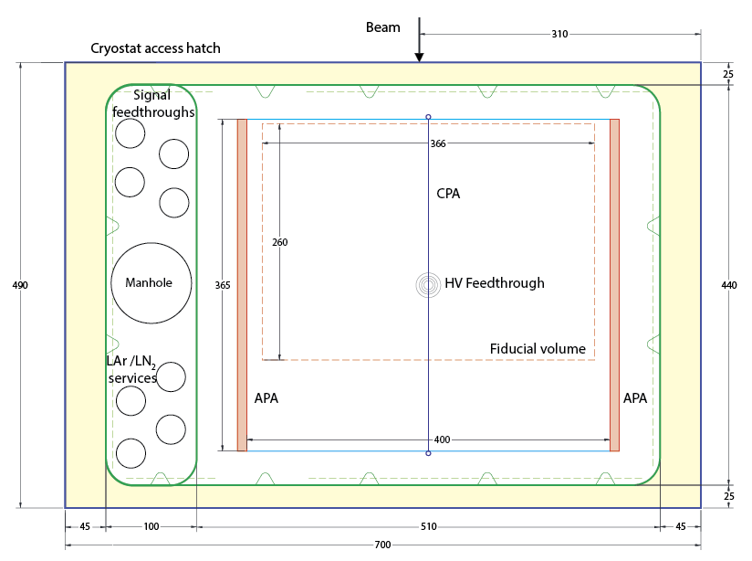
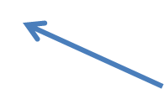
Top View
Important for LBNE:
desired side penetration
for LAr pump.
Insulation 450 mm
This Top Plate
must re-designed
for LAr1-ND
4,900 mm
4,400 mm
Insulation 450 mm
5,100 mm
Insulation 450 mm
7,000 mm
Insulation 450 mm

Slide 9
LAr1-ND 231 m^3 Model (based on 35 ton)
This shows model of 231 m^3 or 322 ton LAr total mass. Note the Top Plate here is just a sample with fewer penetrations.
Assumption: A larger version of the base cryostat. The internal width increased from
4.4 m to 7.9 m
  This is the 3D model of LAr1-ND based on the 35 ton concept.

Slide 10
Heat Leak Summary
 | 129 m^3 Estimated Heat Leak (kW) | 231 m^3 Estimated Heat Leak (kW)
Base of Cryostat | 0.356 | 0.641
End Walls of Cryostat | 0.560 | 1.008
Side Walls of Cryostat | 0.777 | 0.777
Top Plate A | 0.277 | 0.499
Radiative Heat Load through Neck of Top Plate B | ~ 0.326 (from 35 ton estimate) | Assume ~ 0.587 (from 35 ton estimate)
TPC or Electronics | TBD | TBD
LAr Pumps | TBD | TBD
HV Feed through | TBD | TBD
Piping | TBD | TBD
Total | ~2.2 kW + TBD | ~3.5 kW + TBD

Slide 11
Cryogenic System

Slide 12
Cryogenic System Design Requirements
Parameter | Value
LAr purity | 6 ms electron lifetime (~50 ppt O2 equivalent)
Piston purge rate of rise | 1.2 m/hr
Membrane cool-down flow rate | < 10-15 K/hr (vendor’s specifications)
GAr purification flow rate | Value to come from boil off gas and outgassing flow rate
LAr purification flow rate (filling/ops) | 1 volume change/day: - 5.4 m^3/hr = 24 gpm (129 m^3) - 9.7 m^3/hr = 43 gpm (231 m^3)
Convective currents inside the tank | < 10 cm/s
Cooling power | Cool-down: 14 kW (129 m^3) / 22 kW (231 m^3) for cool down. Operations: 2.2 kw (129 m^3) + TBD / 3.5 + TBD (231 m^3).
  Portable system(s) lowered through the top in the SciBooNE hall, with quick connections to/from the cryostat.
  Cryogenic and GAr/LAr purification systems to LBNE design (where possible).
  LN2 refrigeration based on LBNE design is not cost effective.
  GAr purge within the cryostat insulation.
  Cryostat overpressure protection
  Cryostat vacuum protection

Slide 13
LAr1-ND PFD of LAr systems (based on 35 ton)
  This is the PFD of the LAr system of LAr1-ND based on the 35 ton concept (but with an external LAr pump and a system to spray clean LAr/GAr on the top to keep the ullage cold).
  Assumption: 129 m^3 tank (base option).

Slide 14
LAr1-ND PFD of LN2 systems (based on 35 ton)
  This is the PFD of the LN2 system of LAr1-ND based on the 35 ton concept and CERN initial idea as presented on Jun 18, 2014.
  Assumption: 129 m^3 tank (base option).

Slide 15
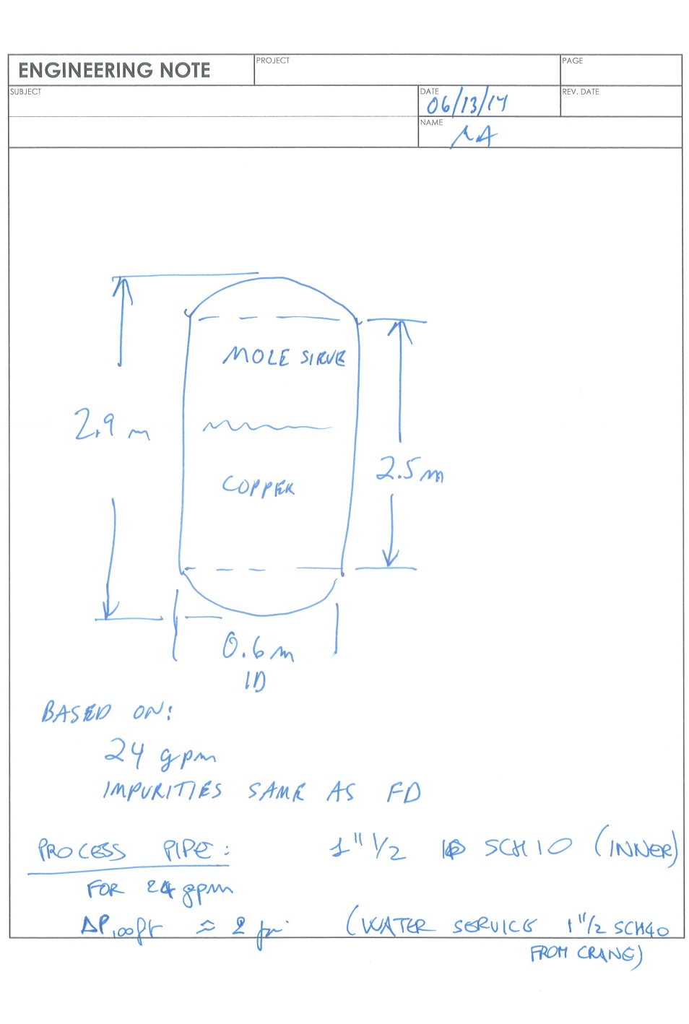
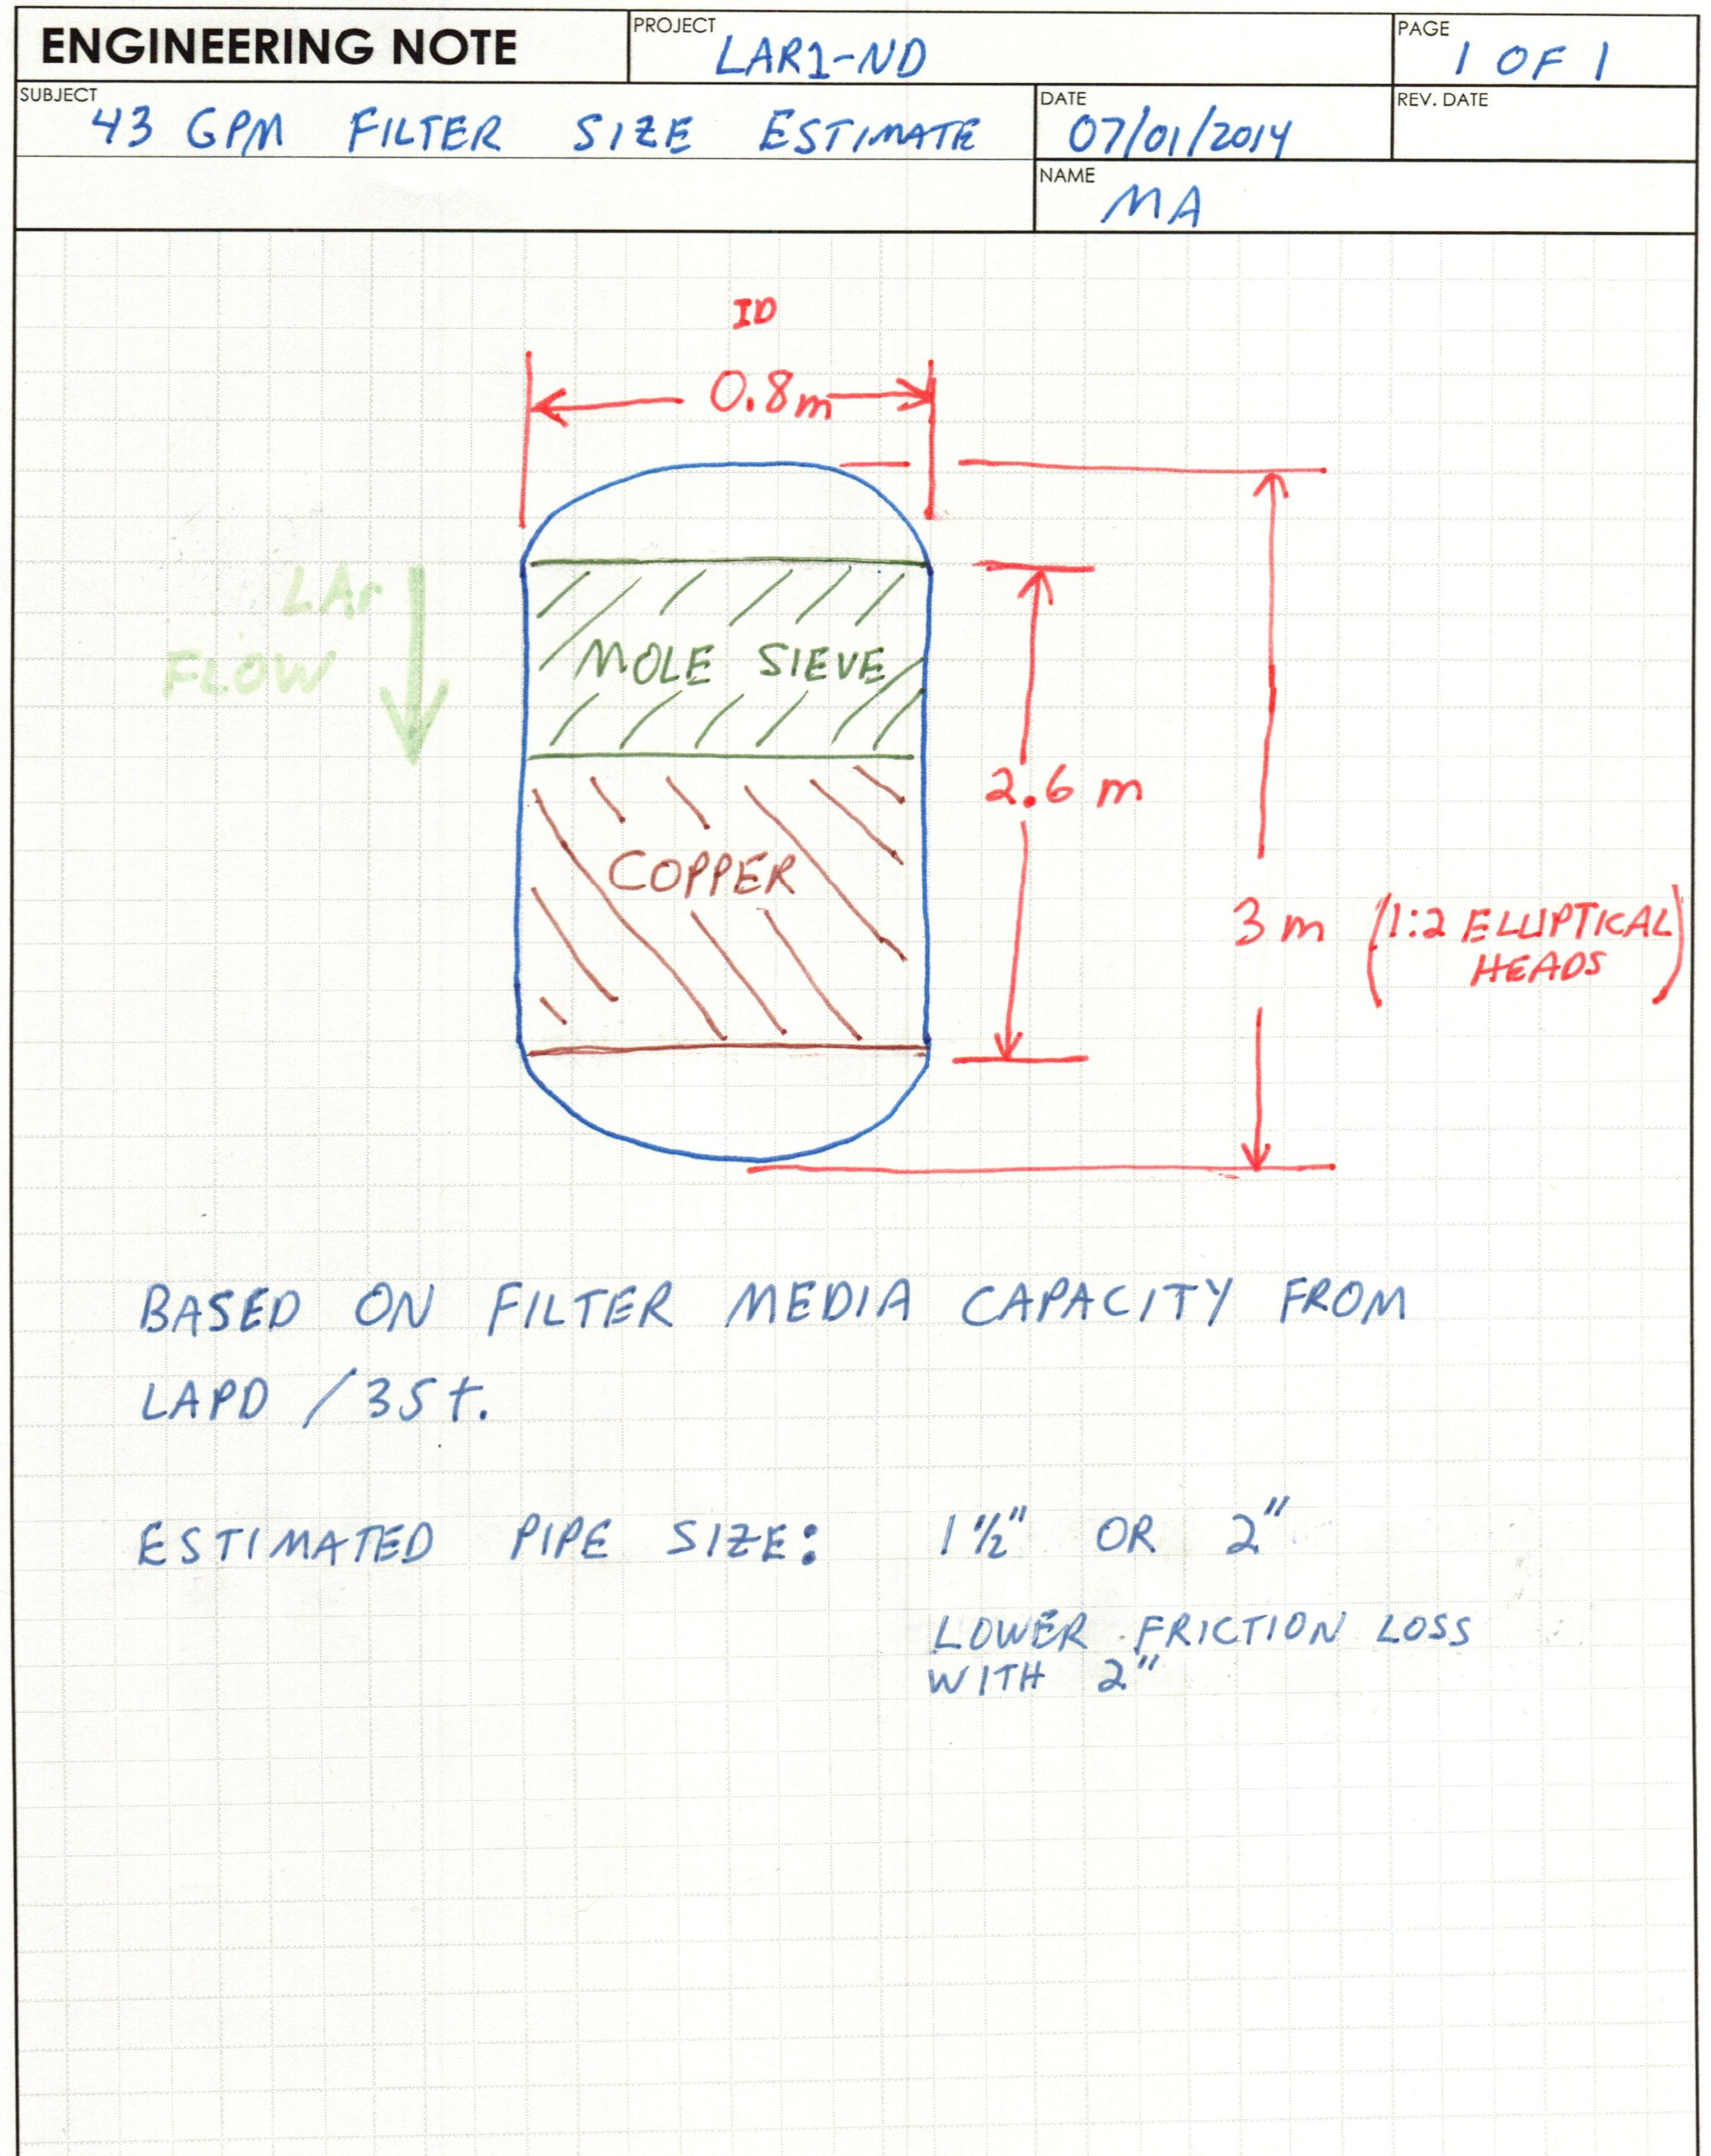
Cryogenic System Conceptual (from Mark A.)
129 m^3
231 m^3

Slide 16
Purification/Filtration systems needs
Gas purge/recirculation: GAr purification during initial cleaning.
Filling: LAr purification.
Operations: LAr + GAr boil off purification.
GAr purge inside the insulation.
LN2 tanker delivery to onsite LN2 dewar (10,000 gal available from D0):
  Five (5) year usage based on estimated heat leak
LN2 Refrigerator based on LBNE cycle (NOT cost effective):
  Estimated Cost of LN2 plant (Design, Procure, Install)
  Power + GN2 costs

Slide 17
Cryogenic System Capabilities
To purify the LAr (filling and operations).
To re-condense and purify the boil off gas.
  LAr condenser and LN2 phase separator.
  LAr circulation pump to send LAr to purification system
To handle the LAr/GAr and LN2/GN2 flows:
  Initial cleaning → GAr purging and venting, GAr recirculation and purification.
  Ops → cool down, LAr filling, GAr boil off purification and re-condensation, LAr purification, LAr return to the tank.
  Make-up GAr.
Pressure control/Vacuum protection (inside the tank):
  PSV, VSV, Auto/Manual venting.
To handle the GAr purge inside the insulation.
Instrumentation and diagnostics: T and P sensors, flow meters, liquid level sensors, etc., analytical instruments to measure the contamination, in-line Purity Monitors (??), etc.
To develop the control system.

Slide 18
Current list of penetrations
Liquid level probe(s).
LAr Out (to LAr pump through the side of the tank)
LAr In (from pump discharge through purification system)
Cool-down ports (depending on cool down method)
GAr purge inlet
GAr purge outlet
GAr to condenser and vent valves
Low P make-up GAr
PSV
VSV
LAr cool-down
T sensors
T sensors Feedthrough
Miscellaneous Feedthrough (LED lights, etc.)
TPC Signal Feedthroughs (warm or cold ??)
TPC HV feedthroughs (on center of cryostat)
Purity Monitor(s)?
Glass window view port ??
Sampling ports
LN2/GN2 heat exchanger ports
Instrumentation & Diagnostics ??
Spare ports

Slide 19
Feedthroughs
TPC HV FT:
  warm FT right on top of the Cathode plane with its c own nozzle.
  Ullage region of the HV needs to be connected to the ullage region in the “chimney” to maintain stable liquid level in the HV nozzle.
Signal Baseline:
  Warm FT. “MicroBooNe” Style.
  Option: Long “Cold” FT dipping into the liquid. Eliminates the exposed cables in the gas region. Needs to be designed.

Slide 20
Outstanding issues
Installation:
  How will the TPCs be installed?
  Do the cryostat dimensions need to be revised to account for the installation of the TPCs?
  Does the location of the openings (feedthroughs and installation hatch) need to be modified?
  How do we connect the cables to the Feedthroughs?
  How do we test the APAs during installation?
  Integration of TPC in cryostat
  Studies on how to keep all surfaces at a Temperature lower than 100 K.
  Studies on how to minimize noise in the vicinity of the wires.
LAr Pump (Outside):
  Need to see how to isolate the pump electrically and mechanically from the TPC. Issues with electronic noise and microphonics.
  Check with Fermilab safety that cryogenic review panel is ok. We believe it it ok.
  This is related to the overall grounding plan. Need to update MicroBooNE’s grounding plan.
Ability to make modifications after run for x years ??
  Replace the electronics ??

Slide 21
Summary
Preliminary thinking has been done on layout of LAr1-ND for two different sizes: base option (129 m^3) and enlarged (80% more) version (231 m^3).
Cryogenically the system ‘feels like’ the 35 ton system at Fermilab’s PC-4 but placed in separate facility detector.
LAr cryogenic system is thought to be a scaled-up version of that of 35 ton/LAPD.
Need to decide on LN2 system design “common” to T600 (FD).
Closing statements:
Fundamentally there are no foreseen issues related to increasing the cryostat size. There are increased costs for the cryostat as well as the cryogenic system. They will scale with heat leak and the purification flow rate.
The two design issues which are key:
  1) How does the TPC installation/integration happen ?
  2) How do we keep the surfaces of the ullage at T <= 100 K ?

Slide 23
Backup

Slide 24
Current Schedule
The goal is to have the detector ready for commissioning in the fall of 2017 and to take beam data in Apr 2018.

Slide 25
LN2 refrigeration conceptual from MA

Slide 26
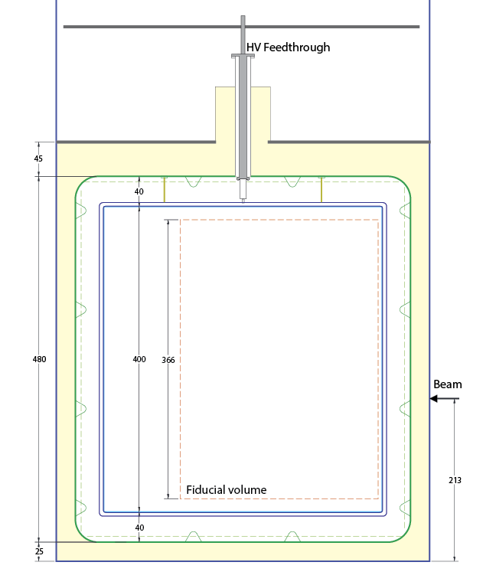
Side View
CHANGE: Note that in new building we request to
Have 450 mm insulation
On all six planes
Insulation 450 mm
The HV feedthrough does not have to be in the center of the CPA in this view
Insulation 450 mm
4,800 mm
Insulation 450 mm
4,400 mm

Slide 27
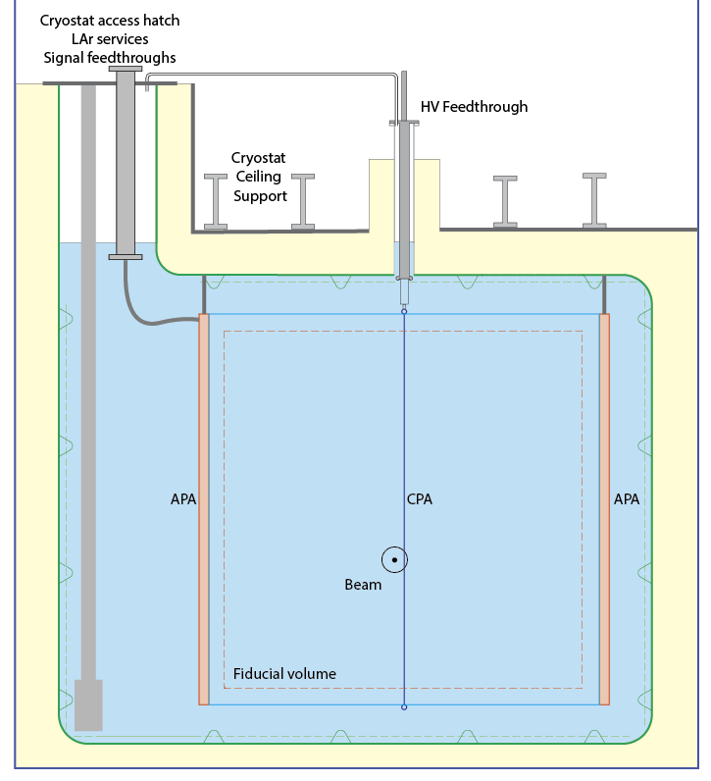
Back View
Insulation 450 mm
1,000 mm
Insulation 450 mm
1,200 mm
Insulation 450 mm
Desired Side Penetration
for LAr pump.
4,800 mm
Insulation 450 mm

Slide 28
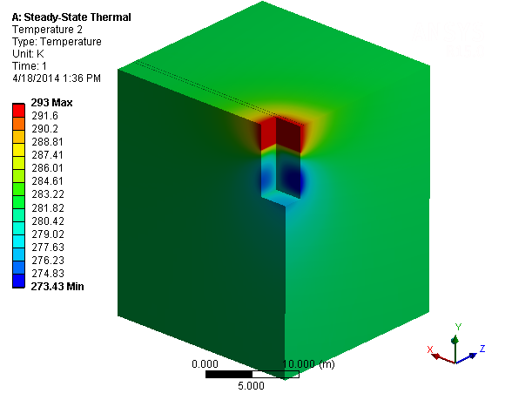
With 400W Floor Heater and 200W Large Side Heaters (800W Total) the concrete along the sides reaches a minimum temperature of ~273K. If the structure if free standing and is does not lay against the soil, the temperatures will be even higher.
Temperature Profile in Concrete/Soil with heaters

