Slide 1
Surge protection for liquid argon tpc detectors
Ben Jones, MIT
Notes:
for liquid argon tpc detectors

Slide 2
This Talk
1. Introduction to the HV transient problem
    HV transients on the field cage
    Possible solutions
    Surge protection : GDTs and varistors
    Devices installed in MicroBooNE
2. Testing of HV surge protectors
    Behavior in cryogenic conditions
    Cryogenic robustness under high energy and voltage
    Purity impacts
    Testing on the MicroBooNE TPC

Slide 3
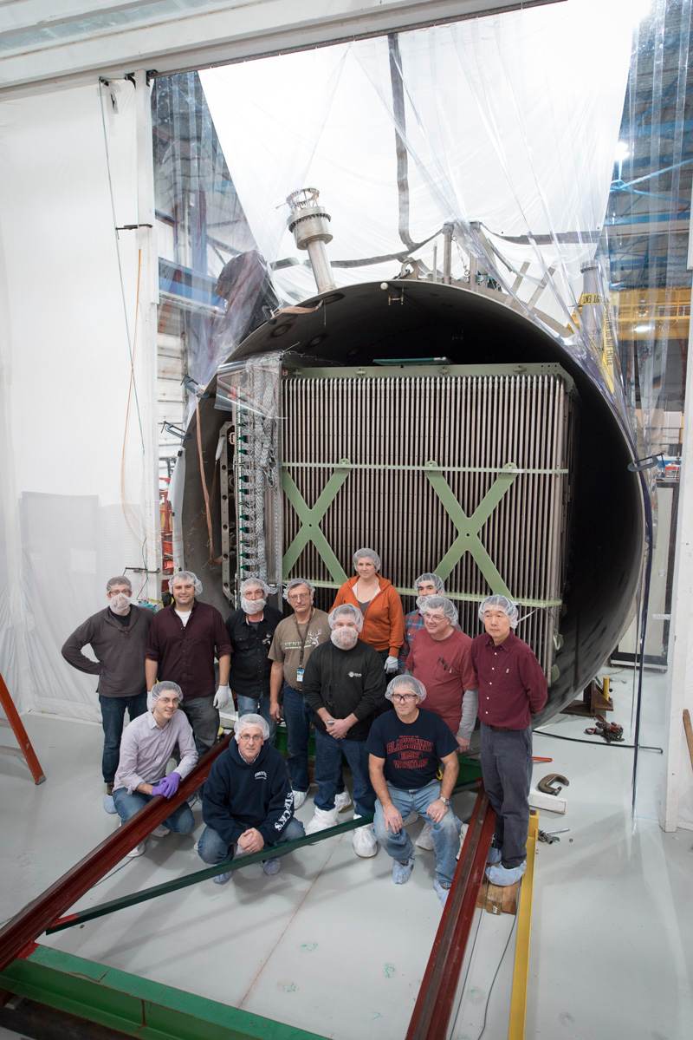
MicroBooNE field cage rings
Anode (ground)
Cathode -128kV
Notes:
----- Meeting Notes (7/3/14 15:21) -----
Where is anode and cathode

Slide 4
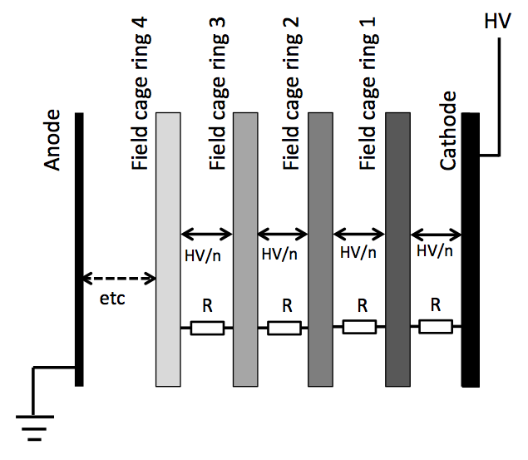
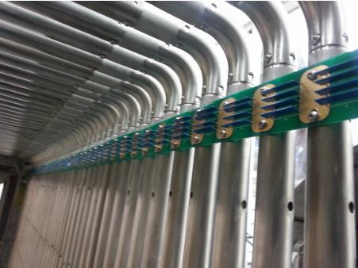
Voltage distribution in the MicroBooNE field cage
MicroBooNE design:
4 x 1 GΩ SlimMox resistors
-> R = 250 MΩ ring-to-ring
Field cage distributes high voltage and provides a uniform E field

Slide 5
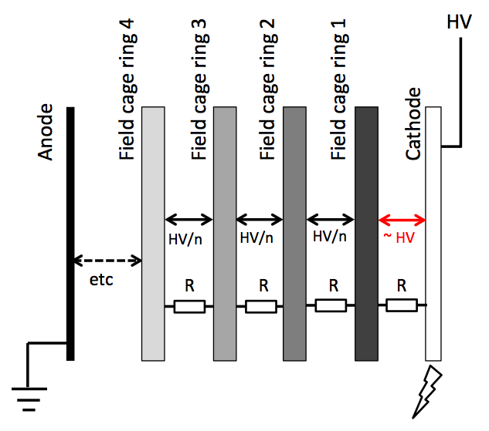
What can happen in a breakdown?
Consider cathode discharge to ground.
Field cage tubes have a capacitance so remain charged.
Large resistances prevent charge redistributing in the field cage.
Capacitances O(1 nF) and resistances O(100 MΩ) lead to relaxation times O(0.1 s)
Similar (sometimes worse) behavior if a field cage tube discharges.
The exact voltages evolved depend on all the capacitances in the TPC-Cathode-Cryostat system

Slide 6
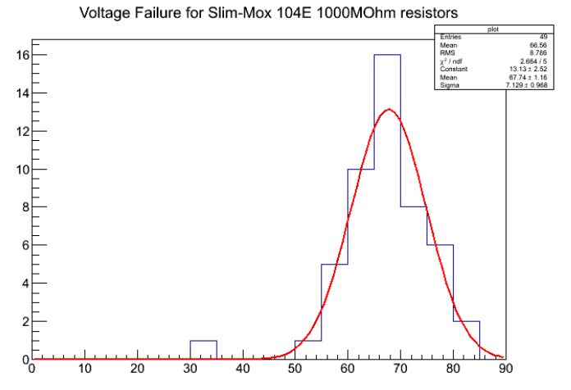
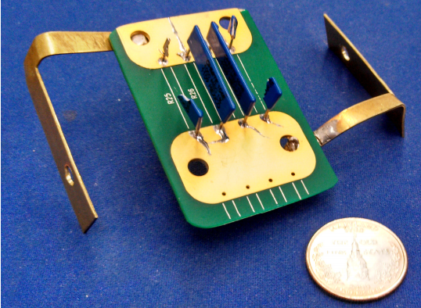
Uh Oh…
Stress tests of installed SlimMox resistors for MicroBooNE show that they fail at voltages as low as 30 kV
Simulations of the TPC in a spark condition show that we expect up to 90 kV held for ~0.5 s in a breakdown event.
Typical failure mode:
Thomas Strauss et al
Paper in preparation.
Notes:
----- Meeting Notes (7/3/14 15:21) -----
Italicize strauss

Slide 7
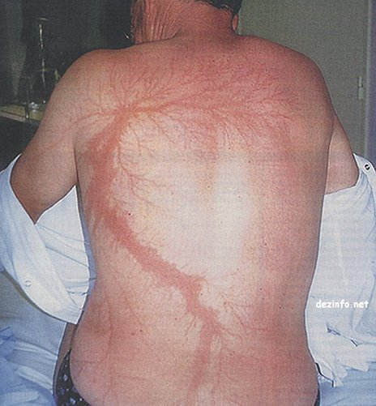
What can we do???
If you don’t want to get hurt by lightning…

Slide 8
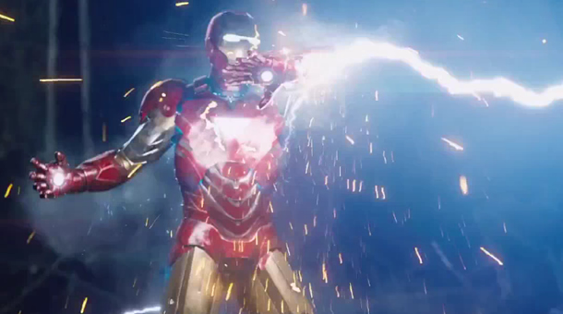
What can we do???
Option 1 – if you have to go out in the lightning, be heavily armored.

Slide 9
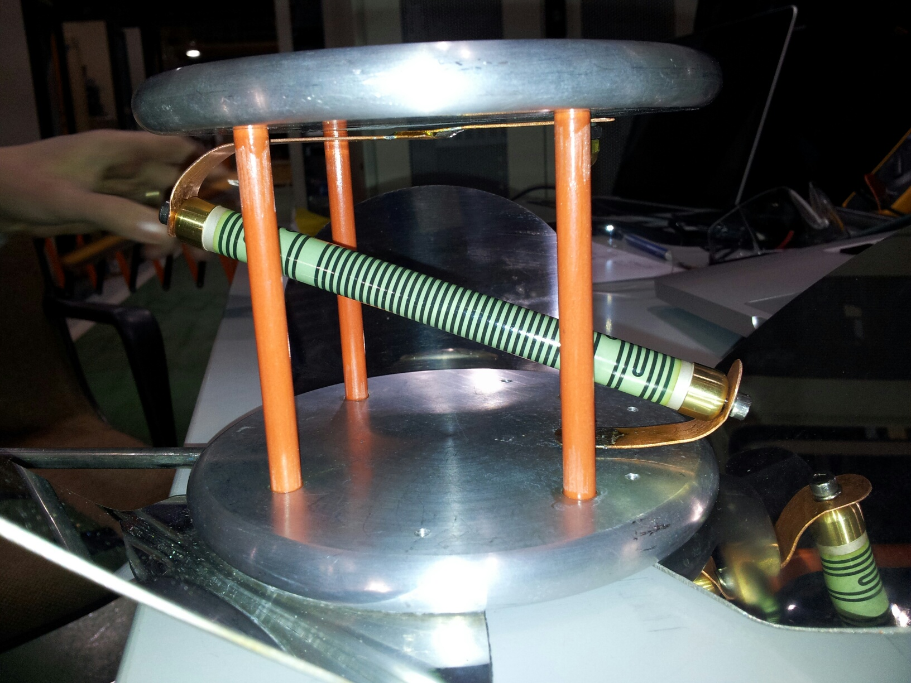
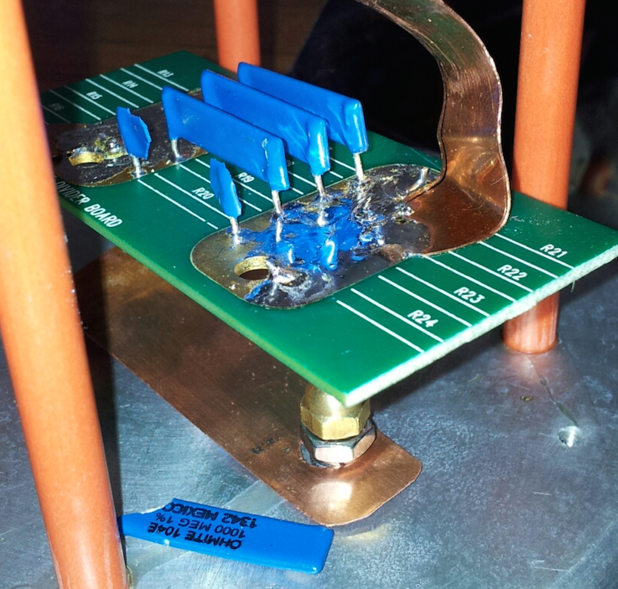
What can we do???
Option 1 – if you have to go out in the lightning, be heavily armored.
MicroBooNE SlimMox resistors
10 kV rating (air)
Failures from 30kV (LAr) experimentally.
Metallux “zebra” resistors
48 kV rating (air)
No failures up to 130 kV (LAr) experimentally
Paper on resistor testing in preparation
Notes:
----- Meeting Notes (7/3/14 15:21) -----
Tested many resistors

Slide 10

What can we do???
Option 2 – don’t go out in the lightning

Slide 11
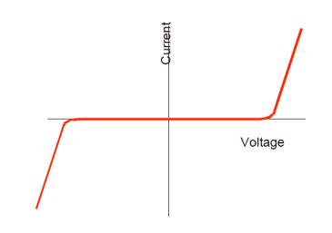
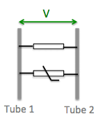
Surge arrestors
Spark
condition
TPC voltage
Very nonlinear V-I characteristic
~ open at low voltages
~ short at high voltages
The transition voltage is called (roughly) the clamping point
We look for devices which clamp above TPC nominal voltage (2kV) but below resistor tolerance (10kV)

Slide 12
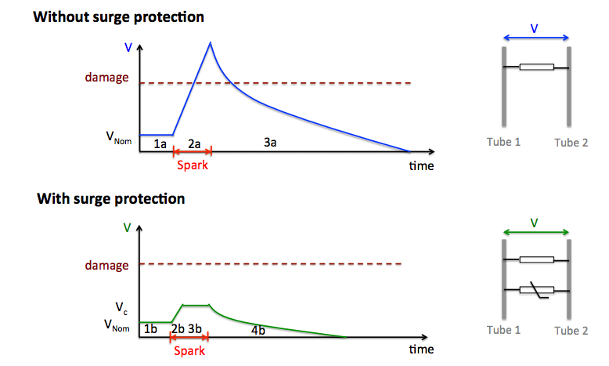
(cartoon)
(cartoon)
With surge protection, the potential difference does not rise above the clamping voltage.
Prevents not only large resistor overvoltage, but also G10, argon breakdowns...
Independent of details of higher order capacitances, spark location, etc.
* Except for possible very short timescales (light travel time) due to inductive effects

Slide 13
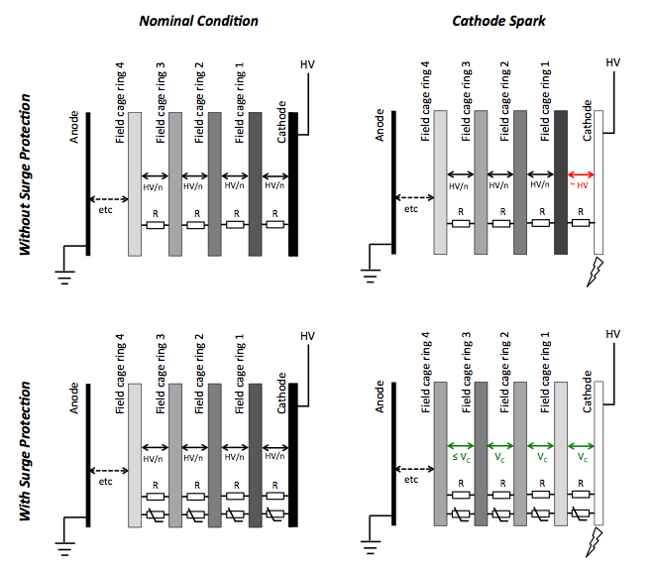

Slide 14
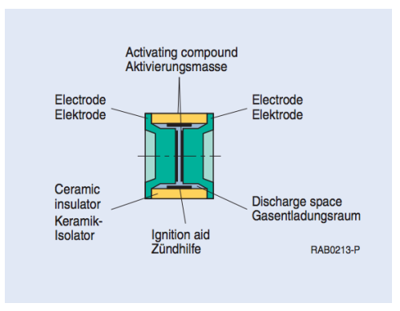
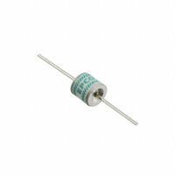
Gas Discharge Tubes
Two electrodes 1-2 mm apart in a gas
About $1.50 each
Very insulating below clamping point
  Our measurements :
  10TΩ warm, 40TΩ in LAr
At clamping point, spark develops within the gas
Single device provides adequate clamping (4500V and 7500V models available)
Very rapid transition from open to conducting with overvoltage, giving a crowbar action
  Our measurements :
  <50 ns warm and Lar

Slide 15
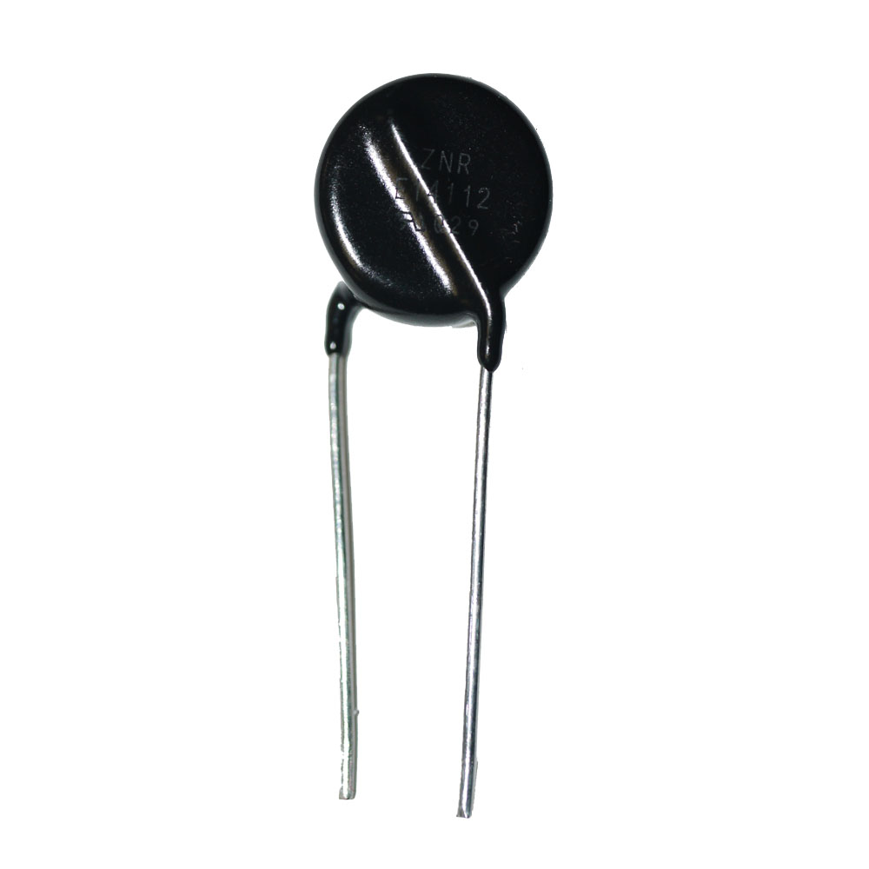
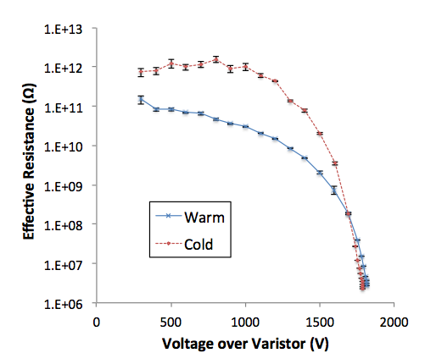
Varistors
Pressed zinc oxide ceramic grains act as a matrix of p-n junctions, giving a highly nonlinear I-V curve
Continuously varying nonlinear resistance from >1TΩ to Ω, giving a clamping action.
About $1.30 each
Clamping voltage can be controlled by varying grain size and dopant composition
Highest voltage device available for TPC mounting has 1800V clamp – need 2 or 3 in series.

Slide 16
What can we do???
Option 1
Option 2
(note – there was also option 3, tune the field cage capacitances to adjust the dynamics of the discharge - this was hobbled by the non-availability of suitably rated capacitors)
Notes:
----- Meeting Notes (7/3/14 15:21) -----
Won't say capacitors

Slide 17

What we actually decided to do:
The MicroBooNE field cage
(schematic)
MicroBooNE Preliminary

Slide 18
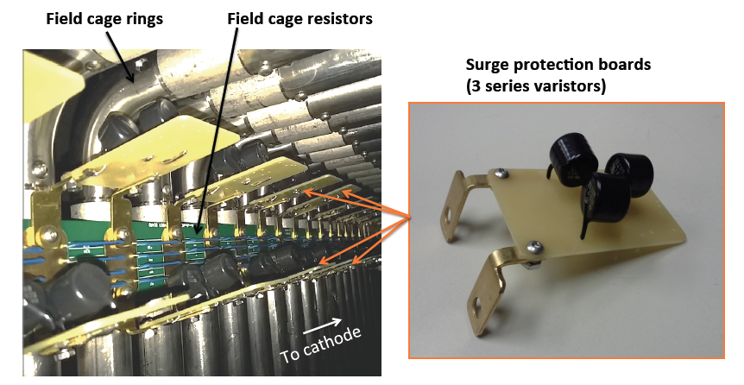
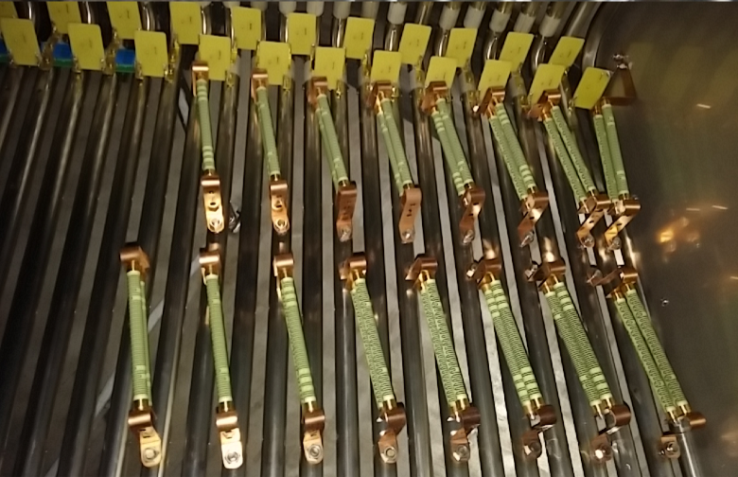
“Chill on the couch” on first 32 of 64 field cage rings
Panasonic ERZ-V14D182 varistors
Rated for 50 J, 5000A surges -55 to 175 C
163 units tested in expected surge condition in LAr
“Wear heavy armor” on first 16 of 64 field cage rings
Metallux 969.23 0.5 GΩ
Rated 48 kV in air -55 to 175 C
8 units tested to full experiment HV (130 kV) in LAr
MicroBooNE Preliminary

Slide 19
This Talk
1. Introduction to the HV transient problem
    HV transients on the field cage
    Possible solutions
    Surge protection : GDTs and varistors
    Devices installed in MicroBooNE
2. Testing of HV surge protectors
    Behavior in cryogenic conditions
    Cryogenic robustness under high energy and voltage
    Purity impacts
    Testing on the MicroBooNE TPC

Slide 20
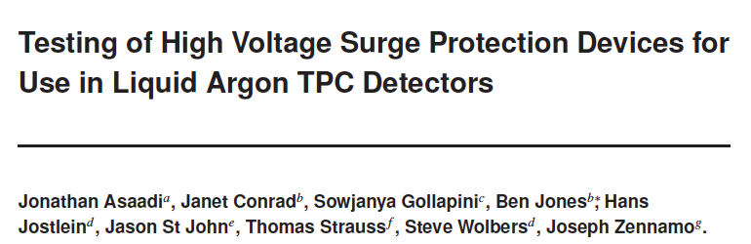
This Talk
1. Introduction to the HV transient problem
    HV transients on the field cage
    Possible solutions
    Surge protection : GDTs and varistors
    Devices installed in MicroBooNE
2. Testing of HV surge protectors
arxiv 1406.5216
submitted to JINST

Slide 21
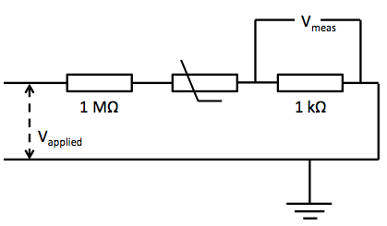
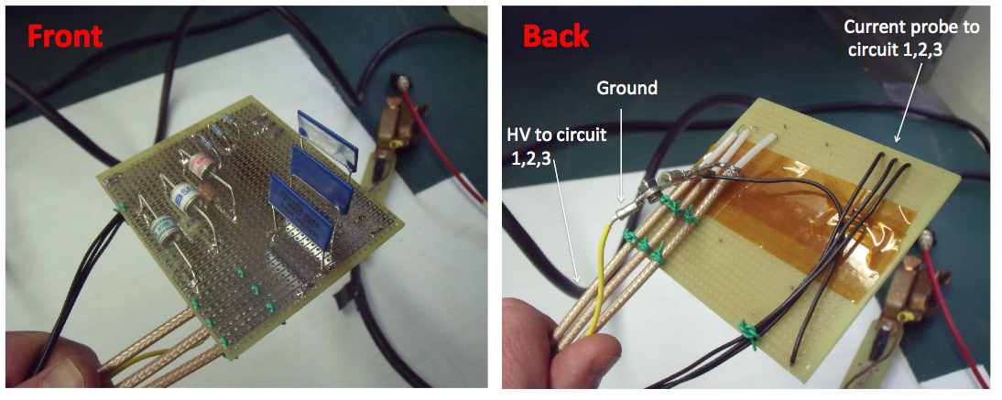
Testing individual units
Measure the numbers + curves I already showed you in the introduction with this circuit →
3 interleaved circuits on a bread board:

Slide 22
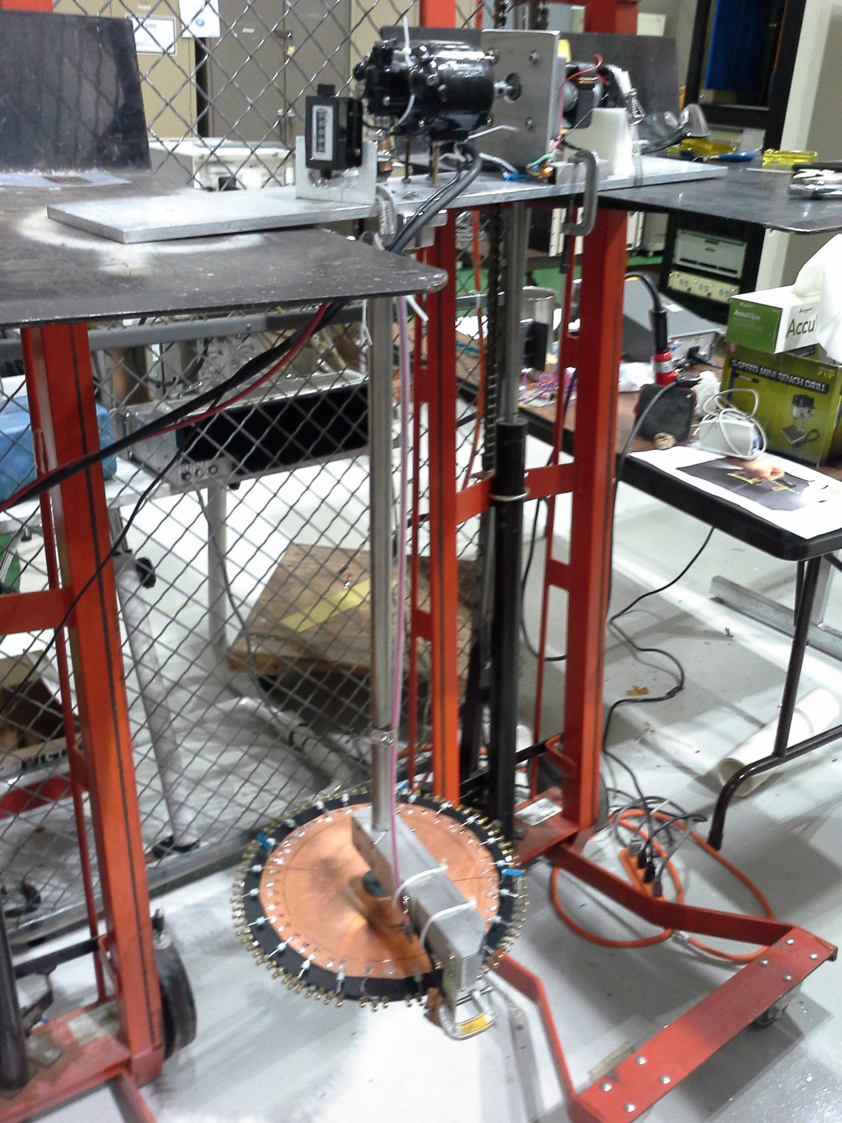
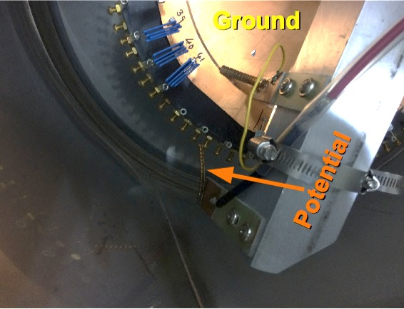
Characterizing large sample of devices
After detailed characterization of a few, 168 varistors and 60 GDTs were tested warm and cold
Motor to turn wheel
Shaft
Ground contact (to center of wheel)
HV contact

Slide 23
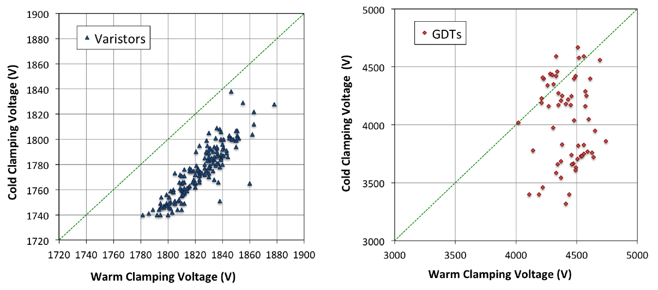
Warm vs Cold Clamping Behaviour
Clamping voltage defined as V applied for 0.5 mA current draw
Clamping voltage defined as V applied for device sparkover and power supply trip

Slide 24
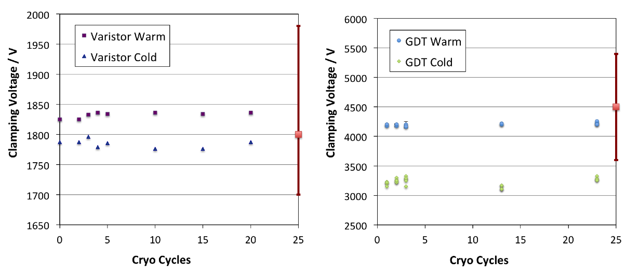
Stress by repeated cryo cycling
Check mechanical robustness under repeated cryo cycles
No deviation from initial properties observed.
Both devices function similarly in both LN2 and LAr.

Slide 25
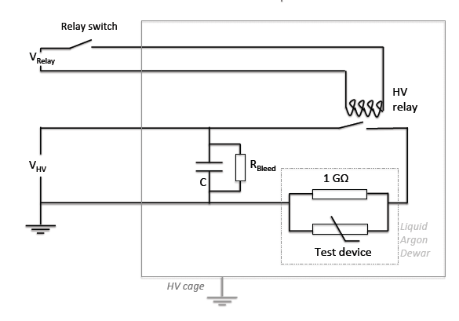
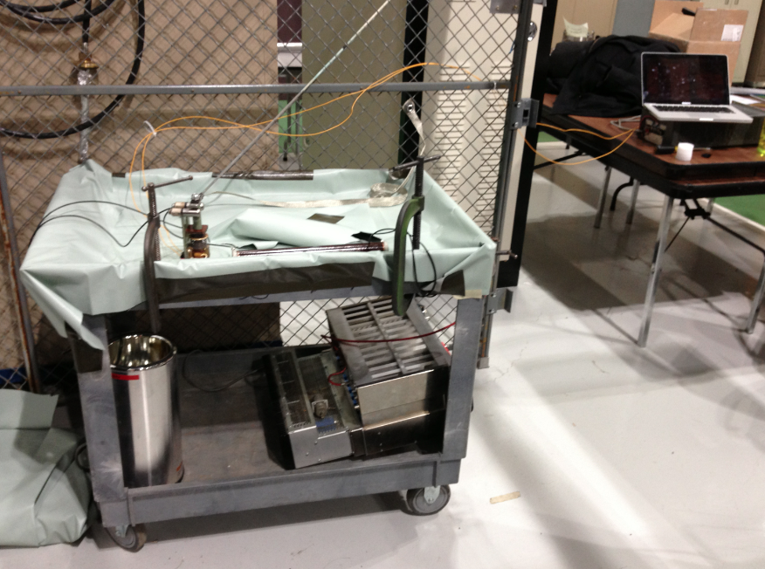
Energy Dissipation Test
Energy which would have been dissipated into resistors has to be dissipated into surge arrestors
We calculate expected energy based on prediction of spice model.
We find nominal MicroBooNE dissipation requirement is at most 2J per device.
We tested energy dissipation using a large capacitor discharged thru a HV relay ->
HV cage
HV relay
Up to 1μF C
Relay control
Up to
15kV DC
Devices in dewar

Slide 26
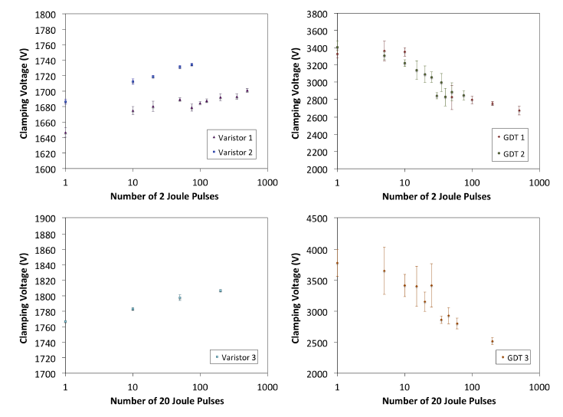
Multi-surge robustness (up to 500 surges)

Slide 27
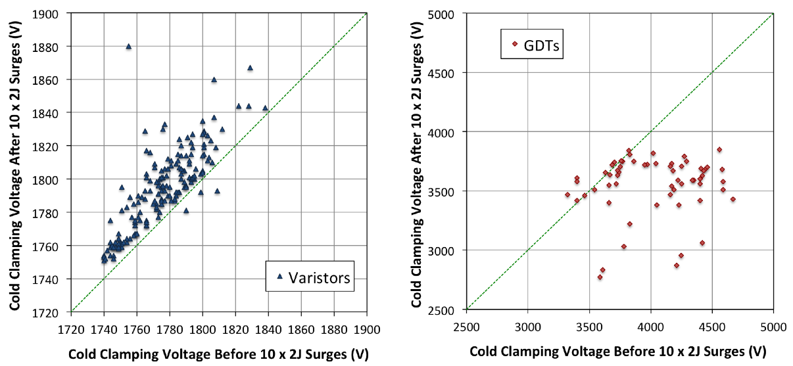
High stats 10 surge test (168 varistors, 60 GDTs)
Notes:
----- Meeting Notes (7/3/14 15:21) -----
Clamping and crowbar

Slide 28
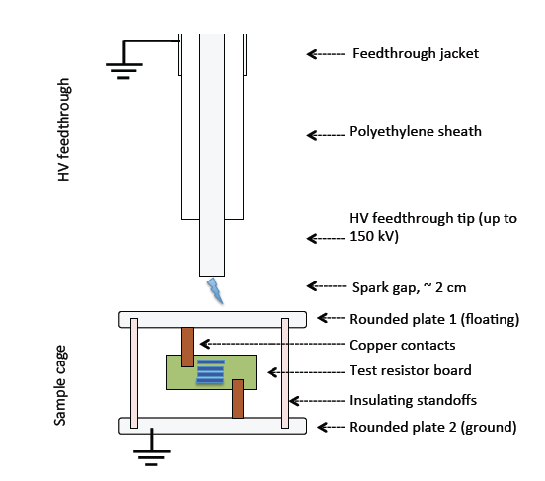
HV transient test
In a non-inductive system, surge arrestor prevents over voltages from being developed
Inductances may cause HV pulses to occur on timescales O(light travel time), tens of ns
We used the MicroBooNE Glassman HV supply and prototype feedthrough to generate a short, full HV transient
A spark provides a conducting path to bring the top plate to full HV and discharge the feedthrough (C ~ 500pF).
Notes:
----- Meeting Notes (7/3/14 15:21) -----
Glassman power supply

Slide 29
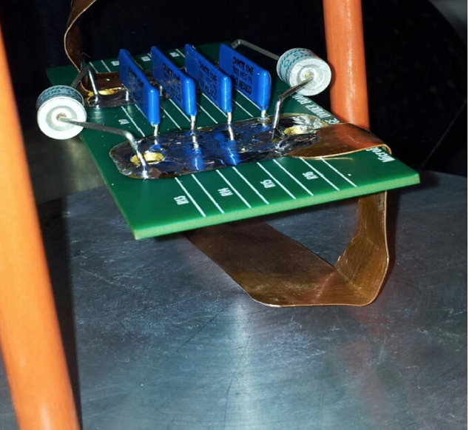
Transient Overvoltage Test
~20 sparks delivered at:
50kV, 60kV, 70kV…. 150kV.
At upper limit of power supply:
20 x 150 kV
GDTs and resistors all survived.
GDTs removed and tested – fully functional with expected clamping voltage.
Repeat with varistors – same behavior
GDTs + varistors are robust against overvoltages of up to 150kV in liquid argon.

Slide 30
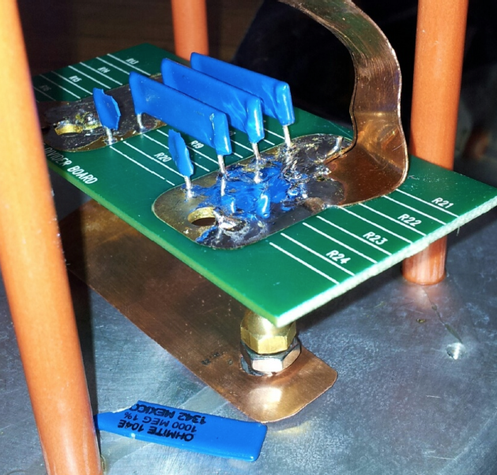
Resistor Protection
Resistors w / surge protection
After > 20 x 150 kV sparks
Resistors only (same set)
after one 70kV spark

Slide 31
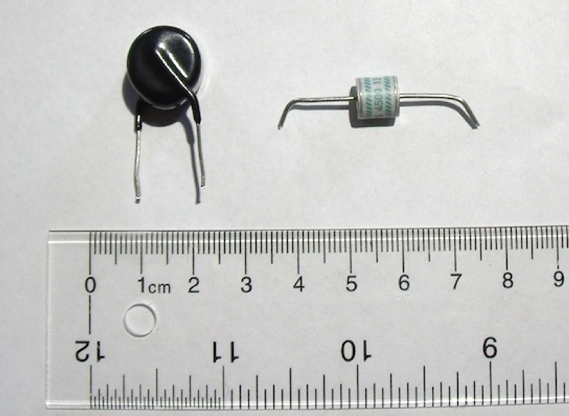
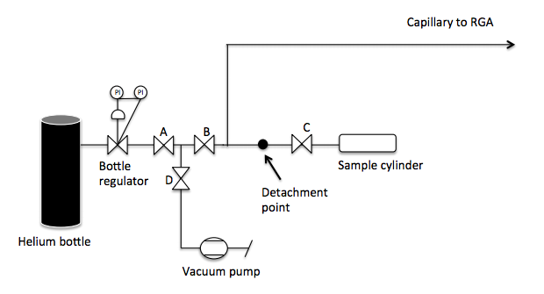
Purity Effects
The device must not damage argon purity
In MTS test, free electron lifetime remained >9ms for 55 hours with filters off.
GDTs contained an unknown gas, which was a potential worry.
We reverse engineered the device and measured the gas composition.
← Home-made setup for breaking open a GDT inside a pre-characterized helium carrier gas
Result: GDT contains only nitrogen at 250 Torr – no problem for purity even in complete leakage situation (10⁻¹² contamination/GDT).

Slide 32
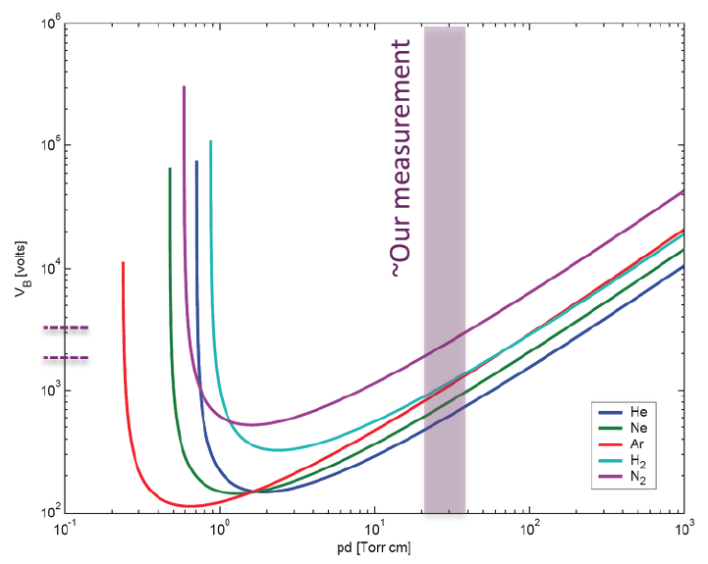
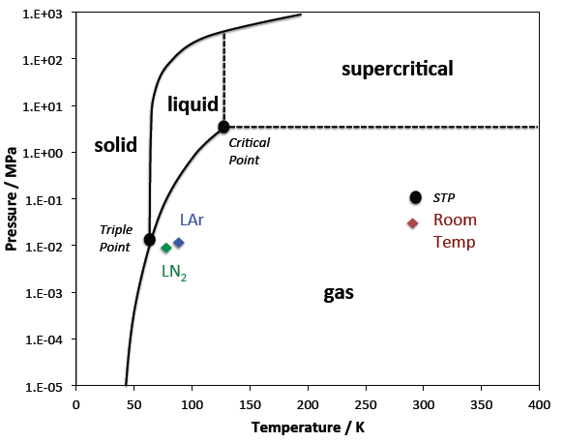
As interesting aside : physics works.
Comparison with Paschen curve shows for this N2 pressure and electrode spacing, ~3kV breakdown.
Comparison with phase diagram for N2 shows that GDT contents remain vapor at LAr and LN2 temperatures, so GDT continues to function.

Slide 33
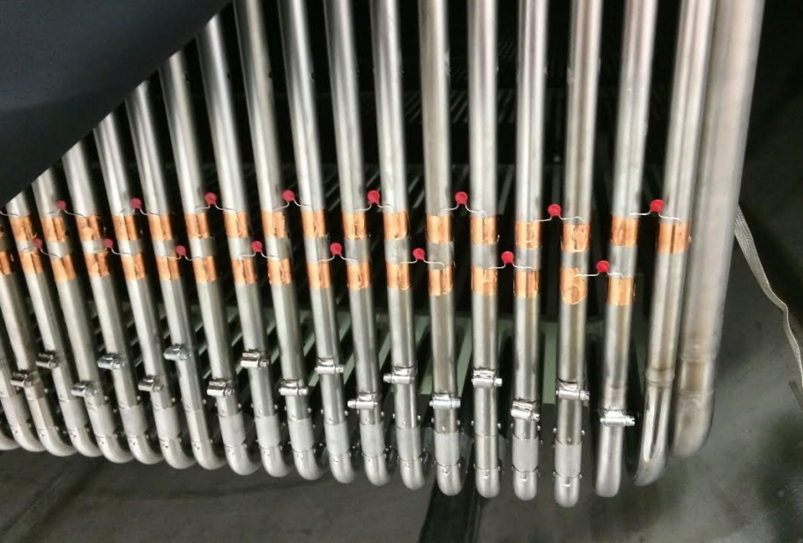
Direct test on field cage
We applied lower clamping varistors to the field cage to demonstrate the clamping effect in the real capacitive network using a lower voltage pulse.

Slide 34
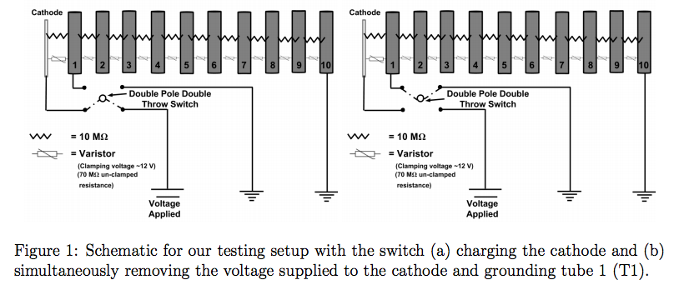
Direct test on field cage
We switch off HV and send a specific tube to ground simultaneously to simulate a HV discharge. We measure voltage on a pair of adjacent tubes.
Simulations show that tube 1 to ground is worst case, so we focus on this first
HV
BEFORE
GND
AFTER

Slide 35
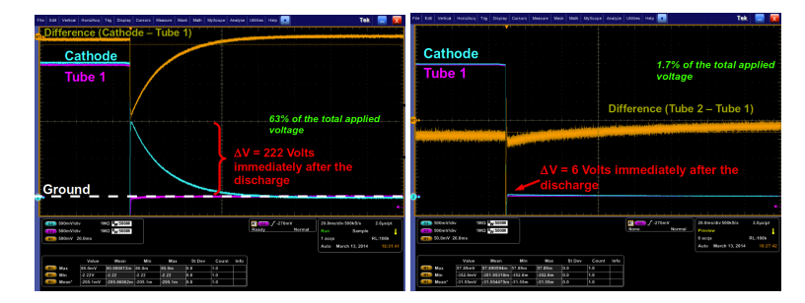
Demonstration of clamping on the TPC
Unprotected
Protected
MicroBooNE Preliminary
Varistors act to clamp potential difference during discharge event

Slide 36
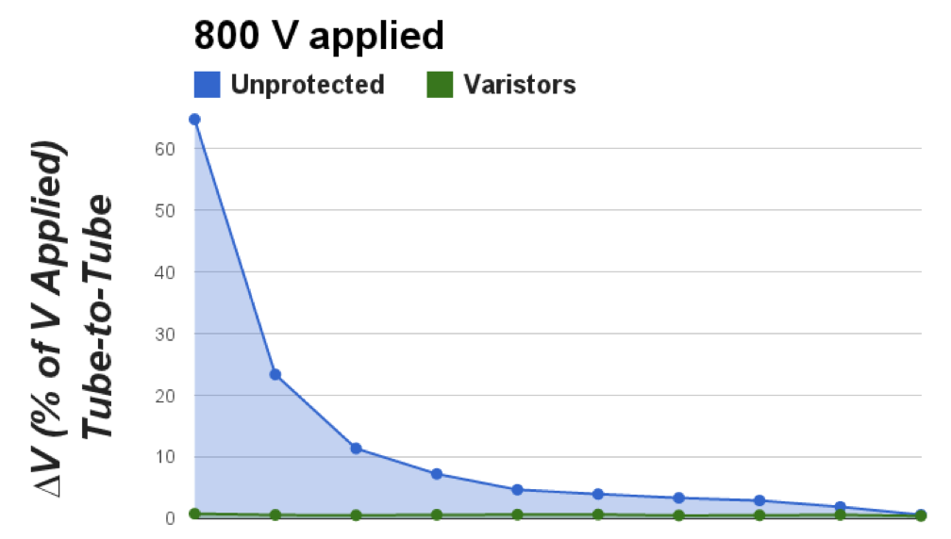
MicroBooNE Preliminary
also grounded several other field cage rings – varistors never allow voltage over clamping point.
0
1
2
3
4
5
6
7
8
9
Gap number

Slide 37
Other bench-top tests (see paper)
No time to talk about…
Other field cage tests:
Test for light emission alongside LBNE paddle tests in TallBo
Insulation resistances measured warm and cold
Measurements of clamping and insulation of series combinations
Long term test performed in LAr (1000 device hours) to check for no spontaneous breakdowns
Run in high purity argon test performed to check functionality in appropriate dielectric environment
Varistor observed to give clamping in all tested situations, including:
  Spark at cathode
  Spark at tube 1
  Spark at tube 8
  Incomplete grounding
  Delayed HV supply trip

Slide 38
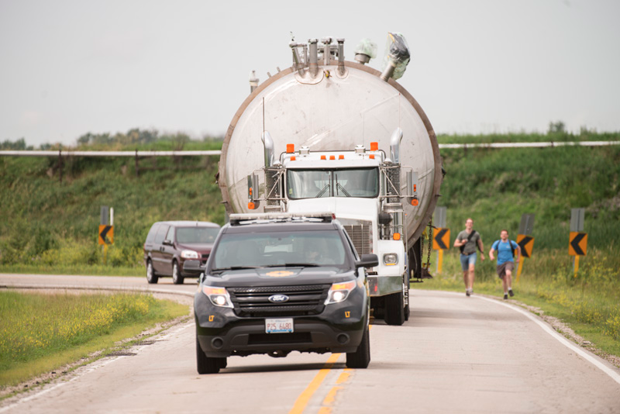
Thank you for your attention.

Slide 39
Backups

Slide 40
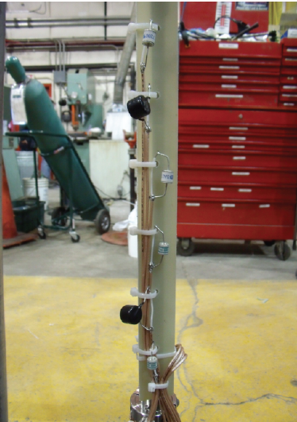
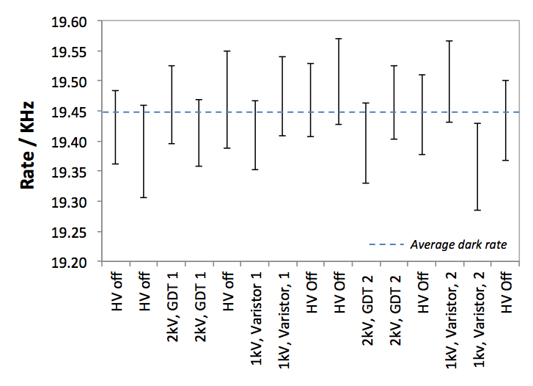
Light Emission
Tested for light emission alongside LBNE light-guide tests in Tall Bo
No emission seen under nominal applied voltage
GDTs were observed to emit light during discharge events
SiPMs
LBNE light guide detector
SHV cables to Bo PMT feedthrough
~15 cm

Slide 41
Flash Emission
A lower rate of larger pulses would also be a problem. We compare pulse size distribution with and without GDT to check for flashes.
No difference from HV-off cosmic spectrum, including in overflow bin.

Slide 42
Discharge Light
We do see the light in the discharge condition – but we don’t care about that (spark will be much brighter)

Slide 43
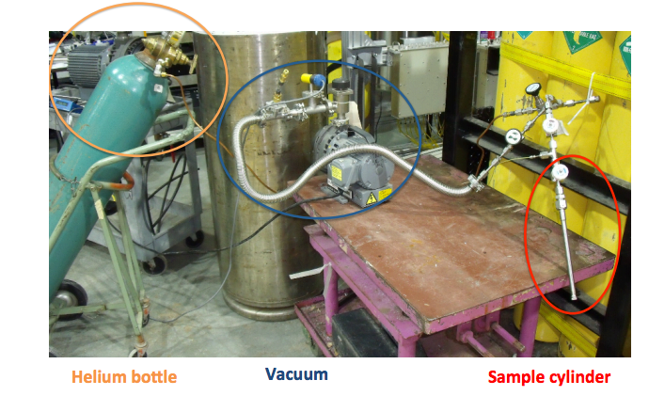
Gas Composition
Built a setup at PAB to supply GDT contents in helium carrier gas to UGA

Slide 44
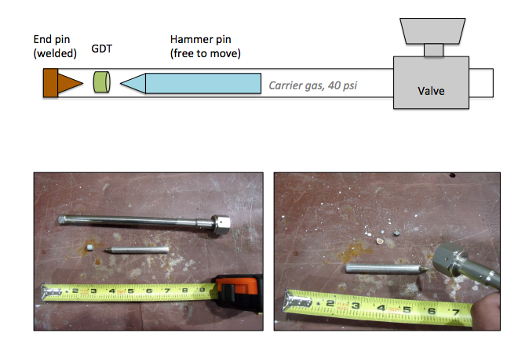
Sample chamber filled carrier gas and this gas is characterized. Then chamber closed and device ruptured.
Measure resulting gas mixture with UGA. Subtract background.
Flush with fresh gas after device broken. Re-characterize to check background stability.
Notes:
----- Meeting Notes (7/3/14 15:21) -----
Cut purity section

Slide 45
Important :
Nothing above atmospheric gasses region

Slide 46
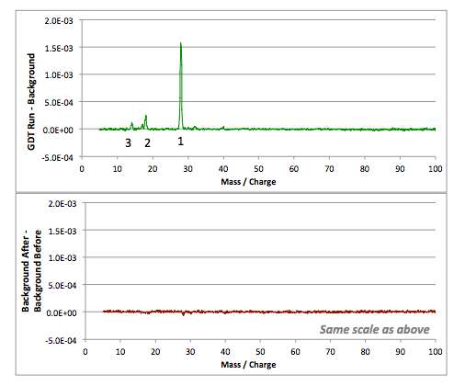
GDT contains only nitrogen at ~99% level
We also characterize the amount of N2 per device
We find that N2 is at 250 Torr in the GDT.
If all nitrogen from all devices leaked into MicroBooNE, 1 part in 10¹⁰ contamination.
-> No purity risk.
1: nitrogen 1x ionized
2: water
3: nitrogen 2x ionized

Slide 47
DC clamping

Slide 48
DC clamping
Test of exact voltage sharing

Slide 49
V_{Relay}
HV relay
Surge protector
1 GΩ
100 kΩ
C = 60nF
V_{supply}
R_{bleed}
1 MΩ
50 Ω
V_{meas 1}
V_{meas 2}

Slide 50
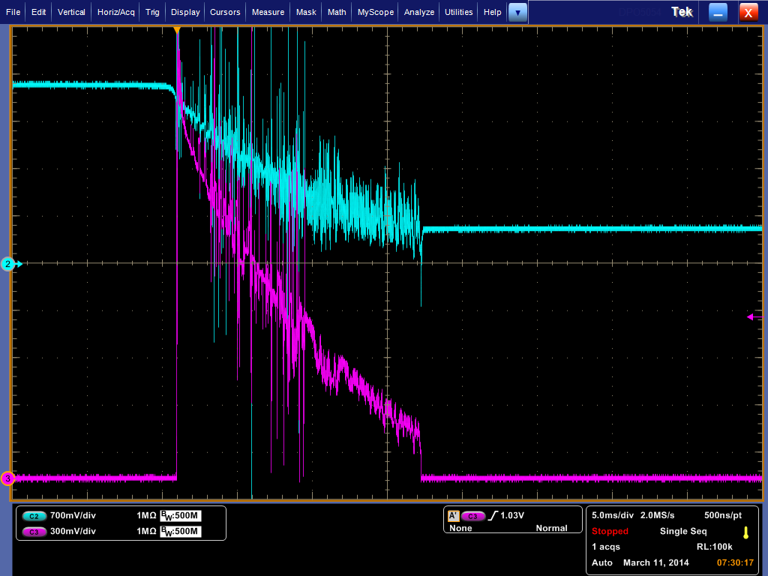
GDT
Extinction measured by capacitor discharge
Clamping
Meas1
Meas2
Extinction
V_{ext} ~ 500V

Slide 51
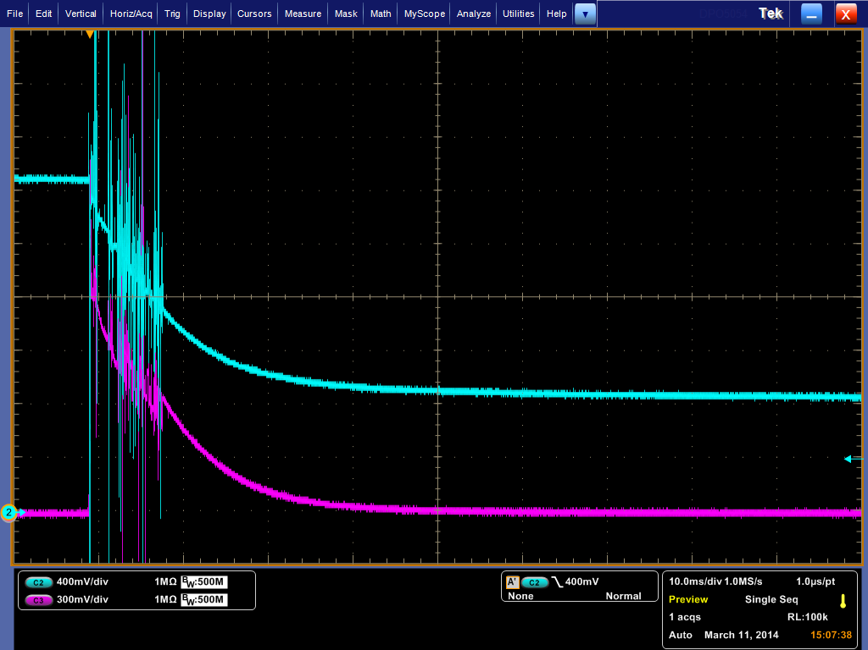
Single varistor capacitor discharge (5kV)
As before:
~ voltage over capacitor
~ current through varistor
V_{clamp}

Slide 52

Series varistors, capacitor discharge
(7.5kV)
2x V_{clamp}
~ voltage over capacitor
~ current through varistor

Slide 53


Other field cage tests:
Brush to ground (rather than hard connection)
Delayed power supply trip
MicroBooNE Preliminary
Varistors clamp field cage voltages successfully in all tested situations.

Slide 54

Role of surge protectors in a spark condition:
(cartoon)
1a: nominal field cage voltage held
2a: spark starts, charge flows, large potential developed
3a: spark ends, field cage discharges with some time constant given by RC network

