Slide 1
Introduction to scintillation light in liquid argon
Ben Jones, MIT

Slide 2
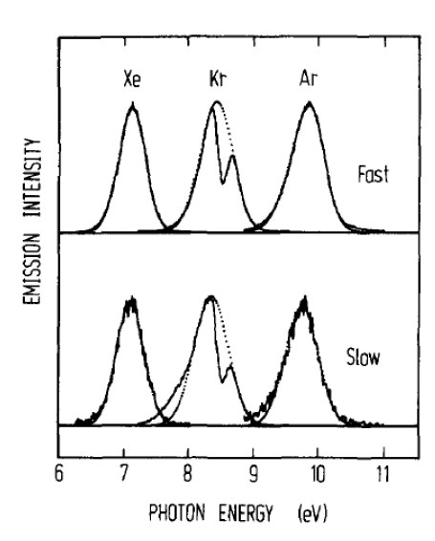
The Basics:
J Chem Phys vol 91 (1989) 1469 E Morikawa et al
Light yield ~ few 10,000’s of photons per MeV (dependences on E field, particle type and purity)
Wavelength of emission is 128nm
Light with two characteristic time constants:
- fast component, 6 ns
- slow component,1500 ns
Argon is highly transparent to its own scintillation light.

Slide 3
Mechanisms of Scintillation in LAr
In liquid argon, there are two important scintillation mechanisms:

Slide 4
Mechanisms of Scintillation in LAr
1: “Self-trapped exciton luminescence”
+
Ar
γ
p
*
*
Ar
Ar
Ar
Ar
Ar
Atomic Excitation
Self-trapping
Radiative decay

Slide 5
Mechanisms of Scintillation in LAr
+
+
e
-
p
Ar
+
*
-
Ar
Ar
Ar
Ar
Ar
e
Ionization
Thermalization of electrons
Recombination
Radiative
decay
Ar
γ
2: “Recombination luminescence”
Ar
Recombination step involves an electron cloud around the track core
-> E-Field dependent scintillation yield
-> dE/dx dependent scintillation yield
-> Charge and light anti-correlation

Slide 6
Self-trapped exciton luminescence
+
Ar
γ
p
*
*
Ar
Ar
Ar
Ar
Ar
Recombination luminescence
+
+
e
-
p
Ar
+
*
-
Ar
Ar
Ar
Ar
Ar
e

Slide 7
Something to note:
+
Ar
γ
p
*
*
Ar
Ar
Ar
Ar
Ar
+
+
e
-
p
Ar
+
*
-
Ar
Ar
Ar
Ar
Ar
e
Both pathways rely on the formation of excimers

Slide 8
Ground state of 2 argon atoms is unbound
Excimer states are Rydberg states : Ar²⁺ core with a bound electron
Ar
Ar
e⁻
Ar₂⁺

Slide 9
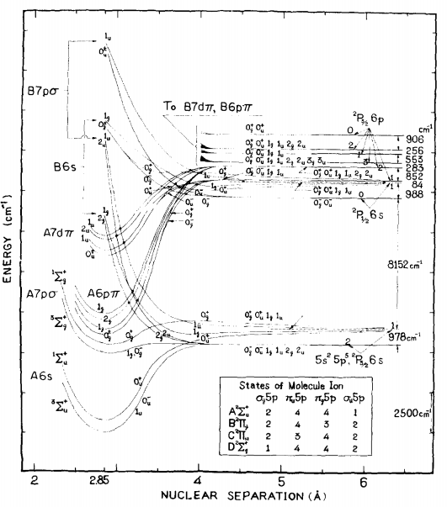
Calculations of the excimer state energies of xenon, as a function of nuclear separation
J. Chem Phys 52, 5170 (1970)
e⁻
Ar₂⁺

Slide 10
Calculations of the excimer state energies of xenon, as a function of nuclear separation
J. Chem Phys 52, 5170 (1970)
There are two low lying excited states:
A singlet state 1Σu⁺
A triplet state 3Σu⁺
Singlet and triplet refer to how the spin of the electron and argon dimer couple in the rydberg “atom”.
e⁻
Ar₂⁺

Slide 11
All scintillation light comes from excimer decay
*
Ar
Ar
Ar
γ
Ar

Slide 12
Calculations of the excimer state energies of xenon, as a function of nuclear separation
Why are LAr / LXe transparent to their own scintillation light?
J. Chem Phys 52, 5170 (1970)
128 nm photon emission

Slide 13
How about the reverse process (absorption?)
γ
Ar
Ar
*
Ar
Ar

Slide 14
Calculations of the excimer state energies of xenon, as a function of nuclear separation
Why are LAr / LXe transparent to their own scintillation light?
J. Chem Phys 52, 5170 (1970)
Typical separation in the liquid phase ground state
(~4A, naively from liquid density)
128 nm photon emission

Slide 15
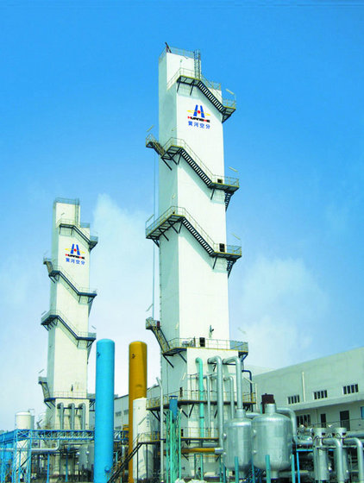
Impurities in LAr
Ultra-pure argon is very transparent. Dirty argon is not.
All liquid argon will have trace impurities at some level.
Some impurities are important for drift, some for light, some for both.
Impurities which are difficult / expensive to remove are those which are
  1) present in the raw gas
  2) similar in boiling point to LAr
  3) not removable by regenerable filtering techniques
The composition of impurities depends on the source of the raw gas.
An argon isolation plant

Slide 16
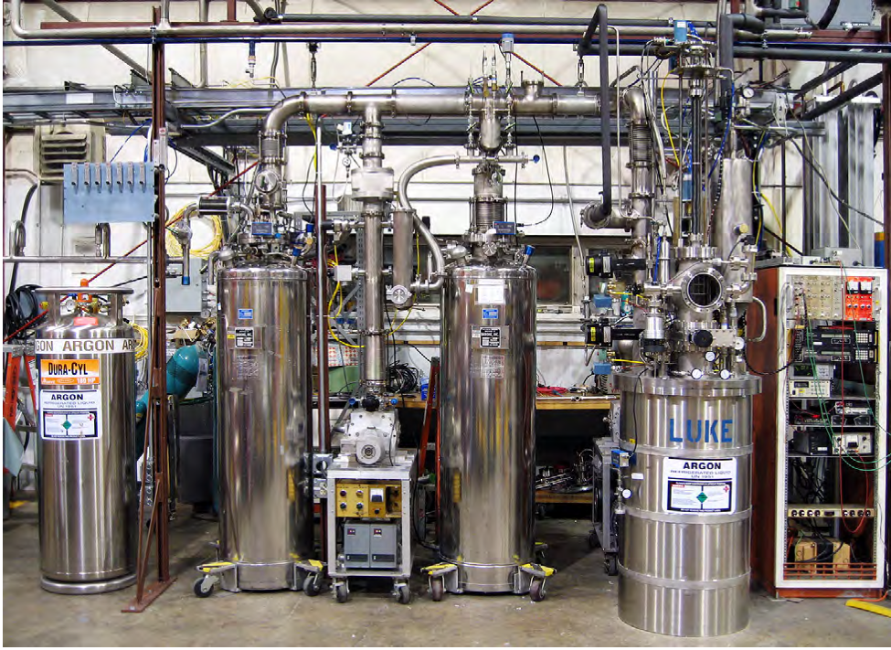
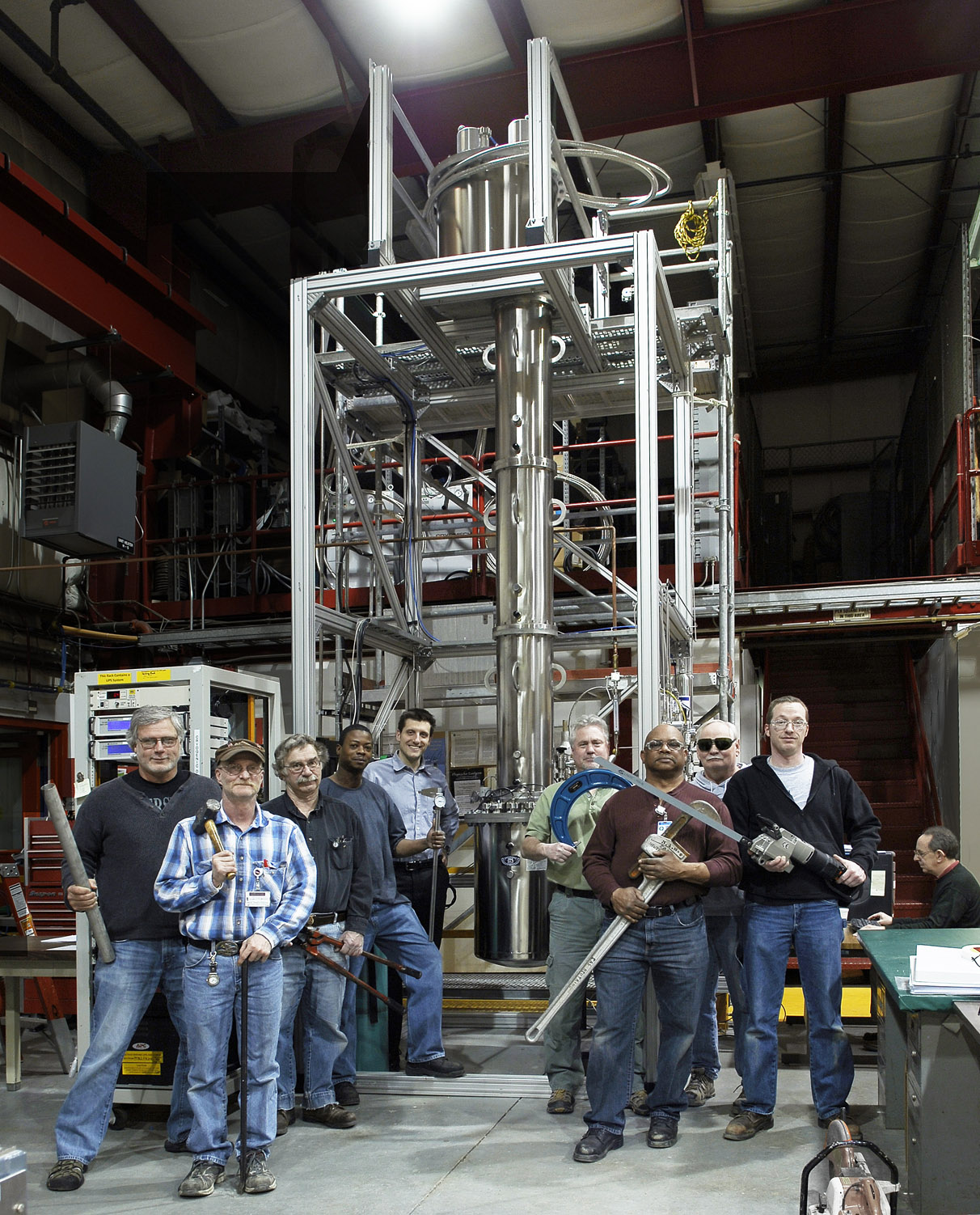
Industrial argon for large neutrino detectors
Large quantity required at low cost
Raw gas : air
Produced by industrial distillation and then purification with molecular sieves and filters
Contaminants include nitrogen (ppm), oxygen and water (<ppb)
Underground argon for dark matter detectors
Low radioactivity from ³⁹Ar required
Raw gas : CO₂ from underground wells
Produced by VPSA, cryogenic distillation and filtering
Contaminants include helium, methane, O₂, CO₂ H₂O
Supply
Molecular sieve
Activated copper
Cryostat
Flare filter + sieve system (FNAL)
Underground argon distillation column (FNAL)

Slide 17
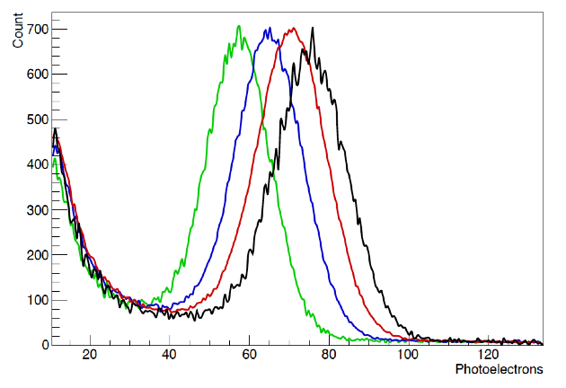
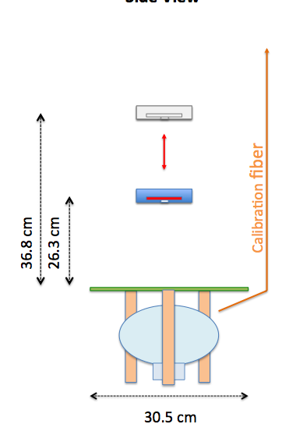
Absorption by Nitrogen
Shown at last years LArTPC workshop – absorption due to dissolved nitrogen at the ppm level:
BJPJ et al, 2013 JINST 8 P07011
Monitor light yield from 2 sources as nitrogen is injected
(near source)
27ppb N2
3.7ppm N2
7.4ppm N2
15.5 ppm N2
Expected attenuation length due to N2 at 2ppm (MicroBooNE cryo spec) is ~30m.

Slide 18
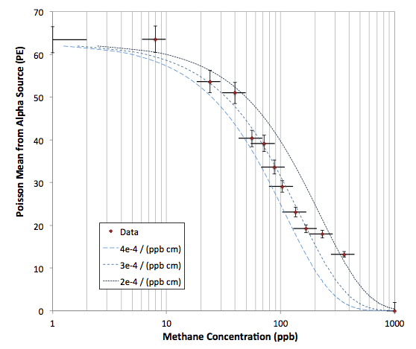
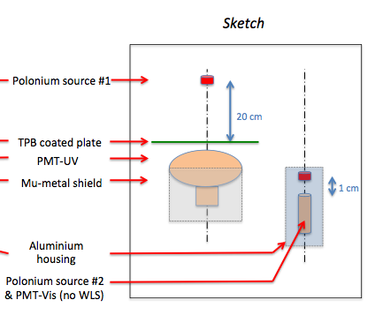
Absorption by Methane
New for this year’s meeting – the effects of methane have also been studied in both visible and UV:
BJPJ et al, 2013 JINST 8 P12015
Absorption is accompanied by no visible re-emission (reported in gas phase)
<10ppb methane contamination is required for modern DM experiments.

Slide 19
Self-trapped exciton luminescence
+
Ar
γ
p
*
*
Ar
Ar
Ar
Ar
Ar
Recombination luminescence
+
+
e
-
p
Ar
+
*
-
Ar
Ar
Ar
Ar
Ar
e

Slide 20
~35%
Self-trapped exciton luminescence
Ar
Ar
*
+
Ar
γ
p
*
~65%
Ar
Ar
Ar
*
Ar
Ar
Recombination luminescence
~50%
+
+
e
-
Ar
Ar
Ar
*
p
+
Ar
e
-
Ar
Ar
~50%
Ar
Ar
*
The production of singlets and triplets is not equally weighted between the two processes

Slide 21
The fate of the excimer states
6 ns
Ar
γ
The singlet decays into two argon atoms and a photon, in 6ns
*
Ar
Ar
Ar
1500 ns
The triplet decays in ~1500 ns
Some disagreement in the literature as to whether this decay proceeds via the singlet, or directly to the ground state
Either way, time constant much longer than the singlet.
*
Ar
Ar

Slide 22
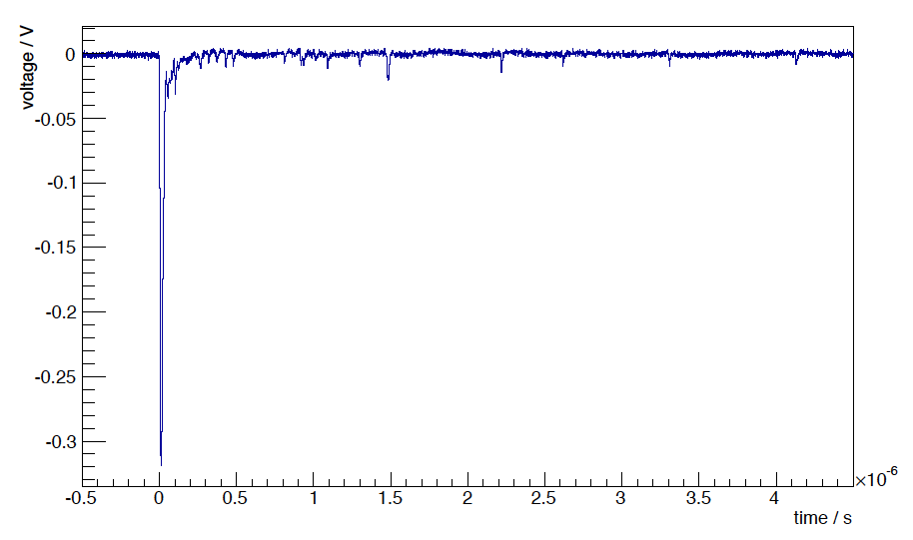
Typical pulse on a PMT, from an a alpha source scintillating in LAr
(from Bo test stand at Fermilab)
Prompt light, from singlet (6ns time constant)
Delayed light from triplet
(1500ns, dribbling in as single photons)

Slide 23
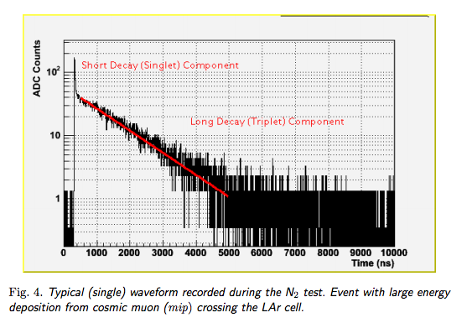
Time Constants of LAr Scintillation
An example from:
2010 JINST 5 P06003
(WArP collaboration)
Summing up many pulses to get an average waveform, you can measure time constants

Slide 24
Quenching of Scintillation Light
Ar
γ
*
Scintillation process
Ar
Ar
Ar
*
Ar
Ar
Ar
Ar
Competing Excimer Dissociation Process
N
N
*
N
N
Rate dependent on the density of excimers and density of impurity

Slide 25
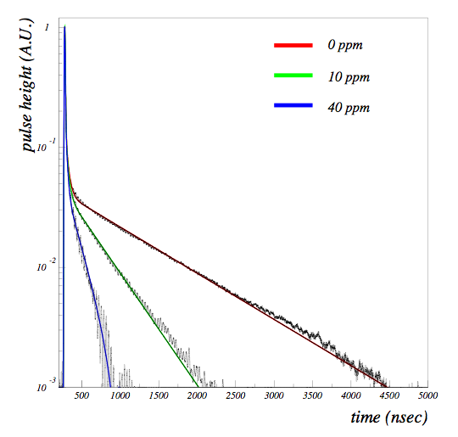
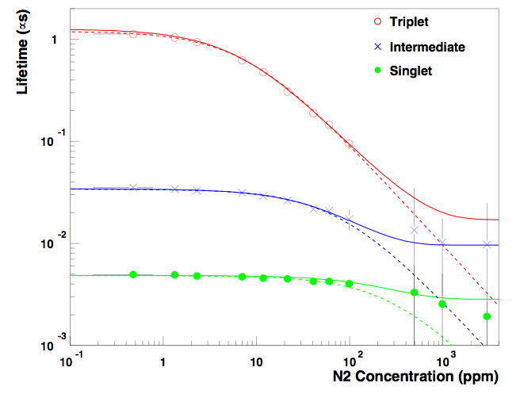
Quenching by Nitrogen
First measured by WArP:
Acciarri et al 2010 JINST 5 P06003
Quenching shortens long time constant and reduces total scintillation yield. significant above ~2 ppm N₂
In MicroBooNE & LBNE/F, quenching and absorption may both be observable, but likely not problematic.

Slide 26
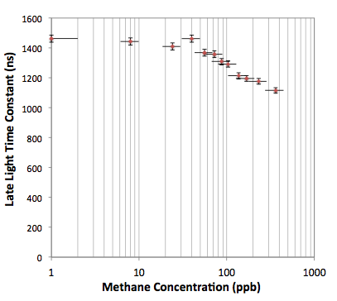
Quenching by Methane
We observed quenching by methane, but at concentrations much above where absorption is problematic
BJPJ et al, 2013 JINST 8 P12015
Single photoelectron shape
Averaged LAr scintillation pulse (alpha)
Deconvolved LAr scintillation pulse (linear y)
Deconvolved LAr scintillation pulse (log y)
Late time const fit

Slide 27
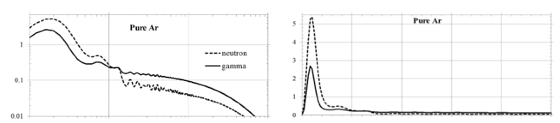
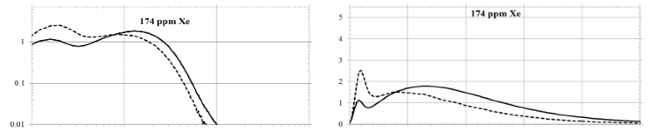
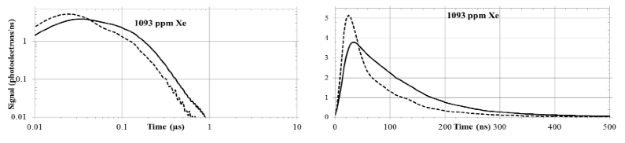
Excitation Transfer to Xenon
Excitation can also be transferred to a dopant which then decays with a photon.
Eg xenon : first studied by ICARUS, and more recently for dark matter detection (left)
175 nm rather than 128 nm emission gives a moderate improvement to light collection capability (depends on WLS coating)
Also brings late light to shorter timescales
From JINST 9 (2014) P06013
Wahl et al

Slide 28
Back to pure argon :
6 ns
Ar
γ
*
Ar
Ar
Ar
1500 ns
*
Ar
Ar

Slide 29
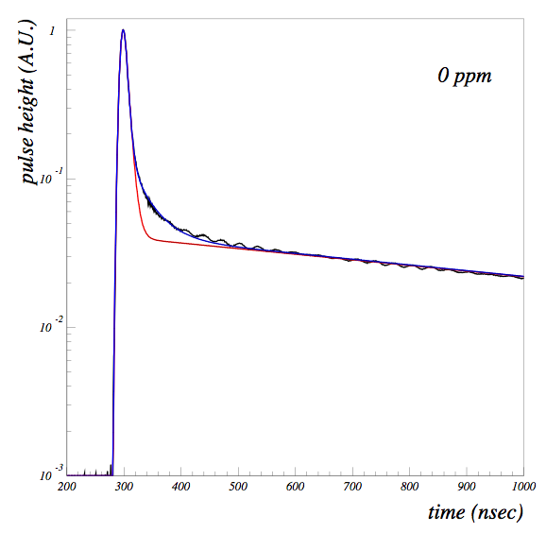
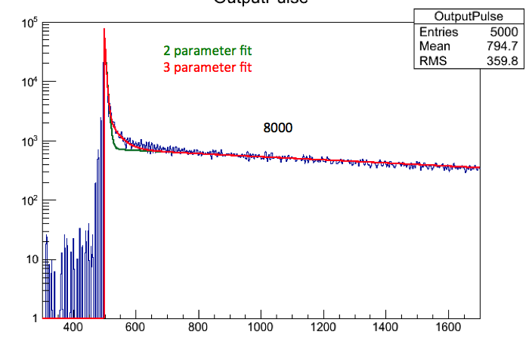
An open mystery – the Third Component
WArP, ArDM, and BoVST, all see some activity in the “intermediate time” region of a deconvolved PMT pulse for pure argon.
Interpretation of “intermediate component” not presently clear.
Instrumental effect or scintillation physics?
T_{I} = 40 ns
T_{I} = 25 ns
(investigations ongoing)
WArP deconvolution (PMT)
BoVST deconvolution (PMT)

Slide 30
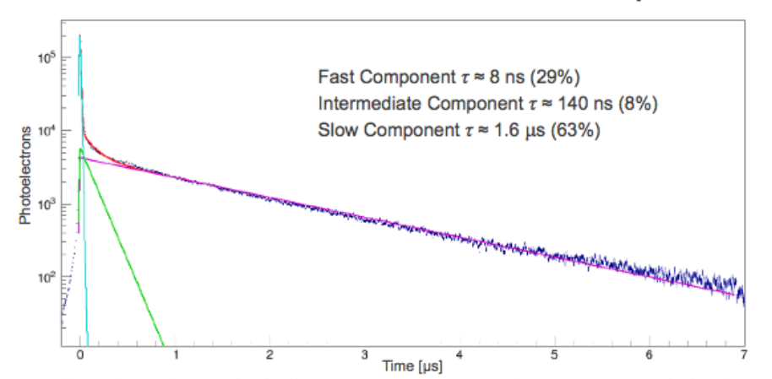
Different measurement methods / experiments do not presently agree on the value of the intermediate time constant or size of the component.
A potentially interesting piece of liquid argon microphysics. What wavelength is it? Dependence on E-field? Purity? dEdx? Other??
Let’s understand it by this session next year!
D Whittington, Neutrino2014 poster
T_{I} = 140ns
LBNE TallBo Tests (SiPM)

Slide 31
Some new and notable papers about (or relevant to) LAr scintillation physics since LArTPC2013
Measurement of Scintillation and Ionization Yield and Scintillation Pulse Shape from Nuclear Recoils in Liquid Argon
arXiv:1406.4825
Observation of the dependence on drift field of scintillation from nuclear recoils in liquid argon
Phys.Rev. D88 (2013) 9, 092006
A study of electron recombination using highly ionizing particles in the ArgoNeuT Liquid Argon TPC
JINST 8 (2013) P08005
Performance of liquid argon neutrino detectors with enhanced sensitivity to scintillation light
arXiv:1405.0848

Slide 32
Summary
I discussed the mechanisms of scintillation in liquid argon
Small concentrations of contaminants can have a detrimental impact on scintillation light
Methane and nitrogen are problems for underground and atmospheric argon respectively, and both have been studied for absorption and quenching effects.
There is mounting evidence of an intermediate time constant of unknown origin, which can hopefully be understood soon!

Slide 33
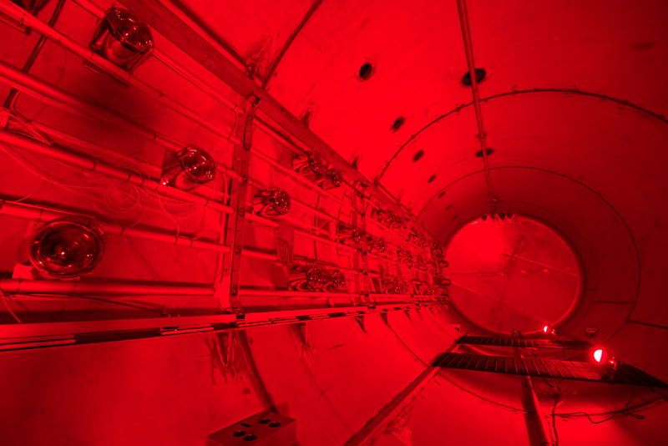
Thank you for your attention!
Thank you for your attention.

