Slide 1
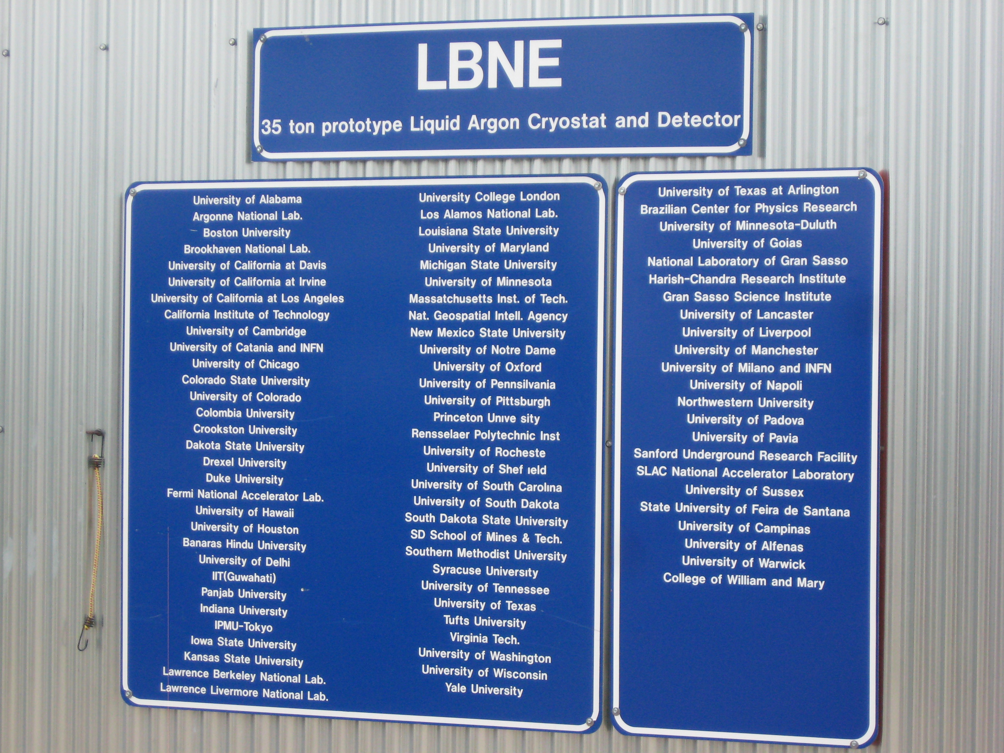
LBNE Prototype Detector in the 35t Membrane Cryostat
Alan Hahn
FNAL

Slide 2
Talk Outline
35 Ton Phase 2 Motivation
Goals for 35 T Phase 2
Design Choices/Compromises
Far Detector APA
35T Prototype Detector
Summary

Slide 3
35t Motivation
During the (2012) reconfiguration of LBNE, we lost LAr-1, a 1 kT cryostat to be built at D0
LAr-1 was meant to be our full system test of the FD Prototype components.
Could hold 3 full scale APAs with 6 CPAs
Each 7m high by 2.5m wide
Able to track cosmic rays.
To regain partial design verification, we “re-purposed” the program of the 35 Ton Cryostat to include a “Phase 2”
Phase 2, a facility to enable a subset of the LAr-1 prototyping goals.

Slide 4
35-Ton Phase 2 Goals
Build a complete functional reduced-scale sized TPC with Photon Detectors inside the 35-ton cryostat.
TPC components will closely resemble the full size counterparts.
APAs will incorporate functional photon detectors
Goals of this prototype TPC
Validate the design of nearly all TPC components (at a small scale); testing the integrity of all components and their interconnects in LAr.
Study the performance of the wire wrapping readout scheme, and the impact of the gaps between APA modules.
Study the electronics noise contribution from potential sources: acoustic, pump, flow driven wire or field cage motion, high voltage ripple coupling, coupling between digital and analog circuits, etc.

Slide 5
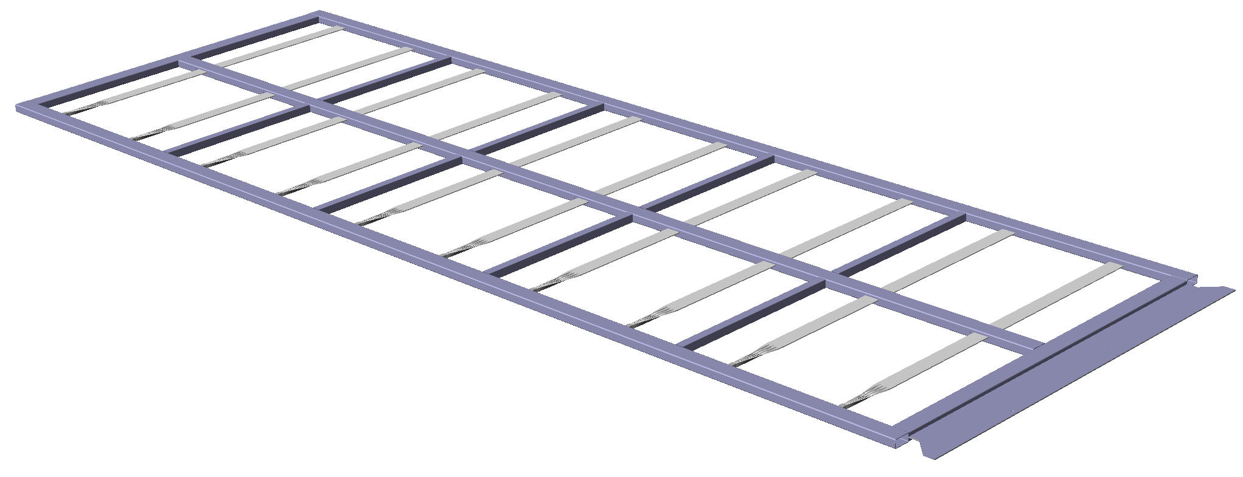
LBNE Full Scale Anode Plane Assembly (APA)
2 APAs
2.5m
Photon Detectors
7 m
APA Features
Photon Detectors are integral to APA
Grounded wire mesh to frame members
X (collection) wires strung from top edge, terminate at bottom edge
X wires on front and back of APA are independent, NOT wrapped.
U, V (induction) wires are wrapped around APA, at ~45º
All terminate at bottom edge
Grid wires on top layer
Note: current PD design utilizes SiPMs, not PMTs as depicted in this drawing

Slide 6
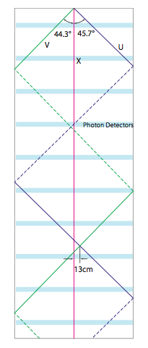
Wrapped U, V Wire planes
From Fig 3.4 of CDR
APA U, V wires wrap around frames
X wires are unique to each side
Can we reconstruct? (“dis-ambiguation”)
Photon Detectors are built into the APA.
Can they help with dis-ambiguation?
Can they trigger on Super Nova burst events?
7 m
~29 wire spacings
2.5 m

Slide 7
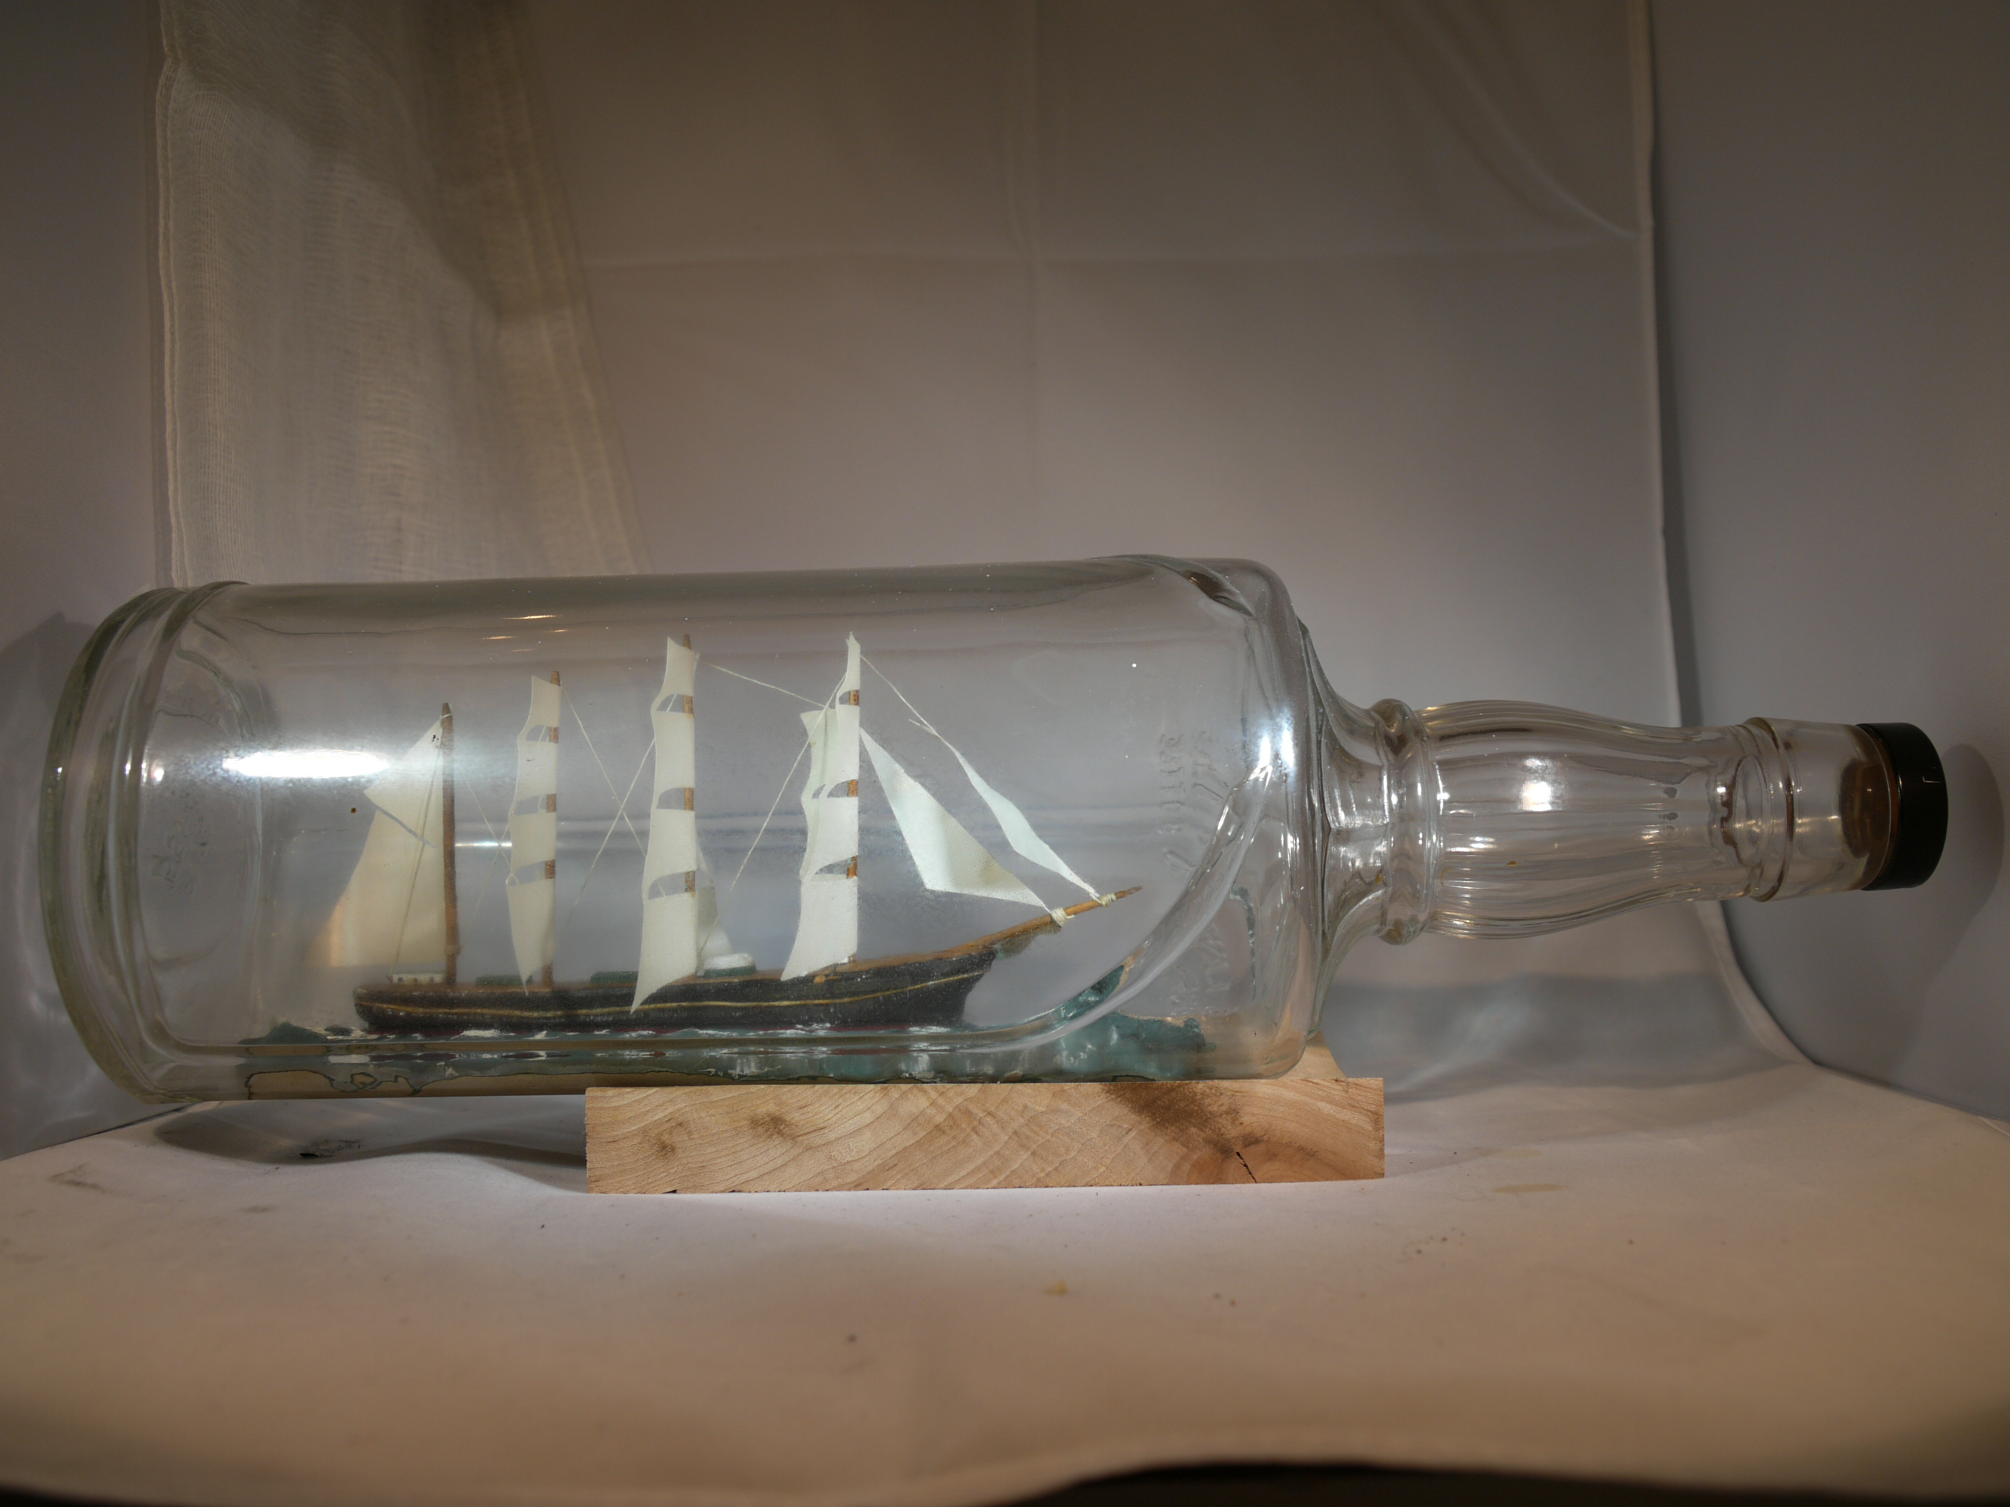
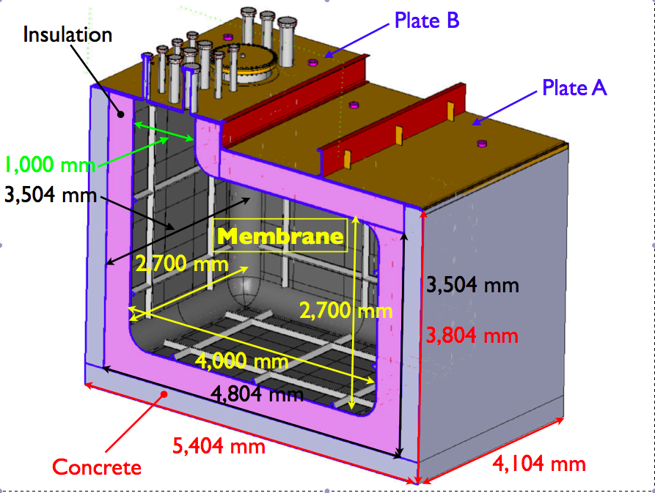
35 T Detector Implementation-- Obvious issues-- size
~75 cm access diameter

Slide 8
35T Prototype Detector Choices
Size restrictions
Cryostat dimensions
Entry diameter
However:
Want two drift regions to check double-sided APA, but want at least one region with drift comparable to actual FD drift distance
2.23m and 0.27m
Want at least ~2m long wires to check for microphonic pickup
Full size FD APA has wire supports every 2m
35T “Long” APAs have unsupported “X” wires ~ this long
Want to see any charge collection issues on edges between APAs

Slide 9
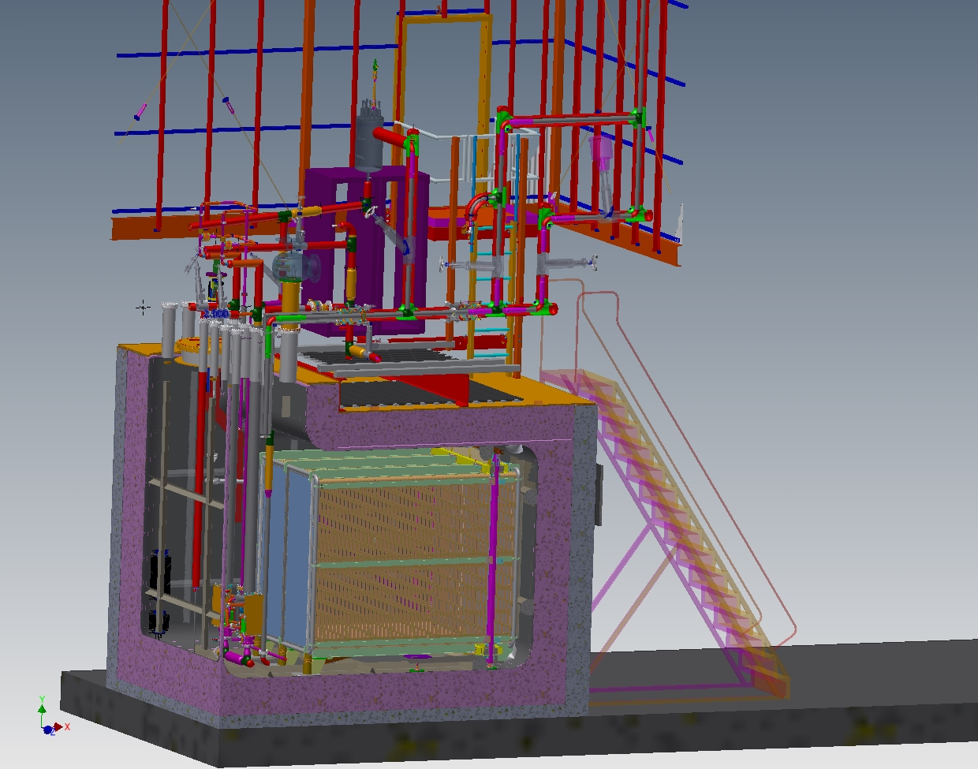
35T Detector 3D Solid Model (J. Fowler)

Slide 10
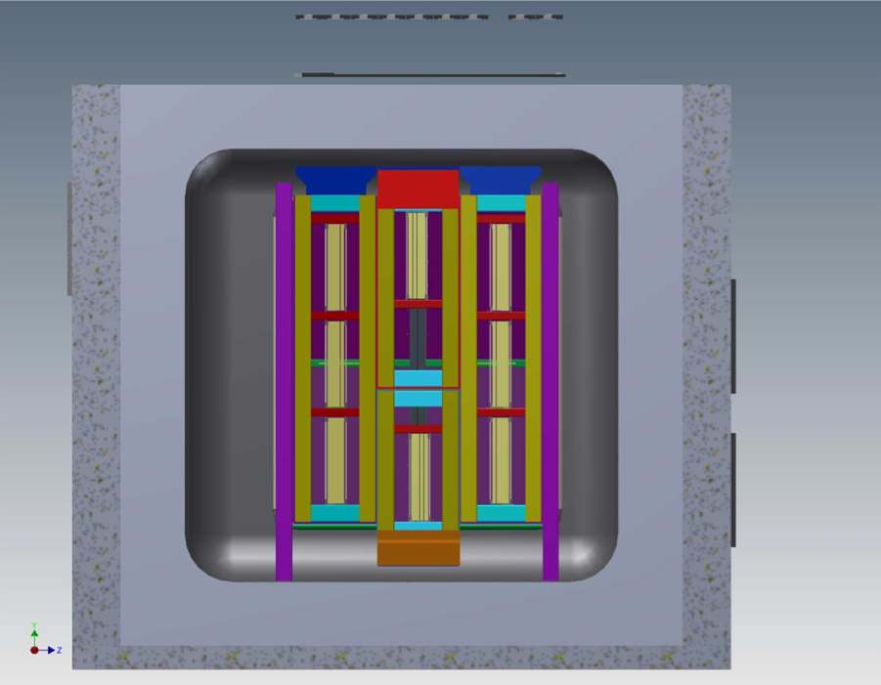
Anode Plane Assembly (APA) Layout in 35T Cryostat
Cosmic Ray Counters
~4m
Photon Detectors
In APAs (3 in each Long,
1 in each Short APA
2 Long APAs
APA Support Structure
μ
Cosmic Ray
Counters
Cosmic Ray
Counters
2 short APAs

Slide 11
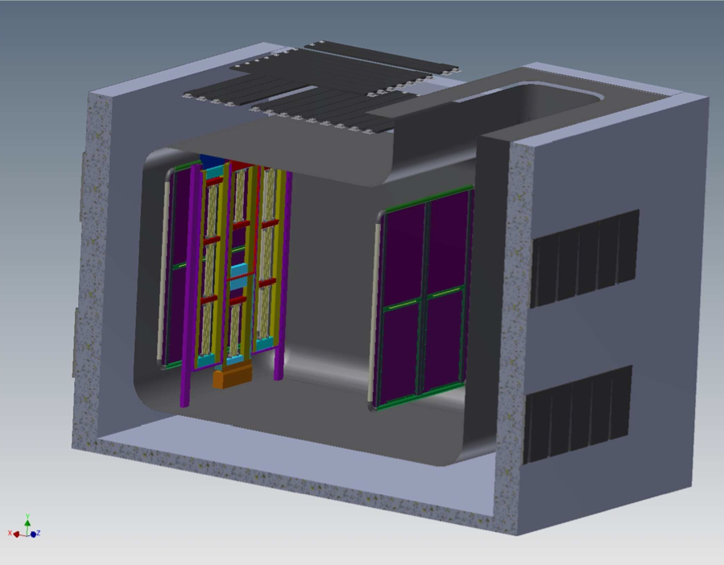
LBNE Style TPC in 35T Cryostat
Cosmic Ray Counters (CRCs)
27 cm short drift region
CRCs
2.23m drift region
CRCs
Photon Detectors
(8 total) in 4 APAs
Cathode Plane
Cathode Plane
Field Cage not shown
J. Fowler

Slide 12
35T Detector “Features”
TPC
2048 instrumented wires with prototype FD digital readout
500 V/cm drift field
2.2 m drift in large drift volume (111 kV), 1.4ms e⁻ max drift time
0.27 m in small drift volume (14 kV), 0.2 ms e⁻ max drift time
Photon Detectors
Eight in total
Three in each long APA
One in each short APA
Three different styles
Four “4-bar” PDs with various wavelength shifter technologies
Three “32 fiber” PDs
One plate coated with TPB and with WLS fiber readout
DAQ
Based on SLAC RCE (Reconfigurable Cluster Elements) Front Ends
artDAQ Back Ends.
NOVA timing module
External Cosmic Ray Counters on sides and top to guarantee events in drift regions we want to probe.

Slide 13
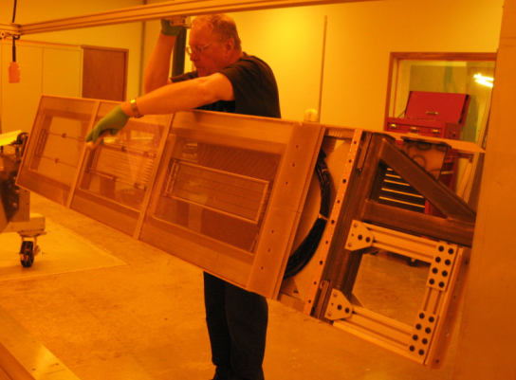
35 T “Long” APA Fabrication – winding (L. Greenler, PSL)

Slide 14
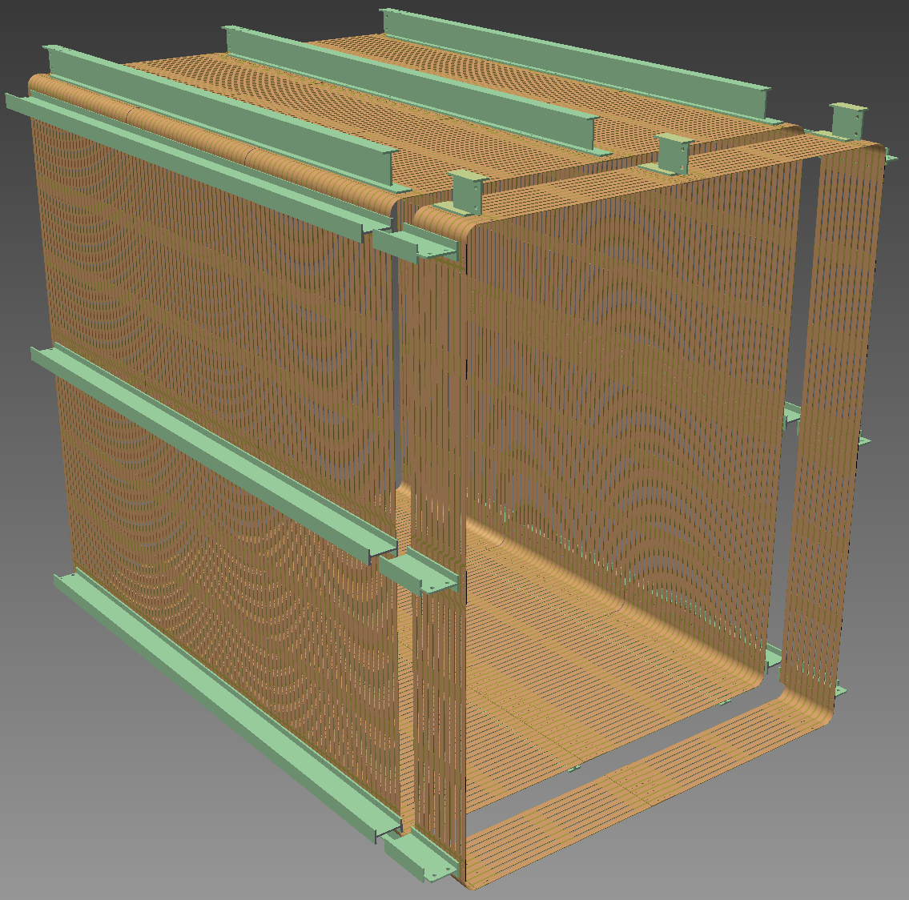
Field Cage (B. Yu)
CPA Long Drift Side
(B. Sands)
HV donut part of this side assembly
Weight of a CPA is ~240 lbs. [ 110 kg

Slide 15
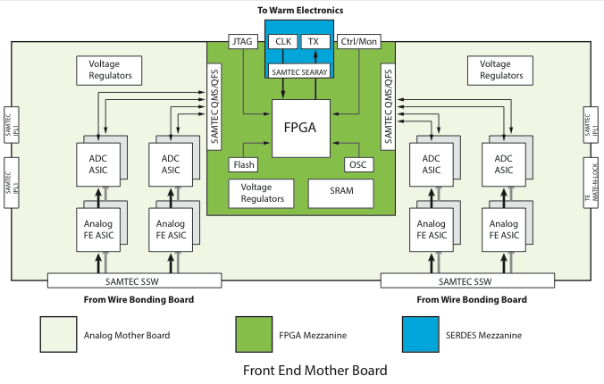
Front End Motherboard for 35-ton Phase 2 TPC (H. Chen)
15
15
15
15
15
Notes:
15

Slide 16
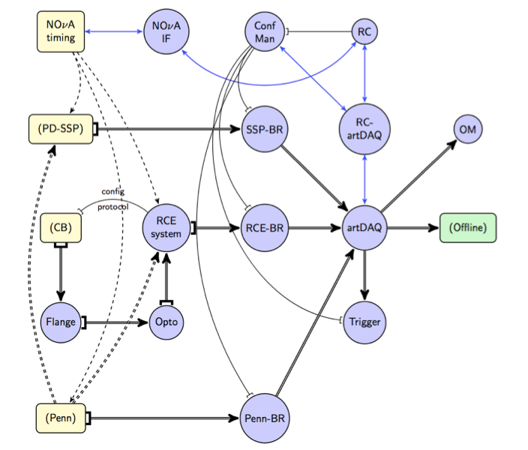
35T Phase 2 DAQ (G. Barr)
(Run Control)
Photon
Detectors
(analog )
(SiPM Signal
Processor)
(Online Monitoring)
(All cold Detector
Cabling comes through
flange board)
TPC Digital Stream
External
Cosmic Ray
Counters (logical)
(trigger logic)
“BR”=Board Readers

Slide 17
35 Ton Running Modes (M. Graham)
TPC
Continuous Mode: continuous streaming (zero-suppressed in RCE) data
Tagged mode: External Cosmic Ray Counters (CRC) tagger
Burst mode: all (no 0-suppression) data from TPC
Limited to a few drift times
Single channel: all (no 0-suppression) for a single or few #’s of channels
Online Software on backend combines data from the detector systems & makes decision whether to keep data.
In Continuous Mode, require that data has a PD or CRC signal

Slide 18
Conclusions
35T Phase 2 Run will be a demonstration of the LBNE Style Detector, testing most of the concepts of the LAr Far Detector
Installation of Detector into Cryostat in late fall.
Cooldown and commissioning in early 2015 (CY)

