Slide 1
Studies of Degradation of CMOS Devices at Cryogenic Conditions for the LBNE Electronics
Guoying Wu and Ping Gui
SMU, Department of Electrical Engineering, Dallas, TX USA
James Hoff and Grzegorz Deptuch
Fermilab, PPD/EED, Batavia, IL USA

Slide 2
Motivation
In the LBNE, the integrated electronics for readout of the liquid argon (87 K) time projection chamber will be operated in cold for the duration of the experiment (more than 20 years)
Research and design of the highly reliable circuits with the capability of operating at low temperature and maintaining a more than 20-year lifetime is imperative
Focus on the operation of electronics in the liquid nitrogen (77 K) temperature because this temperature allows extensive tests conveniently in laboratory's conditions and allows comparison with prior literature data for older processes
The reliability investigation of single devices is the first step to the circuit design
The Accelerated-Stress test is the method to investigate the hot-carrier degradation of devices using minimum sample size and shortest test time (days to weeks)
It is defined as test carried out under larger voltages than the nominal power supply condition
The damage in a shorter time at stronger electric field can be related to the damage at weaker electric field in a longer time

Slide 3
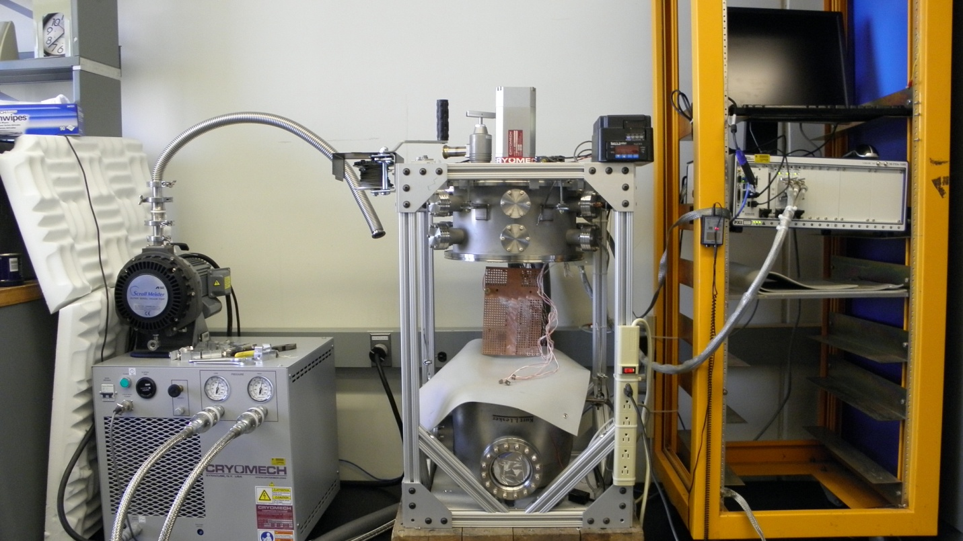
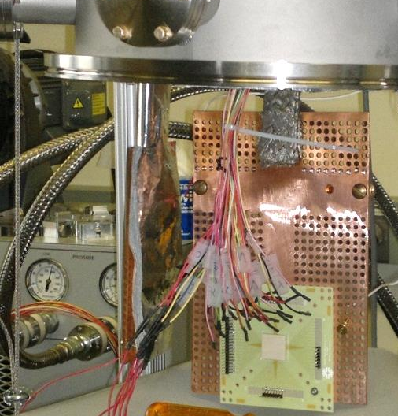
Hardware Setup for the Test
Vacuum Pump & Compressor
Vacuum Chamber
Cryocooler
NI PXIe-1085
PCB with chip
Cryogenic vacuum chamber (built @ Fermilab in 2011)
National Instrument PXIe-1085 embedded controller (acquired in 2014) with 12 source-measurement units (3x4)
MOSFET transistors of different widths and lengths in 130nm and 65nm technologies are available to test

Slide 4
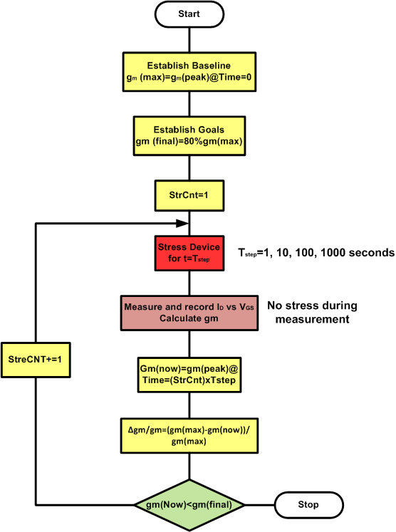
Software Setup for the Test
Labview program is developed to the new tests based on 4-point measurement for precision
Stress conditions of VGS=VDS and VGS=(1/2)VDS are utilized
The degree of degradation is estimated using ID-VGS curves in the linear region, which is detected as the most severe degradation
Transconductance (gm), drain current (IDS) and threshold voltage (VTH) are extracted to estimate the degradation level of devices
Procedure Used in the Lifetime Measurements

Slide 5
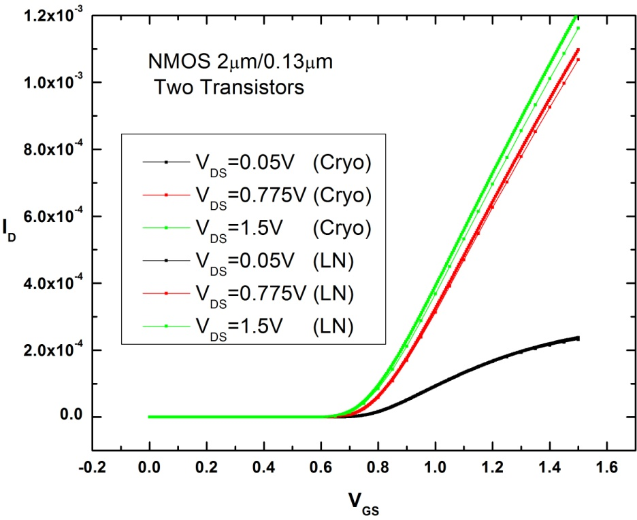
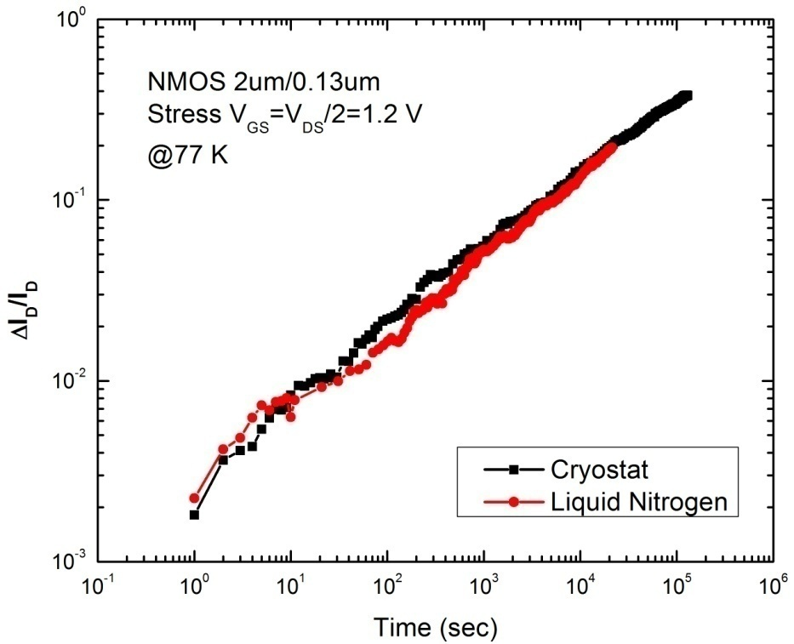
Verifications of the Setup
I-V curves in the Cryostat and in LN Bath (for comparison)
Degradation f(time) in the Cryostat and in LN Bath (for comparison)
Setup operated safely, no ESD problems
Cross-check of operation inside cryostat and in liquid nitrogen
Equivalent I-V curves of fresh devices
Equivalent stress degradation curves

Slide 6
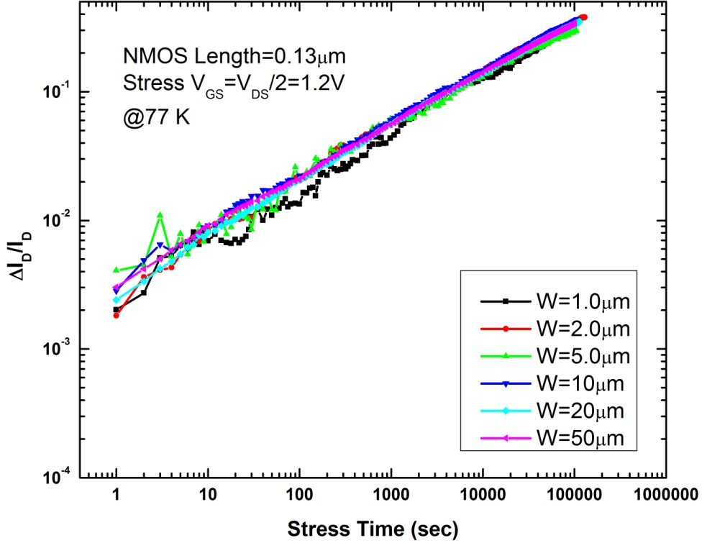
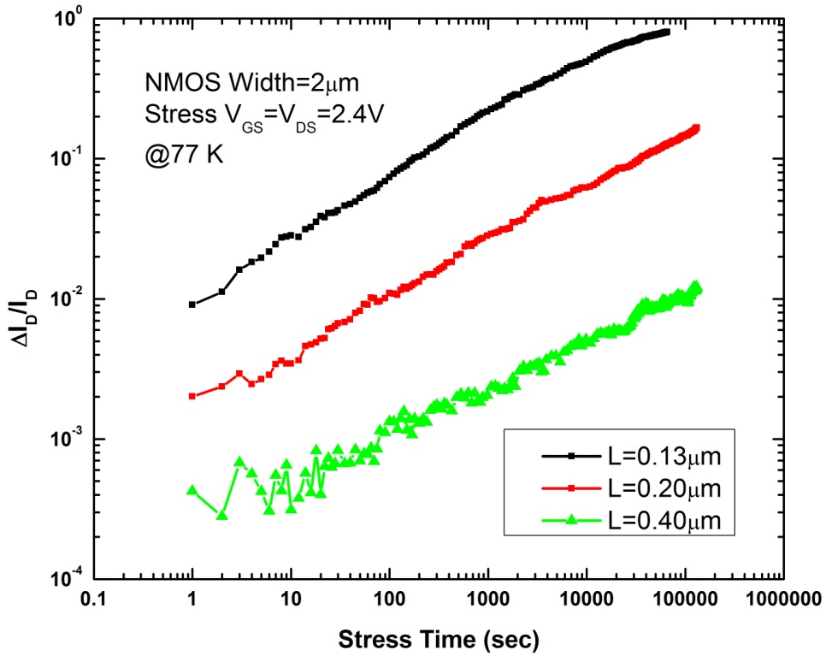
Hot-Carrier Degradation--130 nm
10%
10%
Degradation vs time for transistor with different WIDTHS
Degradation vs time for transistor with different LENGTHS
Devices are tested for longer times than it was possible before (> 100 ks) and at lower stress voltages for more accurate predictions of lifetime
Tests include broad ranges of transistor dimensions (W & L)
Extraction of basic parameters (VTH, gm, ID) and their degradations are investigated---- guidelines for circuit design

Slide 7
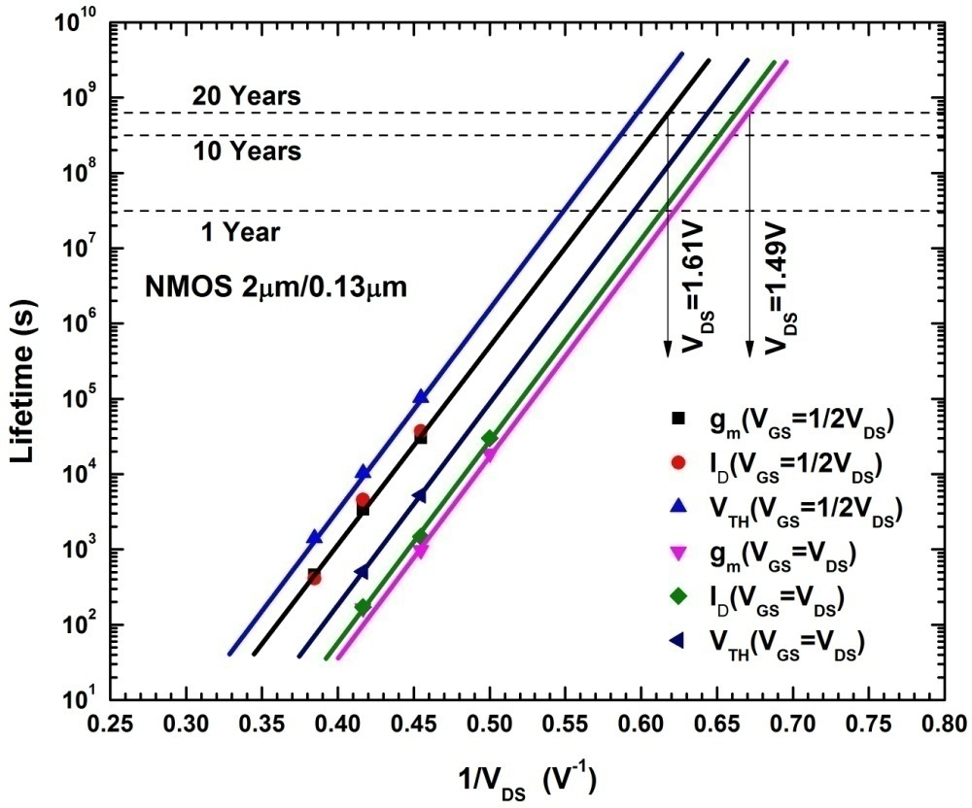
Lifetime Prediction--130 nm
The lifetime predictions of the 2µm/0.13µm transistor at 77 K by 10% degradation of g_{m} and I_{D} and by 50 mV increase of V_{TH} at V_{GS}=V_{DS} and V_{GS}=(1/2)V_{DS} stress conditions
The smallest length transistors at stress condition of V_{GS}=V_{DS} have the shortest lifetime (2µm/0.13µm transistor as an example)
The width dependence of degradation at 77 K is not evident
The degradation at stress condition of V_{GS}=V_{DS} is worse than that of V_{GS}=(1/2)V_{DS} for small length transistors (0.13 µm)
To get to the 20 years lifetime, the power supply voltage should be less than 1.49 V at the worst stress condition (Nominal supply=1.5V)

Slide 8
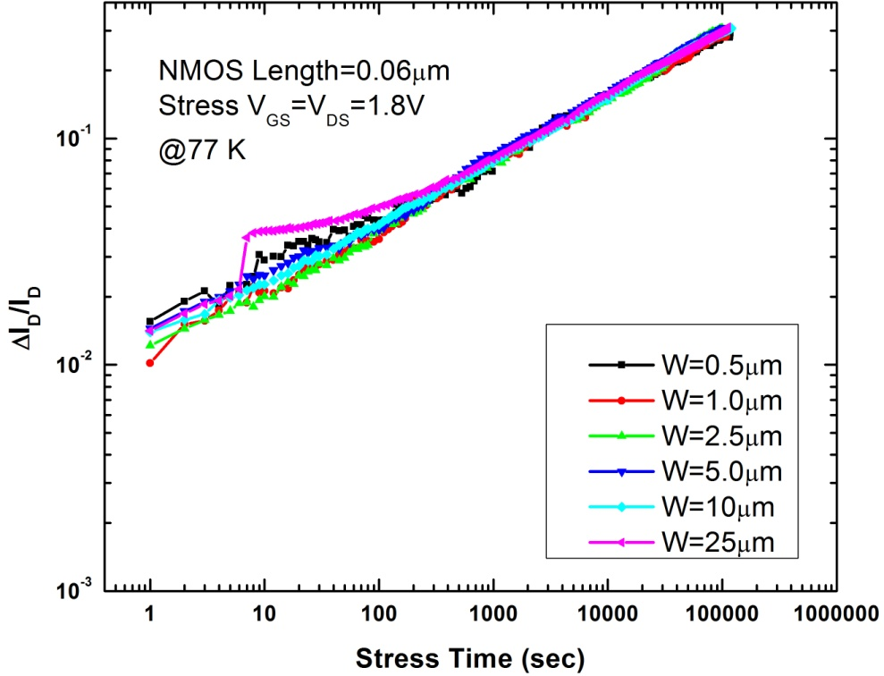
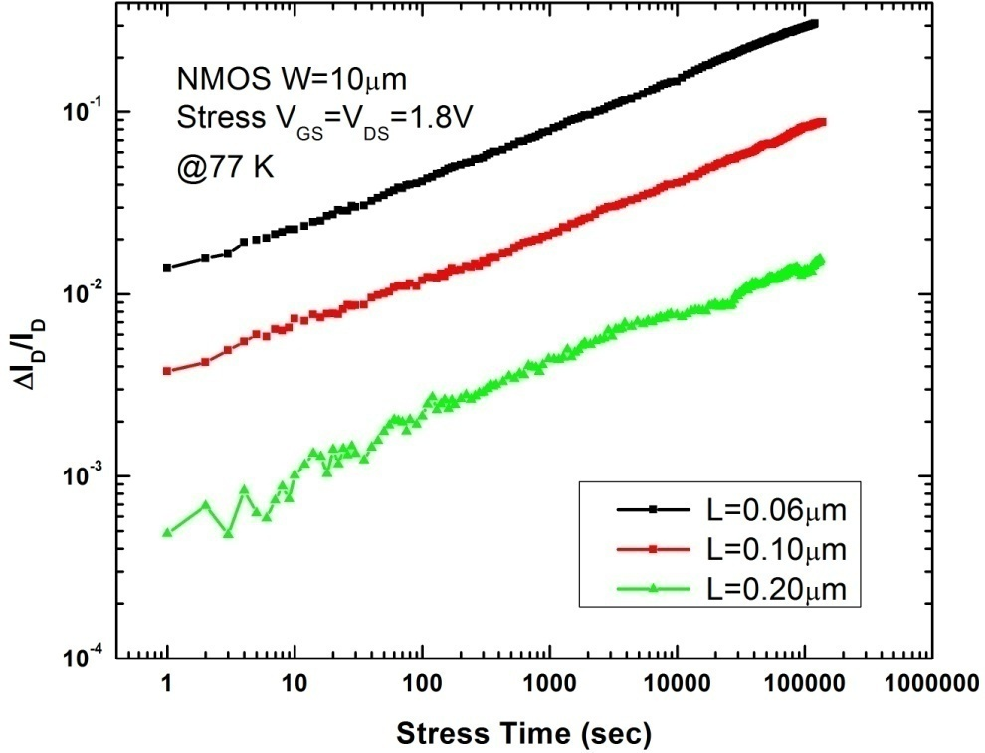
Hot-Carrier Degradation--65 nm
10%
10%
Degradation vs time for transistor with different
WIDTHS
Degradation vs time for transistor with different LENGTHS
Up to now, the similar conclusion as 130 nm technology is obtained for the 65 nm technology
The width dependence of degradation at 77 K is not evident
The degradation at VGS=VDS is worse than that at V_{GS}=(1/2)V_{DS} for small length transistors

Slide 9
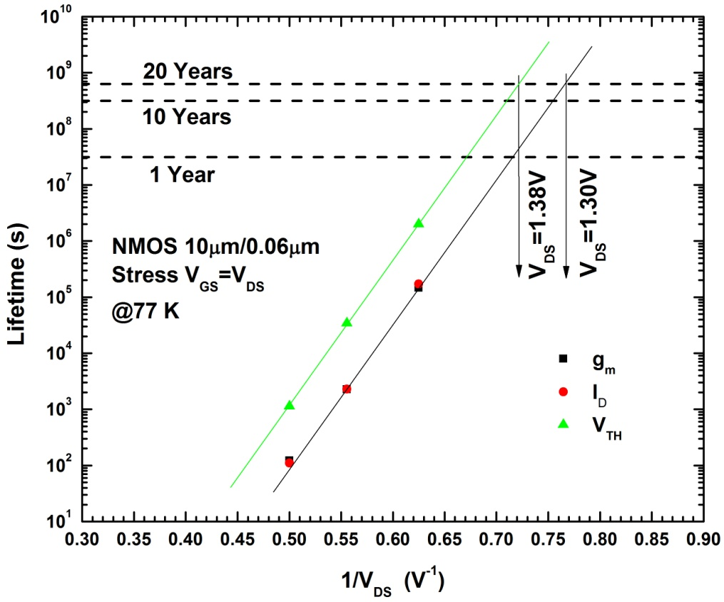
Lifetime Prediction--65 nm
The lifetime predictions of the 10µm/0.06µm transistor at 77 K by 10% degradation of g_{m} and I_{D} and by 50 mV increase of V_{TH} at V_{GS}=V_{DS} stress condition
The smallest length transistors at stress condition of V_{GS}=V_{DS} have the shortest lifetime (10 µm/0.06µm transistor as an example)
The width dependence of degradation at 77 K is not evident
The degradation at stress condition of V_{GS}=V_{DS} is worse than that of V_{GS}=(1/2)V_{DS} for small length transistors (60 nm)
To get to the 20 years lifetime, the power supply voltage should be less than 1.30 V at the worst stress condition (Nominal supply=1.2V)

Slide 10
Summary
What was done already
26 transistors in 130 nm technology
Length=0.13µm, Width=1, 2, 5, 10, 20, 50 µm
Length=0.2 µm and 0.4 µm, Width=2 µm
11 transistors in 65 nm technology
Length=0.06µm, Width=0.5, 1, 2.5, 5, 10, 25 µm
Length=0.1µm and 0.2 µm, Width=10 µm
What will be done next according to the plan
Length=0.2 µm, Width=10 µm at different stress condition
What is to be achieved at the end of the test
Which technology to be used for the circuit design
What guidelines to be used for the circuit design
Obtain basic modeling parameters for the circuit design

Slide 11
Acknowledgement
Thanks to Albert Dyer for his help on the setup of the cryostat and bonding wires of the chips
Thanks to Theresa Shaw, Steve Chappa and Erik Voirin for their helps on the setup of the cryostat
Thanks to URA award for support on this work

