Slide 1
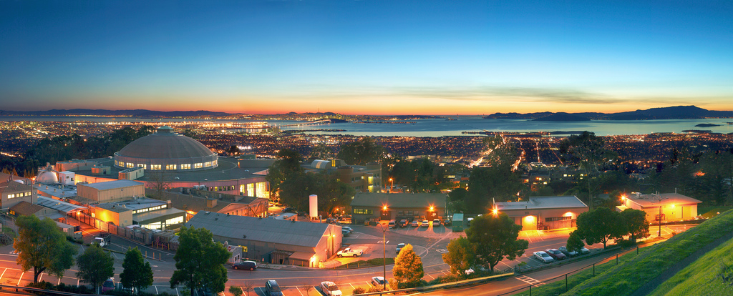
ESnet Update
OSG Council Meeting
SLAC: 4/10/14
Gregory Bell, Ph.D.
Director, Scientific Networking Division
Director, Energy Sciences Network
Lawrence Berkeley National Laboratory

Slide 2
ESnet Update
Science Engagement
European Extension
perfSONAR and Science DMZ
ESnet::OSG discussions this week

