Slide 1
OTE Building PMG Report
Rhonda Merchut
OTE PMG meeting
3/31/14

Slide 2
Agenda
OTE Building Project Status
    Building Construction Status
    State Activities
    Schedule
    Financial
Outfitting
Summary Action Items

Slide 3
Related Work
IASU Update (IGPP)
  OTE Construction Phase 2 complete 12/18/13
    TPC = $4,678,513
  IGPP Funding G10204 closed
      $441,487 returned to Lab
OTE/CDF Coordination
  Minor punchlist items nearing completion

Slide 4
OTE Building Construction Coordination
  Construction Status
  Overarching punchlist approximately 35% complete.
    MEP is not ready for punchlist.
  Project has not reached substantial completion due to issues with the mechanical system & controls not in accordance with the design.
    Fermi working closely with contractor to assist with trouble shooting ideas.

Slide 5
State DCEO Activities
DCEO quarterly report to State for quarter ending 2/28/14 submitted 3/28/14.
  Financial and Project status reported as 100% complete.

Slide 6
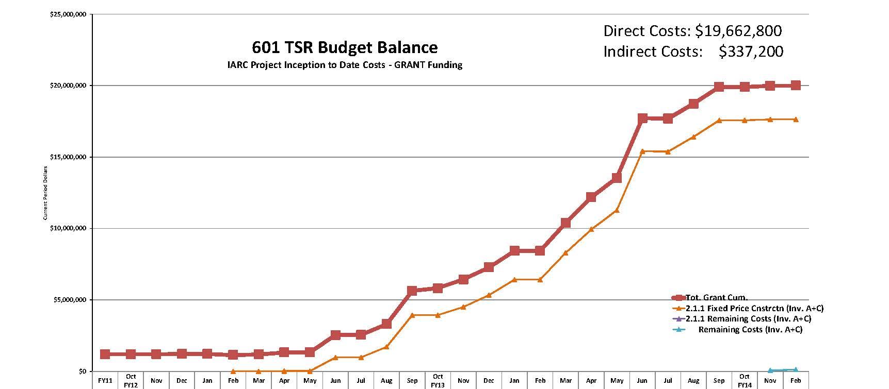
Grant Funding

Slide 7
Schedule
MS 1 Bldg Shell Complete: 6/19/13
MS 2 Substantial Completion: 12/27/13
MS 3, Project Complete: 3/21/14
2 milestones have not been met. Fermi is making every effort to assist the Subcontractor in completing the project.

Slide 8
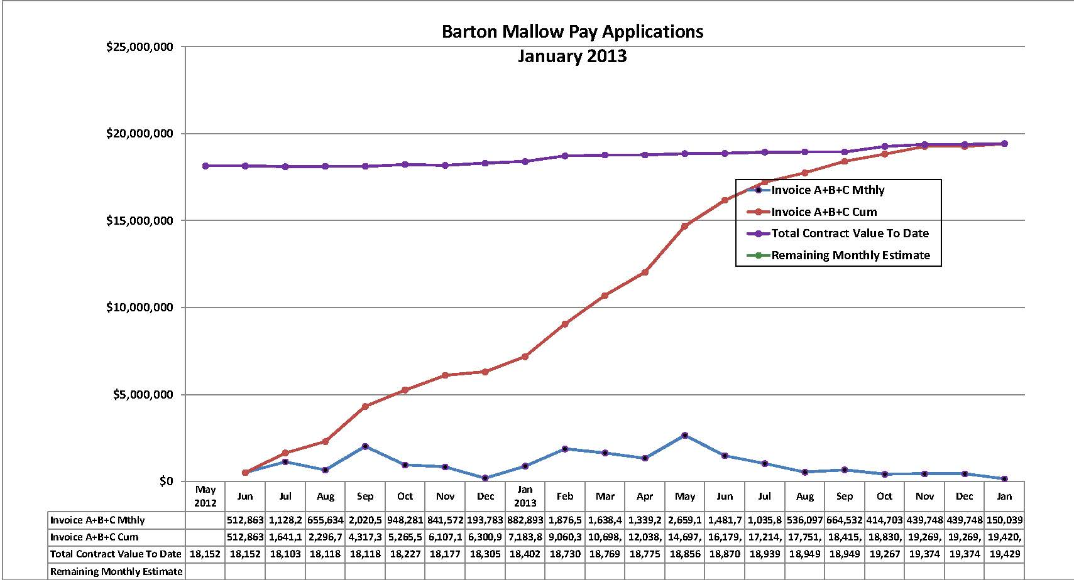
Financial
$10K remains to be costed.
5% Retention is being held.

Slide 9
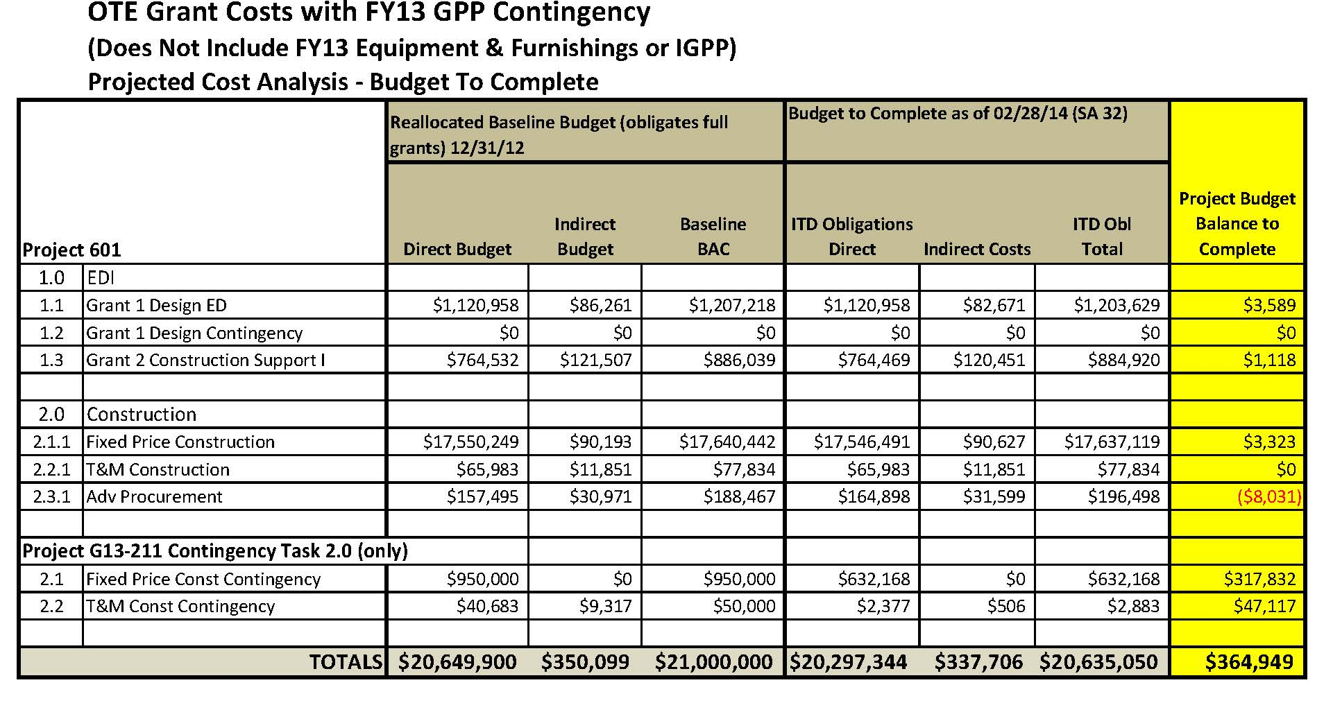
Financial

Slide 10
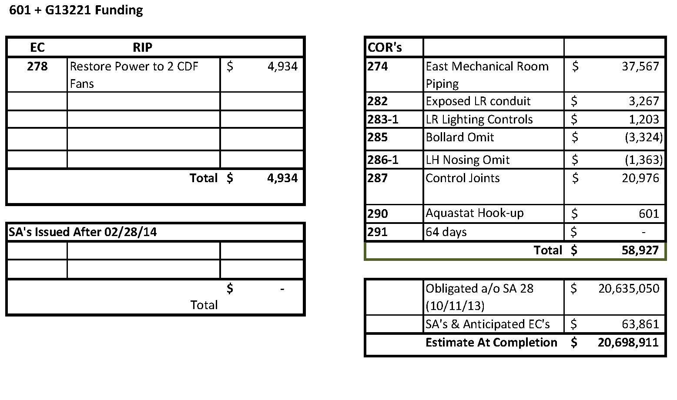
Financial

Slide 11
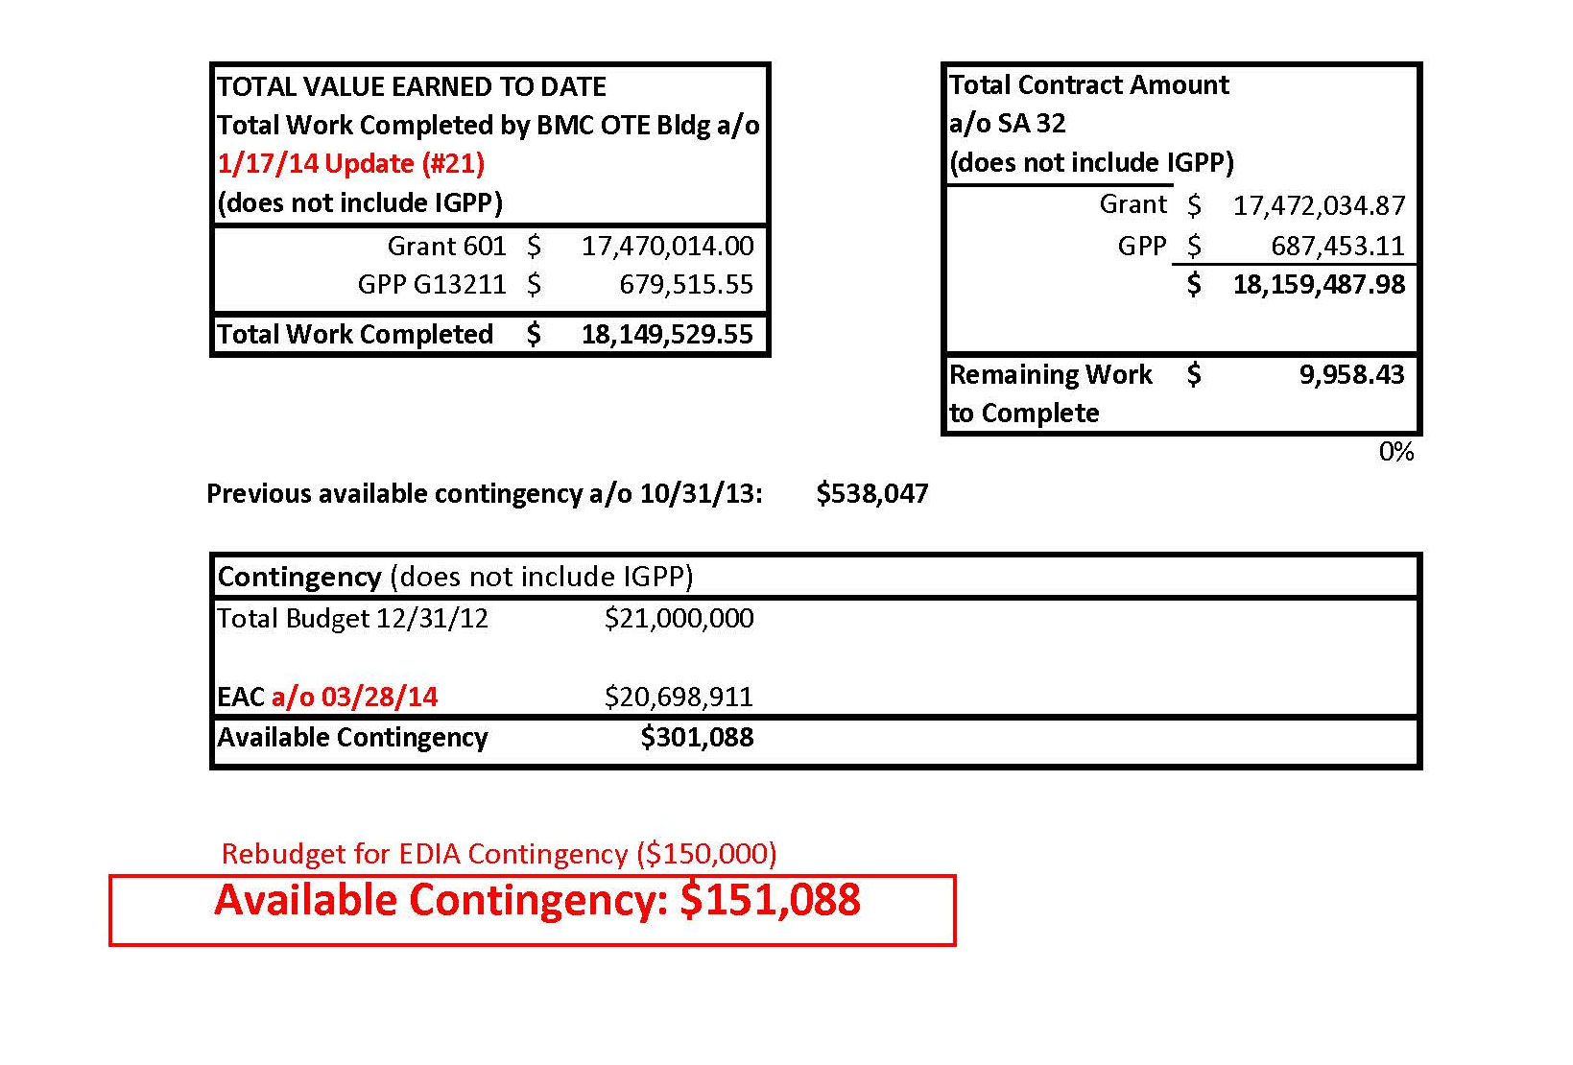
Financial

Slide 12
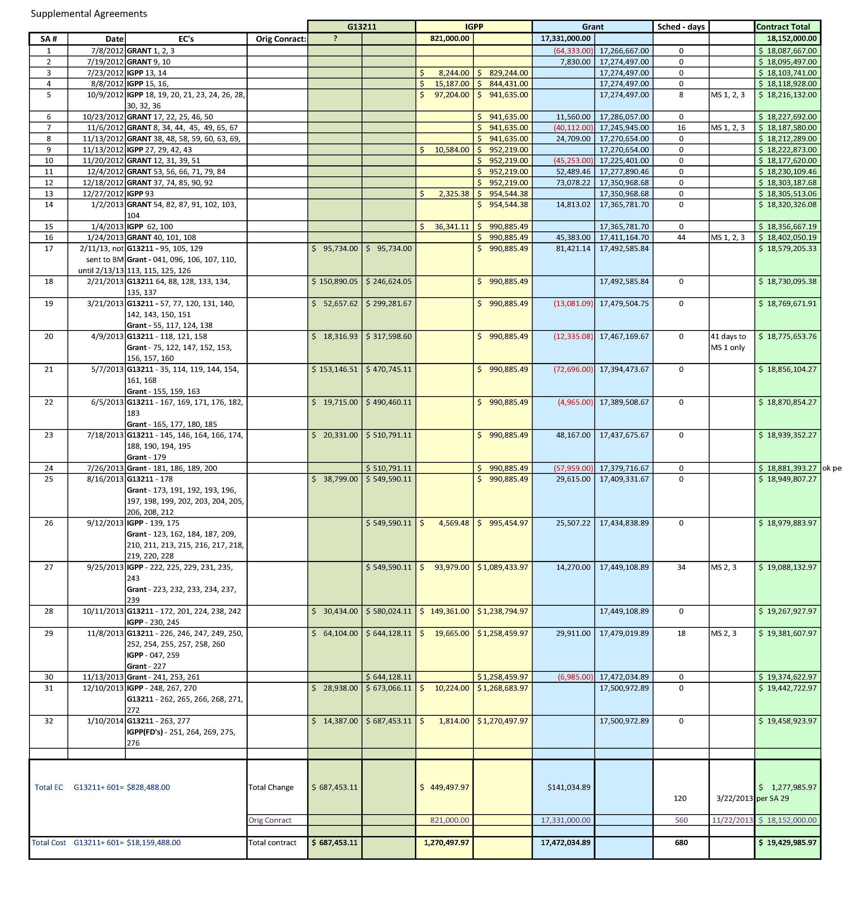
Financial
SA’s by Funding
32 SA’s
6.6% construction costs

Slide 13
OTE Outfitting GPP G13211
2nd and 3rd Floor office layouts approved 12/18/14.
VoIP/Networking redesigning underway to reflect modular office layout. Requires reevaluation of available space, power, cooling, and costs.
Security on hold until BO can be established for OTE Building.
Market research on partition system underway.
Continued construction support costs associated with extended time for OTE Building construction will be from the GPP G13211 funds.

Slide 14
OTE Outfitting GPP G13211
Impact of $1M funding reduction and added scope must be evaluated:
  Building Alteration Costs for private offices including mechanical system optimization.
  Misc. omitted building scope.
  Construction support for completion of building.
  A/E design support for building alterations.
  Added security controls.
  A/V design support & equipment costs.

Slide 15
Action Items
OTE Building Construction
  Functional Testing of Mechanical System
  Functional Testing of Lighting Controls
  Punchlist development for MEP
  Punchlist inspection completion for overarching & MEP
  Finalize all COR evaluations, issue EC’s as required
OTE Outfitting
  Evaluate budget reduction & added scope impact
  Evaluate new tenant impact
  Revise schedule
  Complete VoIP/Networking final design and cost estimate
  Issue A/E RFP’s for building alterations
  Perform market research on partition system & furniture

