Slide 1
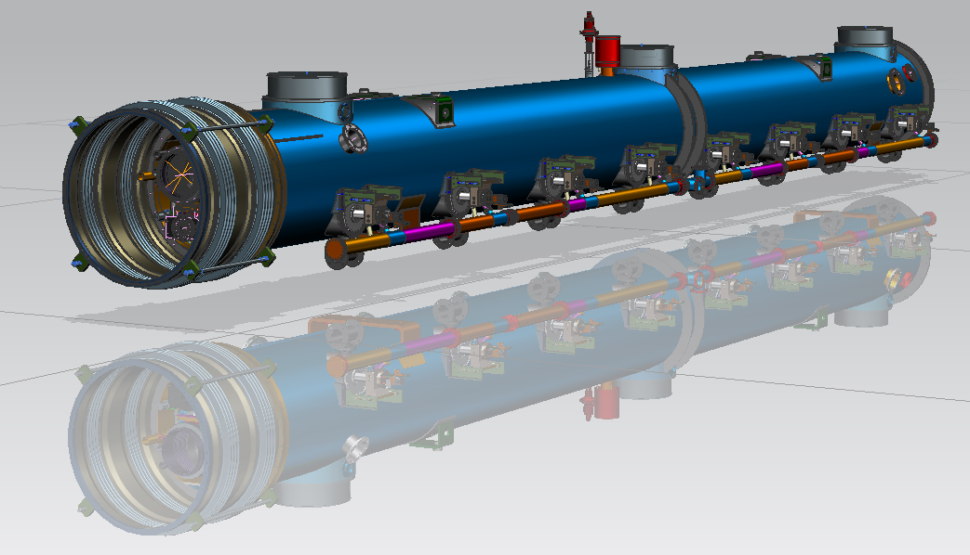
LCLS-II Cryomodule Design Update
Yuriy Orlov, Tom Peterson
15 April 2014

Slide 2
Some comments about thermal design
Heat loads around 80 – 100 W per cryomodule
Depending on local HOM deposition and also on cavity Q0, a cavity may see as much as 25 W or so
Due to the 0.5% slope, most or all of the vapor flow will flow out one port from each cryomodule into the 300 mm vapor return pipe

Slide 3
Cryomodule schematic

Slide 4
2 K heat in first few cryomodules

Slide 5
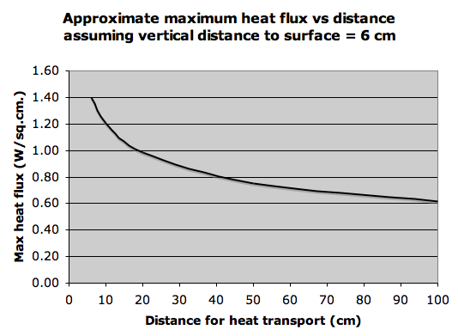

Slide 6
Connection diameter versus heat flux
XFEL

Slide 7
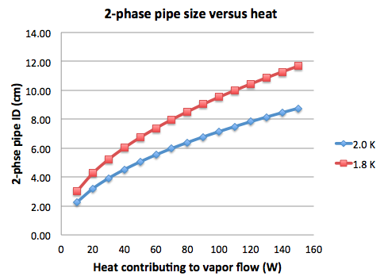
5 meter/sec speed limit for vapor over liquid sets 2-phase pipe size
XFEL

Slide 8
A quick look at mechanical design
Spacings set to even wavelengths
6 lambda cavity slot length
53 lambda cryomodule slot length (12220 mm)
In accordance with SLAC “MAD Deck”, a spreadsheet of linac element positions used for beam dynamics design and analysis
Structure is basically TESLA/Type 3+/XFEL, except
Isolation of 2-phase line
Addition of JT valve
Tuner motor access ports

Slide 9
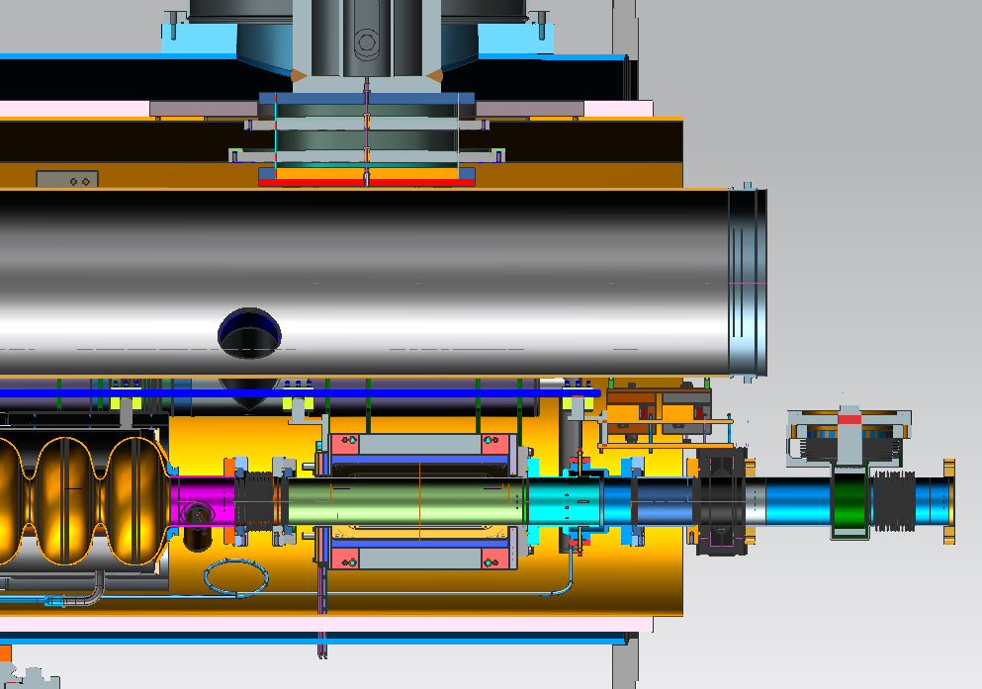
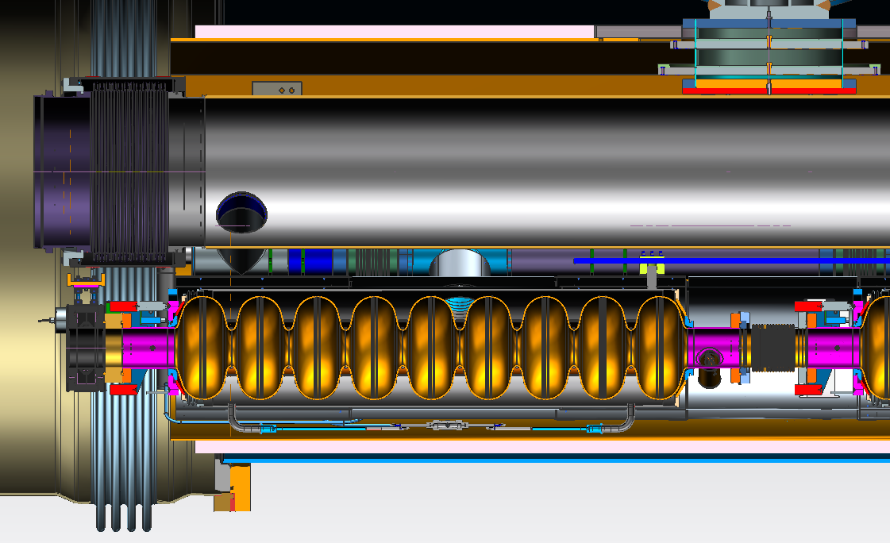
LCLS-II. Y-Z Section
(See ED0001152 Master Spreadsheet 1.3GHz CM LCLS-II for linear dimension)
~12220

Slide 10
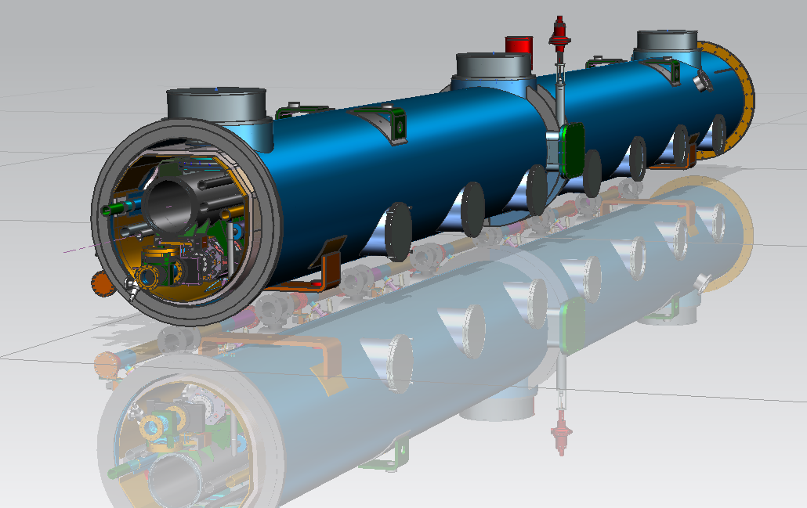
LCLS-II. Y-X Section
He Internal Pressure:
4 bar-cold
2 bar-warm
32.5
Tuner motor
access port’s
389
167.2
356
Tuner motor
access port
233
(2-Phase Pipe location)

Slide 11
LCLS-II-Cold Mass Upstream End
Upstream Gate Valve
End Level tuner
Upstream He level
Warm up cool down line
2-Layer cavity magnetic shields

Slide 12
LCLS-II- Cold Mass Downstream End.
GV support
Downstream GV
Warm Up cool
down line
Quad bearing supports
Splittable Quad
Reentrant BPM

Slide 13
LCLS-II preproduction Level Tuner.
Interconnection magnetic shield (2-layers)-not shown
Beam Pipe interconnection Bellows
Level Tuner

Slide 14
LSLC-II CM Interconnection
850mm
~700mm
407.1mm
633.6mm
342mm
935 mm

