Slide 1
LCLS-II Prototype Dressed Cavity Review
Chuck Grimm
15 April 2014

Slide 2
LCLS-II Prototype Dressed Cavity Review
Agenda:
Introduction/Task
History of Dressing 1.3 GHz ILC Style Cavities at Fermilab
Overview of the LCLS-II Prototype Dressed Cavity
Review highlights of the LCLS-II Prototype Dressed Cavity Technical Design Report
Duel Layer Magnetic Shielding
Manufacturing Plans
Cavity Dressing Sequence: String vs. HTS
Comments/Questions

Slide 3
Introduction/Task
Develop a dressed cavity for LCLS-II that will be used in the two prototype cryomodules, one which will be assembled at Fermilab and the other assembled at Jefferson Lab.
The cavities to dress will be (16) 1.3 GHz ILC style cavities currently in-house at Fermilab.
The ILC style cavities were designed for a bladetuner style helium vessel.
LCLS-II wants to use an end lever style tuner as their slow tuning mechanism.
Incorporate a duel helium fill line to help achieve a more uniform cool-down of the cavity.
Transition to a 316L seamless stainless steel 2-phase header pipe.
Duel layer magnetic shield with a radial spacing of 20 millimeters.

Slide 4
History of Dressing 1.3 GHz ILC Style Cavities at Fermilab
Currently Fermilab has successfully dressed 26 cavities, eight of which are in a string in CM2 being tested at New Muon Lab. Several others are slated for eventual assembly in CM3, the balance are in queues testing/processing…….
The dressed cavities are a mixture of RI and AES fabricated cavities.
Helium vessels were manufactured by Incodema, Inc. (Ithica, NY)

Slide 5
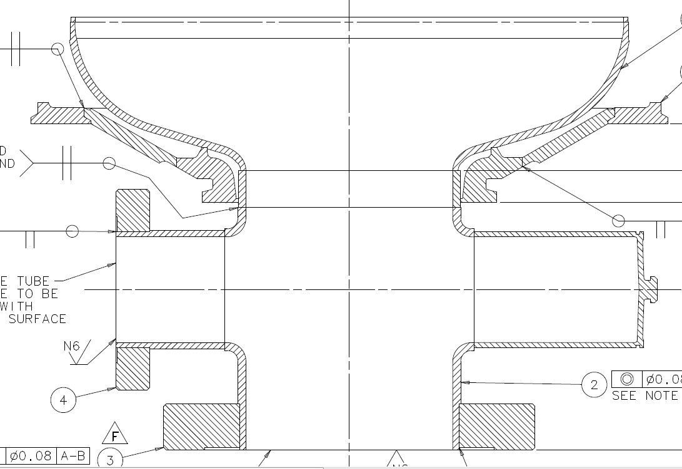
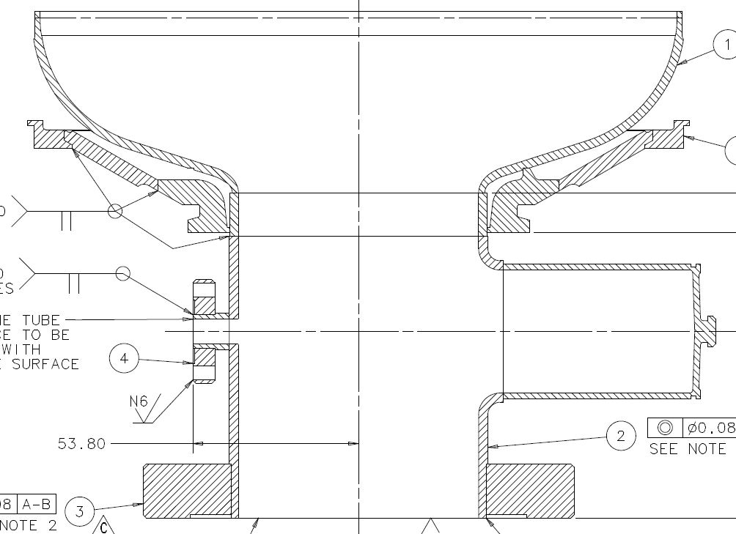
History of Dressing 1.3 GHz ILC Style Cavities at Fermilab
Fabricated cavity endgroups with transition rings:
Main Coupler Endgroup
Field Probe Endgroup

Slide 6
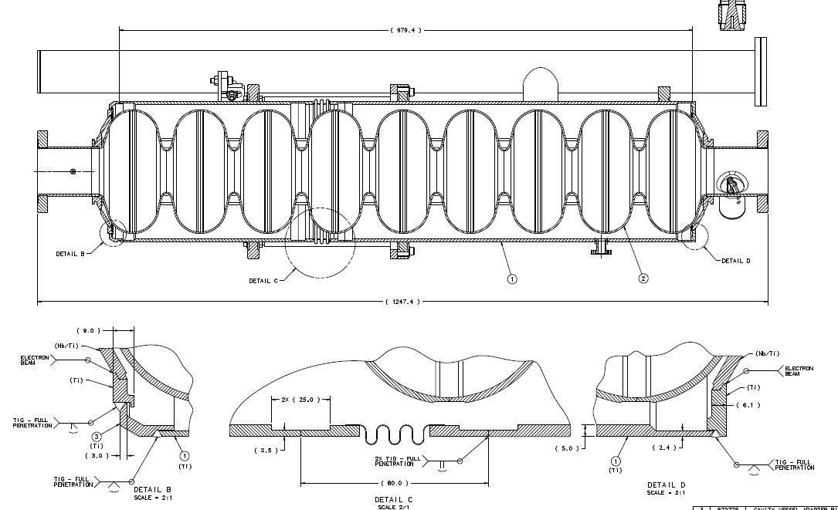
History of Dressing 1.3 GHz ILC Style Cavities at Fermilab
Cross-section of ILC style cavity dressing weld sequence:
Final Weld
1st Weld
2nd Weld

Slide 7
History of Dressing 1.3 GHz ILC Style Cavities at Fermilab
Cavity to helium vessel alignment:
The main coupler is aligned in the horizontal position and parallel to the moving cart using a bracket that engages the coupler flange. The helium vessel is mounted to the cart supported by the bearing lugs and travels along a rail track with bearing rollers. This fixture enables us to adjust and achieve the cavity coupler flange to the helium vessel lugs perpendicularity requirement.

Slide 8
History of Dressing 1.3 GHz ILC Style Cavities at Fermilab
Glovebox TIG welding:
The TIG welding done inside the glove box is operating on three separate argon purge lines. One line is dedicated for the dome purge; a second line has a purge flow inside the helium vessel and the third line is for torch purge and torch cooling. The cables for monitoring the frequency spectrum of the cavity are also attached and connect to feedthrough ports inside the glove box. Once the oxygen level is below 20ppm and humidity levels below 15% are achieved, welding can begin.

Slide 9
History of Dressing 1.3 GHz ILC Style Cavities at Fermilab
Frequency spectrum monitored and recorded during welding:

Slide 10
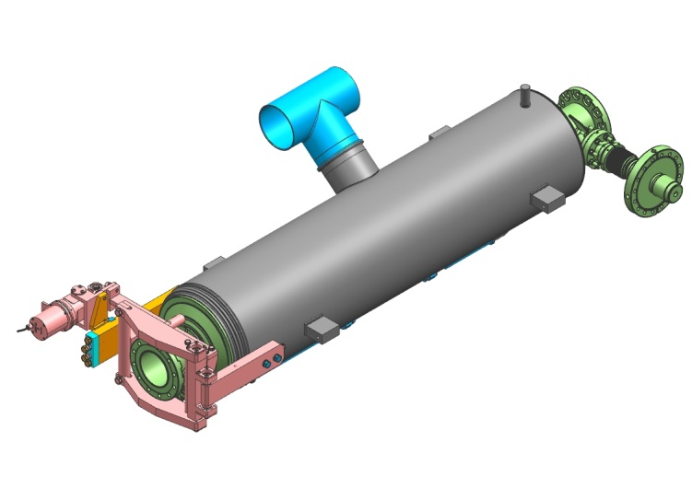
Overview of the LCLS-II Prototype Dressed Cavity

Slide 11
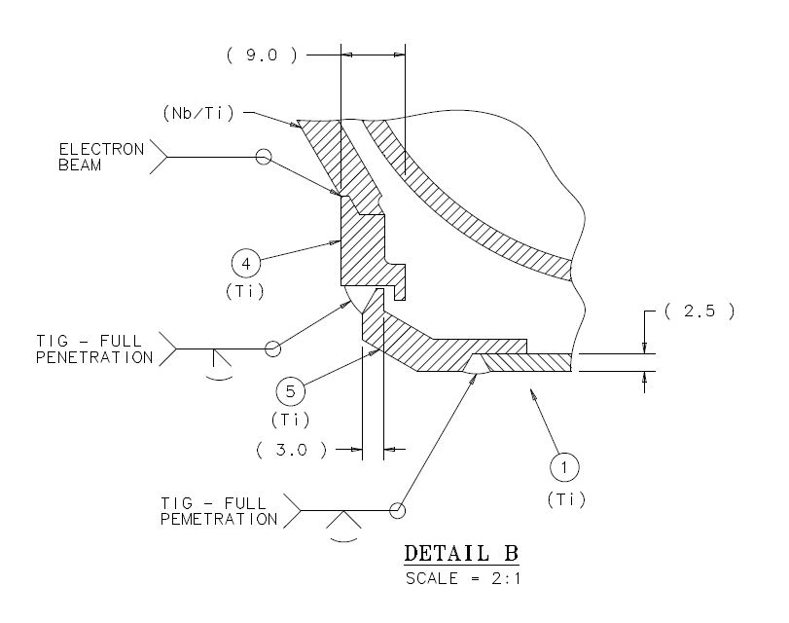
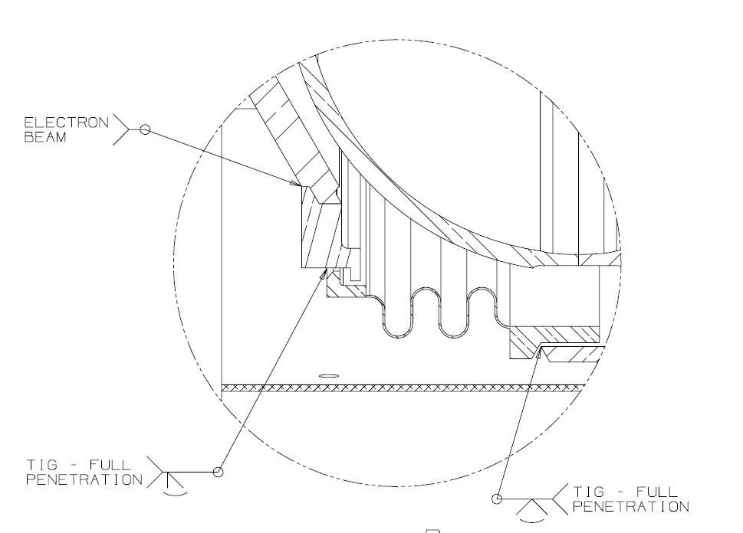
Overview of the LCLS-II Prototype Dressed Cavity
Features that differ from the ILC style dressed cavity
Bellows is at the end of the cavity to accommodate end lever tuner.
Replaces the titanium adapter ring.

Slide 12
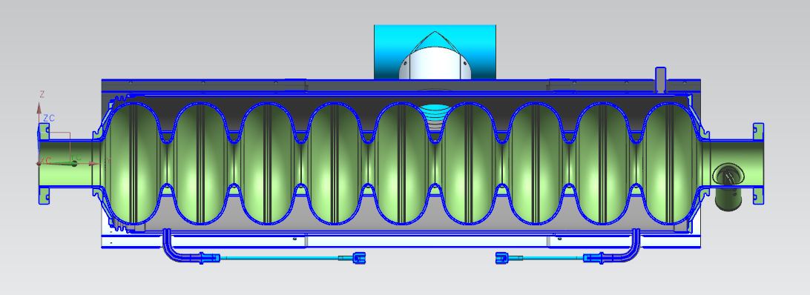
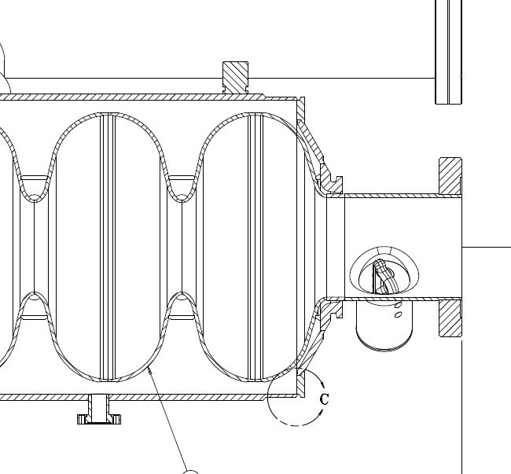
Overview of the LCLS-II Prototype Dressed Cavity
Features that differ from the ILC style dressed cavity
Single mini-conflat helium fill line replaced by duel VCR connections.
VCR connections cutoff at cavity string assembly and tubes orbital welded to the cryomodule fill supply lines.

Slide 13
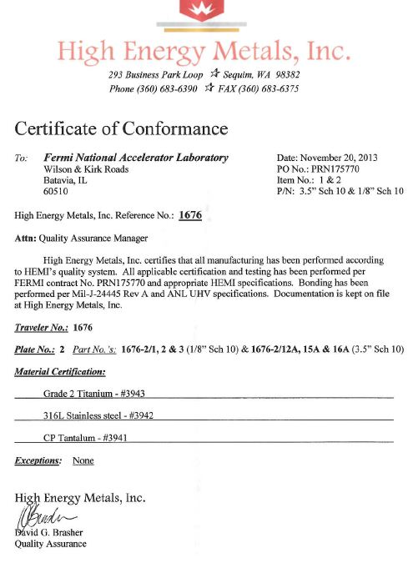
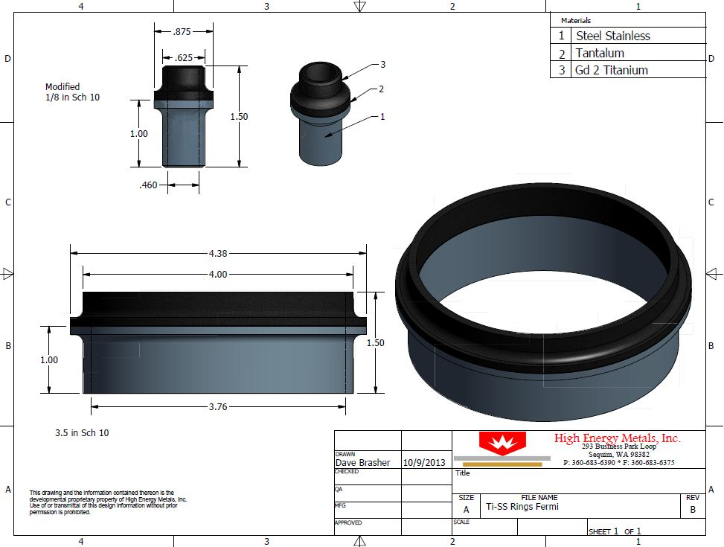
Overview of the LCLS-II Prototype Dressed Cavity
Features that differ from the ILC style dressed cavity
2-Phase bi-metallic transition from titanium to 316L stainless steel.
Helium supply bi-metallic transition from titanium to 316L stainless steel.

Slide 14
Review of the LCLS-II Dressed Cavity Technical Design Report
All technical documents are stored and revision controlled using Fermilab’s installation of Team Center Engineering:
The Technical Design Report is numbered ED0001383, and is still under the initial release. The document presented is approx. 90% complete.
The document covers extensive information about the pressure vessel design, lever tuner description (incomplete), mechanical and RF analysis, magnetic shield descriptions, and appendix’s with samples of pressure test set-ups and notes, and dressed cavity engineering notes with “Statements of Compliance”.
Document has been uploaded to Indico.
Review some highlights of the document.

Slide 15
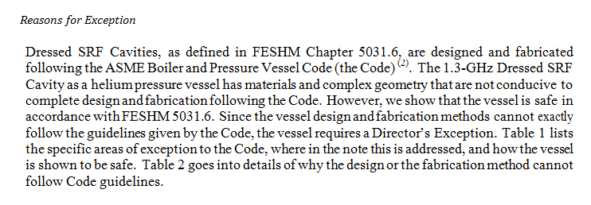
Review of the LCLS-II Dressed Cavity Technical Design Report
Exceptional Vessel Discussion (ED-0001383 Rev. –; Pg. 8-10)

Slide 16
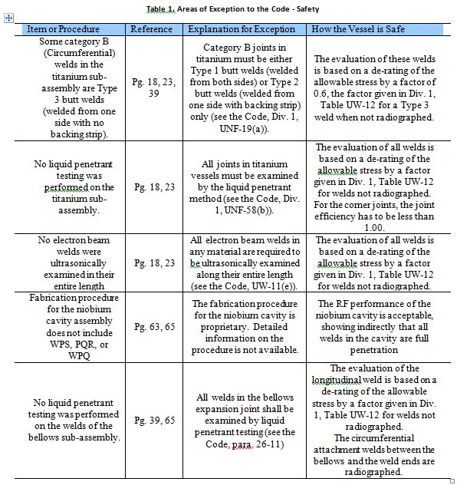
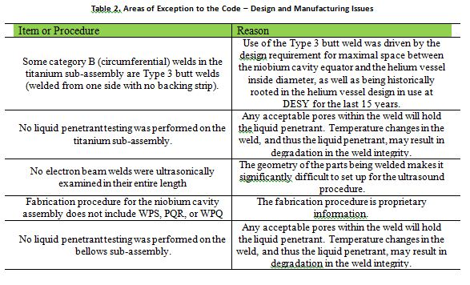
Review of the LCLS-II Dressed Cavity Technical Design Report
Exceptional Vessel Discussion (ED-0001383 Rev. –; Pg. 8-10)

Slide 17
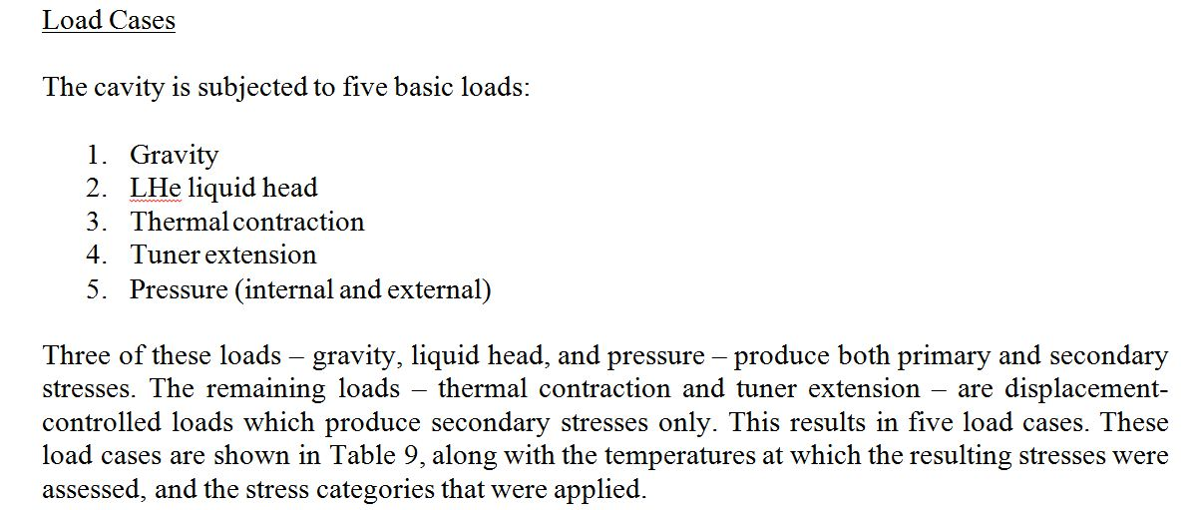
Review of the LCLS-II Dressed Cavity Technical Design Report
Code Mechanical Analysis: (ED-0001383 Rev. –; Pg. 37)

Slide 18
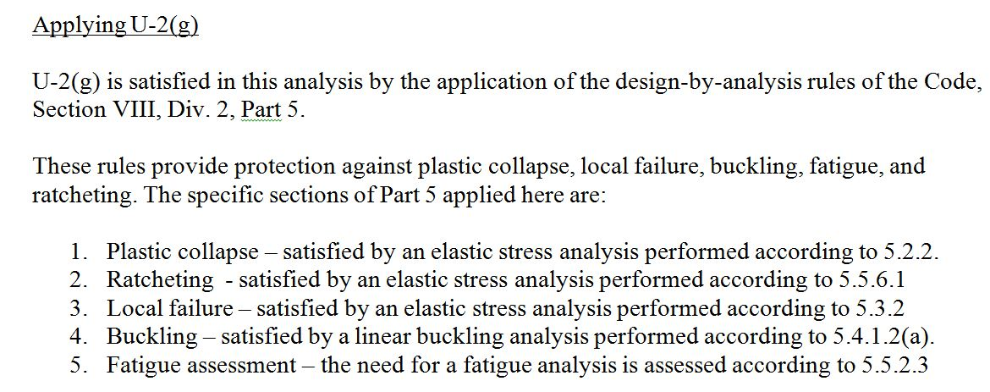
Review of the LCLS-II Dressed Cavity Technical Design Report
Code Mechanical Analysis: (ED-0001383 Rev. –; Pg. 40)

Slide 19
Review of the LCLS-II Dressed Cavity Technical Design Report
RF Analysis: (ED-0001383 Rev. –; Pg. 84)

Slide 20
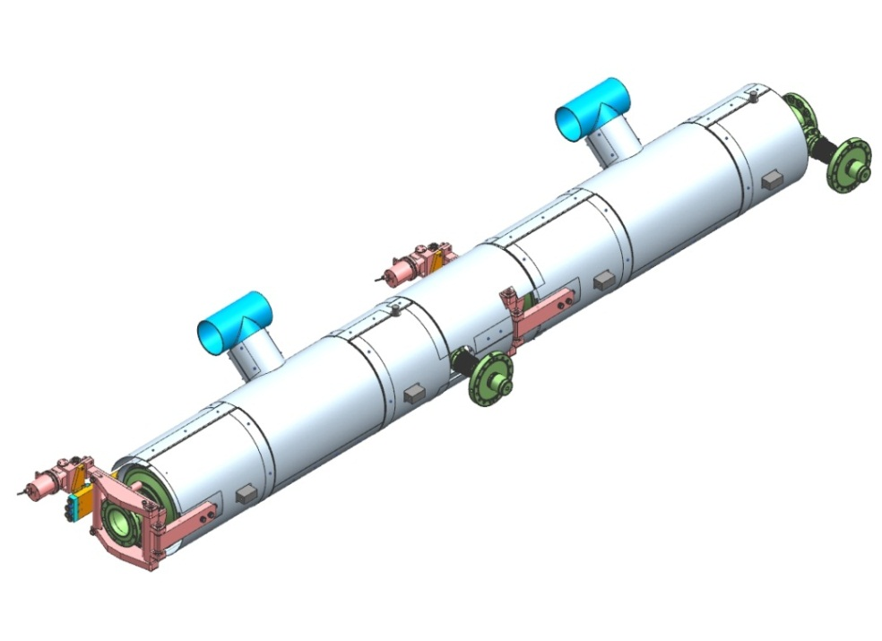
Duel Layer Magnetic Shielding
All technical documents are stored and revision controlled using Fermilab’s installation of Team Center Engineering:
The Magnetic Shield Fabrication Specification is numbered ED0001196, and is still under the initial release. The document presented is complete.
The document covers information about design and manufacturing of the first and second layer of cavity shields and interconnect shields.
Acceptable materials are: Cryoperm 10, Amumetal 4K, or equivalent material approved by FNAL.
Document has been uploaded to Indico.

Slide 21
Assembly Sequence - 1st Level Magnetic Shields to Helium Vessel
3rd Pair Attached Over 1st and 2nd Pair and Around
“Chimney”
All Shield Parts 1mm Thick
2nd Pair Attached
1st Pair Attached

Slide 22
1st Level Magnetic Shields After Assembly
Clamshells Overlap No More than 20mm Relative to Each Other
3.5mm Radial Separation Between 1st Level Shields and Helium Vessel
4mm Space Around All Protrusions

Slide 23
Assembly Sequence – 2nd Level Magnetic Shields to Helium Vessel
3rd Pair Attached Over 1st and 2nd Pair and Around
“Chimney”
2nd Pair Attached
1st Pair Attached
4th Pair Attached to 3rd
Pair’s “Collar” Around “Chimney”
All Shield Parts 1mm Thick
“Chimney Collars” Welded Prior to Attachment of 3rd Pair

Slide 24
2nd Level Magnetic Shields After Assembly
Clamshells Overlap No More than 20mm Relative to Each Other
20mm Radial Separation Between 1st and 2nd Level Shields
4mm Space, or More, Around All Protrusions

Slide 25
2nd Level Magnetic Shields After Assembly
Shield Spacers: (ED-0001196Rev. –; Pg. 4)

Slide 26
Cavity String Interconnect Shields
Interconnect Shield Fixed End
Interconnect Shield
Sliding Joint
2nd Layer Interconnect Shield

Slide 27
Manufacturing Plans
Helium Vessels:
Upon approval 18 helium vessel assemblies can be ordered.
Order lead time 10-12 weeks ARO.
All drawings are complete waiting for approval and release.
Still need to complete the Helium Vessel Fabrication Specification.
FNAL will supply the 316L SS 2-phase tee to the manufacturer. In stock quote received.
FNAL will supply the bi-metallic transitions (2-phase and helium fill) to the manufacturer. Lead time 4 weeks ARO.
Optional: FNAL will perform orbital welds for the manufacturer?
Magnetic Shields:
First layer cavity magnetic shielding complete, drawings complete.
Second layer cavity magnetic shielding complete, only assembly drawing complete.
First and second layer interconnect shield model is complete, waiting for final tuner design before drawings can be finalized (due to complex cuts around the tuner).
Hopefully drawing package can be complete in 4 weeks.
Order lead time 12-14 weeks ARO.
Cavity dressing:
First cavity can be dressed immediately following helium vessel QC.
It will take approximately 3 days to complete the first cavity dressing.
Prior to dressing, minor modifications to assembly and welding fixtures must take place.

Slide 28
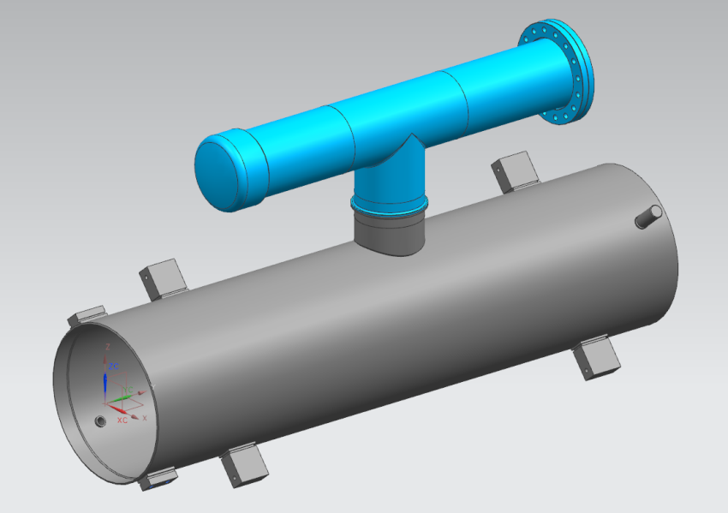
Cavity Dressing Options String vs. HTS
4” tube extensions, pipe cap, and 6” CF flange added
Part cut off prior to string assembly
Cavity Dressed for String Assembly
Cavity Dressed for HTS

Slide 29
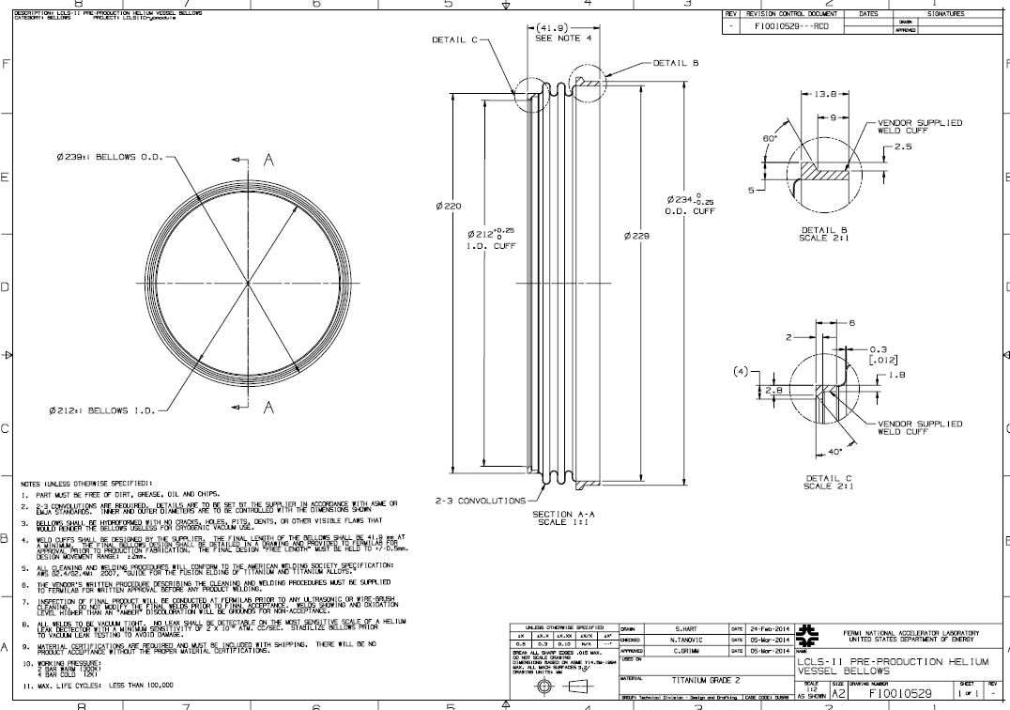
Cavity Dressing Helium Vessel Bellows
Drawing is complete and released.
Received quote for 18 parts.
Delivery 9 weeks ARO.

Slide 30
Thank You! Comments/Questions

