Slide 1
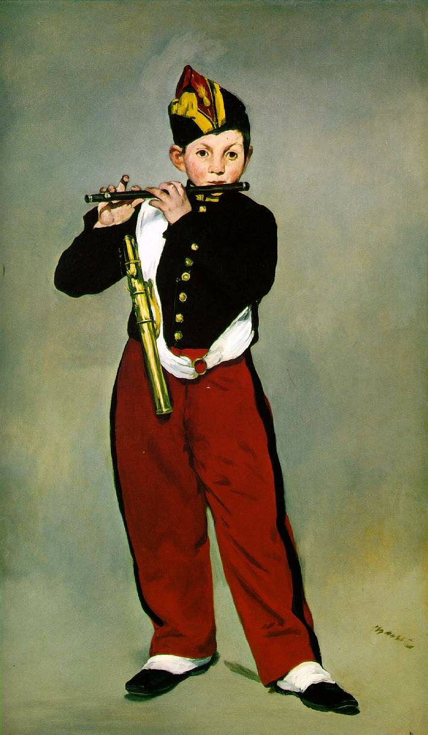
Database Applications Update
Igor mandrichenko
6/16/2014

Slide 2
IFBeam DB
Migrated to new DB servers, they should last for 3 years
Redesigned DB as it is becoming “large database”
Table partitioning: truncate partition instead of deleting old rows
Better indexes
No downtime during migration thanks to redundancy built into the system
Major improvements in device and collector management
Authorized users manage their own device sets (bundles)
Collectors receive new bundle definitions automatically

Slide 3
IFBeam DB
High Availability and Continuity
Added 3rd database replica to the chain
In case one DB server fails, we still have 2 replicas
Virtual IP address to follow master DB instance to reduce downtimes off-hours
With DBAs and SSS, work in progress
Presented the system to LBNE
No major changes needed
More data to collect – more disk space

Slide 4
IFBeam DB
Monitoring
Improvements in NuMI Beam Line monitoring
Added chart caching
Working on moving the plotting to the browser
New System Status page – real time status of the system
Help shifters see and diagnose problems
Negotiating off-hours support with PPD

Slide 5
Conditions Databases
NOvA Conditions DB generalized into ConDB product
In use by NOvA
NOvA is still working on higher level application interface
LBNE is interested
Minerva Conditions DB is another, simpler option
In use by Minerva
uBooNe is looking at it

Slide 6
Collaboration Applications
ECL Suite
Last release – March 2014
Import/export list of users, institutions, affiliations
User requests
Preparation for integration with HCM
Added Speakers Bureau to the Suite
Developed for DES initially
Other improvements
New GUI style
Saved searches shown as links
Improvements in the shift points quota calculations
High availability ECL database for Minerva and MINOS
Mostly DBAs, SSS, work in progress

Slide 7
Redundant Web Services Infrastructure
Performance improvements
Added 2 virtual GPCF machines as data servers
Added squid caching for IFBeam DB and NOvA Conditions DB, which gave us significant performance improvement
Resource management
HTTP proxy for data services – added more resource monitoring functions
Improvements in WDA (web data access library, part of ifdh)
Better delayed retry mechanism
IFBeam DB and conditions databases
Higher Availability
Adding GPCF2 ? SCD Cluster ?

Slide 8
DES
Released DES Publication Board into production
More data selection, plotting functionality for the Telemetry Viewer

Slide 9
Web Application Development Framework
Common framework used to build data and interactive applications and components

