Slide 1
dCache/XRootD
Dmitry Litvintsev
(DMS/DMD)

Slide 2
What is dCache
Distributed multi-petabyte scalable disk storage system with single rooted filesystem providing location independent file access
  Can be interfaced with tertiary storage serving as cache front-end to optimize I/O
dCache.org is a collaboration between DESY, Fermilab and NDGF
dCache is an open source (github.com/dCache/dcache)

Slide 3
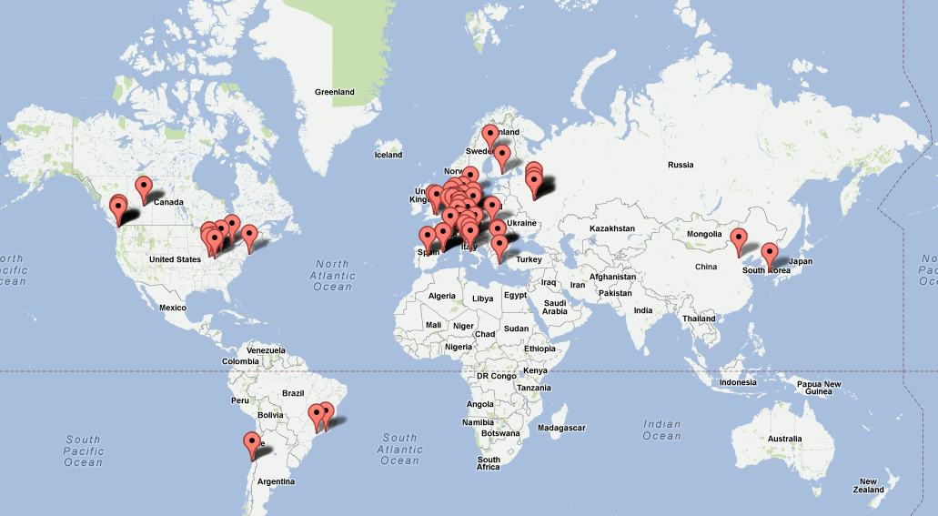
dCache worldwide
More that 70 installations, with total storage volume of ~ 120 PB

Slide 4
dCache @ Fermilab
Long and successful history:
  Run II : CDF (in production since 2003)
  General purpose Public dCache (in production since 2004)
  CMS (since 2005)
  D0 (in production since 2014)
Fall 2013: public dCache expanded by a factor of 20 to meet needs of IF experiments (a part of FIFE program)

Slide 5
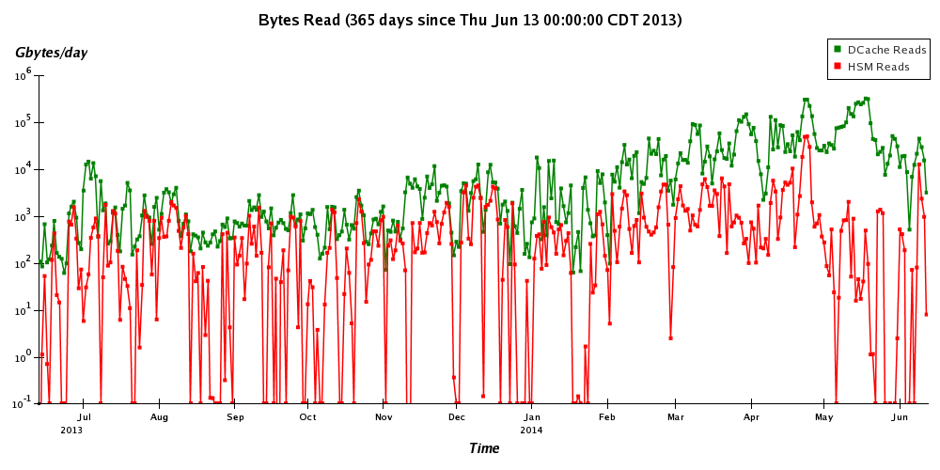
Read transfer volume scaling
x100 scale up

Slide 6
On-line space usage in dCache
On-line space usage in public dCache by storage group (top 10) in GiBs
Total used space currently is about 2PiBs

Slide 7
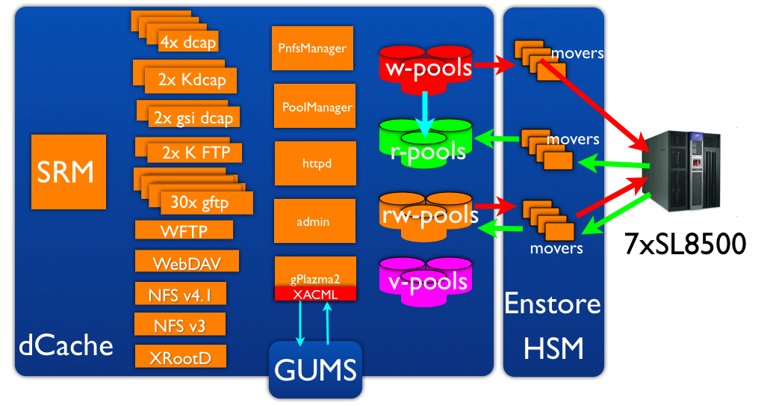
Public dCache (FNDCA)
I/O
Mgmt
Data Servers

Slide 8
Access Protocols
Protocol | URL | Authentication | Client(s)
dcap | dcap://fndca1.fnal.gov:{24125,24136,24137,24138} | None | dccp,dcap, root
 | dcap://fndca1.fnal.gov:{24525,24536} | GSI
 | dcap://fndca1.fnal.gov:{24725,24736} | Kerberos(GSS)
FTP | fndca1.fnal.gov:24126 | passwd | ftp
 | fndca1.fnal.gov:24127 | kerberos(GSS)
gFTP | fndca1.fnal.gov:{2811,2812} | GSI | globus-url-copy, srmcp, uberftp
SRM | srm://fndca1.fnal.gov:8443 | GSI | lcg-cp, srmcp…
NFS v4.1 | stkensrv1n.fnal.gov:2049 | None | POSIX I/O
NFS v3 | stkensrv1n.fnal.gov:2049 | None | POSIX metadata ops, POSIX I/O with dcap preload library
WebDAV | https://fndca1.fnal.gov:2880 | GSI | Browsers, curl, cadaver, davfs, root
XRootD | (x)root://fndca1.fnal.gov:1094 | GSI | xrdcp, xrd, POSIX preload lobrary, FUSE, root

Slide 9
Access from root
Provided the proper plugin the access to files in dCache from root looks like:
  dcap (no auth) on mounted namespace (NFS v3) using preload library
  mount -o nfsvers=3 stkensrv1n:/minos /pnfs/minos
  export LD_PRELOAD=/usr/lib64/libpdcap.so.1
  root [0] f=TFile::Open(”/pnfs/minos/path/to/file");
  dcap (no auth)
  root [0] f=TFile::Open("dcap://fndca1.fnal.gov:24125/full/path/to/file");
  dcap (GSI Auth)
  {grid,voms}-proxy-init …
  export DCACHE_IO_TUNNEL=/usr/lib64/dcap/libgsiTunnel.so
  root [0] f=TFile::Open("dcap://fndca1.fnal.gov:24525/full/path/to/file");
  dcap (kerberos Auth)
  kinit <username>@FNAL.GOV
  export DCACHE_IO_TUNNEL=/usr/lib64/dcap/libgssTunnel.so
  root [0] f=TFile::Open("dcap://fndca1.fnal.gov:24725/full/path/to/file”);

Slide 10
Access from root
NFS v4.1:
mount -t nfs4 -o minorversion=1 stkensrv1n:/minos /pnfs/minos
root [0] f=TFile::Open(”/pnfs/minos/path/to/file”);
WebDAV (TDavixFile plugin)
{grid,voms}-proxy-init ..
root [0] f=TFile::Open("https://fndca1.fnal.gov:2880/path/to/file");

Slide 11
XRootD
Extended rootd (eXtended root daemon)
File access and data transfer protocol
  POSIX-like random access to arbitrary data organized in files of any type
A reference implementation of
  xrootd daemon provides access to distributed data servers
  cmsd daemon clusters xrood daemons
Provides fault tolerant, low latency, high bandwidth access to data

Slide 12
dCache XRootD
dCache provides fully functional xRootD server
  Native Java implementation of xrootd protocol
  Acts as any other dCache door. dCache door is xrootd redirector
  Mover and pools are xrootd data servers

Slide 13
XRootD door
On public dCache we run XRootD door:
root://fndca1.fnal.gov:1094
How to use:
  Create {grid,voms} proxy
  {grid,voms}-proxy-init …
  With root files:
  root [0] f=TFile::Open("root://fndca1.fnal.gov/pnfs/fnal.gov/usr/fermigrid/volatile/fermilab/litvinse/xib.root");
  With any files
  xrdcp xroot://fndca1.fnal.gov/pnfs/fnal.gov/usr/fermigrid/volatile/fermilab/litvinse/gums1.txt .
  [xrootd] Total 0.00 MB |====================| 100.00 % [0.0 MB/s]
  Use xrd - xrootd file and directory meta-data utility

Slide 14
XRootD usage from root

Slide 15
xrd client
Invoke it like so
xrd fndca1.fnal.gov
Type ‘help’ to get list of command.

Slide 16
dCache best practices
For temporary files use scratch area
  /pnfs/<experiment>/scratch/users/<username>
For permanent files:
  Use large files (few GBs). Concatenate small files before putting them to dCache if possible
  Use SFA (Small File Aggregation) with small files
Pre-stage data before running on the grid

Slide 17
Storage Federation
Collection of heterogeneous storage resources managed by co-operating but independent administrative domains transparently accessible via a common namespace.

Slide 18
xRootD Federated Storage (AAA take)
An XrootD based Framework built on top of existing storage

Slide 19
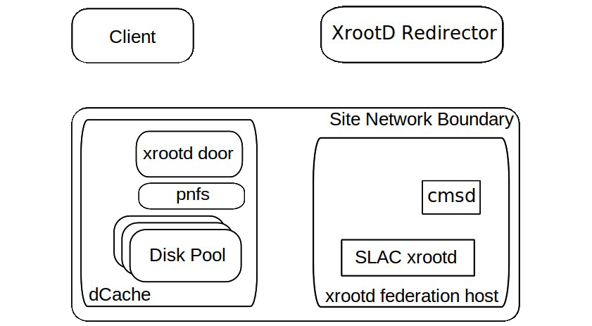
dCache + XrootD Federation
/path/to/lfn ?
/path/to/lfn
-> /mapped/path/to/pnf
Redirect xrootd.federation.host
Redirect fndca1.fnal.gov
/path/to/lfn ?
Path/to/lfn ?
Redirect o pool
Got it
/path/to/lfn ?
TFC

Slide 20
HTTP Plugin for XRootD
(Fabrizio Furano CERN IT-SDC/ID)
XrdHTTP plugin provides support for HTTP(s) and WebDAV in XRootD framework
Can share same port as XRootD protocol. Clients automatically detected.
Support X509 auth., proxy certs. and VOMS extensions
Any XRootD server keeps its advances functionality plus gets HTTP compliance
IPv6 compatible

Slide 21
Why HTTP/WebDAV?
Covers most existing use cases
Supports WAN access
GET/PUT or direct chunked access
Ubiquitous:
  Available on all platforms
  Many standard clients
  Web browsers
  Allow integration with Cloud at protocol level
HTTP moves more data worldwide than HEP
HTTP + Grid allow a browser to interact with GRID SE

Slide 26
Conclusion
dCache is actively used by FIFE experiments
We run XRootD door
We are starting to experiment with storage federations
  XRootD
  WebDAV

