Slide 1
TEM3P simulation of Be Wall Cavity (2)
Tianhuan Luo

Slide 2
Check with analytical calculation
After talking with Zenghai Li at SLAC, it turns out the definition of E field in TEM3P has been normalized by the transient factor with beta=1.
For the model in the current simulation, transient factor ~ 0.888. dT \prop E^2, and (227-80)*0.888^2~ (196-80), thus the analytical calculation and TEM3P agrees.
Question: is 21.6 MV/m the peak field in the cavity or the effective accelerating field in the 6D cooling simulation?

Slide 3
Check case I: constant parameters
R=0.36 m, f0~319 MHz, L=0.25m.
Be wall 1 mm.
Thermal conductivity: 300 W/(mK); electrical conductivity: 9.3e7 S/m; Peak E field 21.6 MV/m; duty factor: 0.92e-3.
T_out =80 K.
 | Analytical | Bob’s Code | TEM3P
T_center (K) | 196.0 | 199 | 196.1

Slide 4
Check case II: T-dependent parameters
R=0.36 m, f0~319 MHz, L=0.25m
Be wall 1 mm. Peak E field 21.6 MV/m; duty factor: 0.92e-3.
T_out =80 K.
Thermal Conductivity (W/(mK))
Resistivity (Ohm*m)
T (K)
T (k)
 | Bob’s Code | TEM3P
T_center(K) | 167.8 | 163.5

Slide 5
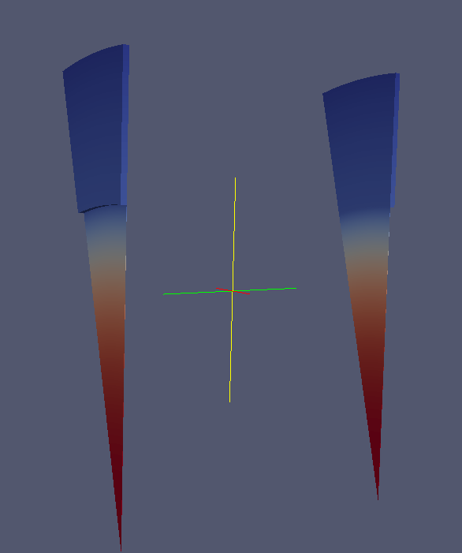
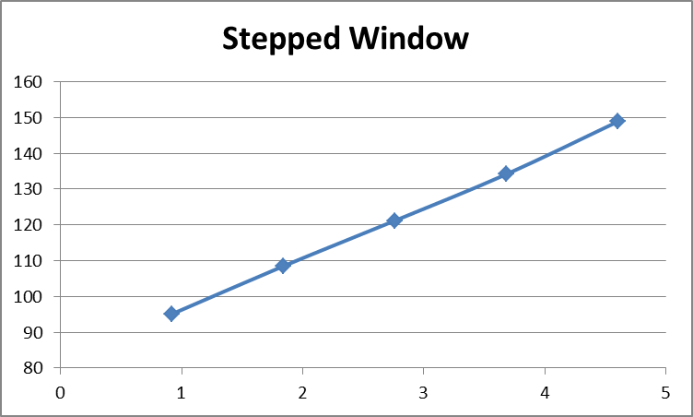
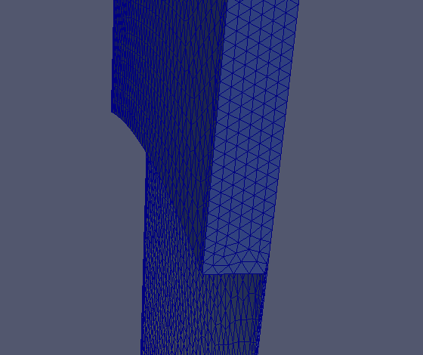
Stepped Window
R_window = 25 cm, t_window= 0.02 cm; R_cavity = 36 cm, t_step = 0.5 cm.
T_out =80 K.
The duty factor has been reduced (10%~50%) to get converging solution.
T (K)
Duty factor (10e-4)

Slide 6
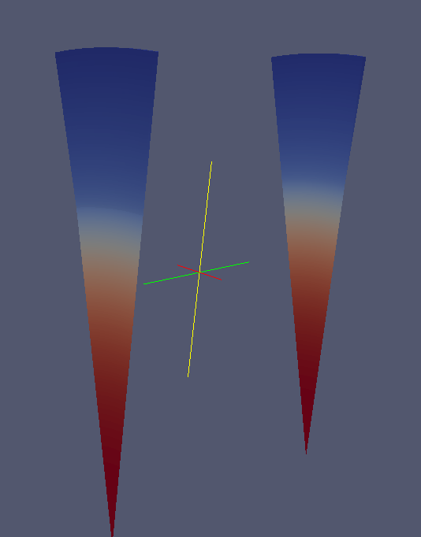
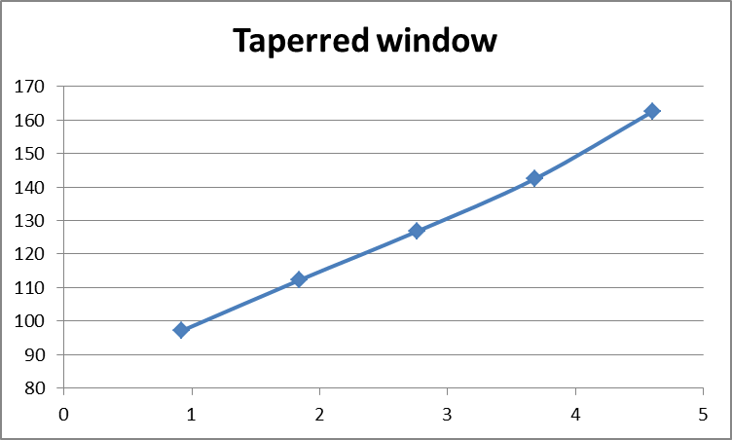
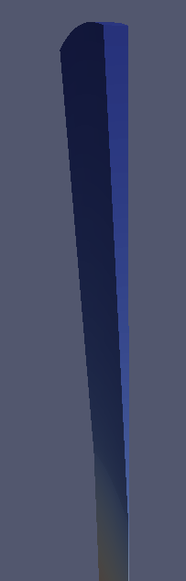
Tapered Window
R_window = 25 cm, t_window= 0.02 cm; R_cavity = 36 cm, t_taper = 0.5-0.02cm.
T_out=80 K.
The duty factor has been reduced (10%~50%) to get converging solution.
T (K)
Duty factor (10e-4)

Slide 7
Summary
The discrepancy between analytical calculation and TEM3P simulation has been resolved.
Cross-checked with Bob’s code, the results are consistent.
Build the model for the Stepped window and Tapered window.

