Slide 1
MAP Cooling Solenoid
(Tuesday, April 15th)
F. Borgnolutti

Slide 2
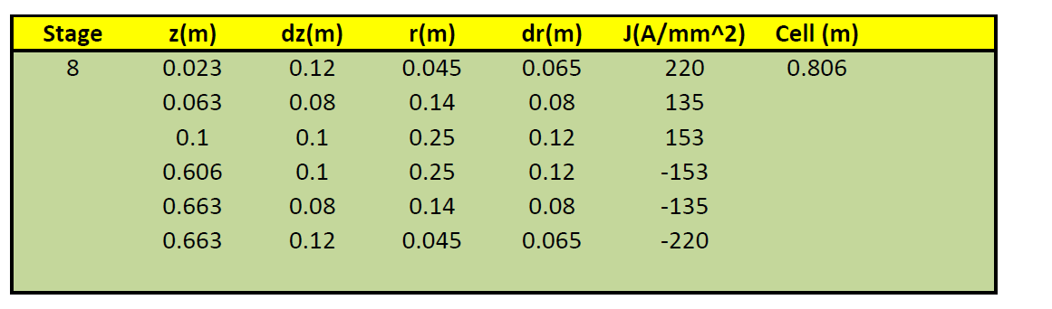
Latest version of the System

Slide 3
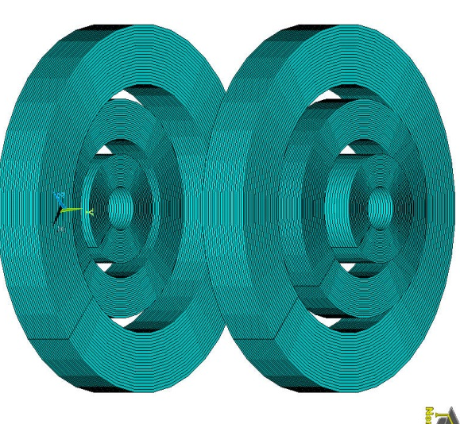
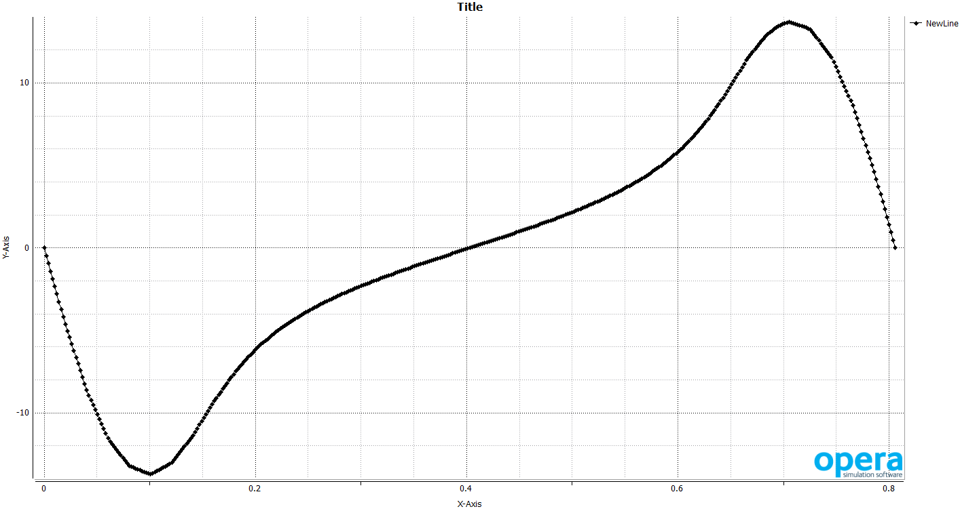
Magnetic field on the axis
13.7 T
-13.7 T

Slide 4
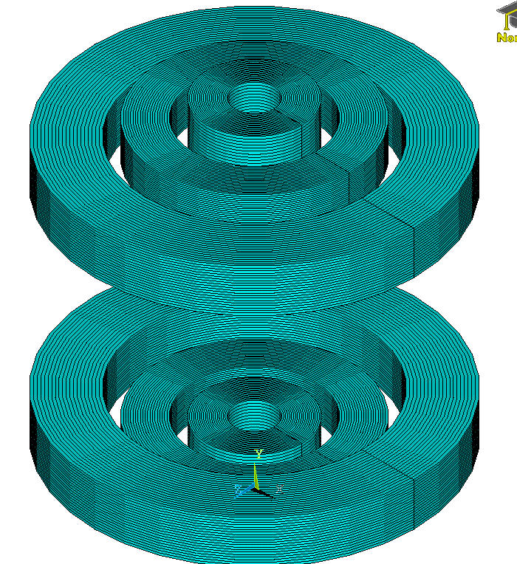
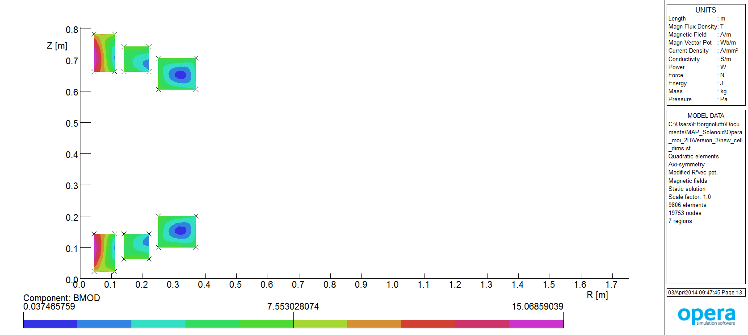
Peak field
Peak field in the coils at nominal current
Inner solenoid: 15.07 T
Middle solenoid: 7.13 T
Outer Solenoid: 6.77 T

Slide 5
Load line
Nb₃Sn (4.2K)
Nb₃Sn (1.9K)
Inner solenoid
Nb-Ti:
  Bottura’s formula
  No sf correction
  No cabling degradation
  Cable filling factor = 0.26
Nb₃Sn:
  QXF jc
  5% current degradation due to cabling
  Self-field corrected
  Cable filling factor = 0.33
Middle solenoid
Outer solenoid
Nb-Ti (4.2 K)
Nb-Ti (1.9 K)
→ Nb-Ti can be used for the Middle and Outer solenoids.
→ Nb₃Sn is required for the Inner solenoid.

Slide 6
Solenoids in Nb3Sn
 | % of the load line at operational current
 | Inner solenoid | Middle solenoid | Outer solenoid
Nb-Ti, 4.2 K | - | 78% | 76%
Nb-Ti, 1.9 K | - | 61% | 59%
Nb3Sn 4.2 K | 86% | - | -
Nb3Sn, 1.9 K | 79% | - | -
→ Middle and Outer solenoids: Nb-Ti at 4.2 K can be used (22-24% margin).
→ Inner solenoid: Nb₃Sn at 4.2 K gives 14% margin on the current. If not enough operating at 1.9 K would give 21% margin

Slide 7
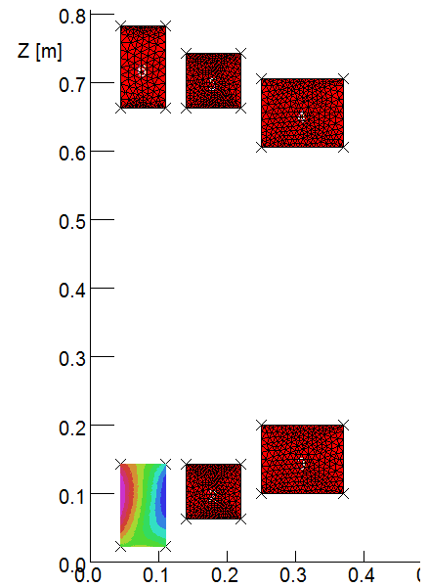
Magnetic Forces
Global forces applied to the coils:
y

Slide 8
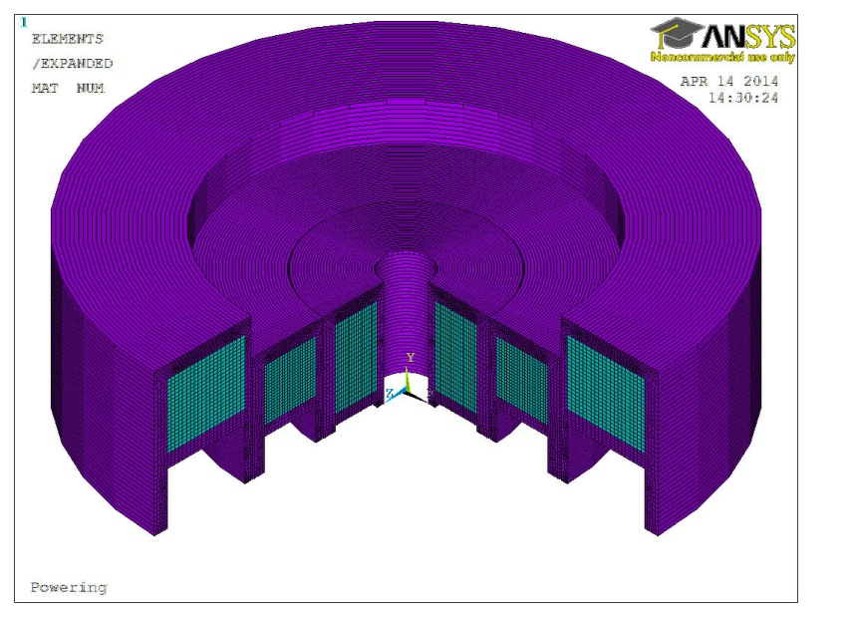
Mechanical Model (Ansys)
Stainless-steel casings
RF cavity
Nb₃Sn Coil
Nb-Ti Coils

Slide 9
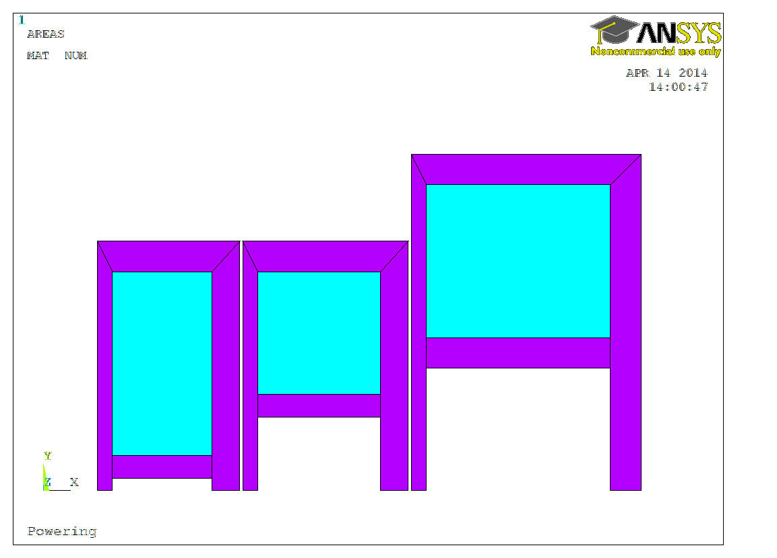
Mechanical Model (Ansys)
20 mm
10 mm
18 mm
18 mm
20 mm
Stainless-steel
10 mm
NbTi
10 mm
Nb₃Sn
NbTi
20 mm
15 mm
15 mm
2 mm gap
2 mm gap

Slide 10
Mechanical Model (Ansys)
Young Modulus
 | 300 K | 4.2 K
316 LN | 210 GPa | 210 GPa
Coil X-section | 45 GPa | 45 GPa
Coil azimuthal | 90 GPa | 90 GPa

Slide 11
Mechanical Model: Loading Sequences

Slide 12
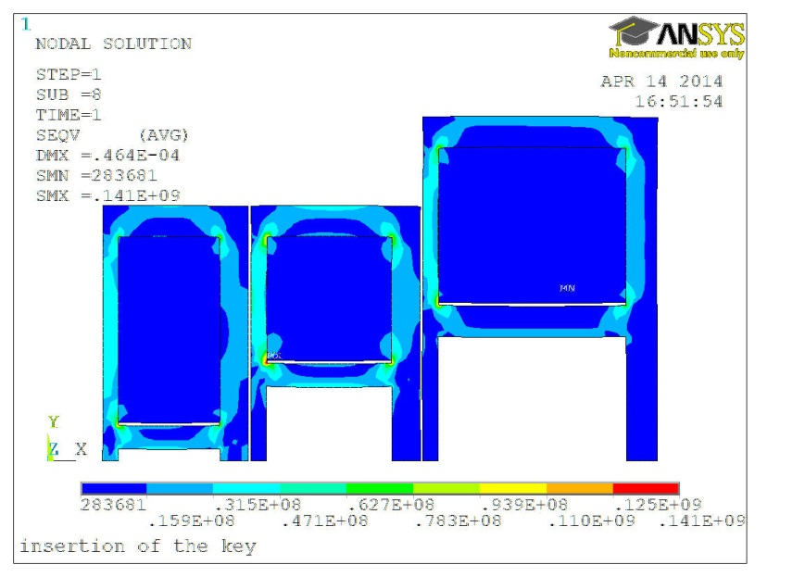
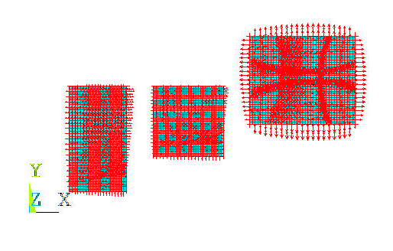
Mechanical Model: Loading Sequences
1 – Coil Pre-stress
2 – Cool-Down
3 – Powering
(magnetic forces)
50 μm shim

Slide 13
Results: Stainless-Steel structure

Slide 14
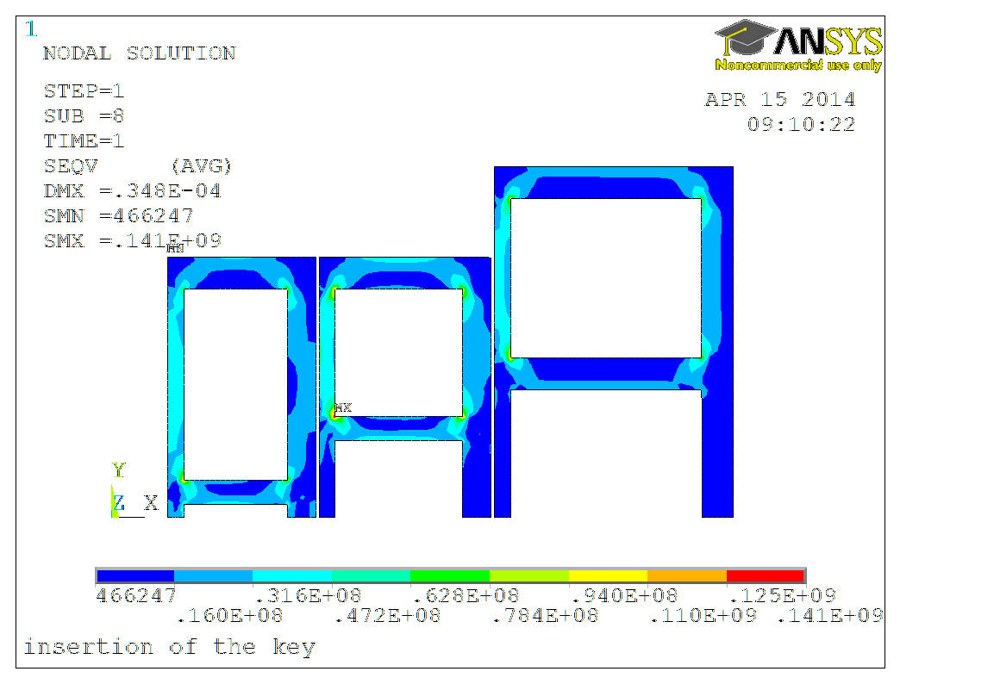
Structure: Application of the pre-stress
Stress in the structure < 141 Mpa
(yield strength 316LN at RT 350 MPa )

Slide 15
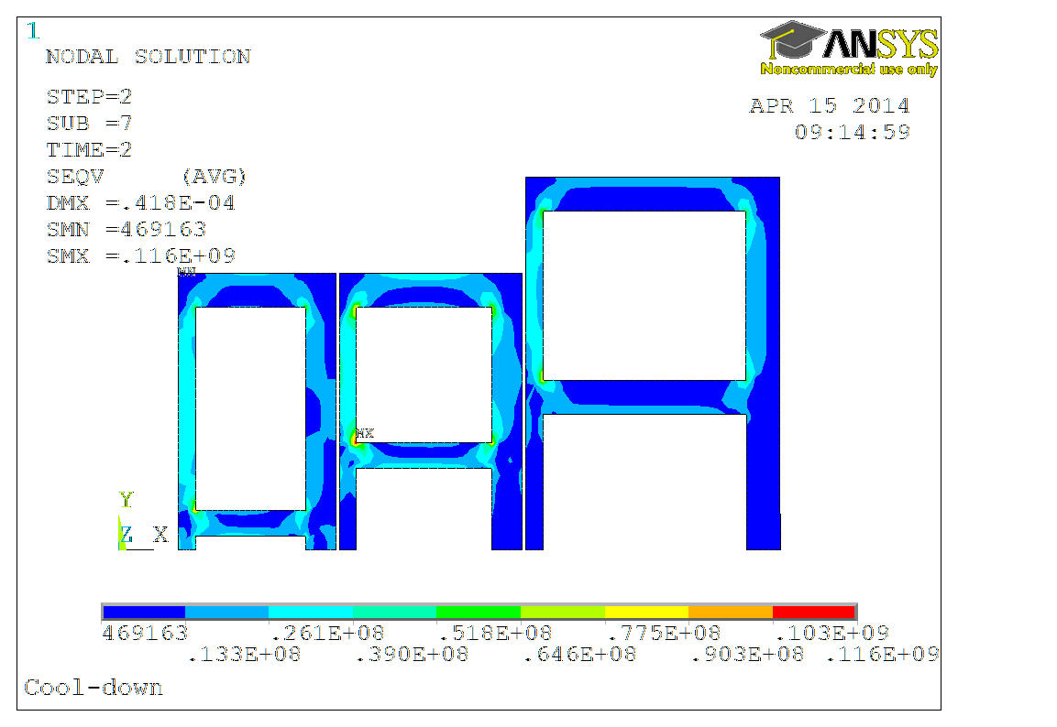
Structure: Cool-Down
Stress in the structure < 116 Mpa
(yield strength 316LN at 4.2K → 1 GPa )

Slide 16
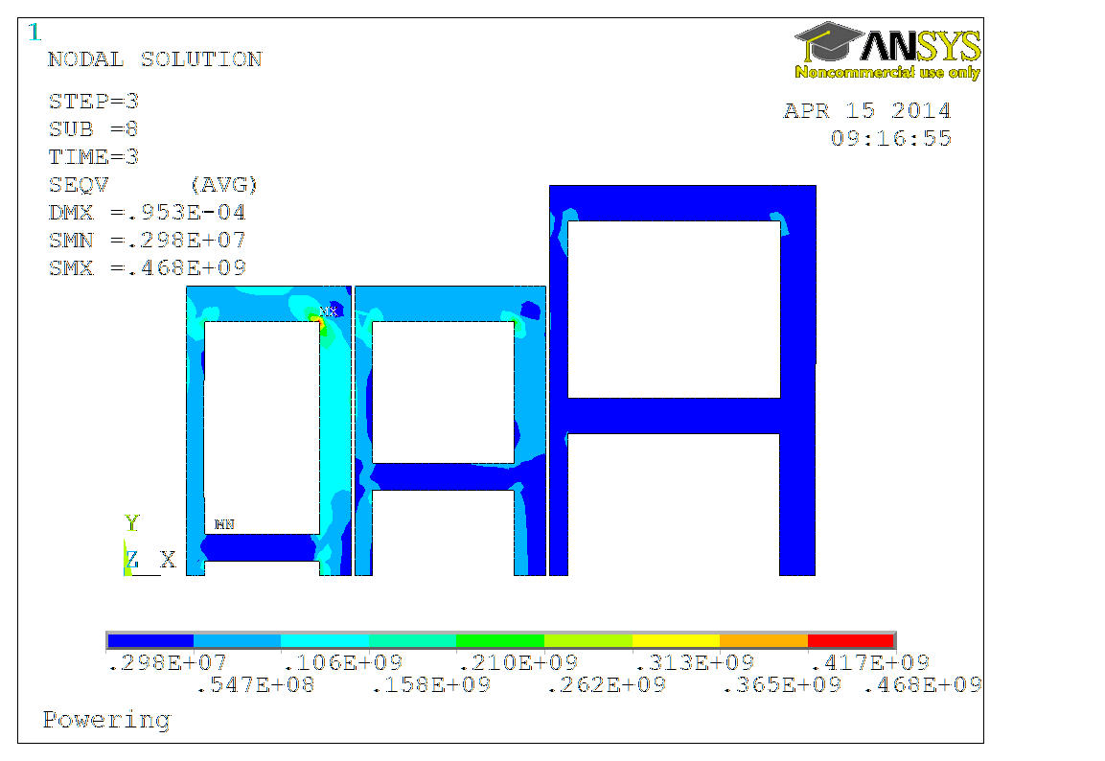
Structure: Powering
Stress in the structure < 470 Mpa
(yield strength 316LN at 4.2K → 1 GPa )

Slide 17
Results: Coils

Slide 18
Coils: Peak stress values
Peak stress in the middle coil < 170 Mpa
Peak stress in the outer coil < 70 MPa
Nb-Ti coils
Inner Coil (Nb₃Sn)
 | σx (Mpa) | σy (Mpa)
Key | -34 | -58
C-D | -25 | -44
Powering | -264 | -317
Nb₃Sn safe limit: 200 MPa

Slide 19
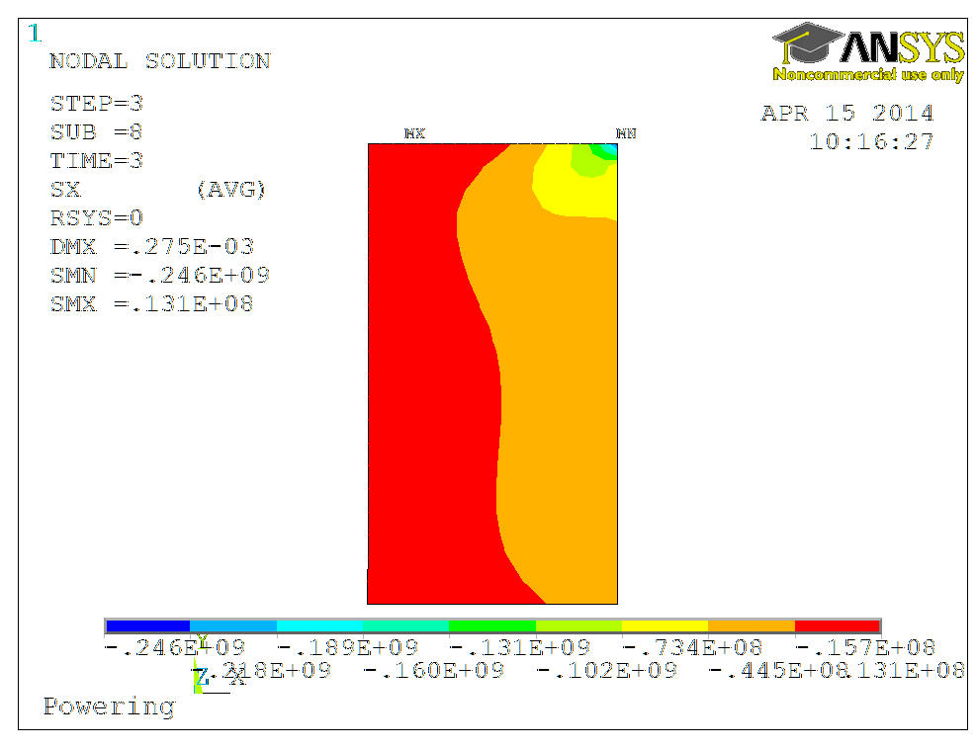
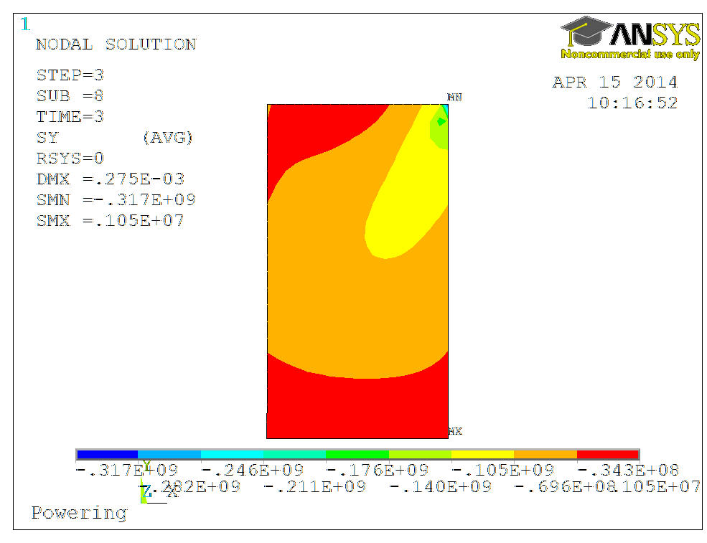
Stress in the Nb₃Sn coil @ Powering
σx
σy
-70 MPa
-180 MPa

Slide 20
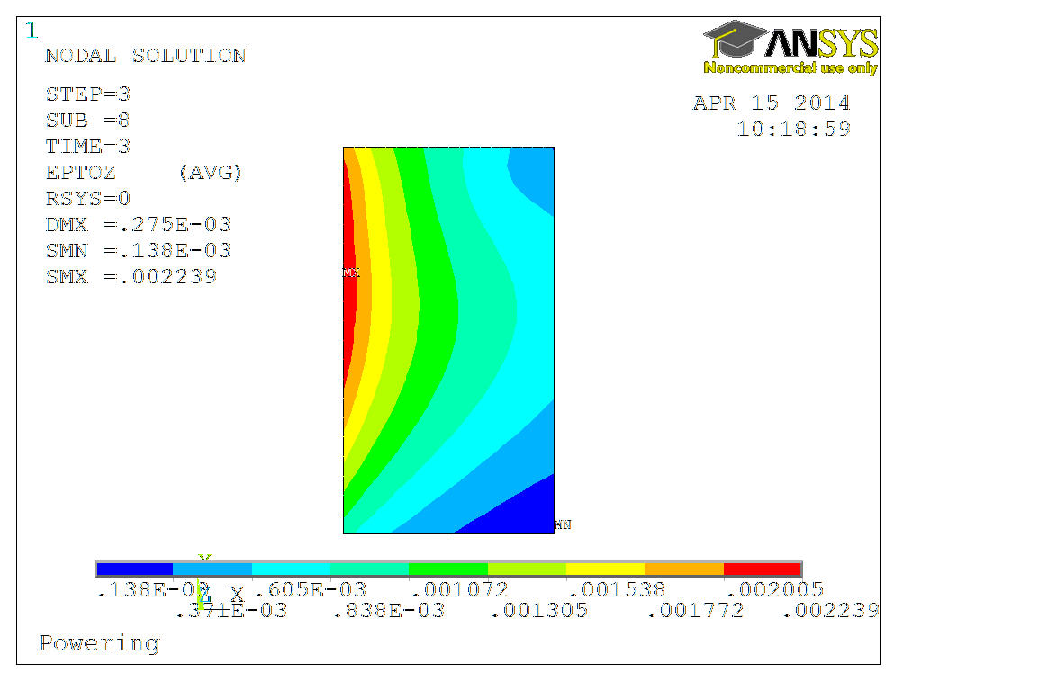
Hoop Strain
Maximum hoop strain in the Nb3Sn coil is 0.22 %
Irreversible strain limit with Ti doped Nb₃Sn strand ~ 0.25 %

Slide 21
CONCLUSION
Nb-Ti @ 4.2 K provide enough margin for the outer coils
Need Nb₃Sn for the inner coil. Small margin at 4.2 K (14%). Good at 1.9 K (21%).
Peak stress in the Nb₃Sn coil: Singularities around 300 Mpa > 200 MPa safe limits
Hoop strain in the Nb3Sn coil: Close to the irreversible strain limit.

