Slide 1
First Integrable Optics Experiment at IOTA
Sergey A. Antipov, The University of Chicago
Advisor: Sergei Nagaitsev

Slide 2
Motivation: Linear Dynamics
Linear focusing lattice – betatron tunes of different particles are almost equal
Hamiltonian depends on time
Nonlinearities (both magnet imperfections and specially introduced) make single particle motion unstable due to resonances
Stability depends on initial conditions
Phase space of 1D motion in linear lattice with 1 octupole nonlinearity
Resonance aisles
Chaotic motion
Px (a.u.)
Particles lost
X (a.u.)
Notes:
Regular trajectories for small amplitudes
Resonant islands for larger amplitudes
Chaos and particle loss for even larger amplitudes

Slide 3
Motivation: Nonlinear Dynamics
Tunes depend on amplitude
Landau Damping increases with the spread of betatron oscillation frequencies. Larger tune spread –> beam more stable against collective instabilities.
Can created by adding octupole magnets
If the system is integrable – no resonances
IOTA Goal: create practical nonlinear accelerator focusing systems with a large frequency spread and stable particle motion.
Notes:
McMillan (1967) – first successful 1-D example
Perevedentsev, Danilov (1990 - 1995) – several 1D, 2D examples
Cary etc (1994) – approximate integrability
Danilov, Nagaitsev (2010) – practical 2D integrability

Slide 4
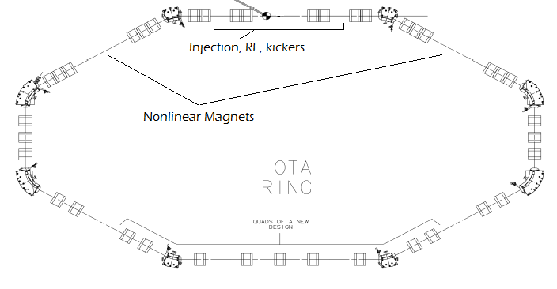
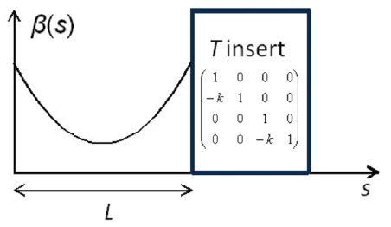
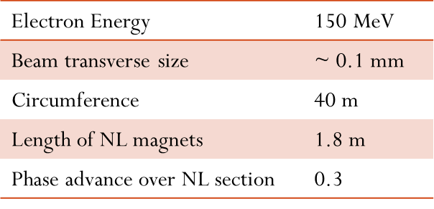
Integrable Optics Test Accelerator
Danilov, Nagaitsev, Phys. Rev. ST Accel. Beams 13, 084002 (2010)

Slide 5
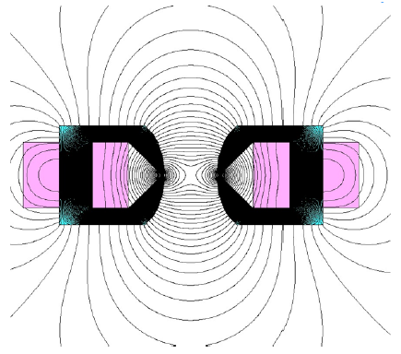
Need a Special Magnet
Can we do anything with just conventional magnets?
Quadrupoles
Octupoles
Cross-section and field lines

Slide 6
Quasi-integrable optics
Beta-function in NL magnet section
Octupole magnet strength ~ 1/β(s)³
Hamiltonian does not depend on s:
Questions:
What about the 3rd degree of freedom?
Imperfections
6D Simulations required
18 10cm-long octupole magnets
t = 0.4, c² = 0.01 cm, l = 10 cm

Slide 7
Frequency Map Analysis
Lifetrac code by D. Shatilov
Tracking for ~10³-10⁴ turns
FFT, find fundamental frequency
Plot deviation
No deviation – sufficient but not necessary condition for particle stability
Model includes:
Dipoles
Dipole fringe fields
Quadrupoles
RF
No sextupoles

Slide 8
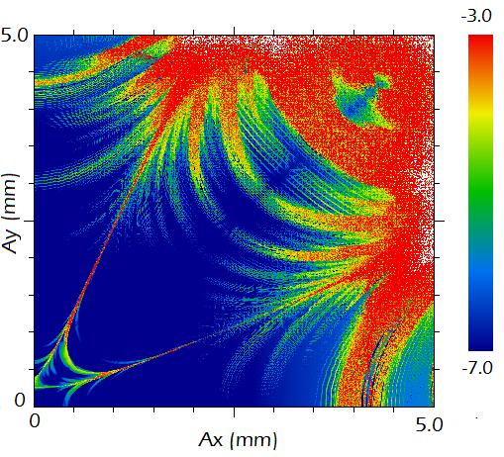
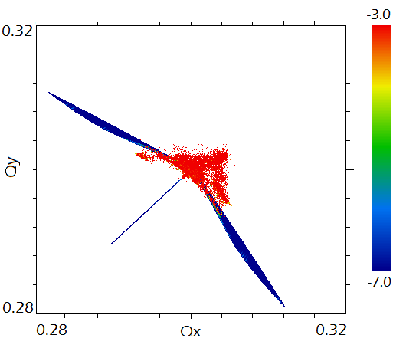
Frequency Map Analysis: 1 Section, Octupole Magnet
Stable region: 2.5 x 2.5 mm
Tune spread: 0.03

Slide 9
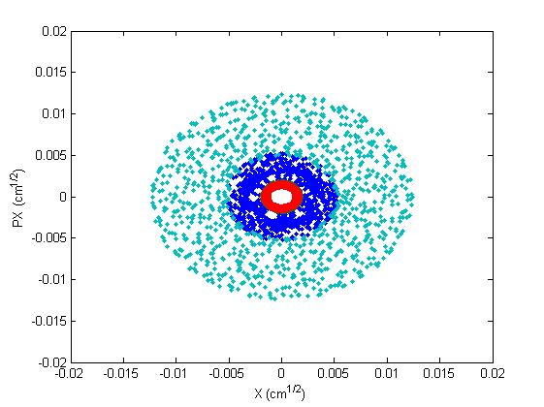
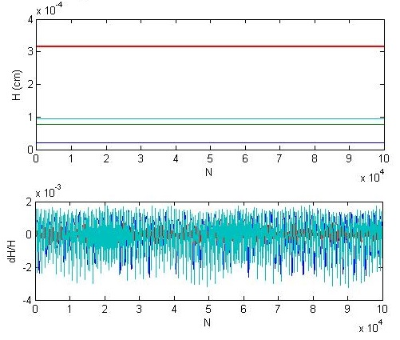
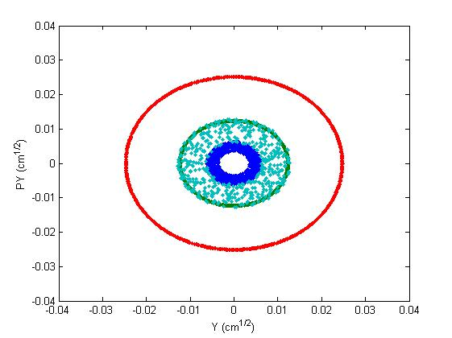
Tracking
Motion is bounded
Hamiltonian is conserved

Slide 10
Imperfections: stable region reduces insignificantly
No imperfections
Random error, σ = 0.1

Slide 11
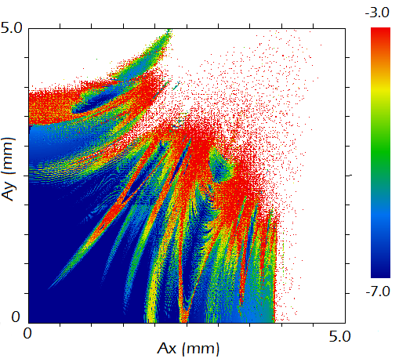
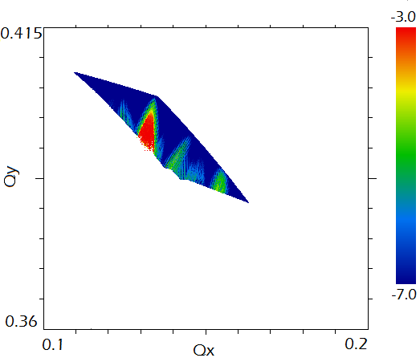
FMA: 1 Section, Quadrupole + Octupole
Stable region: 2.5 x 1.8 mm
Tune spread: 0.05

Slide 12
Experimental Procedure
Two kickers, horizontal and vertical, place particles at arbitrary points in phase space
BPM measures beam position on every turn -> Poincare map:
As electrons lose energy due to synchrotron radiation in ~ 1sec or 10⁷ turns, they will cover all available phase space
Do Fourier on ~ 1 ms, 10⁴-turn-long samples –> betatron frequencies
Repeat
Study Q_{i}(A_{x}, A_{y}) -> tune spread
Final goal – dependence of betatron frequency on amplitude

Slide 13
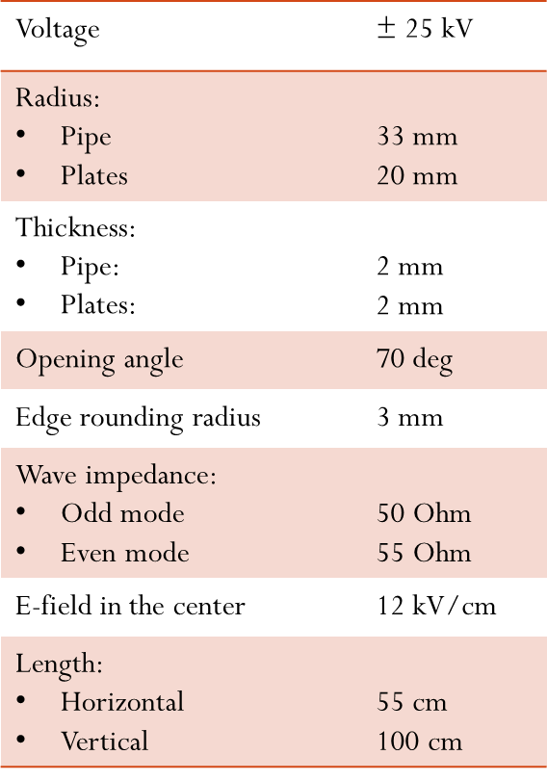
Two Kickers Create an Arbitrary Kick in 2D
Horizontal + vertical stripline kickers
Rectangular pulses up to 25 kV ~ 100 ns duration.
Repetition rate < 1 Hz
Adjustable voltage 0 – V_{max}
Fit inside quadrupole magnets to save space

Slide 14
Beam Position Can Be Measured Precisely
20 horizontal and vertical BPMs
Button type
1 μm closed orbit resolution
100 μm turn-by turn resolution
8 SR ports to measure beam size

Slide 15
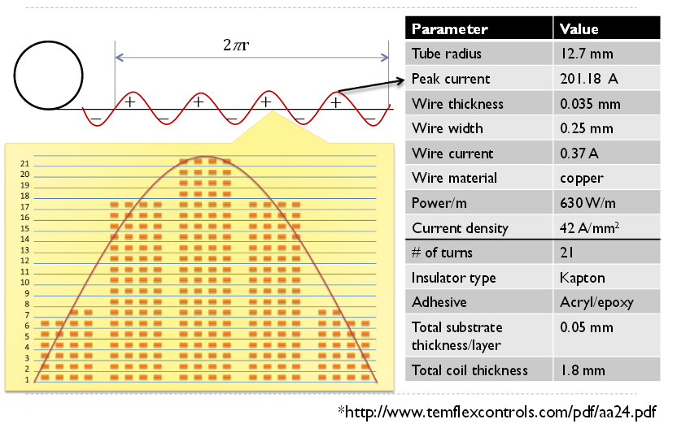
PCB-Based Octupole Magnet V. Vorobiev, PARTI-2013

Slide 16
Sources of Error
Beta functions: 0.01 (relative)
Phase advance: 0.001
BPMs: 0.1 mm
Bunch transverse size: ~ 0.1 mm
Bunch length: 2 cm
FFT: ΔQ ~ 10⁻⁴
Energy loss during 1 ms sampling window
Errors in NL potential
Overall:

Slide 17
Summary
It is possible to achieve tune spreads ~ 10⁻² with just conventional magnet components and still retain large dynamic aperture
Search for optimal combination in terms of tune spread/size of dynamic aperture/complexity of the potential
Compare with full nonlinear potential
Next Steps

Slide 18
Thank You for Your Attention

