Slide 1
A Passive Insertion as a Linearizer for ASTA?
Marco Venturini
LBNL
June 10, 2014
2nd ASTA User’s Meeting, FERMILAB

Slide 2
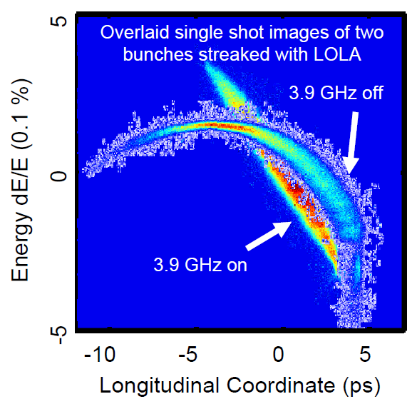
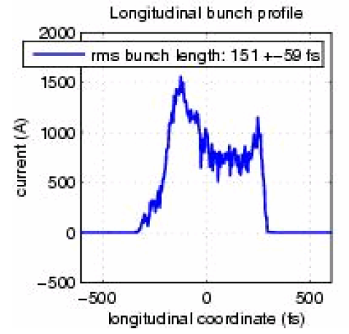
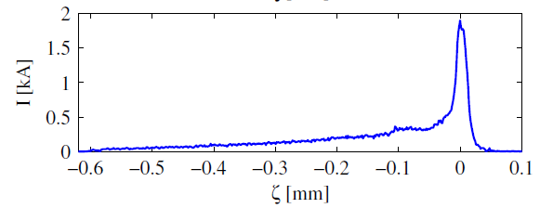
Q: Why is a linearizer useful?
A: to avoid development current spikes when compressing
The FLASH experience
After installation of
the linearizer
Longitudinal phase space
Current profile
Before installation of
the linearizer
Current profile
Most charge
Is lost to long
tail
Radiation output @13nm
increased from
$\sim 70μm$ to $\sim 400μm$
per bunch

Slide 3
RF waveform is the main cause of energy-chirp nonlinearity
On-crest acceleration
adds a quadratic
energy chirp
$$∆E$$
Nonlinear momentum compaction in chicanes also contributes to nonlinearity

Slide 4
Various ways to linearize the longitudinal phase space
Harmonic cavities
effective; method of choice in 4th generation light sources
expensive, somewhat inefficient (beam is decelerated)
Nonlinear-optics elements in dispersive section
pioneered at JLAB
may spoil transverse emittance
Longitudinal wake-field enhancing insertions

Slide 5
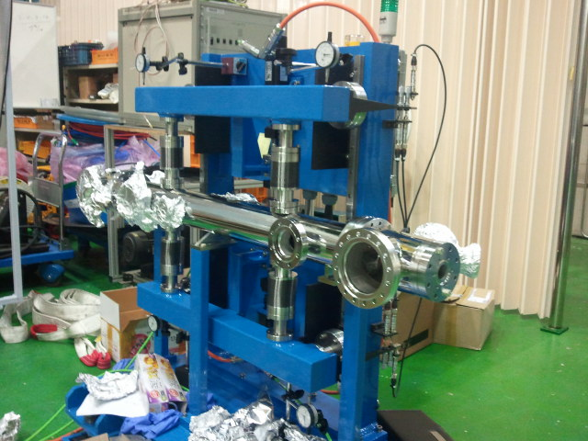
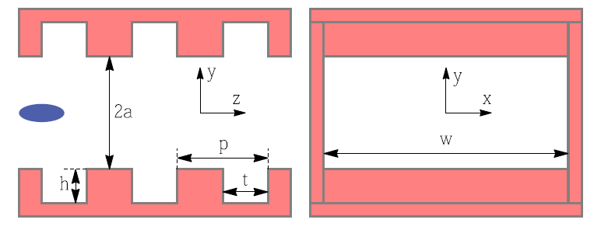
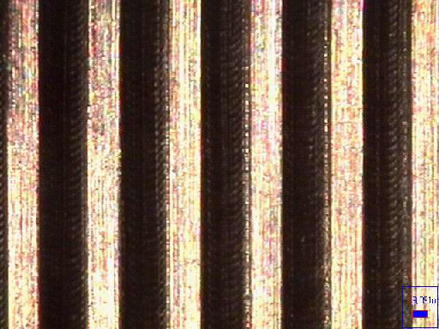
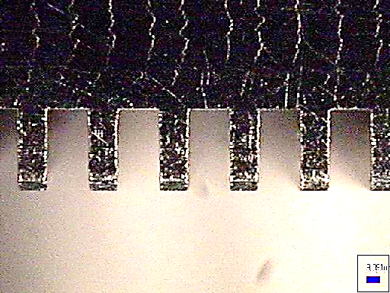
Recent experience with passive insertions
Mechanical support of 1m insertion (PAL)
Recent experiments in 2013
Dielectric lined tube (BNL*)
Corrugated metallic pipe (PAL*)
Tested as “dechirpers’ (affecting linear $E/z$ correlation)
g=2a
Pipe corrugations:
Top view
Side view
$$0.5mm$$
p = 0.5 mm , h = 0.6 mm
g = 0.3 mm, 2a = variable, up to 30mm
width , W = 50 mm
*S. Antipov, et al., PRL 112 114801 (2014)
* P.Emma, et al., PRL 112 034802 (2014)

Slide 6
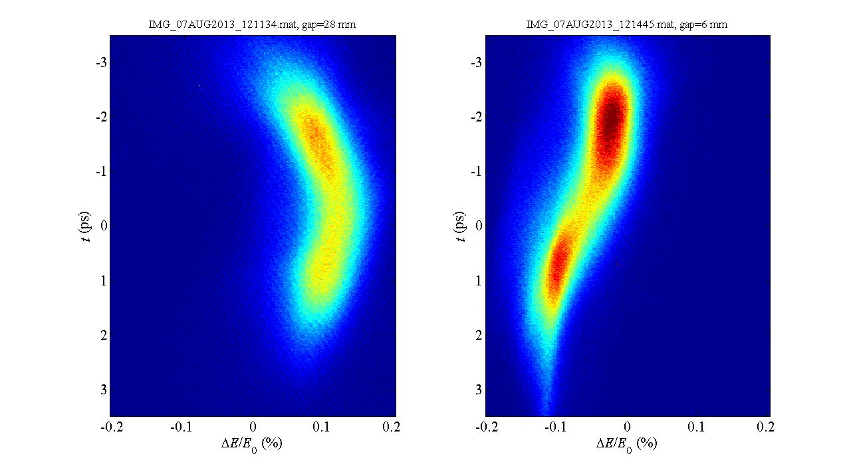
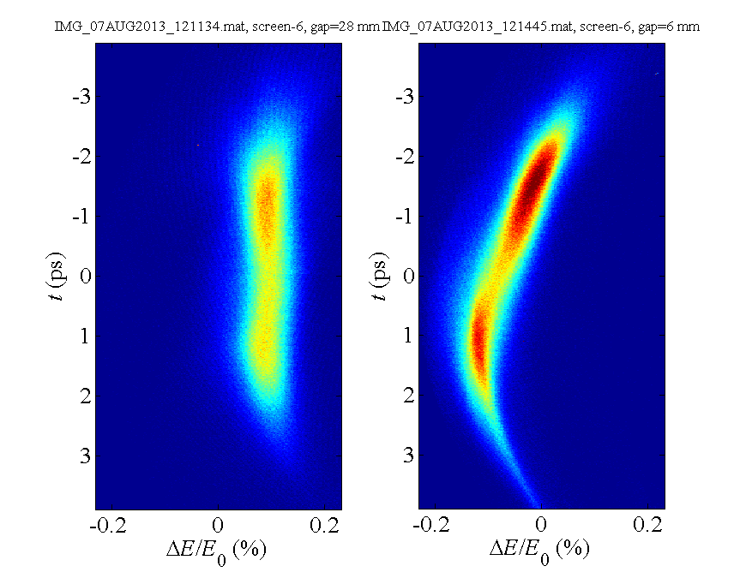
Time-resolved beam measurements at PAL-ITF
2nd –order chirp removed
Dechirper open
Dechirper closed
Dechirper open
Dechirper closed
head
head
Process image,
remove quadratic
energy chirp
(rf curvature)
time
g=28mm
g=6mm
g=28mm
g=6mm
g=6mm
g=6mm
Evidence of wake-field induced
curvature (opposite sign to rf’s !)
Energy chirp
induced by dechiper
energy

Slide 7
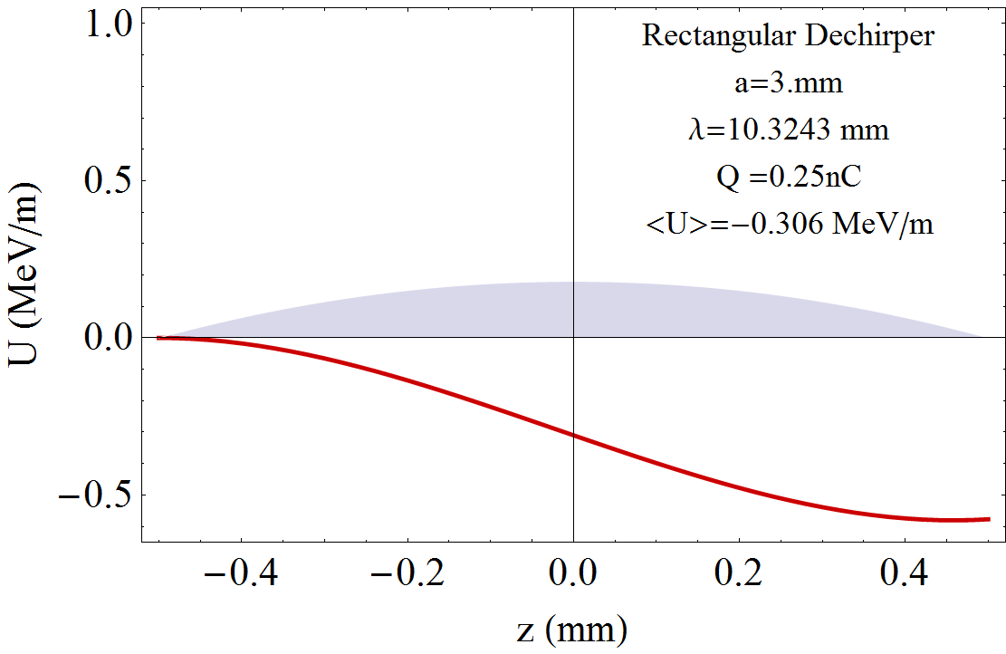
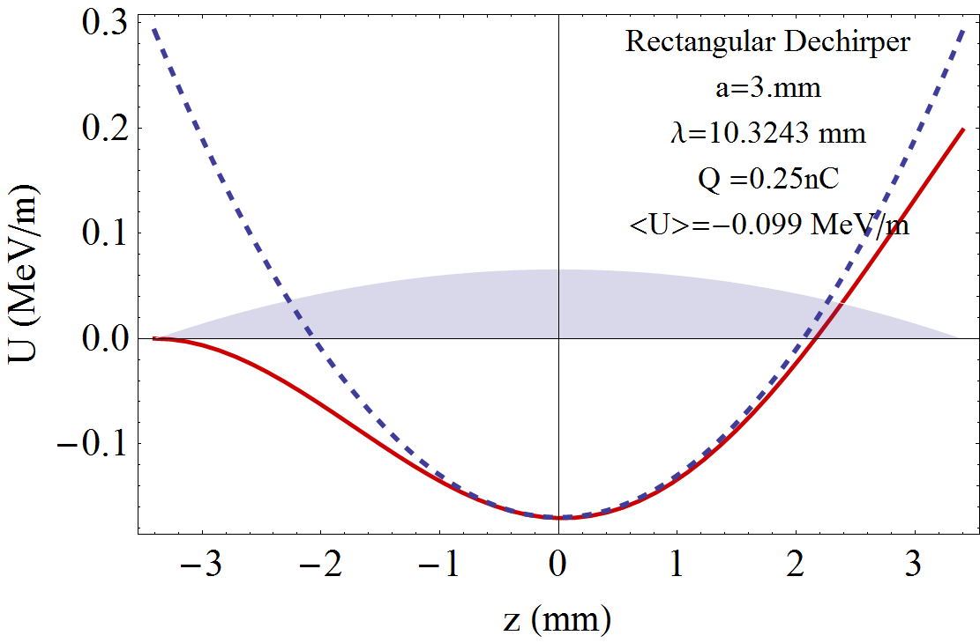
Voltage drop induced by corrugated-pipe insertion (rectangular aperture)
Wakefield dominated by single mode
$$a=3mm$$
$$p=0.5mm$$
$$t=0.3mm$$
$$h=1.5mm$$
$$λ=2π\sqrt{\frac{aht}{p}}=10.3 mm$$
$$w_{z}\left(z\right) \sim \frac{Z_{0}cπ}{16a^{2}}\cos{\frac{2π}{λ}}$$
$$Q=250pC$$
Dechirper regime: short bunch
$L_{b}≪λ$
Linearizer regime: long bunch
$$L_{b}\sim λ/2$$
quadratic
component
linear
component
$$L_{b}\sim 0.9mm$$
$$L_{b}\sim 6mm$$

Slide 8
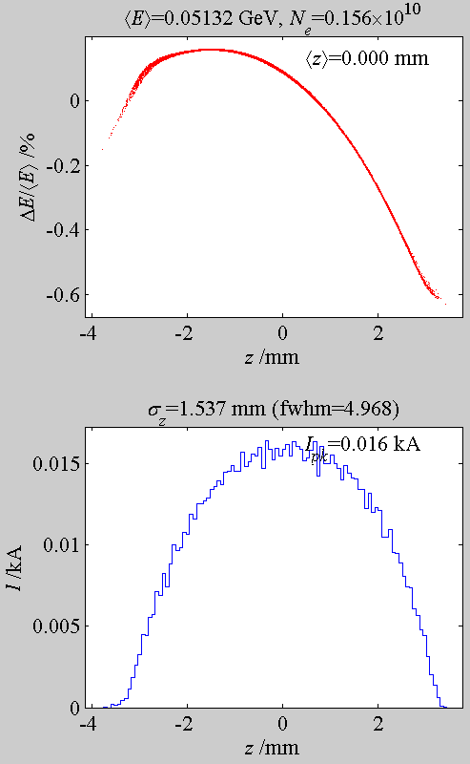
Could a passive insertion linearizer work for ASTA?
Injected beam ($Q=250pC)$
Place holder
harmonic cavity
linearizer
Passive insertion
(~1m) should go
here
$$E_{BC1}\sim 50MeV$$
Longitudinal
phase space
Consider moderate charge bunches out of CAV2 (Q=250pC)
ASTRA simulations (P.Piot, et al.)
Include 3 CMs (up to 600sMeV)
LiTrack simulation
Current profile

Slide 9
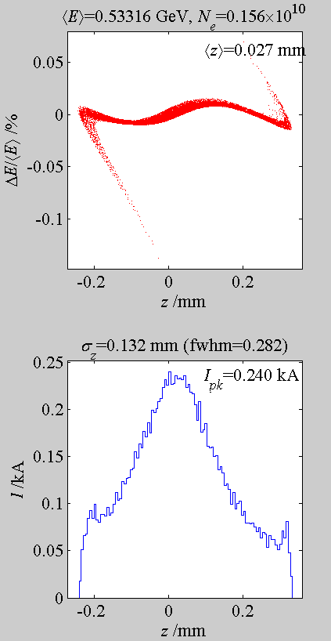
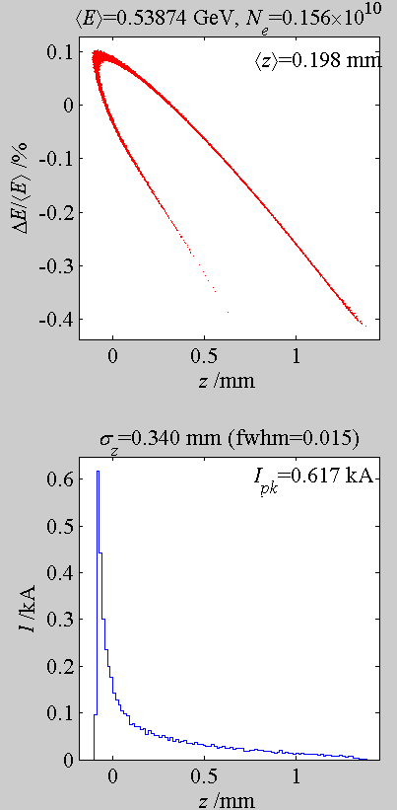
ASTA: Compressing with 3.9GHz harmonic cavity
Linearizer ON
Linearizer OFF
We are interested in moderate compressions to limit emittance growth
We may want to compress even less
Simulation does not include space charge
$$R_{56}=−19cm$$
$$V_{HL}=6MV$$

Slide 10
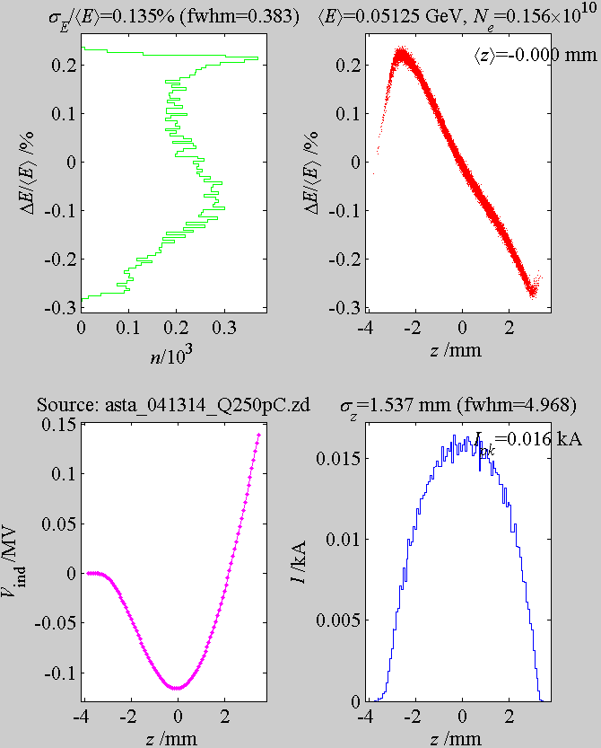
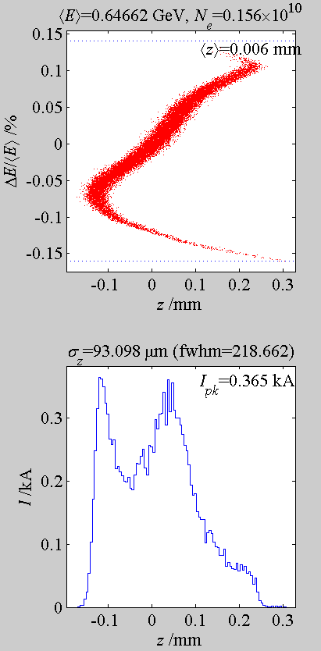
Replace harmonic cavity with corrugated 0.7m pipe
Injected beam
Exit of Insertion
Exit of machine

Slide 11
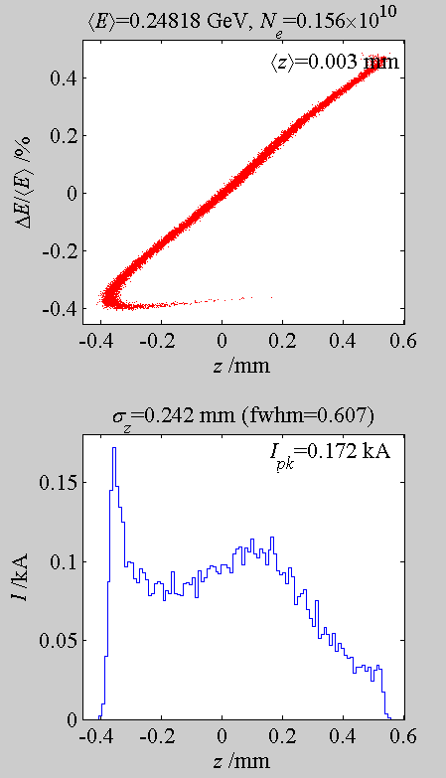
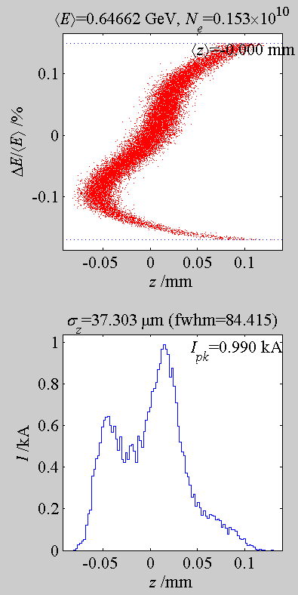
Introducing a 2nd bunch compressor (at ~250MeV)
As a way to increase compression, preserve beam quality
Same 0.7m long passive insertion
Exit of BC1
Exit of machine

Slide 12
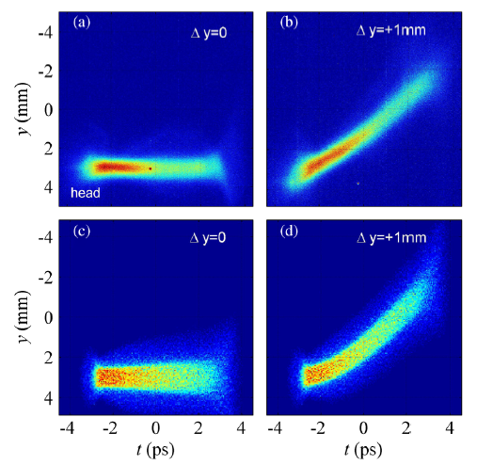
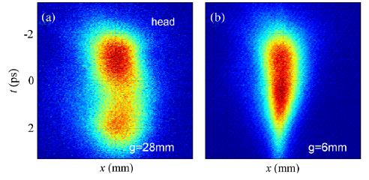
Perturbation to transverse dynamics
Measured effect of dipole-wake
(PAL-ITF experiment)
Measured effect of quad-wake
(PAL-ITF experiment)
open
closed
Simulation
Good control of beam needed to avoid dipole-like kicks
Quad-wake (characteristic of rectangular aperture geometry) will cause projected emittance growth even if beam is well centered
Use a circular aperture insertion (at cost of tunability)?

Slide 13
Conclusions
Linearization by passive insertion may work for ASTA.
Cheap!
Not ‘as clean’ as linearization by harmonic cavities:
higher order-nonlinearities cause appearance of current spikes
It may be adequate for moderate compression
Effects on transverse dynamic to be considered in a serious feasibility study
Include space charge
To avoid quad-wake effects a circular aperture insertion may be used instead
at cost of tunability

Slide 14
Acknowledgments
P.Piot for providing the macroparticle file off the ASTA injector

