Slide 1
ASTA Commissioning & Status
Elvin Harms
ASTA Users Meeting
9 June 2014

Slide 2
Introduction
Recap where we were last year and goals
Accomplishment in past 12 months
What’s on the horizon
Summary
E. Harms 2nd ASTA USers Meeting 9-10 June 2014

Slide 3
CY13 - 50 MeV Injector + 1 Cryomodule
Goal: installation complete and beam commissioning started by end of CY13
RF gun + RF system and photocathode laser system
2 SRF booster cavities (CC1 and CC2) + RF systems
50 MeV beam line elements and instrumentation to the low energy dump
Low energy beam dump
SRF cryomodule (RFCA002/CM2)
Installation of 1st AARD experiment (high brightness X-ray channeling source)
22 meters
50 MeV Beam Energy
flat beam transform
beam dump
1st cryomodule
electron gun
booster cavities
chicane
spectrometer magnet
To be installed
in CY13
ASTA Photoinjector
test beamlines
beam dump
3
E. Harms 2nd ASTA USers Meeting 9-10 June 2014

Slide 4
Accomplishments in 2013 - Recap
Laser installed/UV to ASTA cave
CM-2 Installed and nearly ready for cooldown
Warm Coupler Conditioning completed
Gun installed and first phase of conditioning complete
9-way diagnostic cross installed and operational
Electrons!
Beam sensed on Faraday cup, Loss Monitor, Wall Current Monitor, and now BPM’s
Calibration in progress
4
E. Harms 2nd ASTA USers Meeting 9-10 June 2014

Slide 5
Short-term Future Activities - Recap
Continue conditioning the RF gun (goal is 45 MV/m, currently at 32 MV/m)
Complete installation of RFCA002/CM2
Complete upgrade and install CC1
Cool down and commission CM2, CC1; recommission CC2
Continue gun photoelectron studies @ 3 - 5 MeV
Continue installation of 50 MeV beam line components
Start commissioning 50 MeV injector into beam dump in the Fall
5
E. Harms 2nd ASTA USers Meeting 9-10 June 2014

Slide 6
Accomplishments in 2014 so far
Continue conditioning the RF gun (goal is 45 MV/m, currently at 32 MV/m)
Complete installation of RFCA002/CM2
Complete upgrade and install CC1
Cool down and commission CM2, CC1; recommission CC2
Continue gun photoelectron studies @ 3 - 5 MeV
Continue installation of 50 MeV beam line components
Start commissioning 50 MeV injector into beam dump in the Fall
6
E. Harms 2nd ASTA USers Meeting 9-10 June 2014

Slide 7
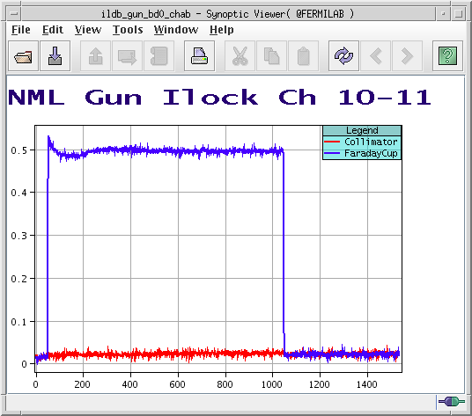
2014 Achievements: Laser & Gun
See Jinhao’s talk at 1040 - Laser
See Giulio’s talk at 13:50 - electron measurements
7 March 2014: Gun cavity was operated at 3.48 MW (GCVTPM), 1 ms pulse width, 1 Hz for 1.5 hours and 2.25 hours separately. 45 MV/m achieved!
18 March 2014: New (Cs₂Te) cathode installed and electrons produced
4 June 2014: 3000 Electron Bunches from the ASTA Photoelectron Gun
YaG screen image of first electrons from Cs₂Te cathode
3000 bunches on Faraday cup
7
E. Harms 2nd ASTA USers Meeting 9-10 June 2014

Slide 8
2014 Achievements: Cryomodules
See Elvin’s talk at 13:30
CM-2 cooled to 2 K and has stayed there with excellent reliability
Individual cavity testing essentially complete – good results
Fewer problems as compared to CM-1
Begin full cryomodule powering this summer
CC2 re-commissioned in late 2013
on-resonance conditioning
peak gradient reduced (<21 MV/m)
should attempt higher power conditioning as conditions allow
updated ESECON LLRF and calibration factors
CC1 upgrade continues
replacing a piezo tuner which failed during final checkout
HLRF (klystron) commissioning begun
support systems in place and checkout in progress
8
E. Harms 2nd ASTA USers Meeting 9-10 June 2014

Slide 9
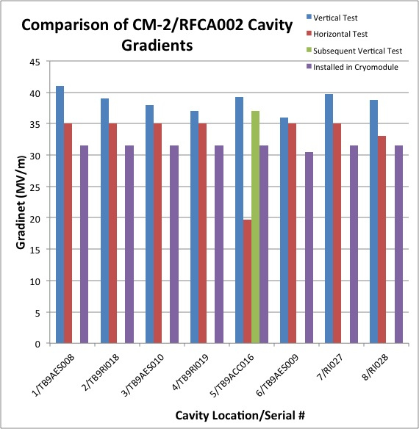
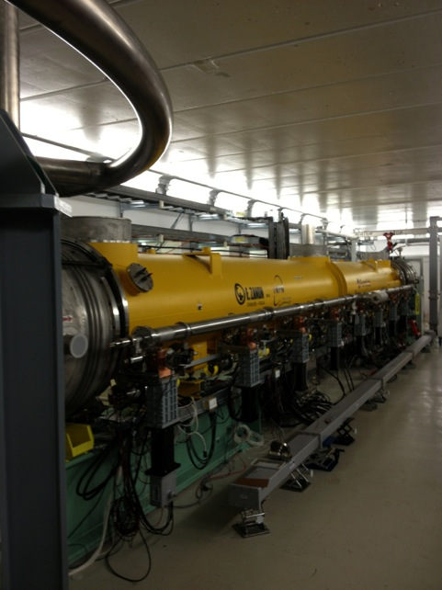
2014 Achievements: CM-2
ILC Milestone
31.5 MV/m
CM2 installed at ASTA
E. Harms 2nd ASTA USers Meeting 9-10 June 2014

Slide 10
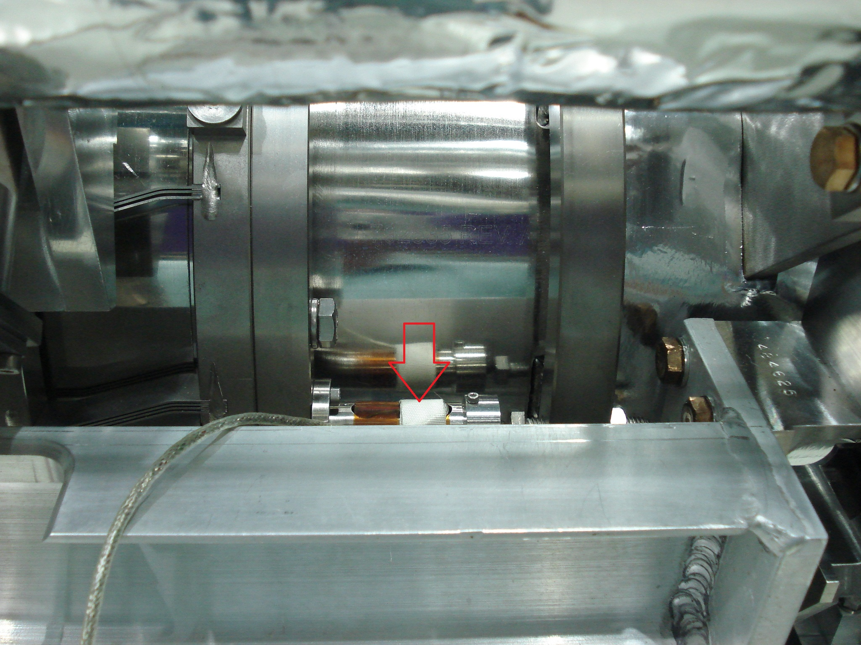
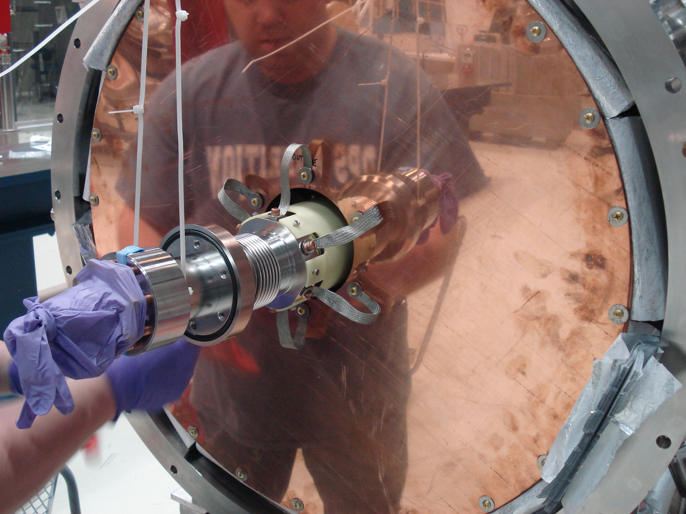
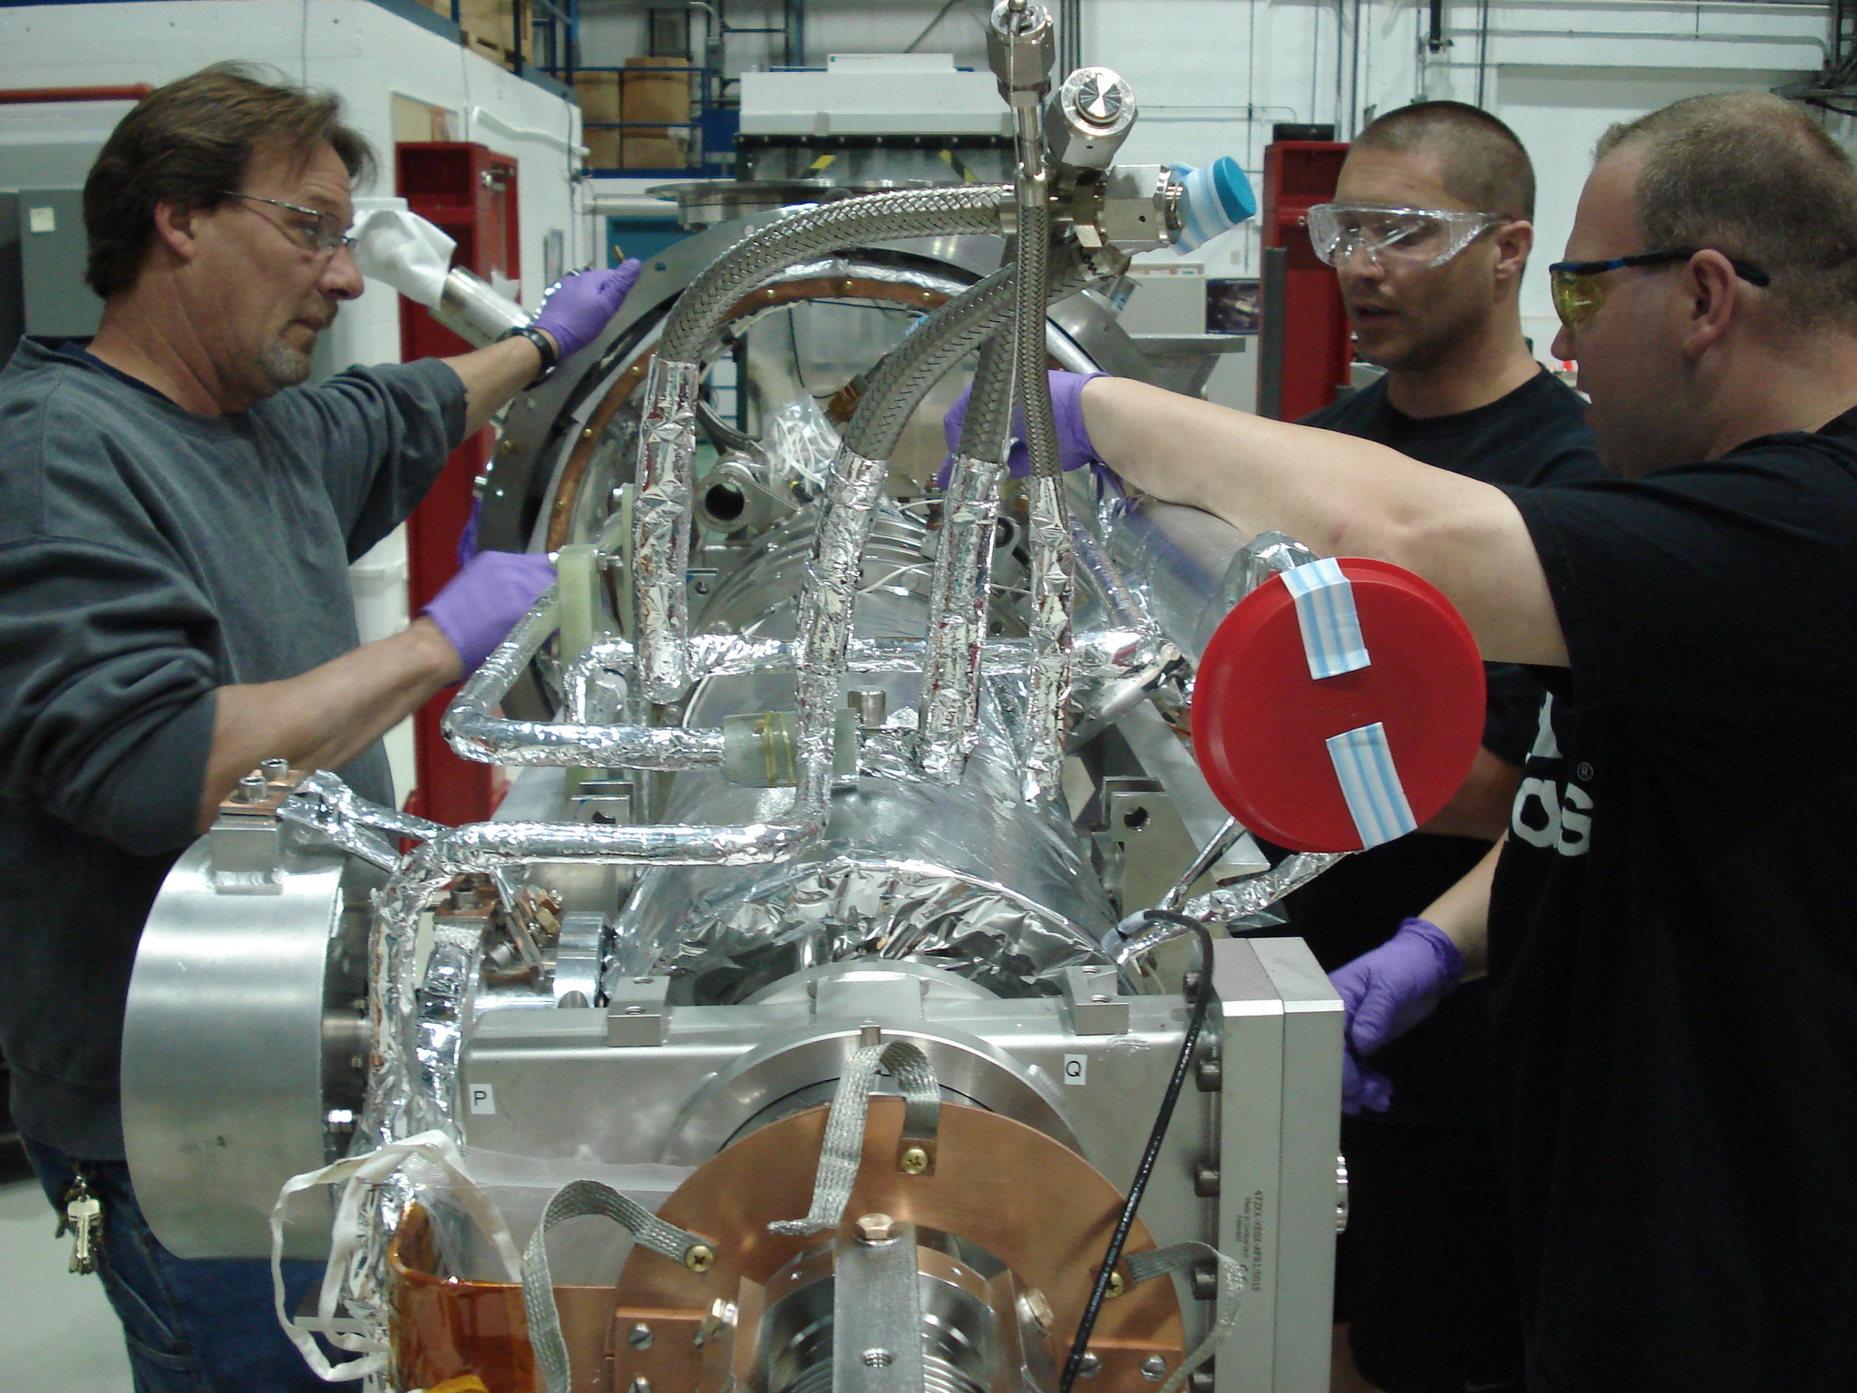
2014 Achievements: CC-1
Failed Piezo tuner
Buttoning up CC-1
Cavity removal
E. Harms 2nd ASTA USers Meeting 9-10 June 2014

Slide 11
2014 Achievements: 50 MeV beam-line
See Curtis’s talk at 11:00
Third Girder (of 3) installed this week
Dump and shielding in place
Components necessary for first beam to dump identified
Priority installation and hook-up for those devices
Careful and extensive check-out
Machine Protection System development & installation proceeding
11
E. Harms 2nd ASTA USers Meeting 9-10 June 2014

Slide 12
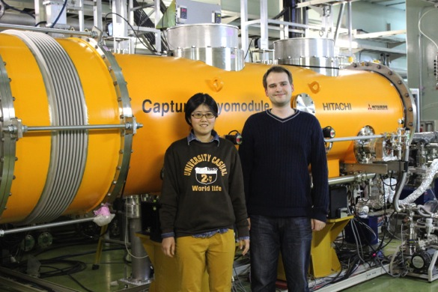
2014 Achievements: Guests & Users
See Auralee’s talk at 14:10
Visitors from KEK: CM-2
Jun Zhu: Guest from Batelle
RTFB development and SRF commissioning
(at least) three Summer interns assigned to ASTA activities
Ayaka & Mathieu
12
E. Harms 2nd ASTA USers Meeting 9-10 June 2014

Slide 13
Summary of 2014 Achievements
RF gun has reached goal of 45 MV/m, 1ms, 1 Hz
Increase repetition rate to 5 Hz
RFCA002/CM-2 works in the cold
full cryomodule powering and other testing to follow
CC1 upgrade nearly complete
(cryo) installation will take time
CC2 cooled back down and operation verified
reduced gradient will require attention
Beam-line installation well along
vacuum, cabling etc. still a significant effort
Pressing for 20 MeV electrons this summer
50 MeV this FY
Balancing installation, Cryomodule commissioning, electron operation requires careful coordination and flexibility
13
E. Harms 2nd ASTA USers Meeting 9-10 June 2014

Slide 14
Summary
Progress on virtually every front
notable achievements
This summer will be busy and hopefully exciting
Looking forward to hosting first experiments
An extremely dedicated and capable ASTA staff
KUDO’s to them!
E. Harms 2nd ASTA USers Meeting 9-10 June 2014

Slide 15
Thank you for your attention
E. Harms 2nd ASTA USers Meeting 9-10 June 2014

