Slide 1
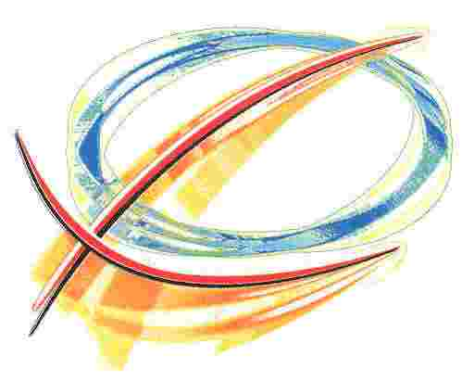
University of Maryland Institute for Research in Electronics and Applied Physics
Controlled Density Perturbations Studies on Longitudinally Uniform Beams in the Advanced Superconducting Test Accelerator (ASTA)
Brian L. Beaudoin and Jayakar Charles Tobin Thangaraj
June 10, 2014
IREAP

Slide 2
Outline
Collaborative support
Controlled perturbation studies on uniform e-beams (UMD)
Space-Charge waves
Soliton wave trains
Using BBO Crystals to optically create various longitudinal distributions with perturbations
ASTA Experiments

Slide 3
Collaborative Support
Recently Announced Kiersten Ruisard won the NSF Graduate Research Fellowship
Award
To work on IOTA related physics using UMER
In Fermilab Today
Student at Last
ASTA Users Meeting.
NSF supports UMD-Fermilab
collaboration at IOTA
URA supports UMD-Fermilab
collaboration at ASTA

Slide 4
Controlled Perturbation Studies on Uniform Electron Beams

Slide 5
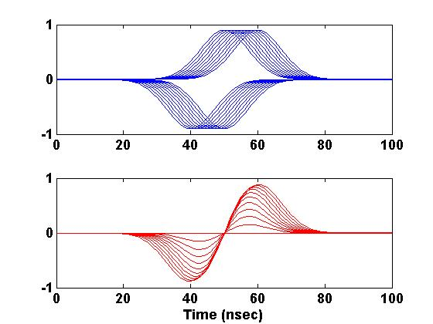
Perturbations to Beams
Four Different Perturbation Cases
Density/Velocity Wave Separation
Good agreement between Experiments, 1D code and full PIC code (WARP)
-K. Tian, Y. Zou, Y. Cui, I. Haber, R.A. Kishek, M. Reiser, and P.G. O'Shea, Physical Review Special Topics - Accelerators & Beams, 9, 014201 (2006).

Slide 6
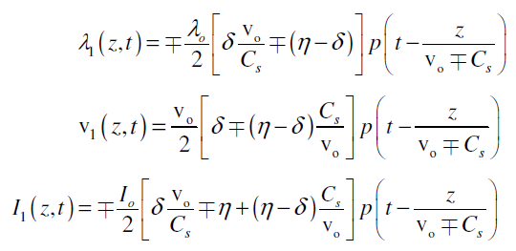
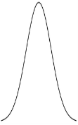
Propagation of Space-Charge Waves
Perturbations are placed onto rectangular (Flat-top) beams
Perturbation
Beam
Wave steepening with sufficient
perturbation amplitude
Density Perturbations
Velocity Perturbations
Turn 6
Turn 5
Turn 5
Turn 4
Turn 4
Turn 3
Turn 3
Turn 2
Turn 2
Turn 1
$$η=\frac{I_{1}}{I_{o}}$$
Turn 1
Turn 0
Turn 0
$$δ=\frac{v_{1}}{v_{o}}$$
-Jayakar C.T. Thangaraj, Brian Beaudoin, Donald Feldman, Rami Kishek, Santiago Bernal, David Sutter, Martin Reiser, and Patrick O’Shea, Proceedings of 13th Workshop on Advanced Accelerator Concepts (AAC), Santa Cruz, CA, July/Aug, 2008, (New York: AIP Press 1086, 2009), p. 732.
-B.L. Beaudoin, S. Bernal, I. Haber, R.A. Kishek, P.G. O'Shea, M. Reiser, J.C.T. Thangaraj, K. Tian, M. Walter, and C. Wu, PAC, 2322 (2007).

Slide 7
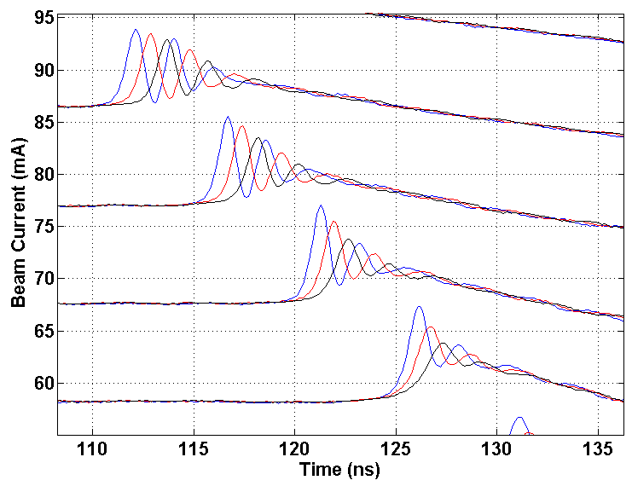
Solitary Wave Trains (PRL,2013)
Positive velocity perturbation
(WARP and Experimental Comparison)
0.5-1 GHz
Blue curve – 369 v
Red curve – 322 v
Black curve – 277 v
-Y.C. Mo, R.A. Kishek, D. Feldman, I. Haber, B. Beaudoin, P.G. O'Shea, and J.C.T. Thangaraj, "Experimental Observations of Soliton Wave Trains in Electron Beams," Physical Review Letters 110, 084802 (2013).

Slide 8
Longitudinally Shaping of the Beam using ASTA Laser

Slide 9
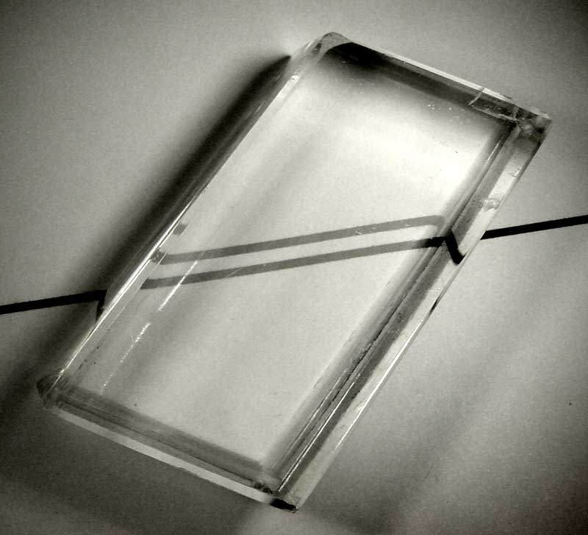
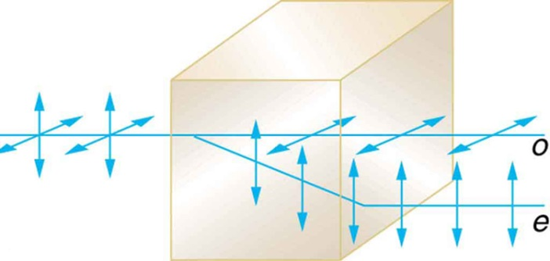
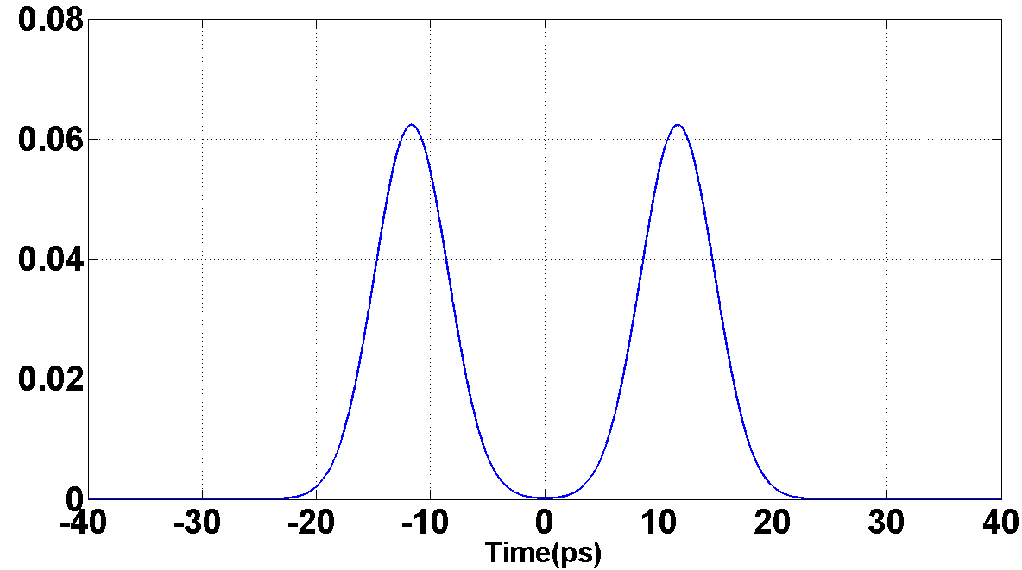
Temporally Shaping the Laser Beam using Birefringent Crystals
$$Δt$$
Birefringence
Time separation
$$Δt=L\left(\frac{1}{v_{ge}}−\frac{1}{v_{go}}\right)$$
Group velocities of the
two pulses
$$v_{ge}=c/{n_{ge}}$$
$$v_{go}=c/{n_{go}}$$
-J.G. Power, C. Jing, I. Jovanovic, “High Frequency Bunch Train Generation from an RF Photoinjector at the AWA”, Proceedings of the 2009 Particle Accelerator Conference, Vancouver, 2009 (IEEE, New York, 2009).
-http://cnx.org/

Slide 10
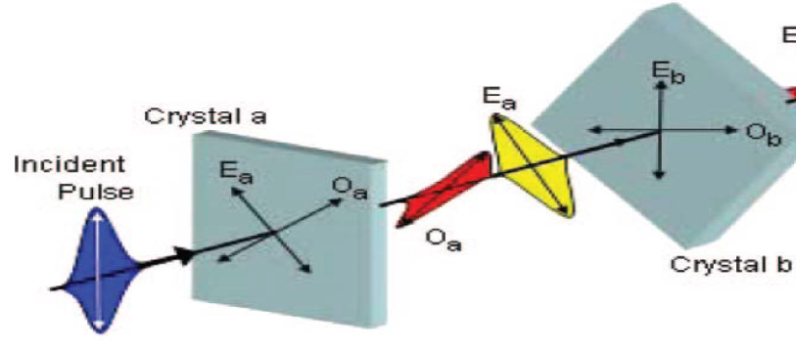
“Slip & Stack”*
θ
θ
18 mm
Control variables:
Thickness of the crystal
Angle
9 mm
*Linac Laser Notcher (Beams-doc-4537-v1) with a twist…longitudinal instead of transverse

Slide 11
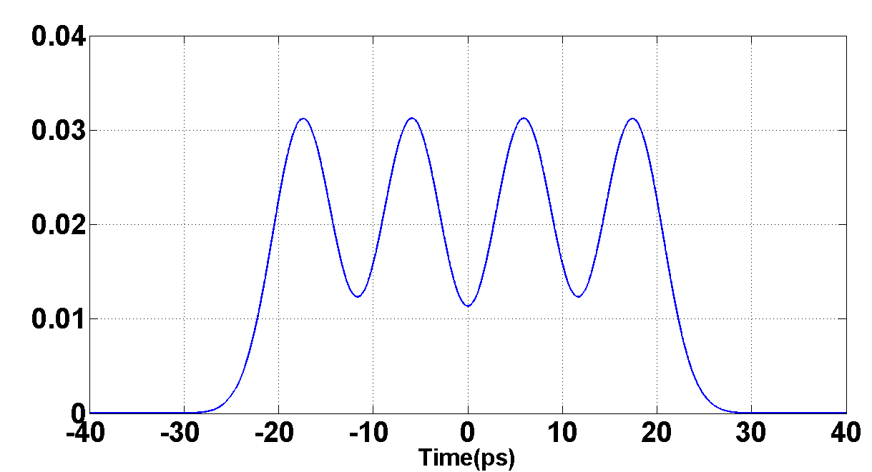
Various Temporal Pulse Shapes
Analytical Calculations
Nominal laser pulse
Three Crystals
Length 1 = 18.0mm, 45º
Length 2 = 9.0mm, 45º
Length 3 = 4.5mm, 45º
Gaussian Pulse
FWHM = 7.54ps
Longitudinally Uniform
FWHM = 31.1ps
4 - Pulse Train
FWHM = 42.36ps
Two Crystals
Length 1 = 27.0mm, 45º
Length 2 = 13.3mm, 45º
$Δt$=11.52ps

Slide 12
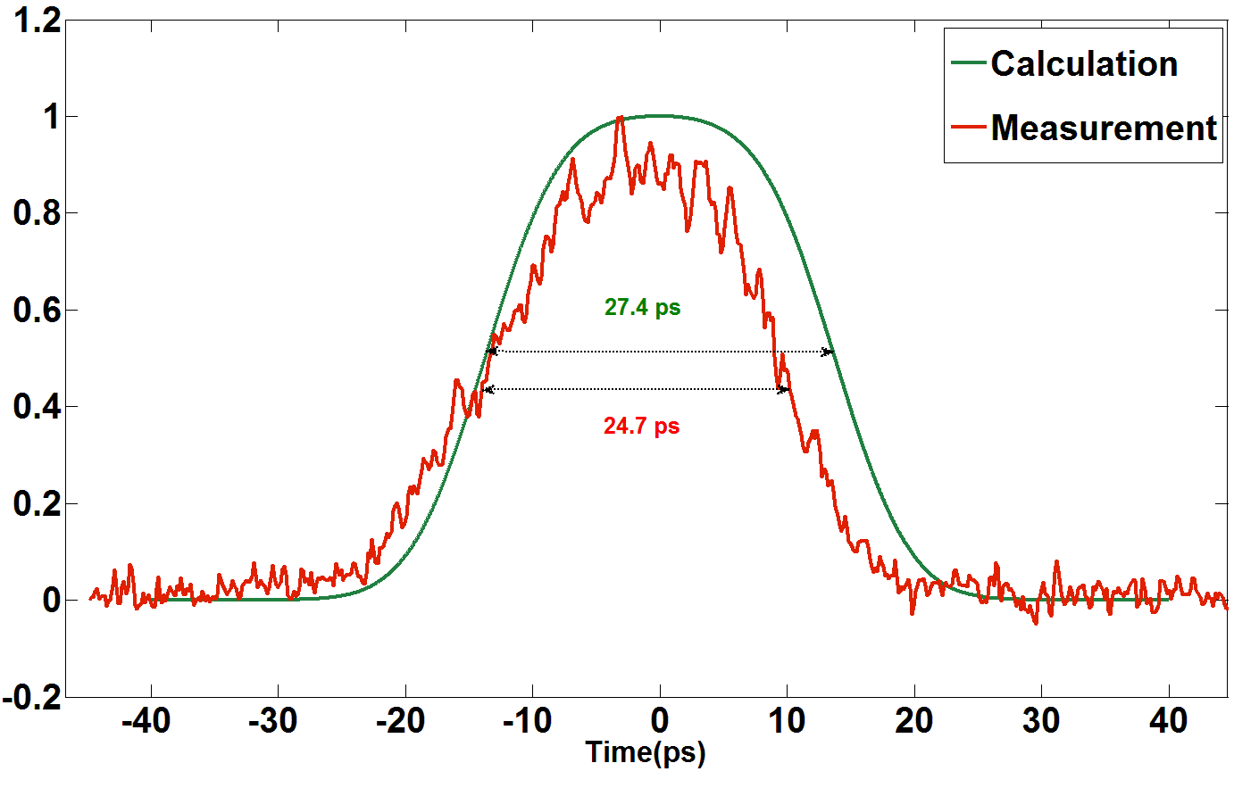
Flat top generation using two crystals
0⁰
45⁰⁰
18 mm
9 mm
< 10%

Slide 13
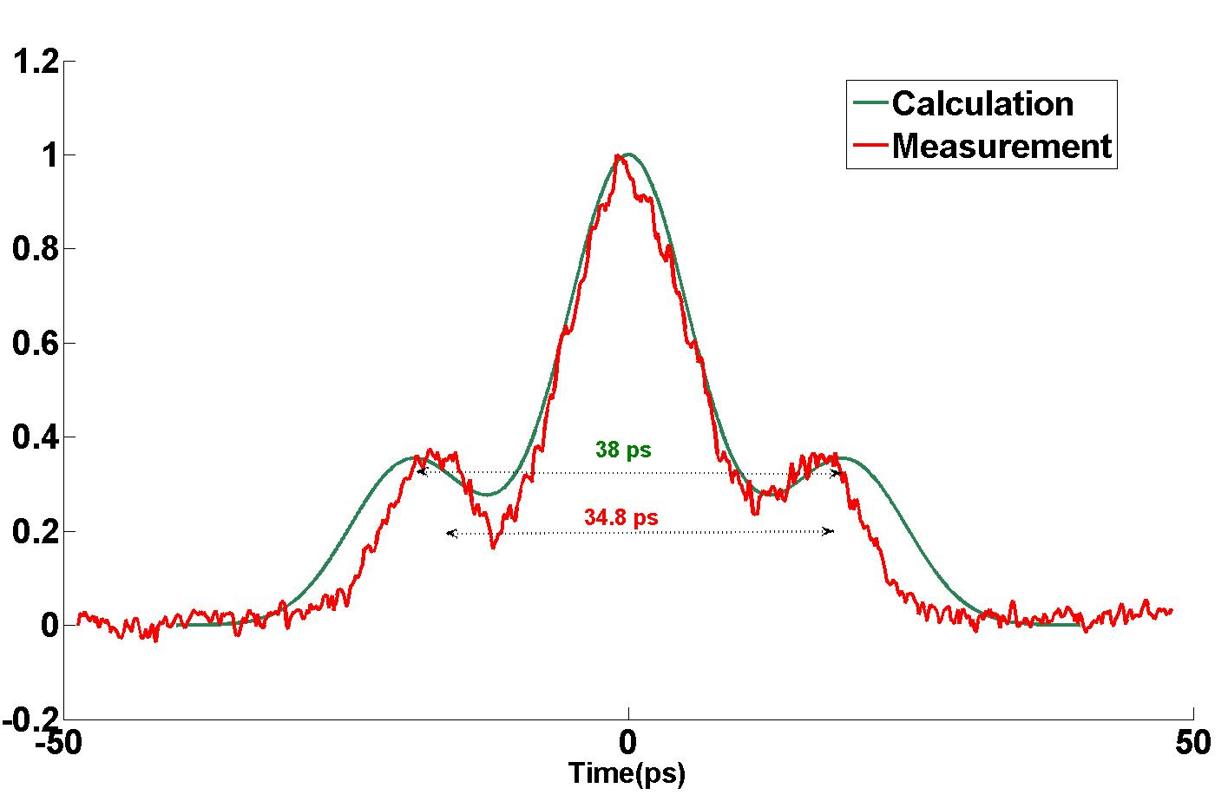
Longitudinal HOTSPOT (Density perturbation)
25⁰⁰
25 mm
-30⁰
-165⁰⁰
18 mm
Perturbation
9 mm
Beam
< 10%

Slide 14
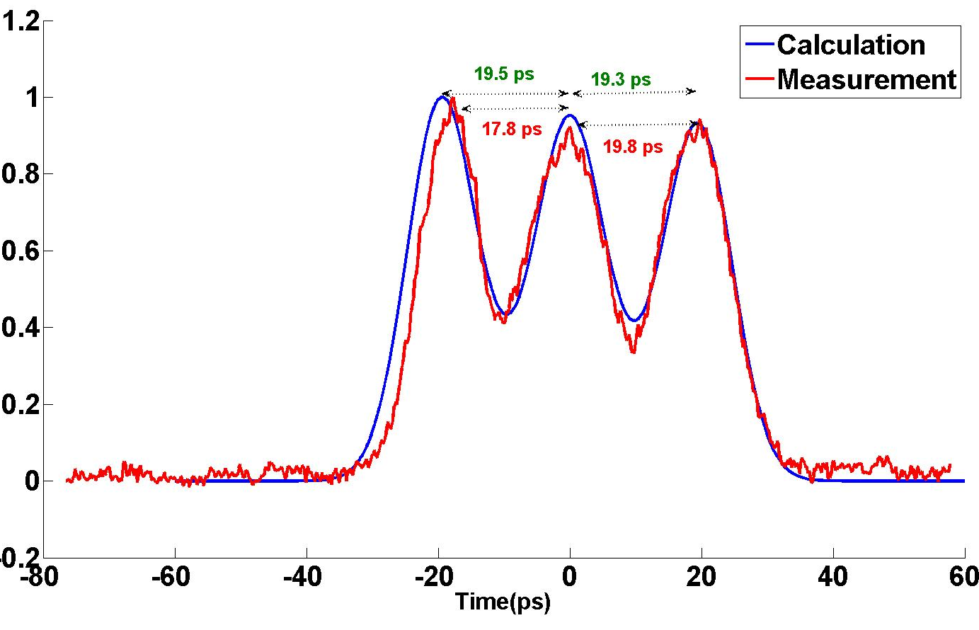
Multiple Longitudinal Perturbation’s
-75⁰⁰
-43⁰
25 mm
-4⁰⁰
18 mm
9 mm
< 10%

Slide 15
ASTA Low Energy Beamline
BC1 = Bunch compressor
VS = Vertical Spectrometer
Initially Gun Phase Scan
RF-Gun
CAV1
CAV2
BC1
VS
Crystals in Laser Room
Time Profile ps Resolution
Streak Camera (0.5ps res) @ X121
Energy | ~20 - 3 MeV
Bunch Charge | 0.5 nC - 3.2 nC
Energy Profile using @ X124
Running e-beams created using BBO crystals at charge levels where longitudinal space-charge is moderate
Measure the effects of space-charge by observing the energy profile as a function of time and perturbation splitting

Slide 16
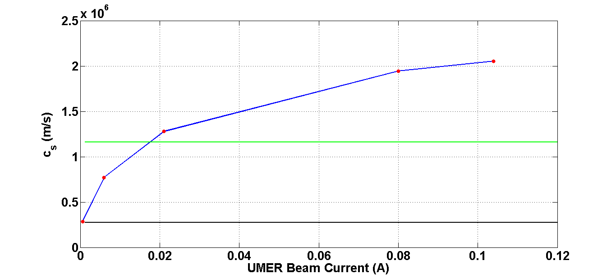
Space Charge Waves with Acceleration
ASTA has fine control on “gamma”
UMER Beams
ASTA Gun at 3nC, 1.75 MeV
ASTA Gun at 3nC, 3.5 MeV
q: Charge; g: geometric factor; I: beam current; m:mass of e-; Λ: line charge density
b: pipe radius; a: average beam radius;γ₀ Lorentz factor

Slide 17
Plan
Phase 1: Install a reproducible 3 crystal optic setup. Look for a closed loop controller to be procured through ASTA. Experimental setup and gun phase scan. Define what are the lower limitations on beam energy transport.
Phase 2: In parallel do simulations using ASTRA or WARP, and perform measurements using streak camera.
Phase 3: Second set of experiments including energy profile.

Slide 18
Thank you to: Jinhao Ruan [Lasers and crystals] “Chip” Dean Edstrom [Optics and Laser] Alex Lumpkin [Streak Camera] Jamie Santucci [Optics] Philippe Piot and Vladimir Shiltsev [URA support] Elvin Harms/Daniel Broemmelsiek [Operations] Rami Kishek [General guidance]

