Slide 1
X-rays from Channeling Radiation
Tanaji Sen
2nd ASTA User’s Meeting
June 9-10, 2014

Slide 2
Outline
Physics of Channeling Radiation
Improvements to the theoretical model
Comparisons with ELBE (Dresden, Germany) channeling results
Calculations for ASTA

Slide 3
Goals of Channeling Radiation
Create a source of brilliant, monochromatic and tunable X-rays
Use the X-rays for imaging; specially phase contrast imaging

Slide 4
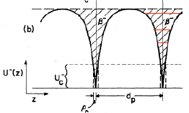
Channeling Radiation
Particles are channeled within a critical angle
Energy of X-rays
E_{X} ~ 2γ²($ε_{i}−ε_{f}$)/(1+ γ² θ² )
For planar channeling, eigenvalues $ε$ found by solving 1D Schrodinger’s equation using the Doyle-Turner form of the atomic potential

Slide 5
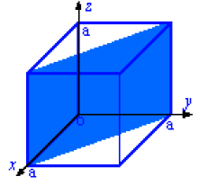
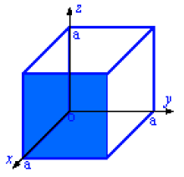
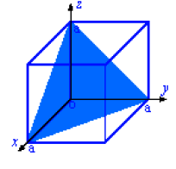
Crystal planes
(110) plane
(100) plane
(111) plane
(110) plane has a deeper potential than (100), higher energy X-rays
(111) plane has more bound states, broader X-ray spectrum
Preferred plane is (110)

Slide 6
Photon Yields
Radiative transitions : apply Fermi’s golden rule
Selection rule: transitions only between states of opposite parity, |m-n| = Odd
Non-radiative transitions, mainly inelastic thermal scattering off lattice vibrations, determine population P_{n}(z)
Approximate selection rule: |m-n| = Even

Slide 7
Line Width
Intrinsic line width from finite lifetime of channeling states
Bloch wave broadening from finite width of energy bands,
Multiple scattering: scattering in planar channels weaker than in amorphous media
Energy spread of electron beam
Detector resolution

Slide 8
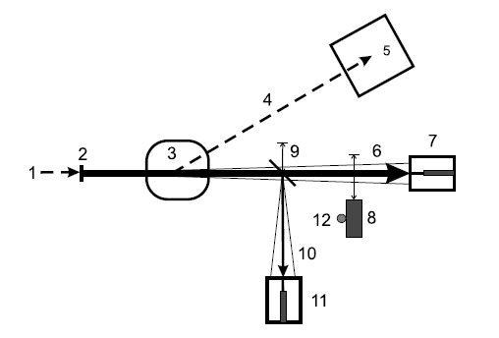
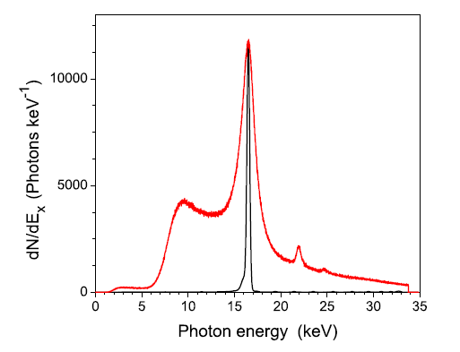
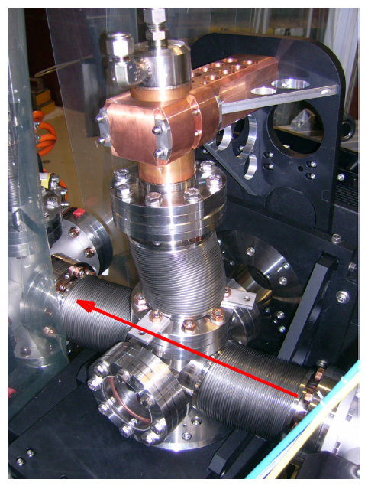
Experiment at ELBE (2007)
Observed CR at beam energies from 14.6 MeV to 30 MeV
Beam current ~ 100 nA
Transverse emittance = 3μm
Now in ASTA beamline
Wagner et al (2007)

Slide 9
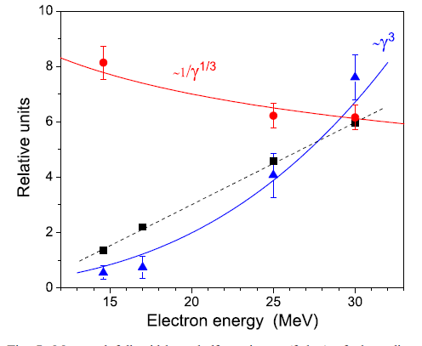
Scaling Laws
Parameter | Energy | Thickness
Critical angle # of bound states X-ray energy Linewidth Photon yield/(el-sr) Chaneling/Incoh. Bremsst. | ~ 1/γ^{1/2} ~ γ^{1/2} ~ γ ^{3/2 – 2} ~ γ² ~ γ^{5/2} ~ γ^{1/2} | - - - ? ~ z^{1/2} ( z < 200 μm) ?
Wagner et al (2007)

Slide 10
ELBE Measurements & Simulations
Energy [MeV] | Thickness [μm] | Exp yield [phot/sr-e] | Theor. Yield [phot/sr-e] | Exp/Theor
14.6 | 42.5 168 | 0.048 0.090 | 0.11 0.22 | 0.45 0.41
17 | 42.5 168 | 0.059 0.13 | 0.15 0.29 | 0.39 0.45
25 | 42.5 | 0.16 | 0.32 | 0.50
30 | 42.5 168 | 0.23 0.52 | 0.45 0.89 | 0.51 0.59
Azadegan (2007)

Slide 11
Improvements to Model
Corrected potential V^{I} for thermal scattering; affects transition rate between states
Included dechanneling from free states
Finite beam divergence
Inclusion of linewidth contributions from multiple scattering, Bloch wave broadening
Correction to the line shape in the intensity spectrum

Slide 12
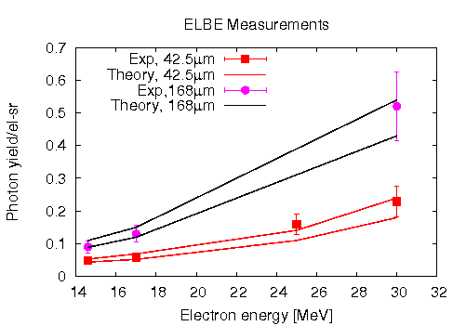
Updated ELBE calculations
Theory bounds for 42.5/168 μm
Lower line : dechanneling from 1st/7th free state and above.
Upper line: dechanneling from 3rd /9th free state and above
Importance of rechanneling (free state to bound state) for thicker crystals

Slide 13
ASTA main parameters
Parameter | Value
Beam energy Bunch charge Bunch frequency Average beam current Transverse emittance Bunch length Energy spread Crystal, plane Critical angle | 20 – 50 MeV ~ 20 pC (low charge operation) 3 MHz 300 nA < 100 nm < 1 mm < 1% Diamond, (110) 1.5 mrad(20 MeV), 1mrad(50MeV)

Slide 14
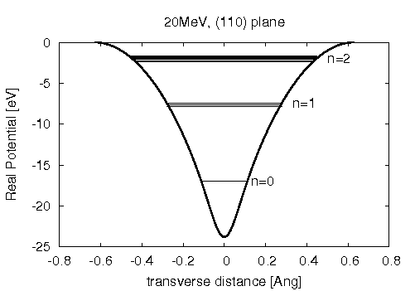
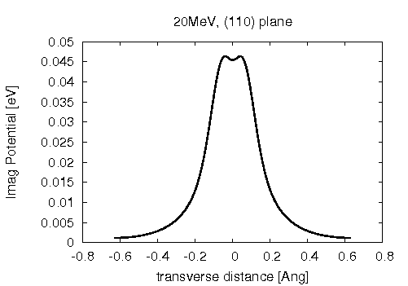
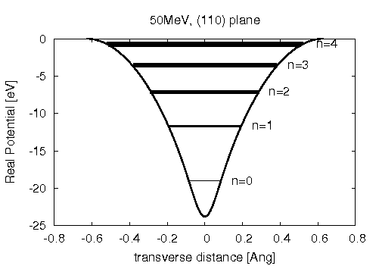
Real and Imaginary Potentials
20 MeV
50 MeV
Depth of real potential about 24 eV
Energy bands differ by few eV in rest
frame, transform to 10’s of keV in lab
frame
Corrected imaginary potential is
weaker, reduces non-radiative transition
rates, reduces intrinsic line widths

Slide 15
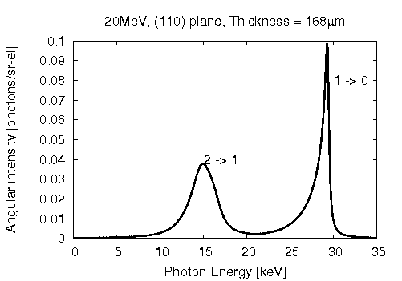
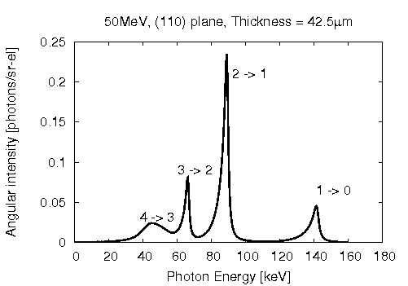
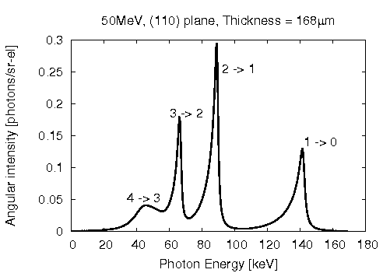
Intensity spectra
20 MeV, 168 μm
20 MeV, 42.5 μm
50 MeV, 42.5 μm
50 MeV, 168 μm

Slide 16
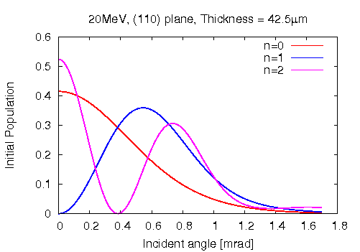
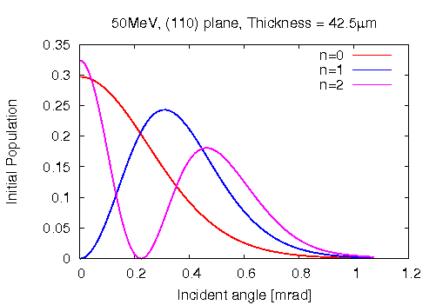
Initial Populations vs incident angle
Initial populations in the bound states determine intensities of different lines
Maximum population in the n=1 state at an incident angle of
- 0.5mrad at 20 MeV
- 0.3mrad at 50 MeV

Slide 17
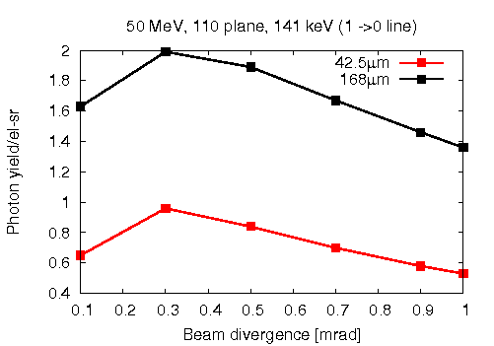
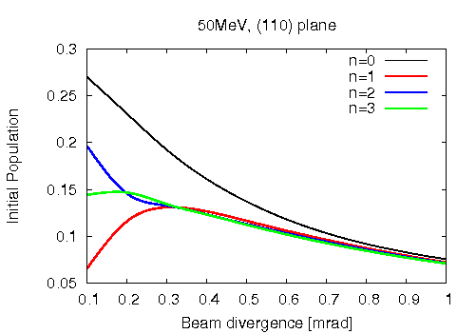
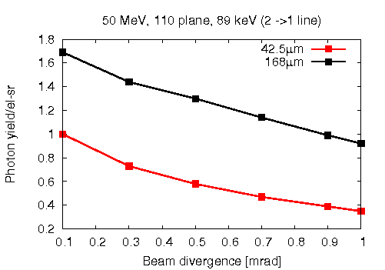
Population, yield vs divergence
1 0
2 1
n=1 initial population is maximum at ~0.3mrad

Slide 18
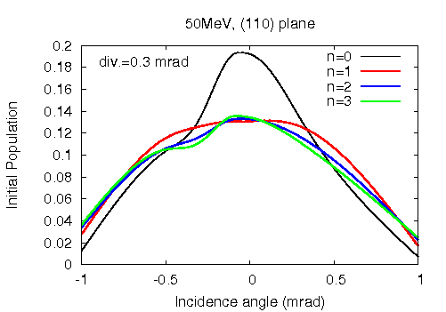
Initial population vs angle
Beam divergence set for max. population in n=1 state
Slight asymmetry about zero angle
Maximum population about zero angle for all states.

Slide 19
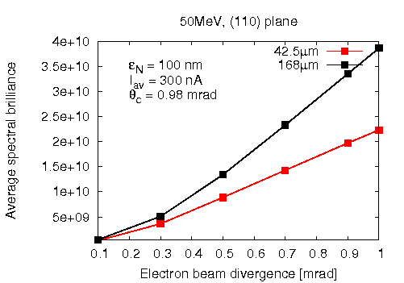
Brilliance at ASTA
$$B_{N}=\left(d^{2}N/{dωdΩ}\right)\left({I_{av}}/e\right)γ^{2}{{(σ′}_{e})}^{2}E_{X}{{10}^{−3}}/{{ε_{N}}^{2}}$$
$${photons}/{\left(s−{\left(mm−mrad\right)}^{2}−0.1\% BW\right)}$$
Expected brilliance with
100nm about 10⁴ times
larger than at ELBE.
FE cathode expected to
lower emittance ~ 10nm
Brilliance would increase
by ~100
Thicker crystals may help
1 0

Slide 20
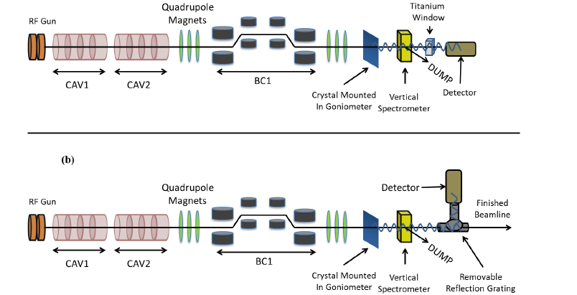
ASTA Channeling Experiments
Goniometer with crystal in the beamline, UHV tested
Initial studies will look at CR dependence on electron beam parameters: energy, bunch charge, emittance, spot size, energy spread. Operate initially with higher bunch charge, fewer bunches.

Slide 21
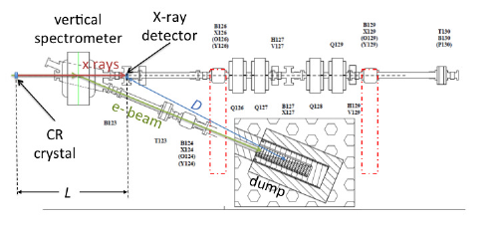
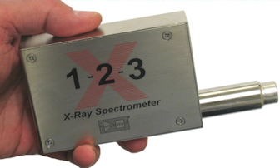
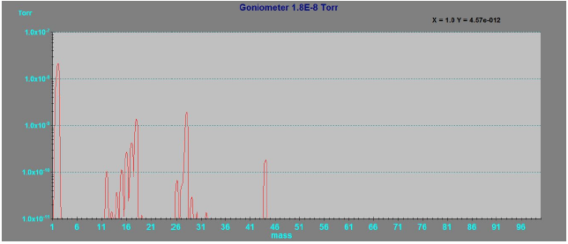
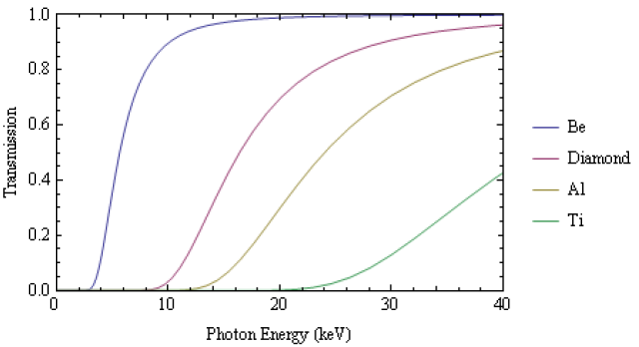
Components
Goniometer passed vacuum requirement
interfacing with ACNET control system
underway (summer intern E. Mercado)
Single crystal diamond extraction window
Transmission > 80% upto 40 keV

Slide 22
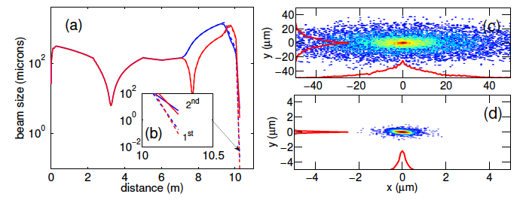
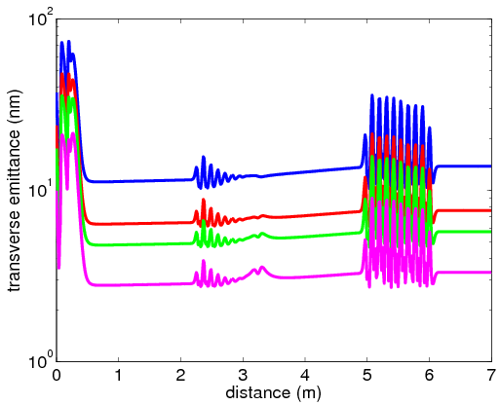
ASTA Simulations
Tracking with 2nd order nonlinearities show spot sizes of a few μm at crystal
Emittance growth not significant along the beamline to the crystal.. Expect ~10nm with field emitter cathodes.

Slide 23
Summary
Updated model results in better agreement with measured photon yields at ELBE
Rechanneling in thicker crystals may be helpful in increasing yield
Optimum beam divergence for photon yield depends on beam energy.
Expected brilliance ~ 3x10¹⁰ phot/(s-(mm-mrad)²-0.1% BW) with transverse emittance 100nm.
Field emitter cathodes expected to increase brilliance about 100 times
Component installation and integration underway

Slide 24
Backups

Slide 25
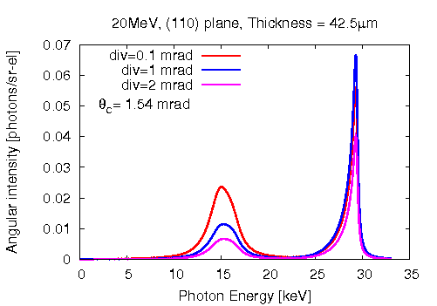
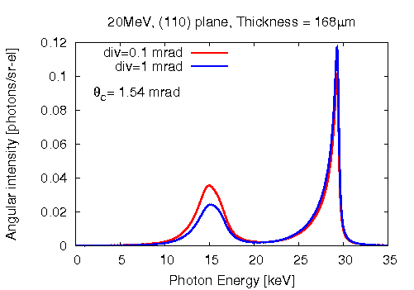
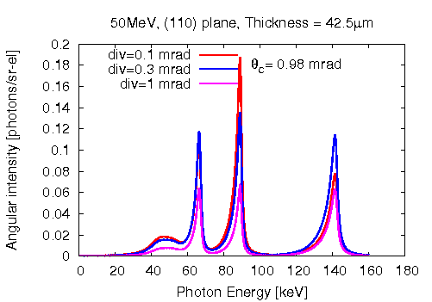
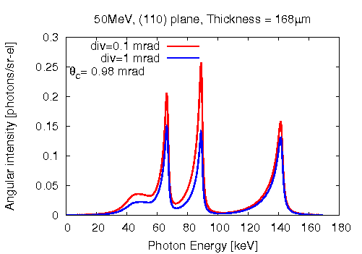
Intensity spectra with divergence

Slide 26
Potential for inelastic thermal scattering
Expand imaginary potential
in a Fourier series
Extract the diffuse scattering intensity from the total scattered intensity:
After small amplitude vibrations, thermal averaging

