Slide 1
ASTA Laser system overviw and Gun Commisioning Results
Jinhao Ruan

Slide 2
Outline
Status of Subsystems
  Photoinjector Gun
  Laser
Gun commissioning
Near future schedules
Summary

Slide 3
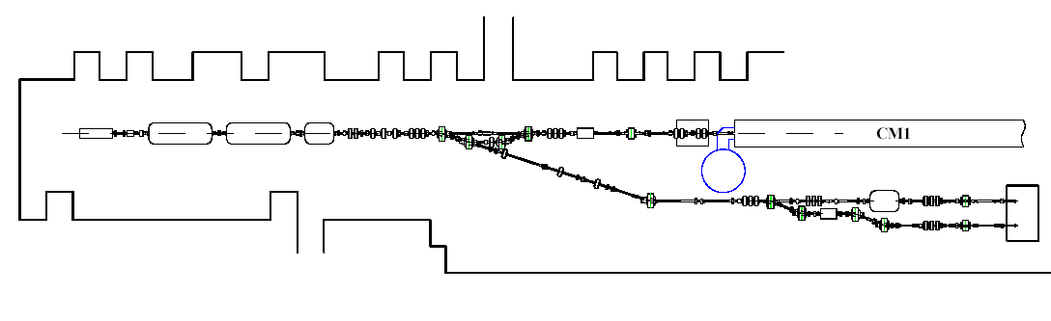
FY14 - 50 MeV Injector + 1 Cryomodule
Goal: installation complete and beam commissioning started by end of FY14
  RF gun + RF system and photocathode laser system (Done)
  2 SRF booster cavities (CC1 and CC2) + RF systems (CC2 is ready , CC1 need more attention)
  50 MeV beam line elements and instrumentation to the low energy dump (2 girder is in and the third one is close)
  Low energy beam dump. (Dump installed)
  SRF cryomodule (RFCA002/CM2) (7 cavity has been commissioned)
Installation of 1st AARD experiment (high brightness X-ray channeling source) (Will be installed in girder 3)
50 MeV Beam Energy
flat beam transform
beam dump
1st cryomodule
electron gun
booster cavities
chicane
spectrometer magnet
test beamlines
beam dump
ASTA Photoinjector

Slide 4
Status – Photoinjector Gun

Slide 5
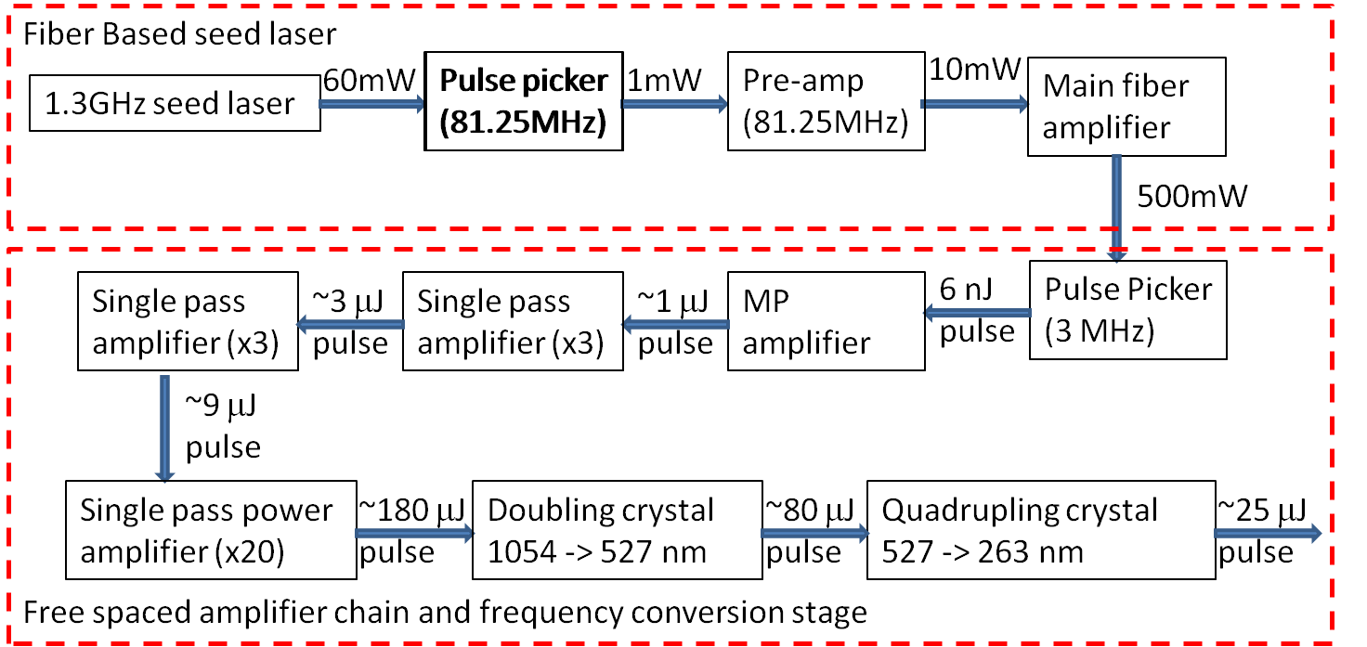
Status – Laser Diagram
Major change since year’s user meeting: 3 single pass amplifier replaced MP structure
  Get rid of the longitudinal laser structure because of the MP cavity
  Enable the possibility of even high repetition rates train (>3MHz)
Preamp ~3 single pass amp

Slide 6
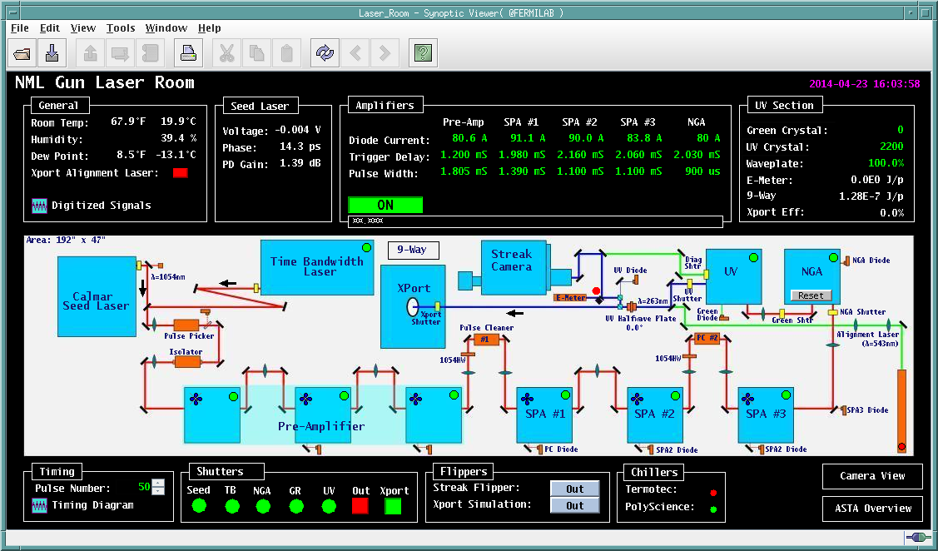
User Interface

Slide 7
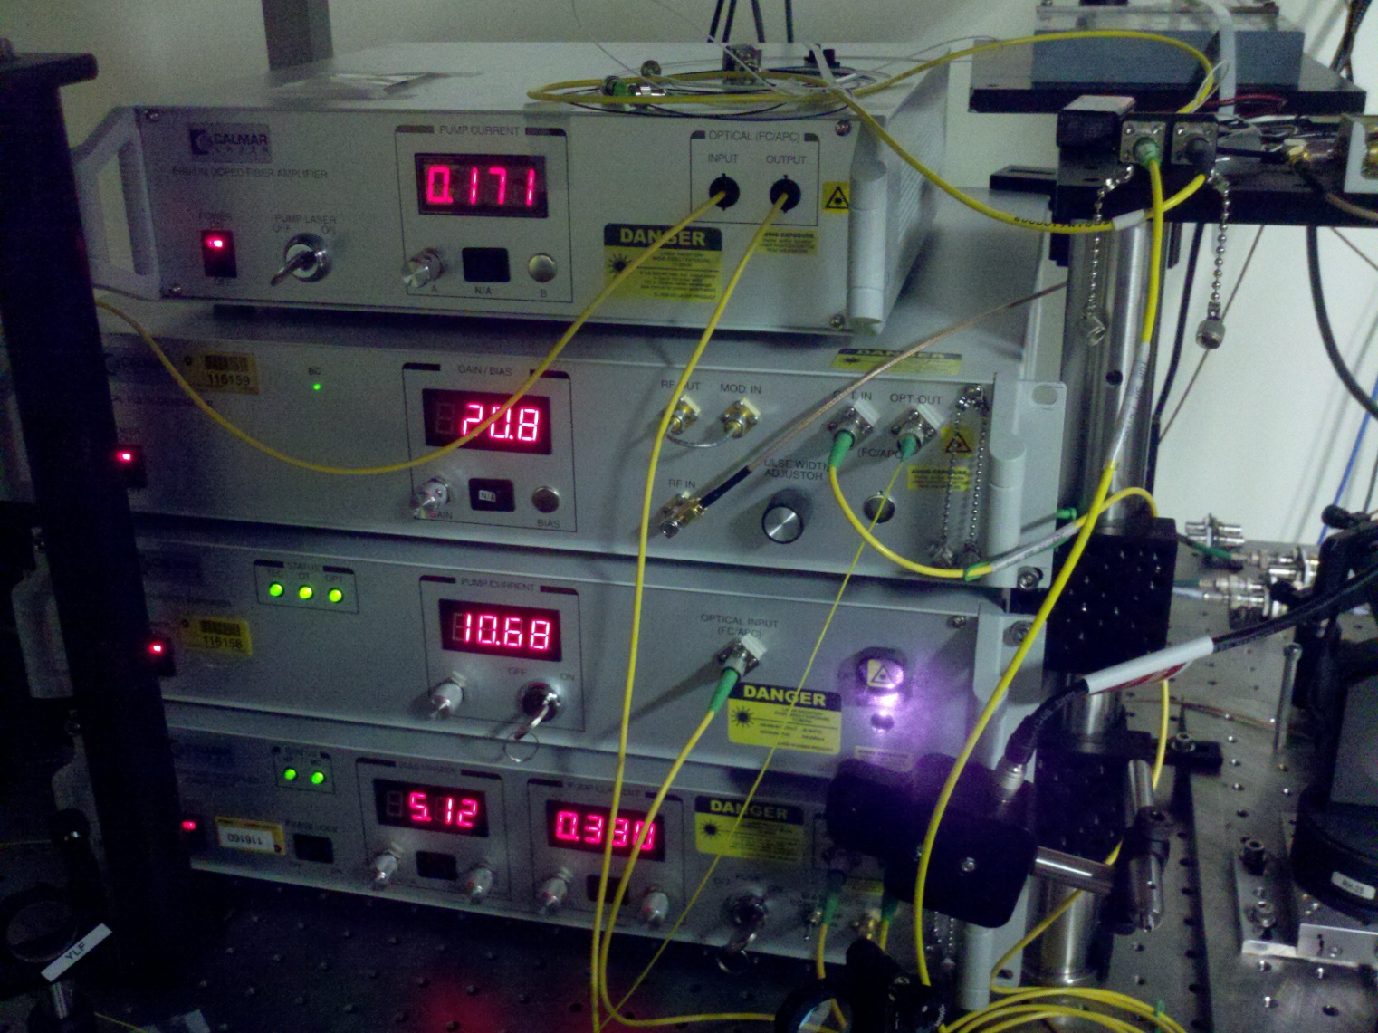
System Performance: Seed Laser

Slide 8
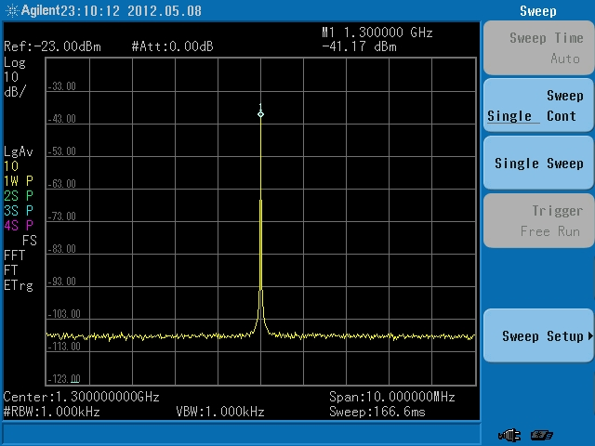
System Performance: Seed Laser

Slide 9
System Performance: Seed Laser

Slide 10
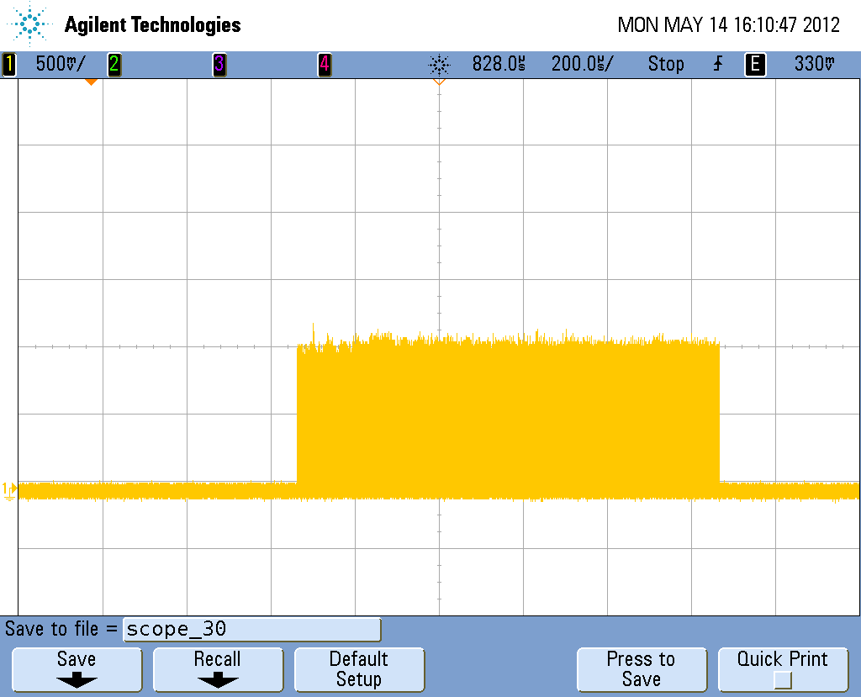
System Performance: Amplifier

Slide 11
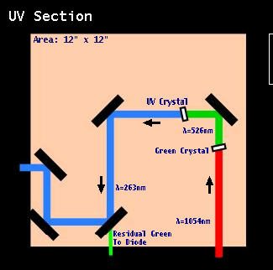
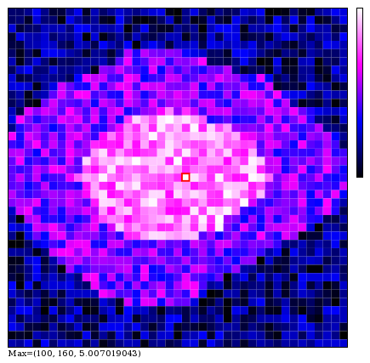
System Performance: UV section

Slide 12
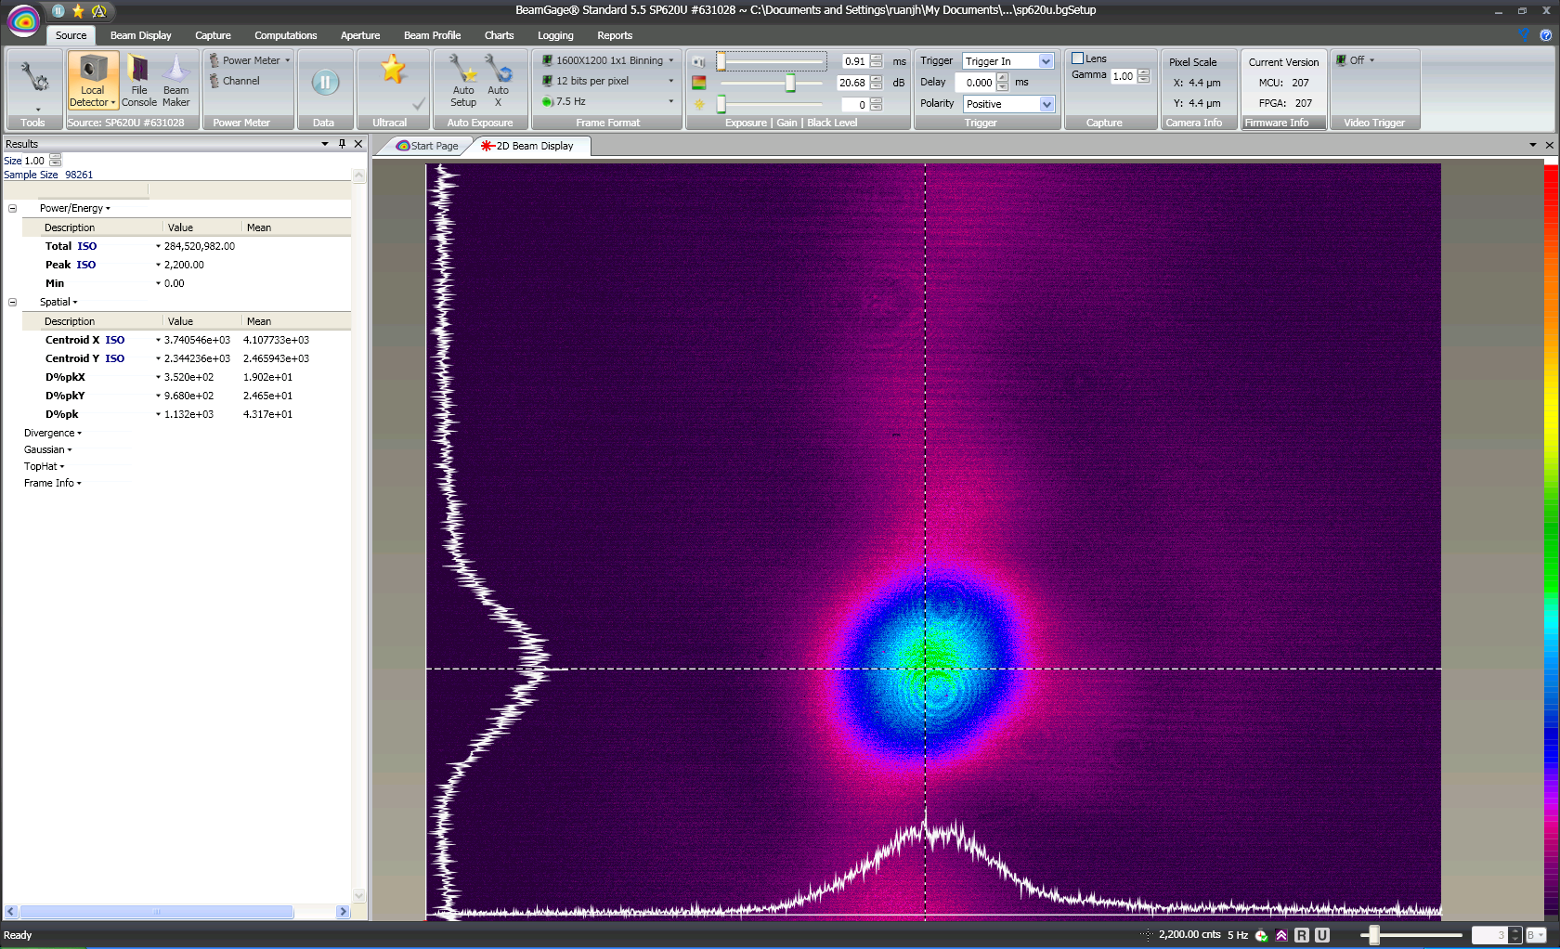
System Performance: UV section

Slide 13
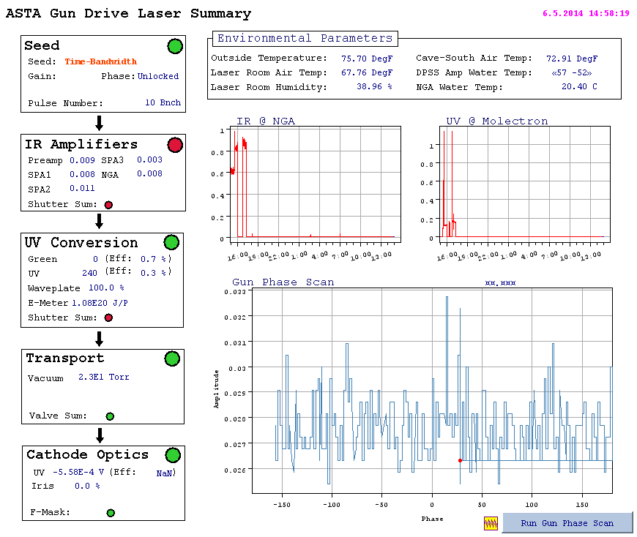
System Performance

Slide 14
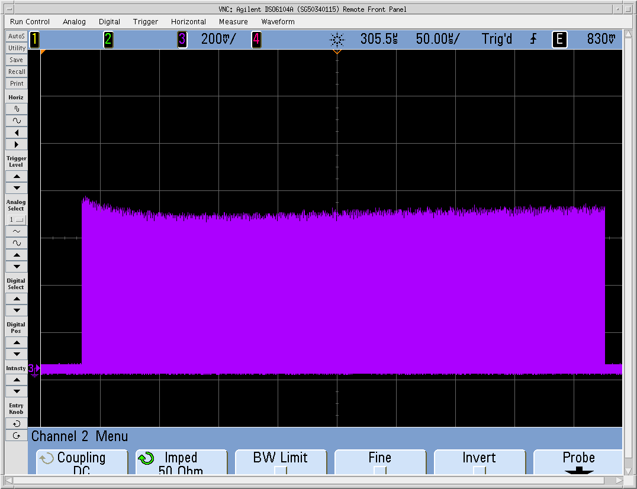
1ms IR laser train

Slide 15
Current Laser system Status
Laser is up running with 3MHz pulse train up to 1ms and 5Hz repetition frequency
User interface is set up
Laser system is designed to be upgradable for up to 1.3GHz in principle, which will be essential to the ICS proposal.

Slide 16
Gun Commissioning Milestone so far
Conditioning of the gun with 3MW Klystron is finished at 2013
Photoelectrons first produced at ASTA on June 20, 2013
  Molybdenum (uncoated) cathode
  First visible on Loss Monitor, Faraday cup
  Charge is very limited due to the low QE
CsTe cathode is installed in Feb 2014.
Photoelectron from CsTe was observed at Mar. 18 2014
Photoelectron up to 1ms long establish in June 2014

Slide 17
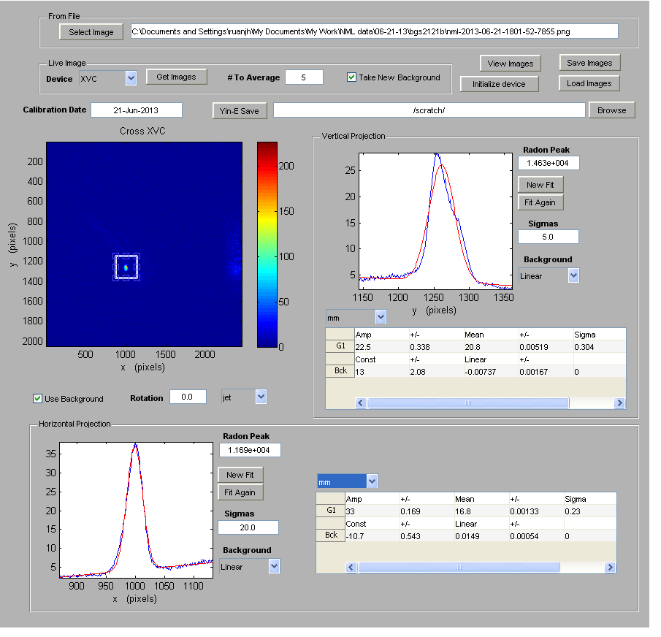
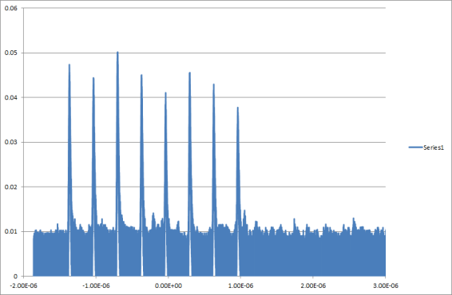
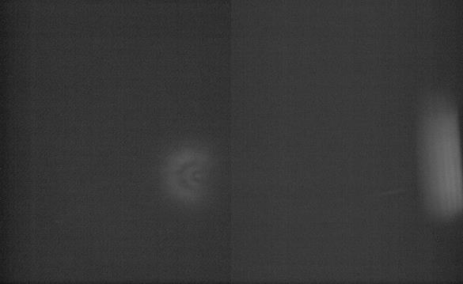
First Electrons June 20 2013

Slide 18
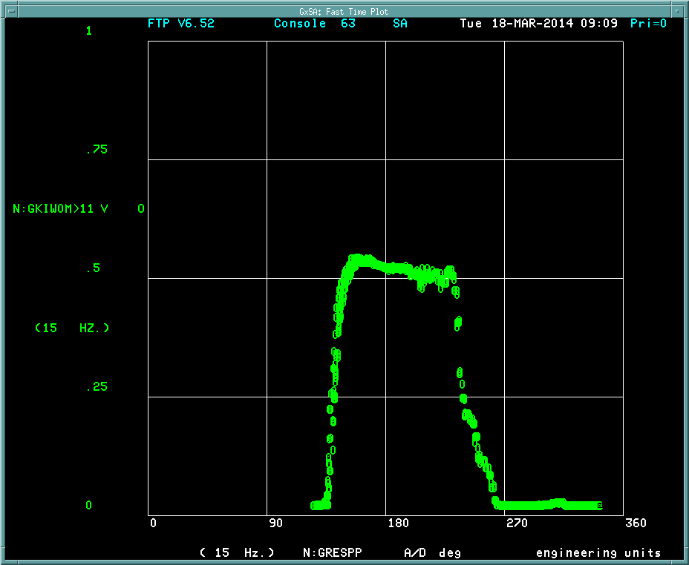
First electrons from CsTe Cathode
First Gun Phase scan done with the CsTe cathode

Slide 19
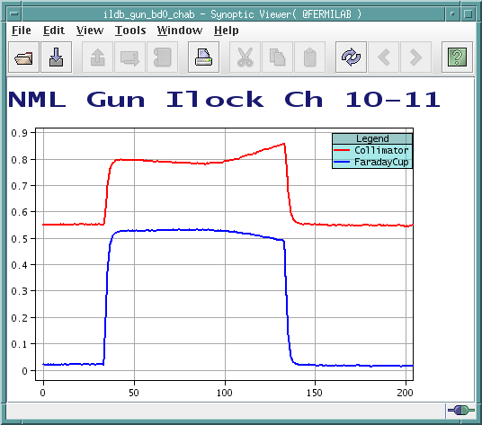
First electrons from CsTe Cathode
100 us long electron bunch train on the faraday cup. Later calibration resolved the current is more than 1.5nC/bunch

Slide 20
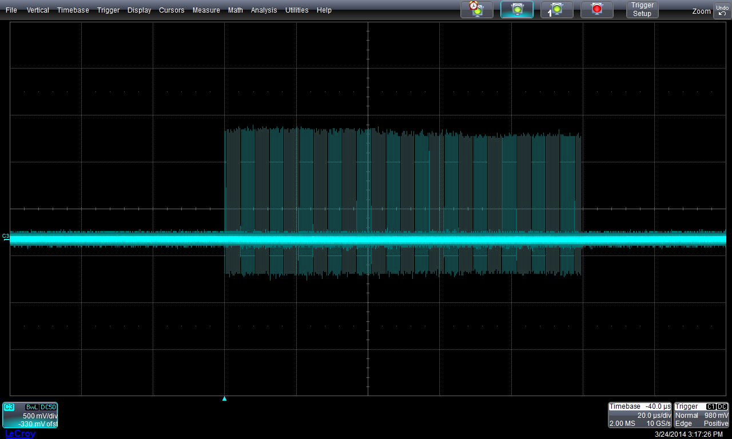
First electrons from CsTe Cathode
Signal from the wall current monitor

Slide 21
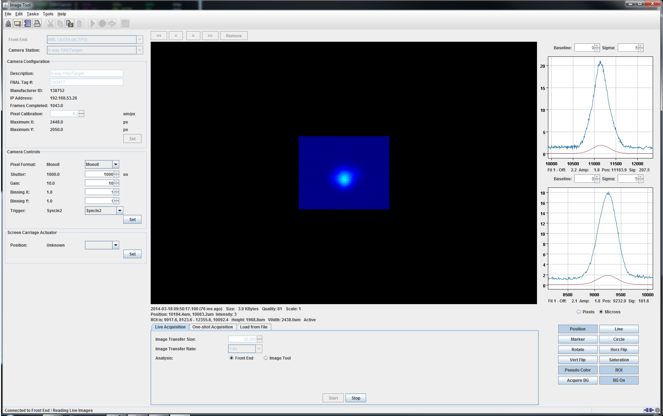
First electrons at 9-way YAG screen

Slide 22
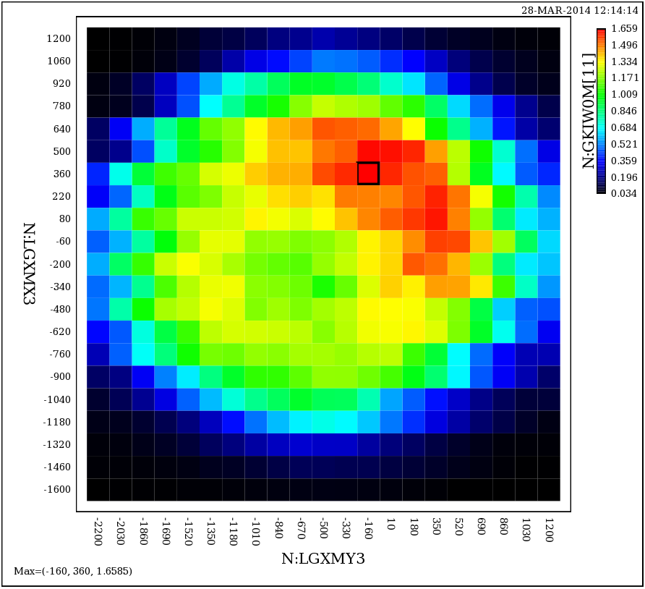
QE map of the new Cathode
The average QE from the cathode is about 1~1.5% according to the calculation.
Courtesy of Dean. Edstrom

Slide 23
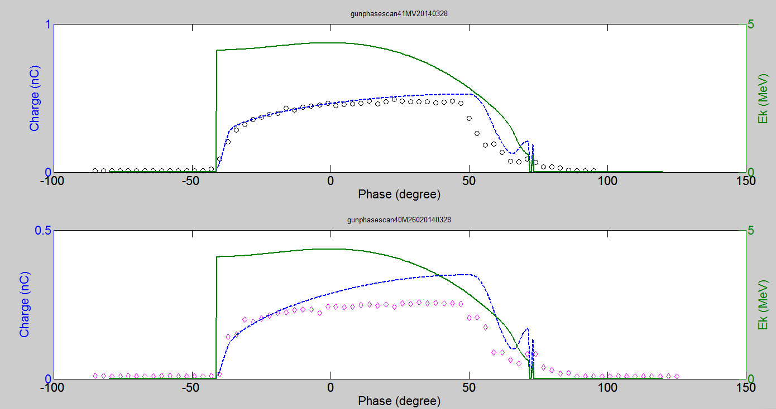
Detailed gun Phase scan
Blue curve is the ASTRA simulation curve for charge vs gun phase. Green curve was also from ASTRA. The black circle is the experiment data.
The initial try fit the rising edge relatively well, however still need better understanding at falling edge

Slide 24
Recent result

Slide 25
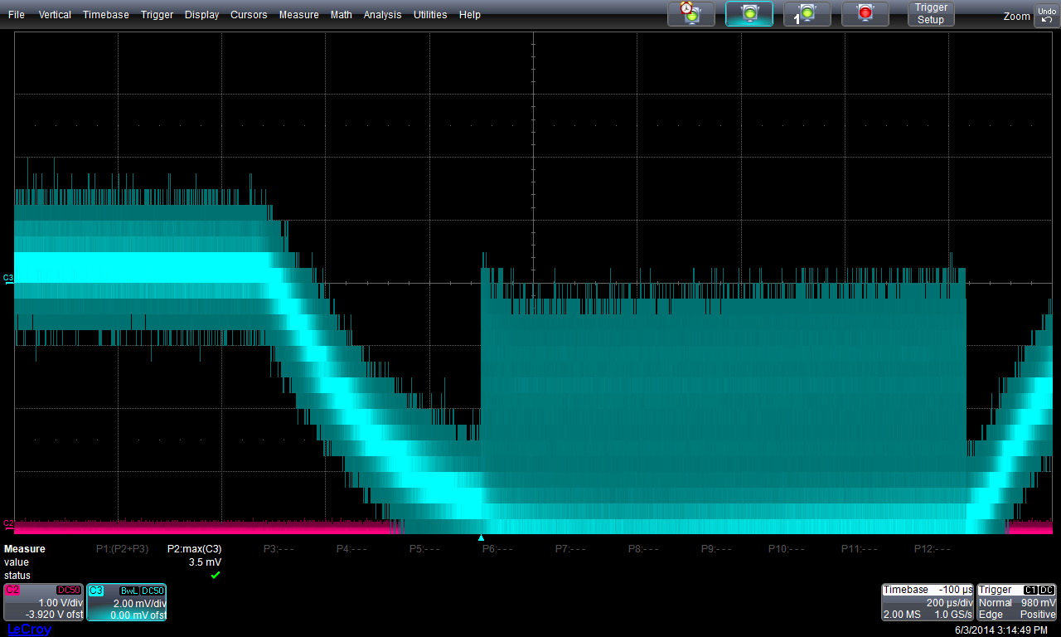
Recent result

Slide 26
Summary
Photoinjector has been commissioned successfully.
  electron pulse train up to 1ms long with about nC electron (3mA).
  9mA is observed with 0.3ms long bunch train
CC1 and CC2 will be commissioned at the end of this FY.
First user experiment will be carried out very soon.

Slide 27
Thank you for your attention !

Slide 28
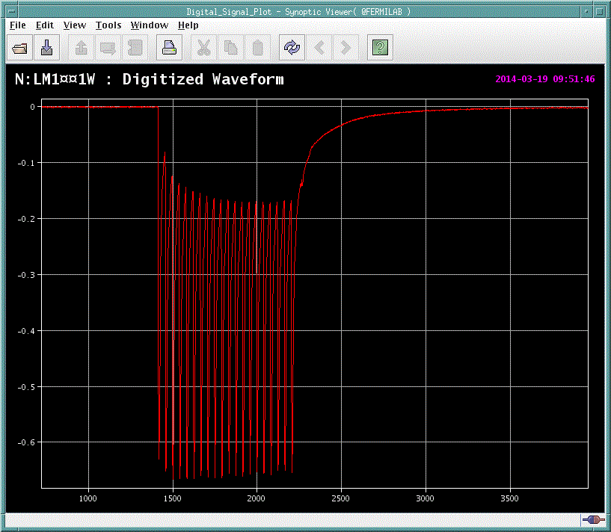
First electrons from CsTe Cathode

